Slide 1

Virtualization of a Real-Time Operating System for Robot Control with a Focus on RealTime Compliance
Halil Pamuk, BSc.
Sebastian Rauh, MSc. Beng.

Slide 2
Introduction
In today’s industrial production and automation, robots must react to their environment and perform time-critical tasks within strict time constraints. Delays or errors can have catastrophic consequences. In a traditional General-Purpose Operating System (GPOS), a high-priority task cannot interrupt a kernel operation, which makes them unsuitable for realtime requirements, as they cannot guarantee deterministic execution times. However, in a Real-Time Operating System (RTOS), a high-priority process can interrupt a lower-priority one, even if it is in the middle of a kernel operation. Virtualizing real-time operating systems for robotic control offers many advantages over traditional hardware-based approaches, especially when it comes to scaling [1], flexibility, and costs [2]. However, virtualization also introduces overhead and latency [3] [4]. In this master’s thesis, the goal was the virtualization of an RTOS, namely Salamander 4, to control a robot, with a focus on compliance with real-time determinism. Specifically, the aim was to bring the latency of the virtualized Salamander 4 closer to that of the bare metal version, as initial latency measurements revealed a significant latency gap between the bare metal and virtualized setup.

Slide 3
Methodology
In order to address this gap and achieve determinism, an extensive real-time performance tuning process was carried out. These tunings were added sequentially and tested together. This involves configurations spanning the BIOS, kernel, host operating system (OS), and QEMU/KVM virtualization layer, as demonstrated in [5]. Xenomai provided real-time capabilities for the guest OS and therefore, no additional modifications were necessary. Ubuntu 22.04.4 LTS served as the host operating system, while Salamander 4, built with Yocto and based on Linux 5.15.94, was the guest OS. The latency tool of the Xenomai tool suite was used to measure the scheduling latency of the real-time OS. QEMU with KVM was employed for virtualization. Trace-cmd and Kernelshark were used for kernel tracing and visualization of trace data. The testing robot was connected to the virtual CPU via a VARAN bus interface.

Slide 4
Practical Implementation
The initial latency values were first measured with the latency program of the Xenomai tool suite. The tests were conducted for 10 minutes with a sampling period of 100 µs, using a periodic user-mode task, and were assigned a priority of 99. If any sample’s latency value was greater than 100 µs, this was considered an overrun. There was a significant initial gap in latency between the bare metal and virtualized Salamander 4. To address this gap, an extensive tuning process was carried out to achieve real-time performance and determinism. These modifications were added sequentially and tested together. Previous tunings were not reverted when moving to the next tunings. First, the BIOS was configured, followed by the kernel. The BIOS settings were not reverted when moving to the kernel configurations. Next, the host was configured, but the BIOS and kernel settings remained unchanged. The guest configurations were not changed since Xenomai already provides real-time capabilities. Finally, QEMU/KVM settings were applied. A robotic application further confirmed the improvements. The difference between the command time and the time the signal reaches the Pulse Width Modulation (PWM) Module was measured 1,000 times to get reliable results for the bare metal, untuned, and tuned versions of Salamander 4.

Slide 5
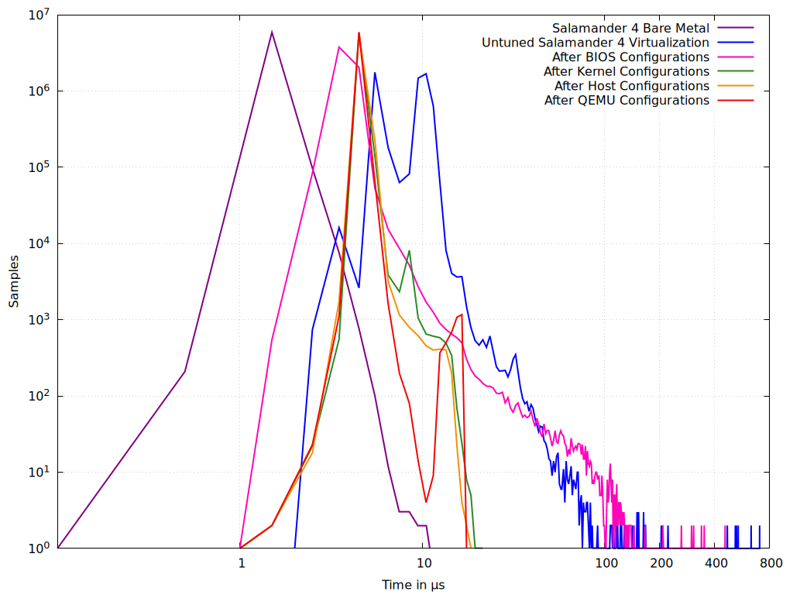
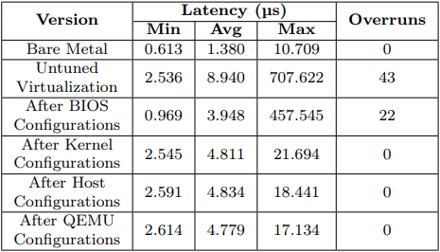
Results (1)
This section summarizes the results after the real-time performance tunings, both in terms of the latency program and the robotic application. Figure 1 displays the change in latency after each real-time performance tuning of Salamander 4. Table 1 gives an overview of the most important metrics of the measurements after each tuning.

Slide 6
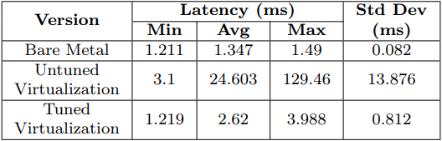
Results (2)
The improved latency was also tested with a robotic application. The difference between the command issuance time and the time the signal reaches the PWM module was measured 1,000 times for the bare metal, untuned, and tuned versions of Salamander 4. The results are visualized in Table 2.

Slide 7
Discussion
The results show that the real-time performance tunings applied to the virtualized Salamander 4 OS reduced latency and improved determinism. The maximum latency decreased from 707.622 µs to 17.134 µs after tuning BIOS, kernel, host, and QEMU/KVM configurations. Especially, applying the PREEMPT-RT patch, along with optimizing both the BIOS and kernel configurations, played a crucial role in reducing the maximum latency to 21.694 µs. This also eliminated overruns going forward. The host configurations, including CPU and interrupt affinity, and real-time prioritization of QEMU, further reduced latency down to 18.441 µs. The guest OS already had real-time capabilities through Xenomai, hence the focus was primarily on optimizing the host and virtualization layer to achieve the desired realtime performance. Finally, QEMU/KVM configurations, such as tuning the LAPIC timer advance and using hugepages, brought the latency down to the final worst latency value of 17.134 µs. This value is very close to the bare metal value of 10.709 µs. The goal was set to achieving latency values below 50 µs in the duration of the measurement. This goal was achieved. A robotic application in a practical scenario validated the improvement of the tuned virtualization compared to the unmodified version. The difference between the command time and the time the signal reaches the PWM module was measured 1,000 times for the bare metal, untuned, and tuned versions of Salamander 4. The worst latency in the virtualization dropped from 129 ms to 3.988 ms in the developed application. Compared to the bare metal version’s worst latency of 1.49 ms, the tuned virtualization came very close to the determinism and reliability of the bare metal.

Slide 8
Summary and Outlook
This master’s thesis aimed to virtualize an RTOS for robot control, focusing on real-time determinism. The goal was to reduce latency in the virtualized Salamander 4 to match its bare metal version. Initial tests showed a significant latency gap between bare metal and virtualized versions. Extensive tuning was performed sequentially, including BIOS, kernel, host, and QEMU/KVM configurations. This process reduced the worst latency from 707.62 µs to 17.134 µs, close to the bare metal value of 10.709 µs, achieving the goal of sub-50 µs latency. A robotic application confirmed these improvements. Measuring the time between command issuance and command arrival at the PWM module 1,000 times showed worst latency dropping from 129 ms to 3.988 ms, approaching the bare metal version’s 1.49 ms. Future work could include additional configurations and optimizations of the virtualization layer, investigating other hypervisors and virtualization technologies, and extensive testing under various workloads and stressed situations.

Slide 9
References

