Slide 1

Virtualization of a Real-Time Operating System for Robot Control with a Focus on Real-Time Compliance
Halil Pamuk, BSc.
Sebastian Rauh, MSc. Beng.

Slide 2
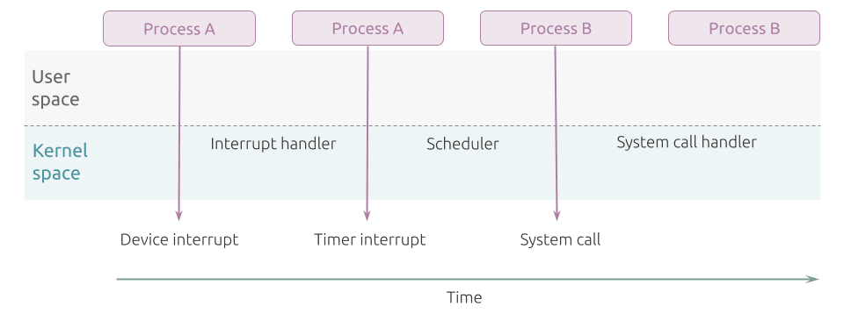
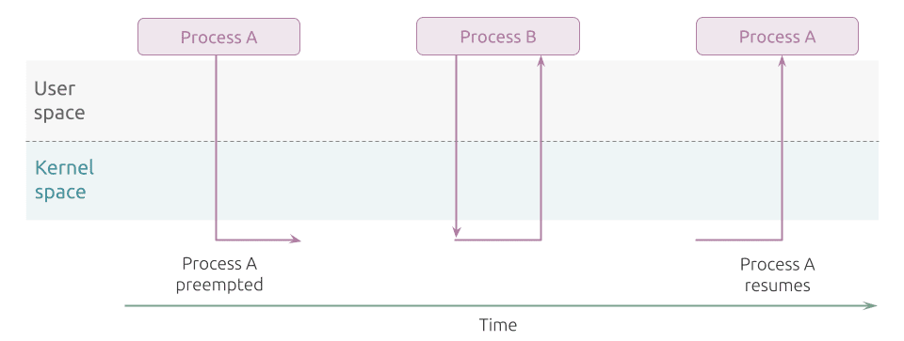
Introduction
Robots perform time-critical tasks
Delays → catastrophic consequences
General-Purpose Operating System vs. Real-Time Operating System
Figure 1: Non-preemptible Kernel [1]
Figure 2: Preemptible Kernel [1]

Slide 3
Problem and Task Definition
Task: Bring latency of virtualization closer to bare metal (below 50 μs)
Virtualization of Real-Time Operating Systems
Advantages | Disadvantages
Scalability & flexibility | Increased overhead and latency
Cheaper | Performance variability
Remote management | Complexity

Slide 4
Methodology
Asses Initial Situation
Measure initial latency difference between bare metal & untuned virtualization with the latency tool of Xenomai
Real-Time Performance Tunings
Sequentially tune virtualization through configurations of
BIOS, kernel, host, guest and QEMU
Comparison
Measure the latency difference with the latency tool
Validation
Measure the latency difference with a real-time robotic application

Slide 5
Application Context and Conditions
This work was written at SIGMATEK GmbH & Co KG
Host OS: Ubuntu 22.04.4 LTS, PREEMPT-RT
Guest OS: Salamander 4
Built with Yocto [1]
Virtualized through Quick Emulator (QEMU) [2]
Hard real-time with Xenomai 3 [3]
Trace-cmd [4] and Kernelshark [5] for kernel tracing and visualization

Slide 6
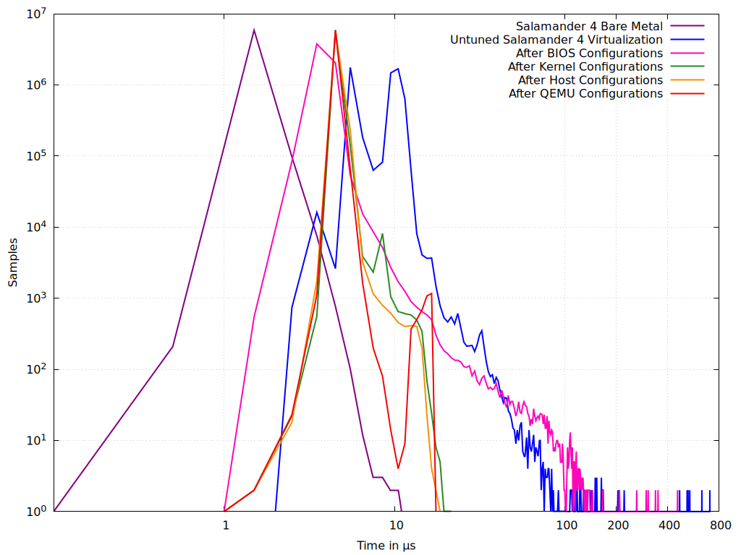
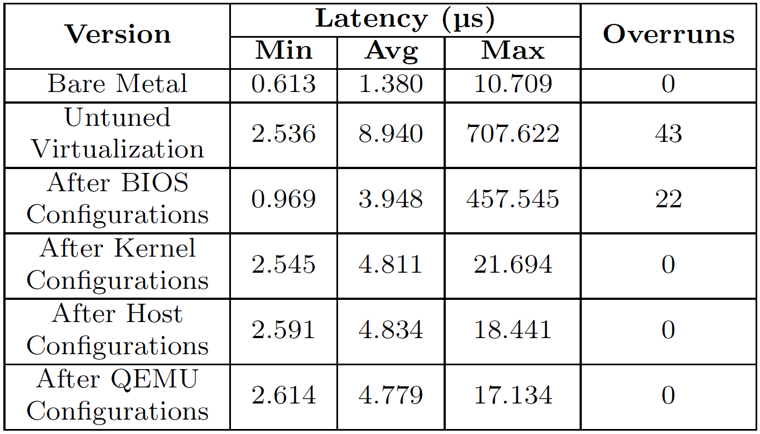
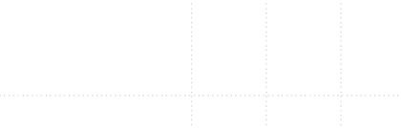
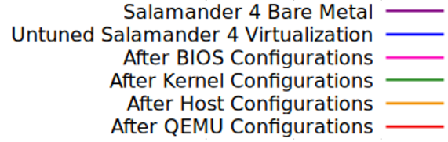
Results – Latency Tool
10 minutes with a sampling period of 100 µs, priority of 99
Figure 1: Comparison of Latency Distributions
Samples
Time in μs
Table 1: Comparison of Latency Statistics

Slide 7
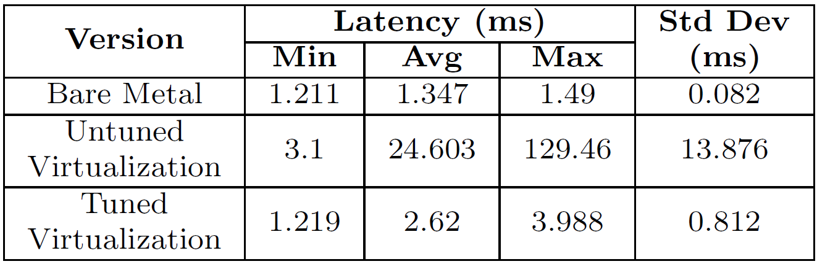
Results – Robotic Application
Difference between command issuance time and signal arrival at PWM
1,000 samples
Table 2: Comparison of Robotic Application Latency Statistics

Slide 8
Discussion
Latency Tool
Worst latency decreased from 707.622 µs to 17.134 µs
No overruns
Close to bare metal’s 10.709 µs
Goal achieved
Robotic Application
Worst latency dropped from 129 ms to 3.988 ms
Close to bare metal’s 1.49 ms
Tunings validated

Slide 9
Outlook
Additional configurations
Other hypervisors and virtualization technologies
More testing under workloads

Slide 10
References
[1] https://ubuntu.com/blog/what-is-real-time-linux-ii
[2] https://docs.yoctoproject.org/
[3] https://www.qemu.org/
[4] https://xenomai.org/
[5] https://trace-cmd.org/
[6] https://kernelshark.org/

Slide 11
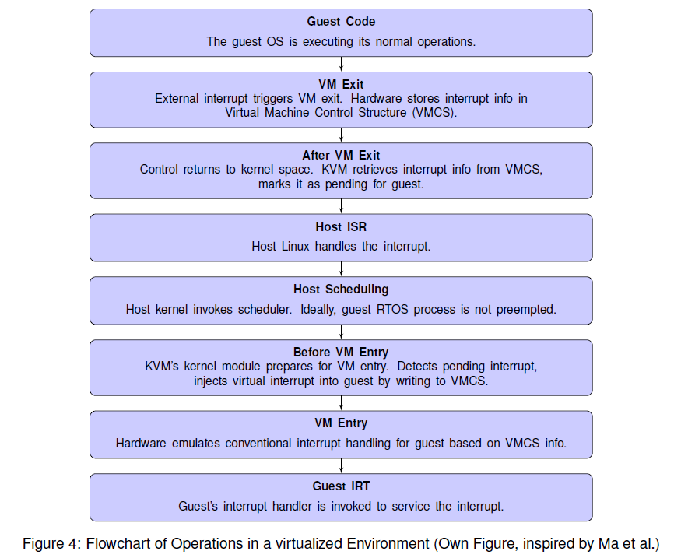
Operations in a virtualized Environment

Slide 12
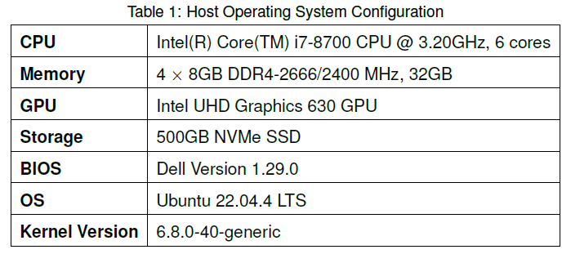
Host Operating System

Slide 13
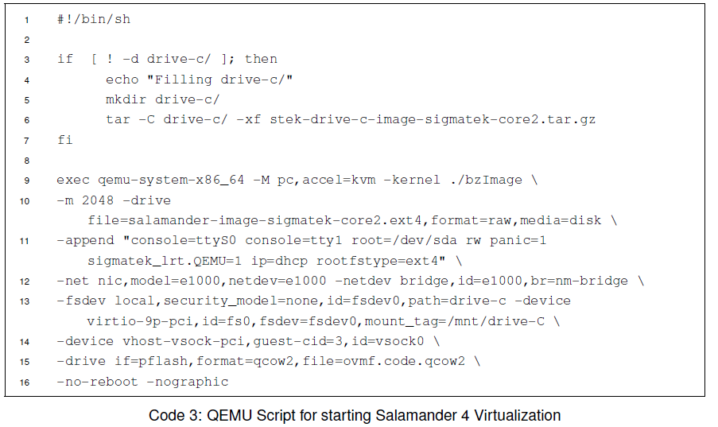
QEMU Script

Slide 14
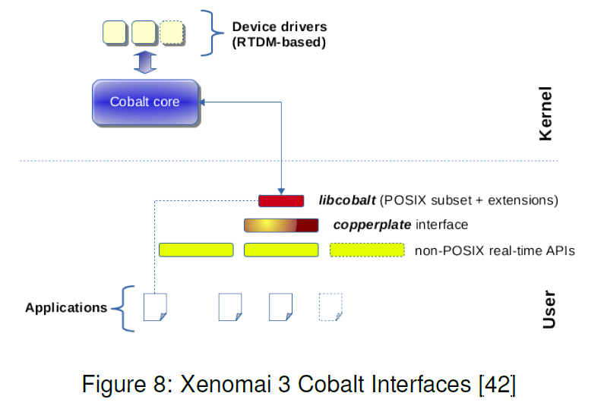
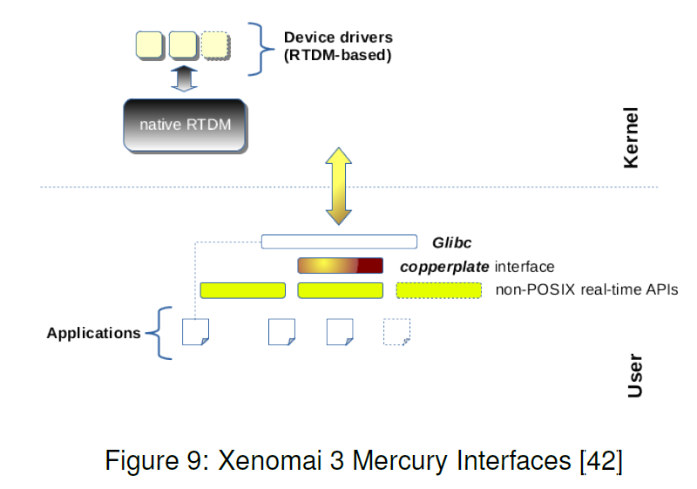
Xenomai Approaches

Slide 15
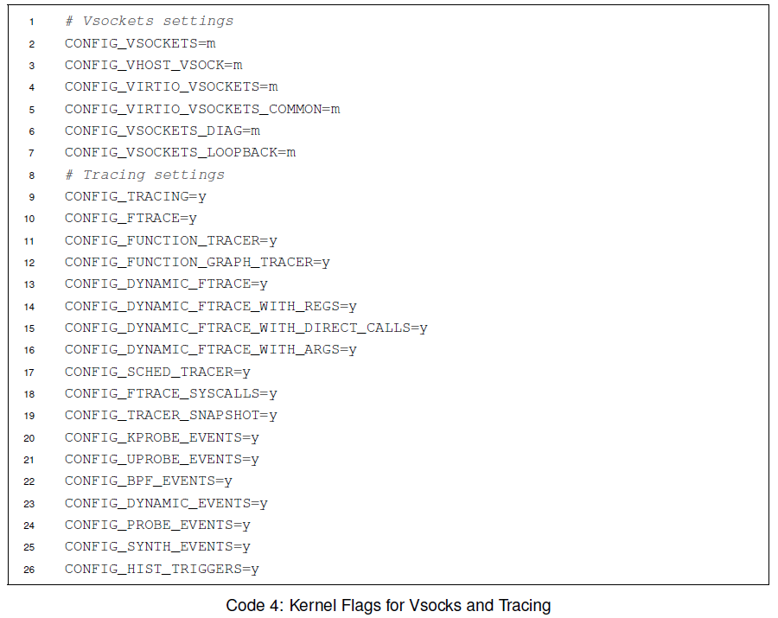
Trace-cmd

Slide 16
Trace-cmd
sudo trace-cmd record -e all -A @3:823 -name Salamander4 -e all
sudo trace-cmd record -e kvm:kvm_entry -e kvm:kvm_exit -A @3:823 -name Salamander4 -e all
sudo trace-cmd record -e kvm -e sched -e irq -e -A @3:823 -name Salamander4 -e all

Slide 17
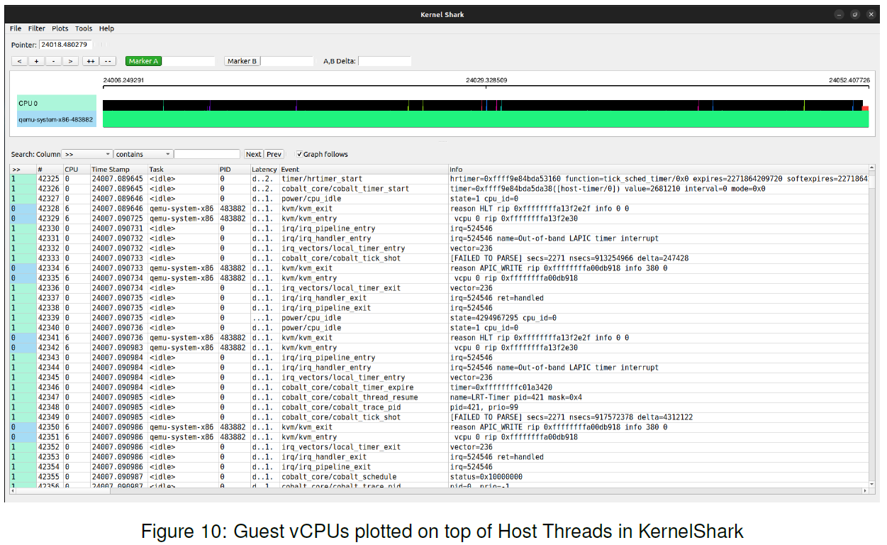
Kernelshark

Slide 18
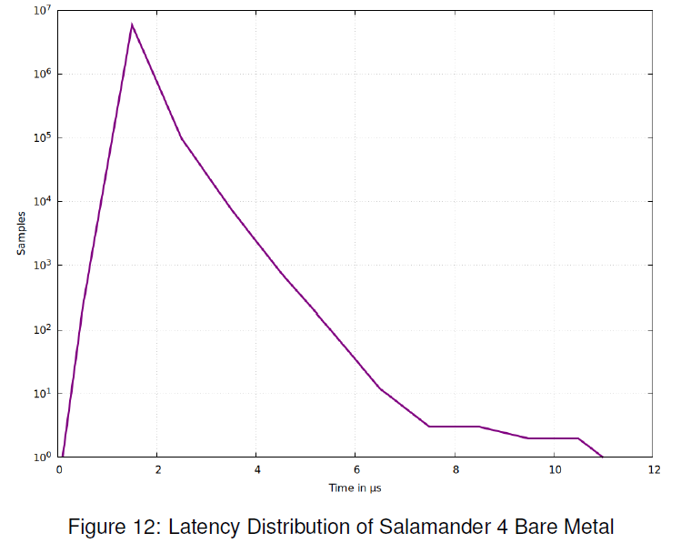
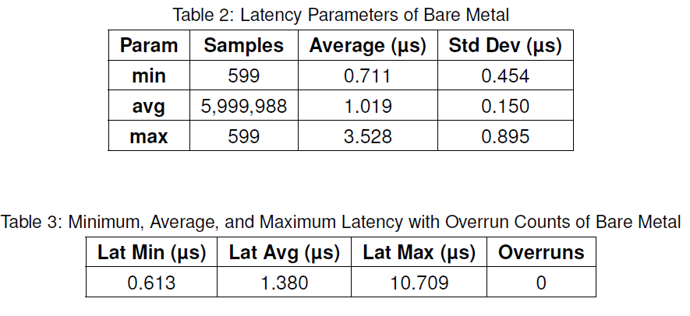
Salamander 4 Bare Metal

Slide 19
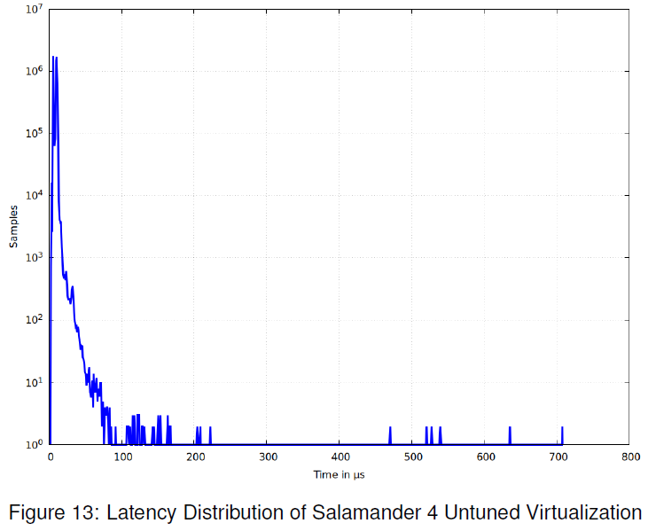
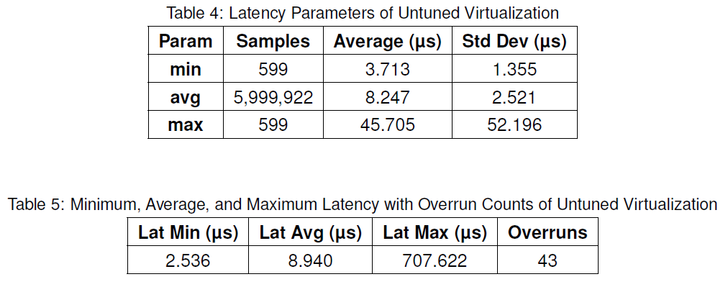
Salamander 4 Untuned Virtualization

Slide 20
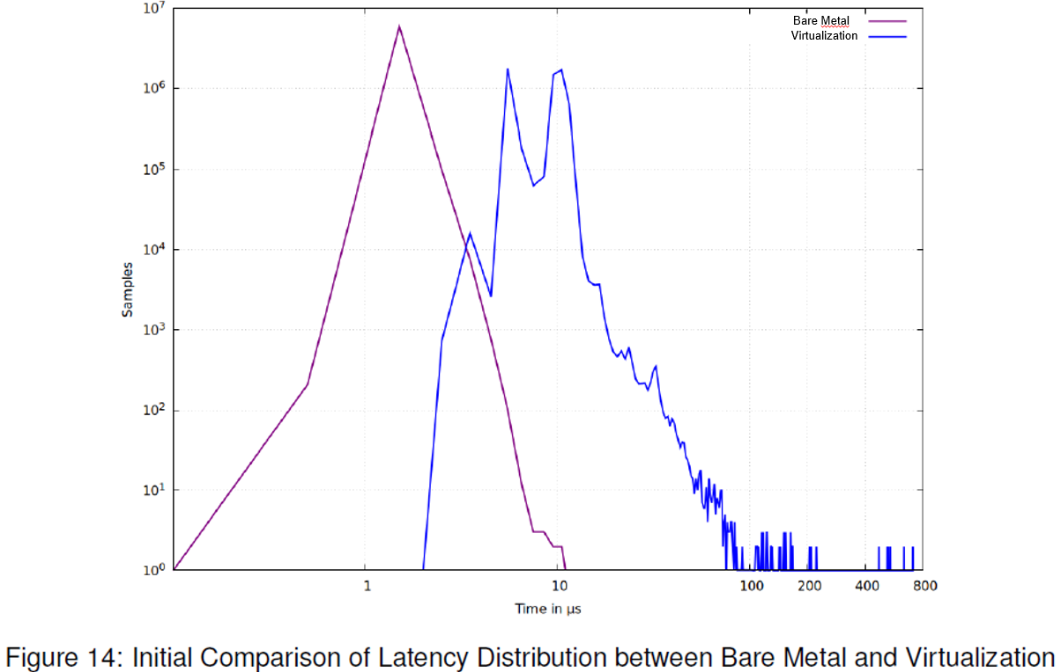
Salamander 4 Bare Metal vs. Virtualization

Slide 21
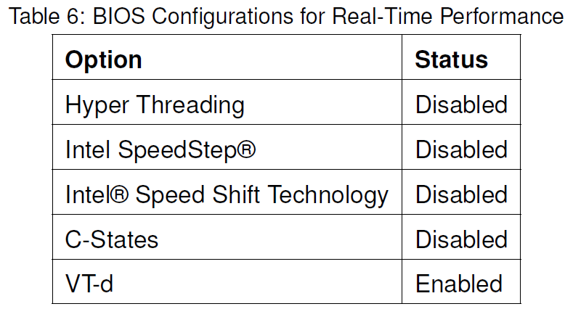
Salamander 4 Virtualization BIOS Configurations

Slide 22
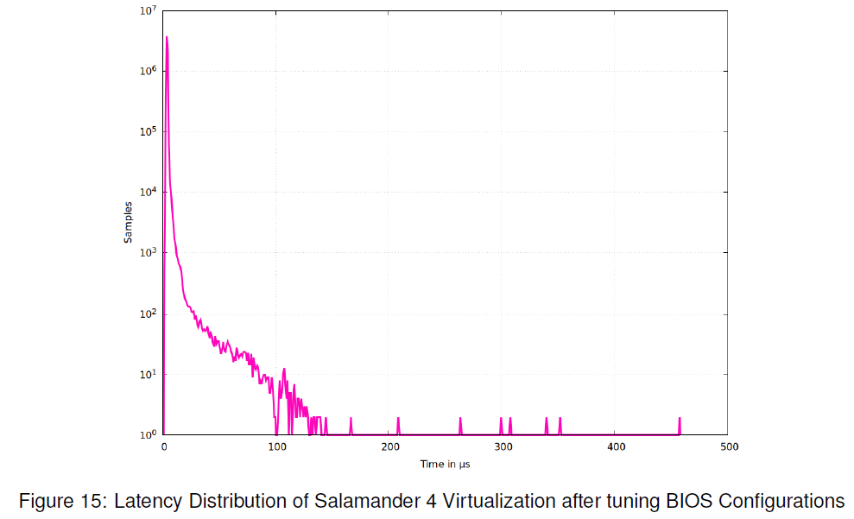
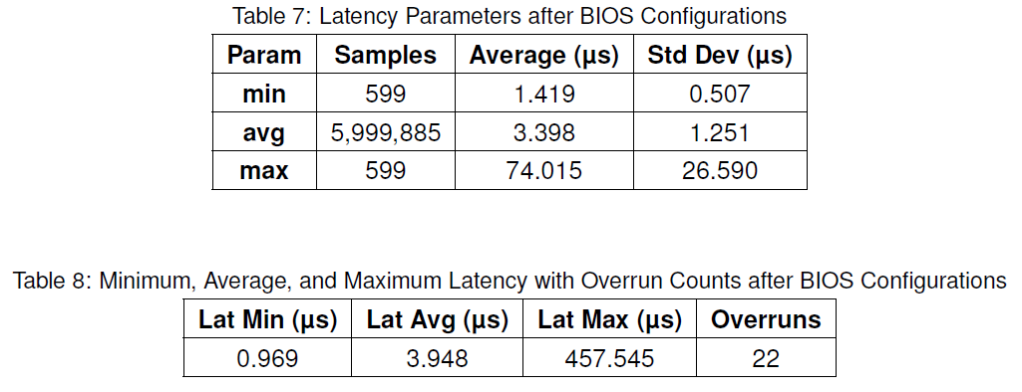
Salamander 4 Virtualization after BIOS Configurations

Slide 23
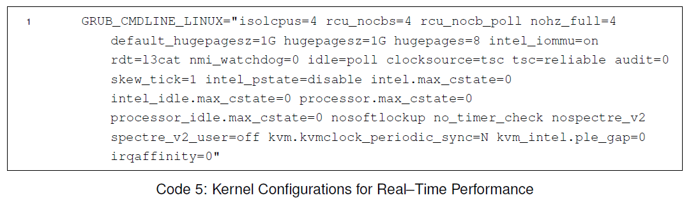
Salamander 4 Virtualization Kernel Configurations

Slide 24
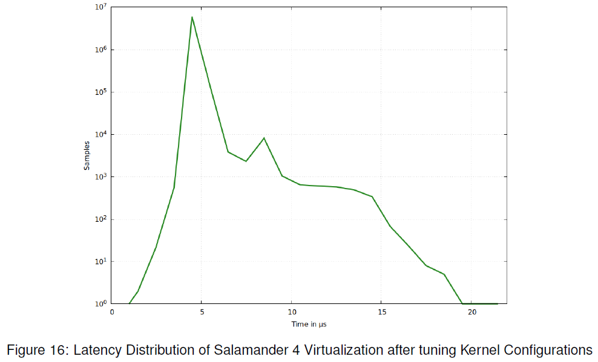
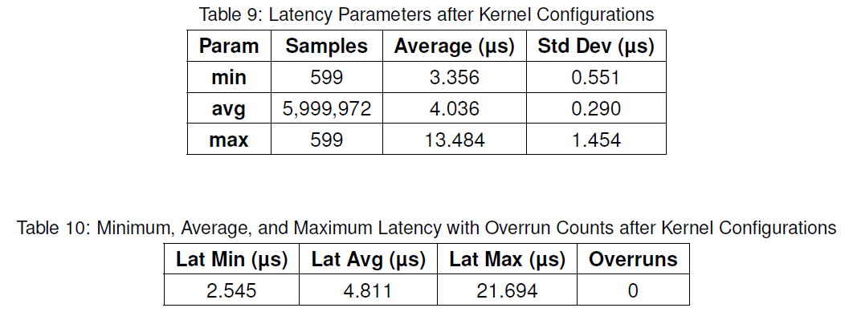
Salamander 4 Virtualization after Kernel Configurations

Slide 25
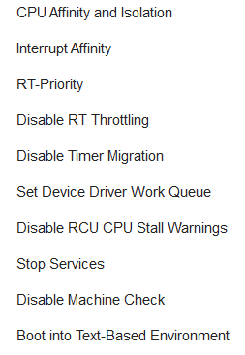
Salamander 4 Virtualization Host Configurations

Slide 26
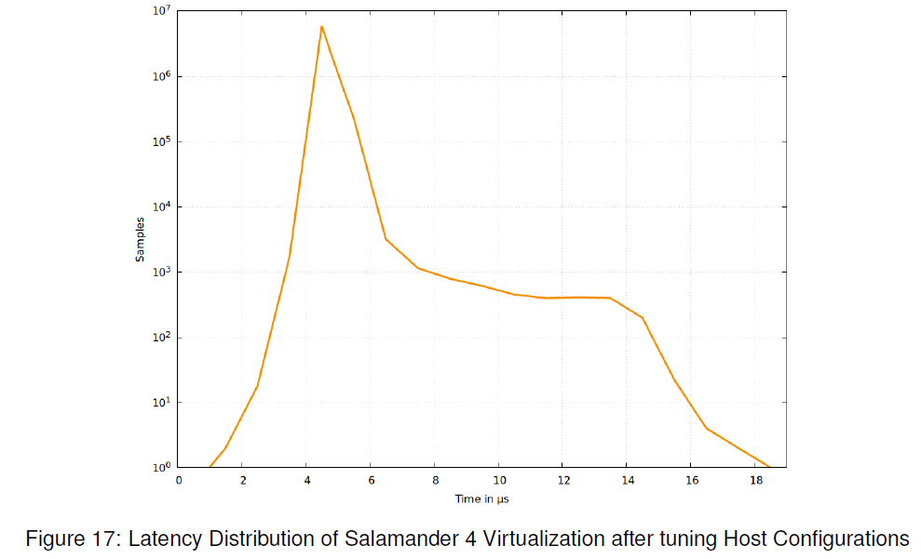
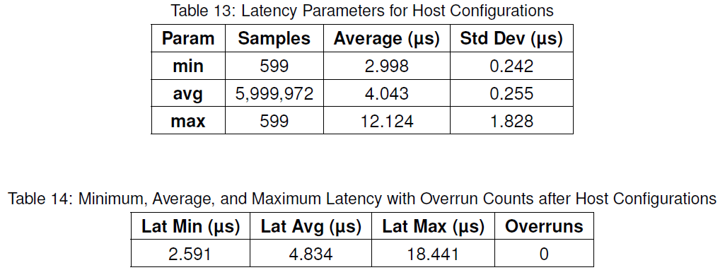
Salamander 4 Virtualization after Host Configurations

Slide 27
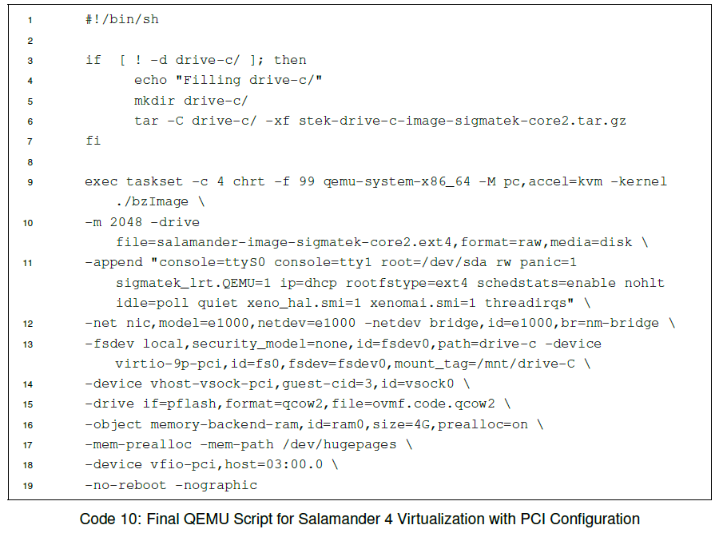

Salamander 4 Virtualization QEMU Configurations

Slide 28
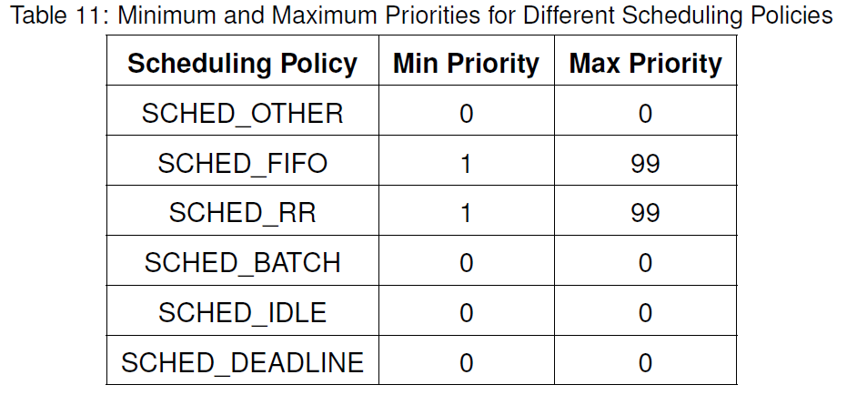
Priorities for Different Scheduling Policies

Slide 29
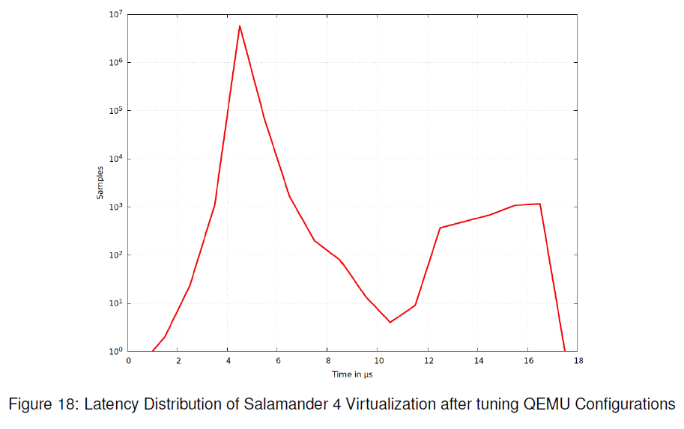
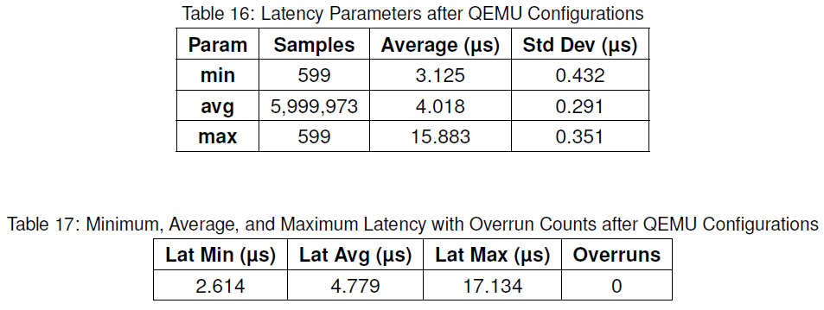
Salamander 4 Virtualization after QEMU Configurations

Slide 30
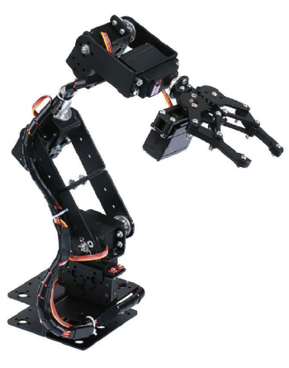
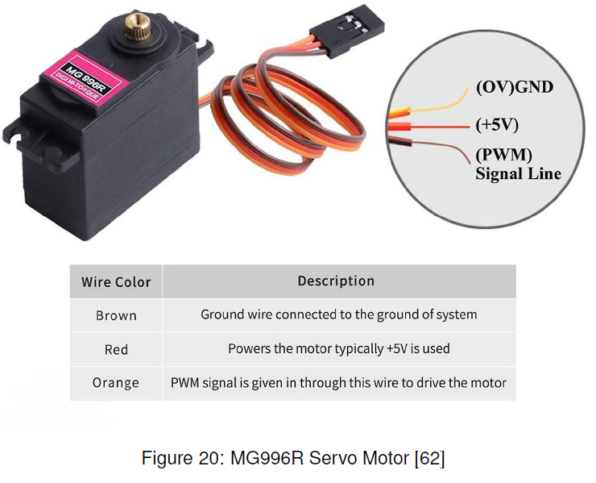
Robot

Slide 31
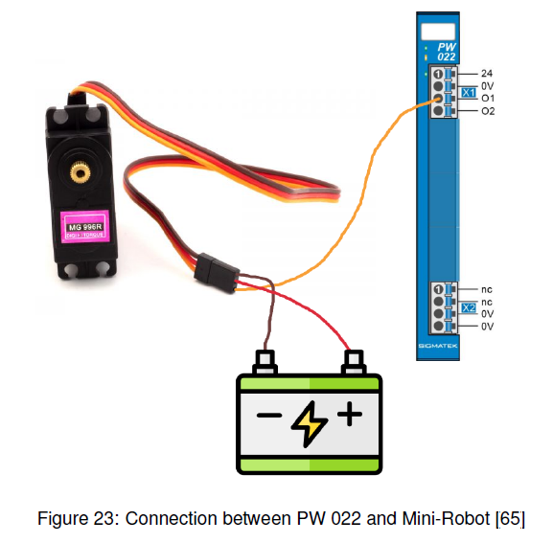
Servo Motor with PWM module

Slide 32
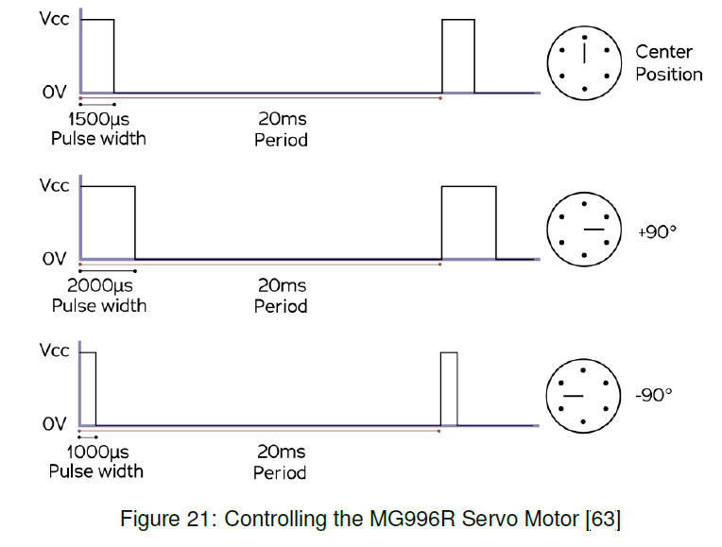
Servo Motor Function

Slide 33
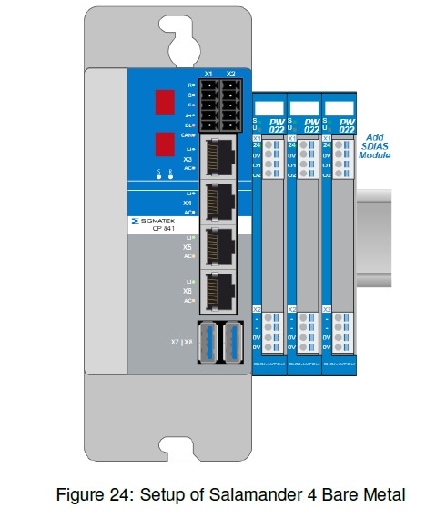
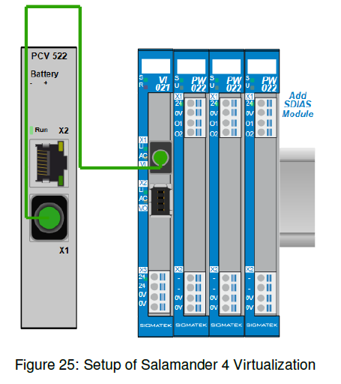
Robotic Application Setups

Slide 34
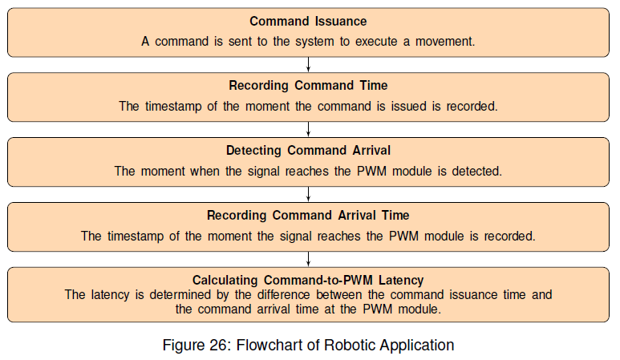
Robotic Application Flowchart

Slide 35
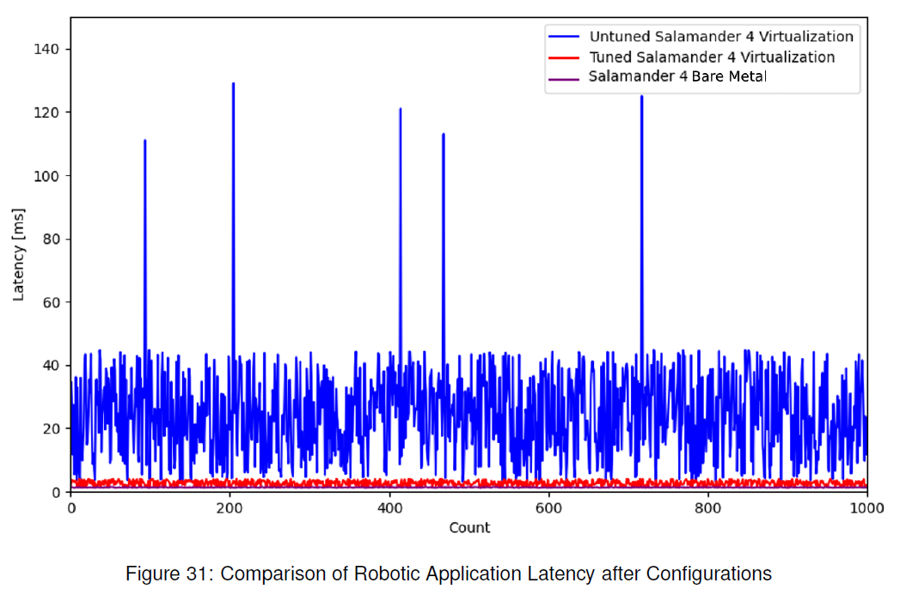
Results of Robotic Application

