Slide 1
Presenting
HIPERmark and HIPERpret

Slide 2
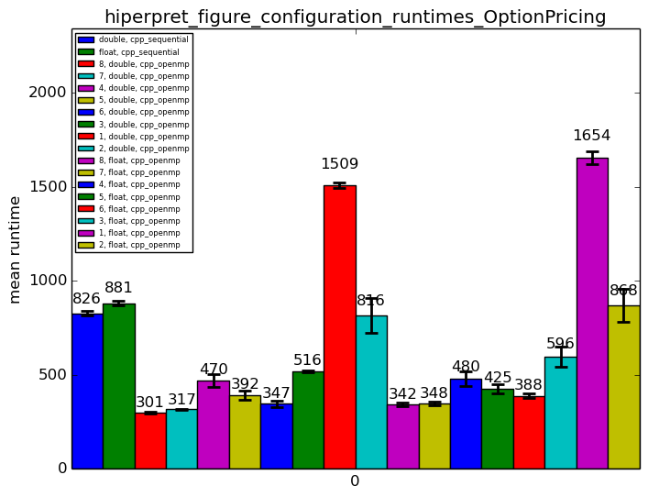
Visualizing Runtimes 1

Slide 3
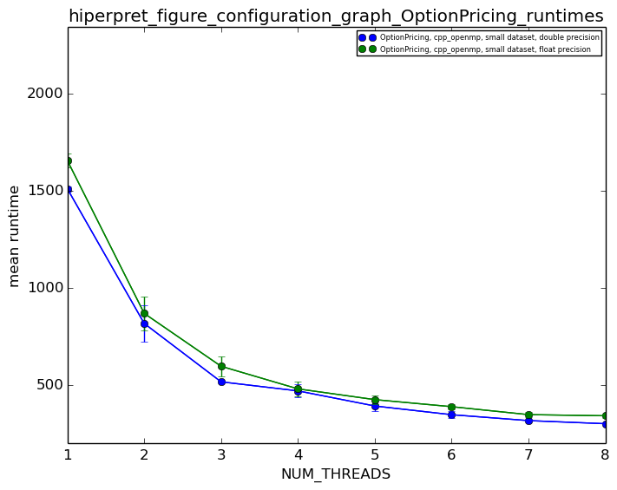
Visualizing Runtimes 2

Slide 4
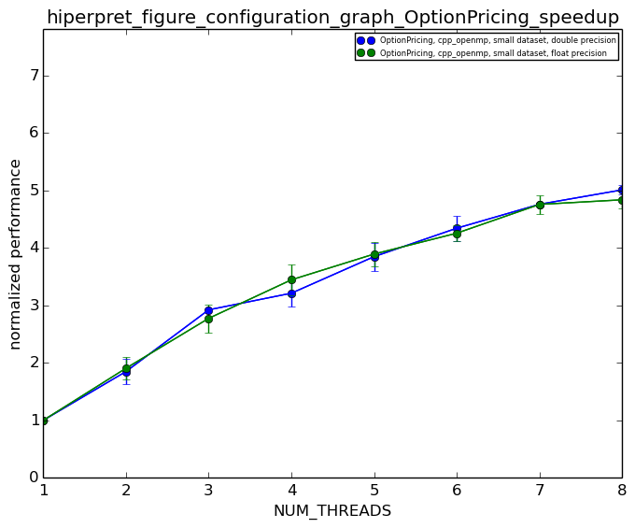
Visualizing Runtimes 3

Slide 5
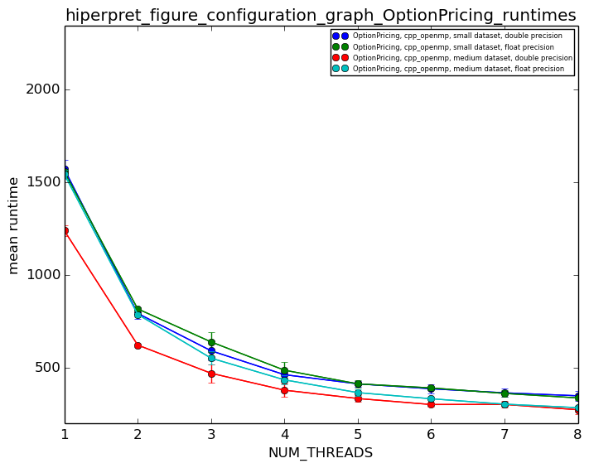
Visualizing Runtimes 4

Slide 6
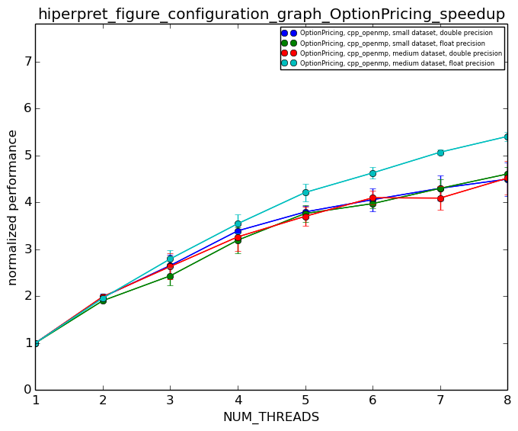
Visualizing Runtimes 5

