Slide 1
MS Office 365
Computer Club 101

Slide 2

Onedrive
Onedrive is a program that can sync the files in your computer 24/7 when online.
For school accounts, it has 1TB of storage, which is about 8.3 times bigger than your computer size. (120GB * 8.3 = approx. 1000GB)

Slide 3
Installation of onedrive
Self-Service
Go to Tech Pagoda
Ask soes64121

Slide 4
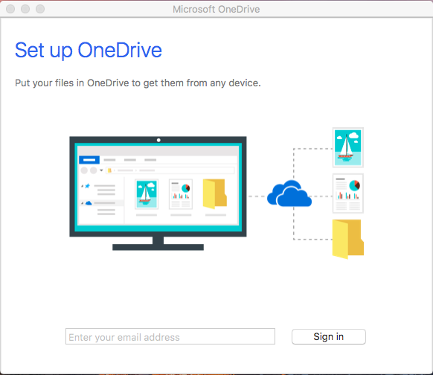
Usage of onedrive in general
Turn on the Onedrive.app
There will be a space where it requires to enter your school account.
Enter your school account.

Slide 5
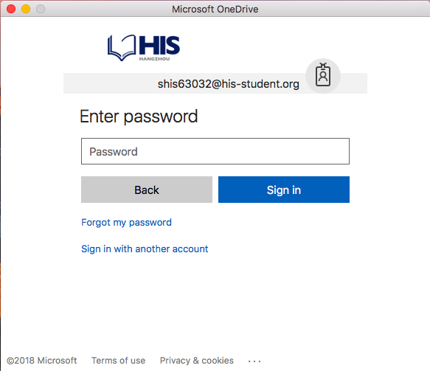
Usage of onedrive in general
After you entered your school account, you will proceed to login page.

Slide 6
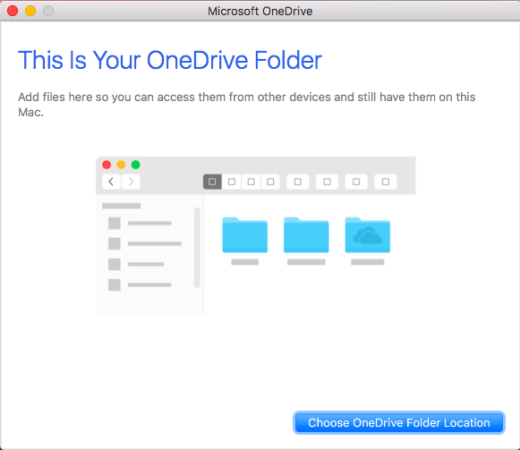
Usage of onedrive in general
Successful access will encounter this page.

Slide 7
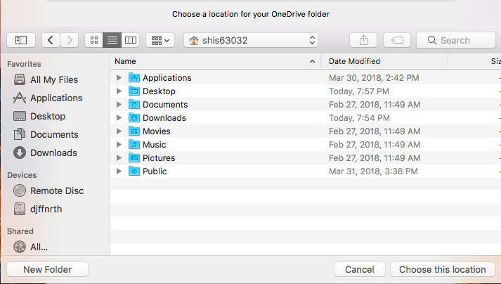
Usage of onedrive in general
Choose the location where your OneDrive Folder will be.

Slide 8
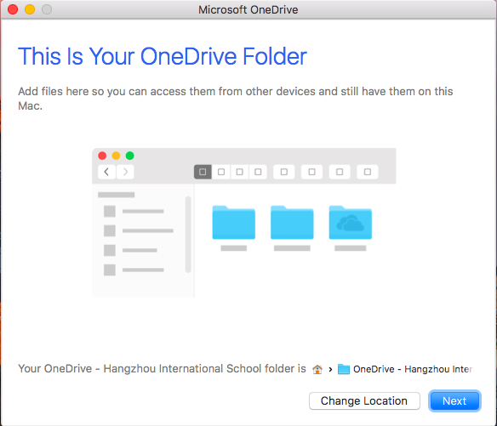
Usage of onedrive in general
After you have confirmed the location, you either can go back by ”Change Location” or proceed to next by clicking “Next”.

Slide 9
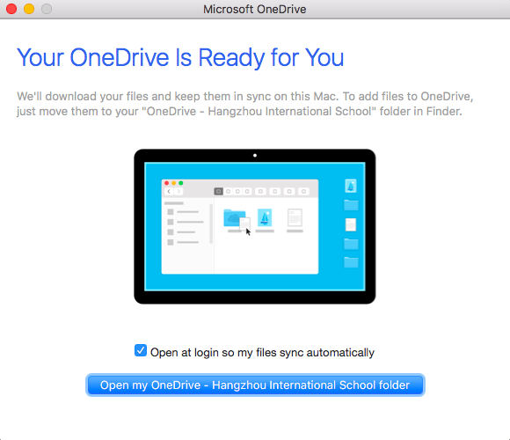
Usage of onedrive in general
By pressing the checkbox in the middle, OneDrive will be opened when your computer is on.
Click the blue bar to continue…

Slide 10
Why is onedrive important?
Even when your computer is:
blown up, trolled by others, hacked, burned, crashed, jammed by EMP, pierced through by an object, exploded, filled in water, deleted, become a metal junk, melted, and etc,
You always can access to OneDrive any time any day.

Slide 11
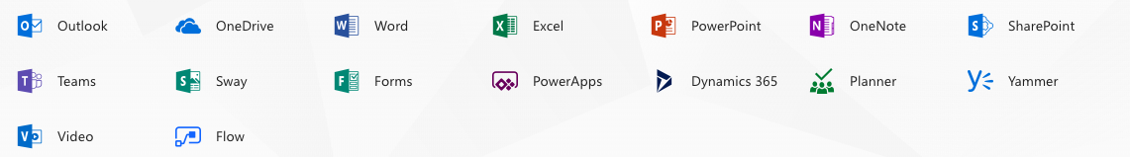
Office 365
Office 365 gives various service that you will never see again after, in personal account.
Why don’t we use more efficiently?

Slide 12
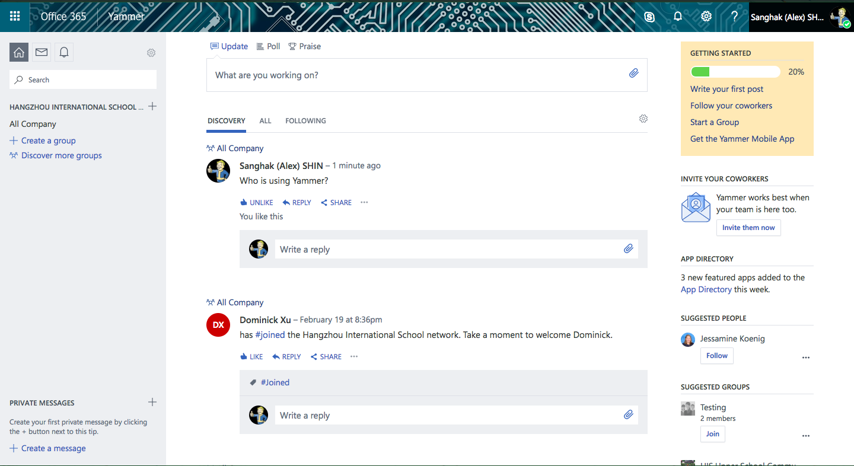
Various office 365 services - Yammer

Slide 13
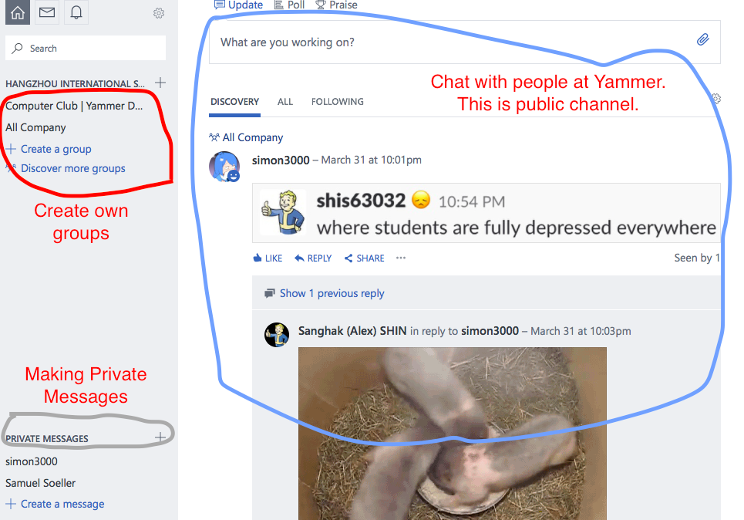

Slide 14
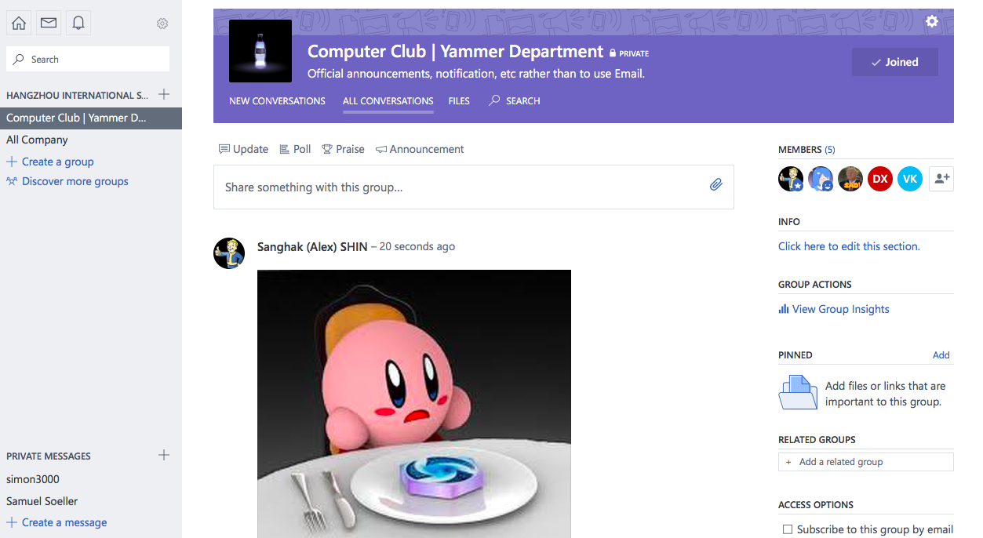

Slide 15
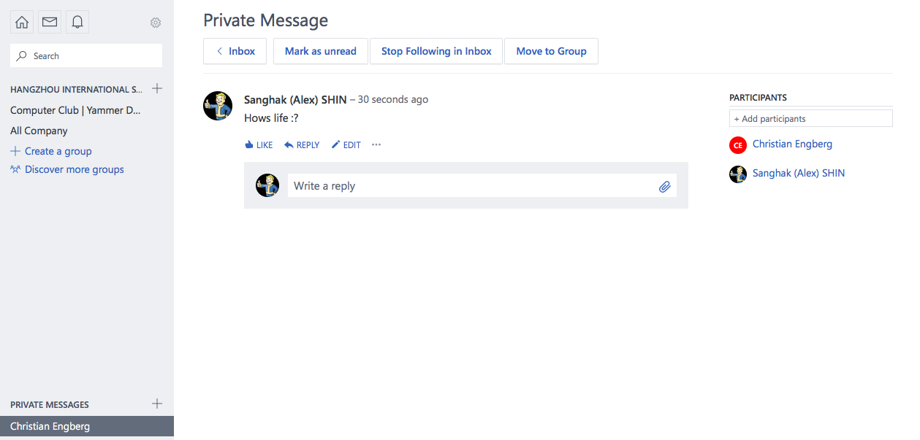

Slide 16
Various office 365 service - yammer
Yammer is an communication app that can be used to contact anyone in the school with the school account.
Just like any SNS, you can do various things that you want to do.

Slide 17
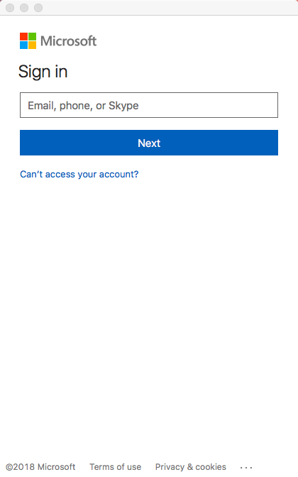
Various office 365 service – Microsoft teams
Click on “Microsoft Teams” after you have installed from the Self-Service.
Log in with your school account.

Slide 18
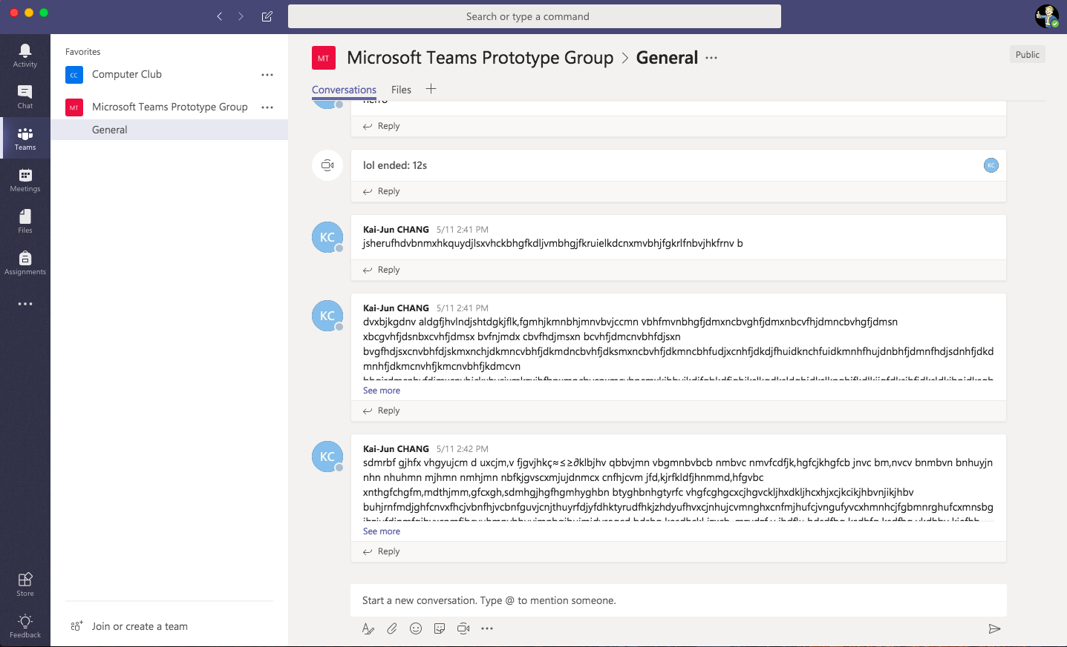
Various office 365 service – Microsoft teams

Slide 19
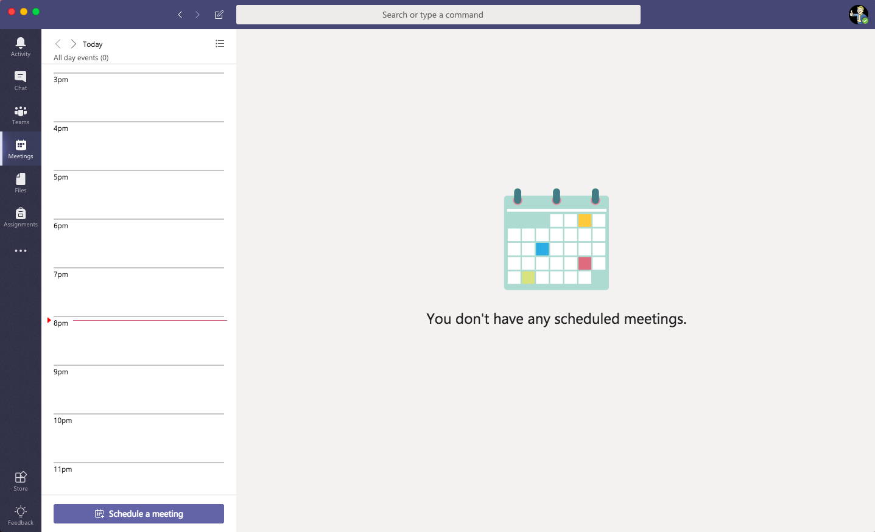
Various office 365 service – Microsoft teams

Slide 20
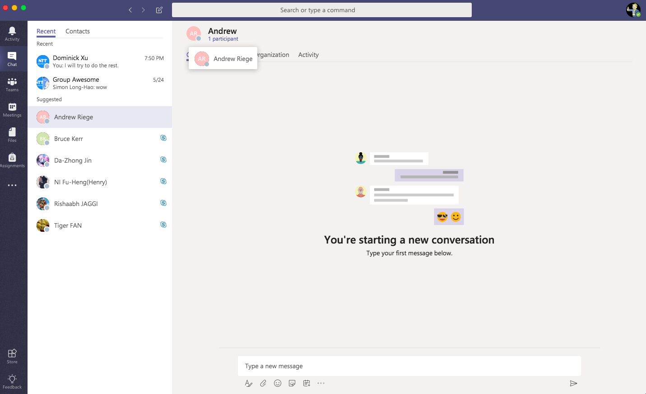
Various office 365 service – Microsoft teams

Slide 21
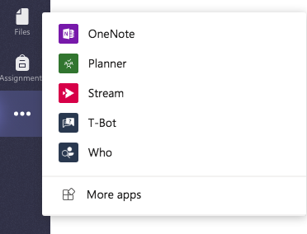
Various office 365 service – Microsoft teams

