Slide 1
MS Office 365
Computer Club 101

Slide 2

Onedrive
Onedrive is a program that can sync the files in your computer 24/7 when online.
For school accounts, it has 1TB of storage, which is about 8.3 times bigger than your computer size. (120GB * 8.3 = approx. 1000GB)

Slide 3
Installation of onedrive
Self-Service?
Idk
App Store
Torrent?
Microsoft Office 365..?

Slide 4
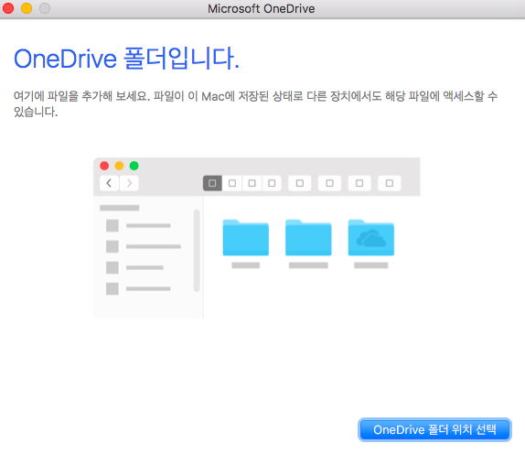
Usage of onedrive in general
(It is Korean due to my preference)
Turn on the Onedrive.app

Slide 5
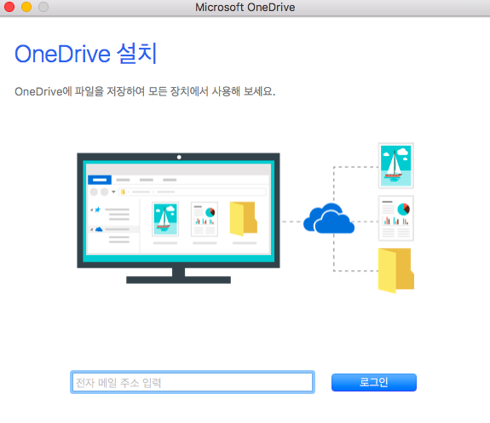
Usage of onedrive in general
There will be a space where it requires to enter your school account.
Enter your school account.

Slide 6
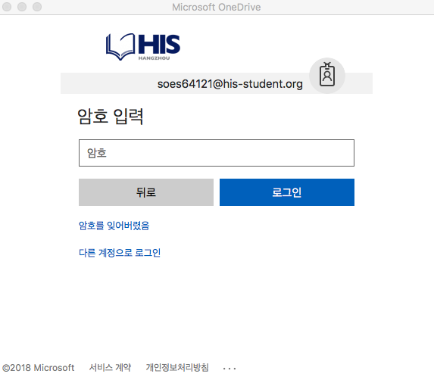
Usage of onedrive in general
After you entered your school account, (the picture shows Samuel’s account), you will proceed to login page.

Slide 7
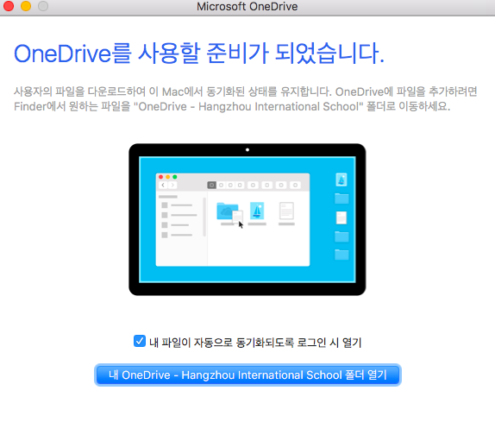
Usage of onedrive in general
After the procedure of locating the folder for Onedrive, (and some other things). Press the box to show the tick, then press the final button.
For the sake of Samuel, I have omitted some pictures for him.

Slide 9
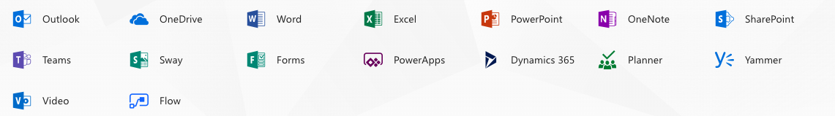
Office 365
Office 365 gives various service that you will never see again after in personal account.
Why don’t we use more efficiently?

