Slide 1
MS Office 365
Computer Club 101

Slide 2

Onedrive
Onedrive is a program that can sync the files in your computer 24/7 when online.
For school accounts, it has 1TB of storage, which is about 8.3 times bigger than your computer size. (120GB * 8.3 = approx. 1000GB)

Slide 3
Installation of onedrive
Self-Service

Slide 4
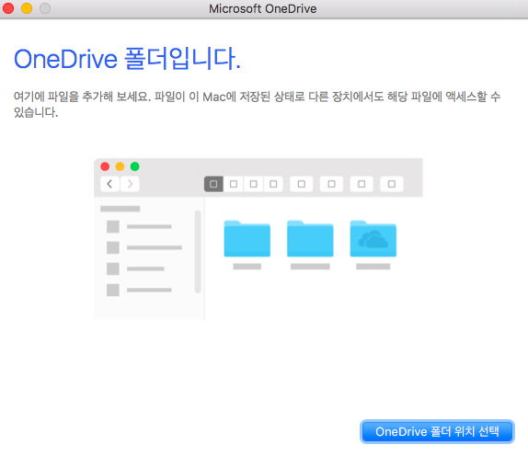
Usage of onedrive in general
(It is Korean due to my preference)
Turn on the Onedrive.app

Slide 5
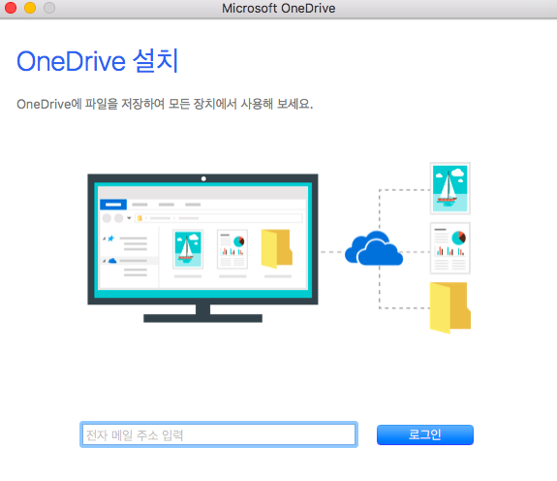
Usage of onedrive in general
There will be a space where it requires to enter your school account.
Enter your school account.

Slide 6
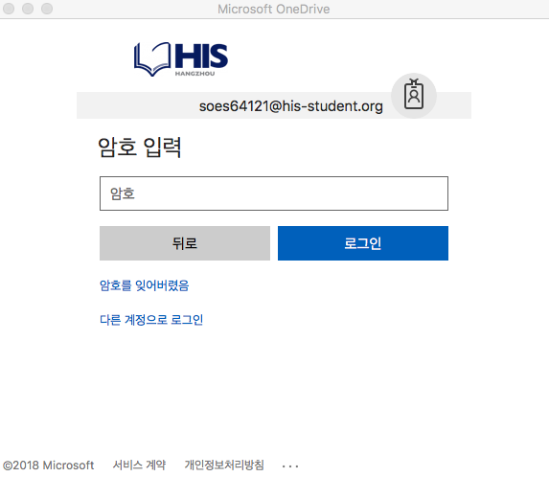
Usage of onedrive in general
After you entered your school account, (the picture shows Samuel’s account), you will proceed to login page.

Slide 7
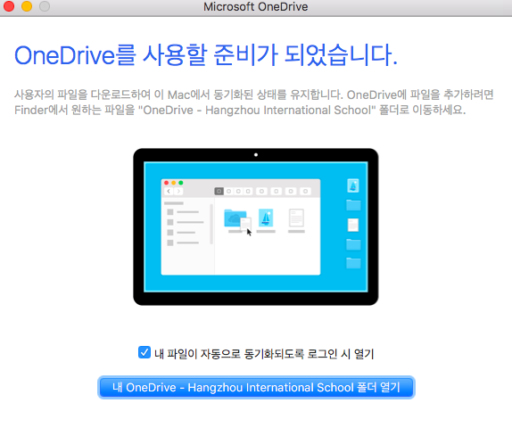
Usage of onedrive in general
After the procedure of locating the folder for Onedrive, (and some other things). Press the box to show the tick, then press the final button.
For the sake of Samuel, I have omitted some pictures for him.

Slide 9
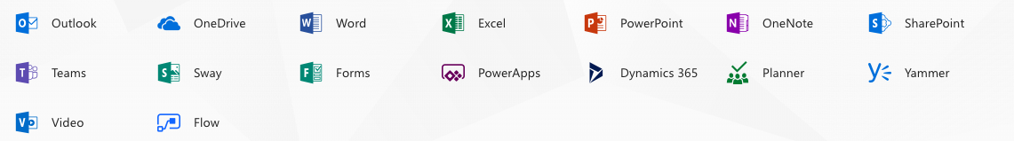
Office 365
Office 365 gives various service that you will never see again after, in personal account.
Why don’t we use more efficiently?

Slide 10
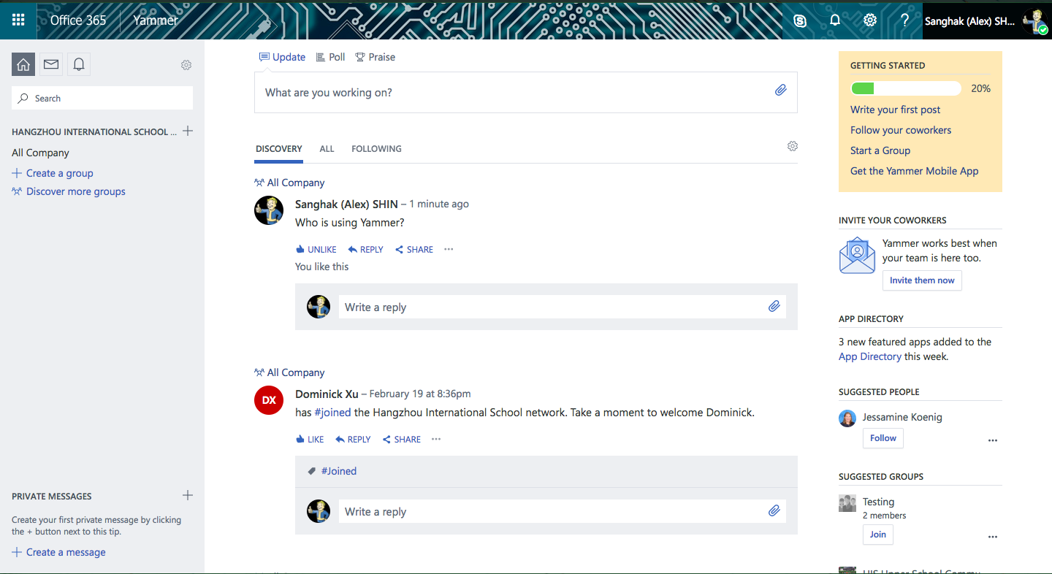
Various office 365 services - Yammer

Slide 11
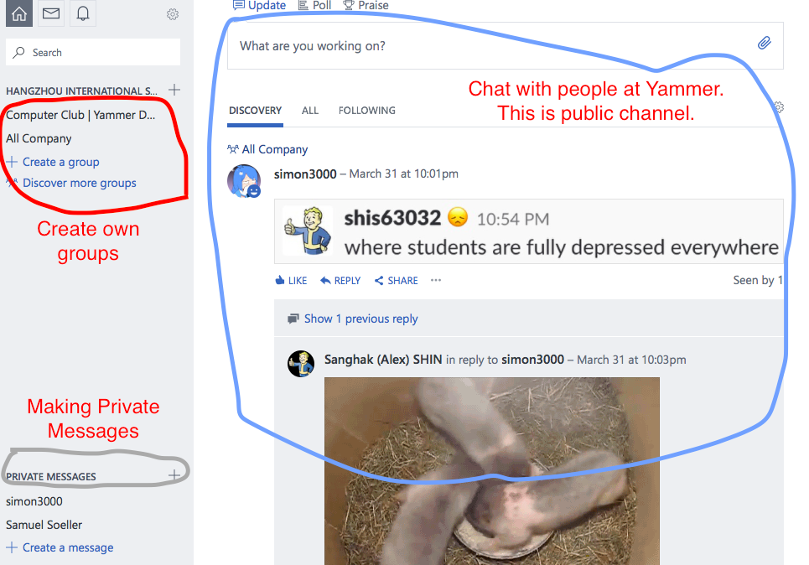

Slide 12
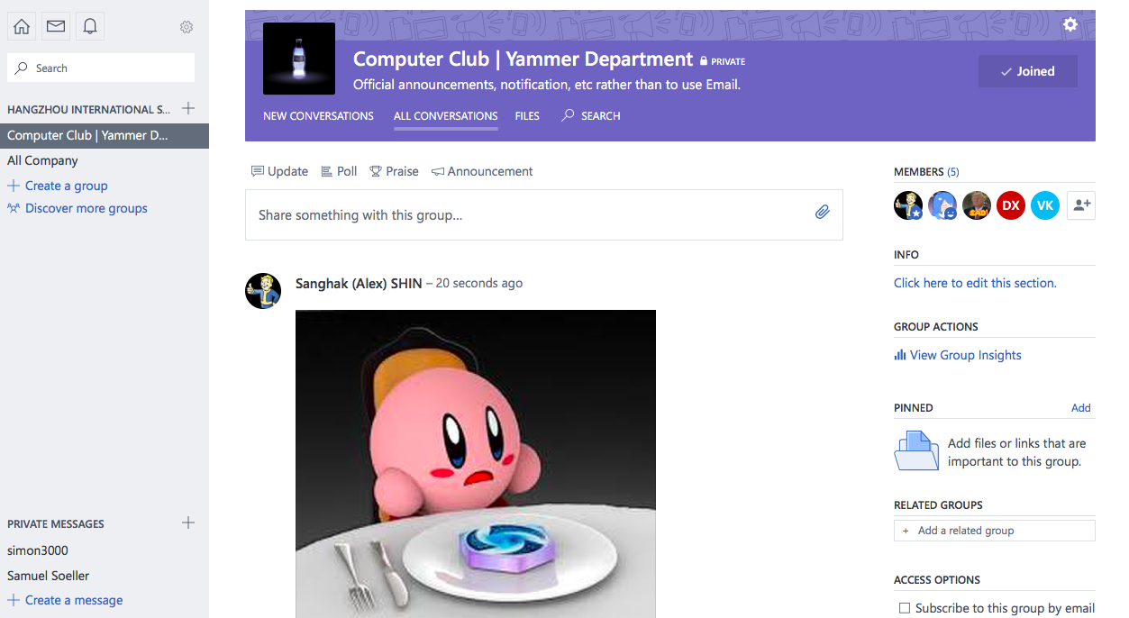

Slide 13
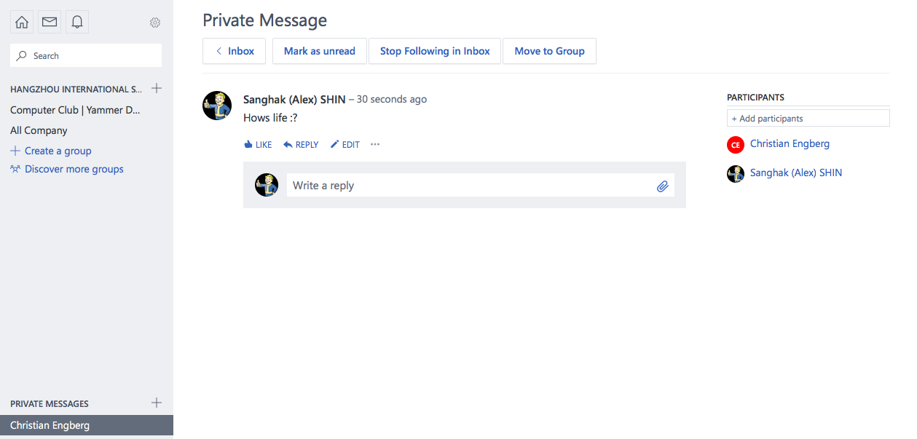

Slide 14
Various office 365 service - yammer
Yammer is an communication app that can be used to contact anyone in the school with the school account.
Just like any SNS, you can do various things that you want to do.

Slide 15
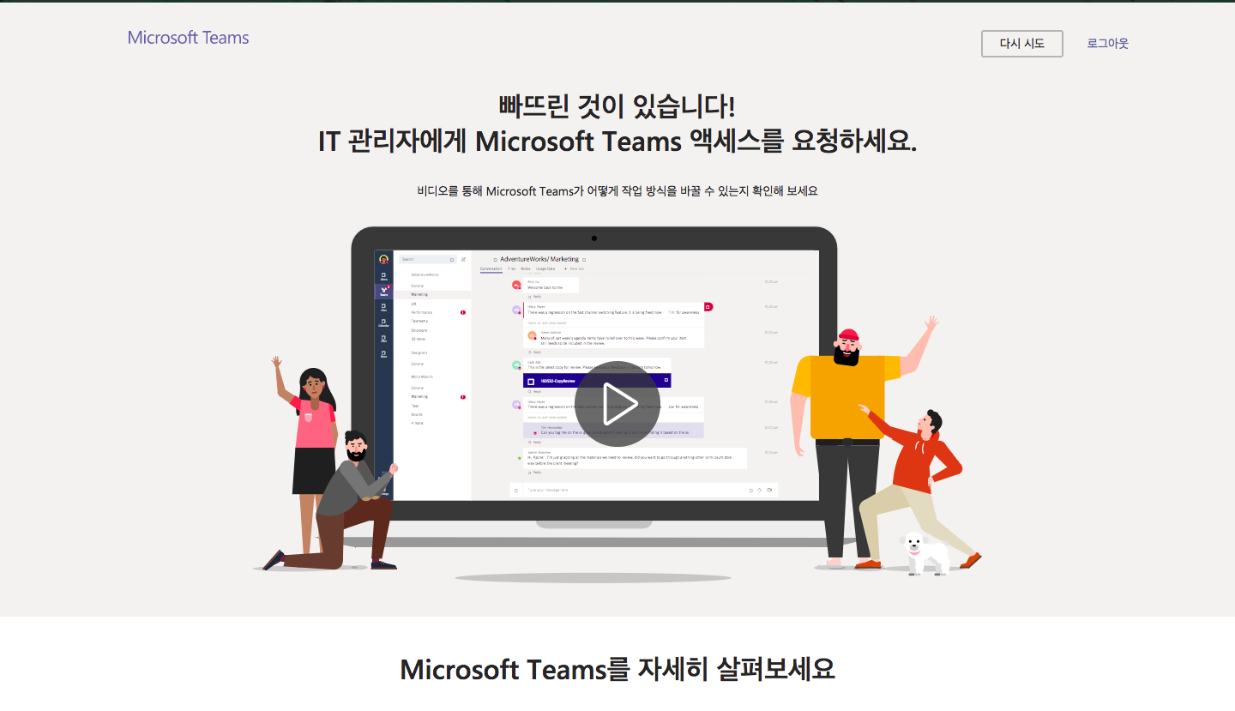
Various office 365 service – Microsoft teams [Currently not accessible]

Slide 16
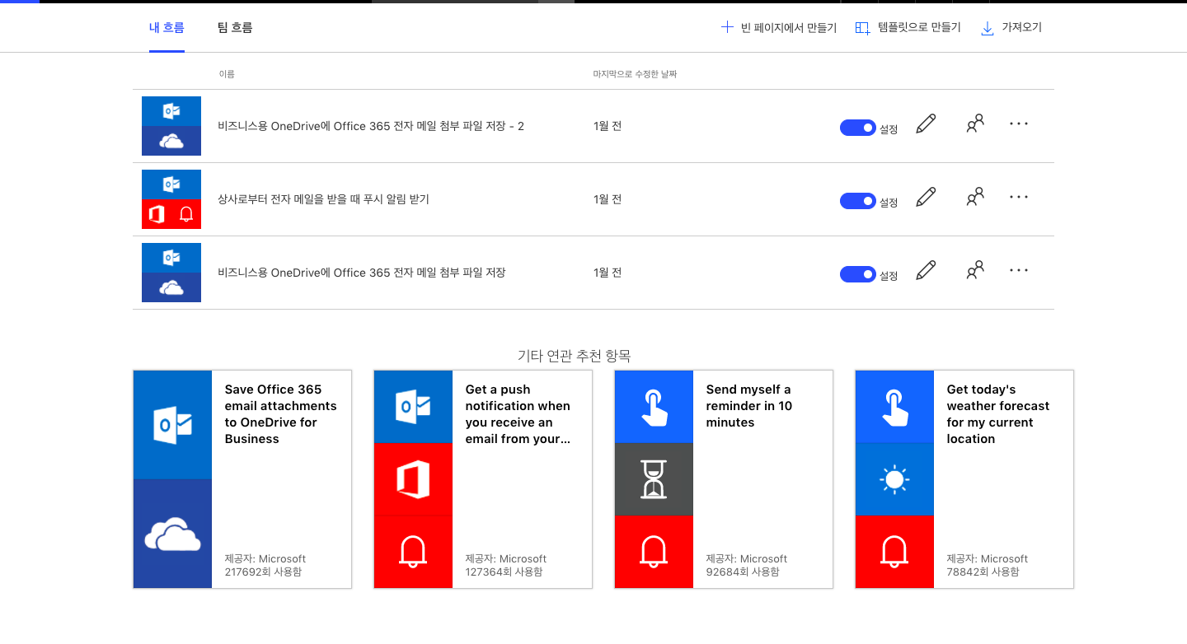
Various office 365 service - flow

Slide 17
Various office 365 service - flow
A simple program builder that is based on same system as Scratch. You can build your code and algorithms in this application to apply to any of your program that is related to Microsoft account.

Slide 18
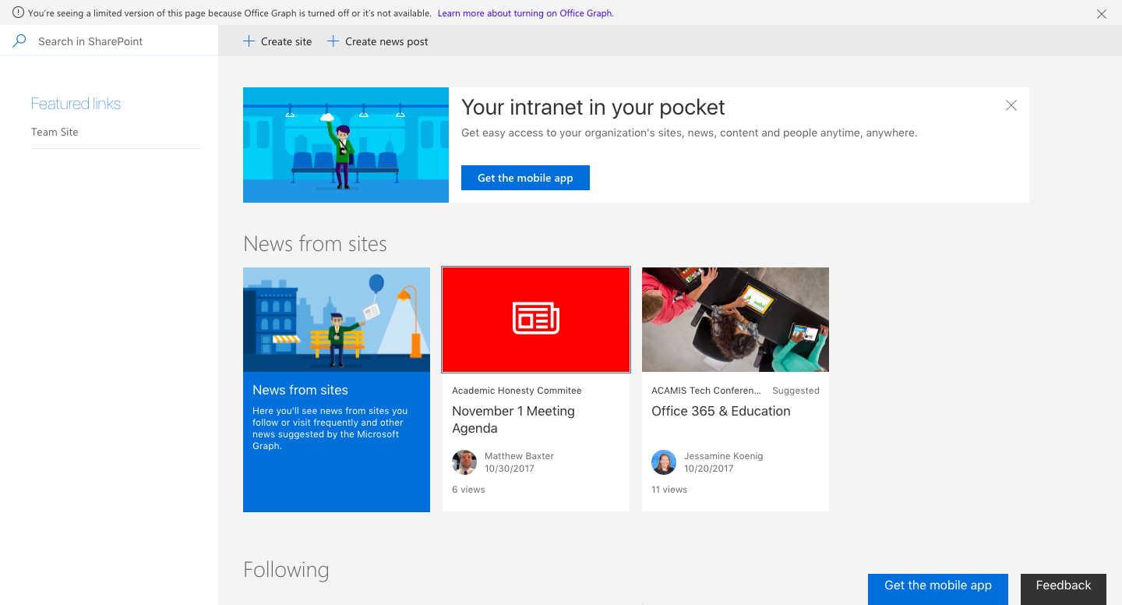
Various office 365 service - sharepoint

Slide 19
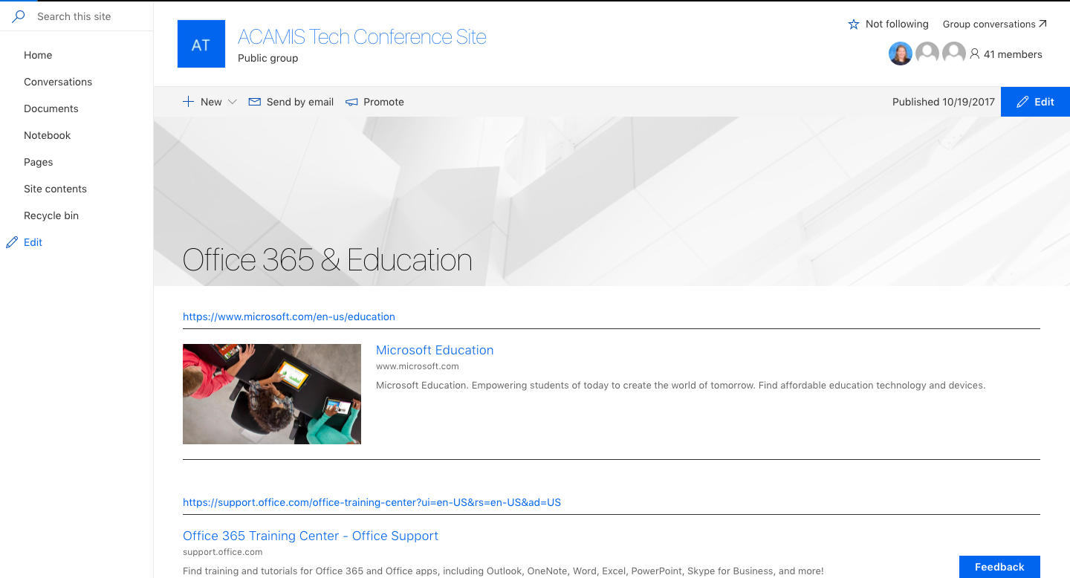
Various office 365 service - sharepoint

Slide 20
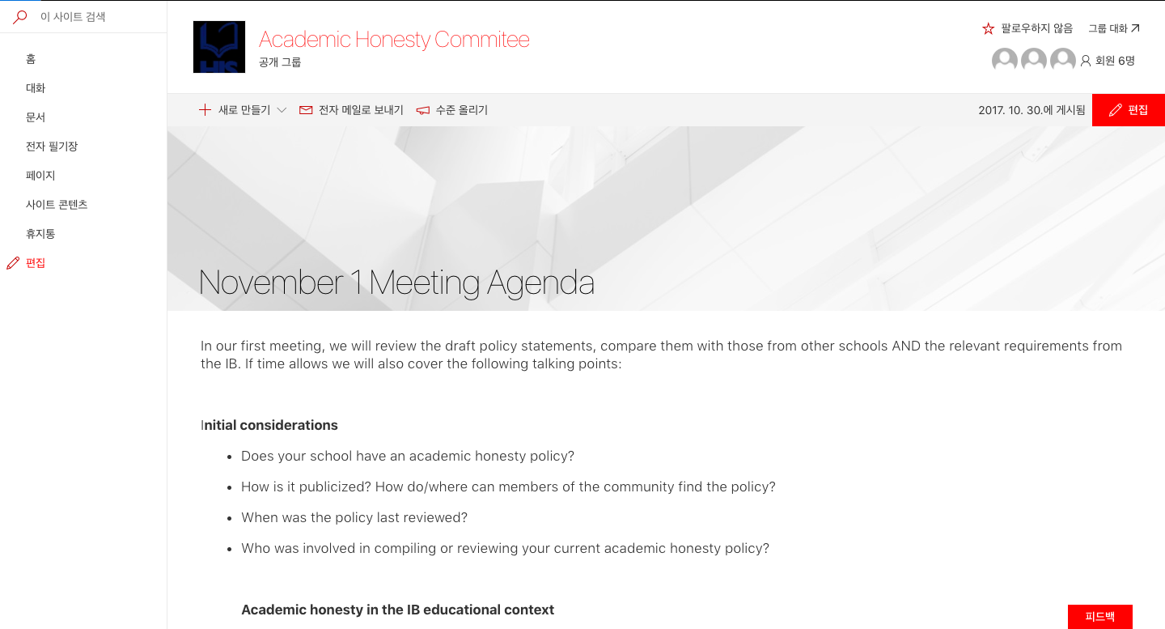
Various office 365 service - sharepoint

Slide 21
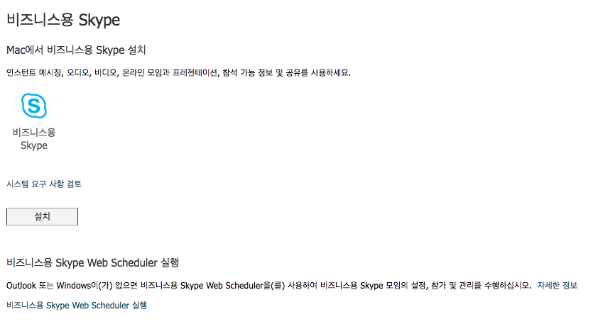
Various office 365 service – skype for business

Slide 22
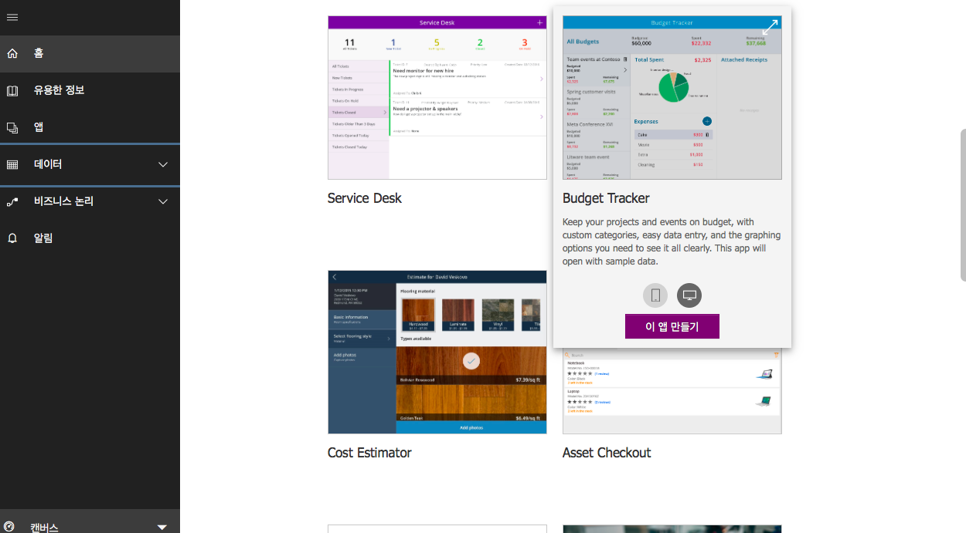
Various office 365 service – Powerapp and dynamics 365

Slide 23
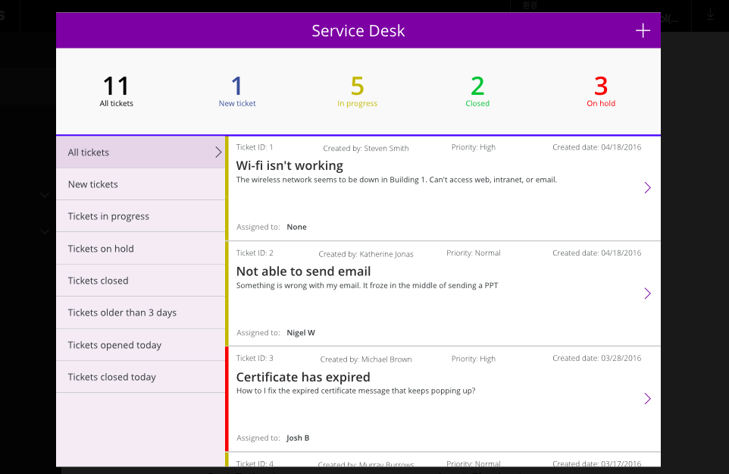

Slide 24
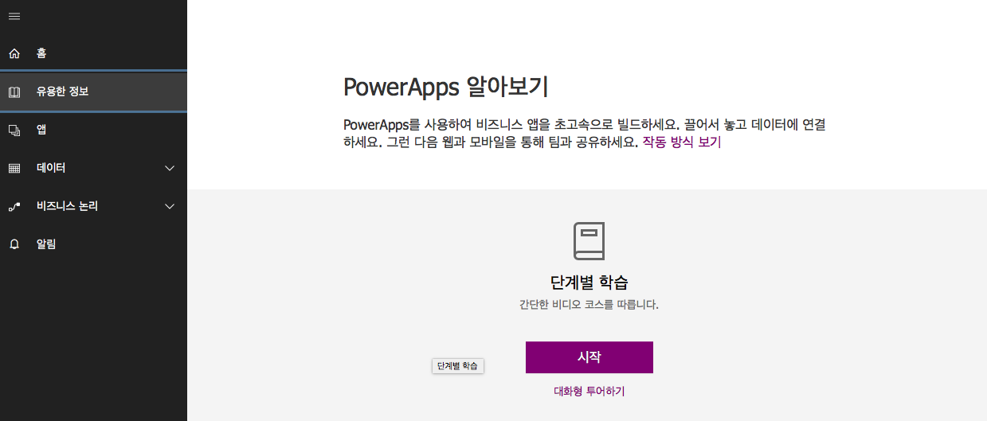

Slide 25
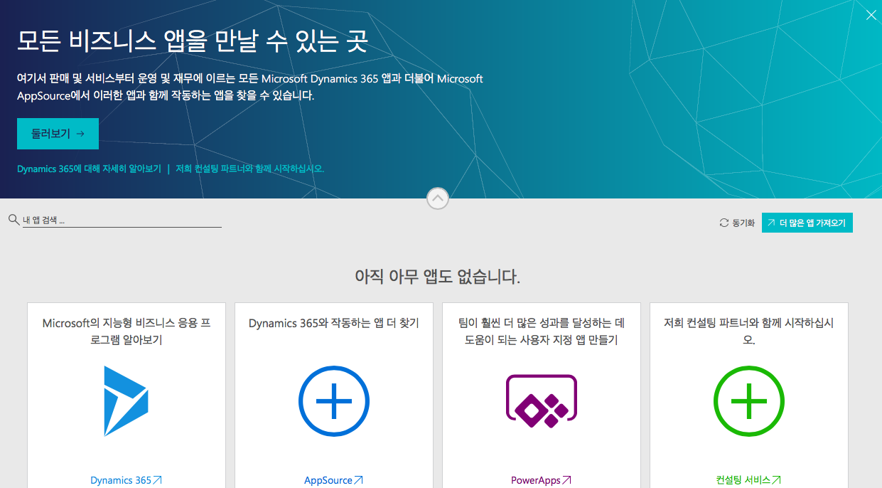

Slide 26
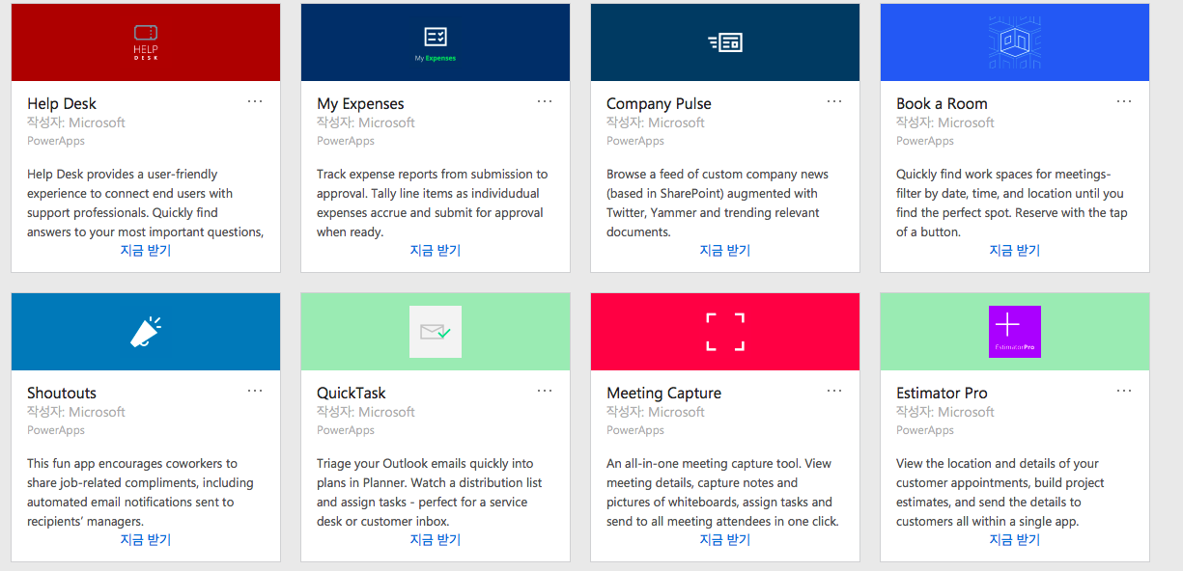

Slide 27
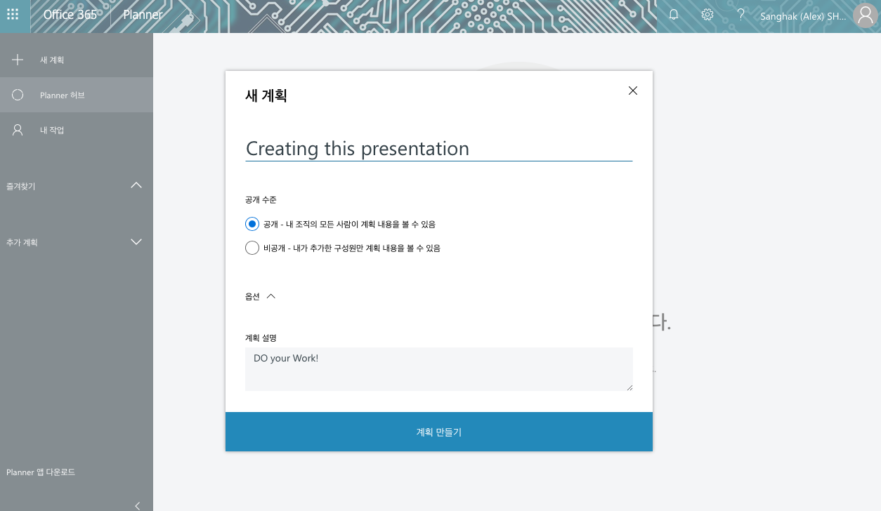
Various office 365 service - Planner

