Slide 1
GIS and History
What is GIS?
Uses of GIS
How do historians use GIS?
Practical applications of our tutorials
Using GIS in our own work
The field of Digital Humanities

Slide 2
What is GIS?
GIS = Geographic Information System
GIS is a way to visually represent data.
GIS allows academics and analysts to “see” information mapped onto physical space; anything that has a spatial component might have GIS applications.
Time and space

Slide 3
Uses of GIS
It’s not just for historians!
How have housing prices in Cleveland neighborhoods changed over time?
Is there a spatial pattern to vehicle break-ins in Arlington?
Is there a relationship between early sex education in schools and teen pregnancy rates?
Is there a relationship between population density and Ebola?
How have changing global temperatures impacted bird migrations?
How should the city of San Francisco be animated in a video game?
Where should Dallas build a new fire station, based on local traffic, response time, and need?
How do wait times at election polling places impact voter turn-out?

Slide 4
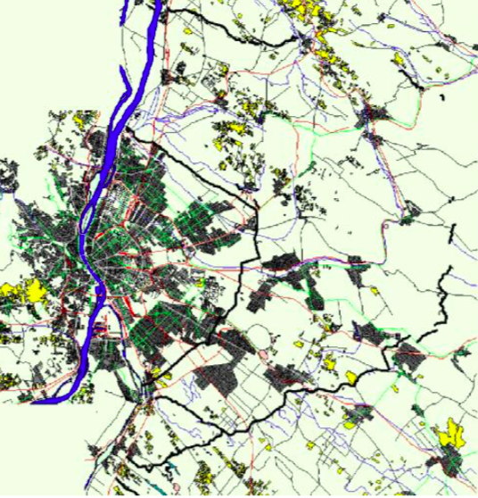
How do historians use GIS? Military history:
Example: Military historical reconstruction of the Attila Line, a defense line around Budapest during WWII.
Source: TUB Department of Photogrammetry and Geoinformatics, HAS-TUB Geoinformation Research Group, “Military historical reconstruction (WWII) with GIS,” Budapest, Hungary. http://www.zmne.hu/aarms/docs/Volume4/Issue3/pdf/04juha.pdf
The reconstructed Attila Line

Slide 5
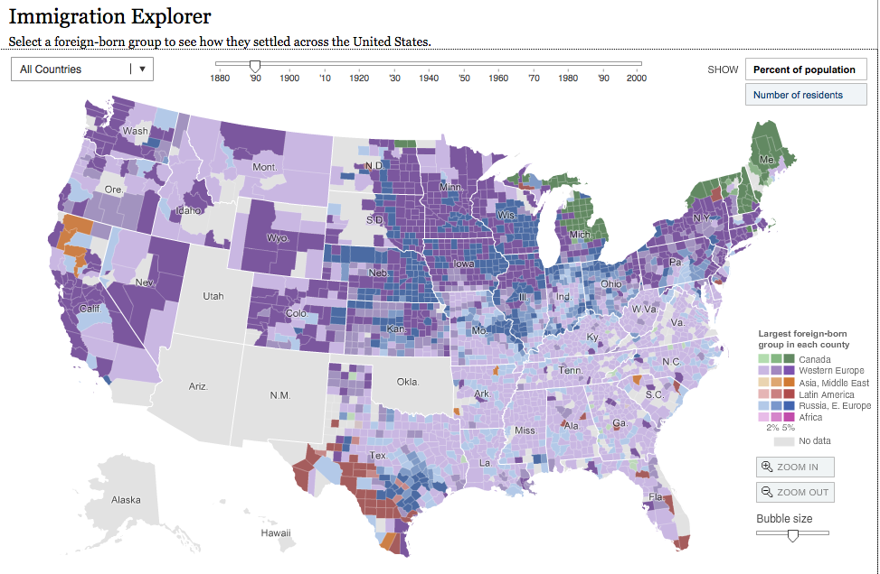
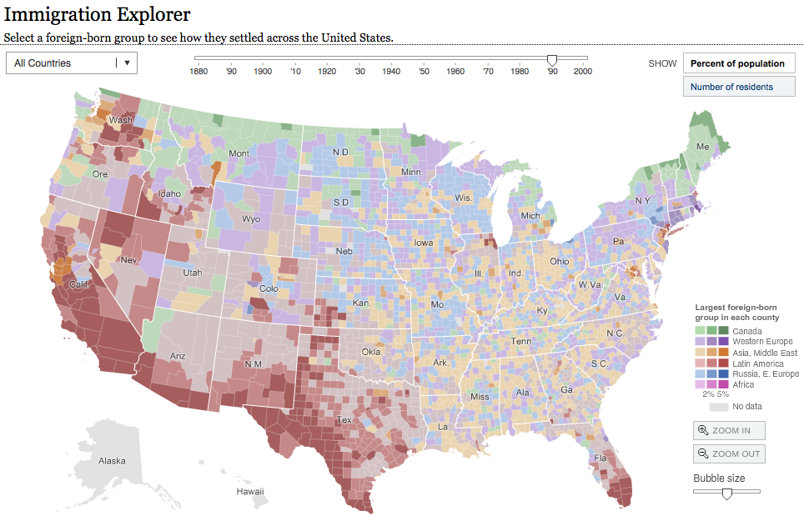
How do historians use GIS? Migration:
New York Times’ Immigration Explorer: http://www.nytimes.com/interactive/2009/03/10/us/20090310-immigration-explorer.html?_r=0
WNYC’s “New Littles” Project: https://project.wnyc.org/census-maps/littles/littles.html

Slide 6
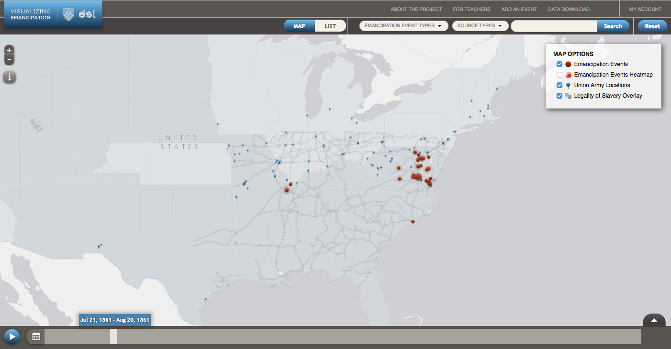
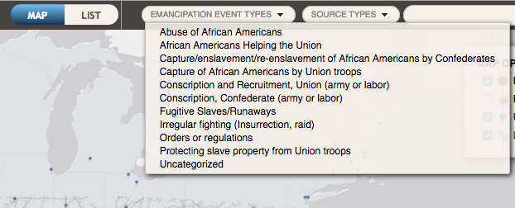
How do historians use GIS? Visualizing social upheaval: Emancipation
“Visualizing Emancipation,” University of Richmond, http://dsl.richmond.edu/emancipation/

Slide 7
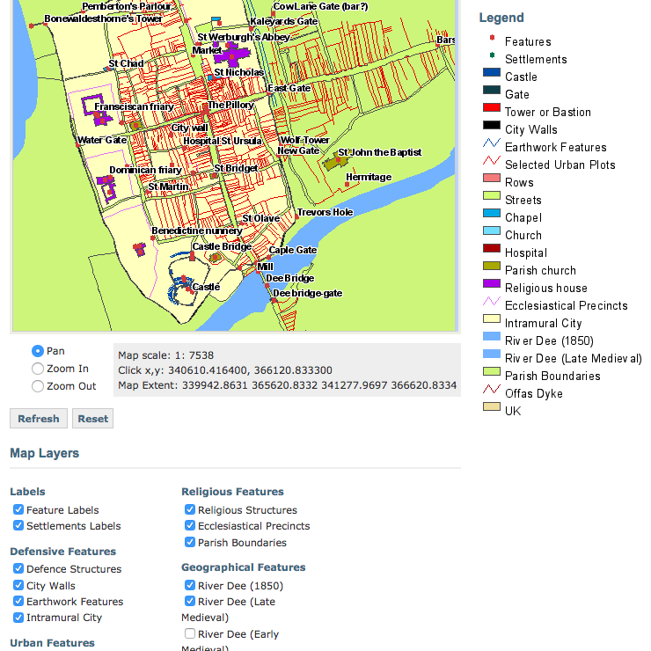
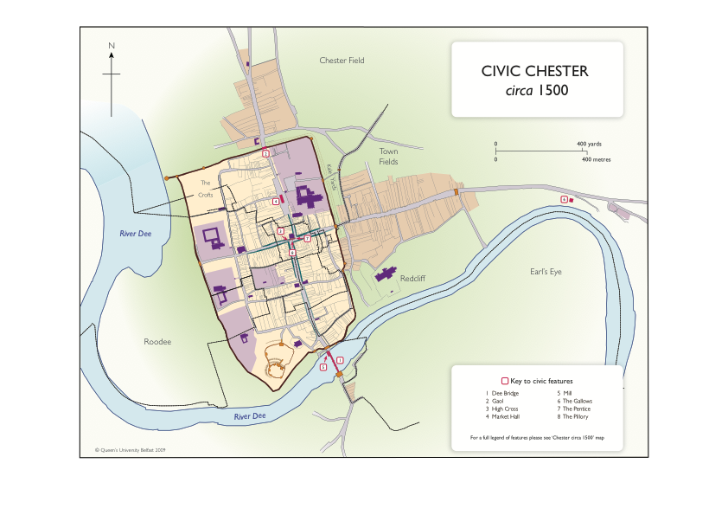
How do historians use GIS? Uniting place/space and time: Mapping Medieval Chester
http://www.medievalchester.ac.uk/mappings/static.html
http://mapserver.cch.kcl.ac.uk/medchest/lowbandwidth.php
Project description (from aag.org): This AHRC-funded research project brings together a team including literary specialists, historical geographers and historians to explore space, place and identity in medieval Chester. The project asks questions about Chester as a city on the (often troubled) border between England and Wales, and about how different medieval inhabitants imagined and represented the urban space around them.

Slide 8
How do historians use GIS? Recovering lost data and information:
Portuguese Mapping of the Coast of Africa: When a tsunami and 8.8 earthquake destroyed nearly all the records of Portuguese exploration of the west African coast, the only surviving maps were those outside of Lisbon at 9.30 AM on November 1, 1755. After a dozen years, we have acquired digital images of nearly every surviving map, and are working backwards from the maps to discover the nature of the survey techniques used. Sponsors: A joint collaboration between the University of California Humanities Research Institute, GIS Data Center at Rice University, and the Texas Learning & Computation Center, University of Houston. Funded by the American Council of Learned Societies and the National Endowment for the Humanities Office of Digital Humanities.

Slide 9
How do historians use GIS?
Trace the movement of ideas by seeing where pamphlets, newspapers, and other publications were present.
Better understand slave culture in the Americas by tracing the ports of call of slave ships.
Trace how transportation (like railroads) and technology affected population and other changes.
Borderlands: track how small or more significant variations in borders impacted contemporary peoples and events.

Slide 10
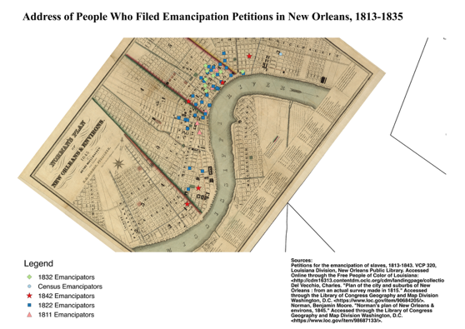
Practical applications of our tutorials:
Mapping points and using geo-referenced maps

Slide 11
The field of digital humanities: STEM -> STEAM
Aug. 2016: Tenure-Track Assistant Professor of U.S. Art History, George Mason University: “Special preference will be given to candidates who can teach the history of photography or have expertise in digital humanities.”
July 2016: Digital Scholarship Librarian, Boston College
July 2016: UMD Postdocs in DH & African American History and Culture
April 2016: Assistant Professor of European and Digital History, Brock University
Dec. 2015: Lead Developer at Princeton University’s Center for Digital Humanities
Nov. 2015: Open Rank Professor / Program Director College Park, MD: The College of Arts and Humanities at the University of Maryland seeks a dynamic scholar at the rank of advanced assistant, associate, or full professor with a proven record of conducting innovative research and teaching at the intersection of African American History & Culture and Digital Humanities to direct a major Andrew W. Mellon Foundation-funded project: Synergies among Digital Humanities and African American History and Culture
Sep. 2015: Assistant, Associate, or Full Professor of English in the Digital Humanities, University of Miami

Slide 12
Useful websites for GIS data
US government’s open data: https://www.data.gov
US Census Bureau: https://www.census.gov/geo/maps-data/data/tiger-cart-boundary.html
Institute for Mapping Technology: http://learninggis.com/gis-resources/sources-of-free-gis-data
UIC American Migrations: http://americanmigrations.uic.edu/censustools.htm
American Association of Geographers: http://www.aag.org/
Projects: http://www.aag.org/cs/projects_and_programs/historical_gis_clearinghouse/hgis_projects_programs
Build your own datasets: http://factfinder.census.gov/faces/nav/jsf/pages/index.xhtml

