Slide 1
An overview of gradient descent optimization algorithms

Slide 2
Gradient descent variants
1、Batch gradient descent 2、Stochastic gradient descent 3、Mini-batch gradient descent

Slide 3

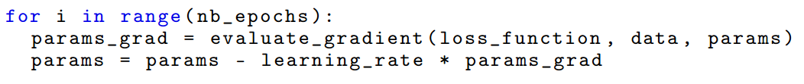
Batch gradient descent

Slide 4
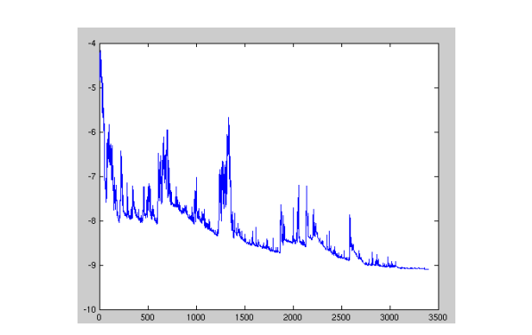

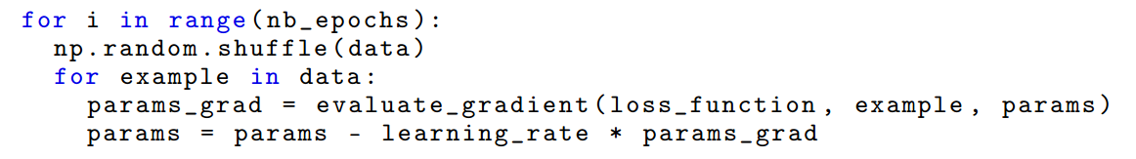
Stochastic gradient descent

Slide 5

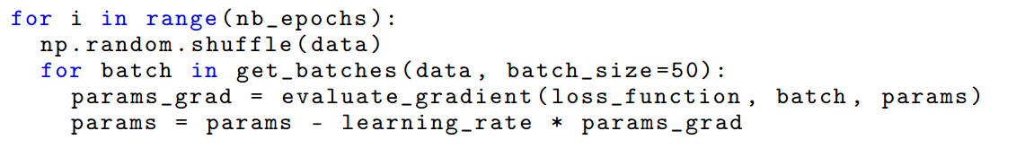
Mini-batch gradient descent

Slide 6
Gradient descent optimization algorithms

Slide 7
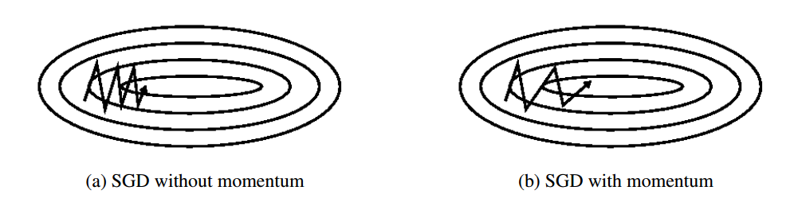

1.Momentum

Slide 8

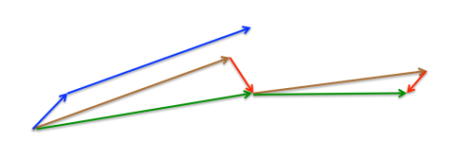
2.Nesterov accelerated gradient

Slide 9


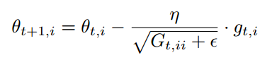

3. Adagrad

Slide 10

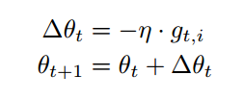

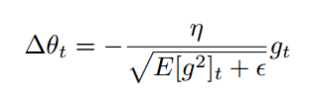
4. RMSprop

Slide 11



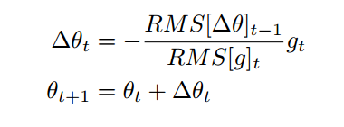
5. Adadelta

Slide 12
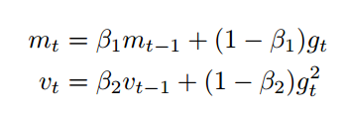
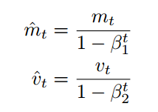

6. Adam

Slide 13

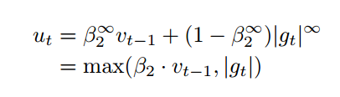


7. AdaMax

Slide 14
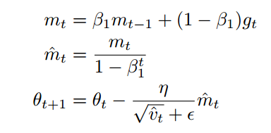
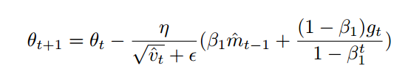
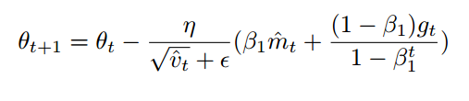
8. Nadam

Slide 15
Additional strategies for optimizing SGD

Slide 16

Additional strategies for optimizing SGD
Shuffling and Curriculum Learning
Batch normalization
Early stopping
Gradient noise

Slide 17
THANK YOU

