Slide 1

Introduction to Boosted Trees
Tianqi Chen
Oct. 22 2014

Slide 2

Outline
• Review of key concepts of supervised learning
• Regression Tree and Ensemble (What are we Learning)
• Gradient Boosting (How do we Learn)
• Summary

Slide 3
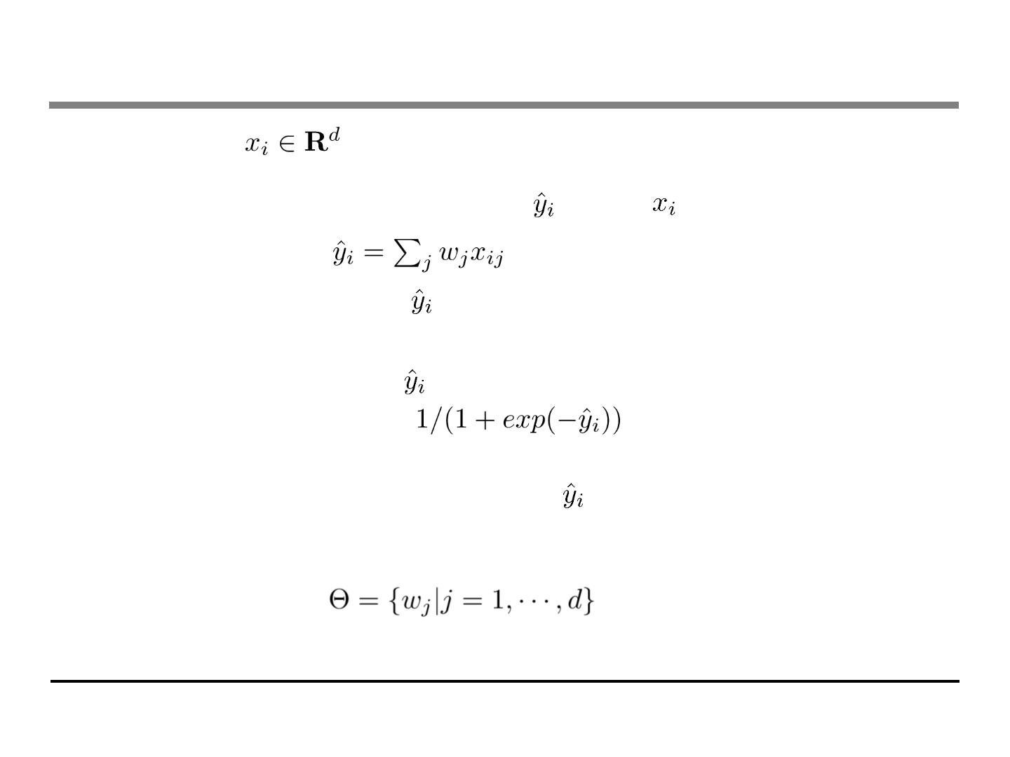
Elements in Supervised Learning
• Notations:
i-th training example
• Model: how to make prediction given
. Linear model:
(include linear/logistic regression)
. The prediction score can have different interpretations
depending on the task
⬥ Linear regression: is the predicted score
⬥ Logistic regression:
is predicted the probability
of the instance being positive
⬥ Others… for example in ranking
can be the rank score
• Parameters: the things we need to learn from data
. Linear model:

Slide 4
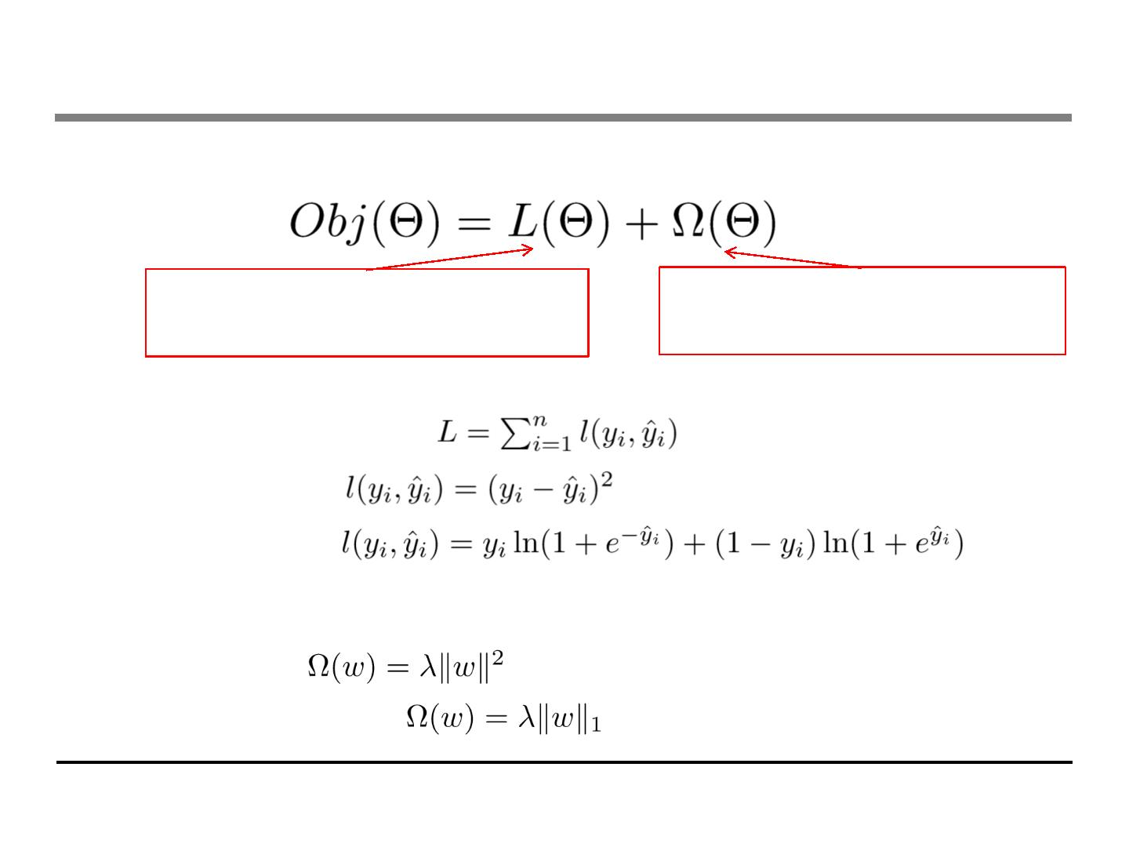
Elements continued: Objective Function
• Objective function that is everywhere
Training Loss measures how
Regularization, measures
well model fit on training data
complexity of model
• Loss on training data:
. Square loss:
. Logistic loss:
• Regularization: how complicated the model is?
. L2 norm:
. L1 norm (lasso):

Slide 5
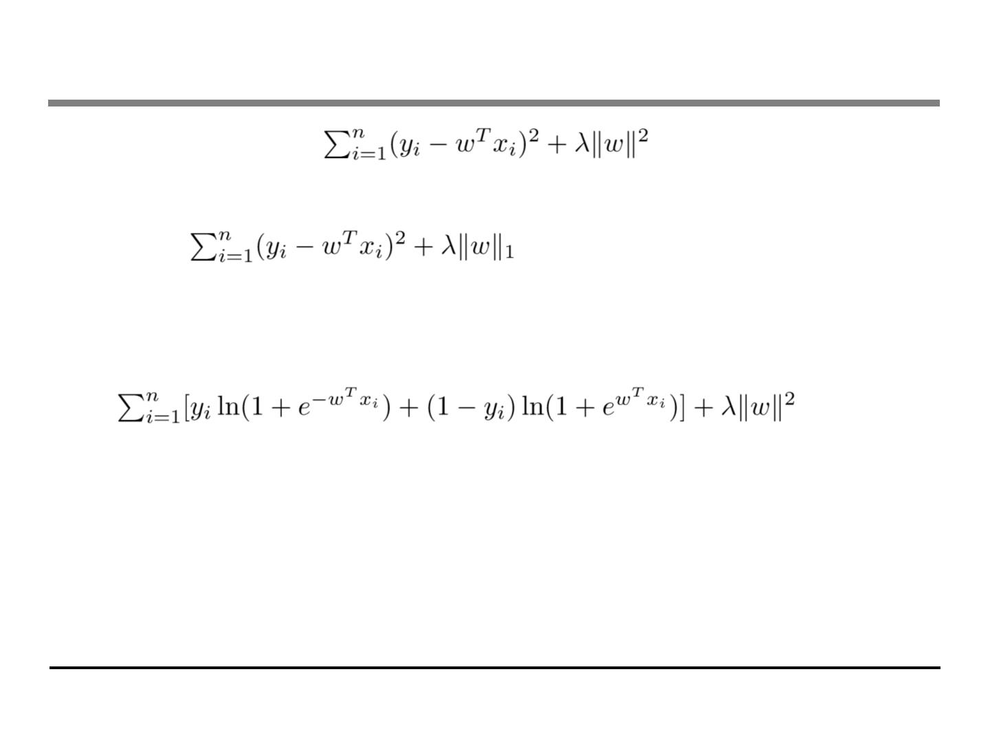
Putting known knowledge into context
• Ridge regression:
. Linear model, square loss, L2 regularization
• Lasso:
. Linear model, square loss, L1 regularization
• Logistic regression:
. Linear model, logistic loss, L2 regularization
• The conceptual separation between model, parameter,
objective also gives you engineering benefits.
. Think of how you can implement SGD for both ridge regression
and logistic regression

Slide 6
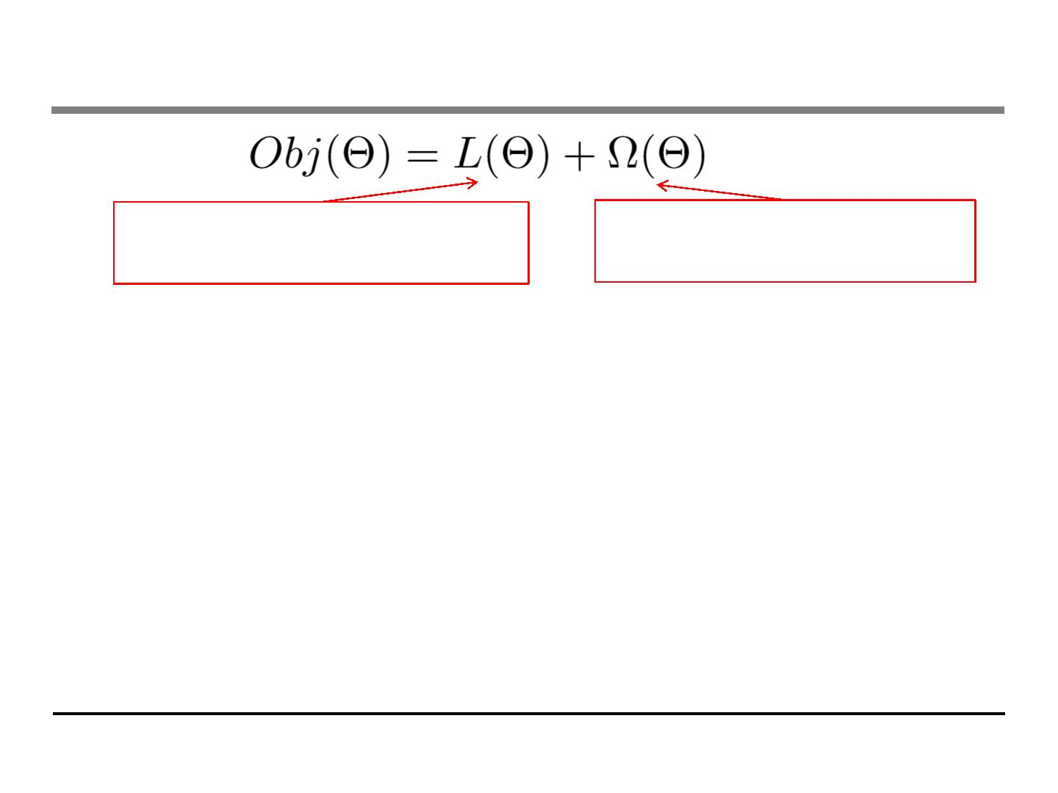
Objective and Bias Variance Trade-off
Training Loss measures how
Regularization, measures
well model fit on training data
complexity of model
• Why do we want to contain two component in the objective?
• Optimizing training loss encourages predictive models
. Fitting well in training data at least get you close to training data
which is hopefully close to the underlying distribution
• Optimizing regularization encourages simple models
. Simpler models tends to have smaller variance in future
predictions, making prediction stable

Slide 7
Outline
• Review of key concepts of supervised learning
• Regression Tree and Ensemble (What are we Learning)
• Gradient Boosting (How do we Learn)
• Summary

Slide 8
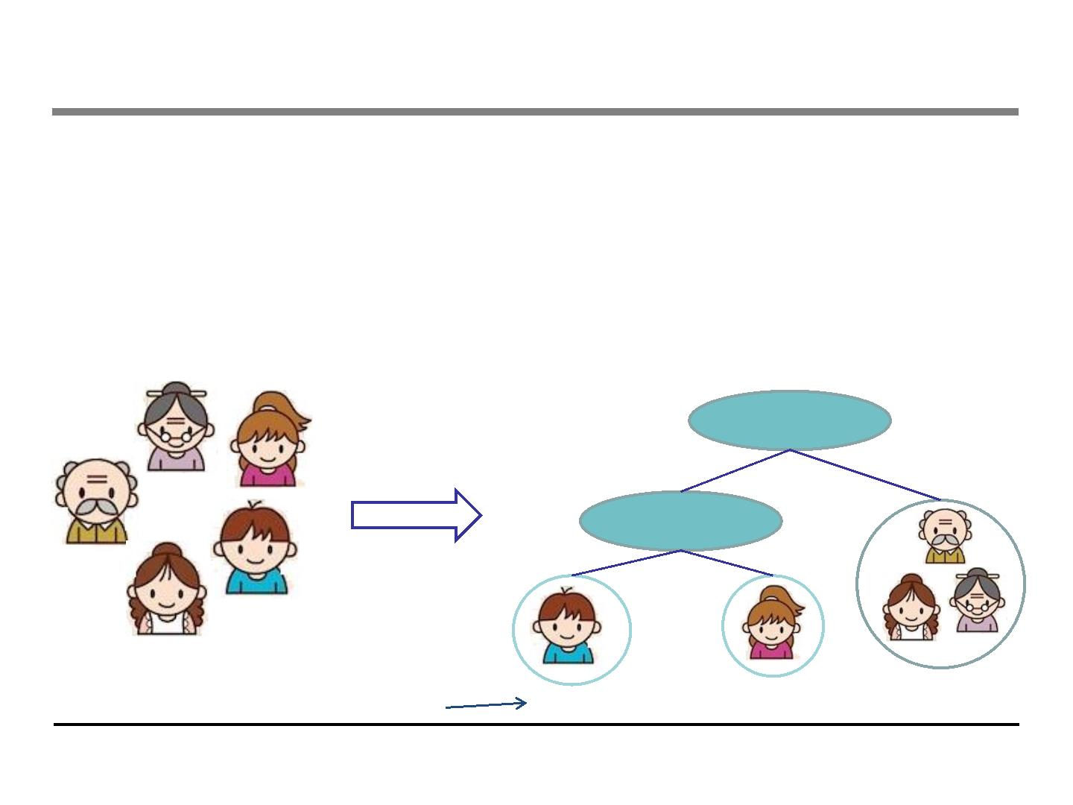
Regression Tree (CART)
• regression tree (also known as classification and regression
tree):
. Decision rules same as in decision tree
. Contains one score in each leaf value
Input: age, gender, occupation, …
Does the person like computer games
age < 15
Y
N
is male?
Y
N
prediction score in each leaf
+2
+0.1
-1

Slide 9
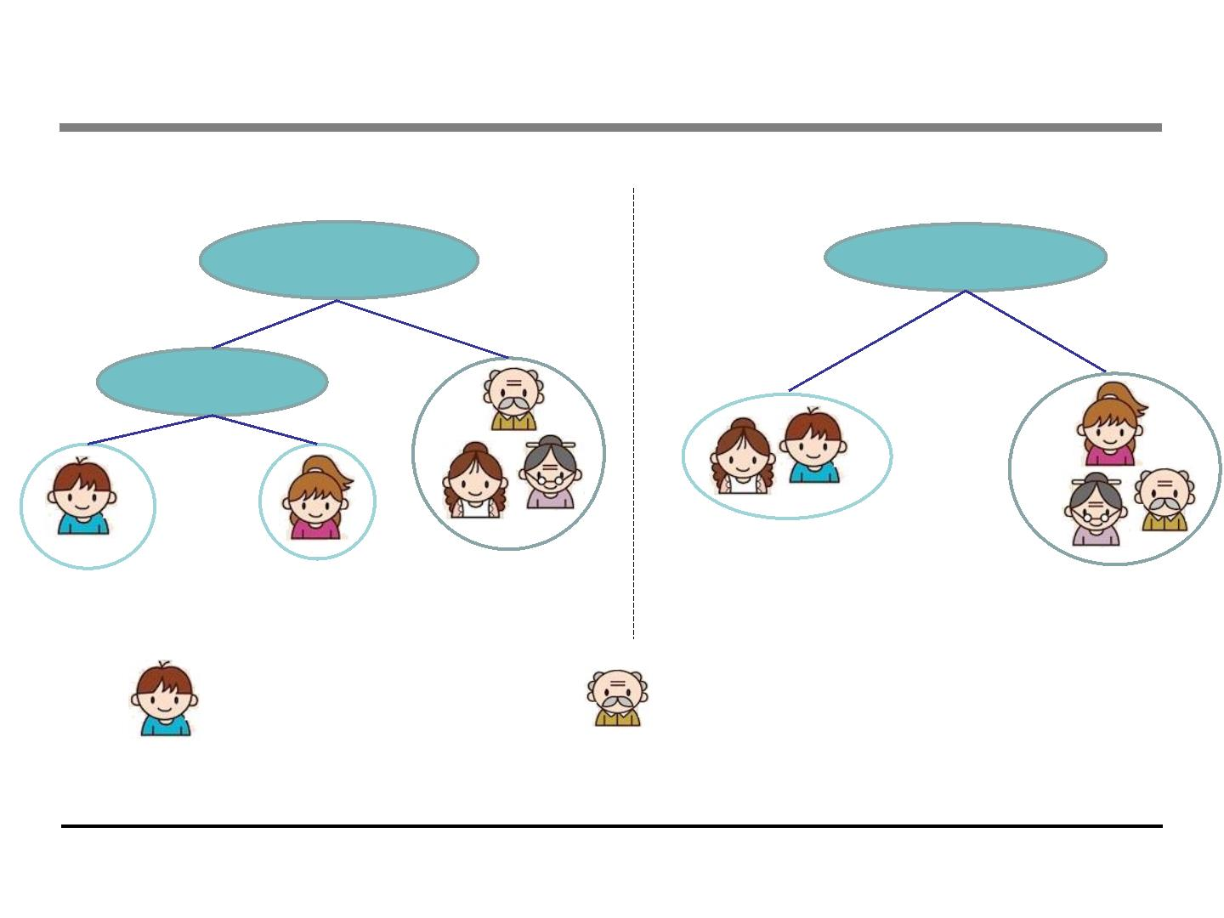
Regression Tree Ensemble
tree1
tree2
age < 15
Use Computer
Daily
Y
N
Y
N
is male?
Y
N
+2
+0.1
-1
+0.9
-0.9
f(
) = 2 + 0.9= 2.9
f(
)= -1 - 0.9= -1.9
Prediction of is sum of scores predicted by each of the tree

Slide 10
Tree Ensemble methods
• Very widely used, look for GBM, random forest…
. Almost half of data mining competition are won by using some
variants of tree ensemble methods
• Invariant to scaling of inputs, so you do not need to do careful
features normalization.
• Learn higher order interaction between features.
• Can be scalable, and are used in Industry

Slide 11
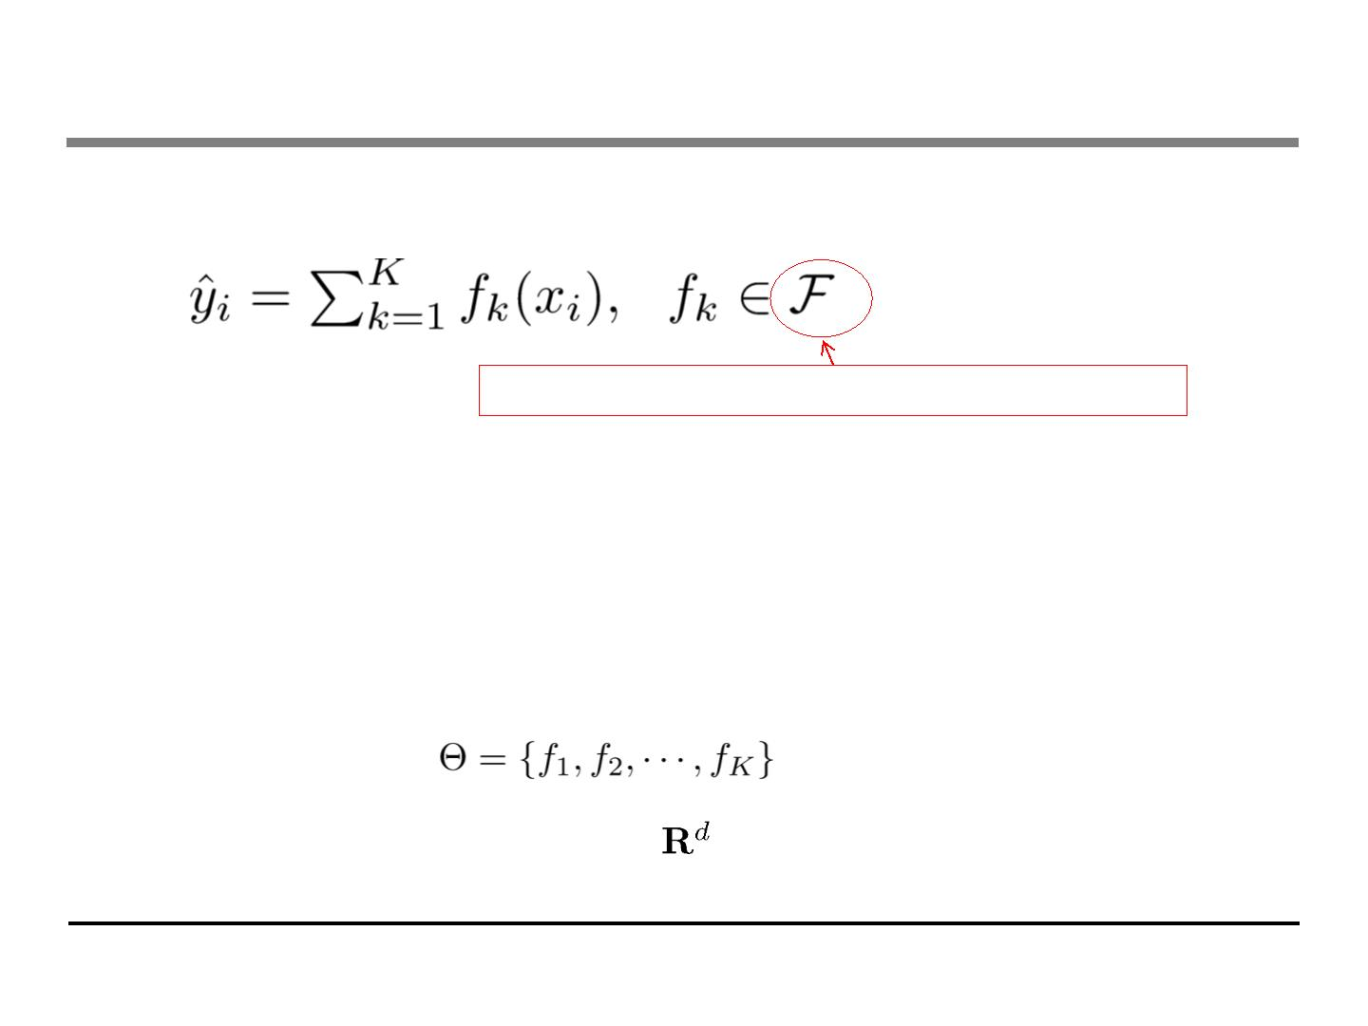
Put into context: Model and Parameters
• Model: assuming we have K trees
Space of functions containing all Regression trees
Think: regression tree is a function that maps the attributes to the score
• Parameters
. Including structure of each tree, and the score in the leaf
. Or simply use function as parameters
. Instead learning weights in , we are learning functions(trees)

Slide 12
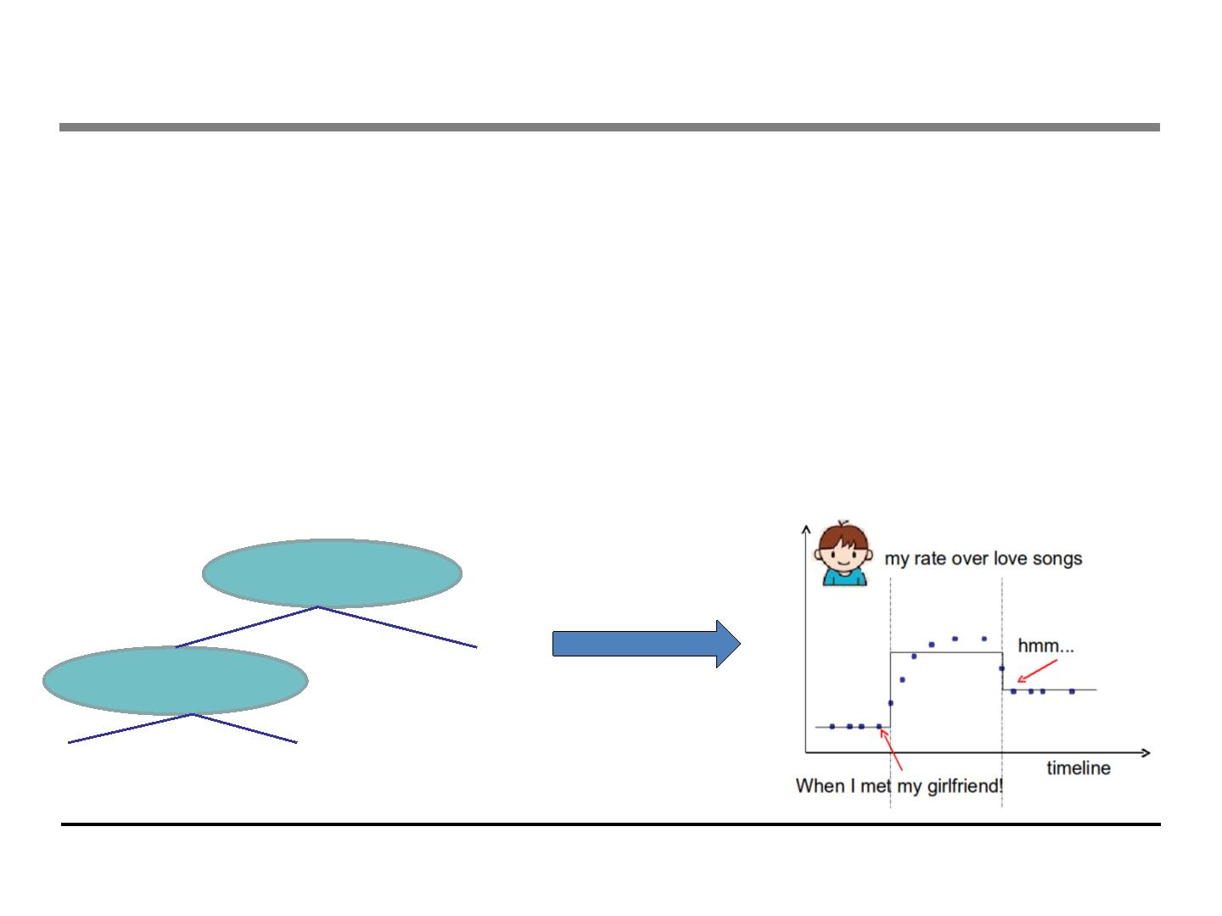
Learning a tree on single variable
• How can we learn functions?
• Define objective (loss, regularization), and optimize it!!
• Example:
. Consider regression tree on single input t (time)
. I want to predict whether I like romantic music at time t
The model is regression tree that splits on time
Piecewise step function over time
t < 2011/03/01
Y
N
Equivalently
t < 2010/03/20
1.0
Y
N
0.2
1.2

Slide 13
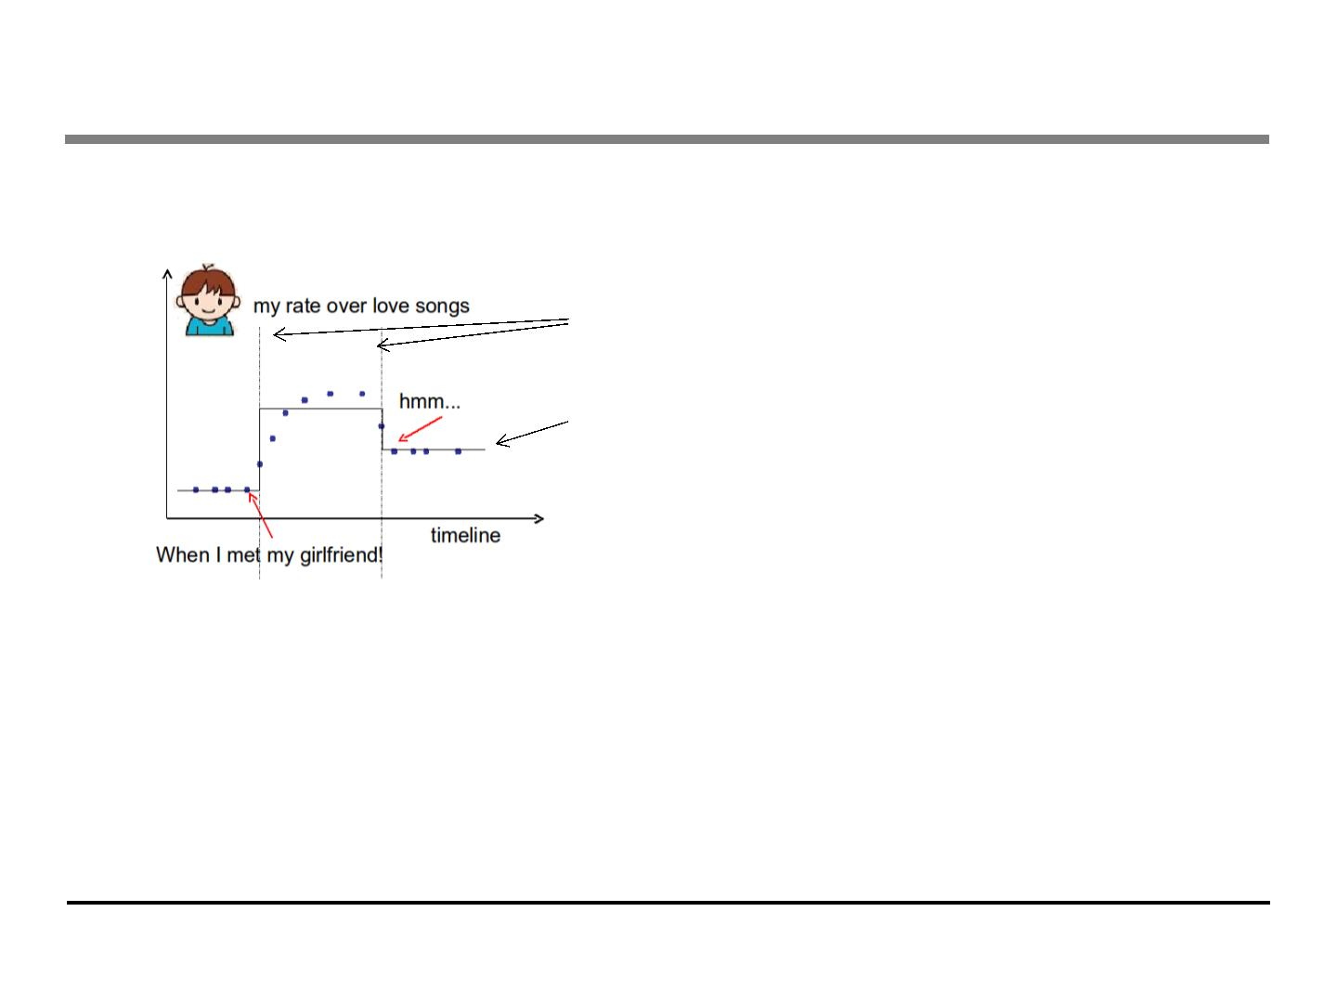
Learning a step function
• Things we need to learn
Splitting Positions
The Height in each segment
• Objective for single variable regression tree(step functions)
. Training Loss: How will the function fit on the points?
. Regularization: How do we define complexity of the function?
⬥ Number of splitting points, l2 norm of the height in each segment?

Slide 14
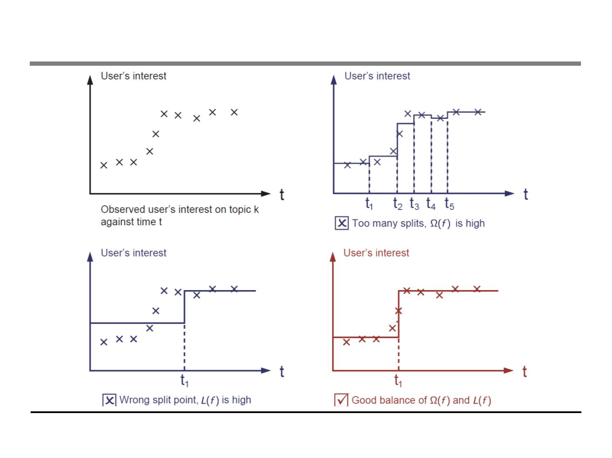
Learning step function (visually)

Slide 15
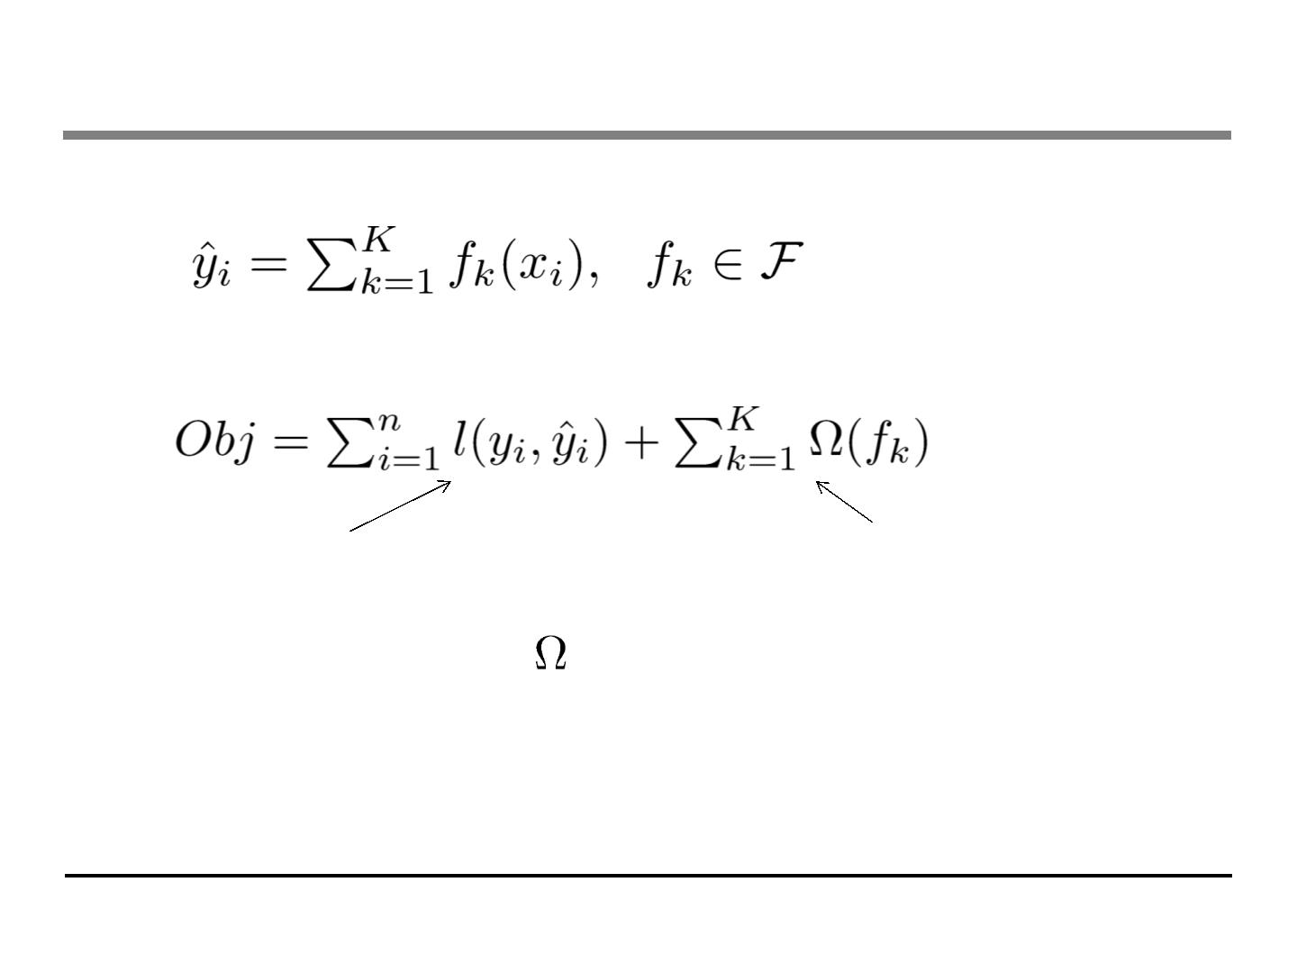
Coming back: Objective for Tree Ensemble
• Model: assuming we have K trees
• Objective
Training loss
Complexity of the Trees
• Possible ways to define ?
. Number of nodes in the tree, depth
. L2 norm of the leaf weights
. … detailed later

Slide 16
Objective vs Heuristic
• When you talk about (decision) trees, it is usually heuristics
. Split by information gain
. Prune the tree
. Maximum depth
. Smooth the leaf values
• Most heuristics maps well to objectives, taking the formal
(objective) view let us know what we are learning
. Information gain -> training loss
. Pruning -> regularization defined by #nodes
. Max depth -> constraint on the function space
. Smoothing leaf values -> L2 regularization on leaf weights

Slide 17
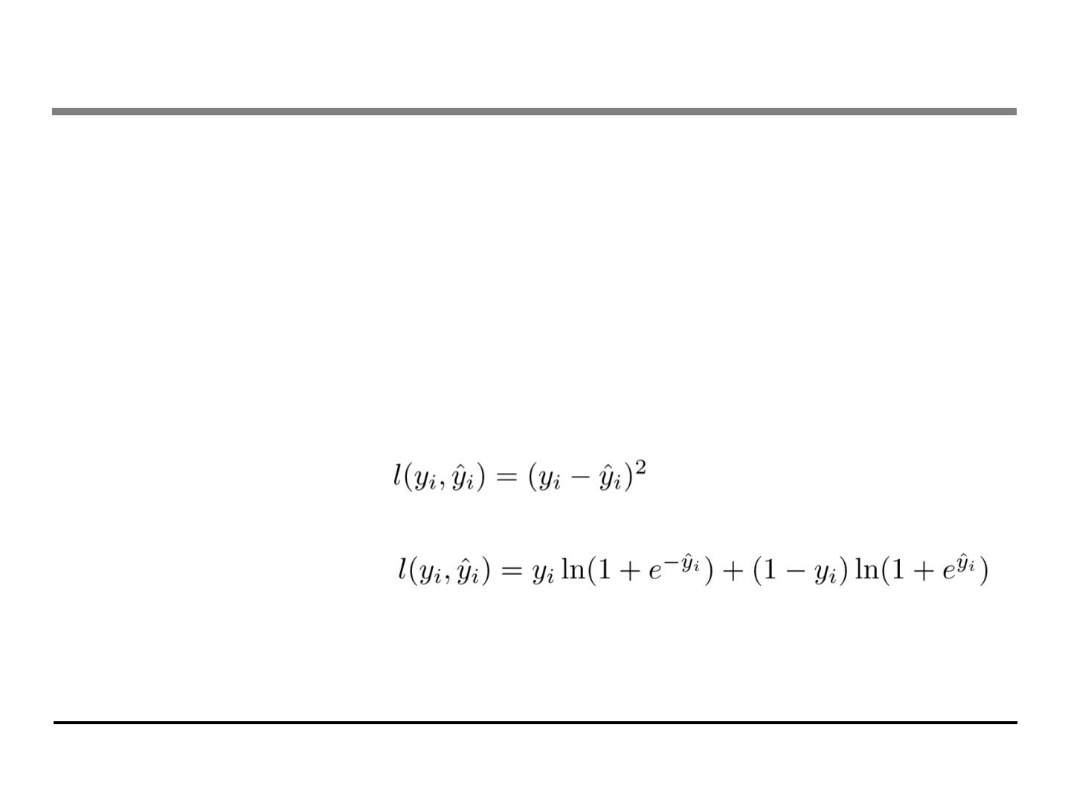
Regression Tree is not just for regression!
• Regression tree ensemble defines how you make the
prediction score, it can be used for
. Classification, Regression, Ranking….
. ….
• It all depends on how you define the objective function!
• So far we have learned:
. Using Square loss
⬥ Will results in common gradient boosted machine
. Using Logistic loss
⬥ Will results in LogitBoost

Slide 18
Outline
• Review of key concepts of supervised learning
• Regression Tree and Ensemble (What are we Learning)
• Gradient Boosting (How do we Learn)
• Summary

Slide 19
Take Home Message for this section
• Bias-variance tradeoff is everywhere
• The loss + regularization objective pattern applies for
regression tree learning (function learning)
• We want predictive and simple functions
• This defines what we want to learn (objective, model).
• But how do we learn it?
. Next section

Slide 20
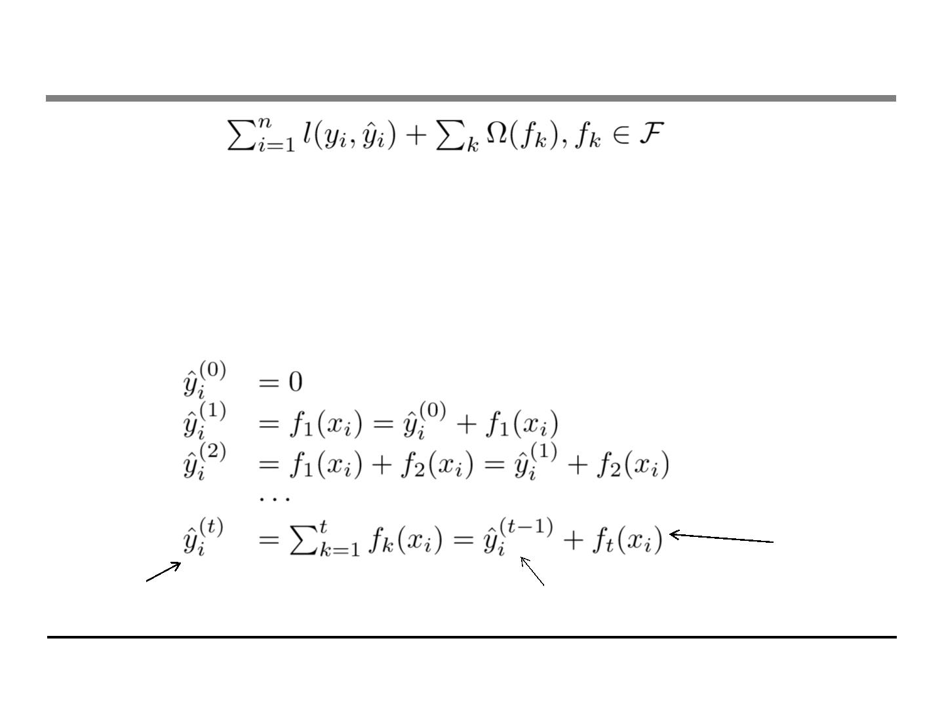
So How do we Learn?
• Objective:
• We can not use methods such as SGD, to find f (since they are
trees, instead of just numerical vectors)
• Solution: Additive Training (Boosting)
. Start from constant prediction, add a new function each time
New function
Model at training round t
Keep functions added in previous round

Slide 21
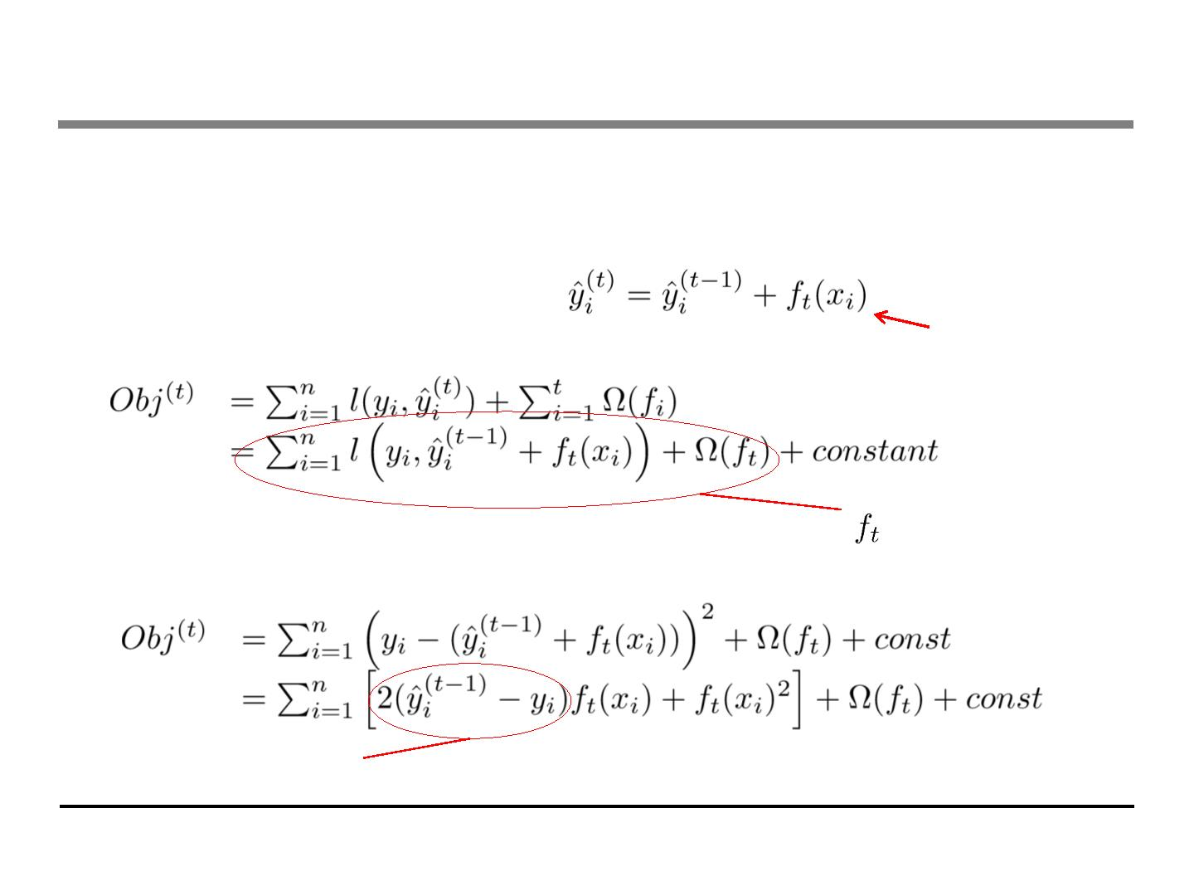
Additive Training
• How do we decide which f to add?
. Optimize the objective!!
• The prediction at round t is
This is what we need to decide in round t
Goal: find
to minimize this
• Consider square loss
This is usually called residual from previous round

Slide 22
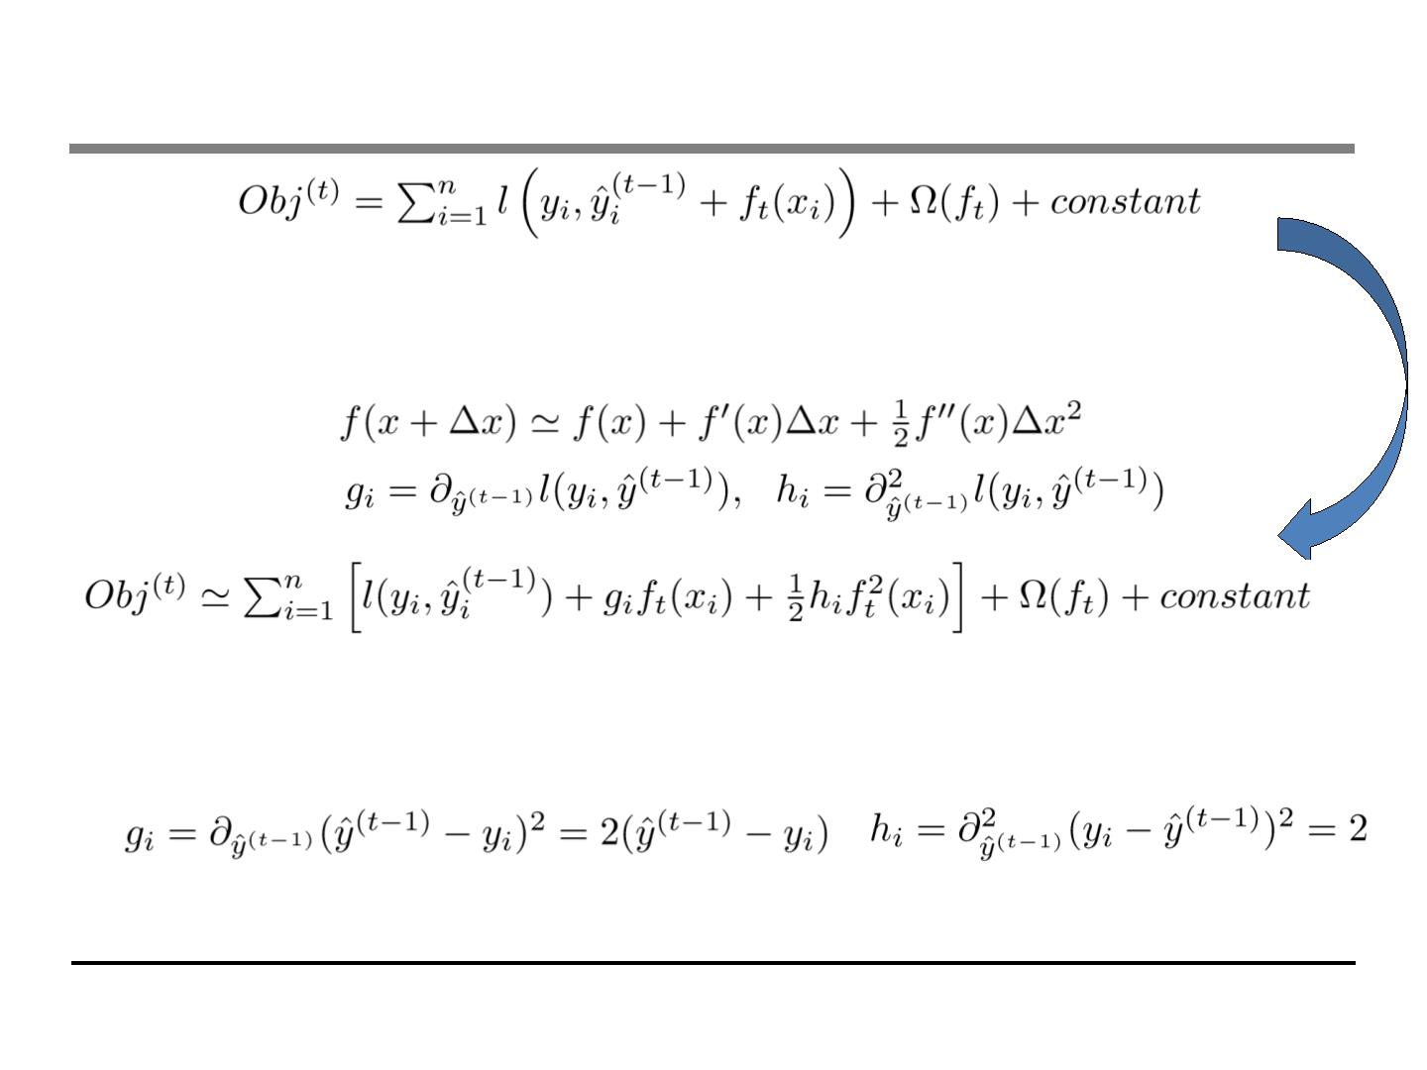
Taylor Expansion Approximation of Loss
• Goal
. Seems still complicated except for the case of square loss
• Take Taylor expansion of the objective
. Recall
. Define
• If you are not comfortable with this, think of square loss
• Compare what we get to previous slide

Slide 23
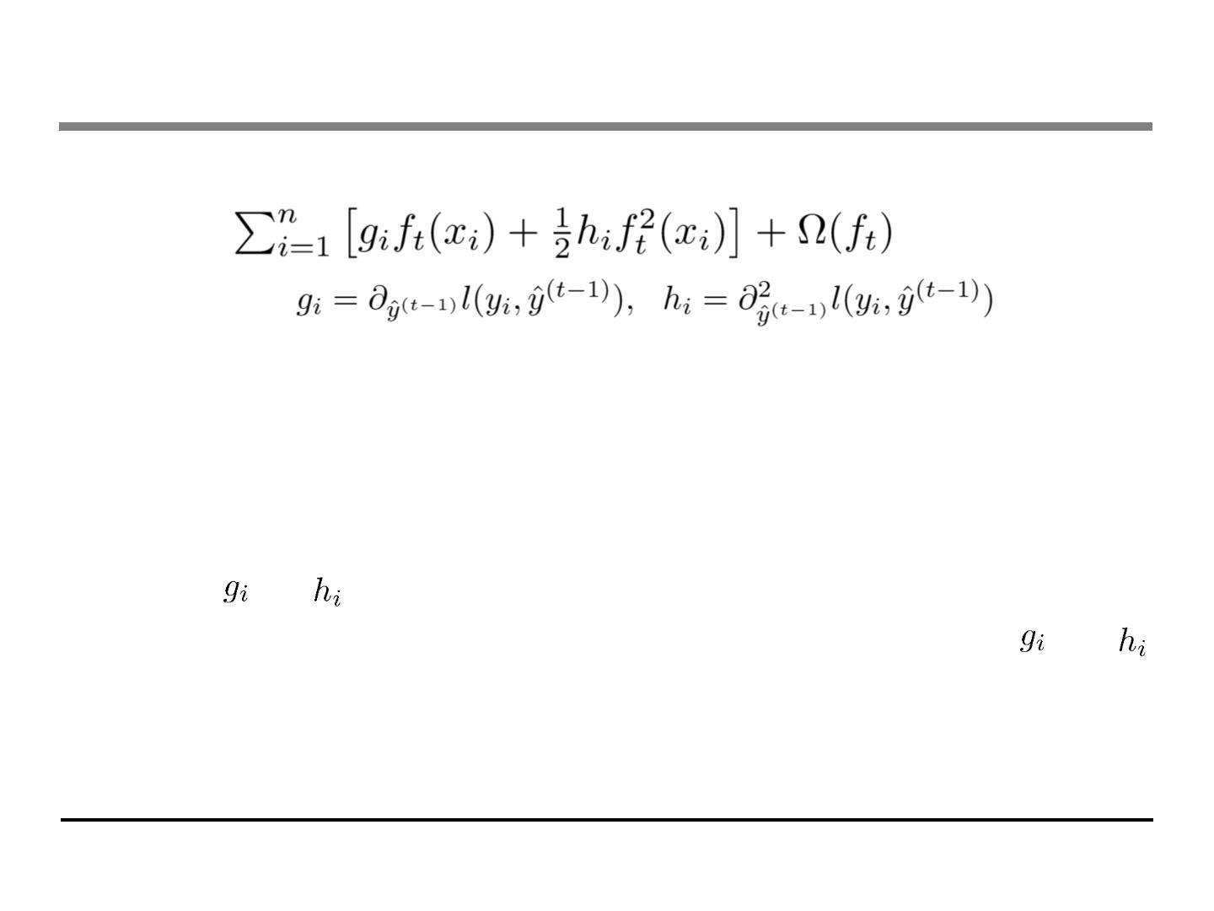
Our New Goal
• Objective, with constants removed
. where
• Why spending s much efforts to derive the objective, why not
just grow trees …
. Theoretical benefit: know what we are learning, convergence
. Engineering benefit, recall the elements of supervised learning
⬥
and comes from definition of loss function
⬥ The learning of function only depend on the objective via and
⬥ Think of how you can separate modules of your code when you
are asked to implement boosted tree for both square loss and
logistic loss

Slide 24
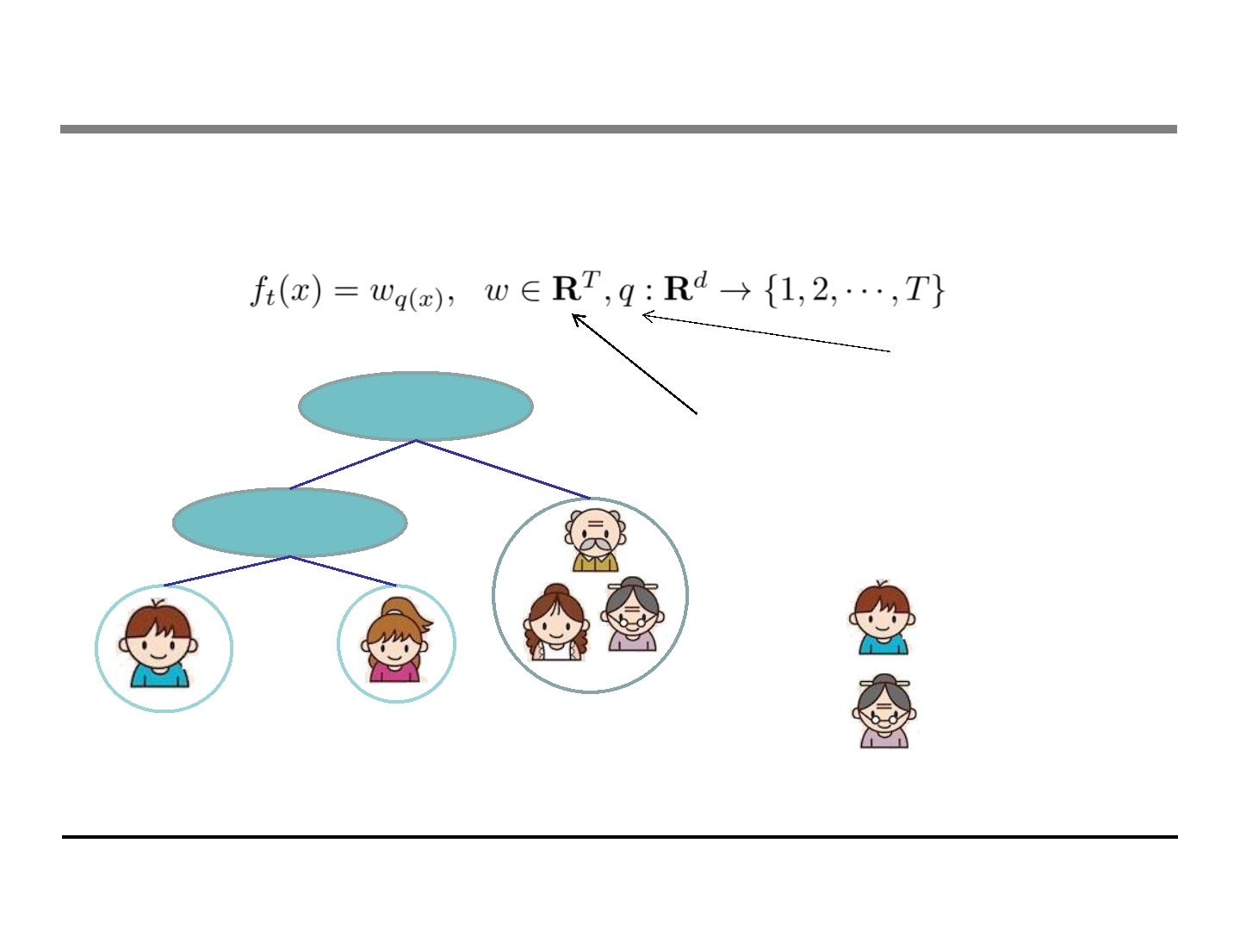
Refine the definition of tree
• We define tree by a vector of scores in leafs, and a leaf index
mapping function that maps an instance to a leaf
The structure of the tree
age < 15
Y
N
The leaf weight of the tree
is male?
Y
N
q(
q(
) = 1
) = 3
Leaf 1
w1=+2
Leaf 2
Leaf 3
w3=-1
w2=0.1

Slide 25
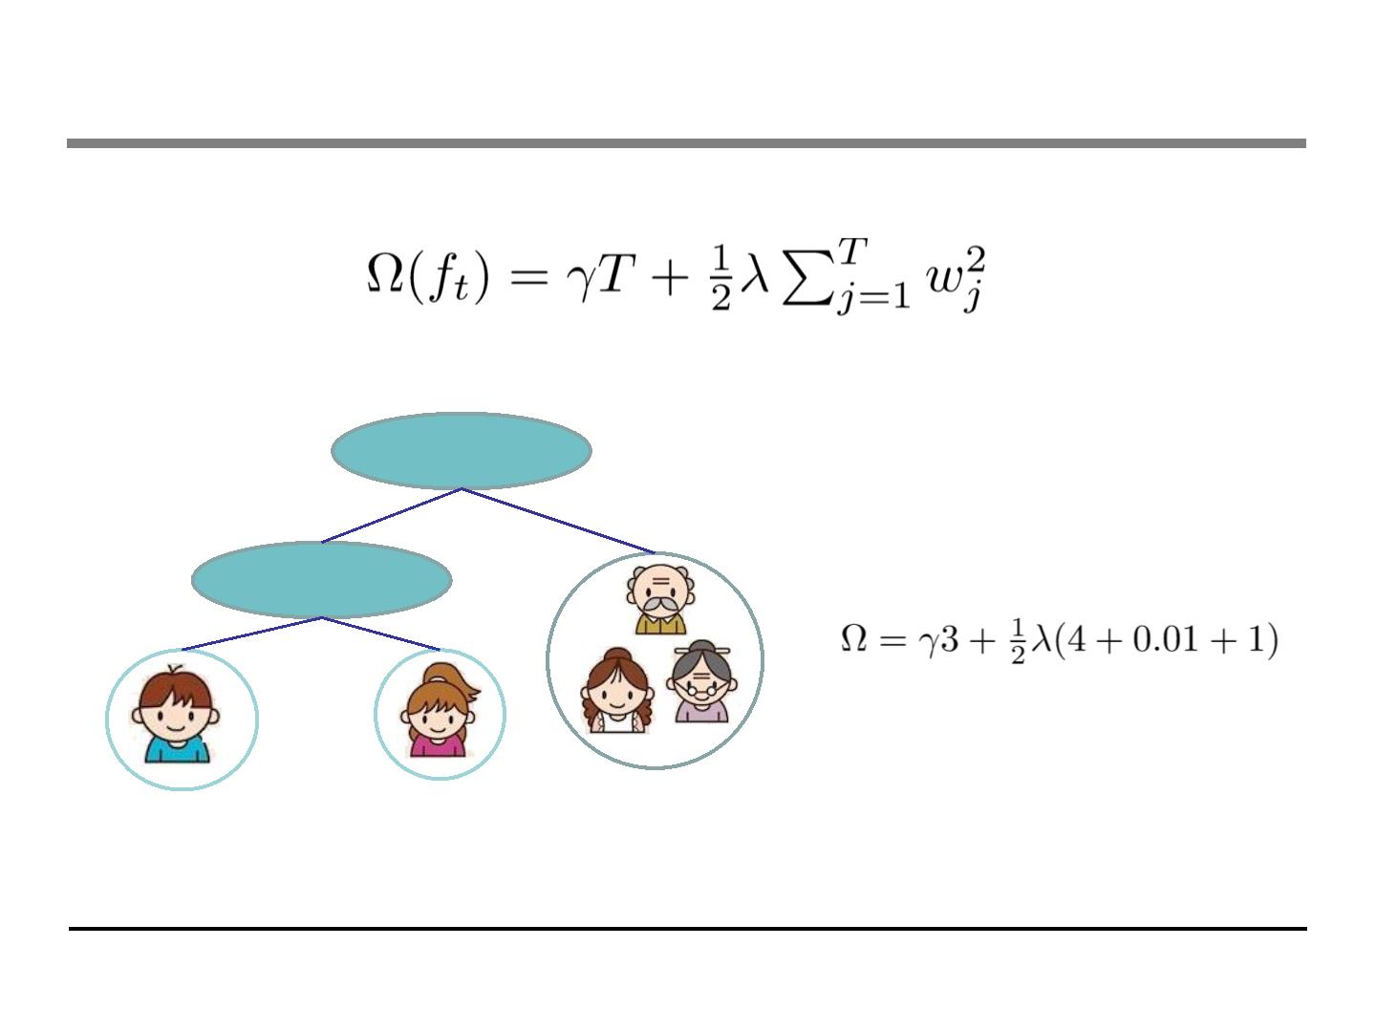
Define Complexity of a Tree (cont’)
• Define complexity as (this is not the only possible definition)
Number of leaves
L2 norm of leaf scores
age < 15
N
Y
is male?
Y
N
Leaf 1
w1=+2
Leaf 2
Leaf 3
w2=0.1
w3=-1

Slide 26
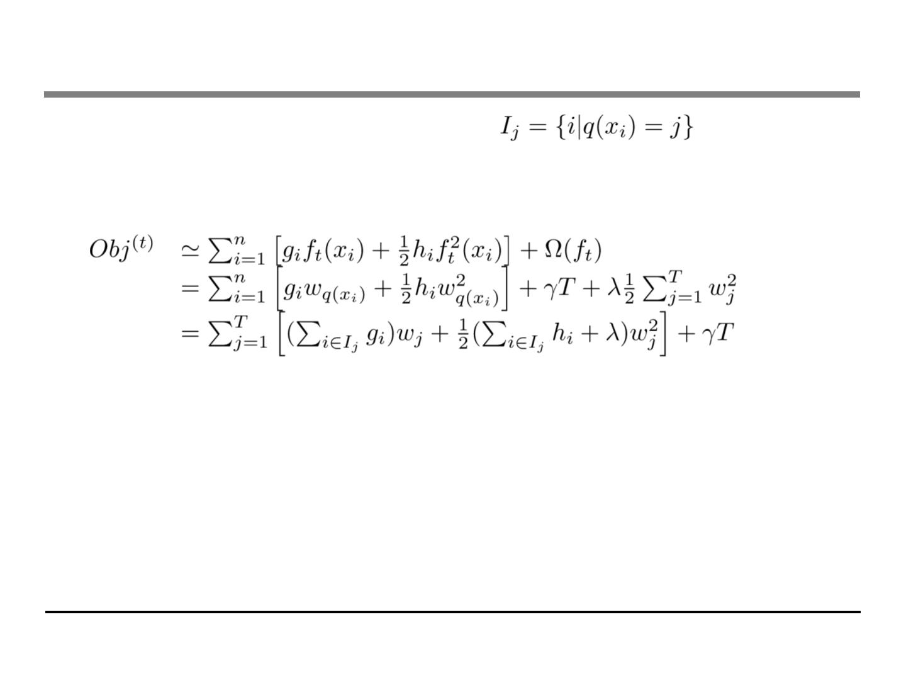
Revisit the Objectives
• Define the instance set in leaf j as
• Regroup the objective by each leaf
• This is sum of T independent quadratic functions

Slide 27
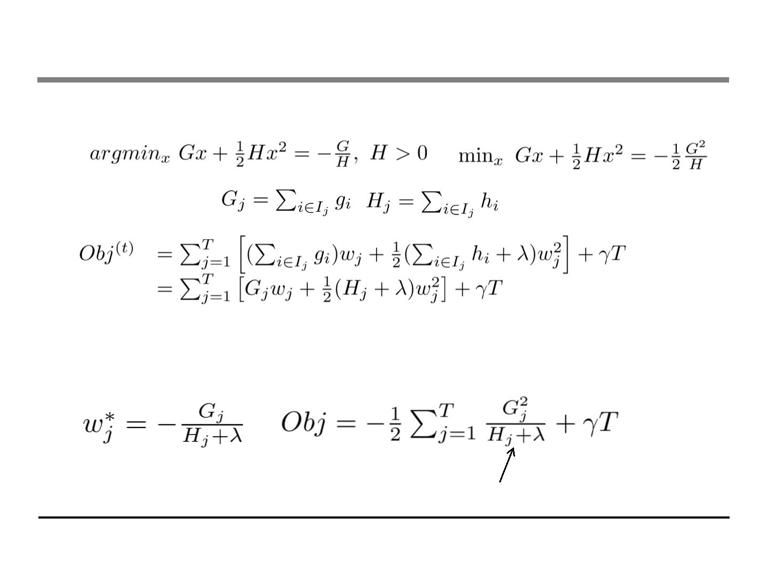
The Structure Score
• Two facts about single variable quadratic function
• Let us define
• Assume the structure of tree ( q(x) ) is fixed, the optimal
weight in each leaf, and the resulting objective value are
This measures how good a tree structure is!

Slide 28
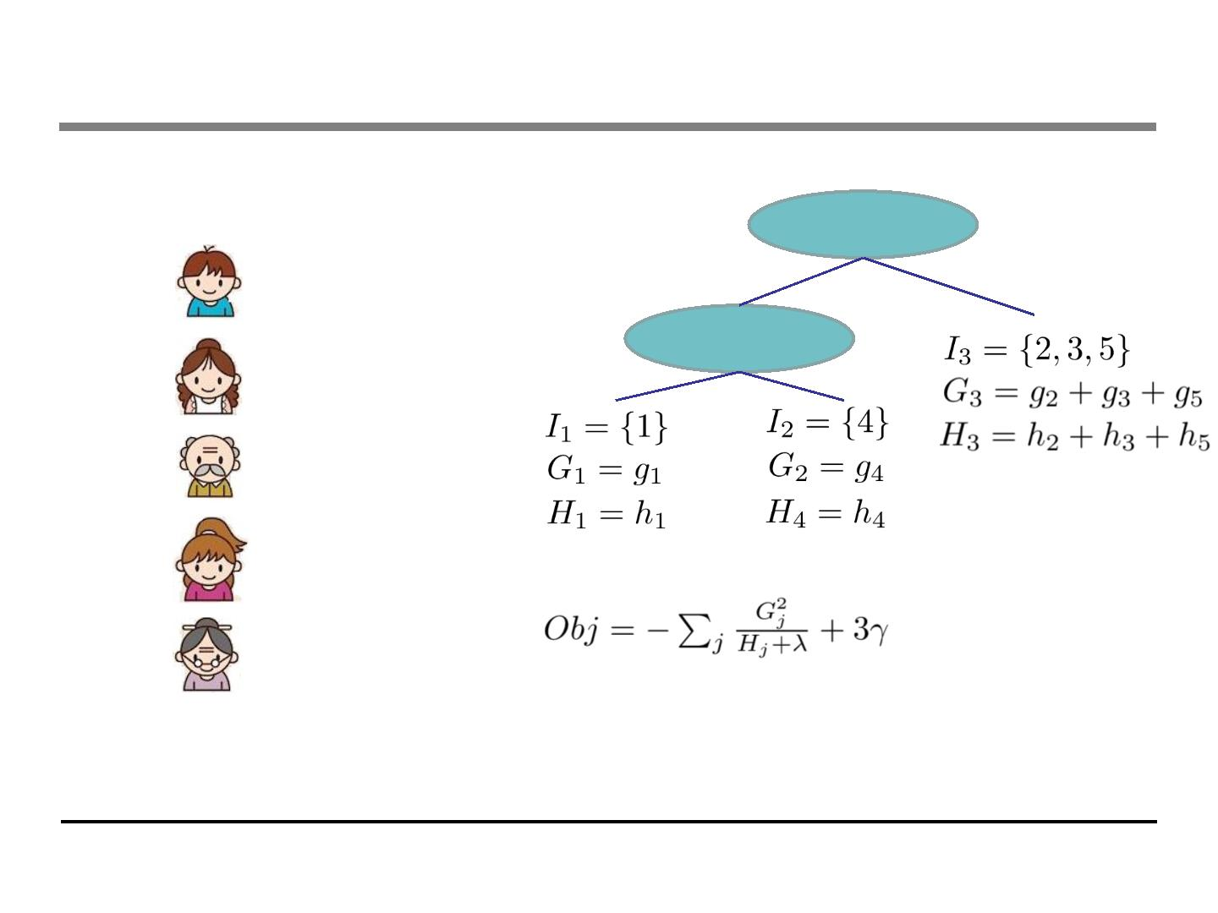
The Structure Score Calculation
Instance index
1
gradient statistics
g1, h1
age < 15
Y
N
is male?
2
3
g2, h2
g3, h3
Y
N
4
5
g4, h4
g5, h5
The smaller the score is, the better the structure is

Slide 29
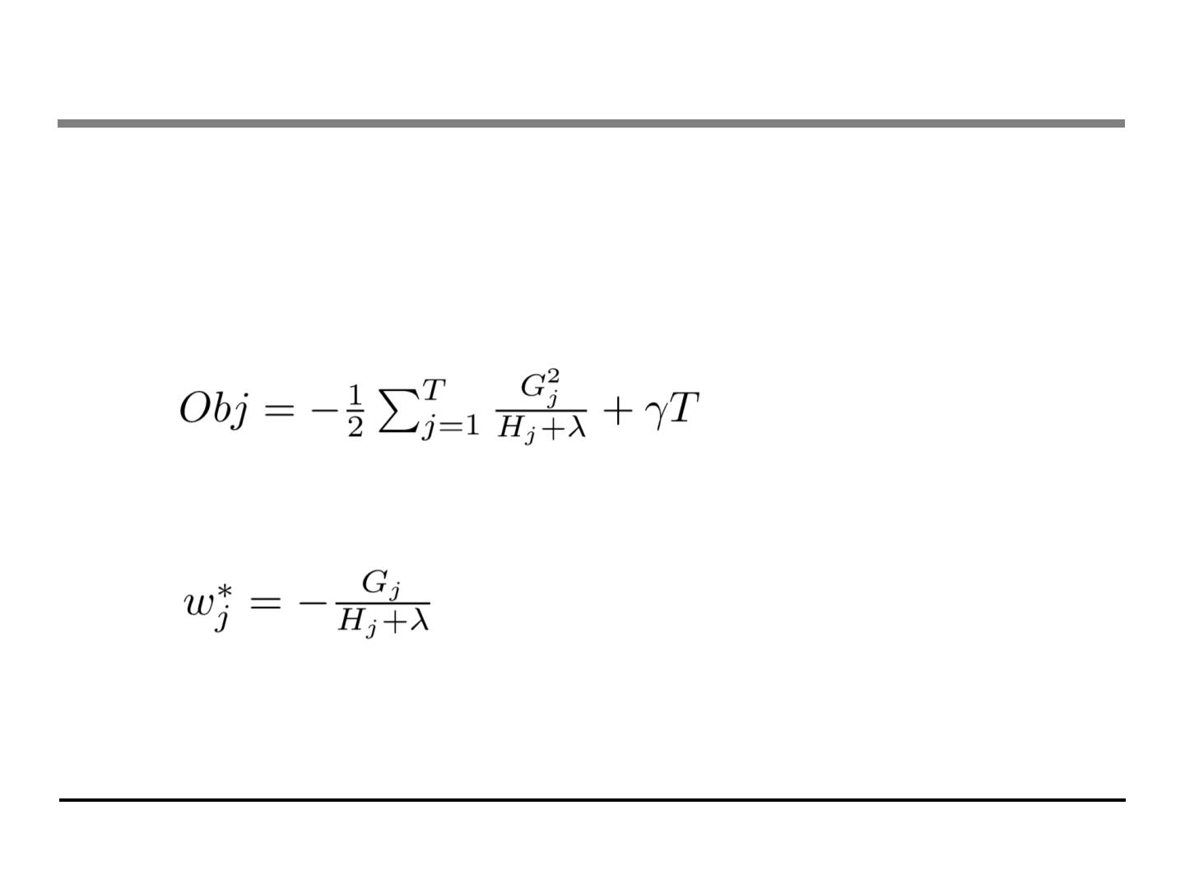
Searching Algorithm for Single Tree
• Enumerate the possible tree structures q
• Calculate the structure score for the q, using the scoring eq.
• Find the best tree structure, and use the optimal leaf weight
• But… there can be infinite possible tree structures..

Slide 30
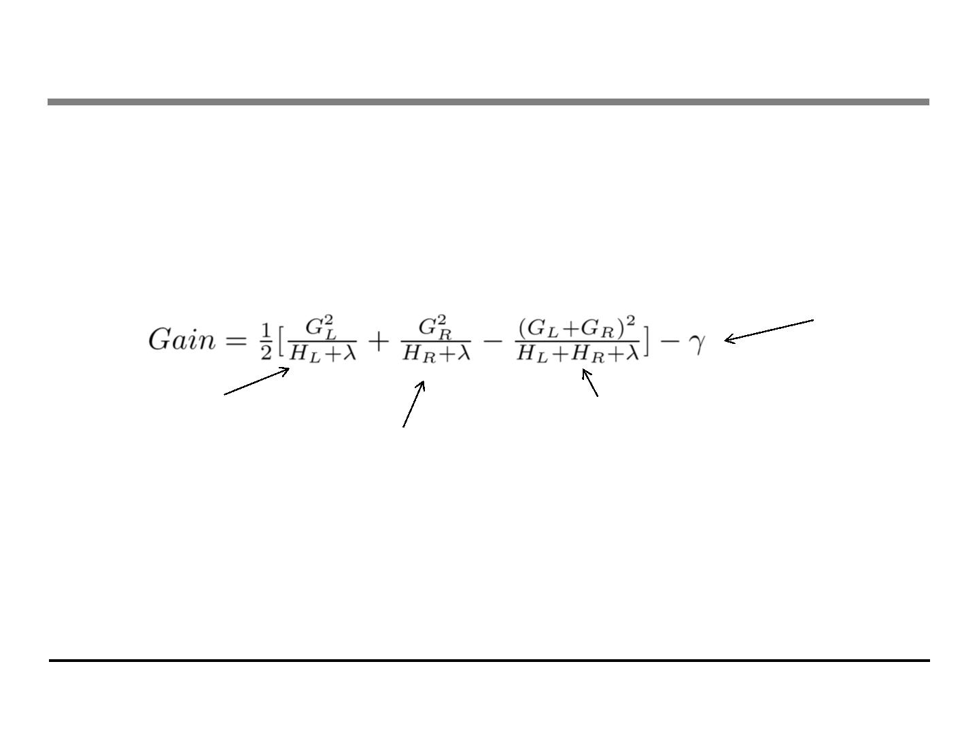
Greedy Learning of the Tree
• In practice, we grow the tree greedily
. Start from tree with depth 0
. For each leaf node of the tree, try to add a split. The change of
objective after adding the split is
The complexity cost by
introducing additional leaf
the score of left child
the score of if we do not split
the score of right child
. Remaining question: how do we find the best split?

Slide 31
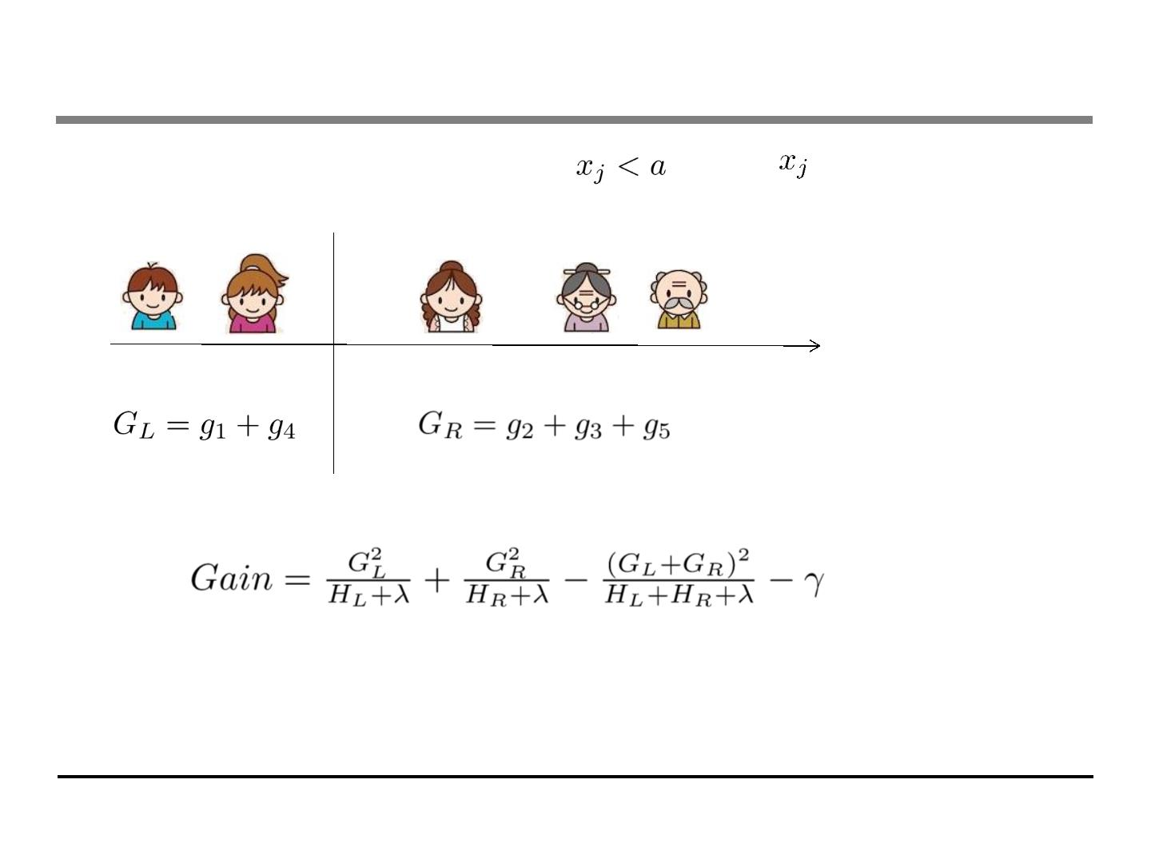
Efficient Finding of the Best Split
• What is the gain of a split rule
? Say is age
a
g1, h1
g4, h4
g2, h2
g5, h5
g3, h3
• All we need is sum of g and h in each side, and calculate
• Left to right linear scan over sorted instance is enough to
decide the best split along the feature

Slide 32
An Algorithm for Split Finding
• For each node, enumerate over all features
. For each feature, sorted the instances by feature value
. Use a linear scan to decide the best split along that feature
. Take the best split solution along all the features
• Time Complexity growing a tree of depth K
. It is O(n d K log n): or each level, need O(n log n) time to sort
There are d features, and we need to do it for K level
. This can be further optimized (e.g. use approximation or caching
the sorted features)
. Can scale to very large dataset

Slide 33
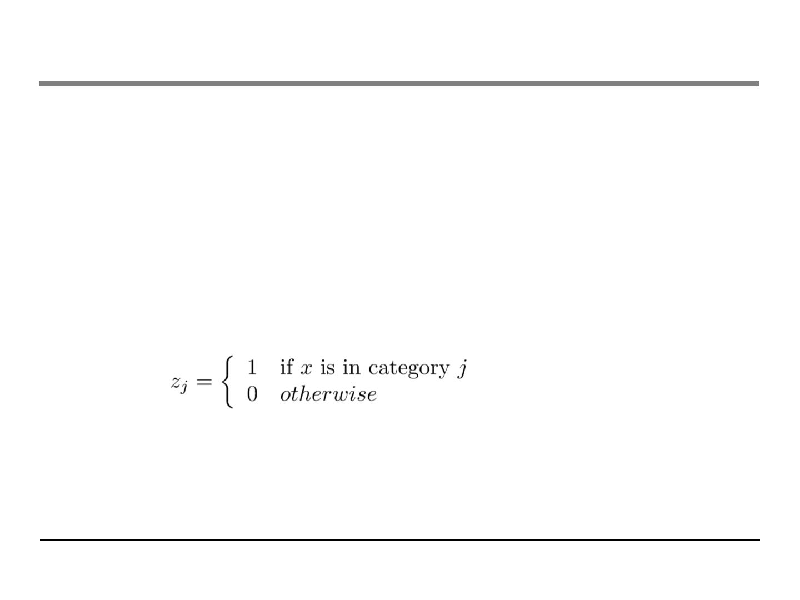
What about Categorical Variables?
• Some tree learning algorithm handles categorical variable and
continuous variable separately
. We can easily use the scoring formula we derived to score split
based on categorical variables.
• Actually it is not necessary to handle categorical separately.
. We can encode the categorical variables into numerical vector
using one-hot encoding. Allocate a #categorical length vector
. The vector will be sparse if there are lots of categories, the
learning algorithm is preferred to handle sparse data

Slide 34
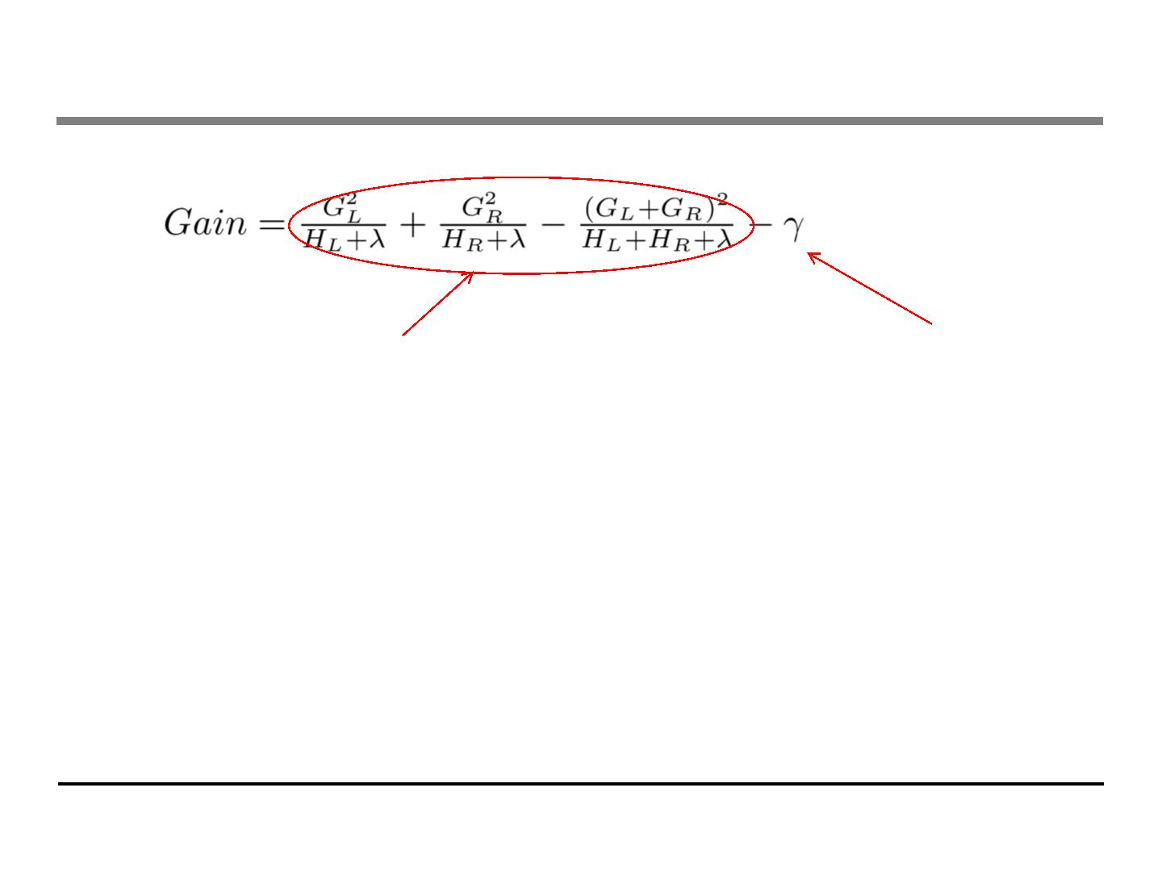
Pruning and Regularization
• Recall the gain of split, it can be negative!
. When the training loss reduction is smaller than regularization
. Trade-off between simplicity and predictivness
• Pre-stopping
. Stop split if the best split have negative gain
. But maybe a split can benefit future splits..
• Post-Prunning
. Grow a tree to maximum depth, recursively prune all the leaf
splits with negative gain

Slide 35
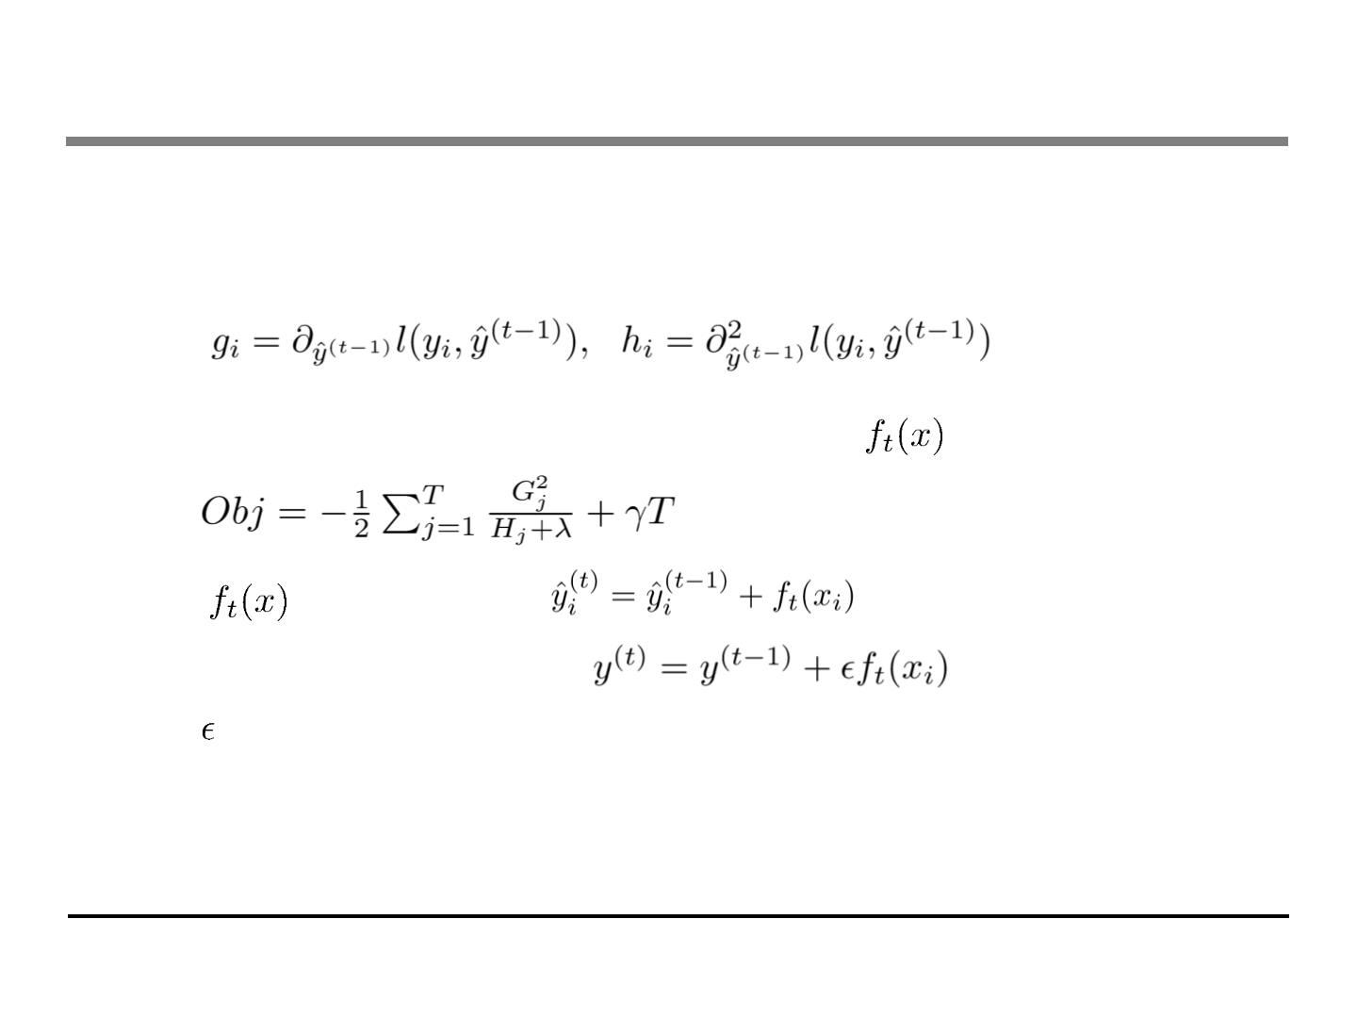
Recap: Boosted Tree Algorithm
• Add a new tree in each iteration
• Beginning of each iteration, calculate
• Use the statistics to greedily grow a tree
• Add
to the model
. Usually, instead we do
.
is called step-size or shrinkage, usually set around 0.1
. This means we do not do full optimization in each step and
reserve chance for future rounds, it helps prevent overfitting

Slide 36
Outline
• Review of key concepts of supervised learning
• Regression Tree and Ensemble (What are we Learning)
• Gradient Boosting (How do we Learn)
• Summary

Slide 37
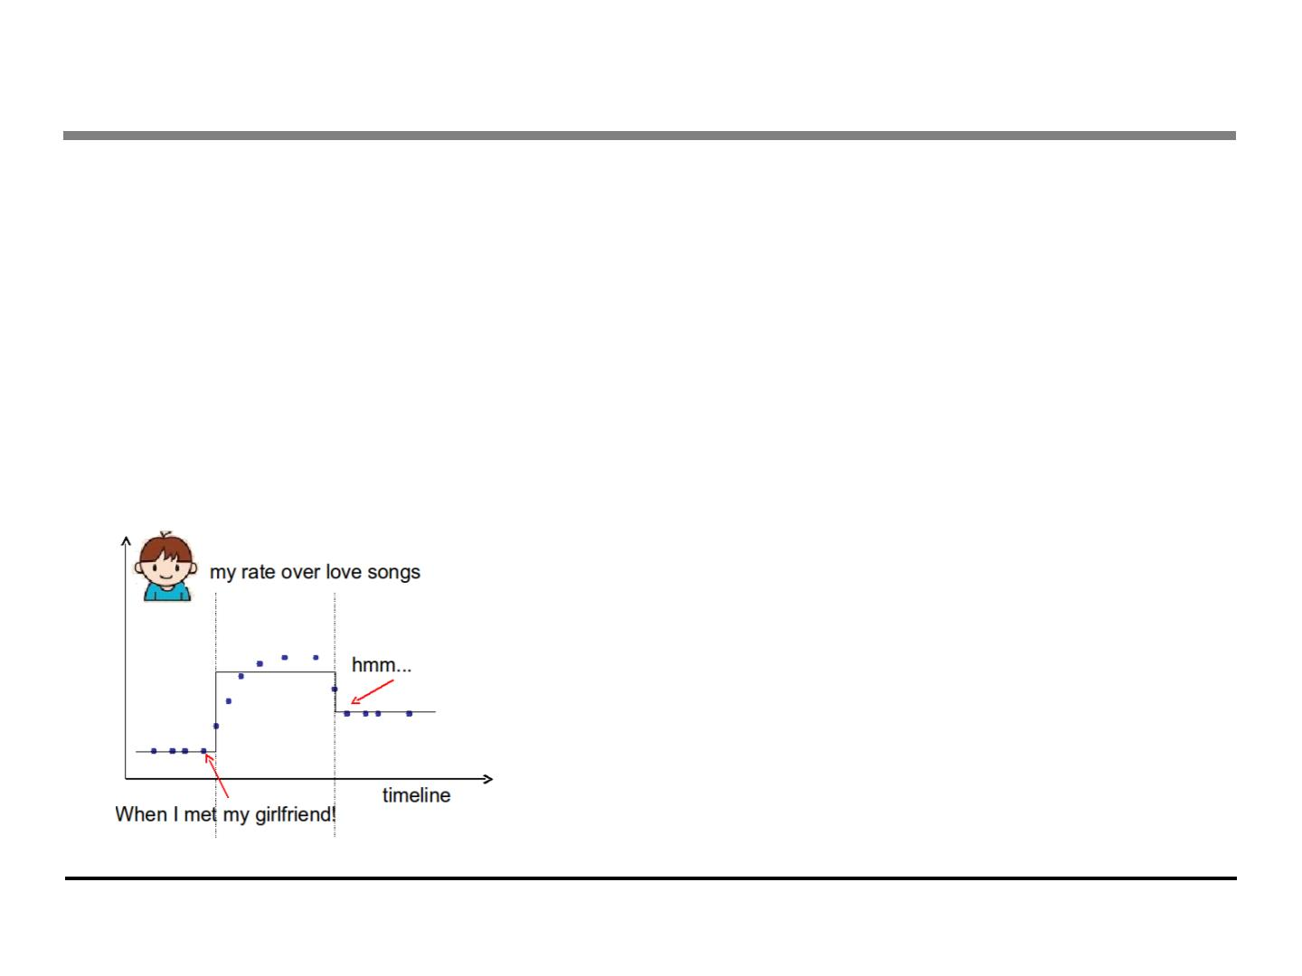
Questions to check if you really get it
• How can we build a boosted tree classifier to do weighted
regression problem, such that each instance have a
importance weight?
• Back to the time series problem, if I want to learn step
functions over time. Is there other ways to learn the time
splits, other than the top down split approach?

Slide 38
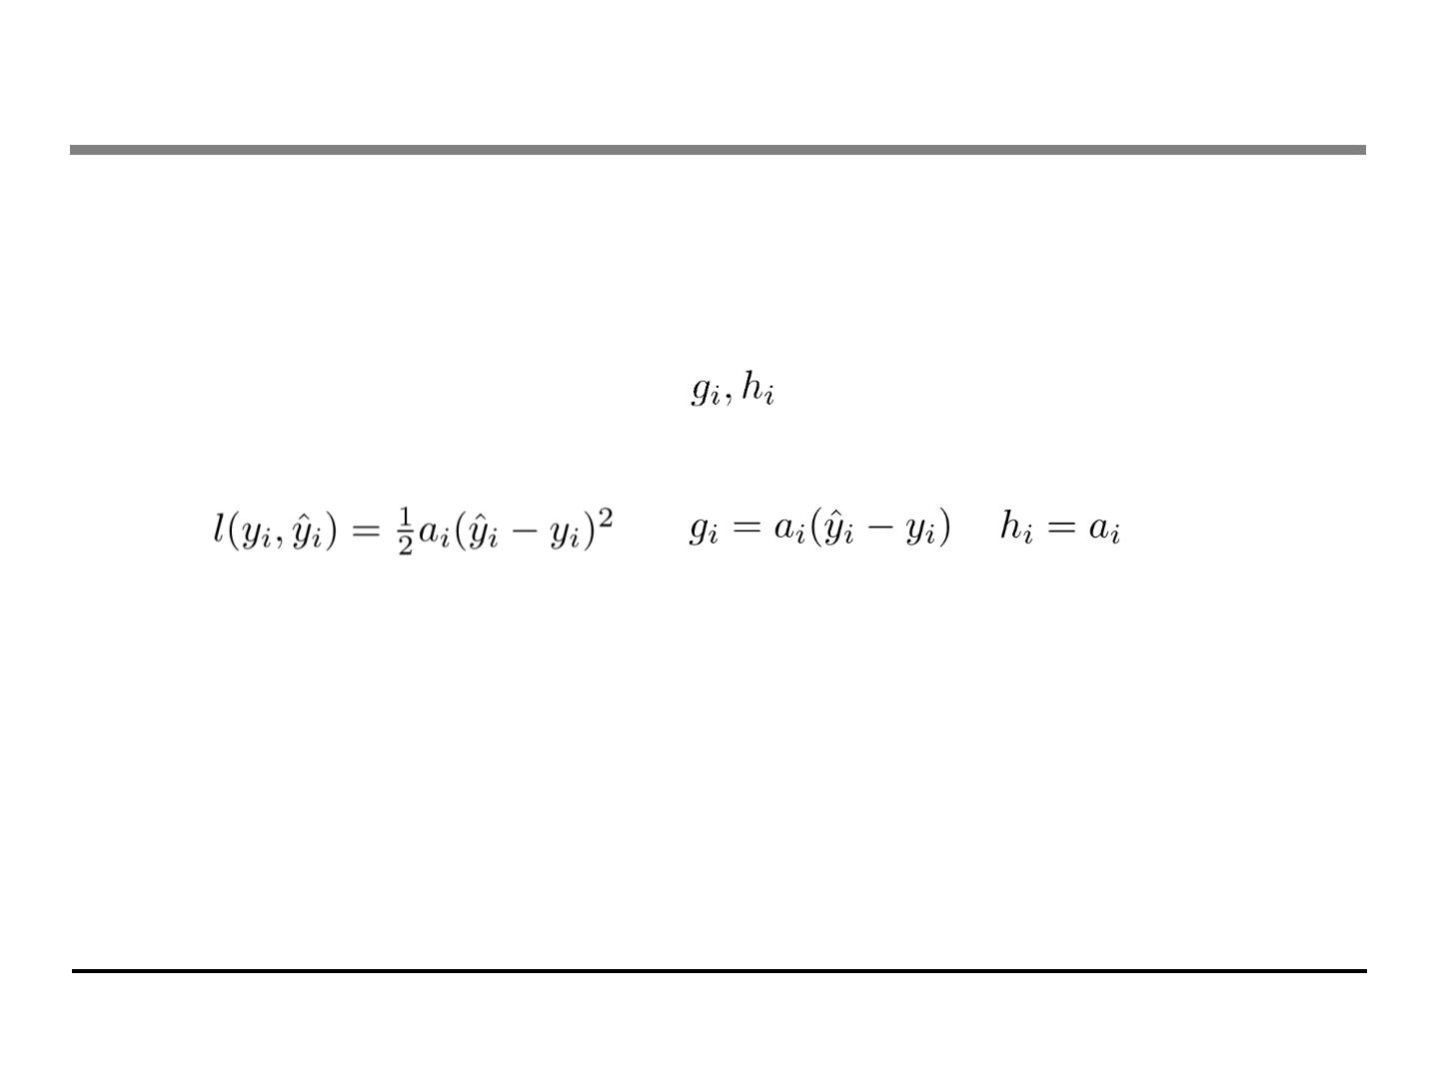
Questions to check if you really get it
• How can we build a boosted tree classifier to do weighted
regression problem, such that each instance have a
importance weight?
. Define objective, calculate
, feed it to the old tree learning
algorithm we have for un-weighted version
. Again think of separation of model and objective, how does the
theory can help better organizing the machine learning toolkit

Slide 39
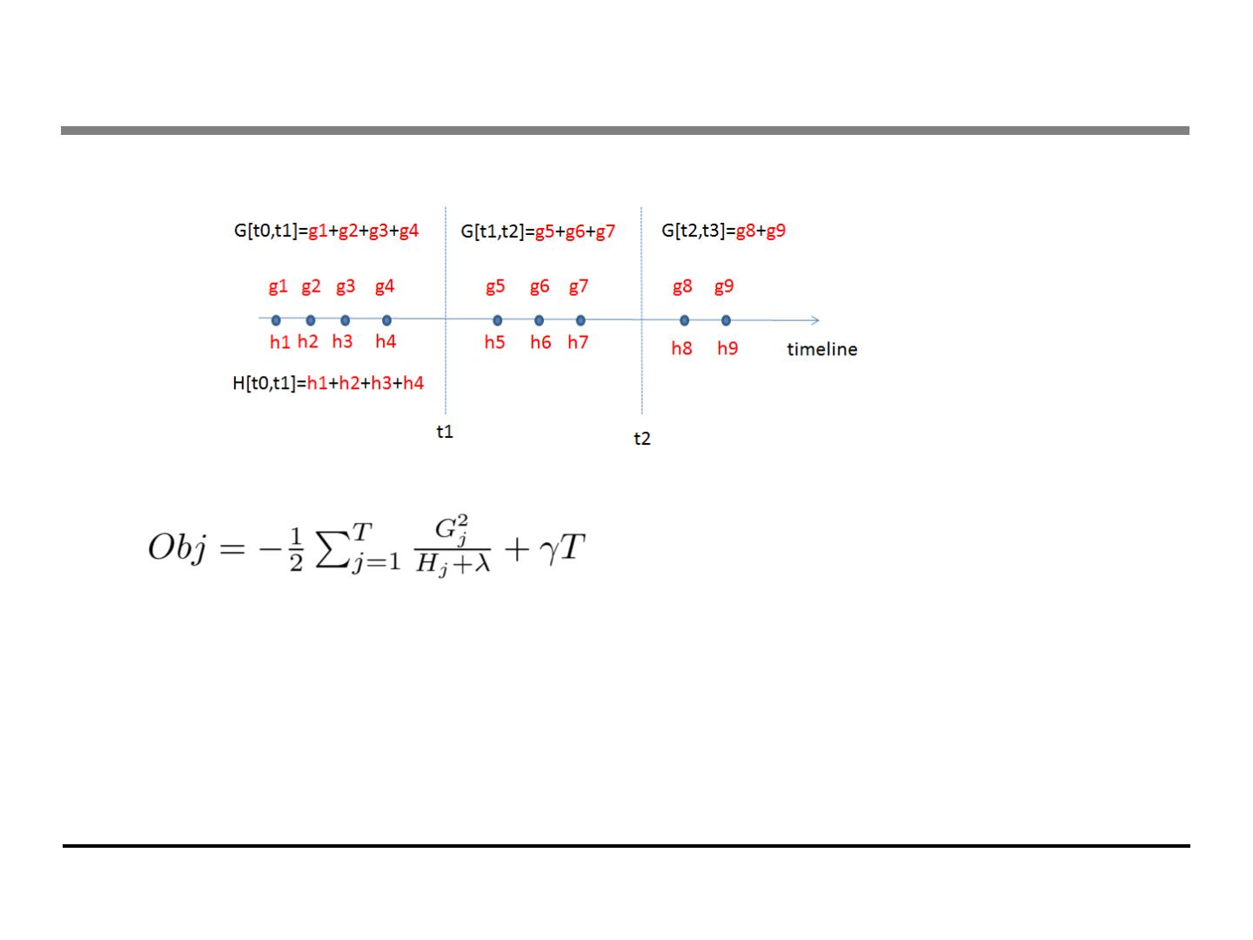
Questions to check if you really get it
• Time series problem
• All that is important is the structure score of the splits
. Top-down greedy, same as trees
. Bottom-up greedy, start from individual points as each group,
greedily merge neighbors
. Dynamic programming, can find optimal solution for this case

Slide 40
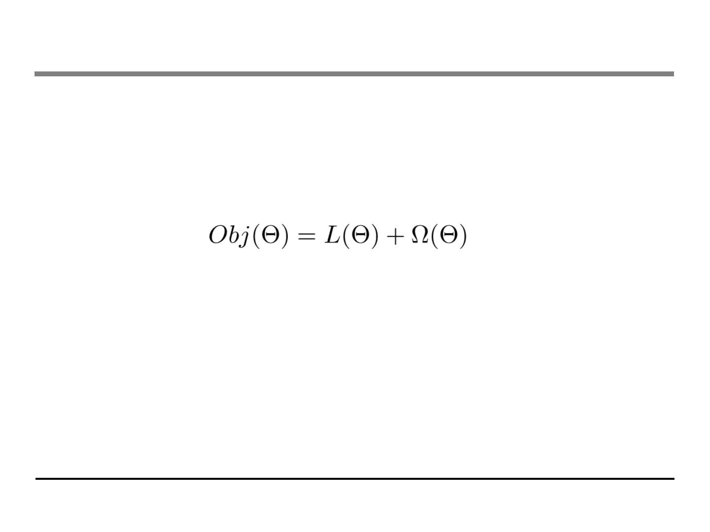
Summary
• The separation between model, objective, parameters can be
helpful for us to understand and customize learning models
• The bias-variance trade-off applies everywhere, including
learning in functional space
• We can be formal about what we learn and how we learn.
Clear understanding of theory can be used to guide cleaner
implementation.

Slide 41
Reference
• Greedy function approximation a gradient boosting machine. J.H. Friedman
.
First paper about gradient boosting
• Stochastic Gradient Boosting. J.H. Friedman
.
Introducing bagging trick to gradient boosting
• Elements of Statistical Learning. T. Hastie, R. Tibshirani and J.H. Friedman
.
Contains a chapter about gradient boosted boosting
• Additive logistic regression a statistical view of boosting. J.H. Friedman T. Hastie R. Tibshirani
.
Uses second-order statistics for tree splitting, which is closer to the view presented in this slide
• Learning Nonlinear Functions Using Regularized Greedy Forest. R. Johnson and T. Zhang
.
Proposes to do fully corrective step, as well as regularizing the tree complexity. The regularizing trick
is closed related to the view present in this slide
• Software implementing the model described in this slide: https://github.com/tqchen/xgboost

