Slide 1
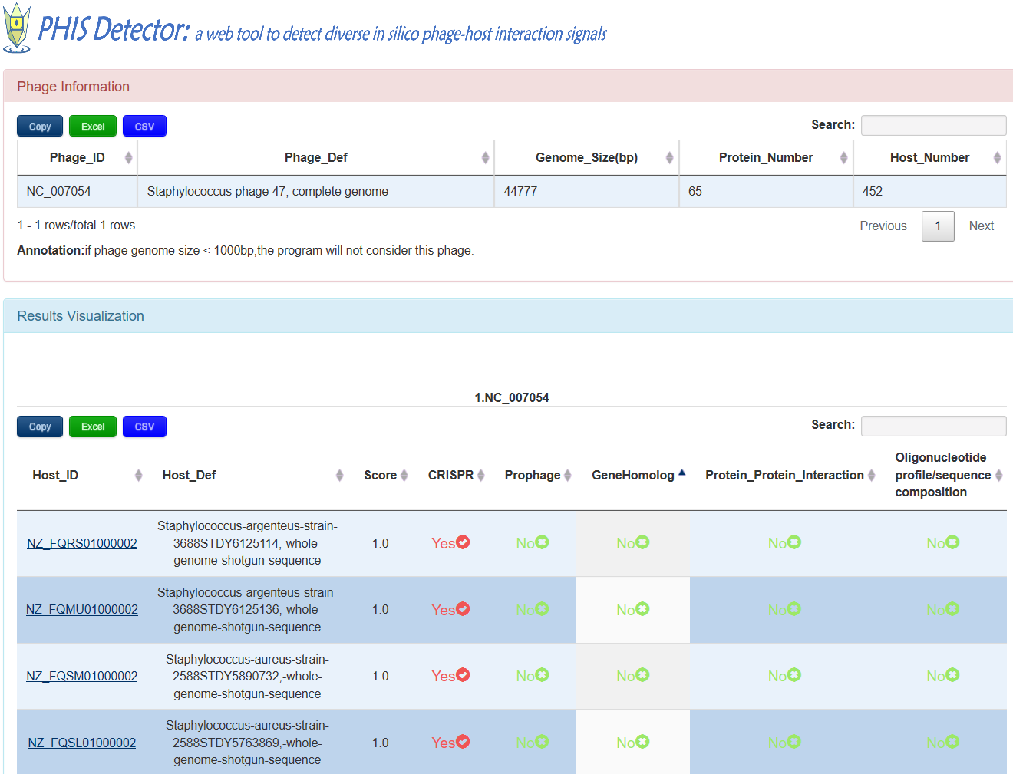
The information of input phage including phage_id,phage definition,genome size,protein number and possibily interactive hosts predicted byPHISDector
The table displays the possibly interactive hosts of input phage,one row for one host.
1.Host_ID:NCBI accession number of the host,click to jump to NCBI.
2.Host_Def:host definition
3.Score:The higher, the better
4.CRISPR:'Yes' means CRISPR support the interaction between input phage and the host under the threshold,'No' mean the contrary.
5.Prophage,GeneHomolog,Protein_protein_interaction,Oligonucleotide profile/sequence composition are the same as CRISPR

Slide 2
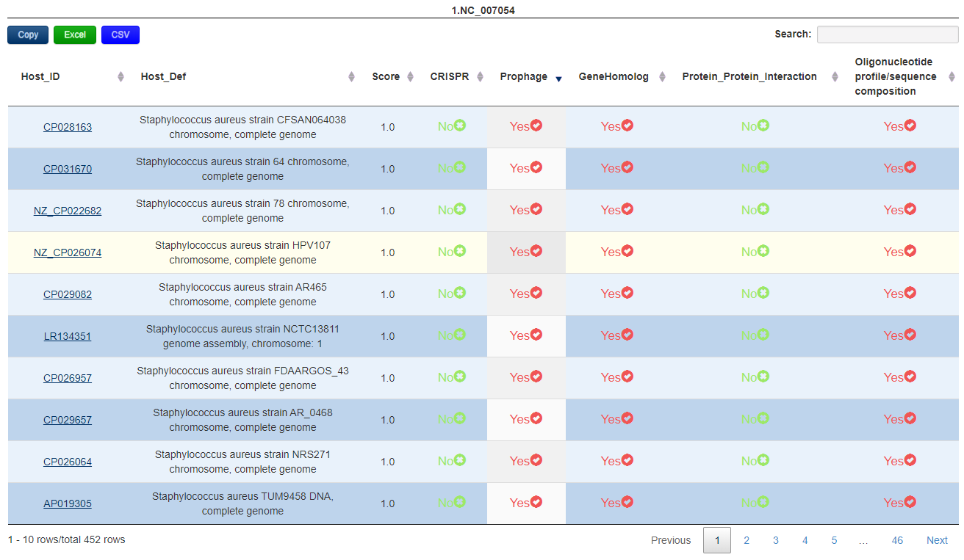
click Copy to copy the table contents
click Excel to download the table as excel format
click csv to download the table as csv format
search for the corresponding rows according to the key words filled in box
click the button to sort the results order according the the column
click the button to jump to the corresponding page

