Slide 1
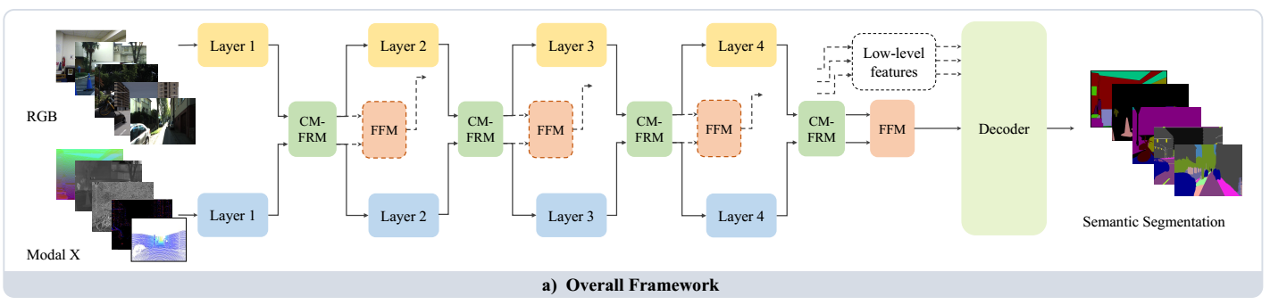



$$Downsample$$
$$Upsample$$
$$1×1Conv$$
$$1×1Conv$$

