Slide 1

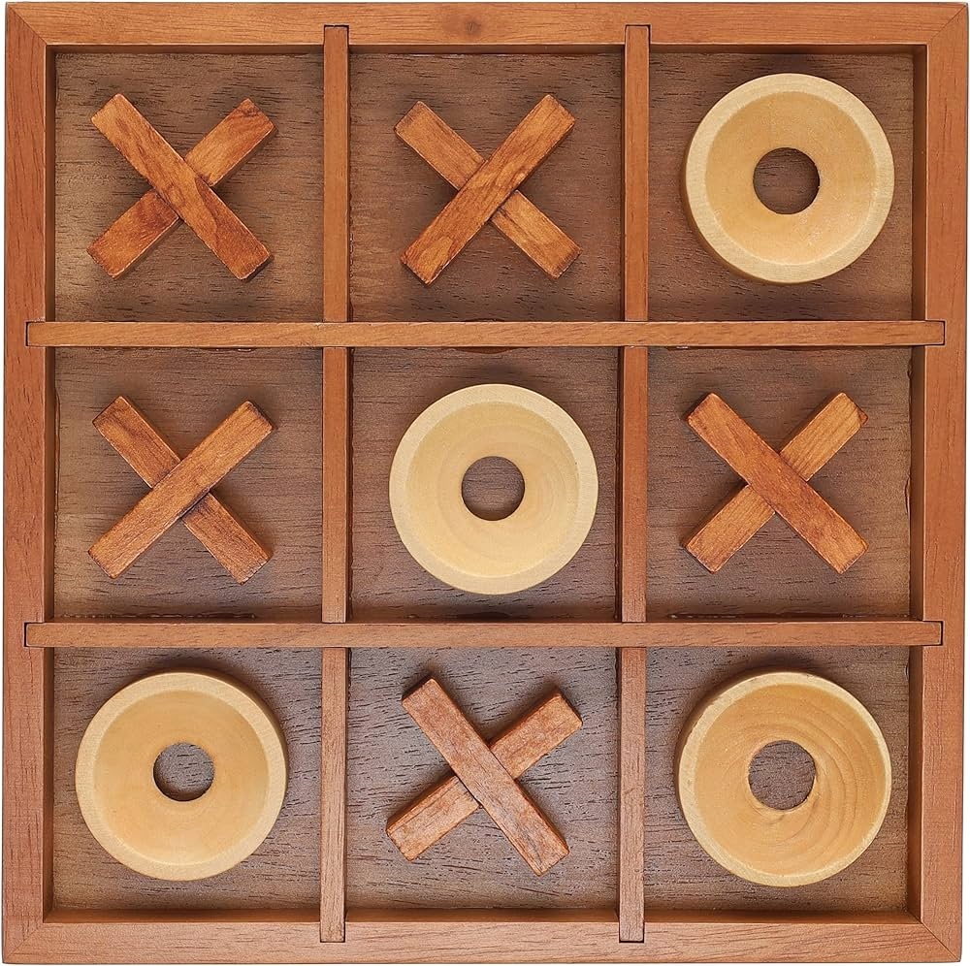


Tic Tac Toe
The Game Of Statergy

Slide 2
ACKNOWLEDGEMENET
I am glad to present my project. This project was given by our respected training teacher Mr. Chirandeep Bhattacharjee. I am really thankful to him for giving us such a wonderful and interesting topic for our project.
I would also like to thank my other teachers from my heart. Without their suggestions and feedback, the project would not have achieved such a good outcome.
I hope everyone will like my project and appreciate my hard work.

Slide 3
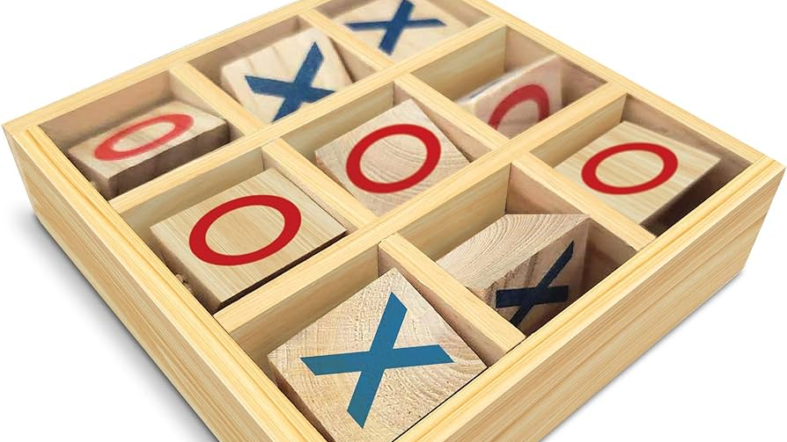
Introduction to Tic Tac Toe
The history of Tic Tac Toe, also known as noughts and crosses or Xs and Os, can be traced back to ancient Egypt Period. The game origin are believed to date back over 3,500 years, making it one of the oldest games still played today.
The earliest known version of the game was discovered in 1300 BC on a roofing tile in the Temple of Seti I in Egypt. The game was played on a 3x3 grid, much like the modern version, but instead of Xs and Os, the players used pebbles and round discs to mark their moves.

Slide 4
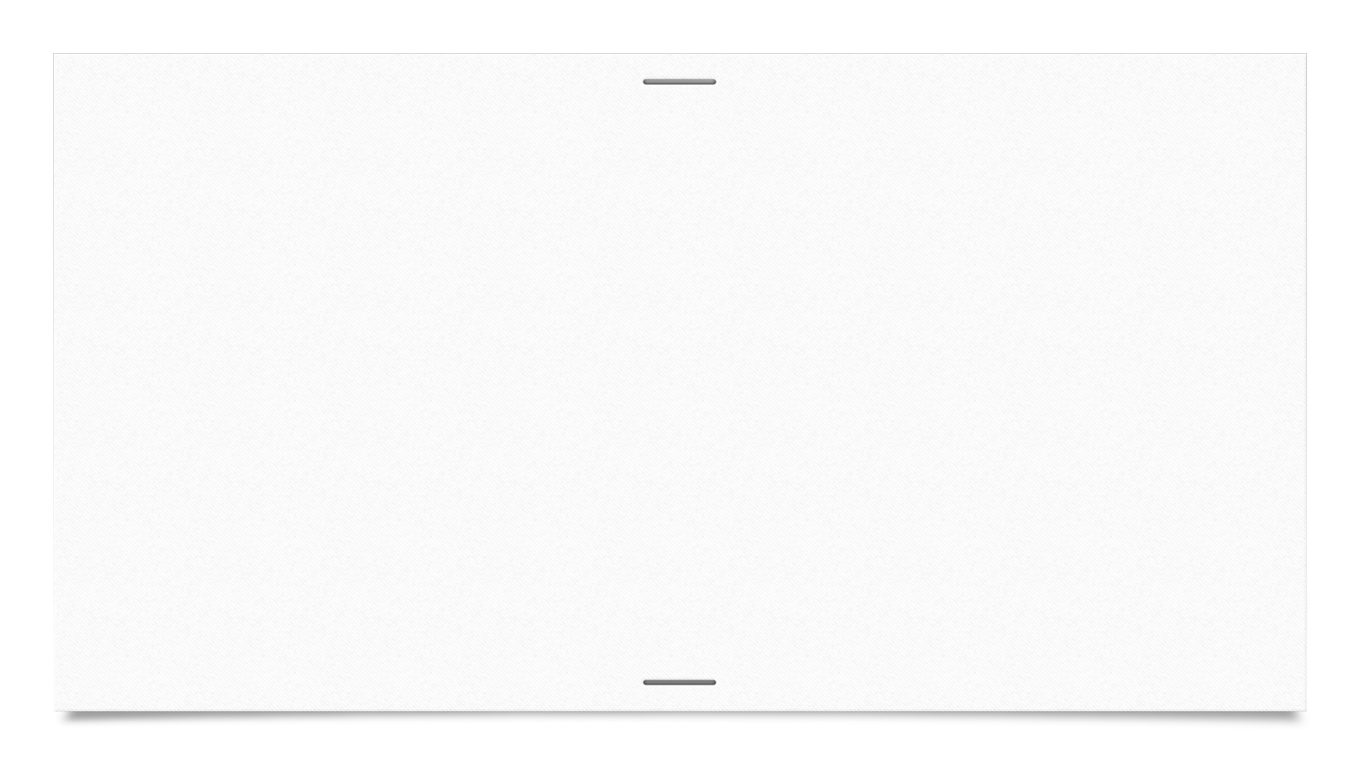

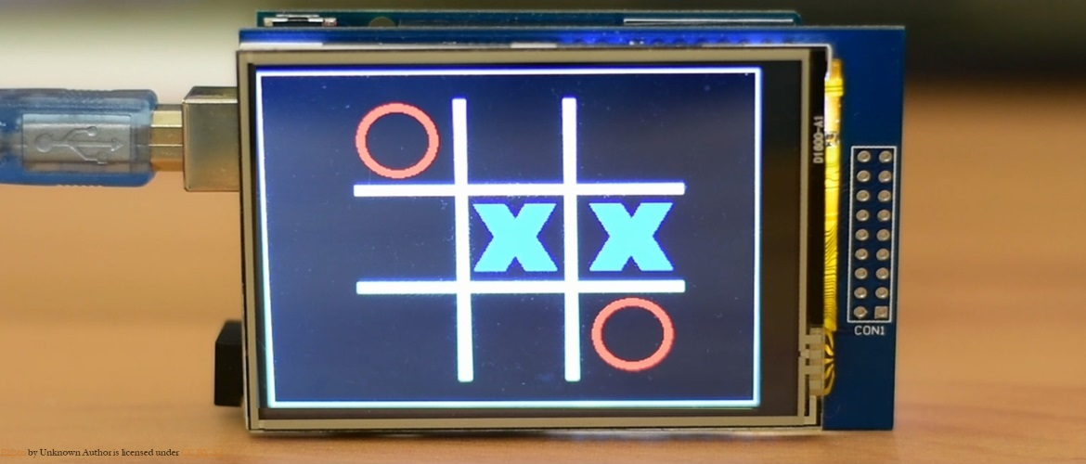
Tic Tac Toe gained popularity over the centuries and spread to other cultures, including the Roman Empire, where it was played on a wooden board with carvings for the grid. The game continued to evolve, with different regions and cultures adding their own variations and rules
In the 20th century, Tic Tac Toe became widely popular as a pencil-and-paper game, especially among schoolchildren. Its simplicity and easy-to-understand rules made it a favorite pastime for people of all ages.
Today, Tic Tac Toe is not only played on paper but also on electronic devices and computers. It remains a popular game due to its simplicity, strategic depth, and the challenge it presents, despite its small grid size.

Slide 5

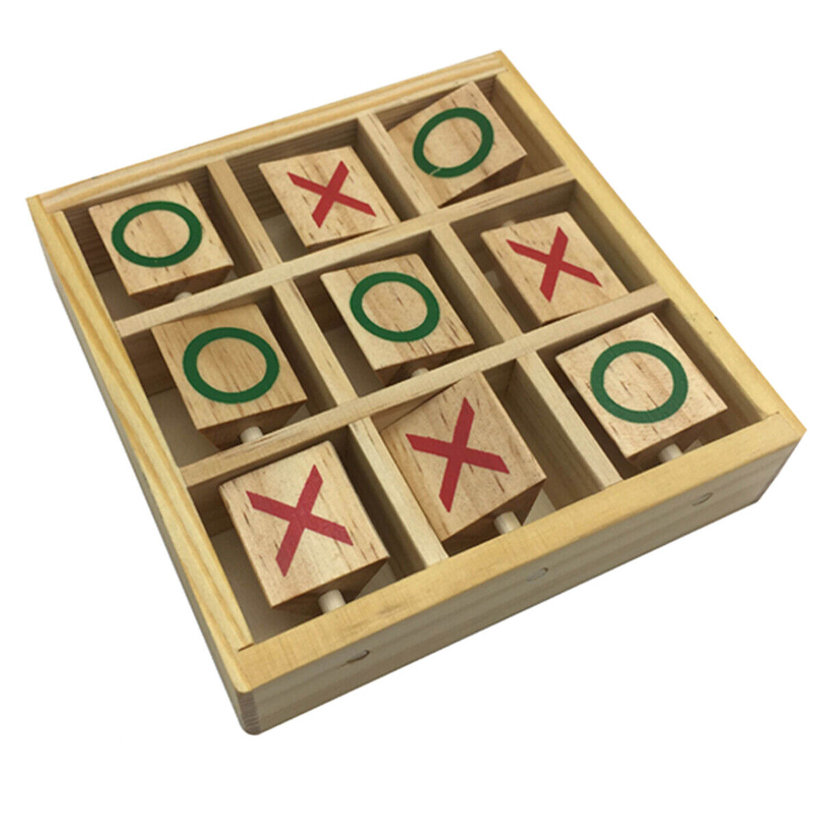
RULES OF TIC TAC TOE
Tic Tac Toe is played on a 3x3 grid.
Two players, X and O, take turns marking an empty cell in the grid.
The player who succeeds in placing three of their marks in a horizontal, vertical, or diagonal row wins the game.
If all cells are filled and no player has achieved a row of three, the game ends in a draw.
The game is typically played until there is a winner or a draw, with players alternating turns.

Slide 6
HOW THE GAME PLAYED
Tic Tac Toe is played on a 3x3 grid, where players take turns marking empty cells.
One player is assigned X and the other O.
The player with X goes first, placing an X in any empty cell.
Players alternate turns, placing their mark in an empty cell each time.
The game continues until one player achieves a row of three of their marks (horizontally, vertically, or diagonally) or until all cells are filled, resulting in a draw.

Slide 7
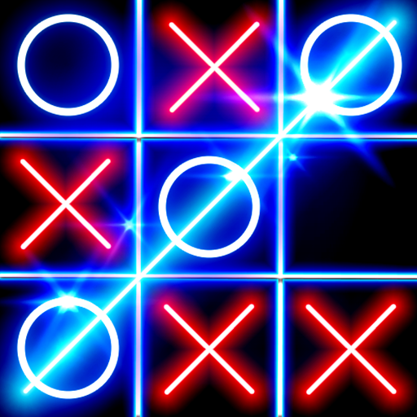
REFERENCE
Website – https://geeksforgeeks.com
Book - Python: The Complete Reference” by Martin C. Brown
Publisher: McGraw Hill Education Edition: Fourth edition

