Slide 1

MSC DATA SCIENCE
Integrated Gaming Analytics Dashboard
Unifying Steam engagement data and global sales into one analytical platform — from raw data to machine-learning-driven insight.
Hitesh Venkata Sai Manchala · Tarun Mikkilineni · Abinav Reddy Tirumala · Madhavapeddy Achyuth Reddy · Navaneeth Narayanan Potty
Professor: Dr. Farhan Khan — Data Analytics · University of Europe for Applied Sciences, Germany

Slide 2







THE CHALLENGE
Fragmented data, unanswered questions
Project objectives
Problem
Integrate & clean three raw Steam / sales datasets
Gaming platforms generate enormous data on sales, engagement, reviews, pricing and platform usage — but it sits fragmented across sources, making comprehensive analysis and decision-making difficult.
Explore patterns via EDA across price, genre & reviews
Engineer features that sharpen predictive power
Build ML models that predict player engagement
Which factors actually drive player engagement and game popularity — price, genre, reviews, ownership, or release timing?
Evaluate with MAE, MSE, RMSE and R² metrics
Deliver business insights for developers & publishers

Slide 3



DATA FOUNDATION
Three datasets, one unified platform
games.csv
steam.csv
steam_description_data.csv
122,611
27,075
27,334
records · 39 attributes
records · 18 attributes
games · text metadata
Price, peak concurrent users, reviews, playtime, developers, publishers, categories and genres.
Ownership estimates, ratings, average playtime, genres, developers and publishers.
Game descriptions and metadata — a base for future NLP analysis of reviews and content.
Integration: after repairing a structural header defect in games.csv, all datasets were cleaned and merged on Steam app ID and normalized game name into a single master table of 122,610 games — engagement, reviews, pricing and global sales in one analytical view.

Slide 4






METHODOLOGY
From raw data to interactive dashboard
01
02
03
04
05
06
Collect
Clean
Integrate
Engineer
Explore
Predict
Import Steam & sales datasets via Pandas
Standardize columns, fix types, drop duplicates
Merge on name, app ID, genre, publisher
Price groups, rating ratios, release years
EDA: distributions, correlations, trends
Train & evaluate regression models
Output: Integrated Gaming Analytics Dashboard
Interactive Power BI dashboard — three pages (Overview · Engagement · Sales & Publishers) with KPI cards, cross-filtering visuals and slicers for genre, price band and release year.

Slide 5






FEATURE ENGINEERING
Turning raw fields into predictive signals
Price groups
Free · Low · Medium · Premium bands to compare engagement across pricing strategies
Positive rating ratio
Positive ÷ total reviews as a clean measure of player satisfaction
Release year
Extracted from release dates to expose long-term popularity trends
Multiplayer flag
Derived from game categories to compare multiplayer vs single-player retention
Popularity score
Composite of ownership, reviews and player activity
Genre encoding
One-hot and label encoding to make genres model-ready

Slide 6



EXPLORATORY ANALYSIS
What the data revealed first
Prices skew low
Genres that grip
Most Steam games sit at the lower end of the market — free-to-play titles are a significant share of the platform.
Action, Adventure and Strategy show consistently high engagement across the catalogue.
Reviews matter
Timing counts
Games with higher positive-review ratios generally achieve higher popularity.
Player activity varies significantly across release periods.
Toolkit: histograms, bar charts, scatter plots, box plots and correlation heatmaps (Matplotlib).

Slide 7

MACHINE LEARNING
Predicting popularity from game attributes
Target variable
Input features
Price
Positive reviews
Peak Concurrent Users (Peak CCU)
The clearest single indicator of overall player activity and game popularity.
Negative reviews
Recommendations
Train / test split
Average playtime
Release year
80% train
20%
Genre indicators
Ownership estimates
Models compared: Linear Regression (baseline) · Random Forest (nonlinear, overfitting-resistant) · XGBoost / Decision Tree (comparative).
Metrics: MAE · MSE · RMSE · R²

Slide 8
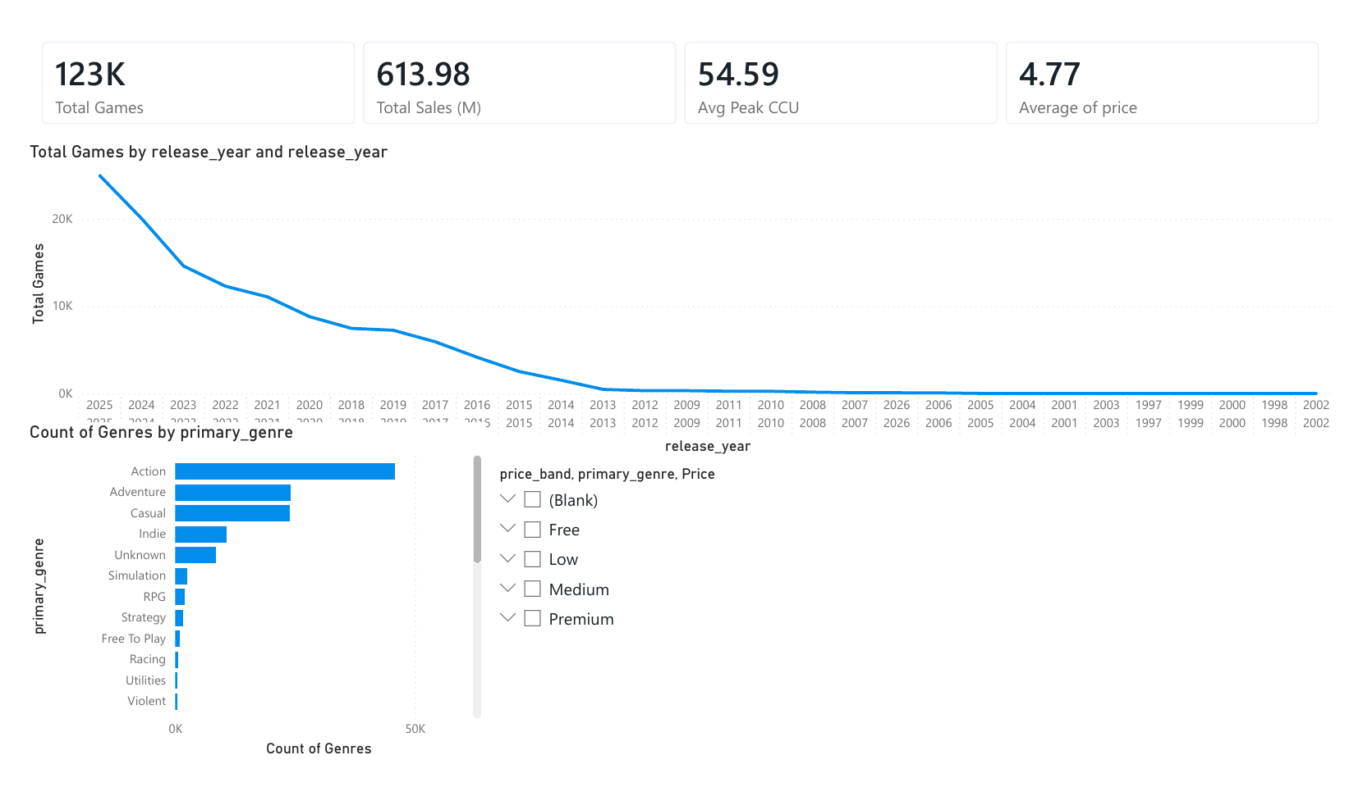
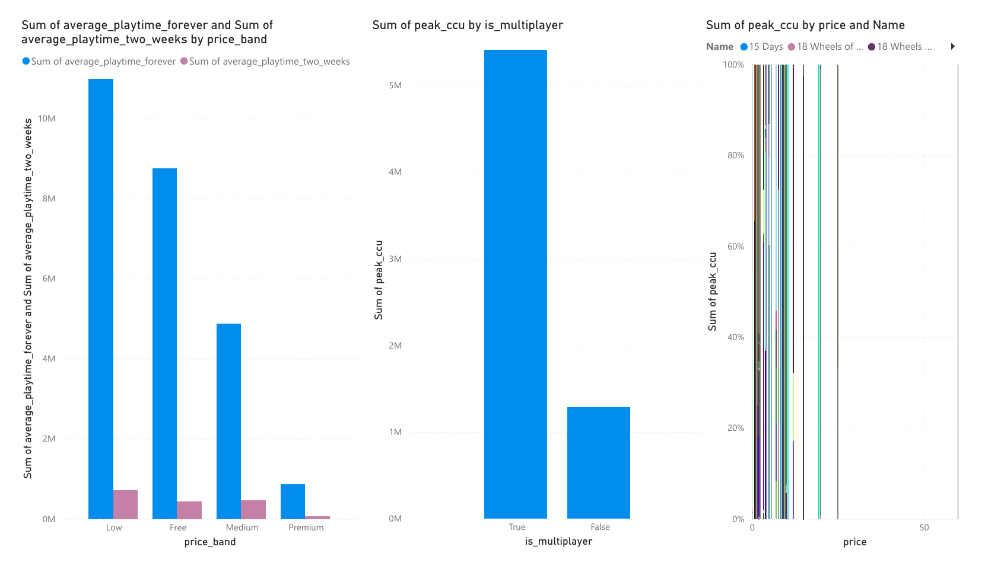
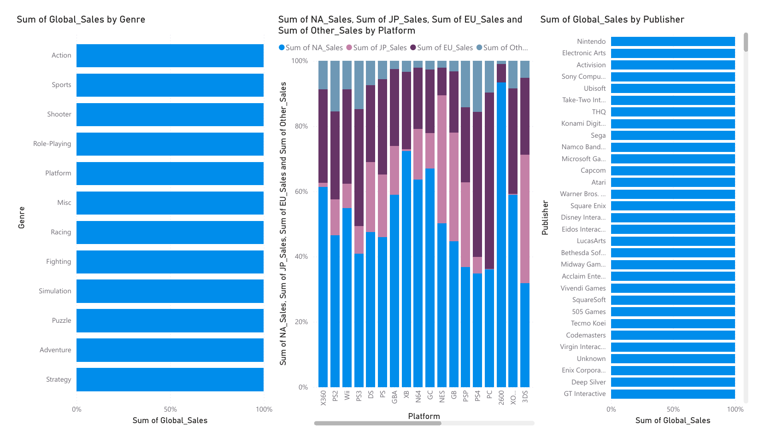

DASHBOARD DEVELOPMENT
One interactive view of the gaming industry
Page 1 · Overview
Page 2 · Engagement
Page 3 · Sales & Publishers
Interactive filters: price band · genre · release year · cross-filtering on every visual
Built with Power BI Desktop — three interactive pages (Overview · Engagement · Sales & Publishers) — designed for developers, publishers, marketers and researchers.

Slide 9
RQ1 · PRICING
Higher-priced games hold players longer
+71%
more playtime for the highest price band vs free games
Average playtime rises with price group — players invest more time in games they've paid more for, though the trend dips slightly at the 'High' band.

Slide 10
RQ3 · GENRES
Where players spend their hours
A surprise at the top
Creative-tool categories on Steam — Audio, Web and Video Production — log the longest sessions of all, ahead of traditional game genres.
2,073 min
average playtime for Audio Production — over 3× the Free To Play average

Slide 11
RQ2 & RQ4 · ENGAGEMENT
Multiplayer keeps players coming back
Ratings: a subtler story
Scatter analysis shows a broad, dispersed relationship between positive-rating percentage and peak CCU — higher-rated games generally reach higher peak concurrency.
−0.0018
linear correlation between positive-rating % and peak CCU — near zero, meaning rating percentage alone doesn't predict popularity linearly. Volume of feedback matters more than its ratio.
+74% longer average sessions in multiplayer titles — a strong retention signal.

Slide 12
RQ5 · PUBLISHERS
Valve towers over the adoption charts
5.5×
Valve's lead over the #2 publisher (KRAFTON) in estimated owners
Owning the platform and shipping evergreen titles compounds: Valve's catalogue dwarfs even global AAA publishers on its own storefront.

Slide 13
RQ6 · PLATFORMS
The PS2 era still defines peak sales
1.26B
units sold on PlayStation 2 — the highest-grossing platform in the dataset
Console generations dominate the historical sales record: PS2, X360, PS3 and Wii together account for over 4 billion units.

Slide 14
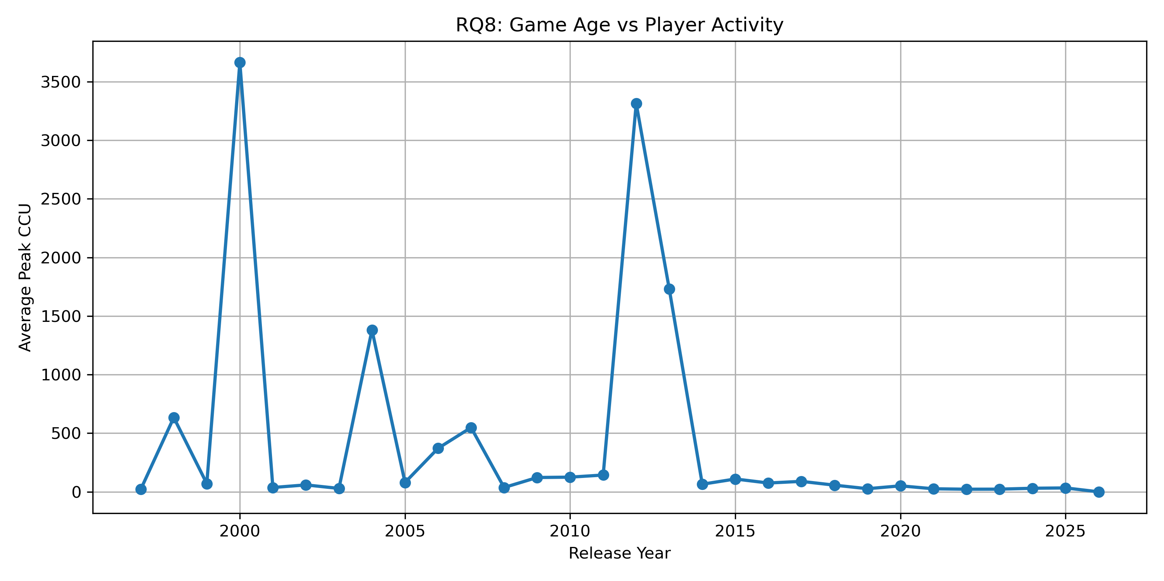
RQ8 · RELEASE TIMING
A few evergreen years dominate activity
Two towering spikes
Games released around 2000 and 2012 average by far the highest peak concurrency — evergreen classics from those years still hold massive player bases decades on.
Post-2014 flattens
Recent years average far lower — thousands of new releases dilute the mean, so age alone doesn't drive engagement; a handful of enduring hits does.
Average peak CCU by release year (EDA output)

Slide 15
RQ9 · REGIONS
Genre taste splits sharply by geography
Japan flips the script
Role-Playing is Japan's #1 genre (352M units) — outselling Action there, while Shooters barely register at 38M.
In NA and EU, Action, Sports and Shooter dominate — evidence that genre strategy and marketing must be regionalized.

Slide 16
RQ7 & RQ10 · PREDICTION
What actually predicts peak players
Correlation with Peak CCU
Model evaluation
0.131
Recommendations
strongest driver of peak concurrency
Model | MAE | RMSE | R²
Linear Regression | 0.3046 | 1.5029 | 0.0320
Random Forest | 0.2808 | 1.4900 | 0.0485
0.093
Negative reviews
even criticism signals attention
0.081
Price
weakest of the measured factors
Random Forest wins — with a caveat
It beats Linear Regression on every metric by capturing nonlinear relationships. Low R² overall shows popularity is driven by many factors beyond the modeled attributes — hype, marketing, timing.
Positive reviews and recommendations move together (r = 0.90) — engaged communities generate both.

Slide 17



RESULTS & DISCUSSION
Five takeaways for the industry
Price isn't destiny
Price alone is not a strong predictor of engagement — value perception matters more than the tag.
Feedback is fuel
Positive reviews and ownership estimates show the strongest links to popularity.
Build for together
Multiplayer-enabled games consistently show higher retention and activity.
Nonlinear wins
Random Forest outperforms Linear Regression by capturing complex, nonlinear relationships.
Genre + voice
Genre and player feedback are among the most influential predictors of game success.

Slide 18



CONCLUSION & FUTURE SCOPE
Data-driven decisions for the games industry
Historical Steam data, carefully preprocessed and modeled, yields meaningful insight into what drives player engagement — supporting developers and publishers in pricing, marketing, genre selection and game design.
Deep learning
NLP on reviews
Live Steam data
Recommenders
Richer features
Neural models for improved prediction accuracy
Mine game descriptions and review sentiment
Real-time integration with live statistics
Suggestions from preferences and play history
Developer reputation, update frequency and more
Thank you · Integrated Gaming Analytics Dashboard · University of Europe for Applied Sciences, Germany

