Slide 1

DA120B
Integrated Gaming Analytics Dashboard
Unified analysis of game performance · player engagement · business insights
GITHUB
TEAM
STATUS
DATE
HITESH8842
DA120B Analytics
In Progress
30 May 2026
TEAM MEMBERS
Hitesh Venkata Sai Manchala
Navaneeth Narayanan Potty
Tarun Mikkineni
Abinav Reddy Tirumala
Madhavapeddy Achyuth Reddy
github.com/HITESH8842/INTEGRATED-GAMING-ANALYTICS-DASHBOARD-DA120B-

Slide 2





PROBLEM STATEMENT
Fragmented Data
Project Objective
Player engagement, sales, reviews, and metadata are stored in completely separate datasets with no unified view.
Analyze and integrate multiple gaming datasets to support better reporting and decision-making through a unified analytics platform.
Hidden Insights
Identify popular games and top genres
Popular games, successful genres, sales trends, and player behavior patterns remain buried in data silos.
Track global & regional sales trends
Understand player behavior patterns
Decision Gap
Perform review & rating analysis
Gaming companies cannot effectively identify performance drivers without cross-dataset analysis in one place.
Deliver KPI-driven dashboard insights
Support data-driven business decisions

Slide 3
DATASETS
01
70,000+ Games
02
16,500+ Games
03
27,000+ Games
Steam Games Dataset
Video Game Sales
Steam Store Games
kaggle / fronkongames
kaggle / gregorut
kaggle / nikdavis
Key Attributes
Key Attributes
Key Attributes
AppID, Name, Price
Name, Platform, Year
Game Metadata & Categories
Peak CCU, Avg Playtime
Genre & Publisher
Genres & Release Date
Positive / Negative Reviews
NA / EU / JP Sales
Platform Support
Genres, Publishers
Global Sales Figures
Price Information
Release Date
Player engagement, popularity, ratings & ML prediction
Commercial performance & regional sales trends
Enrich Steam data with store features

Slide 4

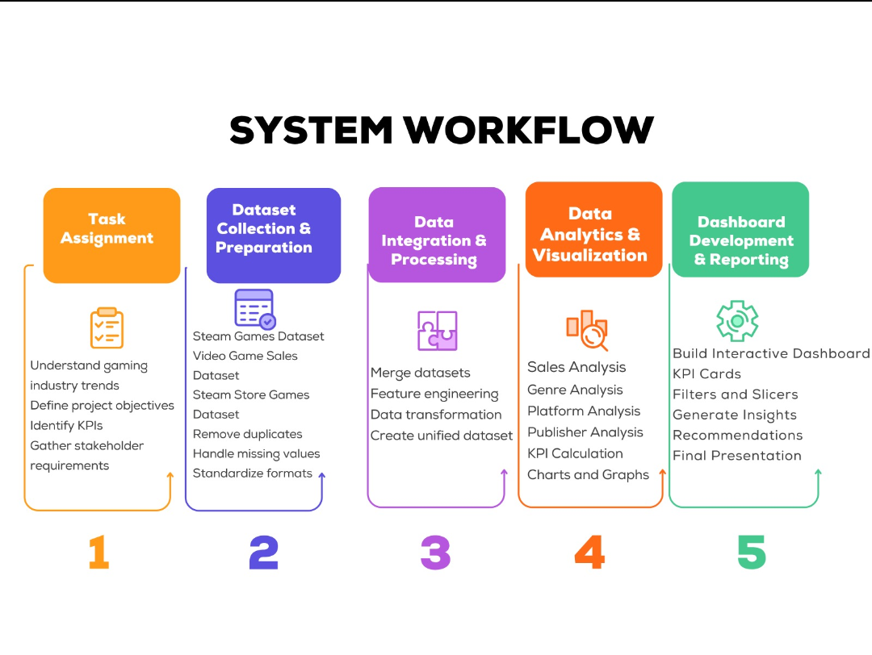
SYSTEM WORKFLOW

Slide 5




ETL PIPELINE & ANALYTICS LAYER
→
→
→
→
→
Extract
Transform
Integrate
Store
Analyze
Visualize
Kaggle download
Python file load
Remove nulls
Standardize columns
Merge on name,
genre & platform
CSV files
PostgreSQL DB
EDA + KPIs
ML predictions
Plotly, Power BI
Tableau dashboards
Analytics Outputs
Genre Analysis
Sales Analysis
Price Analysis
Review & Rating
Player Engagement
Publisher Analysis
Platform Trends
KPI Calculation

Slide 6

PROJECT PLAN & MILESTONES
Week 1
Week 2
Week 3
Week 4
Week 5
Week 6
Problem Analysis & Setup
Dataset Collection
System Design & Workflow
Data Cleaning
Data Integration
Exploratory Data Analysis
Dashboard Development
Testing & Improvements
Documentation & Final Report
M1: Setup
M2: Data Collect
M3: Clean & Integrate
M4: Analysis
M5: Dashboard
M6: Final Report
Final Presentation

Slide 7


TOOLS & TECHNOLOGIES
Programming
Data Processing
Data Storage
Python 3.x
Pandas · NumPy
CSV Files · PostgreSQL
Visualization
Version Control
Collaboration
Matplotlib · Seaborn
Plotly · Power BI / Tableau
GitHub
Microsoft Teams

Slide 8
GITHUB REPOSITORY
HITESH8842 / INTEGRATED-GAMING-ANALYTICS-DASHBOARD-DA120B-
Team Lead Responsibilities
📁 Data/
Create & maintain GitHub repository
├── Raw/
Set up MS Teams channel
└── Processed/
Assign tasks to team members
📁 Source/
Update README.md & daily logs
├── data_cleaning.py
Monitor weekly progress
├── data_integration.py
└── analytics.py
Research References
📁 Dashboard/
Predicting Popularity of Games on Steam (arXiv, 2021)
└── dashboard_file.pbix
Empirical Study of Delayed Steam Games (2022)
📁 Documentation/
Video Game Sales Prediction – ML Model (2024)
📁 Reports/ 📁 Logs/ 📁 Figures/
Steam Review Sentiment – BiLSTM (2026)
📄 README.md · requirements.txt

Slide 9
TODAY'S LOG & NEXT STEPS
✅ Completed — 30 May 2026
🚀 Next Steps
Finalized project title & team name
01
Download all three Kaggle datasets
Completed full problem analysis
Selected and documented 3 datasets
02
Upload raw data to Data/Raw folder
Designed system workflow
03
Start data cleaning pipeline
Created project execution plan
Prepared Gantt chart (6 weeks)
04
Create data dictionary
Identified all tools and technologies
05
Begin Exploratory Data Analysis
Planned GitHub folder structure
Prepared MS Teams discussion update
🟢 STATUS: IN PROGRESS

Slide 10
CONCLUSION
Project Summary
DA120B Integrated Gaming Analytics Dashboard unifies Steam, sales, and store data into one analytics platform — enabling clear, data-driven gaming business decisions.
3 Datasets Integrated
Full ETL Pipeline Built
Interactive Dashboard
70,000+ Steam games, 16,500+ sales records, and 27,000+ store entries unified into one seamless analytics pipeline.
End-to-end workflow: ingestion → cleaning → integration → EDA → KPI analysis → interactive dashboard.
Power BI / Tableau dashboard with KPI cards, genre, regional sales, and player engagement views.
Key Outcomes & Impact
Identifies top-performing games, genres, and publishers across all platforms
Delivers actionable KPIs for stakeholders via a filterable, interactive dashboard
Reveals regional sales trends (NA, EU, JP) and global commercial patterns
Establishes a scalable ETL framework reusable for future gaming data projects
Thank You · DA120B Integrated Gaming Analytics Dashboard · github.com/HITESH8842

