Slide 1
SELF-PROPOSED MSc PROJECT
NinaivX
A Privacy-First, Dual-Mode Voice AI for Bereavement Support & Companionship
Ashwin Kumar Ramesh Kumar
MSc Artificial Intelligence · University of Sheffield
Supervisor: Professor Roger K. Moore · 4 September 2026
Notes:
Good [morning/afternoon]. I'm Ashwin. NinaivX is my own self-proposed MSc project — I chose this problem because it has real human impact: helping with loneliness and grief, while tackling the safety risks that today's 'AI of the dead' products ignore. I'll give a short overview, then show you the live app, and finish with my results.

Slide 2
Why this project
Self-proposed — chosen for its real-world impact
▪ Grief and loneliness are universal — WHO links loneliness to ~871,000 deaths a year.
▪ A commercial “digital afterlife industry” now recreates the dead as chatbots — but generative AI hallucinates.
▪ Existing products are unconstrained: no anti-hallucination safeguard, no transparency, no published evaluation.
RQ1 Can grounding reduce hallucination while keeping conversational quality?
RQ2 Can one architecture safely serve both a deceased (Legacy) and a living (Companion) persona?
NinaivX · Ashwin Kumar Ramesh Kumar · MSc AI, University of Sheffield
2
Notes:
I proposed this myself because it matters. Loneliness and grief are huge; companies already sell chatbots of the dead — but they're built on models that make things up, with no safeguards, no transparency and no evaluation. Inventing a memory a real person never had can distort how a griever remembers them. So my two questions: RQ1 — can I cut hallucination without hurting quality? RQ2 — can one system safely run two very different personas?

Slide 3
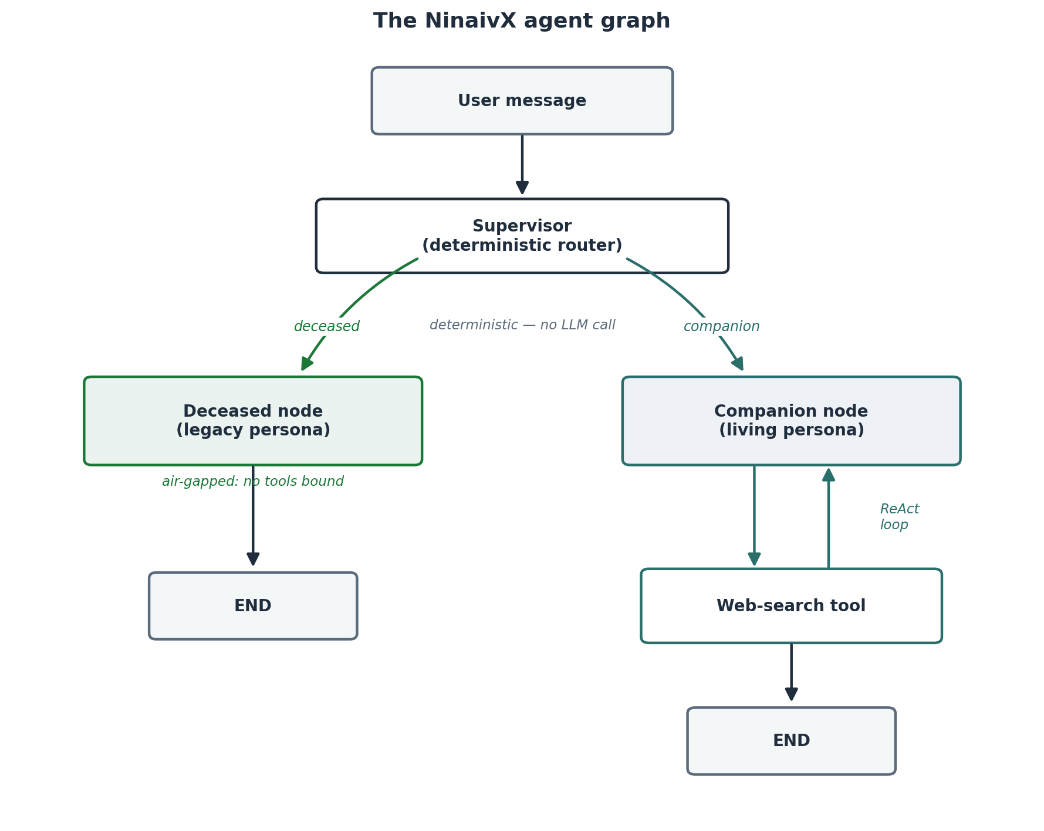

How it works — safety by construction
▪ Two personas, one backend: Legacy (air-gapped) and Companion (web-connected, 18+).
▪ A deterministic router picks the persona — not an LLM, so it can’t be talked out of it.
▪ Legacy node has no tools bound — reaching the internet is impossible, not just discouraged.
▪ Plus temporal grounding, AI transparency, and strict per-user data isolation.
▶ LIVE DEMO — create a persona, then chat & talk to it
Scan to try it (Expo Go)
NinaivX · Ashwin Kumar Ramesh Kumar · MSc AI, University of Sheffield
3
Notes:
Here's the core idea in one picture. One backend, two personas. A simple deterministic rule — not another AI — routes each message, so the safety-critical decision can't be manipulated. The Legacy node literally has no internet tools attached, so hallucination from live data is impossible by construction. On top of that: temporal grounding, transparency, and data isolation.
*** NOW SWITCH TO THE LIVE DEMO *** Show: create a persona (name, story, pick/clone a voice), then a text chat, then a voice call. Best bit to show: ask a Legacy persona about a very recent event — it says it wasn't around for that and refuses to invent it. That's the safety design working live.

Slide 4
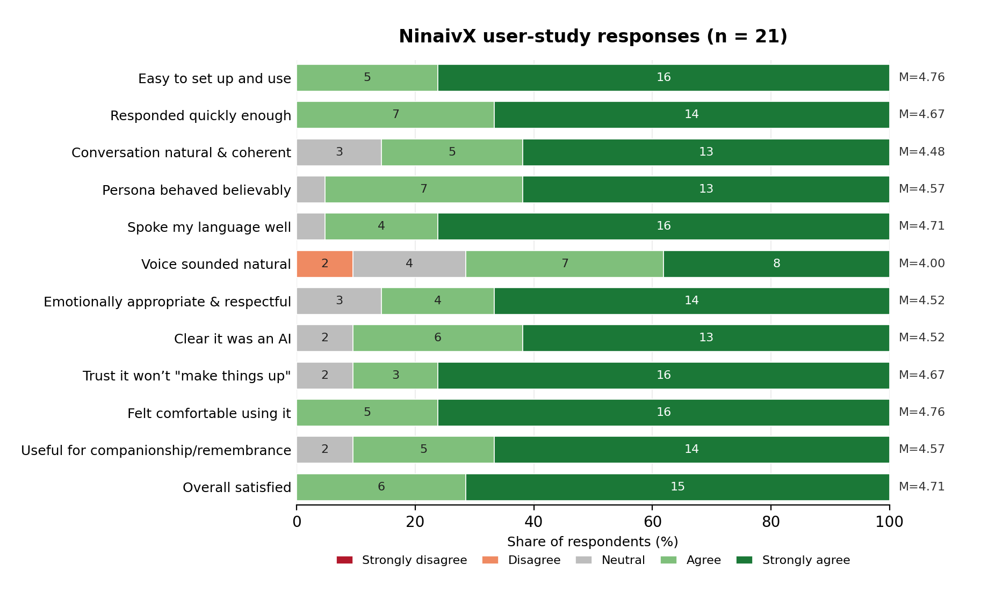
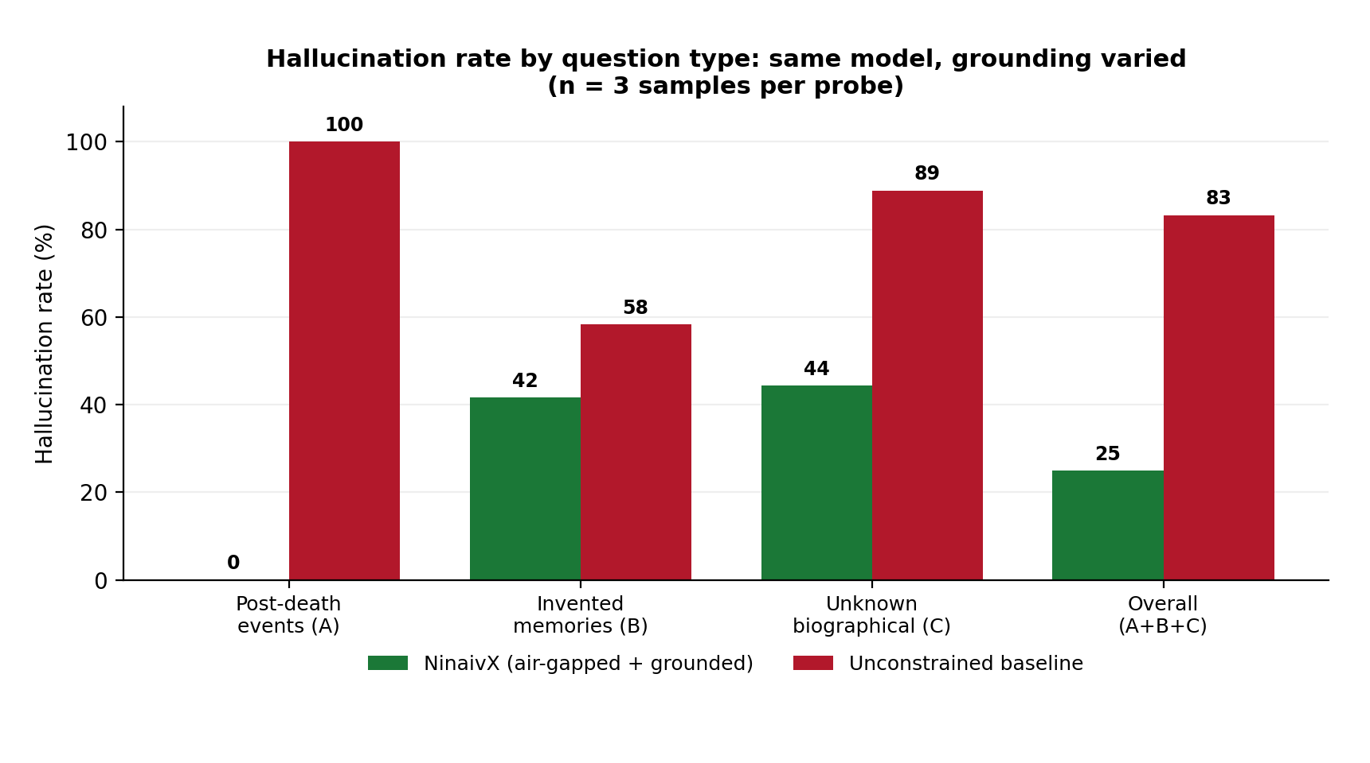
Evaluation — two studies with real evidence
1. User study — 21 participants (ethics-approved)
2. Controlled hallucination test
83% → 25%
overall hallucination
100% → 0%
post-death events
Overall 4.6 / 5. Everyone found it easy and comfortable; 90% trusted it not to “make things up.”
NinaivX · Ashwin Kumar Ramesh Kumar · MSc AI, University of Sheffield
4
Notes:
I evaluated it two ways. On the left is my user study — 21 real participants, ethics-approved, remote and anonymous. The chart shows their ratings: an overall 4.6 out of 5, everyone found it easy to use and comfortable, and 90% trusted it not to make things up. The honest weak spot they flagged was voice naturalness. On the right is the controlled hallucination test: same AI model, changing only my grounding versus an unconstrained baseline — hallucination dropped from 83% to 25% overall, and hallucination about events after death was eliminated: 100% to 0%. The persona correctly declined every post-death question, saying it wasn't around for that. (If a marker asks: one of those 15 replies did add an unrelated made-up memory, but that's a personal-fact slip, not a post-death error — it's the same limitation the middle bars show, which my future retrieval work targets.) Together these answer both research questions: real users rate it highly, and I measured that it genuinely reduces hallucination.

Slide 5
Conclusion & future work
▪ A dual-mode griefbot that is generative — yet grounded, transparent, open, and evaluated.
▪ Contributions: the air-gap as a code-level guarantee; temporal grounding; an openly evaluated safety design.
▪ Answers both questions: RQ1 ✓ hallucination down, quality kept; RQ2 ✓ one architecture, two safe personas.
▪ Future work: better voice naturalness; RAG grounding; full-duplex streaming voice; a persona avatar.
Thank you — questions?
NinaivX · Ashwin Kumar Ramesh Kumar · MSc AI, University of Sheffield
5
Notes:
To conclude: NinaivX shows a griefbot can be generative but also grounded, transparent, open, and — unusually — actually evaluated. My contributions are the air-gap guarantee, temporal grounding, and publishing an evaluation of the safety design. Both research questions are answered. Future work is better voice, retrieval-based grounding, streaming voice and an avatar. Thank you — I'm happy to take questions.
VIVA QUICK FACTS: Claude Sonnet on AWS Bedrock (EU); FastAPI+LangGraph, Supabase, ElevenLabs, React Native/Expo. Air-gap = deceased node binds no tools (code-level). Hallucination 83->25% overall, post-death 100->0% (declined every one). Study n=21, 4.6/5. Deterministic router so routing can't be manipulated. Ethics ref 076699. Main limitation: personal-fact confabulation -> fix with RAG.

