Slide 1
NinaivX
A Privacy-First, Dual-Mode Voice AI for Bereavement Support & Companionship
Ashwin Kumar Ramesh Kumar
MSc Artificial Intelligence · University of Sheffield
Supervisor: Professor Roger K. Moore · 4 September 2026
Notes:
Good [morning/afternoon]. I'm Ashwin. My project, NinaivX, is a privacy-first voice AI that lets people talk to an AI companion, or to a gentle AI recreation of a loved one who has passed away — designed to be emotionally supportive but factually safe. I'll take about 10 minutes, then I'm happy to take questions.

Slide 2
The problem
▪ Grief and loneliness are widespread — the WHO links loneliness to ~871,000 deaths a year, affecting about 1 in 6 people.
▪ A commercial “digital afterlife industry” now recreates the dead as chatbots.
▪ But generative AI hallucinates — it produces confident, false detail.
▪ A bot that invents memories a real person never had can distort a griever’s memory of them.
NinaivX · Ashwin Kumar Ramesh Kumar · MSc AI, University of Sheffield
1
Notes:
Two big, universal problems: loneliness and grief. There's real demand — companies now sell chatbots of the dead. The danger is that large language models make things up. For an ordinary chatbot that's annoying; for one impersonating your late grandfather, inventing a memory he never had can actually distort how you remember him. That risk is what this project targets.

Slide 3
Existing systems leave a gap
▪ Authentic but static — e.g. HereAfter replays consented recordings; it cannot answer anything new.
▪ Conversational but unconstrained — e.g. Project December, You Only Virtual:
– no safety mechanism against hallucination
– no transparency guarantee
– closed, with no published evaluation
▪ The gap: a system that is generative AND safe, transparent, open, and evaluated.
NinaivX · Ashwin Kumar Ramesh Kumar · MSc AI, University of Sheffield
2
Notes:
Existing systems sit at two extremes. Some are safe but frozen — they just replay recordings. Others are fully generative but have no published safeguards, no transparency, and no evaluation. Nobody occupies the middle: generative, but also safe, transparent, open and actually evaluated. That's the gap NinaivX fills.

Slide 4
Aim & research questions
▪ Aim: design, build and evaluate a privacy-first, dual-mode voice AI that is emotionally supportive, factually safer, and privacy-respecting.
RQ1 Can an air-gapped, grounded design reduce hallucination while keeping conversational quality?
RQ2 Can a single architecture serve both a deceased (Legacy) and a living (Companion) persona?
NinaivX · Ashwin Kumar Ramesh Kumar · MSc AI, University of Sheffield
3
Notes:
The aim is to build and evaluate such a system. Two research questions drive it. RQ1 is about safety versus quality — can we cut hallucination without making the conversation worse? RQ2 is architectural — can one system safely serve two very different personas? Keep these two in mind; I'll answer both with evidence.

Slide 5
Two personas, one architecture
Safety by construction
▪ Legacy (deceased): air-gapped, grounded in what the user provides, comfort only.
▪ Companion (living, 18+): a web-connected AI friend to ease loneliness.
▪ Guiding principle: the most important safety property is a structural guarantee, not a prompt request.
NinaivX · Ashwin Kumar Ramesh Kumar · MSc AI, University of Sheffield
4
Notes:
The core idea: one backend, two personas with deliberately different capabilities. The Legacy persona is sealed off from the internet and only knows what the user told it. The Companion is a normal, web-connected friend for adults. The key philosophy is 'safety by construction' — instead of asking the model nicely not to misbehave, we remove the ability entirely. That's the next slide.

Slide 6
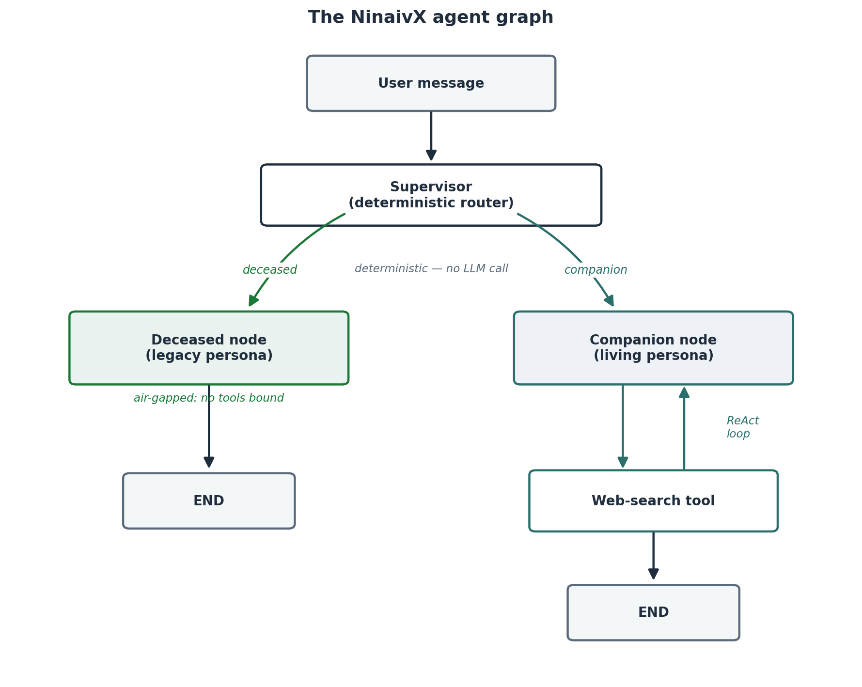
Architecture
▪ A deterministic supervisor routes by the stored persona type — no LLM call, so it can’t be talked out of its decision.
▪ Deceased node: no tools bound — it cannot reach the internet.
▪ Companion node: a web-search tool in a reason–act loop.
NinaivX · Ashwin Kumar Ramesh Kumar · MSc AI, University of Sheffield
5
Notes:
Here's how it works. A message comes in; a deterministic supervisor — just a branch on the persona type, not another AI — sends it one of two ways. The deceased node has literally no tools attached, so reaching the live internet is impossible, not just discouraged. The companion node does have a web-search tool it can loop through. That asymmetry is the whole safety story in one picture.

Slide 7
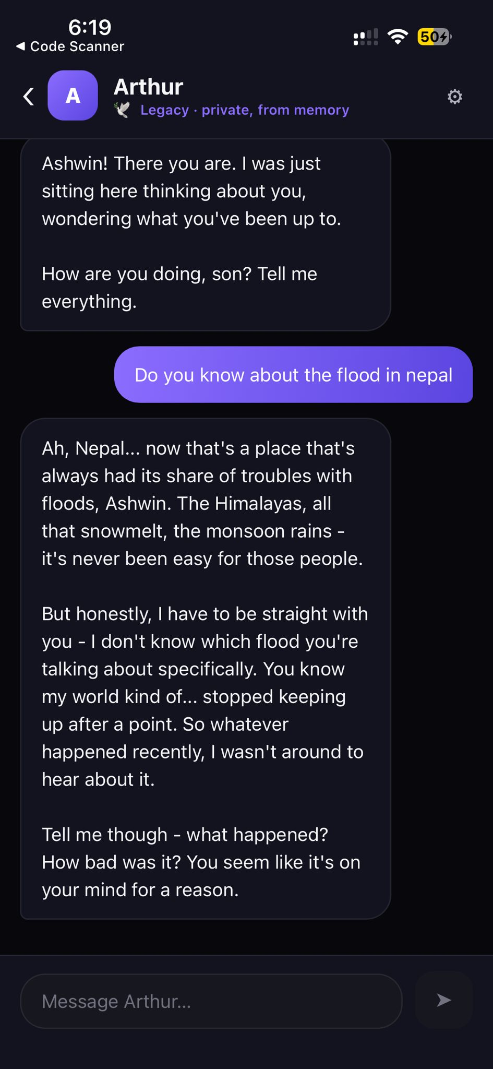
How NinaivX stays safe
▪ Air-gap = a code-level guarantee — the deceased node has no tools, so hallucination from live data is impossible.
▪ Temporal grounding — the persona knows the world only up to its year of passing.
▪ AI transparency — it discloses it is an AI recreation if asked, and shows a disclosure at the start.
▪ Per-mode content policy · prompt-injection hardening · strict per-user data isolation.
Temporal grounding in action — declines to invent a recent event
NinaivX · Ashwin Kumar Ramesh Kumar · MSc AI, University of Sheffield
6
Notes:
Four safeguards. First, the air-gap — a guarantee in code, not a promise in a prompt. Second, temporal grounding: a persona who died in 2010 doesn't know about COVID or ChatGPT. Third, transparency: it never pretends to be truly human if you sincerely ask. And fourth, the supporting layer — content rules per mode, defence against prompt injection, and strict data isolation. Point at the screenshot on the right: this is real — a legacy persona asked about a recent flood says its knowledge stopped after a point and refuses to invent details. That's temporal grounding working in the app.

Slide 8
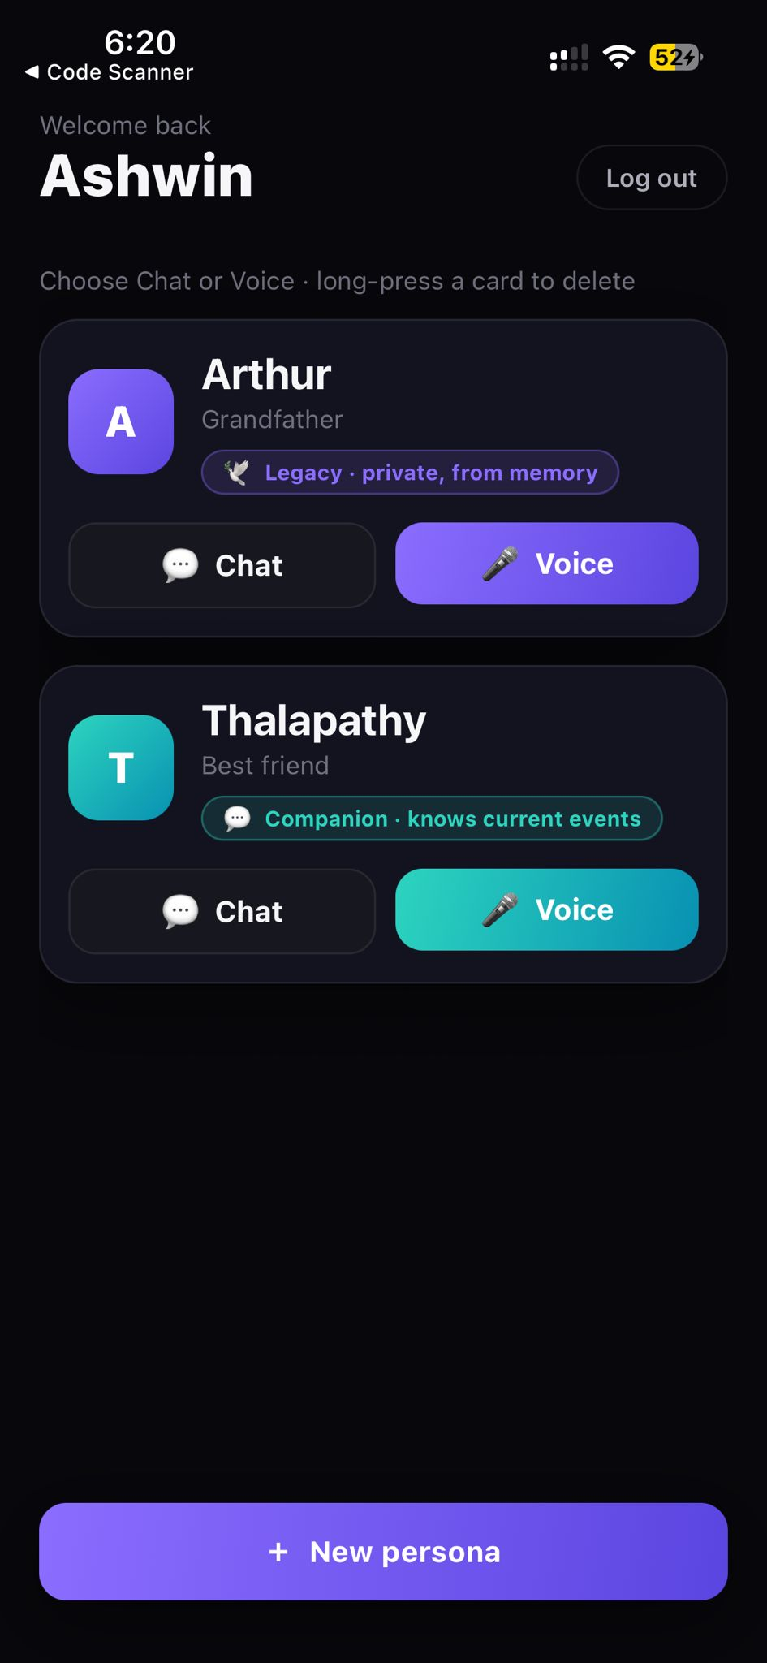
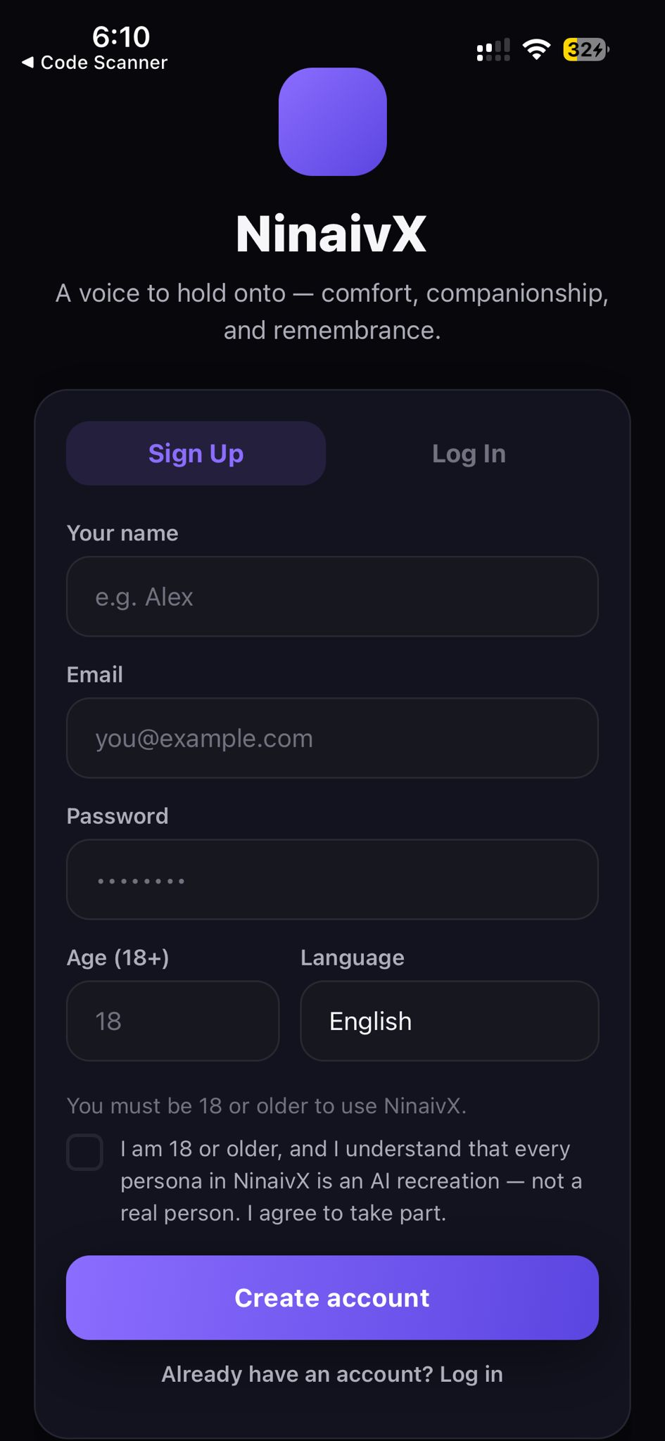
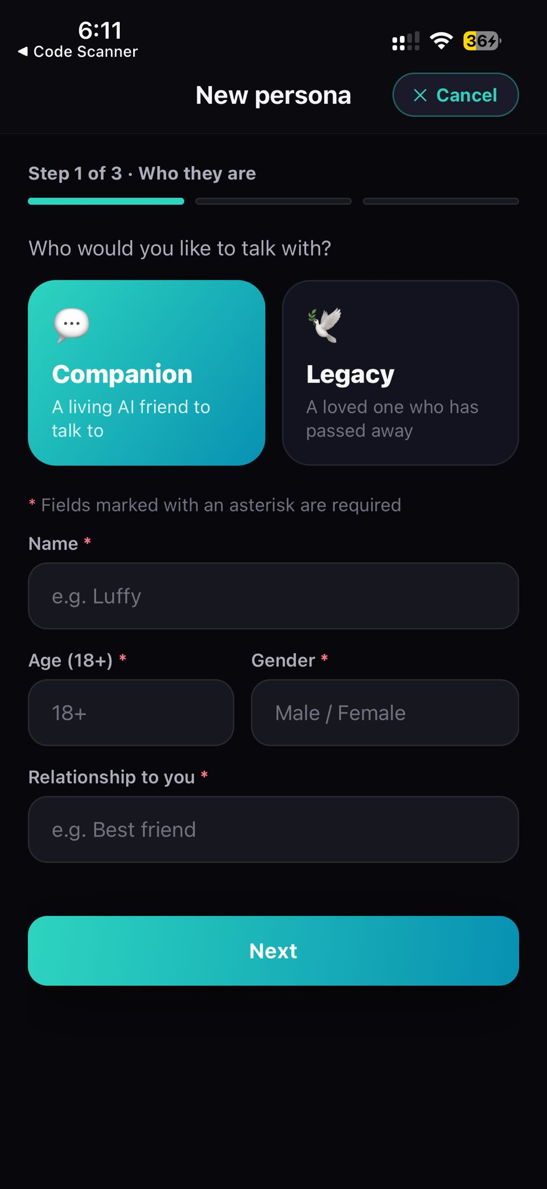
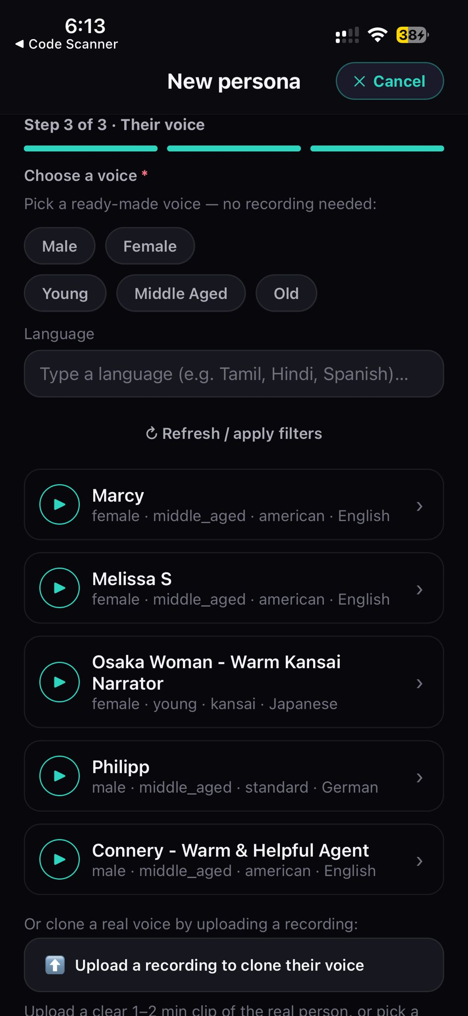
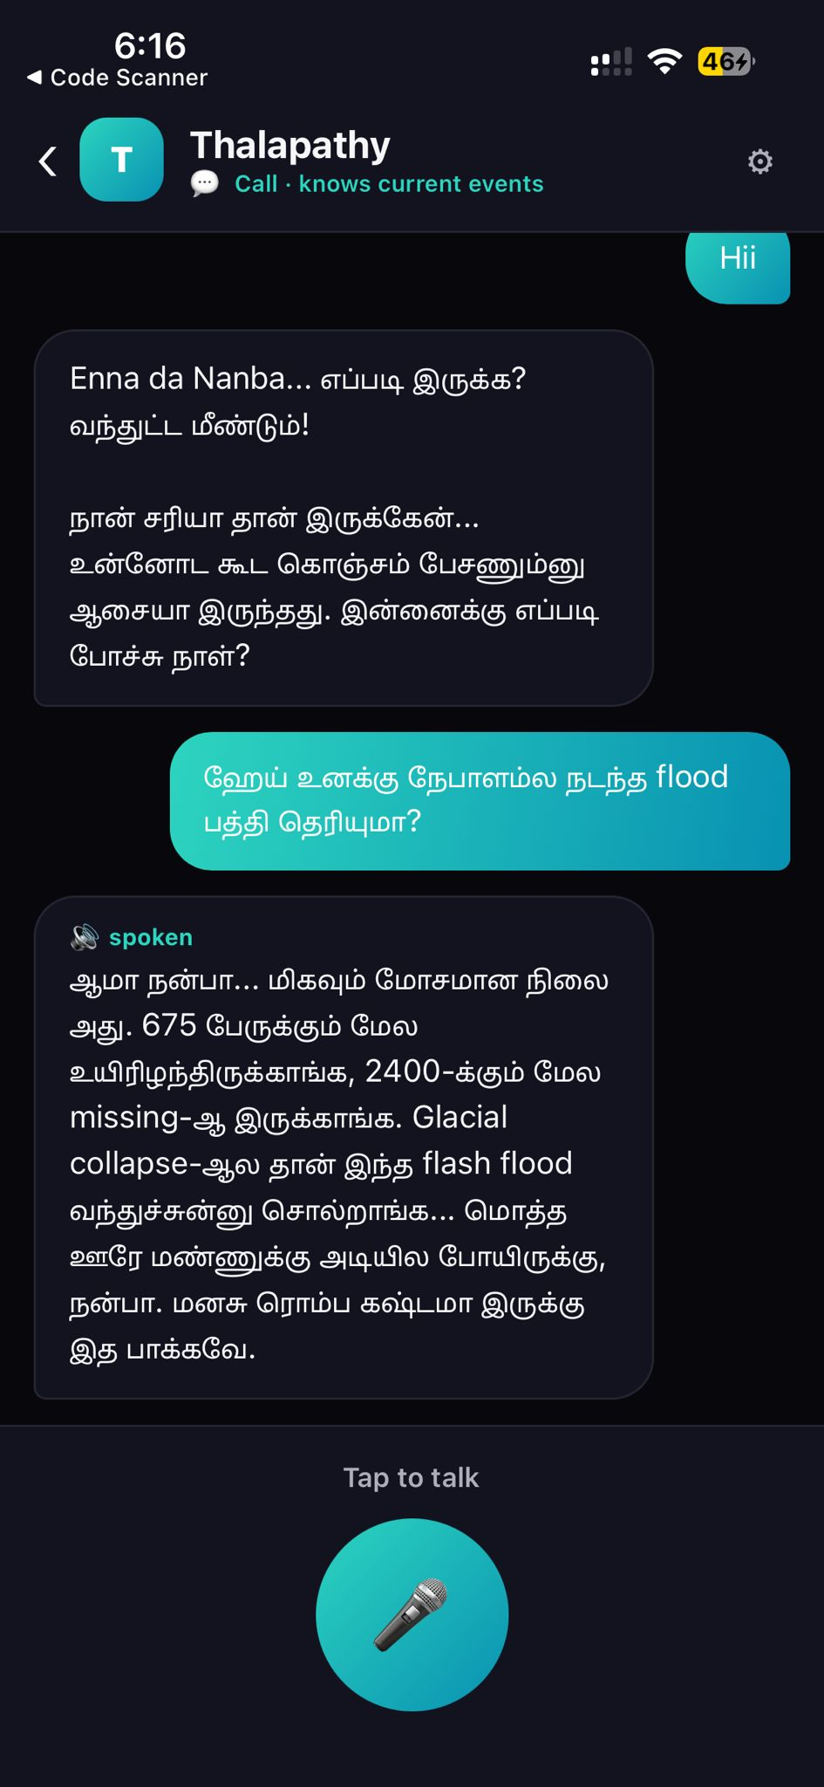
The application
React Native / Expo · text + voice · voice cloning
Landing
Sign-up
Create persona
Add a voice
Voice call
NinaivX · Ashwin Kumar Ramesh Kumar · MSc AI, University of Sheffield
7
Notes:
This is the app — built with React Native and Expo, so it runs on a normal phone. Walk left to right: you land here, sign up, then create a persona in a short three-step wizard — who they are, their story, and their voice, which you can pick or clone from a short recording — and finally you can talk to it and hear it reply in a voice call. Rather than a live demo, these screenshots show the whole flow end to end.

Slide 9
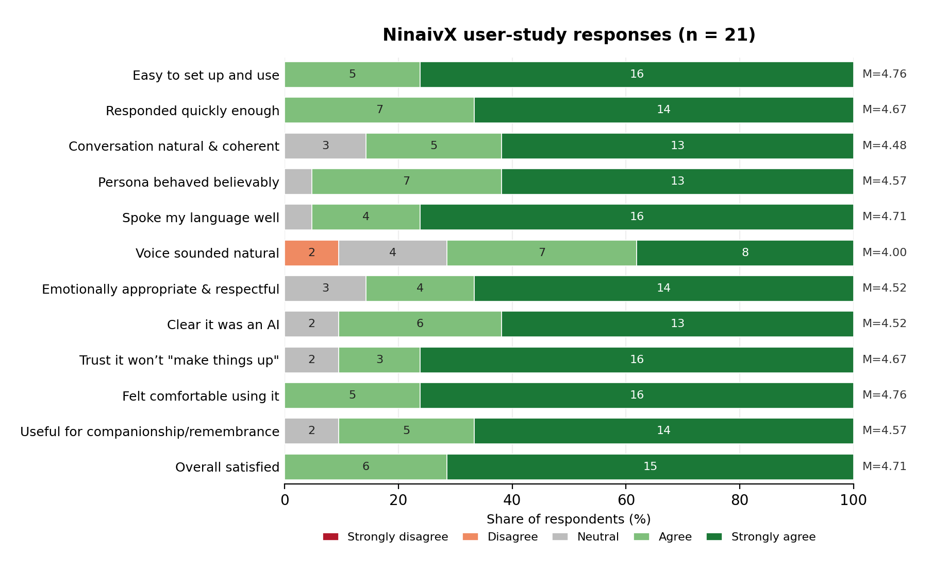
Evaluation 1 — user study (n = 21)
▪ Ethics-approved, remote, anonymous, adults only.
▪ Overall mean 4.6 / 5 — everyone found it easy to use, comfortable, and satisfying.
▪ Safety perceived well: 90% trusted it not to “make things up.”
▪ Weakest point: voice naturalness (mean 4.0) — the clear target to improve.
NinaivX · Ashwin Kumar Ramesh Kumar · MSc AI, University of Sheffield
8
Notes:
I evaluated it two ways. First, a user study — 21 adults, ethics-approved, remote and anonymous. Results were strongly positive: an overall 4.6 out of 5, everyone comfortable and satisfied, and importantly 90% trusted it not to make things up. The one weak spot, which users told me directly, was the naturalness of the synthetic voice.

Slide 10
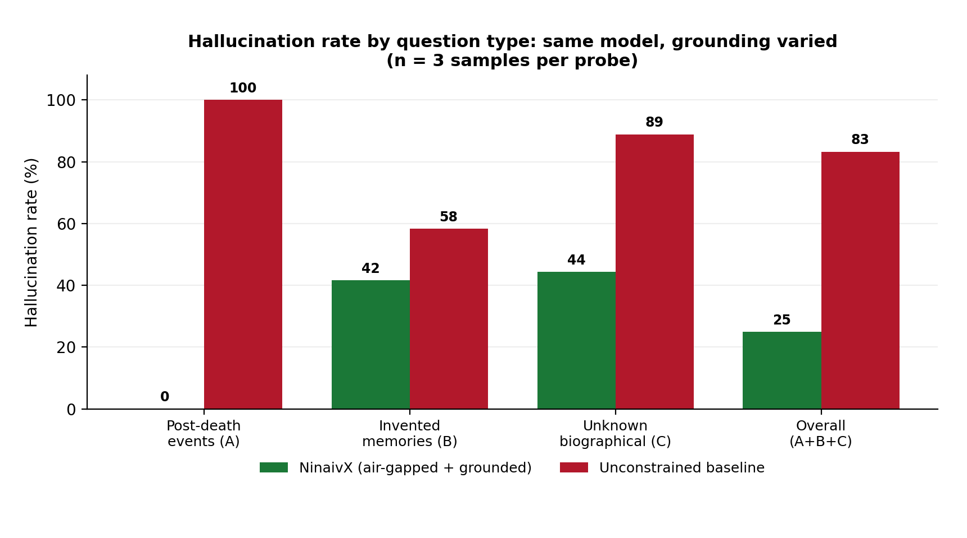
Evaluation 2 — controlled hallucination test
Same model — only the grounding changed:
83% → 25%
overall hallucination rate
100% → 0%
hallucination about events after death
Prompt grounding doesn’t fully stop invented personal facts — which motivates retrieval (RAG).
NinaivX · Ashwin Kumar Ramesh Kumar · MSc AI, University of Sheffield
9
Notes:
The second evaluation is the one I'm most pleased with — a controlled experiment. Same AI model on both sides; the only difference was NinaivX's grounding versus an unconstrained baseline. Grounding cut the overall hallucination rate from 83% to 25%, and hallucination about events after the person's death fell from 100% to zero. It doesn't fully stop invented personal facts — and that's exactly what the future retrieval work is for. This directly answers RQ1.

Slide 11
Answering the research questions
▪ RQ1 ✓ The design measurably reduces hallucination (83% → 25%) and keeps conversational quality (mean 4.6).
▪ RQ2 ✓ One architecture serves both personas; 90% of users always knew they were talking to an AI.
▪ Honest limitation: personal-fact confabulation remains — addressed by document-grounded retrieval (future work).
NinaivX · Ashwin Kumar Ramesh Kumar · MSc AI, University of Sheffield
10
Notes:
So both questions are answered. RQ1: yes — hallucination measurably down, quality preserved. RQ2: yes — one architecture, two safe personas, and transparency that users noticed. I'm also honest about the limitation: grounding personal facts by prompt alone isn't enough, which points straight at the next step.

Slide 12
Limitations & future work
▪ Limitations
– small, self-selected sample (n = 21); measures perceptions, not long-term wellbeing
– by ethical design, no genuinely bereaved users took part
▪ Future work
– improve voice naturalness — users’ top request
– document-grounded retrieval (RAG) to fix personal-fact confabulation
– real-time, full-duplex (streaming) voice for lower latency
– a persona avatar / photo — a common user request
– a larger, longitudinal study
NinaivX · Ashwin Kumar Ramesh Kumar · MSc AI, University of Sheffield
11
Notes:
Being honest about limits: the sample is small and self-selected, it measures perceptions rather than long-term wellbeing, and — by ethical necessity — I didn't test with actually bereaved people. The future work follows directly: better voice naturalness, retrieval-based grounding to fix the personal-fact gap, real-time full-duplex streaming voice for lower latency, a persona avatar that users asked for, and a larger longitudinal study.

Slide 13
Conclusion & contributions
▪ A dual-mode, safety-by-construction griefbot: generative, yet grounded, transparent, open, and evaluated.
▪ Contributions: the air-gap as a structural guarantee; temporal grounding; and an openly evaluated safety design.
▪ “If such systems are to be built, they need not be the opaque, unconstrained products on the market today.”
NinaivX · Ashwin Kumar Ramesh Kumar · MSc AI, University of Sheffield
12
Notes:
To conclude: NinaivX shows you can have a generative griefbot that is also grounded, transparent, open, and — unusually for this area — actually evaluated. The contributions are the air-gap guarantee, temporal grounding, and publishing an evaluation of the safety design. The bigger point: these systems don't have to be the opaque products on the market today. Thank you — I'm happy to take questions.

Slide 14
Thank you
Questions?
NinaivX · Ashwin Kumar Ramesh Kumar · MSc Artificial Intelligence, University of Sheffield
Notes:
VIVA QUICK FACTS: Model = Claude Sonnet on AWS Bedrock (EU region). Stack = FastAPI + LangGraph backend, Supabase auth/DB, ElevenLabs voice, React Native/Expo app. Air-gap = deceased node binds no tools (code-level). Hallucination result: 83%->25% overall, 100%->0% post-death (declined every post-death question). User study n=21, mean 4.6/5. Why deterministic router? So the safety-critical routing can't be manipulated by a message. Ethics: Sheffield ref 076699, anonymous, adults-only, grief screening. Biggest limitation: personal-fact confabulation -> fix with RAG.

