Slide 1
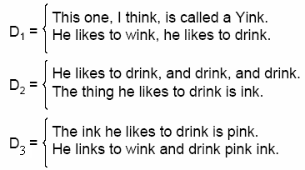


Homework 2
Using the Laplace correction, Lindstone correction ( let ε = 0.001) and Absolute Discounting ( let ε = 0.001) smoothing method to recount the probability of above queries on D1, D2 and D3 respectively.
Notes:
It seems not so simple to compute the probability of a word, students can try to compute the probability of “drink” at first.
End Here.

Slide 2

Homework 2
1. While using cross-entropy for document retrieval, why should we use rather than H(M_{D}||M_{Q})?
2. Given a document set, construct the uni-gram model for each document, and then use a table to list the top 10 words according to their probabilities. Their probabilities should also been given in the table. Each column is corresponding to one document and is named by the document file name.
提交时间：2020.07.09，17:00前
提交方式：email、qq
文件标题格式（严格遵从，否则可能会影响统计）:
IR-HW02-[学号]-[姓名].doc

