Slide 1
Image Processing
Representation & Description
Luguangm@gmail.com

Slide 2
Contents
This lecture will cover:
  Over view
  Representation
  Boundary descriptor

Slide 3
Overview
After an image has been segmented into regions. Representation and description should be considered.
Representation and description used to make the data useful to a computer.
Representing region in 2 ways:
  In terms of its external characteristics (its boundary)  focus on shape characteristics.
  In terms of its internal characteristics (its region)  focus on regional properties, e.g., color, texture.
Sometimes, we may need to use both ways.

Slide 4
Overview
Choosing a representation scheme, however is only the part of the task of making data useful to computer.
The next task is to describe the region based on the chosen representation.
For example:
  Representation  boundary.
  Description  length of the boundary, orientation of the straight line joining its extreme points, and the number of concavities in the boundary.

Slide 5
Sensitivity
Feature selected as descriptors should be as insensitive as possible to variations in
  size
  translation
  rotation
Following descriptors satisfy one or more of these properties.

Slide 6
Representation
Segmentation techniques yield raw data in the form of pixels along a boundary or pixels contained in a region.
These data sometimes are used directly to obtain descriptors.
Standard uses techniques to compute more useful data (descriptors) from the raw data in order to decrease the size of data.

Slide 7
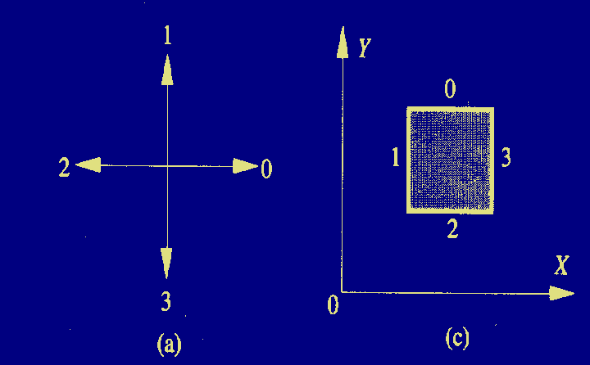
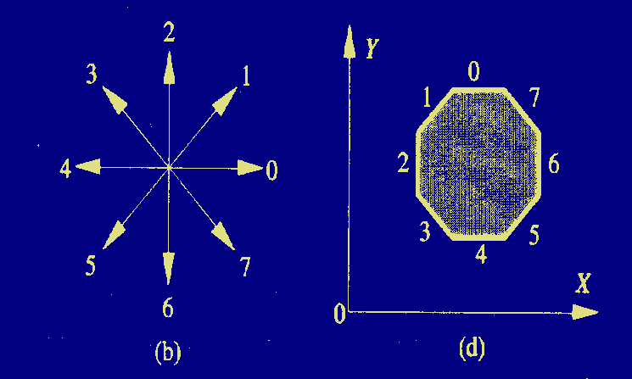
Chain Codes
4 Directional chain code:
0321
8 Directional chain code:
07654321

Slide 8
Chain Codes
Unacceptable because
  The resulting chain of codes tends to be quite long.
  Any small disturbances along the boundary due to noise or imperfect segmentation cause changes in the code that may not be related to the shape of the boundary.

Slide 9
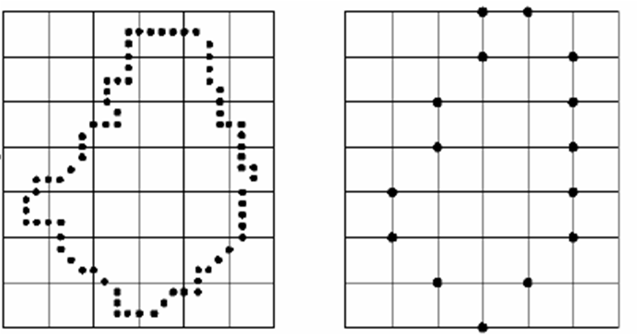
Chain Codes
Solve the problems by
  Resample the boundary by selecting a larger grid spacing.
  Then, as the boundary is traversed, a boundary point is assigned to each node of the large grid, depending on the proximity of the original boundary to that node.

Slide 10
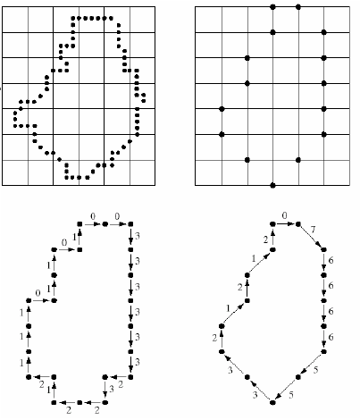
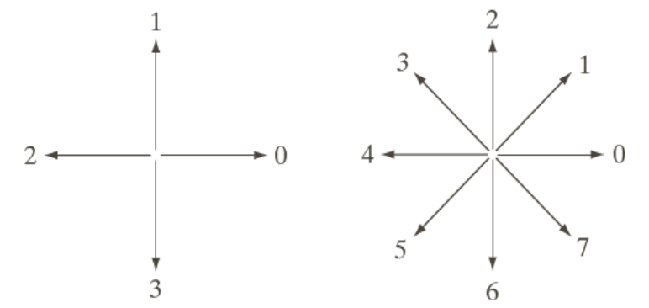
Chain Codes
0033333323221211101101
076666553321212
However, different grid can generate different chain codes.
The accuracy of the resulting code representation depends on the spacing of the sampling grid.

Slide 11
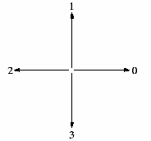
Chain Codes
The chain code of a boundary is depend on the starting point.
However, the code can be normalized with respect to the starting point by a straightforward procedure.
We simply treat the chain code as a circular sequence of direction numbers and redefine the starting point so that the resulting sequence of numbers form an integer of minimum magnitude.
0
0
1
3
1
3
0
0
3
3
1
1
2
2
2
2
1 0 1 0 3 3 2 2
3 3 2 2 1 0 1 0
0 1 0 3 3 2 2 1

Slide 12
Chain Codes
The chain code can be also normalized by using the first difference of the chain code. Then it is insensitive to rotation.
0
0
0
(1)
0
1
0
3
3
2
2
1
(2)
1
2
1
0
0
3
3
2
1
3
1
3
0
3
1
3
3
0
3
0
3
3
1
3
3
0
3
0
3
2
3
3
1
Rotate 90 degree
1
2
2
2
If original chain code is: M_{N}=a₀a₁…a_{n-1}, N=4 or 8
And The first difference chain code is: M’_{N}=b₀b₁…b_{n-1}
Then b₀=(a₀-a_{n-1}) MOD N, b_{i}=(a_{i}-a_{i-1}) MOD N
Size normalization can be achieved by altering the size of the re-sampling grid.

Slide 13
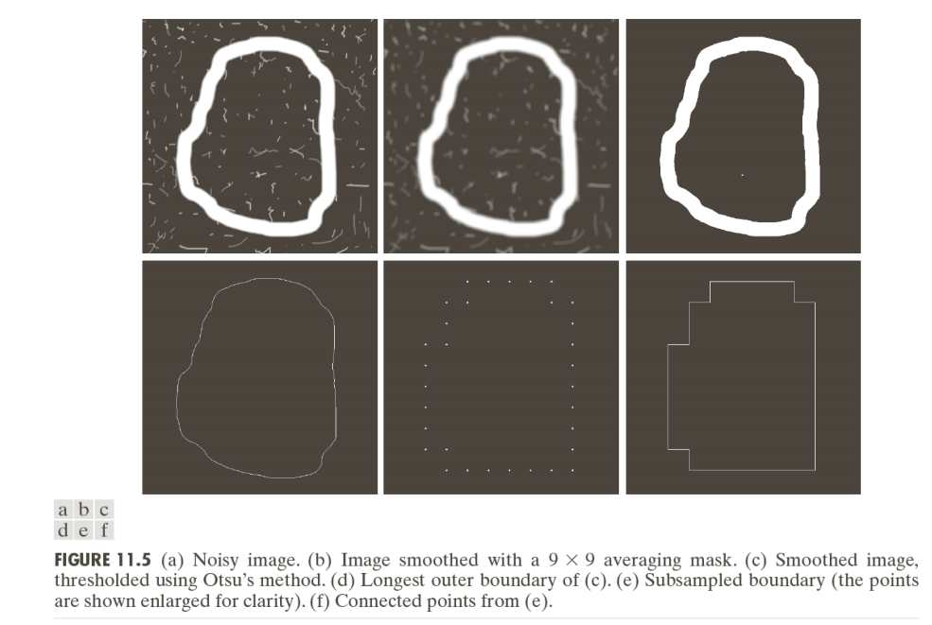
Chain Codes

Slide 14
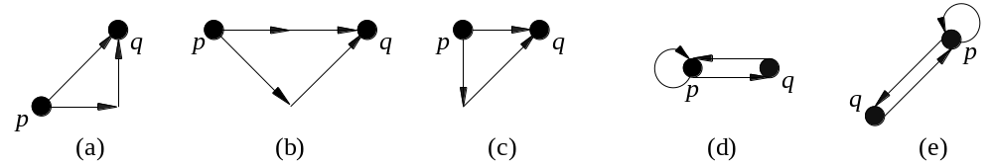
Chain Code Smoothing
Chain code smoothing template:
Broken arrowhead：Original 8- Directional chain code between pixels p and q
Real line arrowhead: The smoothed chain code.
N₈ | N₈ | N₈
N₈ | P | N₈
N₈ | N₈ | N₈

Slide 15
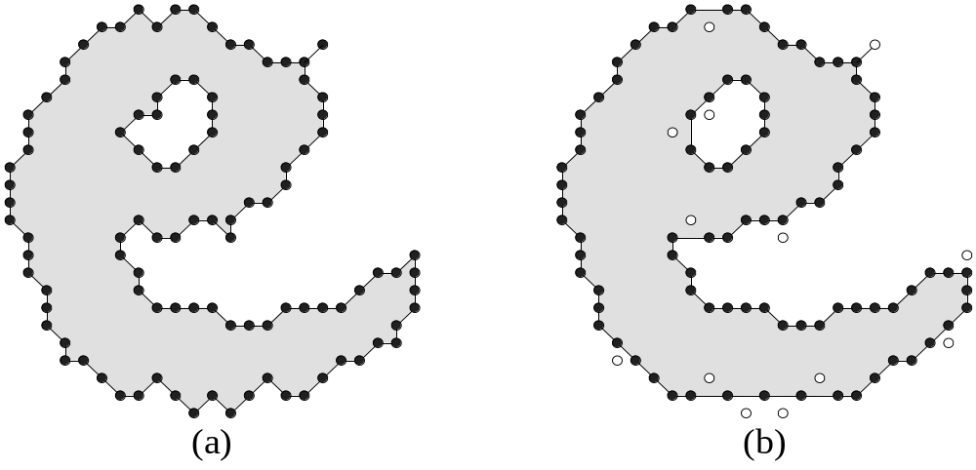
Chain Code Smoothing
Chain code smoothing example:

Slide 16
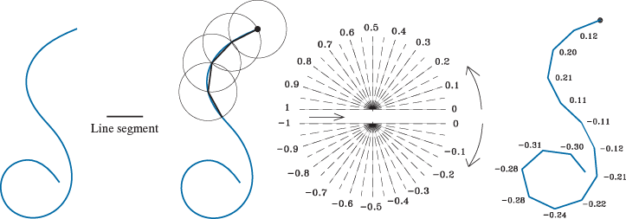
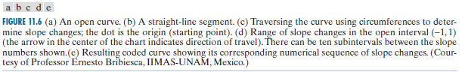
Chain Code Smoothing
SCC Chain code (斜率连码):
Notes:
两条直线段之间的斜率变化。归一化到（-1,1）之间。
不能保证链码曲线的最后一点与曲线本身的最后一点重合，可以通过调整直线段长度或增大角度分辨率来解决。

Slide 17
Polygonal Approximations
Boundary can be approximated with arbitrary accuracy by a polygon.
For a closed curve, the approximation is exact when the number of the segments in the polygon is equal to the number of points in the boundary.
The goal: Try to capture the “essence” of the boundary shape with the fewest possible polygonal segments.
Not trivial and time consuming.
Three methods:
  Minimum perimeter polygons
  Merging techniques
  Splitting techniques

Slide 18
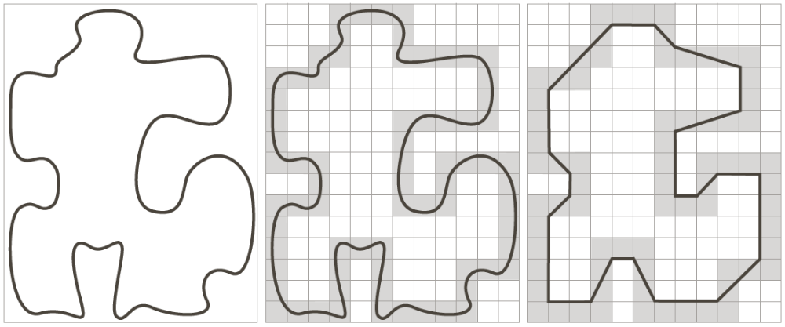
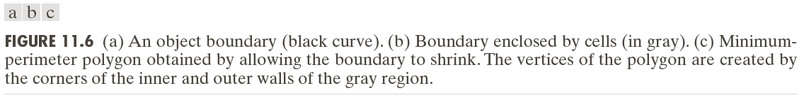
Minimum Perimeter Polygons

Slide 19
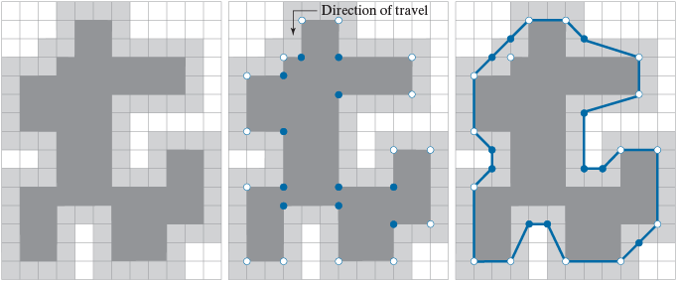
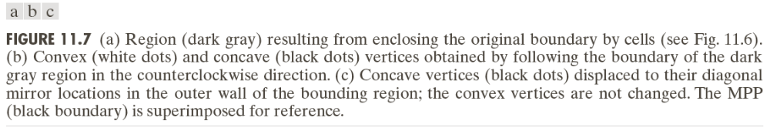
Minimum Perimeter Polygons
Notes:
只有内壁的凸顶点和外壁的凹顶点，才是最小多边形的顶点。

Slide 20
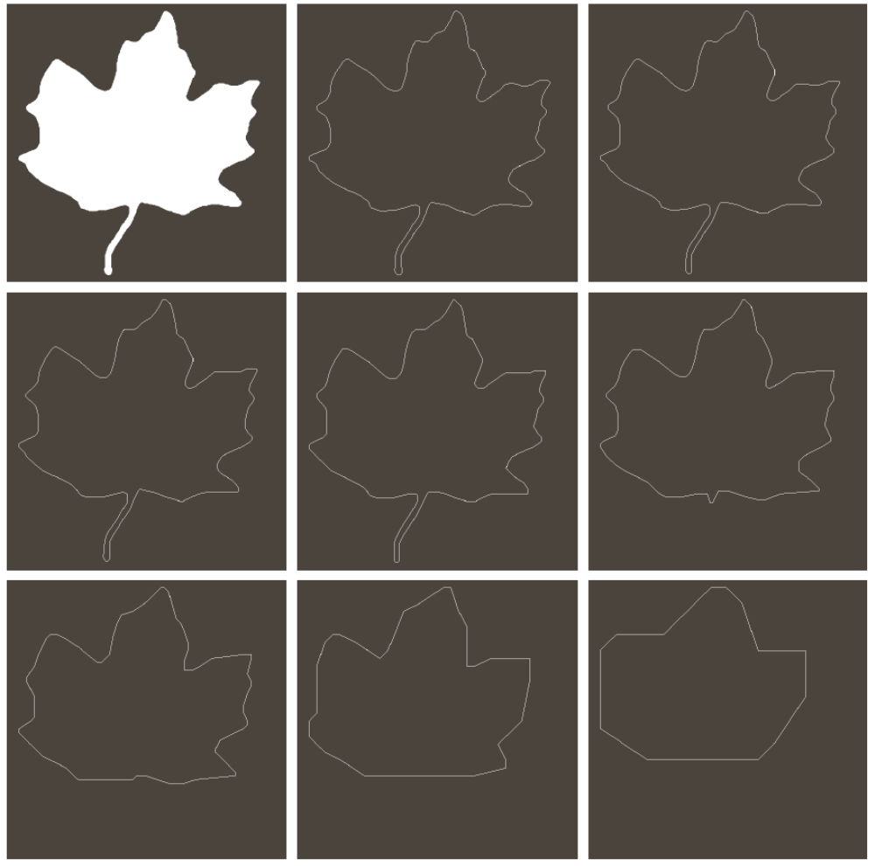
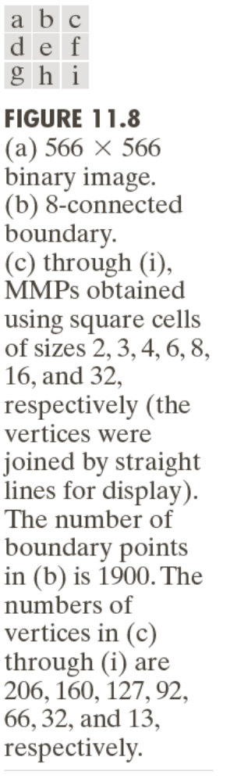
Minimum Perimeter Polygons
Notes:
当单元尺寸大于4*4时，茎部开始消失，越大细节丢失越明显

Slide 21
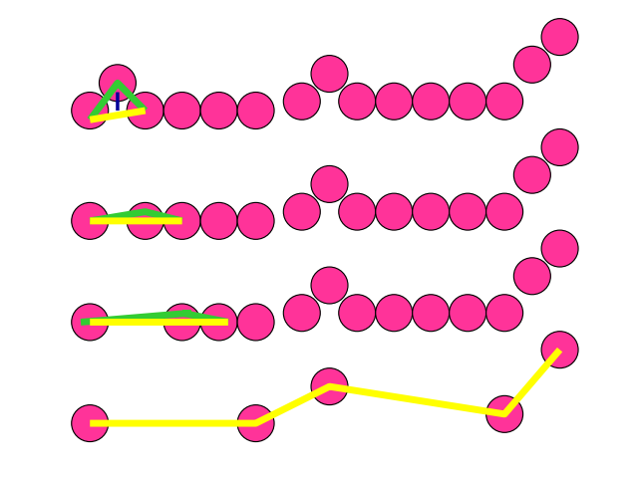
Merging Techniques
Merge points along the boundary, until the distance exceeds a preset threshold.
The procedure is repeated, merging new points along the boundary until the distance again exceeds the threshold.
Points: 15, edges: 14
Points: 5, edges: 4

Slide 22
Merging Techniques
An Example:
h
i
j
g
k
f
3
e
a
2
1
b
d
11—》4
c
Problem: the vertices in the resulting approximation do not always correspond to inflections (such as corners) in the original boundary.

Slide 23
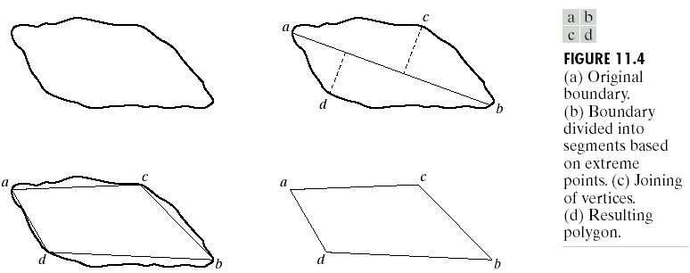
Splitting techniques
Splitting technique is to subdivide a segment successive into two parts until a specified criterion is satisfied.
Find the major axis.
Find max axes which perpendicular to major axis and has distance greater than a threshold.
Repeat until we can’t split anymore.

Slide 24
Splitting techniques
h
h
i
i
j
g
j
g
k
f
k
f
e
e
a
a
b
d
b
d
c
c
Different thresholds lead to different results.

Slide 25
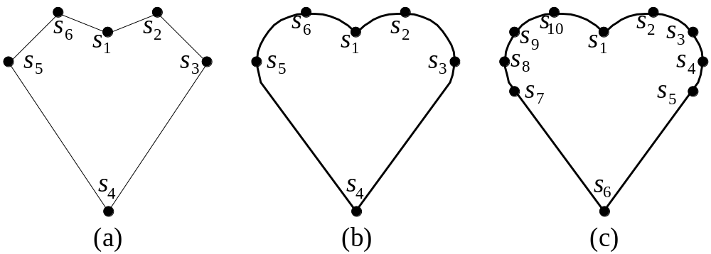
Landmark Points
Landmark Points (地标点或标志点)
Notes:
地标点是一种近似表达方法，但当将边界转换为地标点后经常不能将其恢复回去。所用的地标点数目不同，近似的程度也不同。一般来说，地标点越多，近似的程度越好。地标点的选择也很重要。

Slide 26
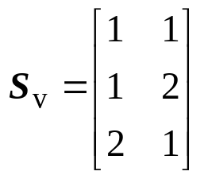
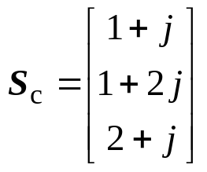
Landmark Points
Landmark points expression:
S₁ = (1, 1)，S₂ = (1, 2)，S₃ = (2, 1)
Method | Expression | Note
2n-vector | S_{o} = [1, 1, 1, 2, 2, 1] | S_{o}是一个2n×1的实坐标矢量
2n-set | S_{f} = {1, 1, 1, 2, 2, 1} | S_{f} 是一个包含2n个实坐标的集合
Matrix |  | S_{v} 是一个n×2 的矩阵，每行包含一个标志点的x-和y-实坐标
Plural-plane |  | S_{c}是一个n× 1 的复数矢量，每个复数表示一个标志点的x-和y-坐标

Slide 27
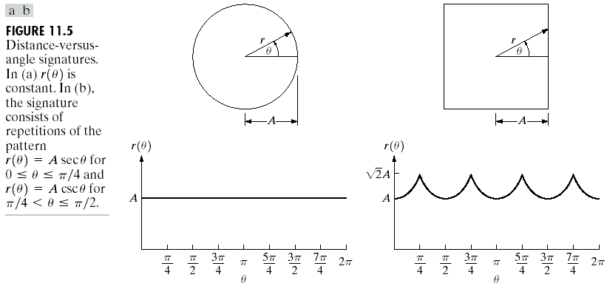
Signatures
Map 2D function to 1D function.
One of the simplest way is to plot the distance from the centroid to the boundary as a function of angle.
Notes:
把质心到边界的距离转化成与角度的函数

Slide 28
Signatures
Signatures are invariant to translation.
Normalization with respect to rotation can be achieved by finding a way to select the same starting point.
One way to do so is to select the starting point as the point farthest from the centroid, if the point happens to be unique and independent of rotational for each shape of interest.

Slide 29
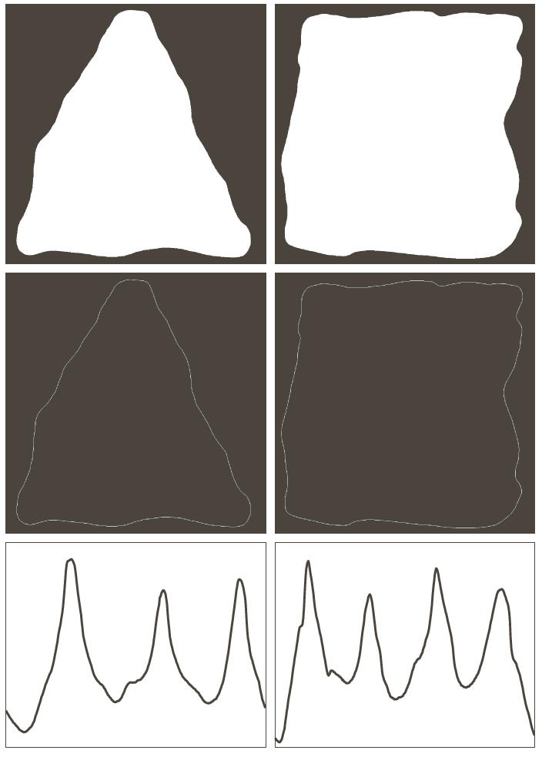
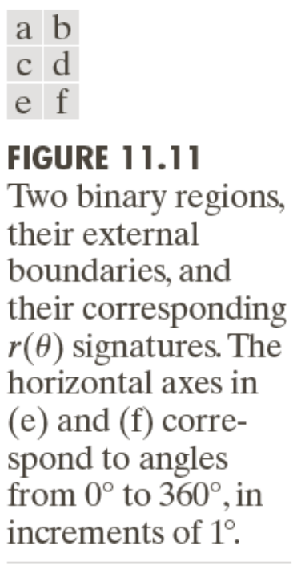
Signatures
Notes:
标记图中波峰的数量足以用来区分这两种形状

Slide 30
Boundary Segments
Decomposing a boundary into segments often is useful.
Decomposition reduces the boundary’s complexity and thus simplifies the description process.
Convex hull is a powerful tool for robust decomposition of the boundary.
Convex hull H of an arbitrary set S is the smallest convex set containing S.

Slide 31
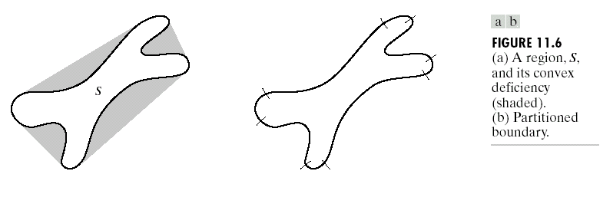
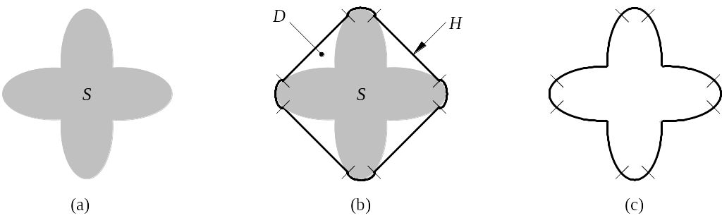
Boundary Segments
H=S+D
The set different H-S is called convex deficiency D (凸形缺陷) of the set S.
D

Slide 32
Boundary Segments
The region boundary can be partitioned by following the contour of S and marking the points at which a transition is made into or out of a component of the convex deficiency.
In practice, digital boundaries tend to be irregular because of digitization, noise. These effect usually result in convex deficiency:
  To smooth a boundary prior to partitioning.
  Use a polygonal approximation first.

Slide 33
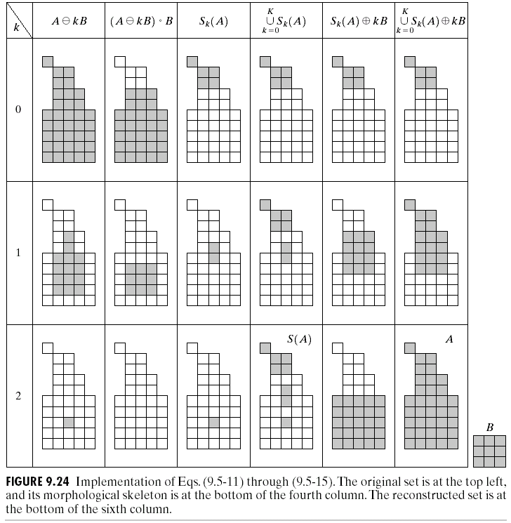
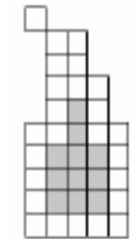
Skeletons
We already discussed the basics of skeleton using morphology. However, as noted in that section, the procedure made no provision for keeping the skeleton connected.
The algorithm developed here corrects that problem.

Slide 34
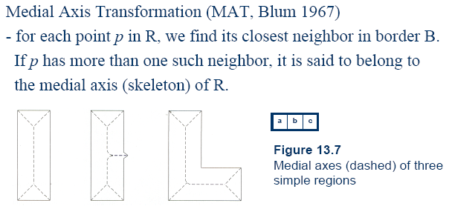
Skeletons
B
R

Slide 35
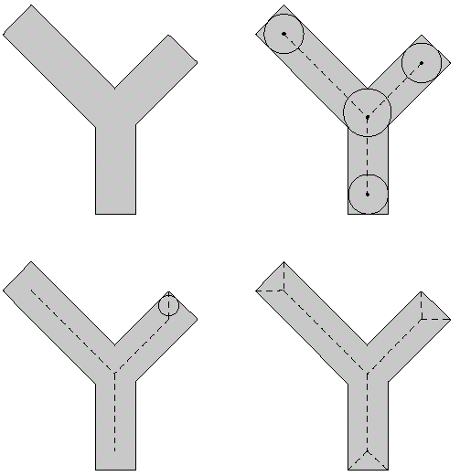
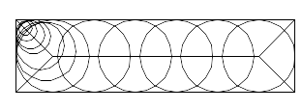
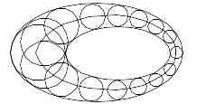
Skeletons
The same results would be obtained with the maximum disk of section 9.5.7

Slide 36
Skeletons
Although the MAT of a region yields an intuitively pleasing skeleton, directly implementation of this definition is expensive computationally.
Numerous algorithms have been proposed for improving computational efficiency.
Typically, these are thinning algorithm that iteratively delete edge points of a region subject to the constraints that deletion of these points:
  1)Does not remove end points.
  2)Does not break connectivity.
  3)Does not cause excessive erosion of the region.

Slide 37
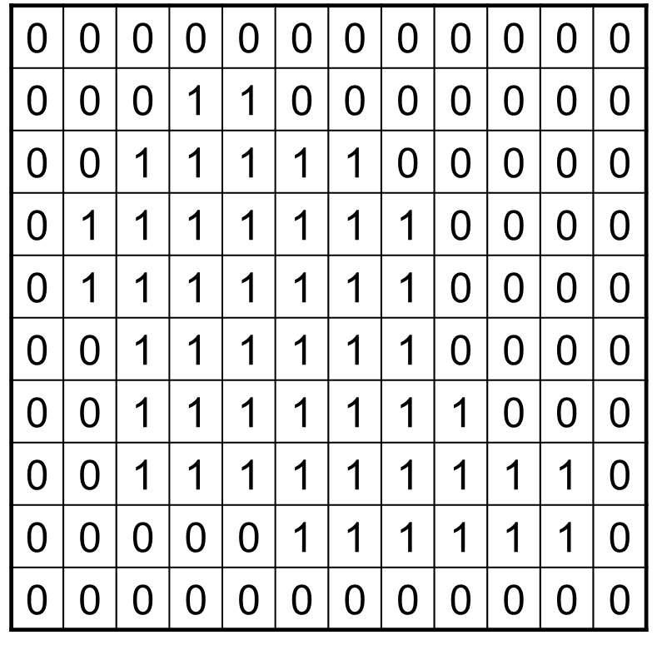
Skeletons
Assume region points have value 1 and background points have value 0.
Here we will introduce a method that consists two steps applied to the contour points of the given region.
Contour points, as define in Section 2.5.2, are any pixels with value 1, and having at least one 8-neighborhood value 0.

Slide 38
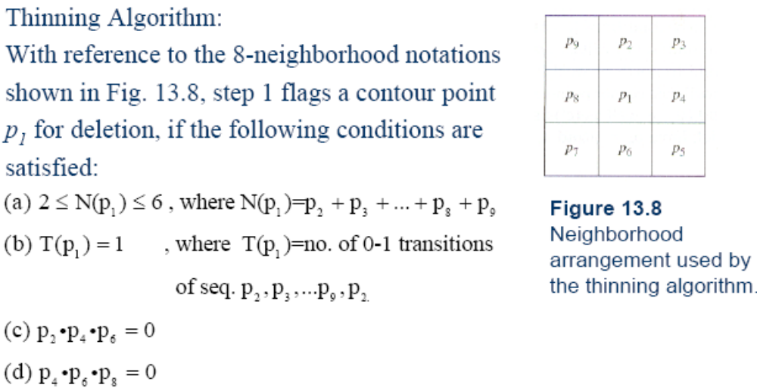
Skeletons
11.8
11.8

Slide 39
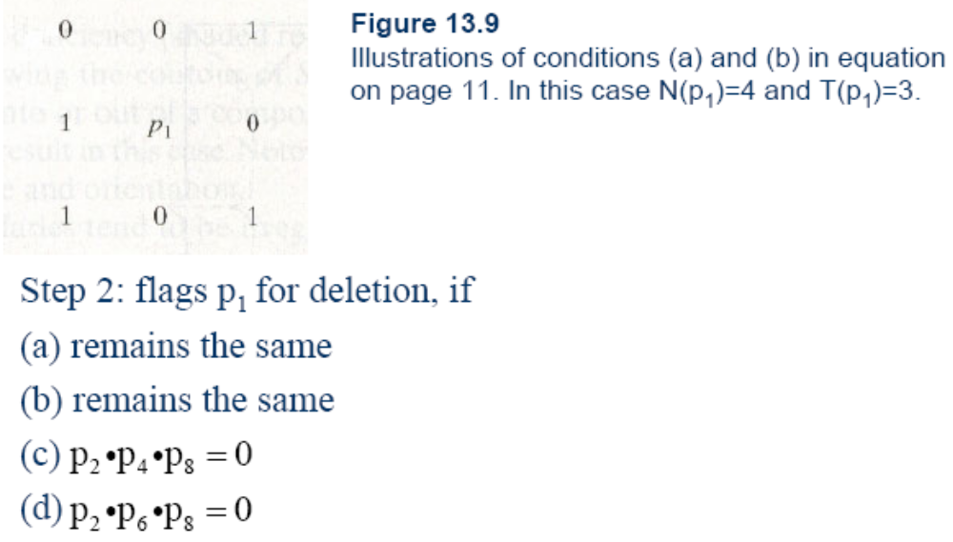
Skeletons
11.9

Slide 40
Skeletons
Step 1 applied to every border pixel in the binary region under consideration.
If one or more of conditions (a)-(d) are violated, the value of the point is not changed, if all conditions are satisfied, the point is flagged for deletion.
However, the point is not deleted until all border points have been processed.
After step 1 has been applied to all border points, those flagged points are deleted.
Then step 2 applied to the resulting data in exactly the same manner as step 1.

Slide 41
Skeletons
Thus one iteration of the thinning algorithm consists of:
Applying step 1 to flag border points for deletion;
Deleting the flagged points;
Applying step 2 to flag the remaining border points for deletion;
Deleting the flagged points;
This basic procedure is applied iteratively until no further points are deleted.

Slide 42
Skeletons
0 | 1 | 0
0 | p | 0
0 | 0 | 0
1 | 1 | 1
1 | p | 1
1 | 0 | 1
1 | 1 | 1
1 | p | 1
1 | 1 | 1
N(p₁)=1
N(p₁)=7
N(p1)=8
0 | 0 | 0
1 | p | 1
0 | 0 | 0
1 | 1 | 0
1 | p | 0
0 | 0 | 0
0 | 0 | 0
0 | p | 1
0 | 1 | 1
T(p₁)=2
p₄ or p₆=0
p₂ or p₈=0

Slide 43
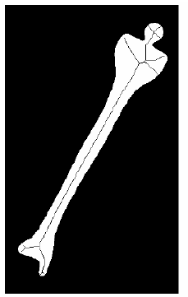
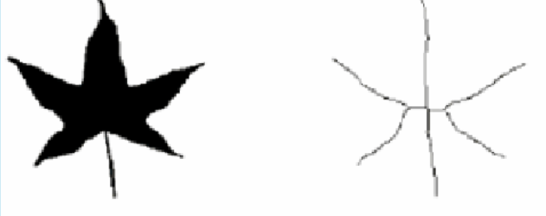
Skeletons

Slide 44
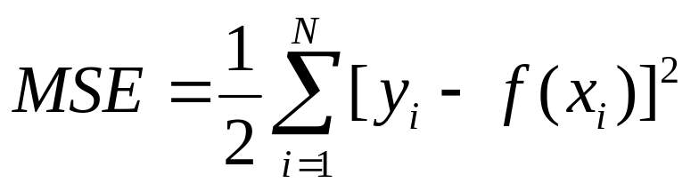
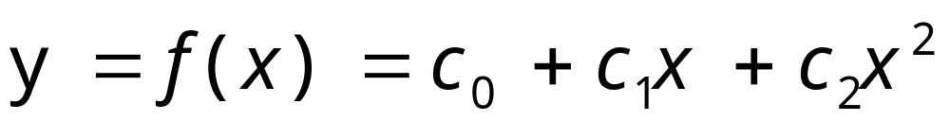
Boundary Fitting
Curve fitting: given a point set (x_{i}, y_{i})，find out a function f (x), and let the MSE (Mean square error) of below expression is the smallest:
N is the point number
If we assume f(x) is a Parabolic Curve, it expression is:

Slide 45
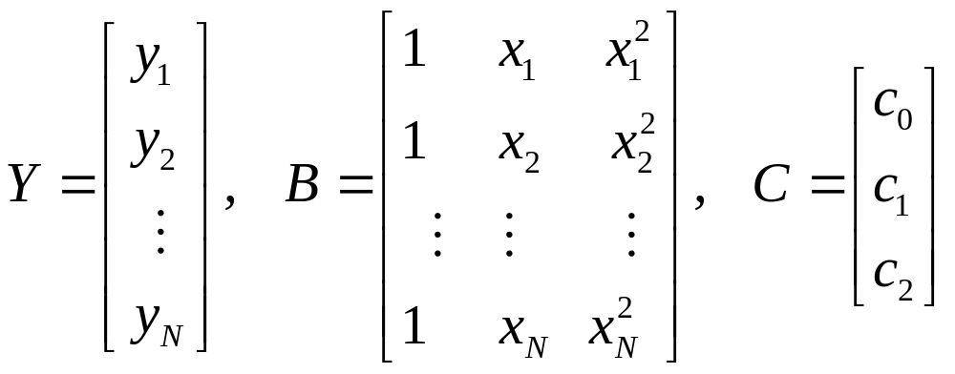
Boundary Fitting
Curve fitting is the process to ensure optimal parameter. It can be solved by classic least square method. Let:
Error vector:
E=Y－BC

Slide 46
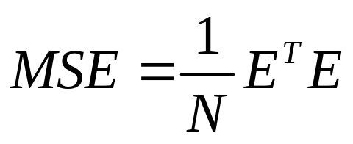
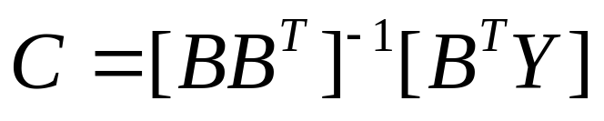
Boundary Fitting
Mean square error:
Optimal solution is:
Matrix [BB^{T}］⁻¹B^{T} is called the pseudo inverse matrix of B (伪逆矩阵).
We can easily spread it to other coefficient form, such as Circle, Ellipse, Two order quadratic equation, Three order quadratic equation, …
Matlab toolbox is very powerful to do this kind of work.

Slide 47
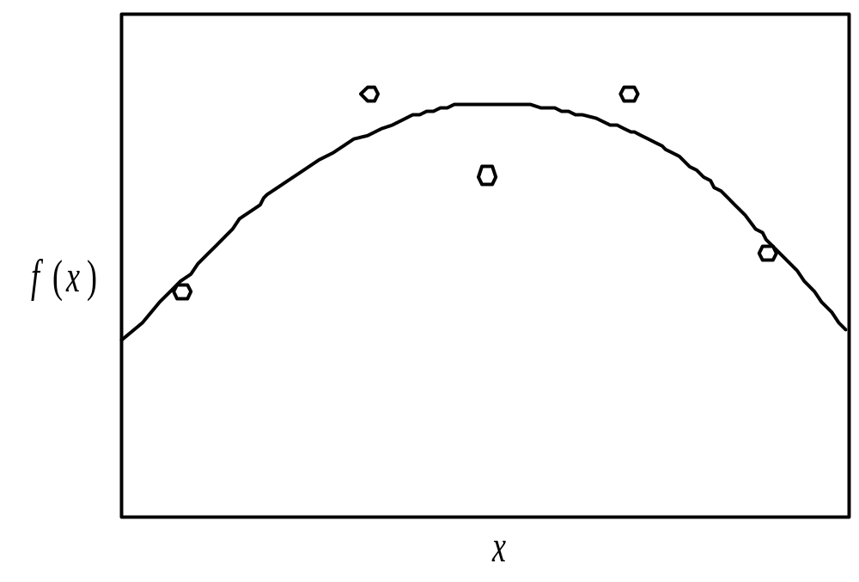
Boundary Fitting
Fitting result

Slide 48
Boundary Descriptors
Position
Direction
Major axis
Length of boundary
Enclose Are
Curvature

Slide 49
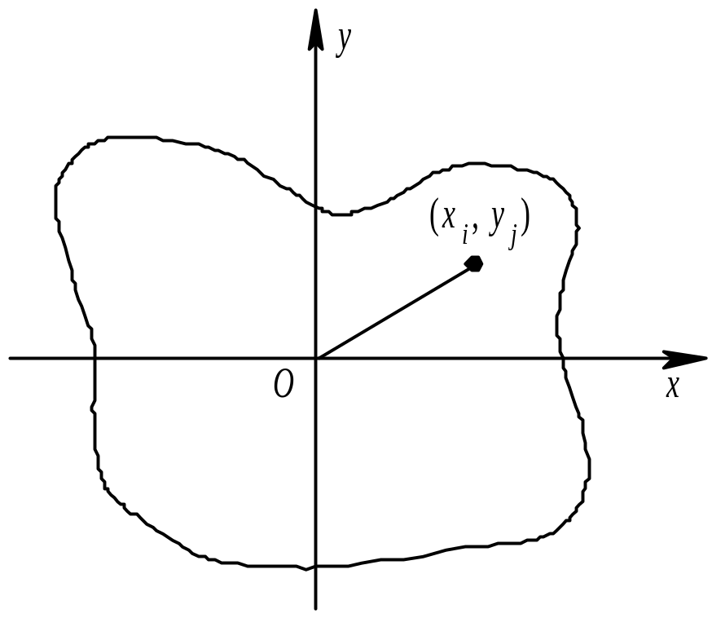
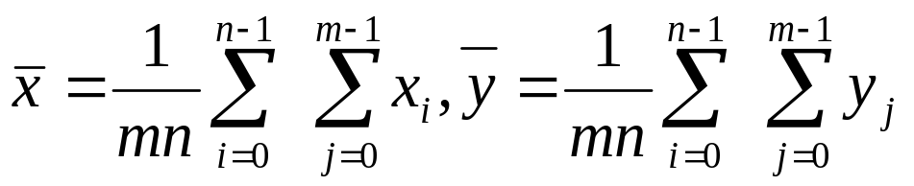
Position
Center of Mass:

Slide 50
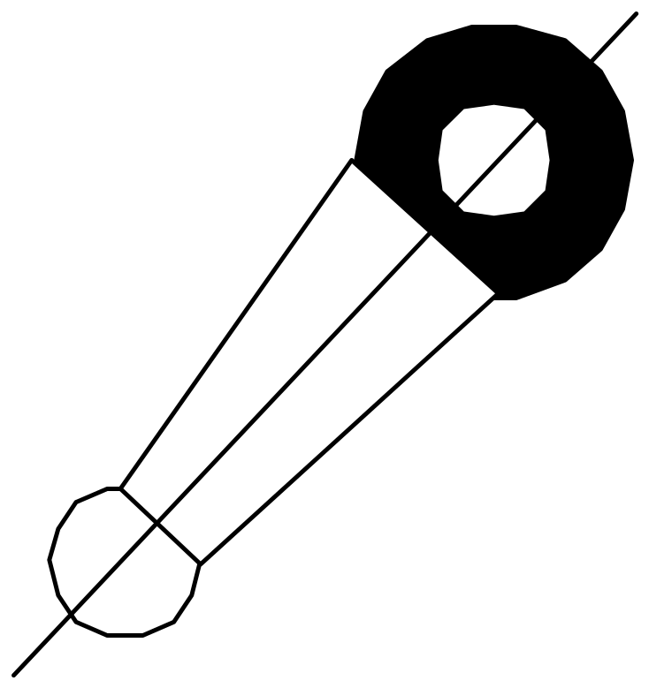
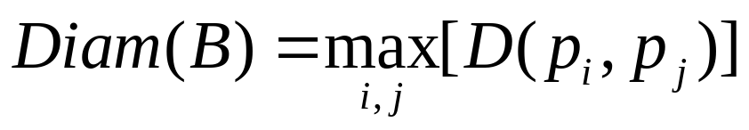
Direction
It is difficult to define the direction of the object. If the object is thin and long, then we can define the direction of long axis is the direction of the object.
D is a distance measure
p_{i} and p_{j} are points on the boundary B
Also called Major axis.

Slide 51
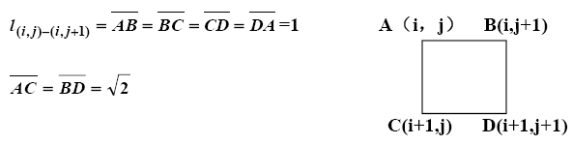
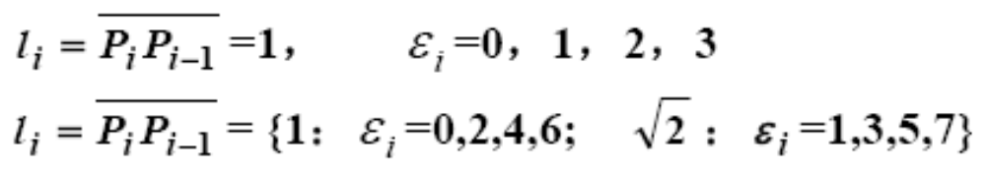


Length of a Boundary
The number of pixels along a boundary.
D(i+1,j)
C(i+1,j+1)
4 directional chain code:
8 directional chain code:
N_{e}: the number of even in the chain code.
N_{o}: the number of odd in the chain code.

Slide 52

Enclose Area
(1)Feret box (外接盒): defined direction
(2)minimum enclosing rectangle，MER (最小外接矩形): arbitratry direction
(3) Convex hull (凸包)

Slide 53
Minimum Enclosing Rectangle
y
y
Minimum Enclosing Rectangle
O
x
O
x
Rectangle
(
a
)
(
b
)

Slide 54


Minimum Enclosing Rectangle
Rectangle degree:
A_{O} is the area of the object, A_{MER} is the area of MER (最小外接矩形). The value of R is in [0, 1], When the object is a rectangle, R=1.0, for a circle, R=π/4, for a triangle R=0.5, and for thin-long object, R will be smaller.
W_{MER} and L_{MER} are the width of length of MER, we can use r to distinguish thin-long object from circle or rectangle object.

Slide 55

Curvature
The rate of change of slope
Difficult to do as digital boundaries tend to be locally “ragged”
Using the difference between the slopes of adjacent boundary segments (which represented as straight lines)
E.g.: k1, and k2 are the slopes of two neighbor lines, and then the curvature at point a is k1-k2.

Slide 56

Curvature
As the boundary if traversed in the clockwise direction, a vertex point p is said to be the part of convex if the change in slope at p is nonnegative. Otherwise, p is said to belong to a concave.
Line (if the change is less than 10 degrees) and corner (changes exceeds 90 degrees)
Curvature of P1>0: Convex
Curvature of P2<0: Concave

Slide 57
Summary
We have looked at:
  Over view
  Representation
  Boundary descriptor

