Slide 1
Image Processing
Image Enhancement:
Filtering in the Frequency Domain
Luguangm@gmail.com

Slide 2
Contents
In this lecture we will look at image enhancement in the frequency domain:
  The Fourier series & the Fourier transform
  DFT Properties
  Steps of Filtering in the Frequency Domain
  Some Basic Frequency Domain Filters
    Image smoothing
    Image sharpening

Slide 3
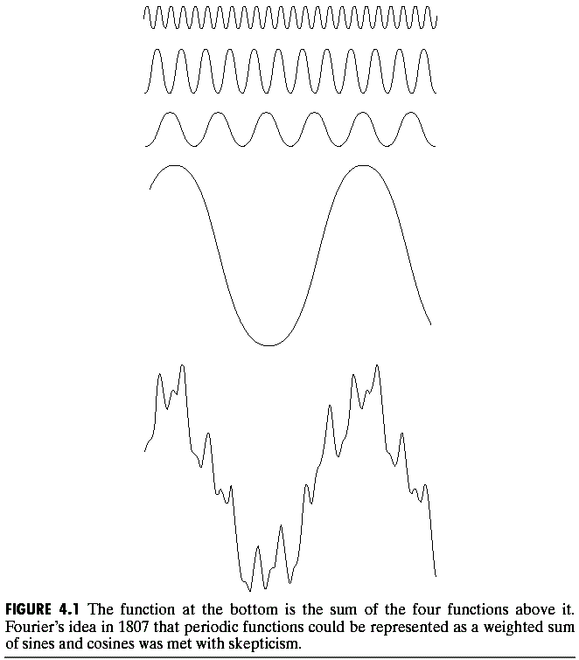
The Big Idea
=
Any function that periodically repeats itself can be expressed as a sum of sines and cosines of different frequencies each multiplied by a different coefficient – a Fourier series.
Even functions that are not periodic, can be expressed as the integral of sines and/or cosines multiplied by a weighing functions. The formulation in this case is the Fourier transform.

Slide 4
The Big Idea
The most important characteristics of Fourier Transform:
A function is transformed by Fourier transform, can be reconstructed (recovered) completely via an inverse process, with no loss of information.
It allows us to work in Fourier domain, and then return to the original domain of the function without losing any information.
During the past century, and especially in the past 60 years, entire industries and academic disciplines have flourished as a result of Fourier’s ideas.
The advent of digital computation and the discovery of a Fast Fourier Transform algorithm in the late 1950s revolutionized the field of signal processing.

Slide 5
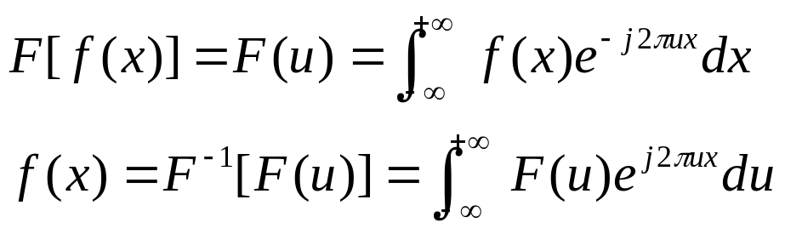
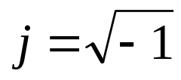
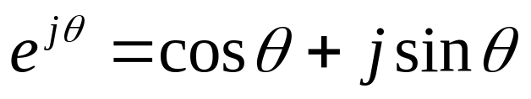
Introduction to
Fourier Transform
f(x): continuous function of a real variable x.
Fourier transform of f(x):
Where ,
We know that:
(u) is the frequency variable.
The integral of above equation shows that F(u) is composed of an infinite sum of sine and cosine terms and each value of u determines the frequency of its corresponding sine-cosine pair.

Slide 6
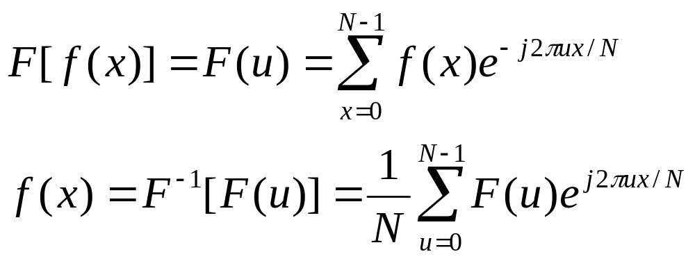

The Discrete Fourier Transform (DFT)
Where：x，u=0， 1， 2， …, N－1。
Note： the coefficient 1/N also can be put in the first equation, or in both equations, or just keep the product of the two coefficients is equal to 1/N.

Slide 7
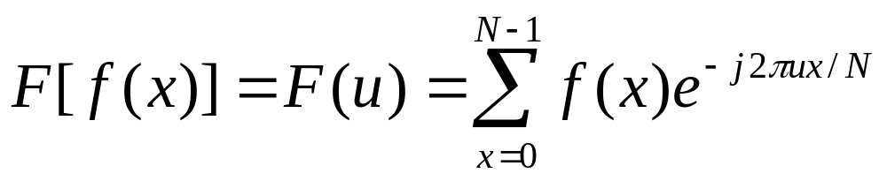
The Discrete Fourier Transform (DFT)
u=0， 1， 2， …, N－1
How to calculate the DFT:
Step1: Let u=0, summing for all value of x.
Step2: Substitute u=u+1, and repeat the summation over all value of x.
Step 3: If u=N-1, terminate, otherwise, return to step 2.
N² summations and multiplications to compute the discrete Fourier transform.

Slide 8
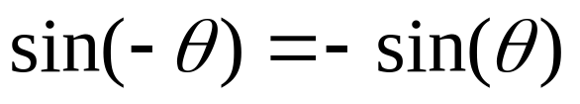
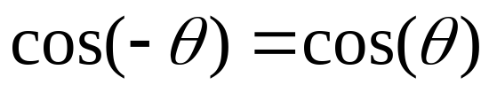
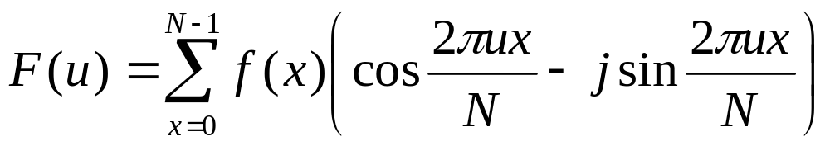
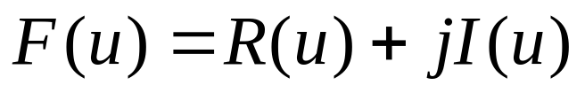
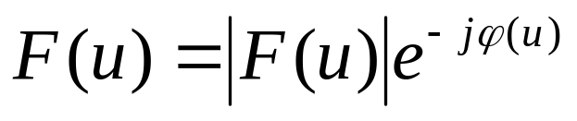
The Discrete Fourier Transform (DFT)
We know that:
And
Then

Slide 9
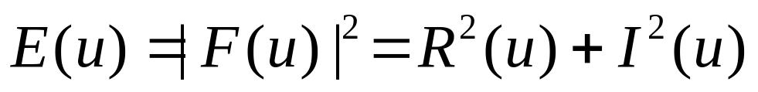
The Discrete Fourier Transform (DFT)
|
F
(
u
)
=
2
+
2
|
R
(
u
)
I
(
u
)
I
(
u
)
ϕ
(
u
)
=
arctan
R
(
u
)
We call |F(u)| is called the magnitude or spectrum of Fourier transform (幅度或频率谱), and φ(u) is called the phase angle or phase spectrum of the transform（相角或相位谱）. The square of the Fourier spectrum is called the power spectrum or spectral density （功率谱或谱密度）:

Slide 10
The Discrete Fourier Transform (DFT)
The values of F(u) for each u are composed of the sum of all values of function f(x).
The values of f(x) are multiplied by sines and cosines of various frequencies.
Similar computation procedure in the inverse Fourier transform.
The domain (values of u) over which the values of F(u) range is appropriately called the frequency domain.
Each of the N terms of F(u) is called a frequency component of the transform.

Slide 11
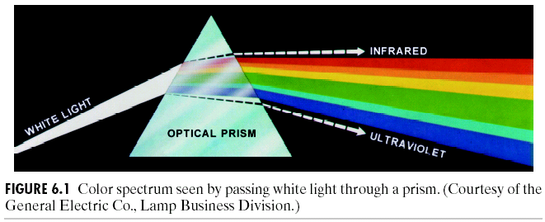
The Discrete Fourier Transform (DFT)
Glass prism
  Separates light into various color components.
  Each depending on its wavelength (or frequency) content.
Fourier transform
  Separates a function into various components.
  Each depending on its frequency content.

Slide 12
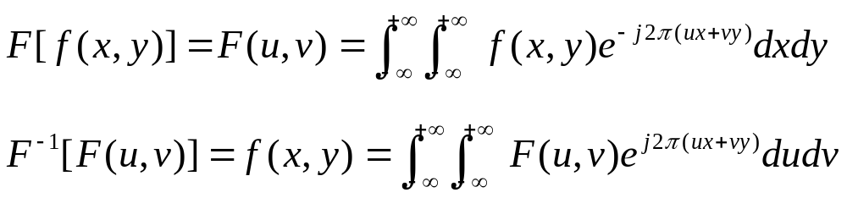
The Discrete Fourier Transform (DFT)
These equations are easily extended to two variables u and v:
The two equations comprise the fourier transform pair. They indicate the important fact: a function can be recovered from its transform.

Slide 13
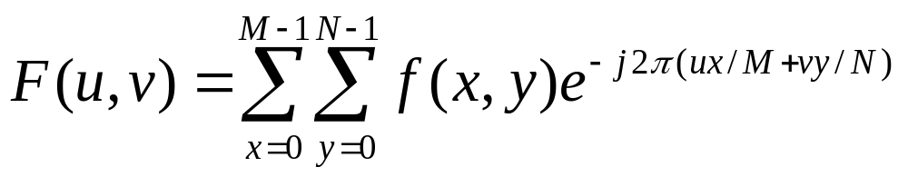
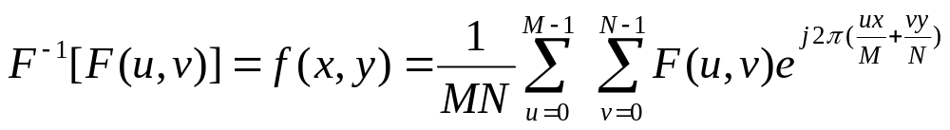
The Discrete Fourier Transform (DFT)
The Discrete Fourier Transform of f(x, y), for x = 0, 1, 2…M-1 and y = 0,1,2…N-1, denoted by F(u, v), is given by the equation:
for u = 0, 1, 2…M-1 and v = 0, 1, 2…N-1.

Slide 14
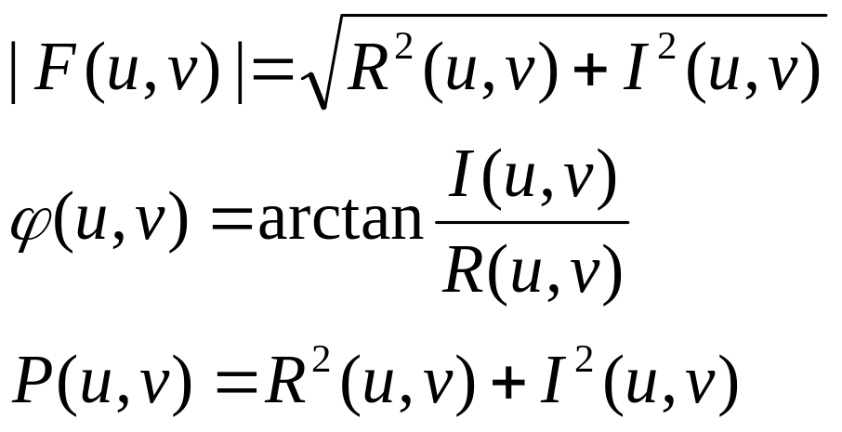
The Discrete Fourier Transform (DFT)
For two dimensional DFT, the Fourier spectrum, phase angle, and power spectrum are defined as :
频率普：
相位普：
功率普：
Where R(u, v) and I(u, v) are the real and imaginary parts of P(u, v), respectively.

Slide 15
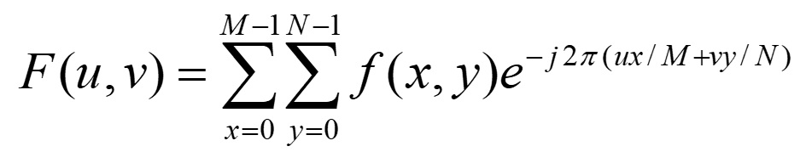
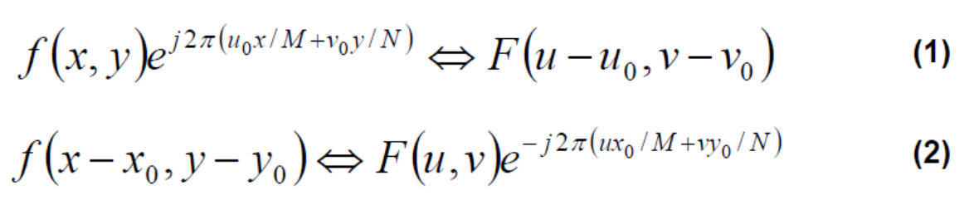
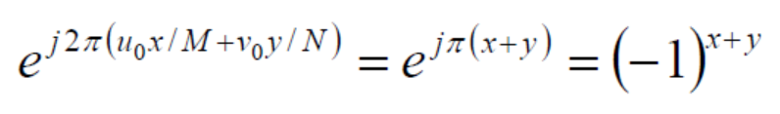
DFT Properties
Translation property:
公式（1）表明将f(x,y)与一个指数项相乘就等于把其变换后的频域中心移动到新的位置。
公式（2）表明将F(u,v)与一个指数项相乘就等于把其变换后的空域中心移动到新的位置。
When u₀=M/2, v₀=N/2

Slide 16


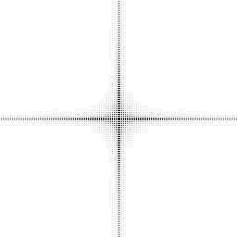
DFT Properties
Translation property:
(a)
(b)
(c)
Original image （b）Fourier spectrum （c）After shifting

Slide 17
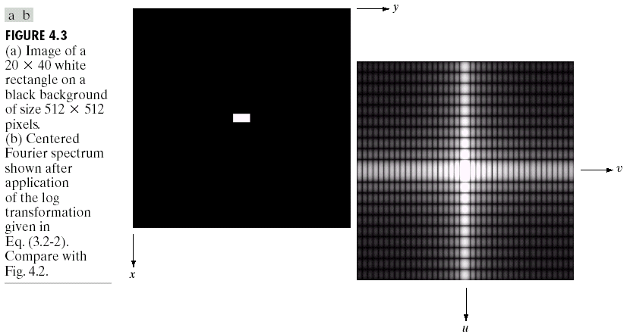
DFT Properties
The DFT of a two dimensional image can be visualised by showing the spectrum of the images component frequencies.
DFT
Exam: fft.m

Slide 18
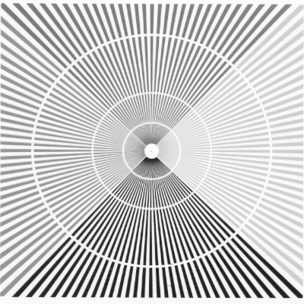
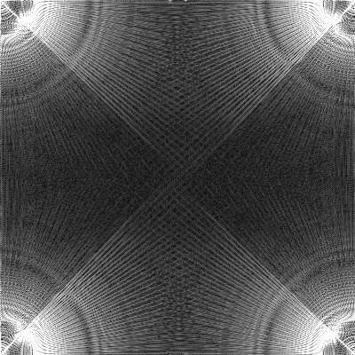
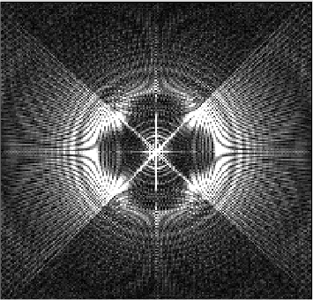
Image DFT Example
DFT Properties
Original ray image X
choice 1: Y=fft2(X)
choice 2:
Y=fftshift(fft2(X))

Slide 19
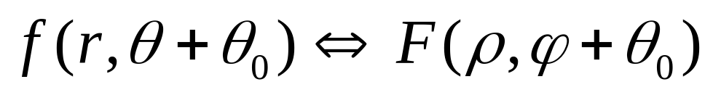

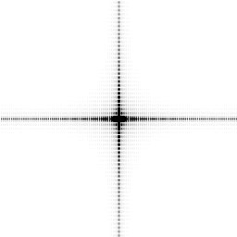
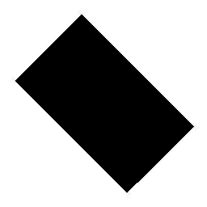
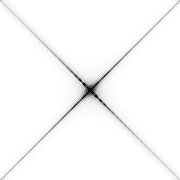
DFT Properties
Rotation property:
(a)
(b)
(c)
(d)
（a） Original image （b） Fourier spectrum of (a)； 
（c） Rotate 45°of (a)； （d） Fourier spectrum of (c)

Slide 20
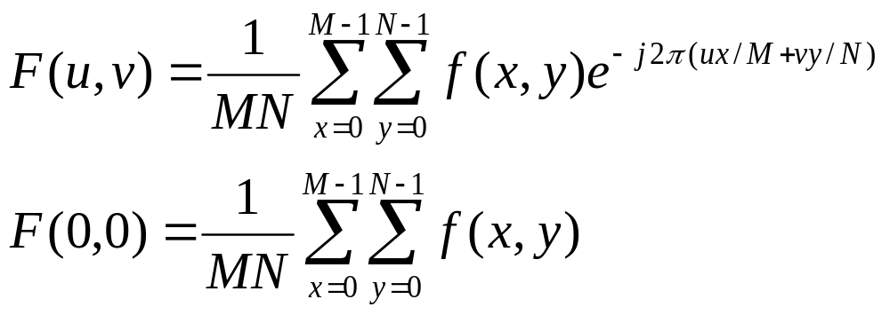
DFT Properties
Average value:
If f(x,y) is an image, the value of the Fourier transform at the origin is equal to the average gray level of the image. F(0,0) is called the DC component of the spectrum.

Slide 21
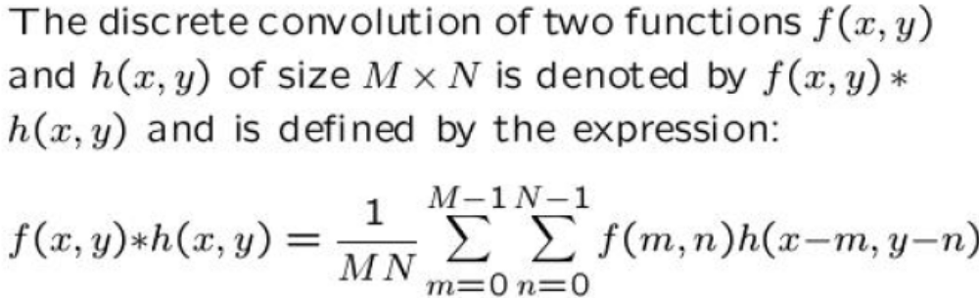
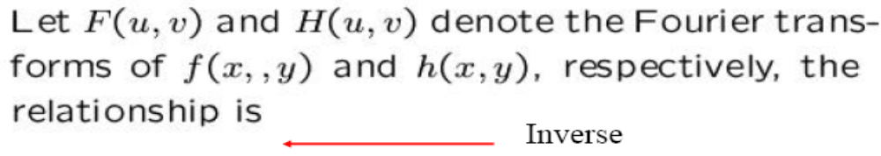
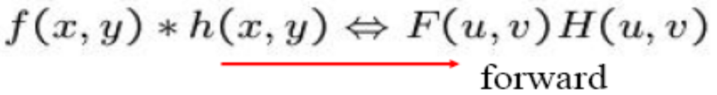
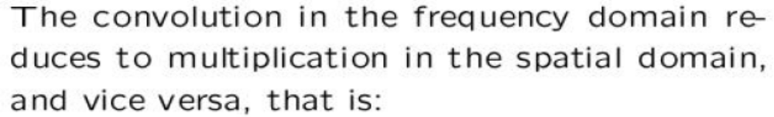

DFT Properties

Slide 22

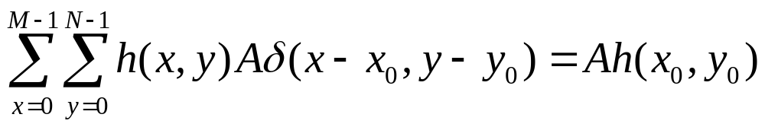

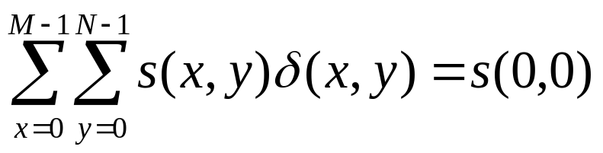
DFT Properties
An impulse function of strength A, located at (x₀,y₀) is denoted by:
It is called the sifting property of the impulse function.
For ,
can be regarded as an image with size M*N, which only has value at the (0,0).

Slide 23
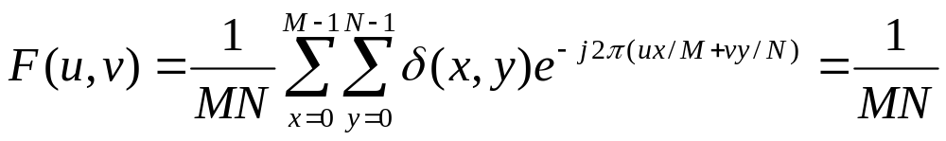
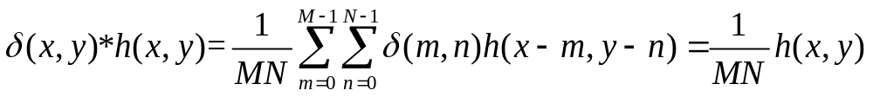
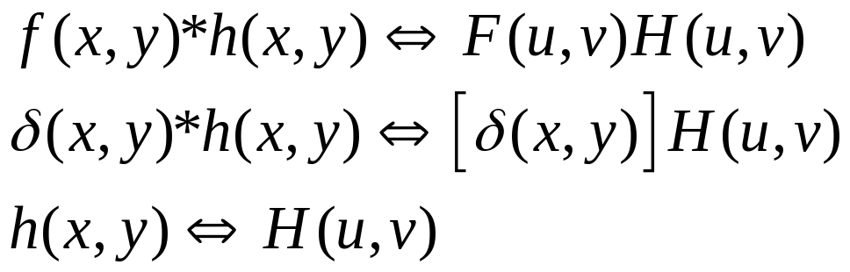
DFT Properties
The Fourier transform of a unit impulse at the origin:
For an image ,
Notes:
根据冲激函数和卷积定理的性质，确定了空间域和频率域中的滤波器组成了傅里叶变换对。因此，给出频率域滤波器，可以通过逆变换得到其空间域相对应的滤波器，反之亦然。

Slide 24
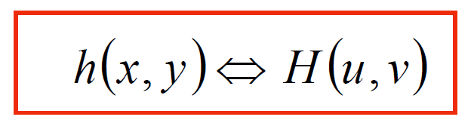
DFT Properties
Note:
Using only the properties of the impulse function and the convolution theorem:
Given a filter in the frequency domain, we can obtain the corresponding filter in the spatial domain by taking the inverse Fourier transform to the former.
The reverse also is true.
Spatial filtering: better for small filter mask.
Frequency filtering: more intuitive.
Notes:
滤波在频率域中最直观，但在空间域使用更小的滤波器更明智。

Slide 25
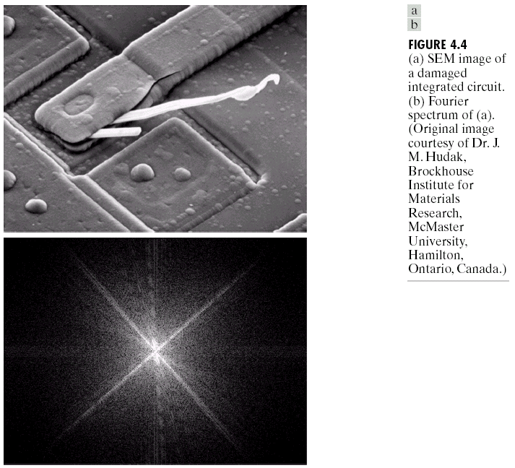
DFT Properties
DFT
Scanning electron microscope image of an integrated circuit magnified ~2500 times
Fourier spectrum of the image

Slide 26
DFT Properties
Features from an image can even sometimes be seen in the Fourier spectrum of the image.
The frequency component (u=v=0) corresponds to the average gray level of an image.
The low frequency correspond to the slowly varying components of an image.
  An image of one room: smooth gray-level variations on the walls and floor.
The higher frequencies begin to correspond to faster and faster gray level changes in the image.
  Edges, noise.

Slide 27
Steps of Filtering in the Frequency Domain
Steps:
  Multiply the input image by (-1)^{x+y} to center the transform.
  Compute F(u,v) the DFT of the image in (1).
  Multiply F(u,v) by a filter function H(u,v).
  Compute the inverse DFT of the result.
  Obtain the real part of the result in (4).
  Multiply the result in (5) with (-1)^{x+y} .

Slide 28
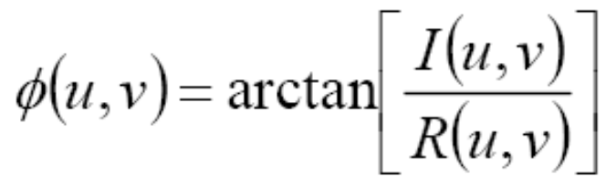
Steps of Filtering in the Frequency Domain
Filter H (u, v)
  Suppresses certain frequencies
  Leaving others unchanged
  G (u, v)=H( u, v) F (u, v)
  The first element of H multiplies the first element of F,…
Zero-phase-shift filter
  The value of H are always real
  Each component of H multiplies both the real and the imaginary parts of F
  Do not change the phase of the transform

Slide 29
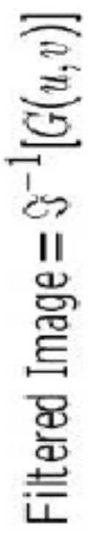
Steps of Filtering in the Frequency Domain
The filtered image is obtained simply by taking the inverse Fourier transform of G(u,v):
The final image is obtained by:
1.Taking the real part of this result.
2.Multiplying by (-1)^{x+y} to cancel the multiplication of the input image by this quantity.
Note: When the input image and the filter function are real, the imaginary components of the inverse transform should all be zero. In practice, the inverse DFT generally has parasitic imaginary components due to computational round-off errors. There component can be ignored.

Slide 30
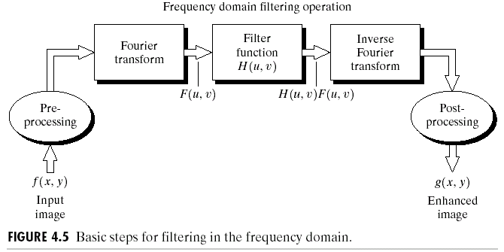
Steps of Filtering in the Frequency Domain
Other steps include:
  Cropping of the input image to its closest even dimensions.
  Gray level scaling.
  Conversion to floating point on input.
  Conversion to an 8 bit integer format on the output.
  Multiple filtering stages and other pre- and post-processing functions are possible.
  There are numerous variations of above basic theme.

Slide 31
Some Basic Frequency Domain Filters
In Fourier transform, low frequencies are responsible for the general gray level appearance of an image over smooth areas.
High frequencies are responsible for detail, such as edges and noises.
Three types of frequency domain filters:
Lowpass filter: smoothing filters
Highpass filter: sharpening filters

Slide 32
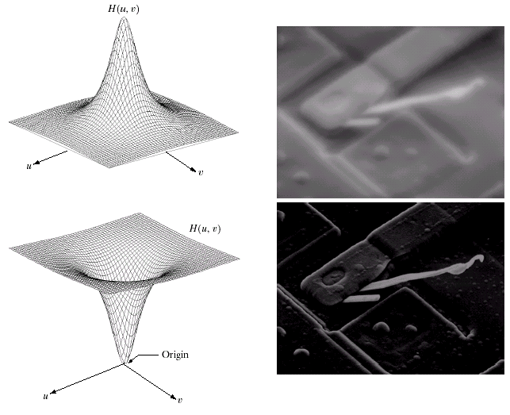
Some Basic Frequency Domain Filters
Low Pass Filter
High Pass Filter

Slide 33
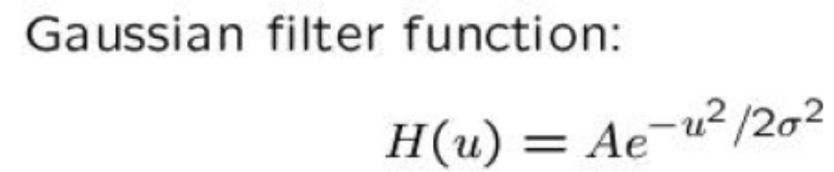
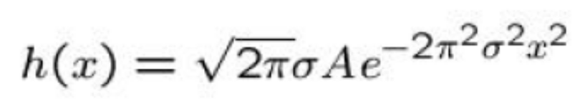
Filters Based on Gaussian Functions
Shapes are easily specified.
Forward and inverse Fourier transforms of a Gaussian function are real Gaussian functions.
The lowpass Gaussian filter function:
The corresponding filter in the spatial domain:

Slide 34
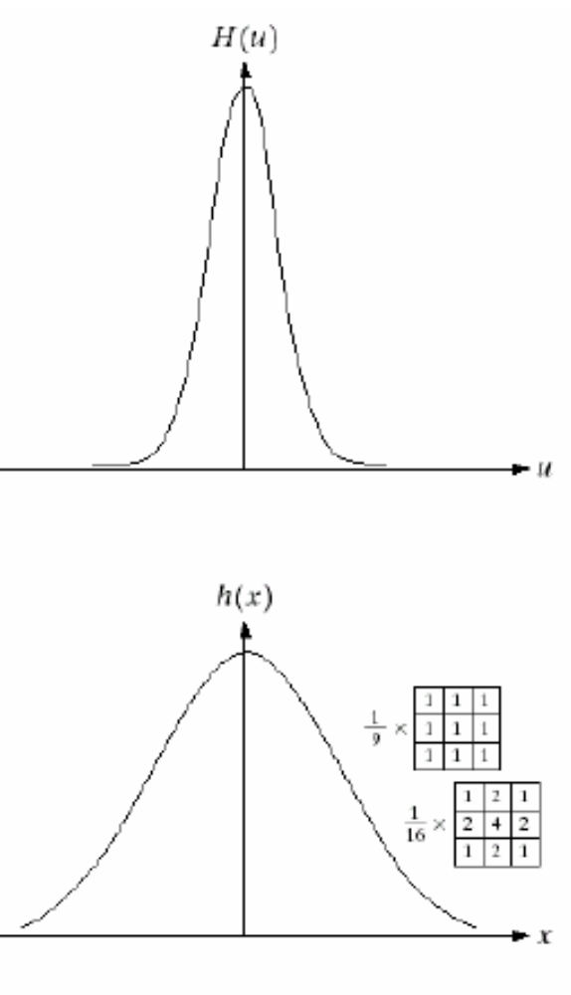
Filters Based on Gaussian Functions
Fourier transform pair
  Both components of which are Gaussian and real.
  The narrower the frequency domain filter:
    The more it will attenuate the low frequencies
    Resulting in increased blurring
  In the spatial domain:
    Implies a larger mask

Slide 35
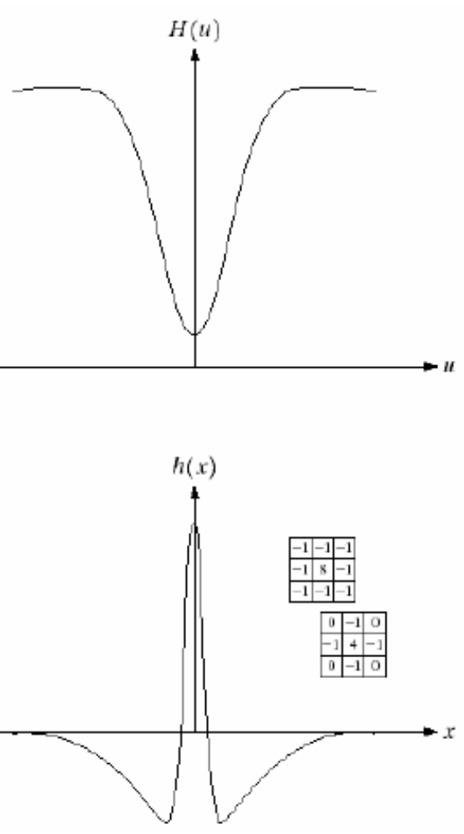

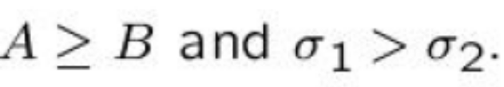
Filters Based on Gaussian Functions
The highpass Gaussian filter function:
The corresponding filter in the spatial domain:

Slide 36
Smoothing Frequency Domain Filters
Smoothing is achieved in the frequency domain by dropping out the high frequency components.
The basic model for filtering is:
G(u,v) = H(u,v)F(u,v)
where F(u,v) is the Fourier transform of the image being filtered and H(u,v) is the filter transform function.
Low pass filters – only pass the low frequencies, drop the high ones.

Slide 37
Smoothing Frequency Domain Filters
Three main smoothing frequency domain filters:
Ideal lowpass filter
Butterworth filter
Gaussian filter
These three filters cover the range from very sharp (ideal) to very smooth (Gaussian) filter functions.

Slide 38

Ideal Low Pass Filter
Simply cut off all high frequency components that are a specified distance D₀ from the origin of the transform.
Changing the distance changes the behaviour of the filter. D₀ is also called cutoff frequency.

Slide 39

Ideal Low Pass Filter (cont…)
The transfer function for the ideal low pass filter can be given as:
It is called 2D ideal low pass filter (ILPF)
where D(u,v) is given as:

Slide 40


Ideal Low Pass Filter (cont…)
One way to establish a set of standard cutoff frequency location is to compute circles that enclose specified amount of total image power P_{T}:
A circle of r with origin at the center of the frequency rectangle encloses a percent of the power:
Notes:
功率谱

Slide 41

Ideal Low Pass Filter (cont…)
Above we show an image, it’s Fourier spectrum and a series of ideal low pass filters of radius 5, 15, 30, 80 and 230 superimposed on top of it.
These circles enclose a percent of the image power, for a=92.0, 94.6, 96.4, 98, and 99.5%, respectively.

Slide 42

Ideal Low Pass Filter (cont…)
Exam:ilpf.m
Result of filtering with ideal low pass filter of radius 5
92%
Original
image
Result of filtering with ideal low pass filter of radius 15
94.6%
Result of filtering with ideal low pass filter of radius 30
96.4%
Ringing property
Result of filtering with ideal low pass filter of radius 80
98%
Result of filtering with ideal low pass filter of radius 230
99.5%

Slide 43
Ideal Low Pass Filter (cont…)
I=imread('aaa.tif');%将要滤波的图像读到I中
figure,imshow(I);
f=double(I);
g=fft2(f);
g=fftshift(g);
[N1,N2]=size(g);
n=2;
d0=15; %此处d0为截止频率，你可以依次换成60、70、80进行滤波比较
n1=fix(N1/2);
n2=fix(N2/2);
for i=1:N1
for j=1:N2
d=sqrt((i-n1)^2+(j-n2)^2);
if d<=d0
result(i,j)=g(i,j);
else
result(i,j)=0;
end
end
end
result=ifftshift(result);
X2=ifft2(result);
J=uint8(real(X2));
figure,imshow(J,[]);

Slide 44

Ideal Low Pass Filter (cont…)
Ringing and Blurring:
A dominant component at the origin is responsible for blurring.
And concentric, circle components abut the center are responsible for ringing.
The narrower the filter in the frequency domain, the more severe the blurring and ringing.
It is possible to achieve blurring with little or no ringing.

Slide 45


Butterworth Lowpass Filters
The transfer function of a Butterworth lowpass filter of order n with cutoff frequency at distance D₀ from the origin is defined as:

Slide 46

Butterworth Lowpass Filter (cont…)
Exam:blpf.m
Result of filtering with Butterworth filter of order 2 and cutoff radius 5
Original
image
Result of filtering with Butterworth filter of order 2 and cutoff radius 15
Result of filtering with Butterworth filter of order 2 and cutoff radius 30
Result of filtering with Butterworth filter of order 2 and cutoff radius 80
Result of filtering with Butterworth filter of order 2 and cutoff radius 230

Slide 47
Butterworth Lowpass Filter (cont…)
I=imread('aaa.tif');%将要滤波的图像读到I中
figure,imshow(I);
f=double(I);
g=fft2(f);
g=fftshift(g);
[N1,N2]=size(g);
n=2;
d0=15; %此处d0为截止频率，你可以依次换成60、70、80进行滤波比较
n1=fix(N1/2);
n2=fix(N2/2);
for i=1:N1
for j=1:N2
d=sqrt((i-n1)^2+(j-n2)^2);
h=1/(1+(d/d0)^(2*n));
result(i,j)=h*g(i,j);
end
end
result=ifftshift(result);
X2=ifft2(result);
J=uint8(real(X2));
figure,imshow(J);

Slide 48

Butterworth Lowpass Filter (cont…)

Slide 49
Butterworth Lowpass Filter (cont…)
n=1 n=2 n=5 n=20
Order 1 has no ringing.
Ringing is a little in filters of order 2, but can become a significant factor in filters of higher order.
A butterworth filter of order 20 already exhibits the characteristics of the ILPF.
Compromise between effective lowpass filtering and acceptable ringing characteristics.

Slide 50


Gaussian Lowpass Filters
The transfer function of a Gaussian lowpass filter is defined as:
The inverse Fourier transform of the Gaussian lowpass filter also is Gaussian. It will have no ringing.

Slide 51

Gaussian Lowpass Filters (cont…)
Result of filtering with Gaussian filter with cutoff radius 5
Original
image
Result of filtering with Gaussian filter with cutoff radius 15
Result of filtering with Gaussian filter with cutoff radius 30
Result of filtering with Gaussian filter with cutoff radius 80
Result of filtering with Gaussian filter with cutoff radius 230

Slide 52
Lowpass Filters Compared
Result of filtering with ideal low pass filter of radius 15
Result of filtering with Butterworth filter of order 2 and cutoff radius 15
Result of filtering with Gaussian filter with cutoff radius 15

Slide 53

Lowpass Filtering Examples
A low pass Gaussian filter is used to connect broken text: D₀=80.

Slide 54

Lowpass Filtering Examples (cont…)
Different lowpass Gaussian filters used to remove blemishes in a photograph.
D₀=100
D₀=80

Slide 55
Sharpening in the Frequency Domain
Edges and fine detail in images are associated with high frequency components.
High pass filters – only pass the high frequencies, drop the low ones.
High pass frequencies are precisely the reverse of low pass filters, so:
H_{hp}(u, v) = 1 – H_{lp}(u, v)

Slide 56

Sharpening in the Frequency Domain

Slide 57

Sharpening in the Frequency Domain

Slide 58


Ideal High Pass Filters
The ideal high pass filter is given as:
where D₀ is the cut off distance as before.

Slide 59

Ideal High Pass Filters (cont…)
Results of ideal high pass filtering with D₀ = 15
Results of ideal high pass filtering with D₀ = 30
Results of ideal high pass filtering with D₀ = 80

Slide 60


Butterworth High Pass Filters
The Butterworth high pass filter is given as:
where n is the order and D₀ is the cut off distance as before.

Slide 61
Butterworth High Pass Filters

Slide 62

Butterworth High Pass Filters (cont…)
Results of Butterworth high pass filtering of order 2 with D₀ = 15
Results of Butterworth high pass filtering of order 2 with D₀ = 80
Results of Butterworth high pass filtering of order 2 with D₀ = 30

Slide 63

Gaussian High Pass Filters
The Gaussian high pass filter is given as:
where D₀ is the cut off distance as before.

Slide 64

Gaussian High Pass Filters (cont…)
Results of Gaussian high pass filtering with D₀ = 15
Results of Gaussian high pass filtering with D₀ = 80
Results of Gaussian high pass filtering with D₀ = 30

Slide 65
High Pass Filter Comparison
Results of ideal high pass filtering with D₀ = 15
Results of Butterworth high pass filtering of order 2 with D₀ = 15
Results of Gaussian high pass filtering with D₀ = 15

Slide 66
Summary
In this lecture we looked at image enhancement in the frequency domain
  The Fourier series & the Fourier transform
  DFT Properties
  Steps of Filtering in the Frequency Domain
  Some Basic Frequency Domain Filters
    Image smoothing
    Image sharpening

