Slide 1
Image Processing
Image Compression

Slide 2
Contents
Image Compression:
  Lossless Image Compression
    Variable length coding(Eliminate coding redundancies)
      Huffman coding
      Arithmetic coding
    LZW coding (Reduce interpixel redundancies)
    Hybrid Coding
  Lossy Image Compression

Slide 3
Arithmetic coding
Elias (1963) thought that: a one-to-one correspondence between source symbols and code words does not exist.
An entire sequence of source symbols is assigned a single arithmetic code word.
The code word defines an interval of real numbers between 0 and 1.
As the number of symbols in the message increases, the interval used to represent it becomes smaller.
And the number of information units (bits) required to represent the interval becomes larger.

Slide 4
Arithmetic coding
Now we explain arithmetic coding algorithm by an example:
For an information source for encoding is “dacab”，and the probabilities of each source symbols are: P(a)=0.4，P(b)=0.2，P(c)=0.2， P(d)=0.2
At the starting of the coding process, the information source is assumed to occupy the entire half open interval [0, 1), and the initial interval of each symbols is initially subdivided into four regions based on the probabilities: a=［0, 0.4), b=［0.4, 0.6), c=［0.6, 0.8), d=［0.8, 1.0)

Slide 5
Arithmetic coding
For the first encoded symbol of “d”，its initial interval is [0.8, 1.0)；
For the second symbol “a”, because the prior symbol “d” is constrained in [0.8, 1.0)，the value of “a” should be in the [0, 0.4) subinterval of [0.8, 1.0), then
Start_{N}=0.8+0×(1.0-0.8)=0.8
End_{N}=0.8+0.4×(1.0-0.8)=0.88
That is the coding interval of symbol “da” lying in [0.8, 0.88).
a=［0, 0.4), b=［0.4, 0.6), c=［0.6, 0.8), d=［0.8, 1.0)

Slide 6
Arithmetic coding
We define an equation:
Where Start_{N} and End_{N} denote the start and end position of a new intervals, Start_{B} presents the start position of the prior interval, and L_{B} is its length. Left_{C} and Right_{C} are the current code interval’s left and right border.
Start_{N}=Start_{B}+Left_{C}×L_{B}
End_{N}=Start_{B}+Right_{C}×L_{B}

Slide 7
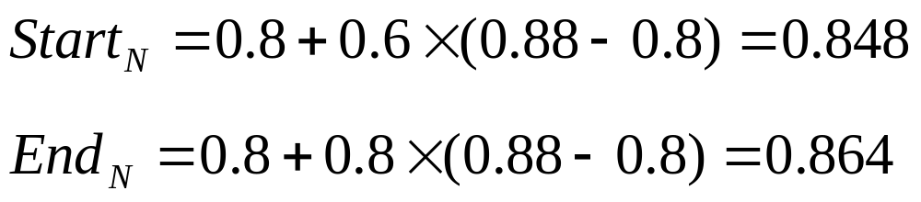
Arithmetic coding
For the third symbol “c”, It should be in the subinterval [0.6, 0.8) of [0.8, 0.88), then:
For the fourth symbol “a”:
Start_{N}=0.848+0×(0.864-0.848)=0.848
End_{N}=0.848+0.4×(0.864-0.848)=0.8544
a=［0, 0.4), b=［0.4, 0.6), c=［0.6, 0.8), d=［0.8, 1.0)

Slide 8
Arithmetic coding
For the fifth symbol “b”:
Start_{N}=0.848+0.4×(0.8544-0.848)=0.85056
End_{N}=0.848+0.6×(0.8544-0.848)=0.85144
Now, the source information “dacab” has been described as a real number interval [0.85056, 0.85144), or we can say that arbitrary real number in this interval can be used to represent the source information.
We can express the interval [0.85056, 0.85144) into binary form [0.110110011011, 0.110110011110).
a=［0, 0.4), b=［0.4, 0.6), c=［0.6, 0.8), d=［0.8, 1.0)

Slide 9
Arithmetic coding
[0.110110011011, 0.110110011110)
We find that 0.1101100111 lies in this interval, and has the shortest length. Then we can take it as the output of the input series symbols “dacab”.
Since all the encoded results includes “0.”, then we can delete it, and take 1101100111 as the arithmetic coding results in this example.
C_{R} =40/10=4

Slide 10
Arithmetic coding
Decimal fraction to binary fraction:
0. 85056:
0.85056*2=1.70112
0.70112*2=1.40224
0.40224*2=0.80448
0.80448*2=1.60896
0.60896*2=1.21972
0.21972*2=0.43584
0.43584*2=0.87168
0.87168*2=1.74336
0.74336*2=1.48672
0.48672*2=0.97344
0.97344*2=1.94688
0.94688*2=1.89376
0.110110011011
Decimal fraction to binary fraction:
0. 85144 :
0.85144*2=1.70288
0.70228*2=1.40456
0.40456*2=0.80912
0.80912*2=1.61824
0. 61824*2=1.23648
0. 23648*2=0.47296
0. 47296*2=0.94592
0. 94592*2=1.89184
0. 89184*2=1.78368
0.78368*2=1.56736
0. 56736*2=1.13472
0. 13472*2=0.26944
0.110110011110

Slide 11
Arithmetic coding
Binary fraction to Decimal fraction : 0.1101100111
0.1->0.5
0.01->0.25
0.0001->0.0625
0.00001->0.03125
0.00000001->0.00390625
0.000000001->0.001953125
0.0000000001->0.0009765625
=0.5+0.25+0.0625+0.03125+0.00390625+0.001953125+0.0009765625
=0.8505859375
[0.85056, 0.85144)

Slide 12
Arithmetic coding
Source: dacab
Decoding: 0.8505859375
a=［0, 0.4), b=［0.4, 0.6), c=［0.6, 0.8), d=［0.8, 1.0)
0.8505859375 ∈ [0.8, 1.0) -> d
Segmentation [0.8, 1.0) into 4 regions: a=［0.8, 0.88), b=［0.88, 0.92), c=［0.92, 0.96), d=［0.96, 1.0) ; 0.8505859375 ∈ [0.8, 0.88) -> a
Segmentation [0.8, 0.88) into 4 regions: a=［0.8, 0.832), b=［0.832, 0.848), c=［0.848, 0.864), d=［0.864, 0.88) ; 0.8505859375 ∈ [0.848, 0.0.864) -> c
…
a=［0, 0.4), b=［0.4, 0.6), c=［0.6, 0.8), d=［0.8, 1.0)

Slide 13
LZW Coding
Invented by Lempel and Ziv in 1977, and improved by Welch in 1984 (interpixel redundancies).
Numerous variations and improvements since then.
United States Patent No. 4,558,302, LZW compression has been integrated into a variety of mainstream imaging files formats:
  Including the graphic interchange format (GIF)
  Tagged image file format (TIFF)
  And the portable document format (PDF)

Slide 14
LZW Coding
Lempel-Ziv-Welch (LZW) coding
  Assigns fixed-length code words to variable length sequences of source symbols.
  Requires no priori knowledge of the probability of occurrence of the symbols to be encoded.
LZW coding is conceptually very simple.
At the onset of the coding process, a codebook or ’dictionary’ containing the source symbols to be coded is constructed.

Slide 15
LZW Coding
Example:8-bit monochrome images
The first 256 words of the dictionary are assigned to the gray values 0, 1, 2, · · · , 255.
As the encoder sequentially examines the image’s pixels, gray-level sequences that are not in the dictionary are placed in algorithmically determined locations.
If the first two pixels of image are white, for instance, sequence 255-255 might be assigned to location 256, the address following the locations reserved for gray levels 0~255.
The next time, when 255-255 is encountered, code word 256, the address of the location containing this sequence, is used to represent them.

Slide 16
LZW Coding
If a 9-bits, 512 word dictionary is employed in the coding process, the original (8+8) bits that were used to represent the two pixels are replaced by a single 9-bit code word.
The size of the dictionary is an important system parameter.
  If it is too small, the detection of matching gray-level sequences will be impossible.
  If it is too large, the size of the code words will adversely affect compression performance.

Slide 17
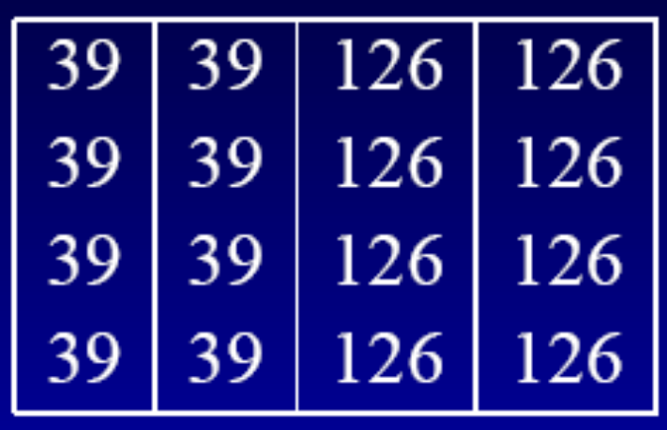
LZW Example
Example: Consider the following 4 × 4, 8-bit image of a vertical edge:
Initialization: 9 bits dictionary
Dictionary | Entry
0 | 0
1 | 1
… | …
255 | 255
256 | -
… | …
511 | -

Slide 18
LZW Example
Encoding
Define two variables:
  S1: S1 is a temporary variable
  S2: S2 to store the input data pixel by pixel
They are initialized to empty at the beginning.
The image is encoded by processing its pixels in a left-to-right, top-to-bottom manner.
Each pixel is read into S2 one by one:
  If stream S1+S2 lies in the entry, then output nothing, and S1=S1+S2.
  Otherwise, output the entry index of S1, and add the new sequence S1+S2 to the dictionary entry, S1=S2.
  When all pixel are read, output the entry index of S1.

Slide 19
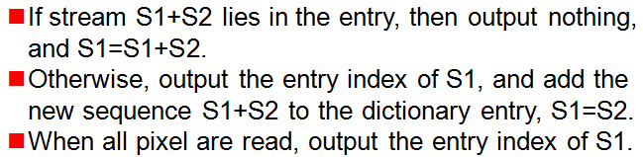
LZW Example
Input data S2 | S1+S2 | Output data | S1 | New dictionary entry
39 | 39 |  | 39
39 | 39-39 | 39 | 39 | 256: 39-39
126 | 39-126 | 39 | 126 | 257: 39-126
126 | 126-126 | 126 | 126 | 258: 126-126
39 | 126-39 | 126 | 39 | 259: 126-39
39 | 39-39 |  | 39-39
126 | 39-39-126 | 256 | 126 | 260: 39-39-126
126 | 126-126 |  | 126-126
39 | 126-126-39 | 258 | 39 | 261: 126-126-39
39 | 39-39 |  | 39-39
126 | 39-39-126 |  | 39-39-126
126 | 39-39-126-126 | 260 | 126 | 262: 39-39-126-126
39 | 126-39 |  | 126-39
39 | 126-39-39 | 259 | 39 | 263: 39-126-39
126 | 39-126 |  | 39-126
126 | 39-126-126 | 257 | 126 | 264: 39-126-126
 |  | 126

Slide 20
LZW Example
Then the image is encoded as: 39-39-126-126-256-258-260-259-257-126
LZW algorithm reduce the original 16*8=128-bit image to 9*10=90 bits (ten 9-bits codes).
The resulting compression ratio is 128/90=1.42

Slide 21
LZW Example
Decoding
Define two variables:
  S1: to store the input data (encoded data) one by one.
  S2: a temporary variable.
  They are initialized to empty.
Dictionary | Entry
0 | 0
1 | 1
… | …
255 | 255
256 | -
… | …
Each pixel is read into S1 one by one:
  If S1 lies in the index, then output the corresponding value, otherwise, output str(S2)+firstcode(S1).
  Add str(S2)+firstcode(S1) to the dictionary entry, S2=S1.

Slide 22
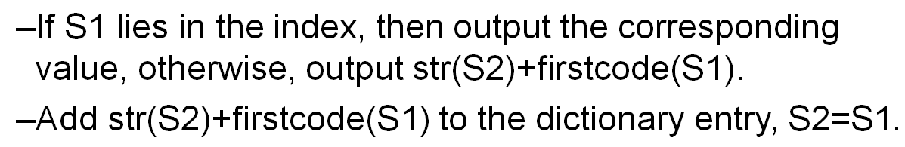
LZW Example
Decoding procedure: 39-39-126-126-256-258-260-259-257-126
Input data (S1) | New string | Output data | S2 | New dictionary entry
39 |  | 39 | 39
39 | str(S2)+firstcode (S1)=39-39 | 39 | 39 | 256: 39-39
126 | str(S2)+firstcode (S1) =39-126 | 126 | 126 | 257: 39-126
126 | str(S2)+firstcode (S1)=126-126 | 126 | 126 | 258: 126-126
256 | str(S2)+firstcode (S1) =126-39 | 39-39 | 256 | 259: 126-39
258 | str(S2)+firstcode (S1)=39-39-126 | 126-126 | 258 | 260: 39-39-126
260 | str(S2)+firstcode (S1)=126-126-39 | 39-39-126 | 260 | 261: 126-126-39
259 | str(S2)+firstcode (S1)=39-39-126-126 | 126-39 | 259 | 262: 39-39-126-126
257 | str(S2)+firstcode (S1)=126-39-39 | 39-126 | 257 | 263: 126-39-39
126 | str(S2)+firstcode (S1)=39-126-126 | 126 | 126 | 264: 39-126-126
Then the encoded data is decoded as: 39-39-126-126-39-39-126-126-39-39-126-126-39-39-126-126

Slide 23
LZW Example
Input data S2 | New dictionary entry
39
39 | 256: 39-39
126 | 257: 39-126
126 | 258: 126-126
39 | 259: 126-39
39
126 | 260: 39-39-126
126
39 | 261: 126-126-39
39
126
126 | 262: 39-39-126-126
39
39 | 263: 39-126-39
126
126 | 264: 39-126-126
Input data (S1) | New dictionary entry
39
39 | 256: 39-39
126 | 257: 39-126
126 | 258: 126-126
256 | 259: 126-39
258 | 260: 39-39-126
260 | 261: 126-126-39
259 | 262: 39-39-126-126
257 | 263: 126-39-39
126 | 264: 39-126-126
The dictionaries are the same.

Slide 24
LZW coding
Remark
A unique feature of the LZW coding is that the coding dictionary or code book is created while the data are being encoded.
Remarkably, an LZW decoder builds an identical decompression dictionary as in encoder.
The dictionary is not saved in compressed file.
Most practical applications require a strategy for handling dictionary overflow.
  Is to flush or reinitialize When dictionary becomes full and continue coding with a new initialized dictionary.
  Monitor compression performance and flush the dictionary.

Slide 25
Hybrid Coding
An example of Hybrid Coding:
Information source “aaaabbbccdeeeeefffffff”, data size is 22*8=176(bits)
If it is coded by run-length method:
  a4b3c2d1e5f7, data size is 6*(8+3)=66(bits)
  The Compression ratio is: 176:66=2.67
If it is coded by Huffman method:
  We can get: f=01, e=11, a=10, b=001, c=0001, d=0000
  The Compression ratio is: 8:2.4=3.33
Combine with run-length and Huffman:
  It can be coded as “10400130001200001115017”, data size is (2+3)+(3+3)+(4+3)+(4+3)+(2+3)+(2+3)=35(bits)
  The Compression ratio is: 176:35=5.03

Slide 26
Hybrid Coding
    Coding redundancy
      Huffman coding: 变长编码，把较短的码字分配给出现概率较大的灰度级
        Arithmetic coding: 信源符号和码字之间不存在一一对应的关系。
    Interpixel redundancy
      Run-length Coding: 变长的信源符号序列用等长的行程码进行编码。
      LZW coding: 变长的信源符号序列用等长的码字进行编码。

Slide 27
Lossy Image Compression
Lossy image compression
  Why lossy?
  An simple example
Lossy transform coding
  Image Transform Selection
  Wavelet Coding
  Joint Photographic Expert Group (JPEG)

Slide 28
Why Lossy?
In most applications related to consumer electronics, lossless compression is not necessary.
  What we care is the subjective quality of the decoded image, not those intensity values.
  Compromising the accuracy of the reconstructed image in exchange for increased compression.
  If the resulting distortion can be tolerated, the increase in compression can be effective.

Slide 29
Why Lossy?
With the relaxation, it is possible to achieve a higher compression ratio (CR).
Many lossy encoding techniques are capable of reproducing:
  Recognizable monochrome images from data that have been compressed by more than 100:1.
  And images that are virtually indistinguishable from the originals at 10:1 to 50:1.
  Lossless coding of monochrome images, however, seldom results in more than a 3:1 reduction in data.

Slide 30
Transform Coding
The coding techniques discussed before operate directly on the pixels of an image, and thus are spatial domain methods.
Now we will look at compression techniques that are based on modifying the transform of an image (transform coding).
A linear, reversible transform (such as the Fourier transform) is used to map the image into a set of transform coefficients, which are then quantized and coded.
For most natural images, a significant number of (high frequency) coefficients have small magnitudes and can be coarsely quantized with little image distortion.
Other than the DFT, we have the Discrete Cosine Transform (used in JPEG) and the Walsh Hadamard Transform.

Slide 31
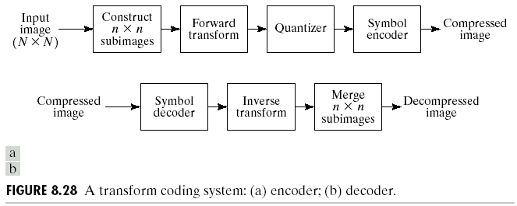
Transform Coding

Slide 32
Transform Coding
For the purpose of image compression, the transform operation should be:
  To decorrelate (“Break”) the correlations. Or to pack as much information as possible into the smallest number of transform coefficients.
  Basis transform functions are independent on the input images.
  Fast computation.
  Typical transforms:
    DFT transform
    DCT transform
    Walsh Hadamard Transform
    KL transform

Slide 33
DFT
Discrete Fourier Transform (DFT)
  Use cosθ+sinθ as its basis functions.
  Fast Fourier Transform (FFT).
  Not so popular in image compression because.
    Performance is not good enough.

Slide 34
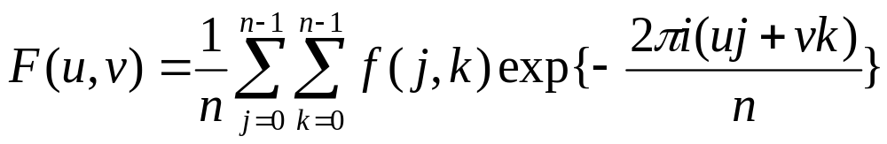
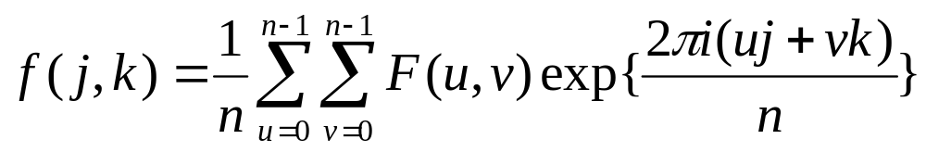

DFT
Discrete Fourier Transform (DFT)
Transform
Inverse
and f(j.k) is the input sequence.

Slide 35
DCT
Discrete Cosine Transform (DCT)
  Use cosine function as its basis function
  Performance approaches KLT
  Fast algorithm exists
  Most popular in image compression application
  Adopted in JPEG

Slide 36
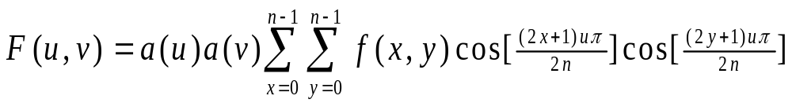
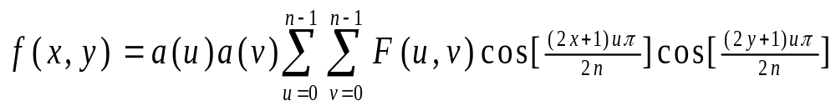
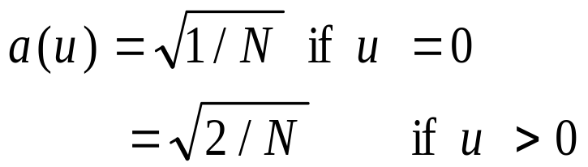
2D DCT
2D DCT: transfer spatial domain to frequency domain
  DC: F(0,0), average of f(x,y)
  AC: other coefficients

Slide 37

WHT
Walsh-Hadamard Transform (WHT)
  Simple basis functions: all kernel values are +1 or -1.
  Only addition and subtraction operations are needed.
  Popular when efficiency consideration dominates.
  Performance moderate.

Slide 38
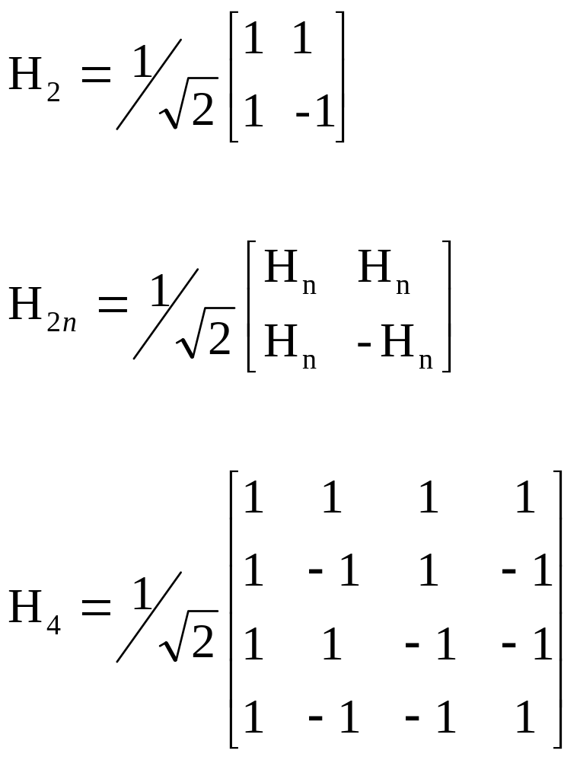
WHT
The smallest Hadamard matrix is H₂:
Bigger Hadamard matrix can be defined:
e.g.:

Slide 39
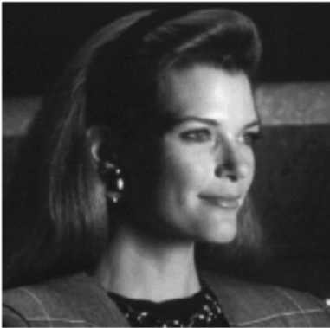
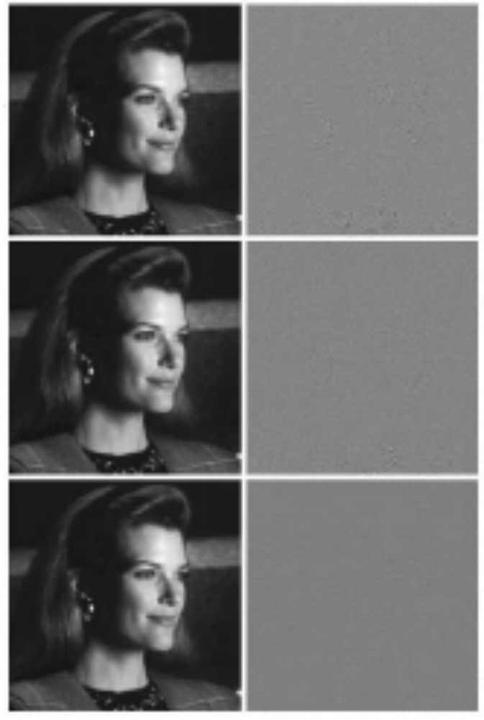
Transform Selection
DFT
rms=1.28
WHT
rms=0.86
DCT
rms=0.68
Divided the original image into 8*8 subimages.
Transformed by DFT, WHT, and DCT, respectively.
Truncating 50% of the resulting coefficients. Then the compression ratio is 2:1.
Taking the inverse transform.
It shows that DCT is superior to DFT and WHT.
Notes:
2:1，不考虑量化和编码问题的时候，相当于压缩了2倍。

Slide 40
KL Transform
Karhunen-Loeve Transform (KLT)
  Optimal transform, better than prior transforms.
  Basis functions are image dependent.
  No fast algorithm exists.
  Not so useful in image compression.
  Usually used for comparison.

Slide 41
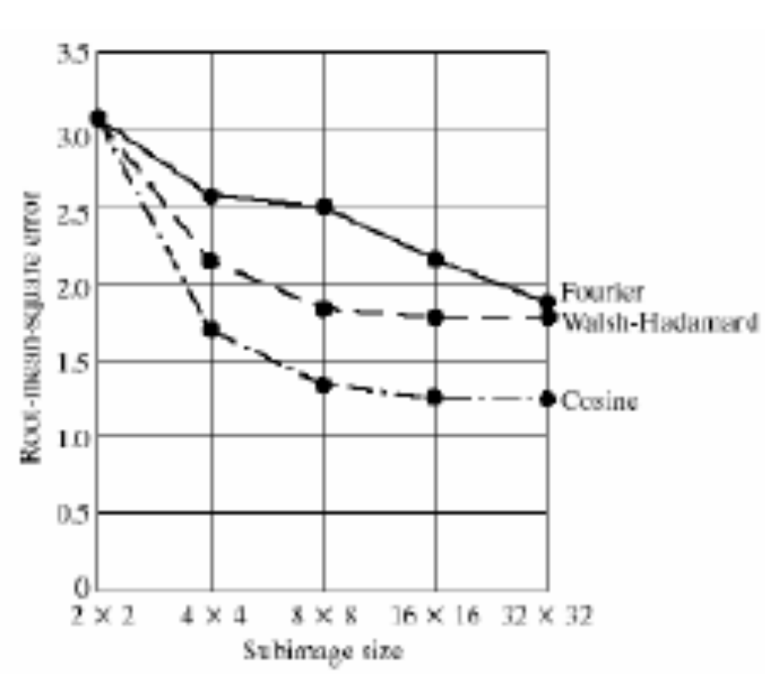
Transform Selection
Subimage size selection:
The size of subimage will be significant affecting transform coding error and computational complexity.
In most application, images are subdivided so that the correlation redundancy between adjacent subimages is reduced to some acceptable level.
In general, both the level of compression and the computational complexity increase as the subimage size increases.
The most popular sizes are 8*8, or 16*16.
Computing the transform of each subimage with different size, truncating 75% of the resulting coefficients, and taking the inverse transform.

Slide 42
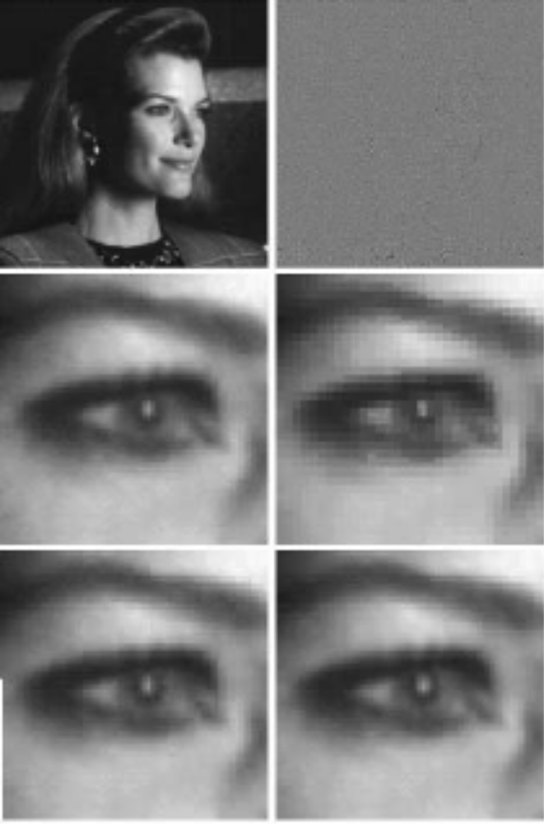
Transform Selection
Approximations using 25% of the DCT coefficients with 8*8 subimage results.
The scaled error images between a) and original image.
The zoomed original eye image.
The zoomed eye image when n=2.
The zoomed eye image when n=4.
The zoomed eye image when n=8.
We can find that the blocking artifact is obvious in d), and decrease in e) and f).

Slide 43
Wavelet Transform
Wavelet coding is based on the idea that the coefficients of the transform that decorrelates the pixels of an image can be coded more efficiently than the original pixels themselves.
Wavelets can pack most of the important visual information into a small number of coefficients, the remaining coefficients can be quantized coarsely or truncated to zero with little image distortion.
Since many of the computed coefficients carry little visual information, they can be quantized and coded to minimize intercoefficient and code redundancy.
Moreover, one or more of the lossless coding methods can be incorporated into the final symbol coding step.

Slide 44
Wavelet Transform
  The main difference between the wavelet transform and the transform coding system is the omission of the transform coder’s subimage processing stages.
  Because wavelet transfroms are both computationally efficient and inherently local, subdivision of the original image in unnecessary.
Wavelet
transform
Quantizer
Symbol
encoder
Input image
Compressed image
Symbol
decoder
Wavelet
transform
Compressed image
Decompressed image

Slide 45
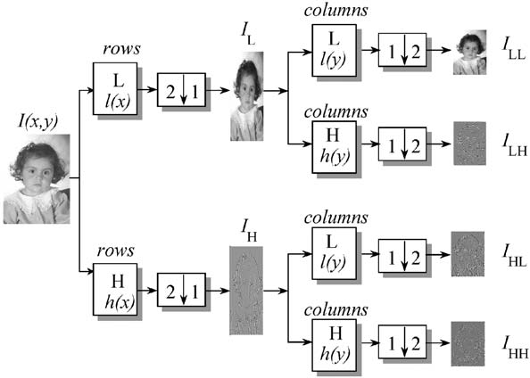
Wavelet Transform
  Initially, wavelet transform just focused on the 1-D situation.
  2-D wavelets, in the same way, can be treated as two 1-D wavelet transforms: one 1-D wavelet transforms along the row direction and the other one along the column direction.
  Generally, an one-octave transform of an image can be decomposed into four components: low-pass rows, low-pass columns (LL); low-pass rows, high-pass columns (LH); high-pass rows, low-pass columns (HL); high-pass rows, high-pass columns (HH).
  LL: low resolution of I(x,y)
  HL: vertical high frequencies of I(x,y)
  LH: horizontal high frequencies of I(x,y)
  HH: high frequencies in both directions of I(x,y)

Slide 46
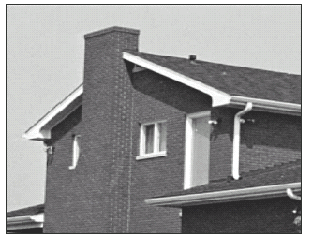
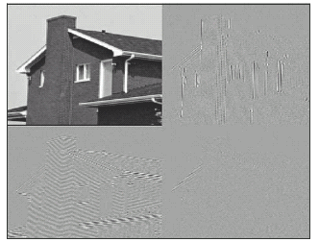
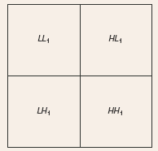
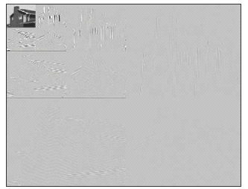
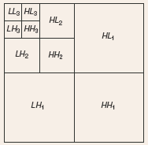
Wavelet Transform
The coefficients obtained by applying the 2-D wavelet transform on an image are called the sub images of the wavelet transform.

Slide 47
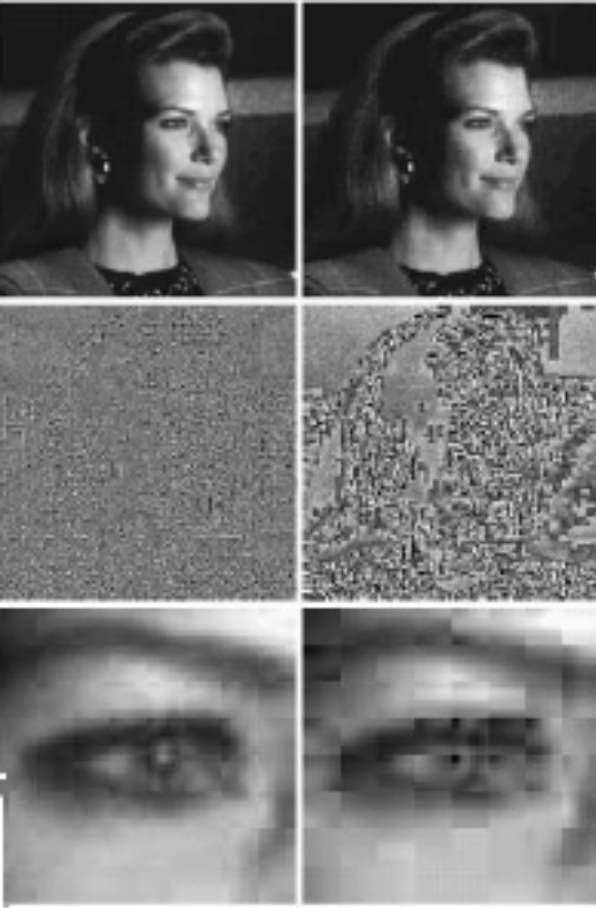
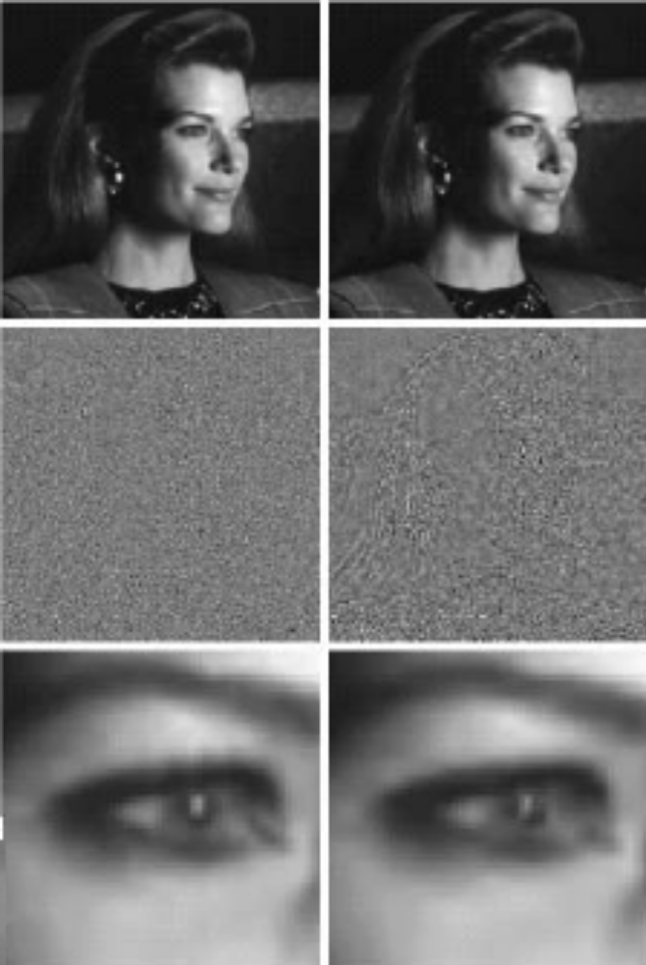
Wavelet Transform
DCT
Wavelet
Comparison with DCT
Compression ratios are 34:1, and 67:1.
For DCT, the rms are 3.42 and 6.33.
For wavelet, the rms are 2.29, 2.96
It reveals a noticeable decrease of error in the wavelet coding results.
Wavelet coding also greatly increases image quality.

Slide 48
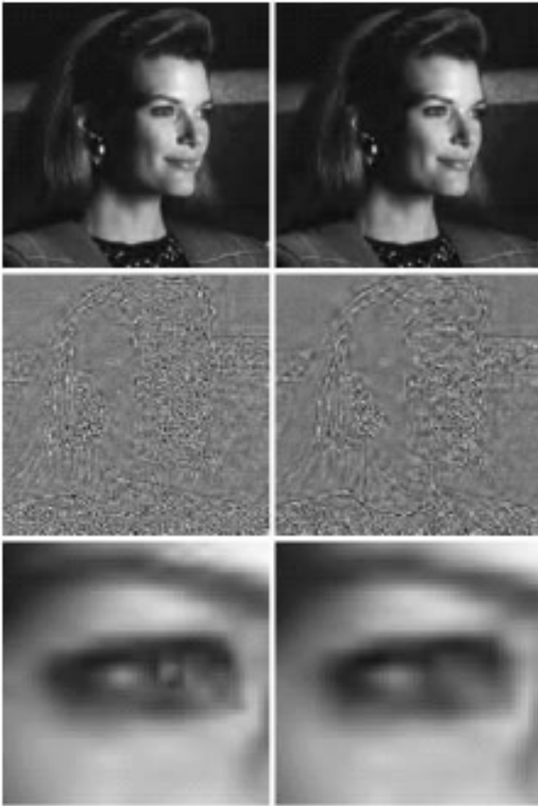
Wavelet Transform
DCT
Comparison with DCT
Compression ratios are 34:1, and 67:1 in DCT, and 108:1, 167:1 in wavelet.
For DCT, the rms are 3.42 and 6.33.
For wavelet, the rms are 3.72 and 4.73
But a subjective evaluation of either image reveals wavelet obvious better than DCT
For 167:1, its rms is only 75% in DCT
Wavelet

Slide 49
JPEG
JPEG - Joint Photographic Experts Group (联合图像专家组)
  Joint refers to CCITT (国际电报电话咨询委员会) and ISO (国际标准化协会).
  Compression standard of general continuous-tone still image.
  Became an international standard in 1992.
It defines three different coding systems
  A lossy baseline coding system, which is based on the DCT and is adequate for most compression applications.
  An extended coding system for greater compression, higher precision, or progressive reconstruction applications.
  A lossless independent coding system for reversible compression.
Notes:
Video compression: H.264, H.265…

Slide 50
JPEG 2000
Eliminates the blocky appearance of the JPEG image standard.
  This is because it uses a wavelet transform instead of the discrete cosine transform (DCT).
  In the previous DCT version, blocks of the image are compressed individually without reference to the adjoining blocks.
  Using a DWT creates a much smoother image.
The compression rate is much higher, while the retention rate is the same, and often, better resolution is exhibited.
  20%-200% better than JPEG Standard with lossy compression.

Slide 51
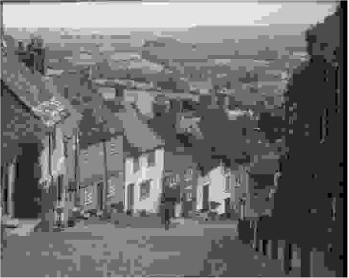
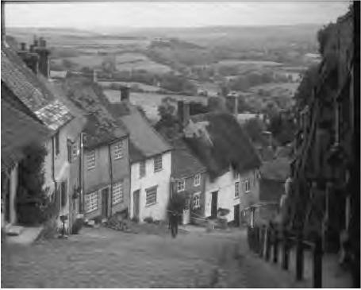
JPEG vs. JPEG 2000
discrete cosine transform based
wavelet transform based
JPEG (CR=64)
JPEG2000 (CR=64)

Slide 52
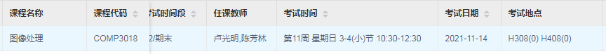
Thanks and Good Luck!
Thanks and Good Luck!
Your opinions and suggestions are greatly appreciated!

