Slide 1

Image Processing
Image Compression

Slide 2
Contents
Today we will begin looking at image Compression:
  Fundamentals
  Data Redundancies
  Image Compression Models
  Lossless Image Compression

Slide 3
Fundamentals
Motivation
Much of the on-line information is graphical or pictorial, storage and communications requirements are immense.
The spatial resolutions of today’s imaging sensors and the standard of broadcast television are greatly developed.
  1991, Kodak, MC-200, 0.4M pixels, 1.7M Japan Yuan(around 95000RMB).
  June 2020, Canon IXUS 190, 20M pixels, around 950RMB(JD).
  VGA resolution: 320×240, 640×480(标清), 1280×720(高清), 1920×1080(1080P), 3840x2160(4K), 7680×4320(8K)…
Methods of compressing the data prior to storage and/or transmission are of practical and commercial interest.

Slide 4
Fundamentals
Image compression addresses the problem of reducing the amount of data required to represent a digital image.
  Remove the redundant data.
  Statistically uncorrelated data set.
The transformation is applied prior to storage or transmission of the image.
Decompressed to reconstruct the original image or an approximation of it.

Slide 5
Fundamentals
Applications
Increased spatial resolutions
  Image sensors
  Broadcast television standards
Tele-video-conferencing
Remote sensing
Document and medical imaging, fax
An ever-expanding number of applications depend on the efficient processing, storage, and transmission of binary, gray-scale, and color images

Slide 6

Classification
Lossless compression
  Also called information preserving compression or error-free compression.
  Lossless compression for legal and medical documents, remote sensing.
Lossy compression
  Provide higher levels of data reduction.
  Useful in broadcast television, video conference, internet image transmission.
  Where some errors or loss can be tolerated.

Slide 7
Fundamentals
Data and Information
Distinguish the meaning of data and information:
  Data: the means by which information is delivered.
  Information: various amounts of data may be used to present the same amount of information.
Data Compression:
  The process of reducing the amount of data required to represent a given quantity of information.

Slide 8
Fundamentals
Example: Story
• Story is information
• Word is data
• Data Redundancy
  If the two individuals use a different number of words to tell the same basic story.
  At least one includes nonessential data. It is thus said to contain data redundancy.
  Eg. 100000000 & 10⁸, People‘s Republic of China: PRC.

Slide 9
Fundamentals
Data redundancy is the central issue in digital image compression.

Slide 10
Data Redundancy
Data Redundancy: it is not an abstract concept, but a mathematically quantifiable entity.
If n₁ and n₂ denote the number of information-carrying units in two data sets that represent the same information.
The relative data redundancy R_{D} of the first data set can be defined as:
R_{D} = 1 −1/C_{R}
where compression ratio C_{R} is
C_{R} =n₁/n₂

Slide 11
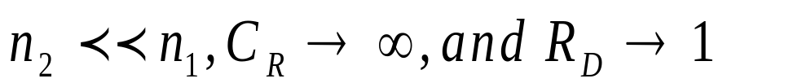


Data Redundancy
C_{R} and R_{D}: R_{D} = 1 −1/C_{R}
When n₂=n₁, C_{R}=1 and R_{D}=0
When
When , not hoped situation.
Usually, C_{R} and R_{D} lie in the open intervals and .
Example:
  Compression ratio is 10:1.
  Redundancy is 0.9.
  It implies that 90% of the data in the first data set is redundant.

Slide 12
Data Redundancy
In image processing, there are three basic data redundancies can be identified and exploited:
Coding Redundancy
Interpixel Redundancy
Psychovisual Redundancy
Data compression is achieved when one or more of these redundancies are reduced or eliminated.

Slide 13
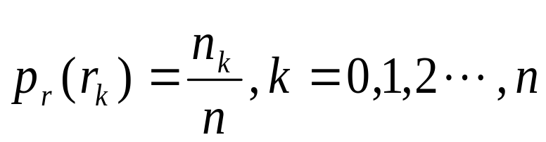
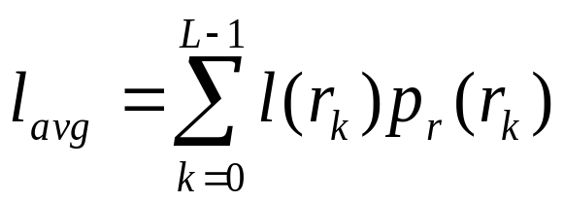
Coding Redundancy
A discrete random variable r_{k} in the interval [0,1], represents the gray levels.
Each r_{k} occurs with probability p_{r}(r_{k}):
If the number of bits used to represent each value of r_{k} is l(k), then the average number of bits required to represent the image pixel is:
The total number of bits required to code an M×N image is MNL_{avg}.

Slide 14
Coding Redundancy
For example, the gray levels of an image with a natural m-bit binary code.
The constant m may be taken outside the summation, leaving only the sum of the p_{r}(k) equals 1.
Then: L_{avg}=m

Slide 15
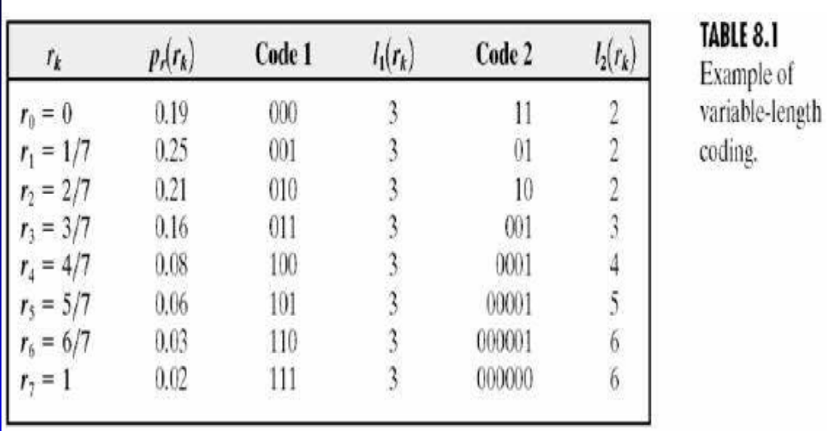
Coding Redundancy
Example of Variable-length Coding: 8-level image

Slide 16
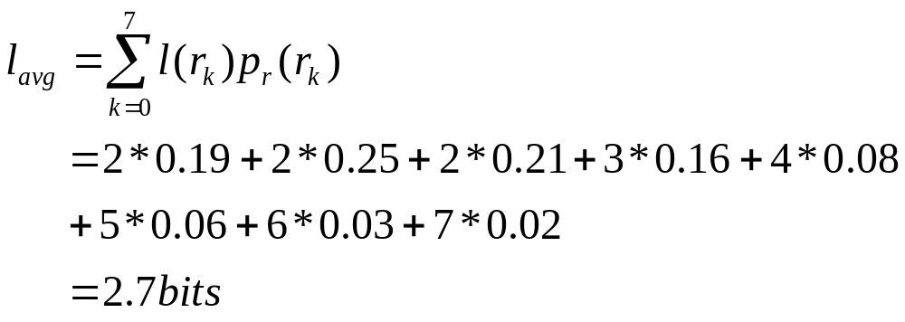
Coding Redundancy
For code 2, the average number of bits required to code the image is reduced to:
The resulting compression ratio C_{R} is 3/2.7 or 1.11.
Redundancy is R_{D} = 1−1/1.11 = 0.099.

Slide 17
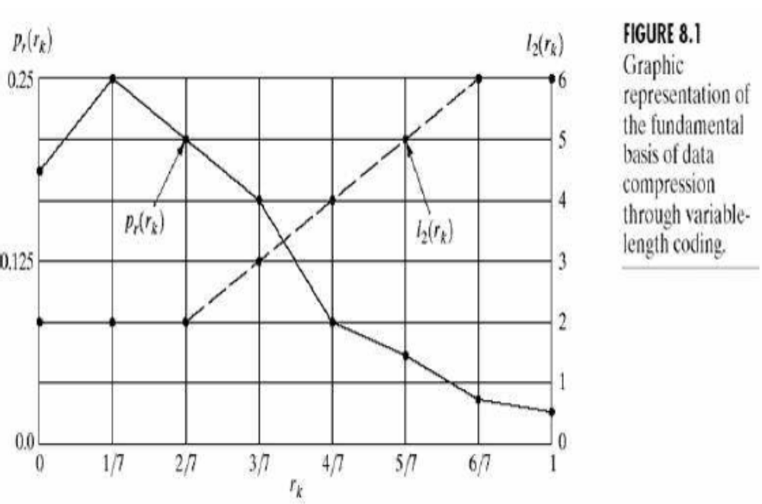
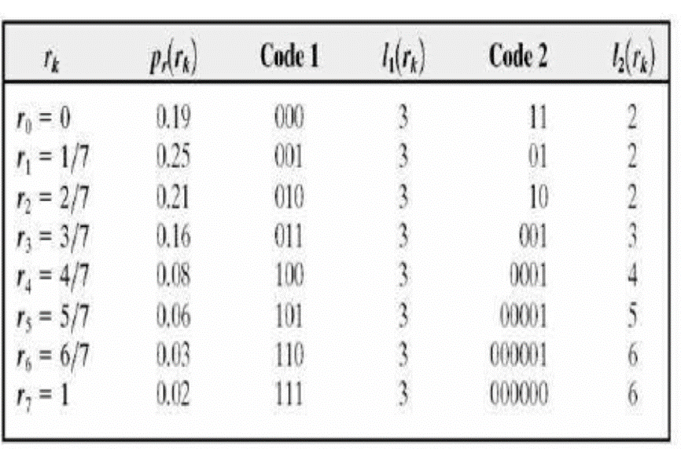
Coding Redundancy

Slide 18
Coding Redundancy
Variable-length coding: Assigning fewer bits to the more probable gray-levels.
Having coding Redundancy:
  When not take full advantage of the probabilities of the events.
  It is almost always present by using natural binary code.
Underlying basis:
  Certain gray levels are more probable than others.

Slide 19
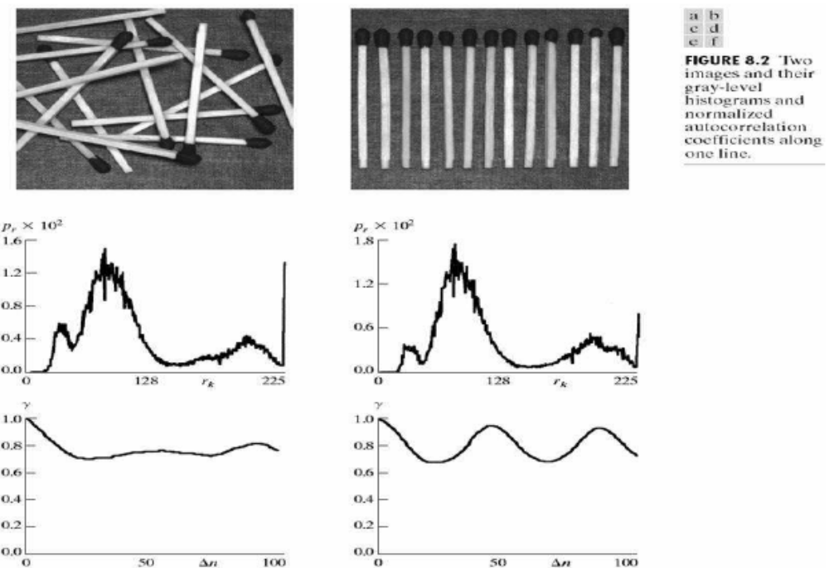
Interpixel Redundancy

Slide 20
Interpixel Redundancy
Remark
The gray levels in these images are not equally probable, variable-length coding can be used to reduce the coding redundancy.
The coding process would not alter the level of correlation between the pixels within the images.
The correlations come from the structural or geometric relationships between the objects in the image.
These reflect another important data redundancy—interpixel redundancy: one directly related to the interpixel correlations within an image.

Slide 21
Interpixel Redundancy
Properties of Interpixel Redundancy
The value of any given pixel can be predicted from the value of its neighbors.
The information carried by individual pixels is relatively small. Much of the visual contribution of a single pixel is redundant to an image.
Other nomenclatures:
  Spatial Redundancy.
  Geometric redundancy.
  Interframe redundancy.

Slide 22
Interpixel Redundancy
Reduced Approaches
Transform into a more efficient (but usually ’nonvisual’) format.
Example
  The difference between adjacent pixels.
  Mapping: transformations of the types that remove interpixel redundancy.
Reversible Mappings: Can be reconstructed.

Slide 23
Interpixel Redundancy
Run-length Coding
Mapping the pixels along each scan line f(x, 0), f(x, 1), · · · , f(x, N − 1), into a sequence of pairs (g₁,w₁), (g₂,w₂), · · ·
g_{i} denotes the ith gray level encountered along the line.
w_{i} the run length of the ith run.
“aabbbcddddd”, can be represented as (a, 2)(b, 3)(c, 1)(d, 5).
1111102555555557788888888888888, can be represented as: (1, 5)(0, 1)(2, 1)(5, 8)(7, 2)(8, 14).

Slide 24
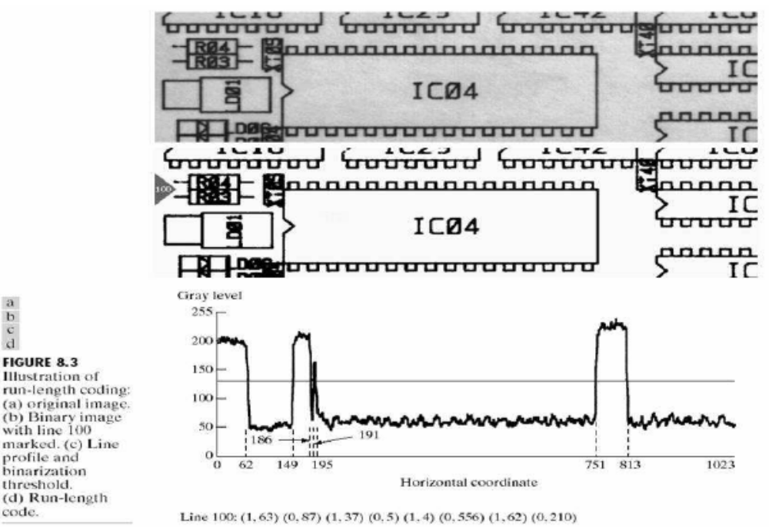
Interpixel Redundancy
Image size:
1024*343

Slide 25
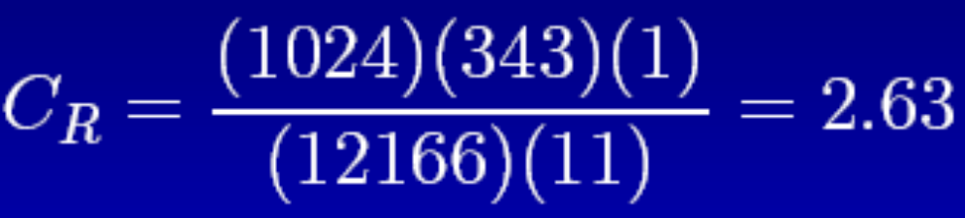
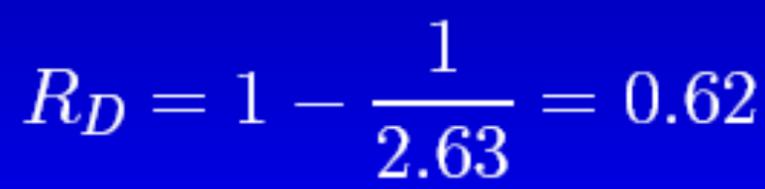
Interpixel Redundancy
Computational Results
• Only 88 bits are needed to represent the 1024 bits of binary data.
• The entire 1024×343 section can be reduced to 12,166 runs.
• The Compression ratio is:
and the relative redundancy is

Slide 26

Psychovisual Redundancy
Eye does not respond with equal sensitivity to all visual information.
Certain information has less relative importance. This information is said to be psychovisual redundant.
It can be eliminated without significantly impairing the quality of image perception.

Slide 27
Psychovisual Redundancy
Basic Cognitive Procedure
Human perception of the information in an image normally does not involve quantitative analysis of every pixel value in the image.
  Find features such as edges or textual regions.
  Mentally combines them into recognizable groupings.
  The brain correlates these groupings with prior knowledge.
  Then, complete the image interpretation process.

Slide 28
Psychovisual Redundancy
Lead to a loss of quantitative information (quantization).
  Mapping a broad range of input values to a limited number of output values.
  Irreversible Operation.

Slide 29
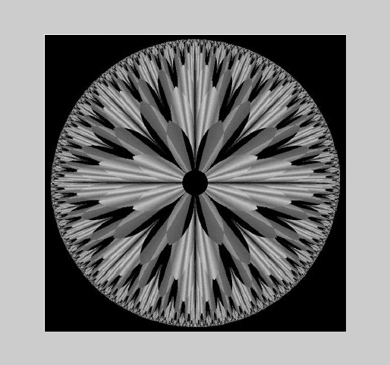
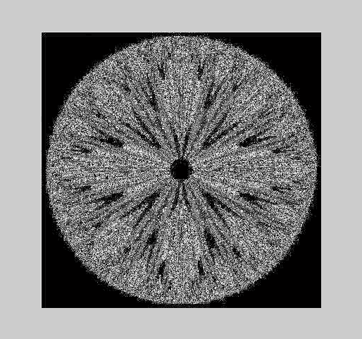
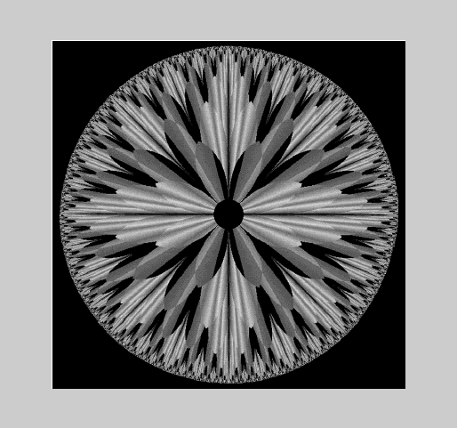
Psychovisual Redundancy

Slide 30


Psychovisual Redundancy
256 grey levels (8 bits per pixel)
128 grey levels (7 bpp)
64 grey levels (6 bpp)
32 grey levels (5 bpp)
16 grey levels (4 bpp)
8 grey levels (3 bpp)
4 grey levels (2 bpp)
2 grey levels (1 bpp)

Slide 31
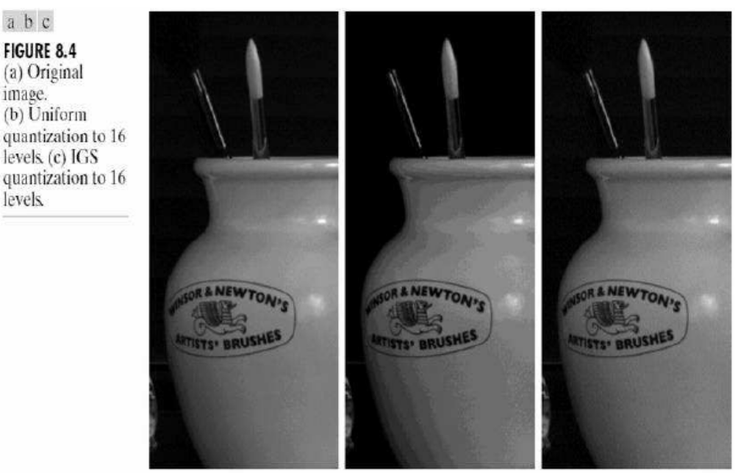
Psychovisual Redundancy
Example: Compression by quantization
Original image with 256 gray levels.
Uniform quantization to 16 gray levels.
Improved Gray-Scale (IGS) quantization.
The compression are 2:1, but IGS is more complicated.

Slide 32
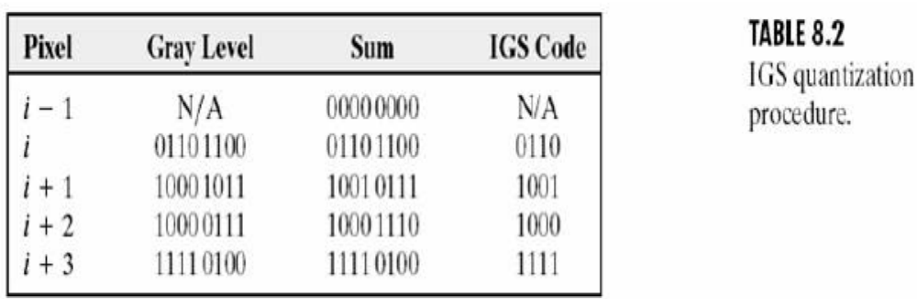
Psychovisual Redundancy
Improved Gray-Scale (IGS) quantization
A sum: initially set to zero.
Add the four least significant bits of a previously generated sum with current 8-bit gray level.
If the four most significant bits of the current value are 1111₂, however, 0000₂ is added instead.
The four most significant bits of the resulting sum are used as the coded pixel value.

Slide 33
Fidelity Criteria
Compression may lead to loss information
Quantifying the nature and extent of information loss
  Objective fidelity criteria
    When the level of information loss can be expressed as a function of the input image, the compressed and output image.
    Easy to operate (automatic).
    Often requires the original copy as the reference.
  Subjective fidelity criteria
    Evaluated by human observers.
    Do not require the original copy as a reference.
    Most decompressed images ultimately are view by human.

Slide 34
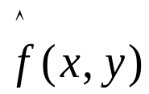
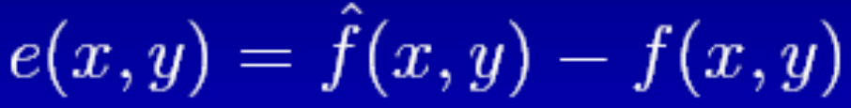
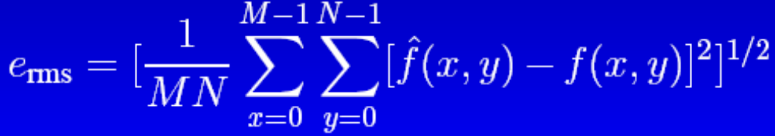
Fidelity Criteria
Objective Fidelity Criterion
Root-Mean-Square (rms) Error:
Let f(x, y) represent an input image
Let be an estimate or approximation of f(x, y)
For any value of x and y, the error e(x, y) is given by:
The root-mean-square error (e_{rms}) is

Slide 35
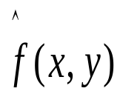

Fidelity Criteria
Mean-Square Signal-to-Noise Ratio:
Assuming that is the sum of the original image f(x, y) and a noise signal e(x, y).
The mean-square signal-to-noise ratios of the output image (SNR_{ms}) is:
SNR_{rms} is the square root of above equation.

Slide 36
Fidelity Criteria
Subjective fidelity Criterion
Most decompressed images are viewed by humans.
Measuring image quality by the subjective evaluations is more appropriate.
Example: evaluation or voting.

Slide 37
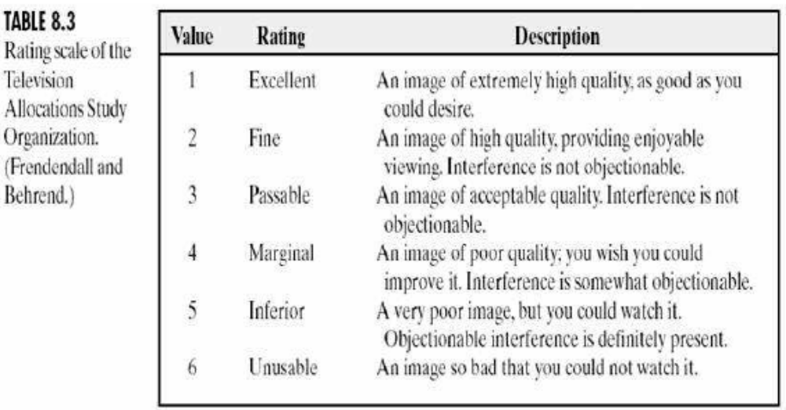
Fidelity Criteria
极好
好
过得去
勉强可以
差
不可用

Slide 38
Fidelity Criteria
For example, the rms of b) and c) are 6.93 and 6.78.
Based on objective fidelity, these values are quite similar.
A subjective evaluation of the visual quality of the two coded images might: b)-marginal, and c)-passable.

Slide 39
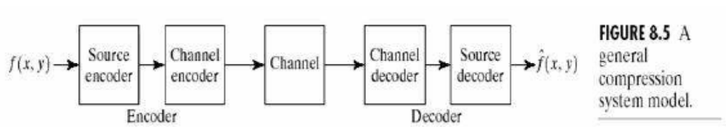
Compression Models
Three general techniques are always combined to form practical image compression systems.
The overall characteristics of compression:
  A compression system consists of two distinct structural blocks: an encoder and a decoder.
  Encoder and a decoder: Source and Channel.
  Channel encoder: Increases the noise immunity of the source encoder’s output. If noise free, can be omitted.

Slide 40
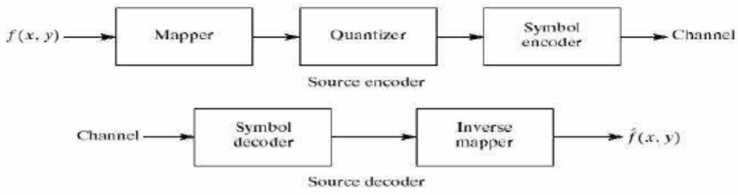
Compression Models
The Source Encoder and Decoder
Source Encoder: Remove input redundancies.
Each operation is designed to reduce or eliminating one of the three redundancies.
  Interpixel redundancy (Mapper, reversible).
  Psychovisual redundancy (Quantizer, irreversible).
  Coding redundancy (Symbol Encoder, reversible).

Slide 41
Compression Models
Three steps for source encoder:
First, the mapper transforms the input data into a format designed to reduce interpixel redundancies in the input image (run-length coding), this operation generally is reversible.
Second, quantizer block reduces the accuracy of the mapper’s output in accordance with some pre-established fidelity criterion. This stage reduces the psychovisual redundancies of the input image. It is irreversible.
Third, symbol coder creates a fixed or variable length code to represent the quantizer output. It can reduce coding redundancy, and it is reversible.

Slide 42
Compression Models
Remark
The quantizer must be omitted when error-free compression is desired.
Some compression techniques normally are modeled by merging blocks that are physically separate in above figure.
The source decoder only contains two blocks: symbol decoder and an inverse mapper. Because quantization results in irreversible information loss, an inverse quantizer block is not included in the general source decoder model.

Slide 43
Compression Models
The Channel Encoder and Decoder
They play an important role in the overall encoding-decoding process when the channel is noisy or prone to error.
Reduce the impact of channel noise
  Insert a controlled form of redundancy into the source encoded data.
Source encoder contains little redundancy
  It would be highly sensitive to transmission noise without the addition of this "controlled redundancy".

Slide 44
Lossless Image Compression
Also called Error-Free compression
The need for error-free compression is motivated by the intended use or nature of the images.
In some applications, it is the only acceptable means of data reduction.
  Archival of medical or business documents, where lossy compression usually is prohibited for legal reasons.
  Other is the processing of satellite imagery, where both the use and cost of collecting the data makes any loss undesirable.
  Another is digital radiography, where the loss of information can compromise diagnostic accuracy.

Slide 45
Lossless Image Compression
Two relatively independent operations
  Eliminate coding redundancies.
  Reduce interpixel redundancies.
They normally provide compression ratios of 2 to 10.
Approaches:
  Variable length coding(coding redundancies)
    Huffman coding
    Arithmetic coding
  LZW coding(interpixel redundancies)

Slide 46
Variable-Length Coding
Reducing coding redundancy: assign the shortest possible code words to the most probable gray levels.
  Huffman Coding
  Arithmetic Coding
Remark: The source symbols may be either the gray levels of an image or the output of a gray-level mapping operation.

Slide 47
Huffman Coding
Huffman coding, 1952
Coding Procedures for an N-symbol source, two steps:
  Source reduction
    List all probabilities in a descending order.
    Merge the two symbols with smallest probabilities into a new compound symbol.
    Repeat the above two steps until a reduced source with two symbols.
  Codeword assignment
    Start from the smallest source and work back to the original source.
    Each merging point corresponds to a node in binary codeword tree.

Slide 48
Example-I
For a string: “SENSSNSW”
Step 1: Source reduction
symbol x
p(x)
S
0.5
0.5
0.5
N
0.25
0.25
0.5
E
0.125
(NEW)
0.25
W
0.125
(EW)
compound symbols

Slide 49
Example-I
Step 2: Codeword assignment
symbol x
p(x)
codeword
1
0
0.5
0.5
0.5
0
0
NEW
0
S
N
1
0
S
0.25
0.25
0
10
0.5
1
EW
10
E
0.125
0
110
N
1
1
0
0.25
W
0.125
111
110
1
111
W
E

Slide 50
Example-I
1
0
0
1
NEW
0
NEW
1
1
0
S
0
1
S
or
EW
10
EW
01
N
N
1
0
1
0
110
001
000
W
E
W
E
The codeword assignment is not unique. In fact, at each
merging point (node), we can arbitrarily assign “0” and “1”
to the two branches (average code length is the same).

Slide 51
Example-II
Step 1: Source reduction
symbol x
p(x)
e
0.4
0.4
0.4
0.6
(aiou)
a
0.2
0.2
0.4
(iou)
0.4
i
0.2
0.2
0.2
o
0.1
0.2
u
0.1
(ou)
compound symbols

Slide 52
Example-II
Step 2: Codeword assignment
symbol x
p(x)
codeword
e
0.4
0.4
0.4
0.6
0
1
0
(aiou)
a
0.2
0.2
01
0
0.4
1
(iou)
0.4
i
0.2
0.2
1
000
0.2
o
0.1
0
1
0010
0.2
u
0.1
(ou)
0011
1
compound symbols

Slide 53
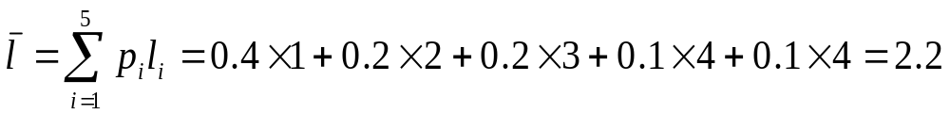
Example-II
symbol x
p(x)
codeword
length
0.4
1
1
e
a
0.2
01
2
i
0.2
000
3
o
0.1
0010
4
u
0.1
0011
4
If we use fixed-length codes, we have to spend three bits per
sample, so the compression ratio is 3/2.2=1.364, and the code
redundancy is 0.267.

Slide 54
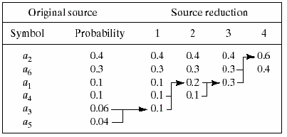
Example-III
Step 1: Source reduction
compound symbol

Slide 55
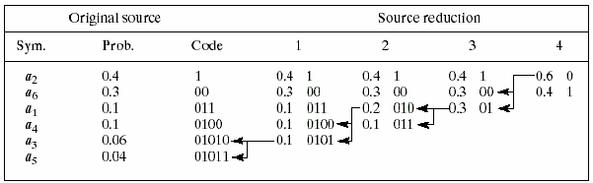
Example-III
Step 2: Codeword assignment
compound symbol
The average length of the code is:
    L_{avg} = (0.4)(1) + (0.3)(2) + (0.1)(3) + (0.1)(4)+(0.06)(5) + (0.04)(5)
    = 2.2 bits/symbol

Slide 56
Huffman Coding
After the code has been created, coding and/or decoding is accomplished in a simple lookup table manner.
Example: 01010 011 1 1 00
Answer: a₃a₁a₂a₂a₆

