Slide 1
covid
File created on: 11-06-2020 10:52:35 PM

Slide 2
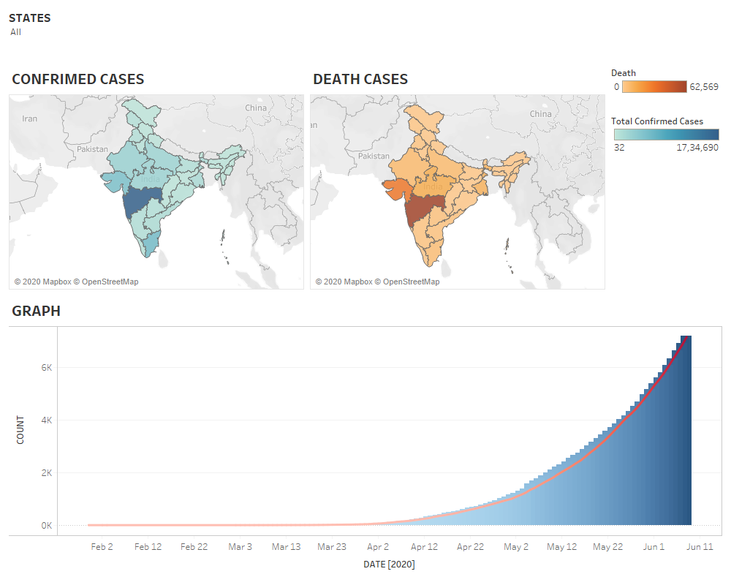

Slide 3
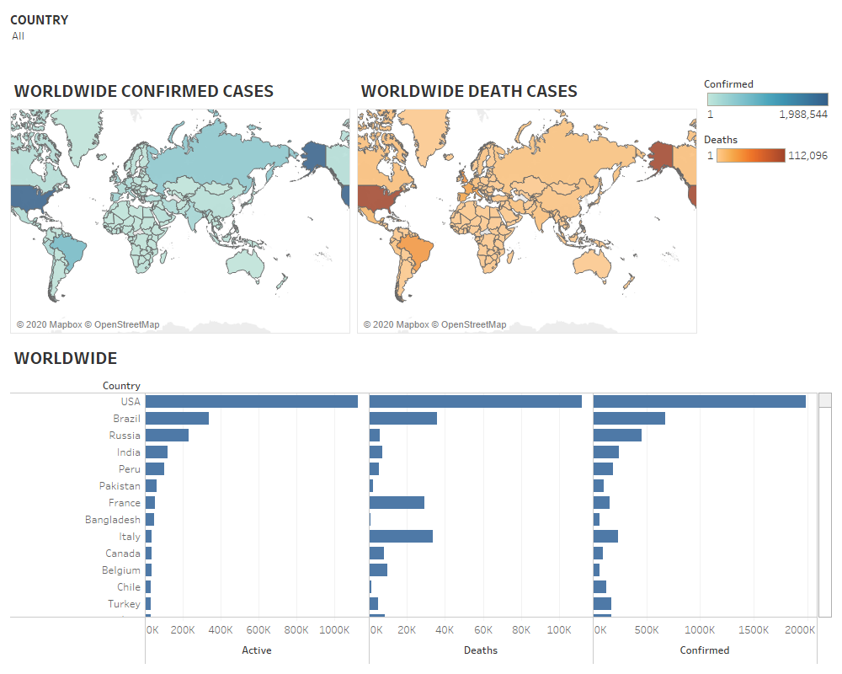

Slide 4
