Slide 1
Open https://www.google.co.in/

Slide 2
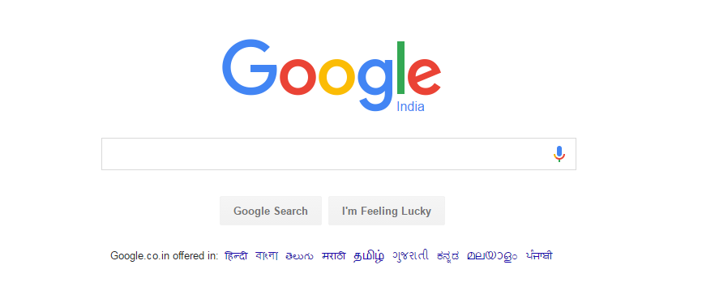
Skip
exist

Slide 3
Type gmail signUp

Slide 4
click

Slide 5

click

Slide 6
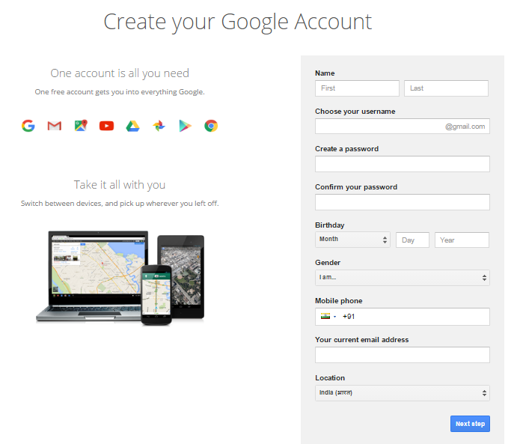
Type firsName

Slide 7
Type LastName

Slide 8
Type Anything00007Uniques@gmail.com

Slide 9
Type wqedfskjfjdkds12

Slide 10
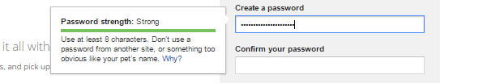
Type wqedfskjfjdkds12

Slide 11
click

Slide 12
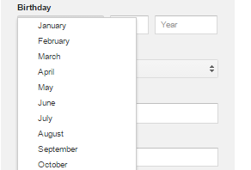
click

Slide 13
Type 14

Slide 14
Type 1989

Slide 15
click

Slide 16

Click

Slide 17
Type 9681790309

Slide 18
Type hitimran@gmail.com

Slide 19
click

Slide 20
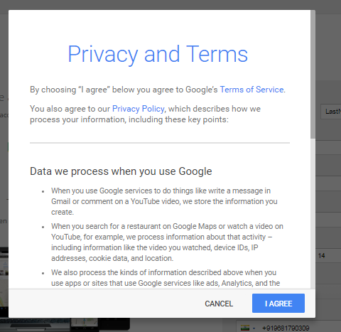

Slide 21
click

