Slide 1

World Happiness Report
By Group # 4 [phanit tameerug, Savita Hirilall, Tejal Kotkar, Hibo Dahir]

Slide 2
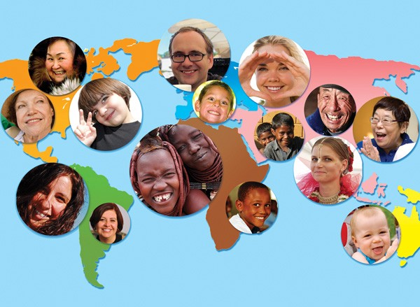
What is the World Happiness Report?
The world happiness report is based on the state of global happiness that ranks 156 countries by how their citizens see themselves.

Slide 3

Hypothesis
The core message of our group is to analyze and visualize the survey done on Happiness Score data for the past three years and to understand how the key factors are related to the Happiness Score of 156 countries.
And to understand if there is any relationship between Happiness Score and Human Development Index (HDI) of these countries.
Notes:
What is HDI? The Human Development Index (HDI) is a summary measure of average achievement in key dimensions of human development: a long and healthy life, being knowledgeable and have a decent standard of living

Slide 4

Questions & Motivation To Answer Them.

Slide 5
The questions we found interesting and motivation to answer them
The data we observed was fascinating and we wanted to know how these demographic factors are related to the well being of people living in the world.
We were curious to know if any country experienced a significant increase or decrease in their happiness score.
Comparing the USA's happiness score over the past three years.
Compelling questions found for this analysis:
How does happiness score depend on different demographic factors i.e. GDP/ Economy, Health & Corruption?
What are the similar facts for the top and bottom 5 countries?
Which is the most and the least Happy Region in the dataset? Are there any outliers in terms of happiness score across region over the years?
Which country experiences a significant increase or decrease in their happiness score?
What is the trend of happiness score for USA, over three years?
Is there any relationship between Happiness score to HDI?

Slide 6
How did we find the data?
Happiness Score data source - Kaggle [https://www.kaggle.com/mathurinache/world-happiness-report]
HDI data source - human development resource api [http://hdr.undp.org/en/content/human-development-report-office-statistical-data-api]

Slide 7
Data Clean Up Process
Collected data for last three years i.e. 2018, 2019 and 2020.
Read csv file for each year and created data frames with only required columns i.e. Country, Region, Happiness Score, GDP per Capita, Healthy life expectancy and Perceptions of corruptions.
Renamed columns to make them uniform across all years
Merged all three data frames together with inner join.
Checked for missing values and dropped rows with missing values
Renamed sub-regions to concise into region

Slide 8
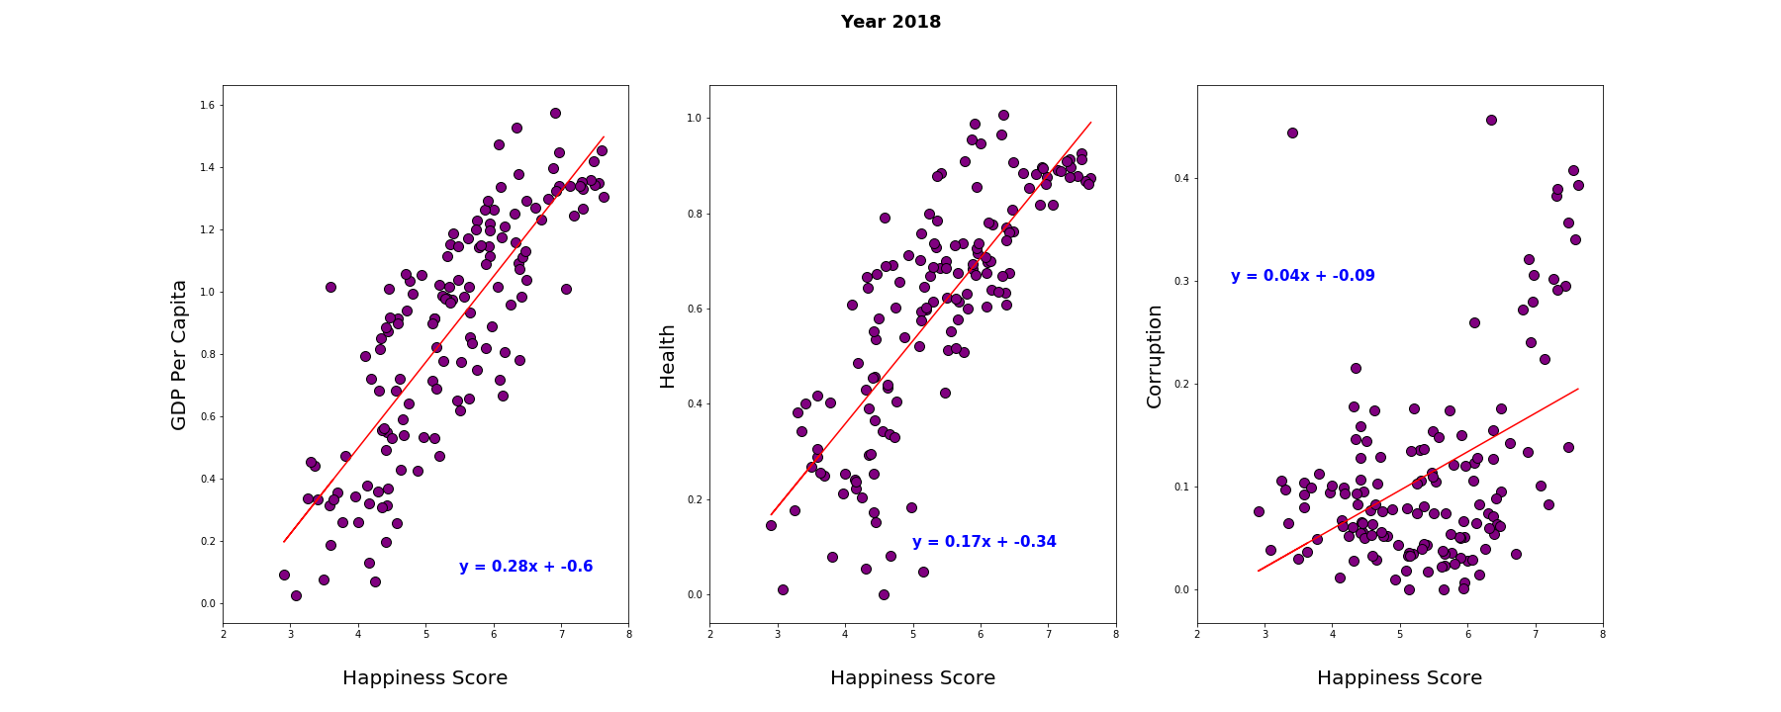
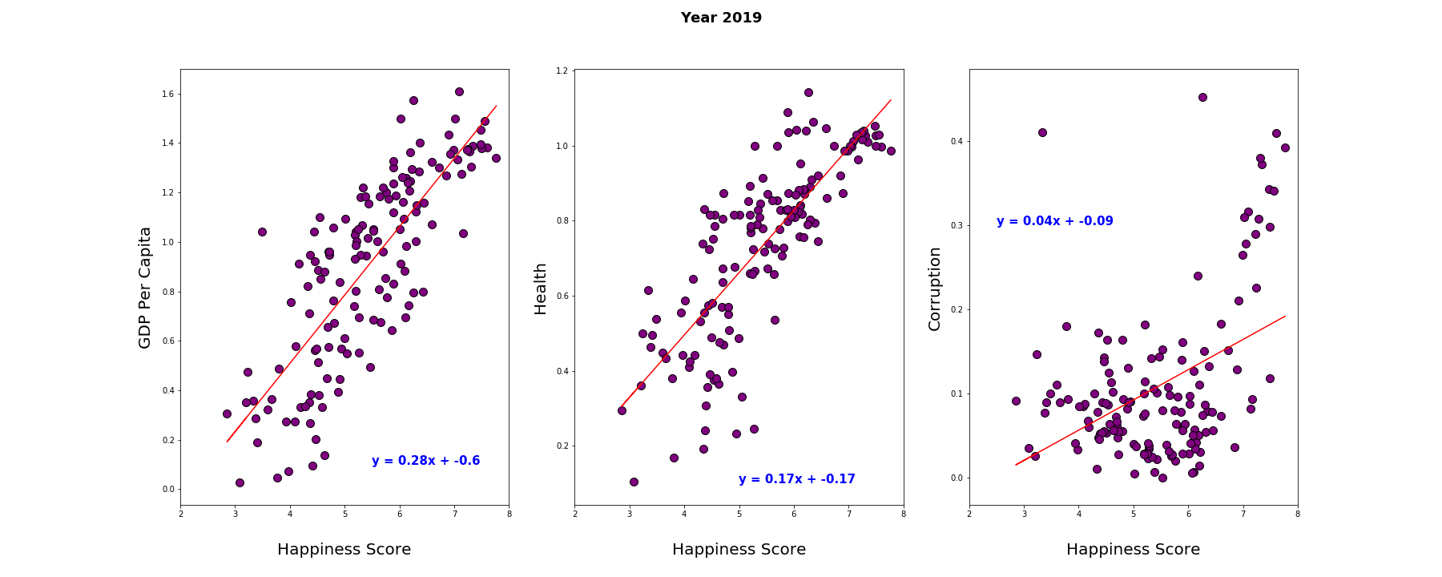
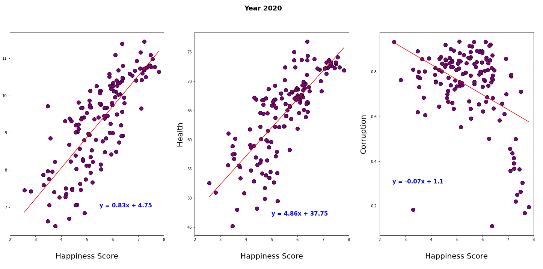
How does happiness score depend on different demographic factors i.e. GDP/ Economy, Health & Corruption?
Happiness Score is strongly related to GDP & Health.
Happiness Score has a weak correlation to Corruption.

Slide 9
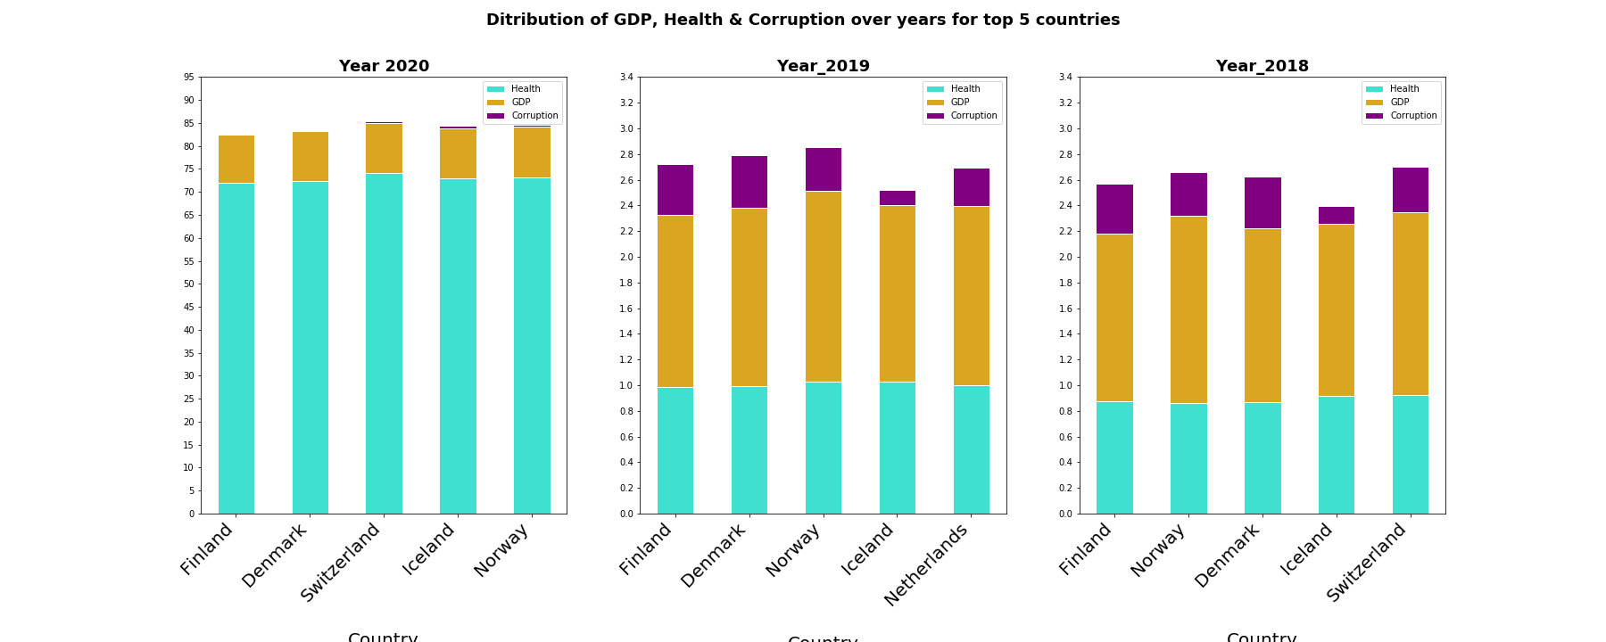
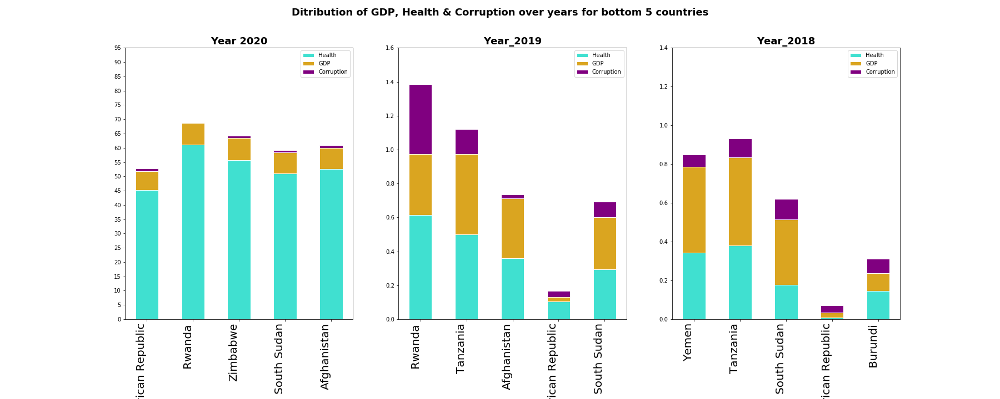
What are the similar facts for the top and bottom 5 countries?
Finland has consistently topped being the happiest country in last 3 years
Bottom 5 countries over last 3 years are mostly from Africa Region
All top 5 countries over last 3 years are from Europe region

Slide 10
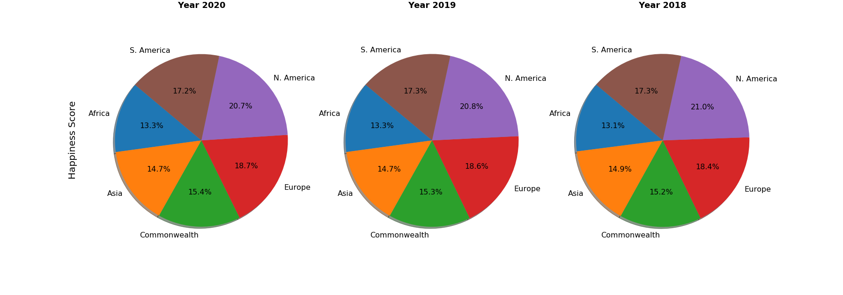
North America is consistently the happiest region over last 3 years.
Which is the most and the least Happy Region in the dataset?

Slide 11
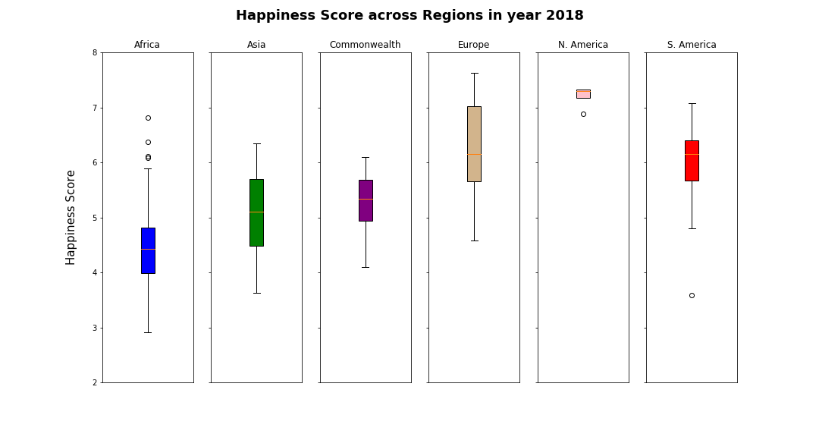
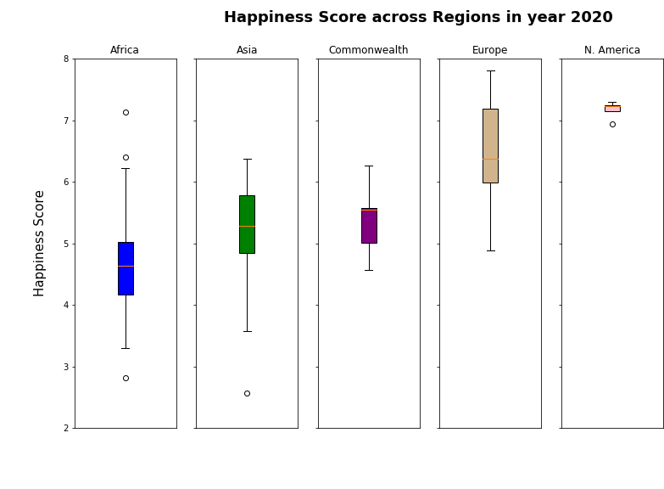
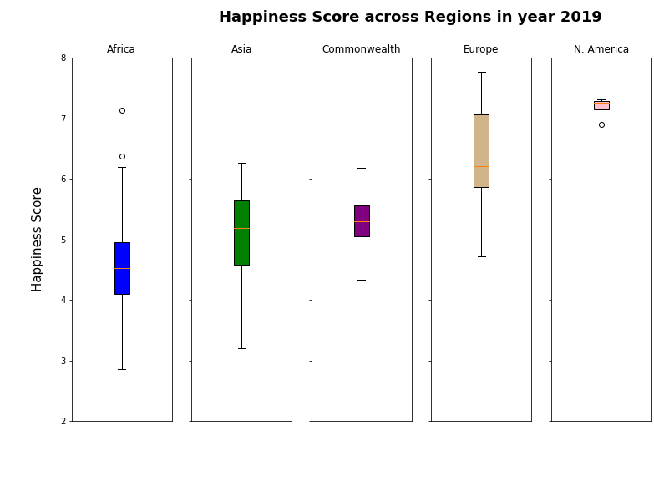
Are there any outliers in terms of happiness score across region over the years?
Commonwealth & Europe region had no outliers over last 3 years

Slide 12
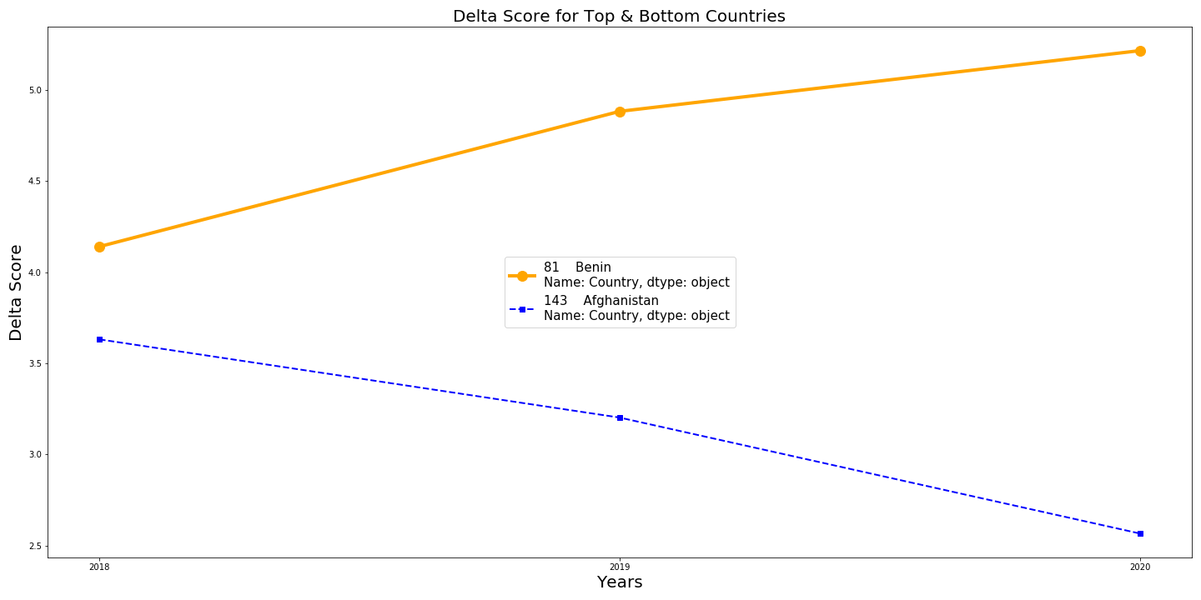
Which country experiences a significant increase or decrease in happiness?
The country that experienced a significant increase in happiness is Benin, Africa. There is a moderate increase after calculating the delta is 1.075.
Afghanistan has experienced a significant decline over the years further some, after calculating the delta is -1.0651.

Slide 13
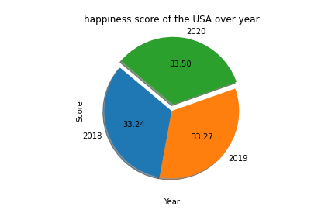
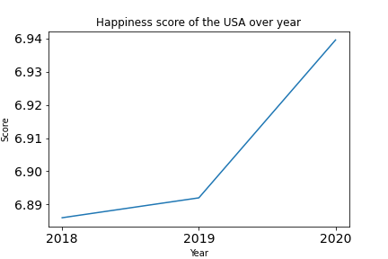
What is the trend of happiness score in USA, over three years?
The happiness score in US from year 2018 to 2019 has shown increasing trend.
Rate of happiness from 2019 to 2020 is far higher than the rate from 2018 to 2019

Slide 14
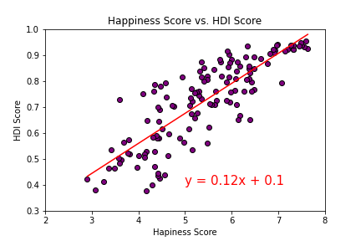
Is there any relationship between Happiness score to HDI?
As per the R-value in the given graph, the Happiness score and HDI have a positive correlation.
The r-squared is: 0.70
Note: HDI Score is available only for year 2018. Website is not updated for year 2019 and 2020.

Slide 15

Q&A

