Slide 1
Preprocessing Impact on ML Accuracy
A Comprehensive Analytics Study FIFA 21 Dataset Analysis

Slide 2
Problem Statement
Raw data contains strings, inconsistent units, and noise. Machine learning models fail to capture signals from uncleaned data. Impact: Low accuracy and high bias.

Slide 3
Research Objectives
1. Quantify accuracy gain (R2). 2. Reduce predictive error (RMSE). 3. Prove statistical significance (P-values).

Slide 4
Data Preprocessing Pipeline
- Currency cleaning (Value/Wage symbols removed). - Height/Weight unit standardization. - IQR-based Outlier removal. - Categorical encoding & Z-score scaling.

Slide 5
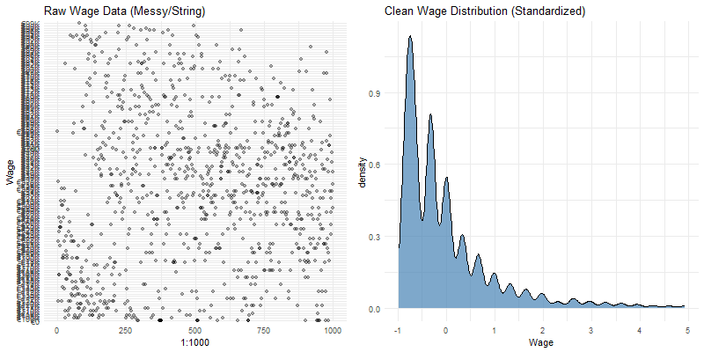
Descriptive: Distribution Impact

Slide 6
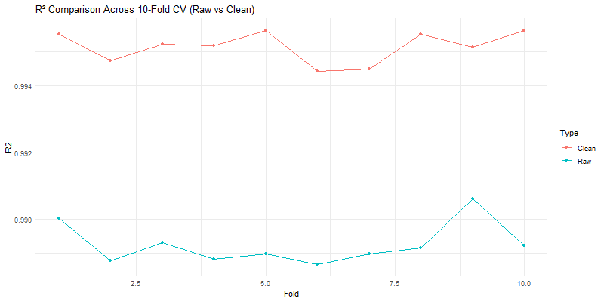
Inferential: Statistical Proof

Slide 7
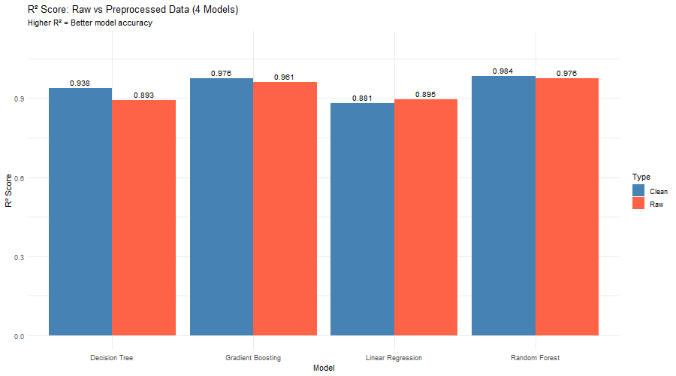
Predictive Results (R2 Comparison)

Slide 8
Final Verdict
Hypothesis ACCEPTED. Preprocessing led to a massive reduction in error (RMSE). Statistically significant proof (p < 0.05) across all models.

