Slide 1
Monetary Policy According to Hank Pt.3
Greg Kaplan
Benjamin Moll
Giovanni L. Violante

Slide 2
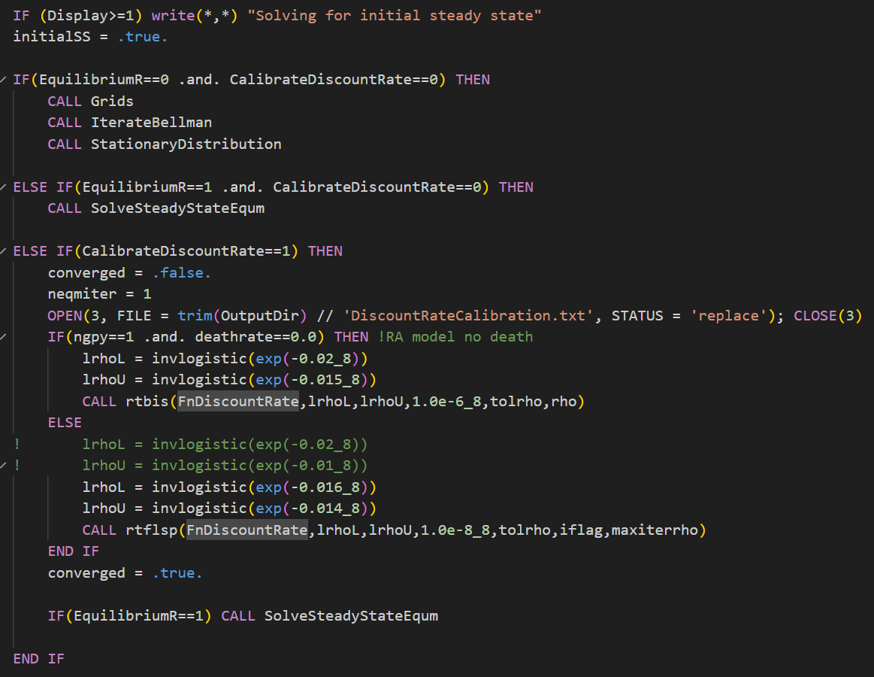
InitialSteadyState.f90

Slide 3
IterateBellman.f90
!set drifts
ltau = 15.0
ltau0 = (ra+PerfectAnnuityMarkets*deathrate)*(agrid(ngpa)*0.999)**(1.0-ltau)
adrift = ra*agrid + PerfectAnnuityMarkets*deathrate*agrid - ltau0*(agrid**ltau)
비유동자산 수익률 연금시장 사망률
ra = (rcapital - deprec + divrate - fundlev*rb)/(1.0-fundlev)
- rcapital = mc*alpha/Kyratio
mc = (elast-1.0)/elast
alpha = 0.33
- deprec = 0.07/4.0 (0.0175) !depreciation rate
Notes:
Q. ltau의 역할: 자산 증가 억제
-

Slide 4
Spending Surge
Inflation and composite spending
A crisis (pandemic or war), leads to unexpected surge in G_{t +i} , i = 0 ,. . . ,M.
Temporary surge: spending returns to pre-crisis levels after M periods Assume growth and real interest rates approximately equal and stable:
「 ( \
( \ (
\l
G
t
^{G}t +1 ^{Y}t +1
^{G}t +M ^{Y}t +M
Y · ∆
+ ∆
+ · · · + ∆
(1)
t
Y_{t}
Fiscal Influences on Inflation in OECD Countries

Slide 5
Government Bonds
Inflation and composite spending
Assume total of coupon and principal payments rise over time with expected path of nominal GDP. Otherwise, amounts uniform out to maximum debt maturity, T.
Reaction to surge in spending assumed to be surge in inflation rates, π_{t +1} . . . π_{t +T} , above target, π∗ for T periods, with π∗ assumed fixed.
Shifts in inflation rates appear in long-term nominal interest rates ⇒
Market value of debt drops.
Monetary authority accommodates path of inflation dictated by fiscal considerations. We do not detail this process. Fiscal & monetary authorities cooperate.
Fiscal Influences on Inflation in OECD Countries

Slide 6
Change in Value of Public Debt
Inflation and composite spending
Change in market value of debt generated by shift in (actual and expected) inflation rates from π∗ to sequence π_{t +1} . . . π_{t +T} given by:
_{B}∗
「 l 「 l 「 l
− 1 + 1 1
∗
(1 + π∗)²
(1 + π_{t +1})(1 + π_{t +2})
(1 + π∗)^{T}
(1 + π_{t +1}) . . . (1 + π_{t +T} )
(1 + π )
∆B =
t
− + · · · +
−
1 + T (1 + π_{t +1})
B∗ is the value of outstanding public debt. A boost to inflation rates, π_{t +i} > π∗,
t
implies a negative ∆B.
As stressed by Cochrane, multiplicity of future inflation rates correspond to given ∆B. If debt maturity, T, long, part of inflation surge can occur in distant future.
May be optimal to smooth out boost to inflation rates.
Fiscal Influences on Inflation in OECD Countries

Slide 7
Debt devaluation and inflation
Inflation and composite spending
If higher inflation rate, π_{t +i} , is constant at π > π∗ for T periods, result is:
1
∗ ∗
∆B ≈ −B · T · (π − π )
t
2
Negative value of ∆B corresponds to a boost in the inflation rate, π > π∗. Given ∆B, larger B∗ (initial debt) or ^{T} (debt duration) ⇒ smaller π − π∗.
t 2
Fiscal Influences on Inflation in OECD Countries
6/29

Slide 8
A parsimonious expression for inflation
Inflation and composite spending
We obtain a simple relation between change in inflation and COVID fiscal stimulus rescaled for amount and duration of outstanding government debt
!
( \
M
G
∗
π − π = η ∑ ∆ _{Y}
t +i
B T
∗
/
t
P_{t} Y_{t} 2
i =1
t +i
Verify whether relation can explain cross-country variation in inflation
π_{it} = π∗ + η · (∆G) + X_{t} + βZ_{it} + u_{it}
i it
where π∗ is a country-specific fixed effect, X_{t} is year fixed effect to capture the effects
i
of the pandemic, Z_{it} is a border with Ukraine or Russia dummy.
Fiscal Influences on Inflation in OECD Countries
6/29

Slide 9
State-Contigent Public Finance
Inflation and composite spending
η = 0 when surge in spending matched by expectations of future fiscal adjustments. corresponds to standard intertemporal public finance, holds in most circumstances
η > 0 applies only during economic emergencies, such as COVID crisis or large war.
Discussion fits with state-contingent fiscal-deficit policies of Lucas/Stokey (1983) in context of wartime, notably WWII.
Upshot is fiscal deficits and inflation not much related during “normal” economic times but could be closely connected during unusual events, such as COVID crisis.
Fiscal Influences on Inflation in OECD Countries

Slide 10
Ukraine-Russia War
Inflation and composite spending
Model says inflation rate reacts to composite government-spending variable, which equals cumulative surge in ratios of government spending to GDP divided by initial debt-GDP ratio and average debt maturity.
Empirical application allows for additional effect from Ukraine-Russia War (started 2022). Countries that share common border with Ukraine or Russia found to have higher inflation rates than would otherwise be predicted.
Fiscal Influences on Inflation in OECD Countries

Slide 11
Data
Empirical strategy
1
Duration of public debt
Data from OECD on “average remaining maturity” of general govt gross public debt (also BIS). Refers to principal payments, not coupons. Approximation to calculate duration of debt, using formula that factors in stated maturity along with current and lagged nominal interest rates on government bonds.
2
Euro-area data
Weighted averages of 17 countries with Euro area viewed as single economy.
3
Proximity to war in Ukraine
Assembled information related to distances and trade shares. Empirically, results best with simple dummy variable for whether country shares common border with Ukraine or Russia (8 OECD countries).
Fiscal Influences on Inflation in OECD Countries

Slide 12
Identification
Empirical strategy
Assume composite govt-spending variable exogenous with respect to inflation.
Spending variable relates negligibly to extent of economic downturn gauged by real GDP growth 2019-2020.
Identification comes from cross-sectional variation across OECD countries. Country-fixed effect controls for average/target inflation in each country
Time-fixed effect controls for impact of the pandemic and other global shocks
Fiscal Influences on Inflation in OECD Countries

Slide 13
Empirical Setup
Empirical strategy
Sample comprises 37 OECD countries (all except Turkey), 20 outside Euro, 17 Euro.
Main setting treats Euro zone as single economy.
For 21 - economy sample, means of ^{G(t +i )} are .360 in 2019, .414 in 2020, .391in
Y₍ t +i )
2021, .364 in 2022, .370 in 2023.
Pattern suggests rise in spending ratios may be temporary; after 2 years (corresponding to M), spending ratios back to pre-crisis levels from 2019.
⇒ Measure spending surge as cumulative increase in primary spending ratios for 2020-2021, relative to 2019, divided by debt to GDP and duration of debt in 2019.
Inflation measured as 1-year change in price index.
Fiscal Influences on Inflation in OECD Countries

Slide 14
Baseline regression - Euro zone treated as one economy
Main results
Headline CPI inflation rate Core CPI inflation rate
2020 | 0.472** (.189) |  | 0.507*** (.150)
Coefficients of ²⁰²¹ | 0.533*** (.189) |  | 0.804*** (.150)
Composite 2022 | 1.156*** (.191) |  | 1.320*** (.152)
Government 2023 | 0.969*** (.191) |  | 0.737*** (.152)
^{Spending} 2020 - 2023 p-value equal coefficients | 0.018 | 0.777*** (.109) | 0.001 | 0.838*** (.088)
2022 | 0.028*** (.008) |  | 0.009 (.007)
Coefficients of ₂₀₂₃ Border | 0.047*** (.008) |  | 0.037*** (.007)
2022 - 2023 p-value equal coefficients | 0.098 | 0.040*** (.006) | 0.002 | 0.025*** (.005)
R-squared | 0.80 | 0.79 | 0.80 | 0.78
^{Statistics,} s.e. of regression | 0.013 | 0.013 | 0.010 | 0.011
^{Number of Obs.} p-value 6 equal coefficients | 0.015 |  | 0.0001
Dummy
= 294
Regressions by panel OLS, s.e.’s in parentheses. Each regression includes country and year fixed effects. ***p<0.01, **p<0.05, *p<0.1
Fiscal Influences on Inflation in OECD Countries

Slide 15
Key takeaways
Main results
Hump shape in the inflation response, coefficients statistically significant and positive Estimated coefficients of govt-spending variable average to around 0.8.
Ukraine-Russia border dummy positive, significant, raises R² and does not significantly affect coefficients of govt-spending.
Around 80% of spending surge financed by unanticipated inflation, rest by standard public finance.
Estimated coefficient not statistically different from 1.
Fiscal Influences on Inflation in OECD Countries

Slide 16
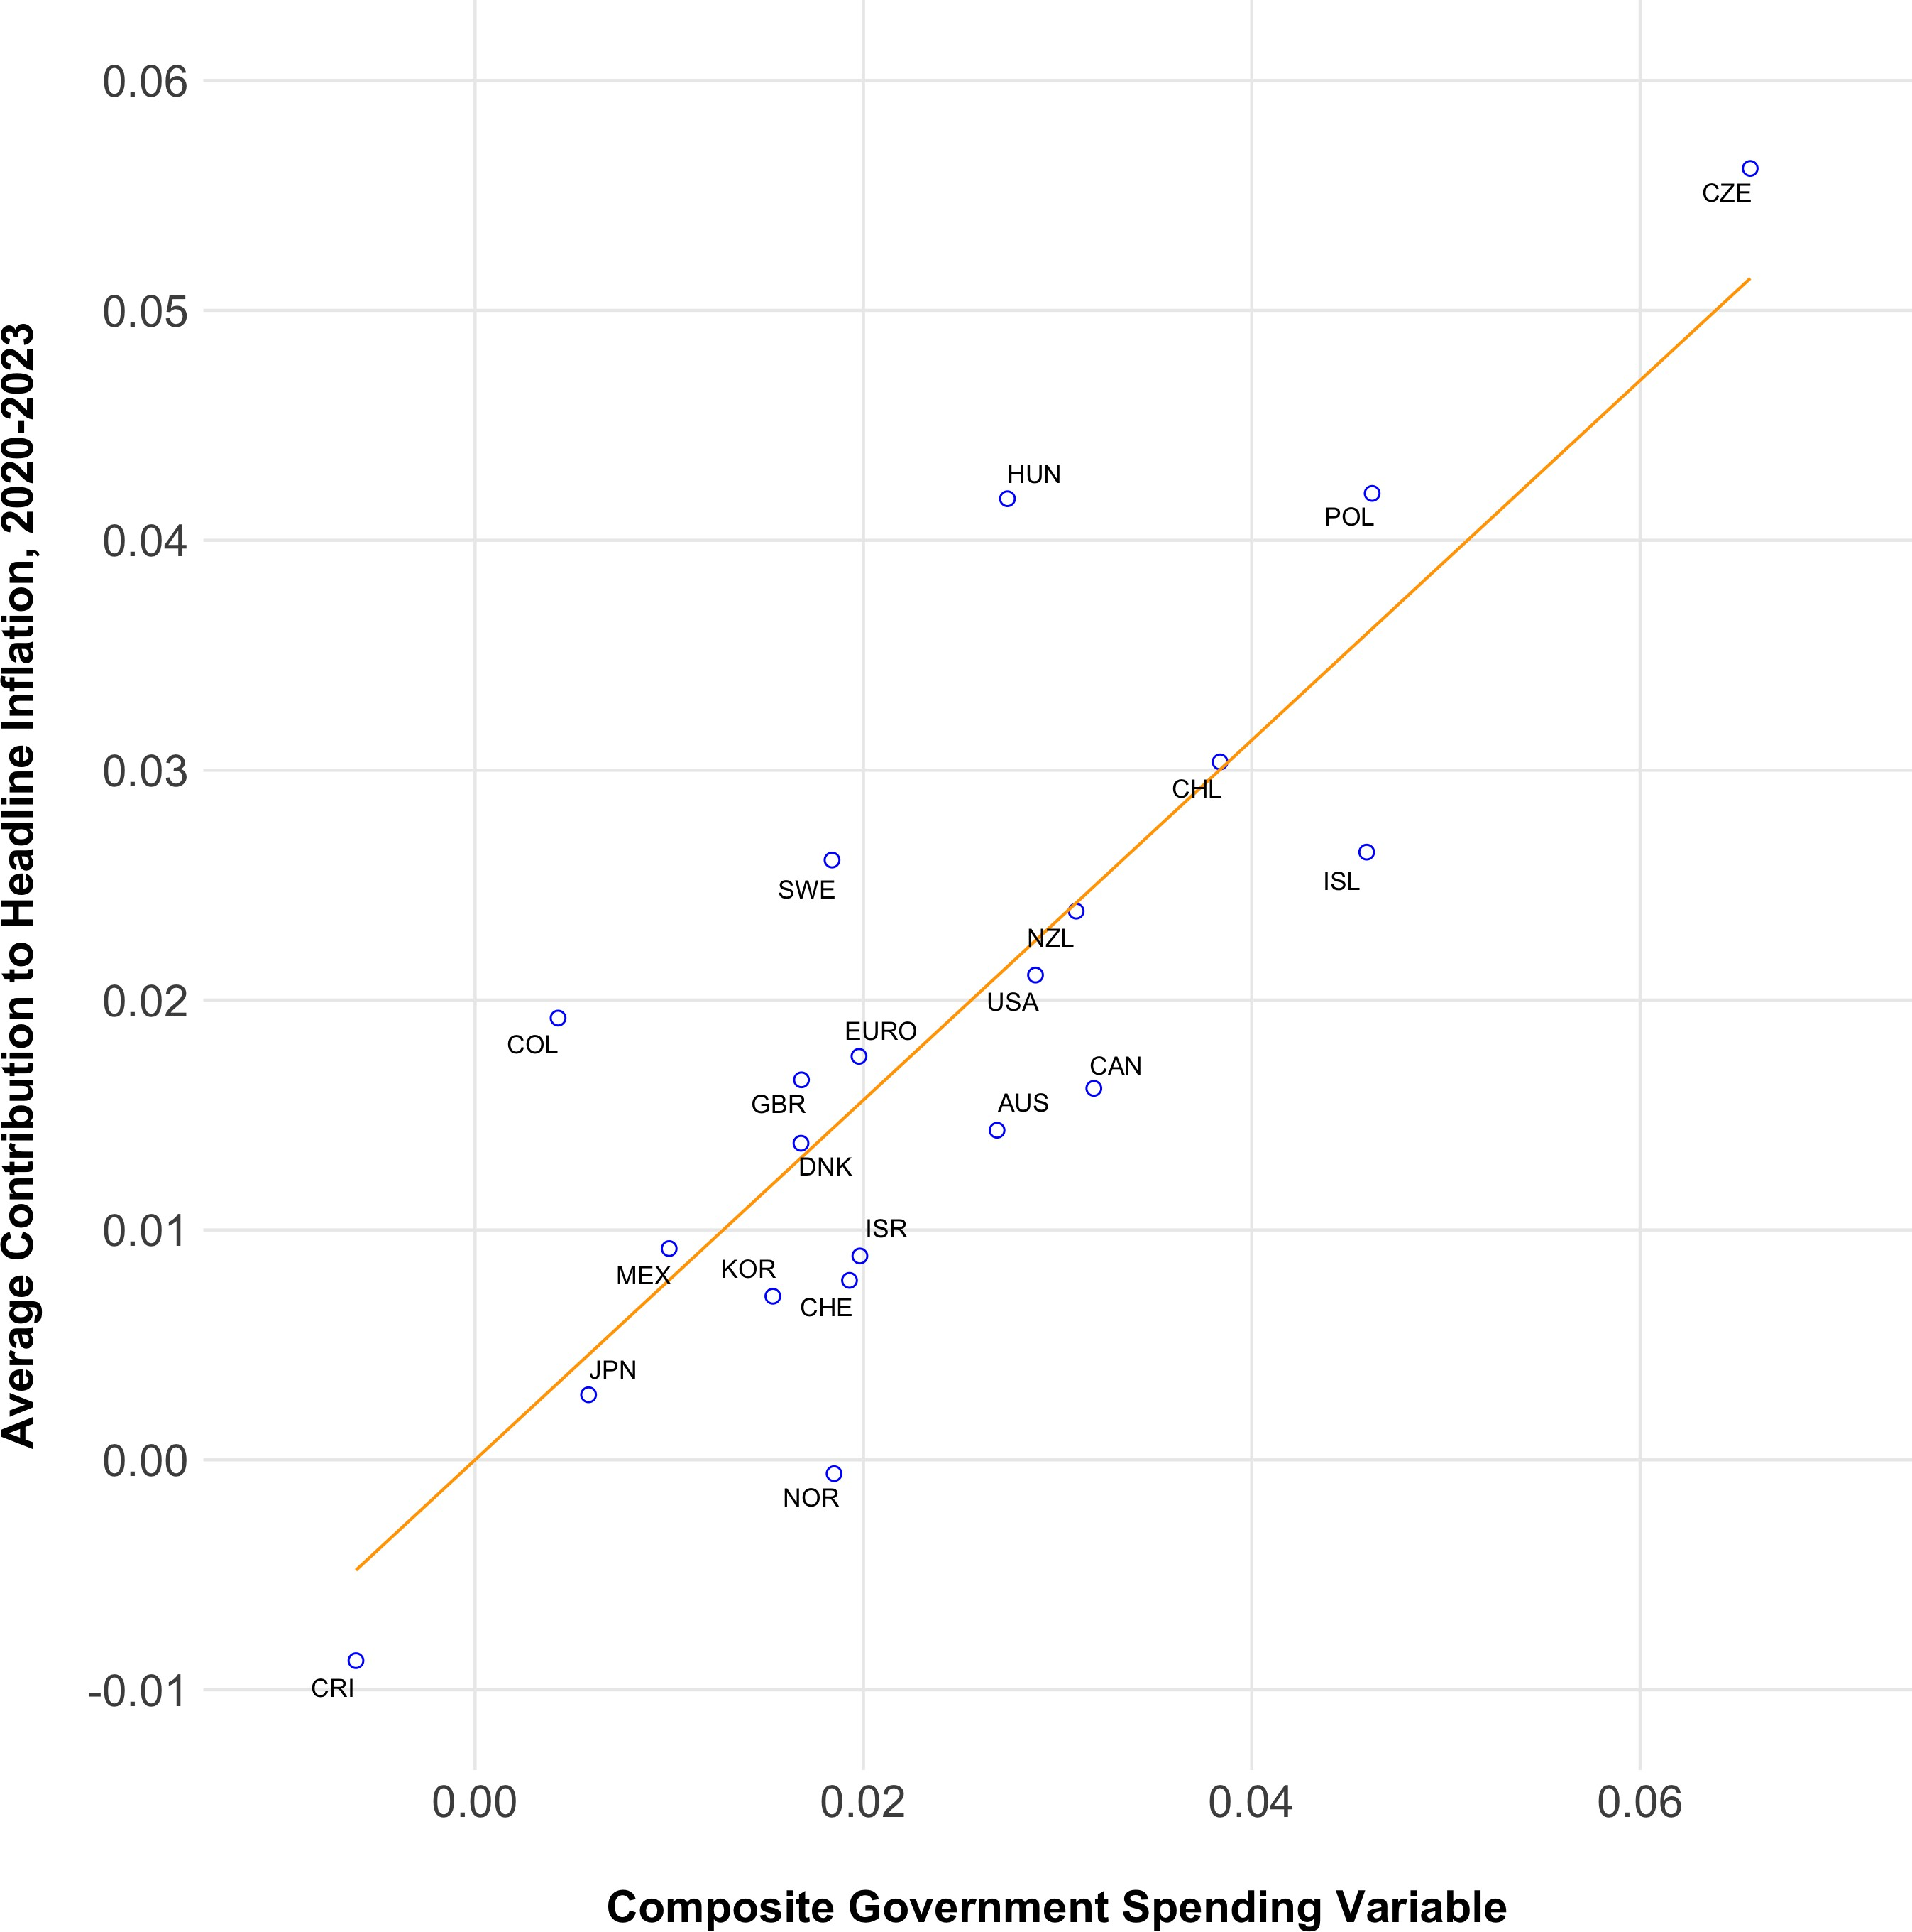
Headline CPI inflation versus composite govt-spending variable
Main results
Fiscal Influences on Inflation in OECD Countries

Slide 17
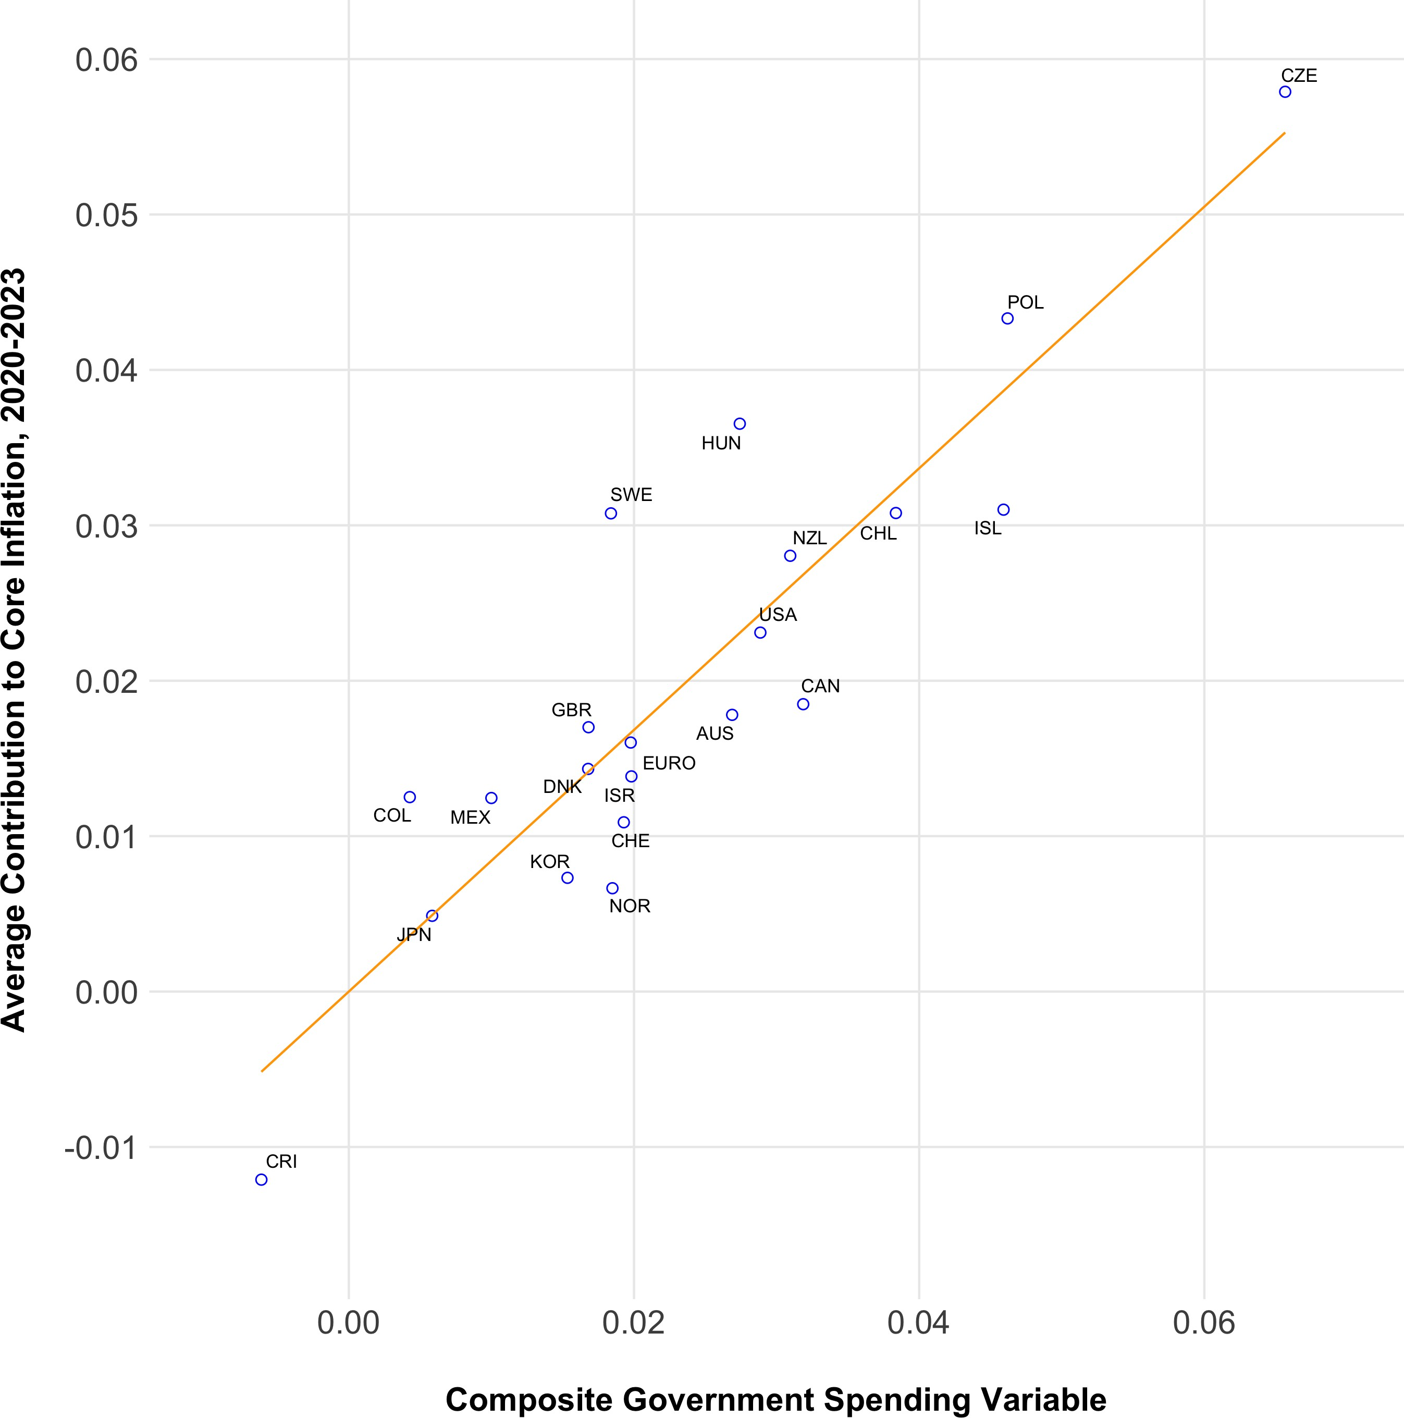
Core CPI inflation rate versus composite govt-spending variable
Main results
Fiscal Influences on Inflation in OECD Countries

Slide 18
Inflation versus Govt Spending
Main results
Figures depict the relationship between the change in CPI inflation rate (headline & core) and the govt-spending variable. Effects of border dummy filtered out.
U.S. not an outlier. Lies moderately above average for the govt-spending variable (0.029 vs. 0.024) and close to average for changes in inflation rates.
Euro area below U.S. for inflation and govt-spending variable.
Clear positive slopes that do not seem to be driven by extreme observations.
Fiscal Influences on Inflation in OECD Countries

Slide 19
Components of Govt-Spending Variable
Extensions and robustness checks
Assess how statistical significance of composite government-spending variable relates to 3 components: ∆(G/Y ), debt-GDP ratio, debt duration.
1
Each component set, one at a time, at sample mean → Designated variable restricted not to contribute to explanation of cross-sectional variations in inflation.
Constraint amounts to one coefficient restriction imposed on estimation: Test validity of restriction using -2*log(likelihood ratio) distributed asymptotically as Chi-squared variable with one degree of freedom.
Restricted model always strongly rejected for headline and core inflation.
2
3
Can also use linear approximation to express right side as 3 separate terms: values relative to sample means of spending surge, initial debt-GDP ratio, initial duration.
1
Get three separate coeffs, pattern: +, -, -.
Accept hypothesis that coeffs equal size with this sign pattern.
2
Fiscal Influences on Inflation in OECD Countries

Slide 20
Including only Fiscal Surge
Extensions and robustness checks
Positive connection between change in inflation rate and incremental government
spending, ∆ ^{G} , not surprising from Keynesian perspective.
Y
Distinguishing feature of present model is two scaling variables—initial values of debt-GDP ratio and debt duration.
In particular, effect of debt-GDP ratio on boost to inflation negative for given ∆ ^{G} ,
Y
whereas aggregate-demand model might generate opposite sign.
If fiscal variable enters just as ∆ ^{G} , estimated coefficients positive, but only marginally
Y
significant and fit much poorer.
Fiscal Influences on Inflation in OECD Countries

Slide 21
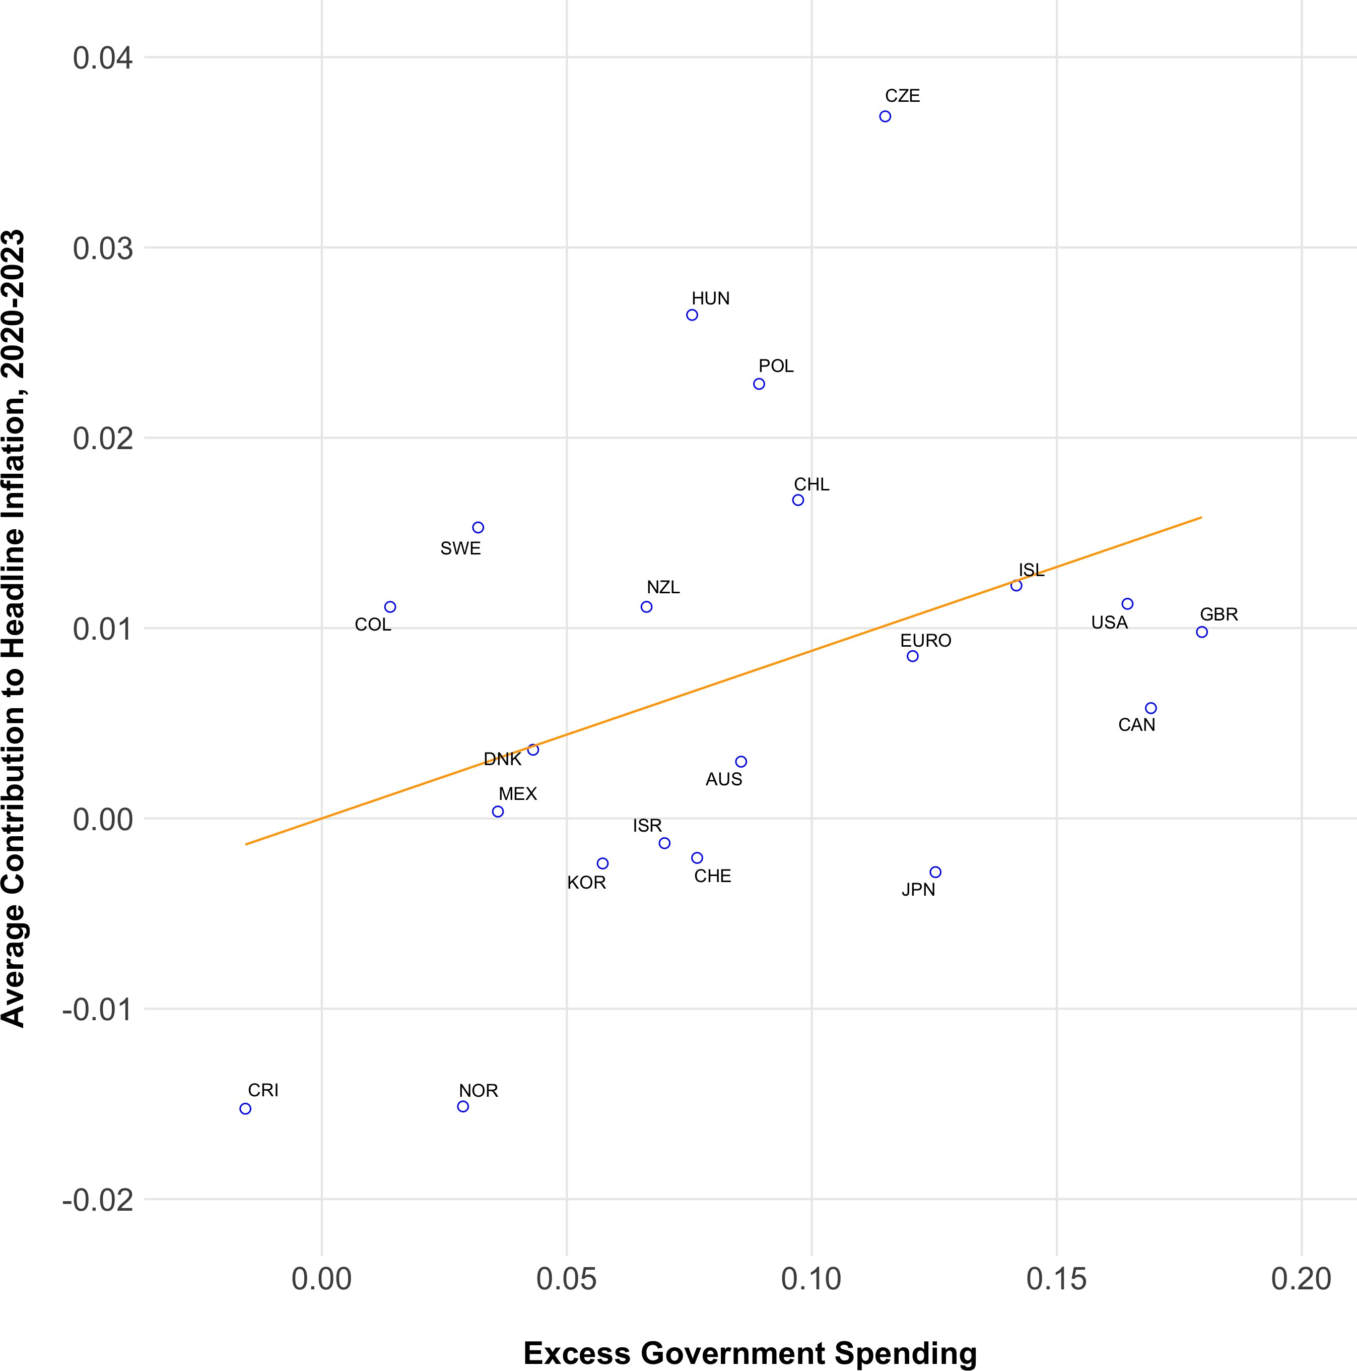
Change in headline CPI inflation rate versus excess govt spending
Extensions and robustness checks
Fiscal Influences on Inflation in OECD Countries

Slide 22
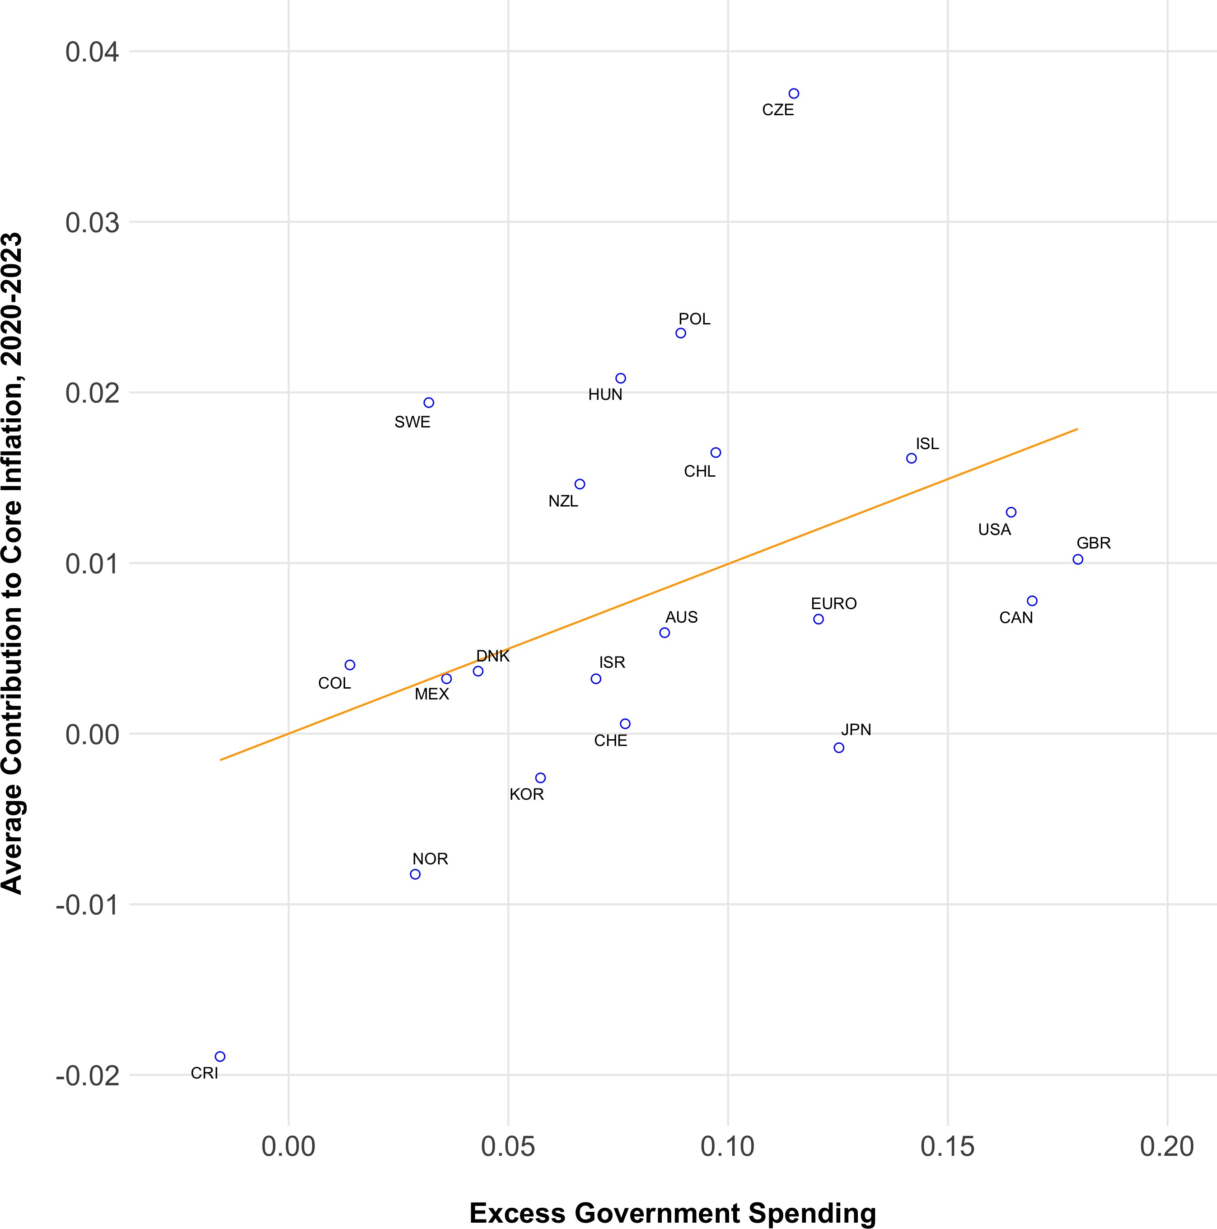
Change in core CPI inflation rate versus excess govt spending
Extensions and robustness checks
Fiscal Influences on Inflation in OECD Countries

Slide 23
Euro-zone countries entered separately
Extensions and robustness checks
First G-variable same as baseline; Euro countries have Euro-area weighted average. Second G-variable for Euro zone is individual G relative to Euro-area average.
Coefficient on second variable does not differ significantly from zero for core inflation, marginally significant for headline.
Main conclusion is aggregating Euro-zone countries into one economy satisfactory for analyzing effects of G variable on inflation rates.
Does not mean that Euro zone is a “fiscal area.”
Fiscal Influences on Inflation in OECD Countries

Slide 24
Regressions for Change in Inflation - EA countries
Extensions and robustness checks
 | Headline CPI inflation rate | Core CPI inflation rate
Excess govt spending/(gross debt)*duration Table 1 | 0.737*** | 0.810***
 | (0.104) | (0.080)
Excess govt spending/(gross debt)*duration: Euro area | 0.143** | 0.071
 | (0.065) | (0.050)
Border with Ukraine/Russia | 0.0457*** | 0.0283***
 | (0.0041) | (0.0031)
Number of Observations | 518 | 518
R-squared | 0.823 | 0.805
s.e. of regression | 0.0129 | 0.0099
log(likelihood) | 1548 | 1684
Regressions by panel OLS, s.e.’s in parentheses. Each regression includes country and year fixed effects.
***p<0.01, **p<0.05, *p<0.1
Fiscal Influences on Inflation in OECD Countries

Slide 25
Additional Results
Extensions and robustness checks
Prediction that length of high inflation equal to duration of public debt. For U.S., this is 5 years, starting 2020. Higher duration for UK (10-12 years), Euro area (7).
Next figure shows evolution of ratios of gross public debt to GDP—U.S. and GDP-weighted average for 21 economies.
Surge in 2020 with fiscal deficits. Down since—effects of rising nominal GDP and decline in market value of debt because of rising nominal interest rates.
Fiscal Influences on Inflation in OECD Countries

Slide 26
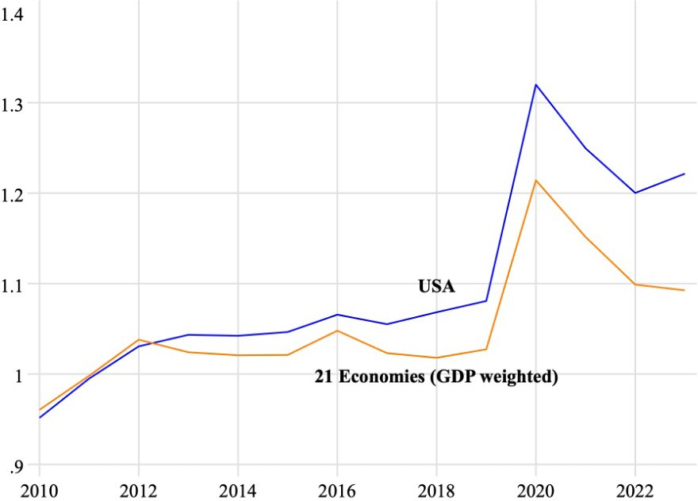
Extensions and robustness checks
Ratio of Gross Public Debt to GDP
Fiscal Influences on Inflation in OECD Countries

Slide 27
Conclusions
Extensions and robustness checks
We examine the relationship between fiscal stimulus and post-pandemic inflation
We find strong and positive relation between inflation and the increase in spending rescaled by maturity and size of outstanding debt
We control for global effects of the pandemic via a time fixed effect
All components of the composite spending variable matter. Relation weaker when one of the components is excluded by the analysis.
Fiscal Influences on Inflation in OECD Countries

Slide 28
Current Research
What’s next?
Adding 9 non-OECD countries with data: Brazil, Croatia, India, Indonesia, Malaysia, Peru, Singapore, South Africa, Thailand.
Will apply to U.S. states. Analogous to Euro zone?
Policy implications: was it mistake to have inflation surge, contingent on paths of government spending?
Fiscal Influences on Inflation in OECD Countries

Slide 29
Table 6
What’s next?
Headline CPI Inflation Rate
Core CPI Inflation Rate
 | (1) | (2) | (3) | (4) | (5) | (6)
Variable Set at Sample Mean: | Govt Spending | Gross Debt | Duration | Govt Spending | Gross Debt | Duration
Composite Government Spending | 0.415*** | 0.487*** | 0.722*** | 0.498*** | 0.537*** | 0.776***
 | (0.146) | (0.128) | (0.125) | (0.124) | (0.108) | (0.104)
Border Dummy | 0.0394*** | 0.0435*** | 0.0479*** | 0.0235*** | 0.0285*** | 0.0333***
 | (0.0071) | (0.0067) | (0.0065) | (0.0060) | (0.0057) | (0.0054)
Number of Observations | 294 | 294 | 294 | 294 | 294 | 294
R-squared | 0.761 | 0.766 | 0.781 | 0.724 | 0.732 | 0.759
s.e. of Regression | 0.0142 | 0.0140 | 0.0136 | 0.0120 | 0.0119 | 0.0113
log(Likelihood) | 853.151 | 856.684 | 866.552 | 901.164 | 905.687 | 921.138
p-value | 0.000 | 0.000 | 0.000 | 0.000 | 0.000 | 0.000
Relative Likelihood (AIC) | 0.000 | 0.000 | 0.000 | 0.000 | 0.000 | 0.000
Regressions by panel OLS, s.e.’s in parentheses. Each regression includes country and year fixed effects. ***p<0.01, **p<0.05, *p<0.1
Fiscal Influences on Inflation in OECD Countries

Slide 30
Table 7
What’s next?
Headline CPI inflation rate Core CPI inflation rate
⁽G − G⁾ · Ω/G
⁽B − B⁾ · Ω/B
⁽D − D⁾ · Ω/D
0.749*** (0.169)
-0.520*** (0.144)
-0.721**
(0.306)
0.0412*** (0.0069)
0.825*** (0.141)
-0.554*** (0.120)
-0.781***
(0.255)
0.0262*** (0.0058)
Border with Ukraine/Russia
Number of Observations R-squared
s.e. of regression p-value
294
0.776
0.0138
0.406
294
0.750
0.0115
0.166
Regressions by panel OLS, s.e.’s in parentheses. Each regression includes country and year fixed effects.
***p<0.01, **p<0.05, *p<0.1
Fiscal Influences on Inflation in OECD Countries

Slide 31
Table 5 - Alternative version - OLS with 21 economies
What’s next?
Headline CPI inflation rate Core CPI inflation rate
 | (1) | (2) | (3) | (4)
Constant | 0.0079 | 0.0066 | 0.0005 | -0.0004
 | (0.0060) | (0.0049) | (0.0044) | (0.0039)
Excess govt spending/(gross debt)*duration | 0.856*** | 0.758*** | 0.887*** | 0.822***
 | (0.209) | (0.175) | (0.156) | (0.137)
Border with Ukraine or Russia |  | 0.0251*** |  | 0.0166***
 |  | (0.0079) |  | (0.0062)
Observations | 21 | 21 | 21 | 21
R-squared | 0.468 | 0.660 | 0.631 | 0.737
s.e. of regression | 0.0151 | 0.0124 | 0.0112 | 0.0097
Regressions by panel OLS, s.e.’s in parentheses. Each regression includes country and year fixed effects.
***p<0.01, **p<0.05, *p<0.1
Fiscal Influences on Inflation in OECD Countries

