Slide 1
Which customers are happy customers?
Kaggler Part.2 3조
2015. 4. 23

Slide 2
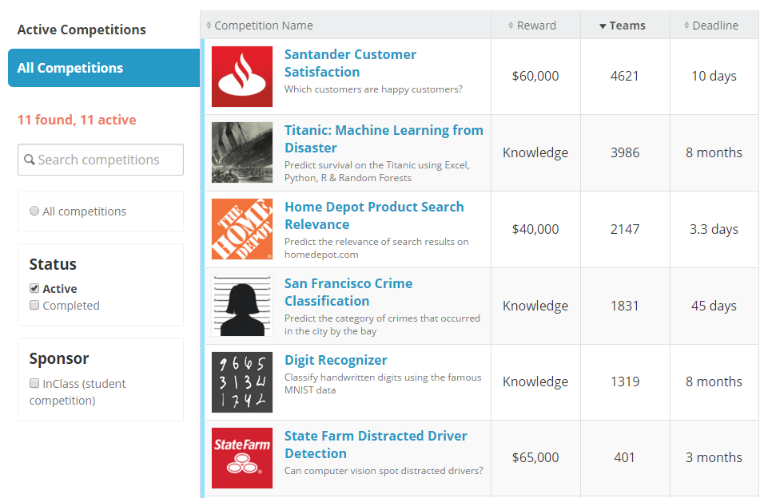
Will this be the biggest competition to date?

Slide 3

Kaggle competition
Customer satisfaction is a key measure of success
Identify dissatisfied customers early in their relationship
Work with hundreds of anonymized features to predict
*Prize : 1st place - $30,000, 2nd place - $20,000, 3rd place - $10,000 (~5/2)

Slide 4
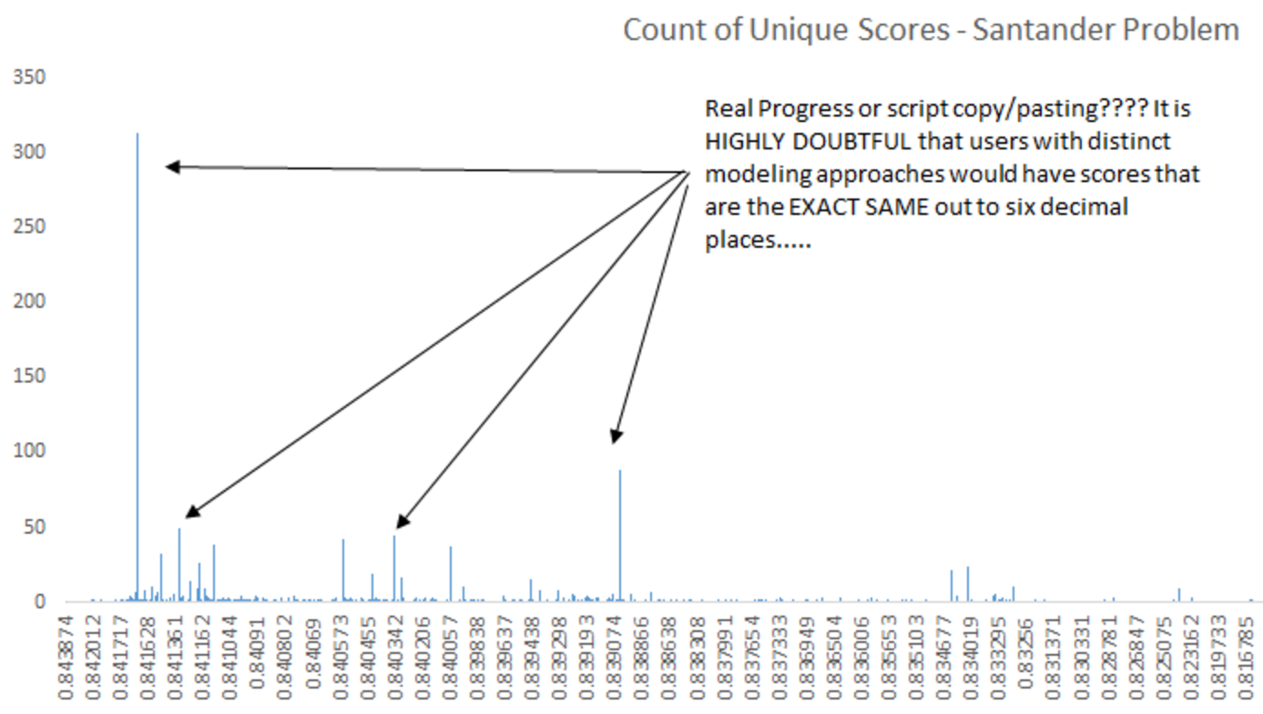
Real Progress ? or Script Copy/Pasting ?
Count of Scores

Slide 5
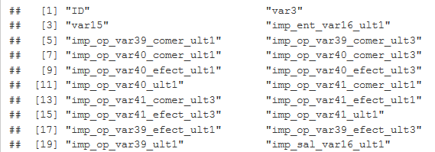

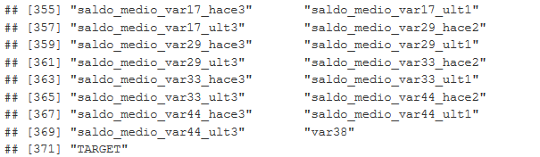
Data Dictionary ?
* 고객 수 76,000여명 , 변수 371개
Notes:
variable

Slide 6
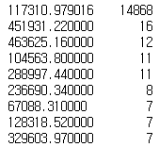
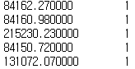
Exploring Features (Var38) - 1/3
Unique Value
Count
The most common value
117,311
Overall Average
117,386
Average (Except for the most common value)
117,218
In Spain the average mortgage has been fluctuating between 118,000 euros in 2011 and 105,000 in 2015.
** Var38 = Mortgage Value

Slide 7
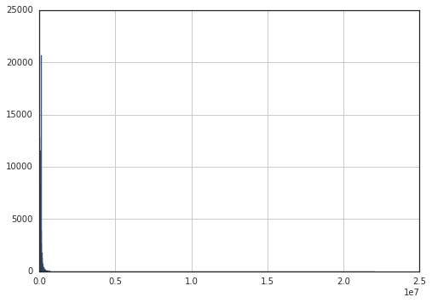
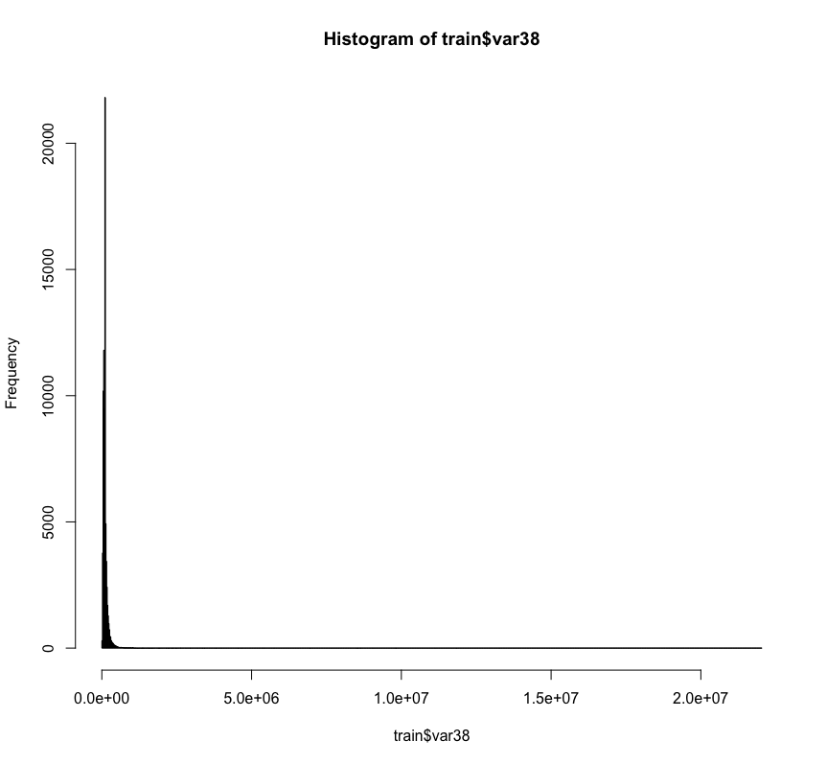
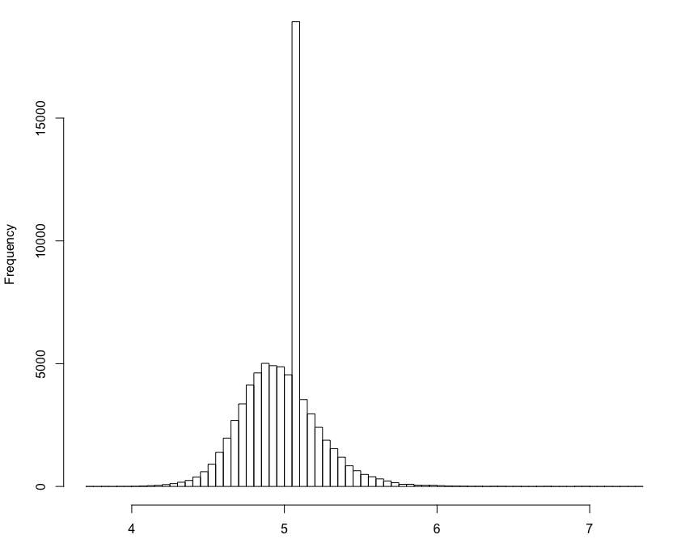
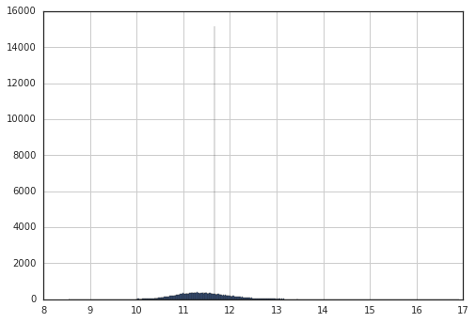
Exploring Features (Var38) - 2/3
Histogram_Var38
Histogram_Var38
Histogram_log10_Var38
Histogram_log_Var38

Slide 8
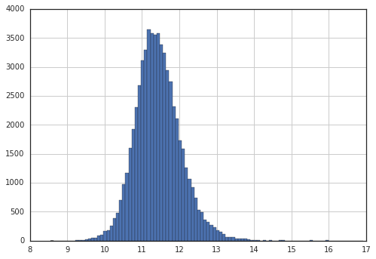
Exploring Features (Var38) - 3/3
Histogram_Var38
Histogram_log10_Var38
(Except for the most common value)
Histogram_log_Var38

Slide 9
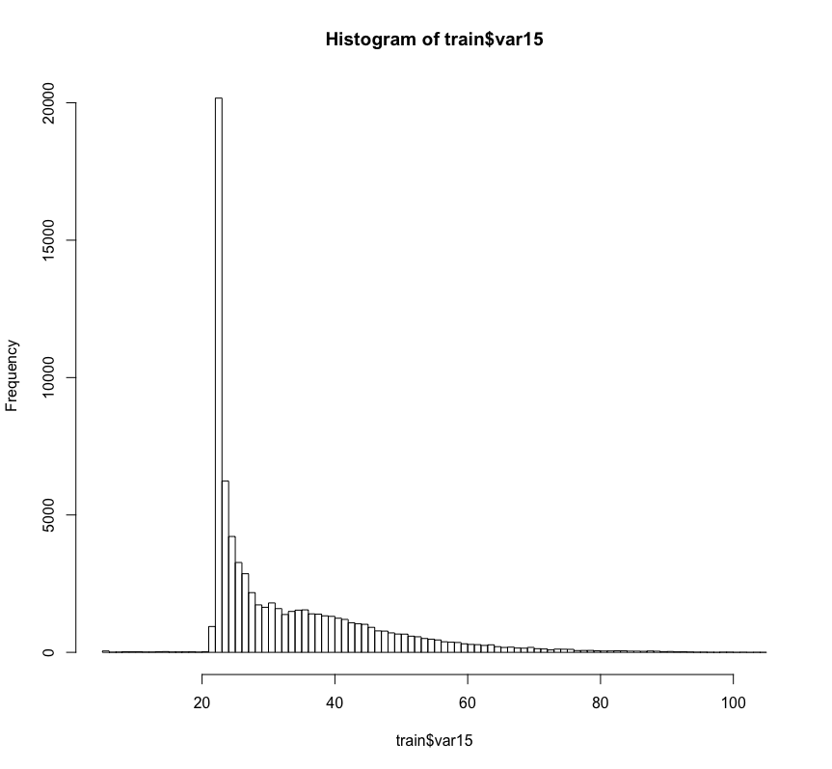
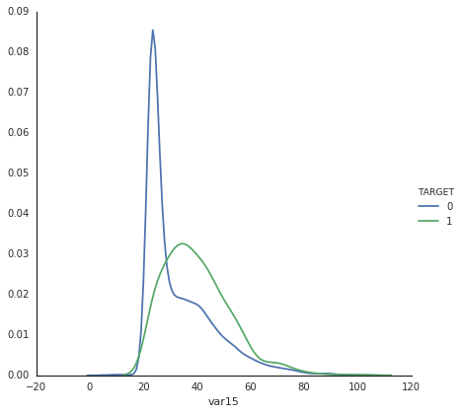
Exploring Features (Var15)
Histogram_Var15
Histogram_Var15
Happy Customer
Unhappy Customer
Min : 5.00
Max : 105.00
Avg : 33.14
** Var15 = Age

Slide 10
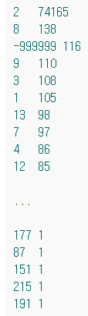
Exploring Features (Var3)
Unique
Value
Count
Count of Variable
208
There are about 208 different codes, and the distribution is pretty similar to what I would expect for a Santander Bank
** Var3 = Country or Residence

Slide 11
Exploring Features (num_var4)
Unique
Value
Count
Count of Variable
208
There are about 208 different codes, and the distribution is pretty similar to what I would expect for a Santander Bank
** Var3 = Country or Residence

Slide 12
Exploring Features (Cash Product)
Var 13
Var 24
Var 14
Var 20
Var 30
(Total Cash Balance)
Var 05
Var 08
Var 42
Var 06
Var 29
Var 12

Slide 13
Exploring Features (Card/Credit Product)
Var 39
Var 40
Var 41
Card Product
Var 01
Var 18
Var 34
Credit Product
Var 31
Var 17
Var 44
Var 33

Slide 14
Introduction to Boosted Trees
XGBoost is short for “eXtreme Gradient Boosting”
“Gradient Boosting” is proposed in the paper Greedy Function Approximation: A Gradient Boosting Machine, by Friedman.
XGBoost is used for supervised learning problems

Slide 15
Reference
http://xgboost.readthedocs.org/en/latest/model.html#final-words-on-xgboost
http://www.slideshare.net/ShangxuanZhang/kaggle-winning-solution-xgboost-algorithm-let-us-learn-from-its-author
https://www.kaggle.com/red8012/santander-customer-satisfaction/0-68-subsample-571/run/193187/code

