Slide 1
Predicting Dubai Property
Transaction Value
An End-to-End ML Pipeline on Dubai Land Department Data
ML 7501 – Applied Machine Learning | 2026
ML 7501 | Dubai Real Estate ML Project

Slide 2
Project Overview
Problem Statement
Pipeline Stages
Predict actual_worth (transaction selling price) from raw Dubai Land Department records, enriched with rental-market and hotel-sector context.
01
Exploratory Data Analysis
02
Data Preprocessing & Feature Engineering
Hypothesis
Sale price is driven by structural attributes, location, and market context — not size alone. Tree-based ensembles should outperform linear baselines due to non-linearity and interactions.
03
Model Training & Tuning (≥3 models, 2 tuned)
04
Comparative Evaluation & Error Analysis
Data Sources
• DLD Transaction Records (5,000 rows, 47 cols) — master table
• DLD Rental Contracts — area-time enrichment
• UAE Hotel Statistics — annual macro context
05
Conclusions & Data-Driven Storytelling
ML 7501 | Dubai Real Estate ML Project

Slide 3
Exploratory Data Analysis
Understanding the raw data landscape
ML 7501 | Dubai Real Estate ML Project

Slide 4
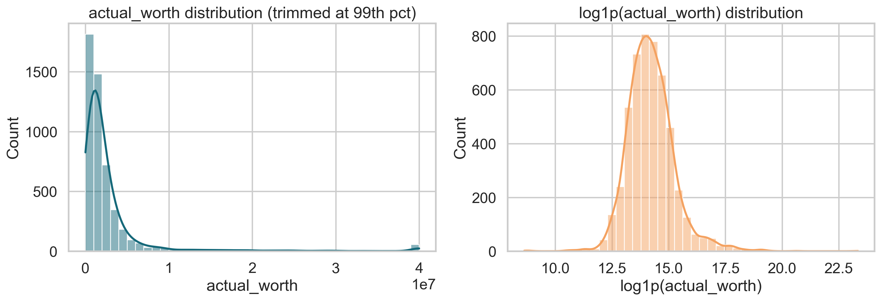
Dataset Overview & Quality Issues
5,000
47
5,000
3
Transaction rows
Transaction columns
Rental rows
Data sources merged
Key EDA Findings
Target Distribution: actual_worth
▸ actual_worth is strongly right-skewed with major outliers — supports log-target testing
▸ meter_sale_price identified as leakage risk — excluded from all features
▸ Rental/project fields are useful but sparse; area_id is the most reliable join anchor
▸ Hotel data suitable only as annual macro context (no neighborhood-level join)
▸ Mix of numerical, categorical, temporal, and multilingual columns requiring careful encoding
ML 7501 | Dubai Real Estate ML Project

Slide 5
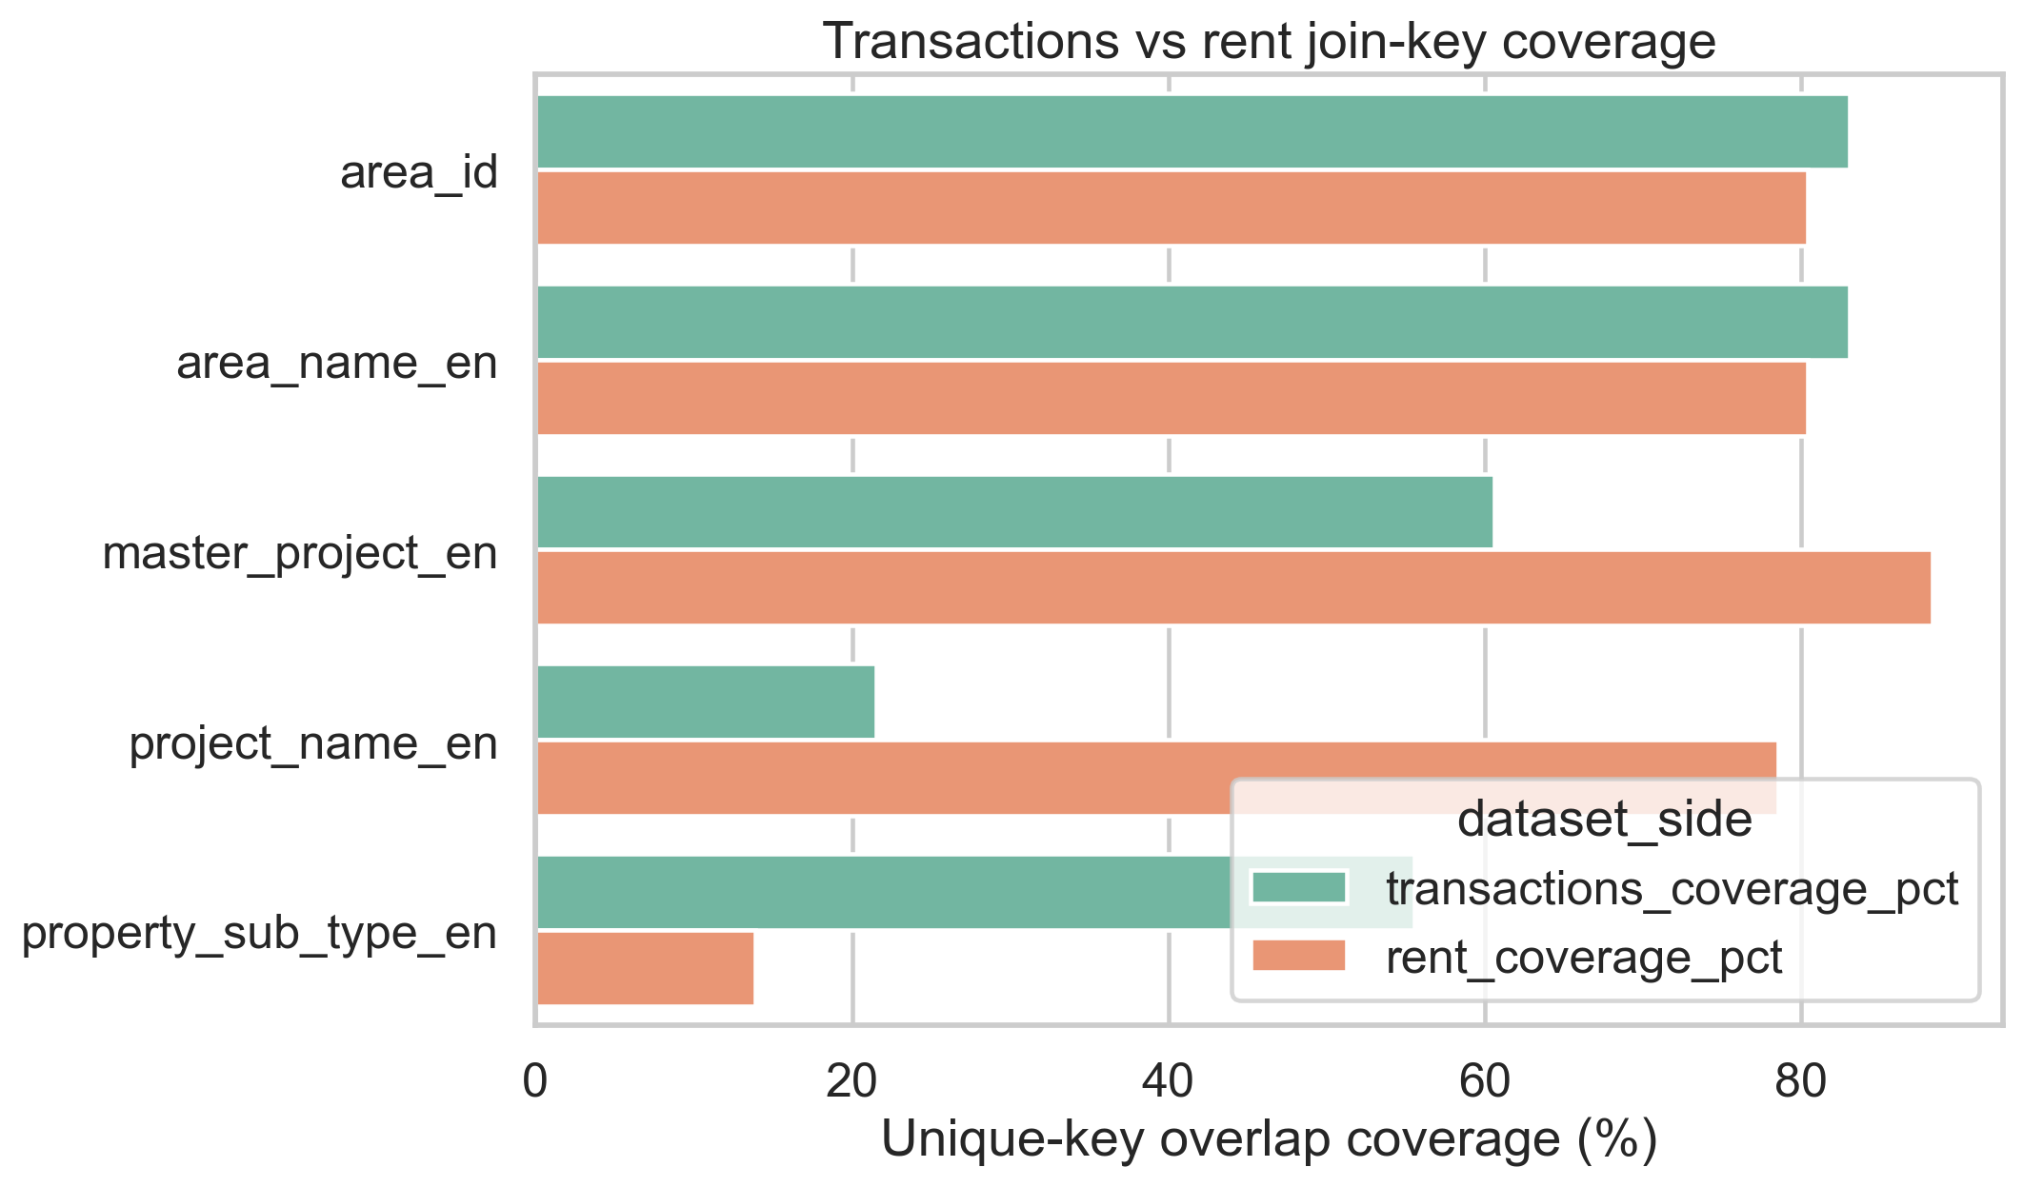
Multi-Source Join Strategy
Join Feasibility Analysis
Join Strategy Decisions
Strong overlap
area_id & area_name_en — primary join keys
Weak overlap
Project-name joins unreliable — avoided
Annual only
Hotel data joined at year level — macro signal
Leak-free
Rental features aggregated before transaction date
Imputation
Median for numerical, mode for categorical missing vals
ML 7501 | Dubai Real Estate ML Project

Slide 6
Preprocessing & Feature Engineering
Building a leak-free, model-ready feature set
ML 7501 | Dubai Real Estate ML Project

Slide 7
Preprocessing Strategy
Missing Value Handling
Numerical Scaling & Leakage
• Numerical: median imputation within HistGradientBoosting's native NaN support
• StandardScaler applied for Ridge/SVM pipelines
• Categorical: mode imputation + 'Unknown' fill for sparse fields
• Tree models: no scaling required (native)
• Rationale: preserves distribution without distortion
• meter_sale_price excluded — direct price proxy (leakage)
Categorical Encoding
Feature Engineering
• Tree models: OrdinalEncoder (integer codes, HGB splits natively)
• area_time rental aggregates: median rent by area + year window
• Linear models: OneHotEncoder(handle_unknown='infrequent_if_exist', min_frequency=15)
• Annual hotel macro features joined at transaction year
• Arabic/multilingual text columns: dropped before encoding
• Temporal features: month, quarter, year-of-transaction
ML 7501 | Dubai Real Estate ML Project

Slide 8
Model Training & Hyperparameter Tuning
Systematic comparison of 5 algorithms
ML 7501 | Dubai Real Estate ML Project

Slide 9
Model Lineup & Train/Validation/Test Split
Temporal Split (no random shuffle — preserves time order to prevent leakage)
Train: 3,500 rows
Validation: 750 rows
Test: 750 rows
1994-07-13 → 2024-03-26
2024-03-27 → 2025-05-07
2025-05-07 → 2026-03-23
Model
Description
Tuned Parameters
Tuned?
Best?
Dummy Baseline
Zero-rule baseline
None
✗
✗
Ridge Regression
L2-penalised linear model
alpha, solver
✗
✗
SVM
Linear kernel (LinearSVR/LinearSVC)
C
✗
✗
Random Forest
Bagging of decision trees
n_estimators, max_depth, max_features
✓
✓
HistGradientBoosting
Native-NaN gradient boosting
lr, max_depth, max_leaf_nodes, min_samples_leaf
✓
✓
ML 7501 | Dubai Real Estate ML Project

Slide 10
Hyperparameter Tuning Details
Regression Tuning
Classification Tuning
Random Forest (CV score: −130,900,305)
Random Forest (CV AUC: 0.9292)
• n_estimators: 550
• n_estimators: 400
• min_samples_split: 2
• min_samples_split: 10
• min_samples_leaf: 1
• min_samples_leaf: 1
• max_features: 1.0
• max_features: 0.5
• max_depth: 10
• max_depth: 20
HistGradientBoosting ★ Best (CV: −130,608,864)
HistGradientBoosting ★ Best (CV AUC: 0.9309)
• learning_rate: 0.08
• learning_rate: 0.03
• max_depth: 8
• max_depth: None (unlimited)
• max_iter: 250
• max_iter: 500
• max_leaf_nodes: 15
• max_leaf_nodes: 15
• min_samples_leaf: 10
• min_samples_leaf: 40
• l2_regularization: 0.0
• l2_regularization: 0.0
ML 7501 | Dubai Real Estate ML Project
Search method: Randomized Search CV (5 folds, neg_RMSE / ROC-AUC scoring)

Slide 11
Results & Evaluation
Regression and classification performance analysis
ML 7501 | Dubai Real Estate ML Project

Slide 12
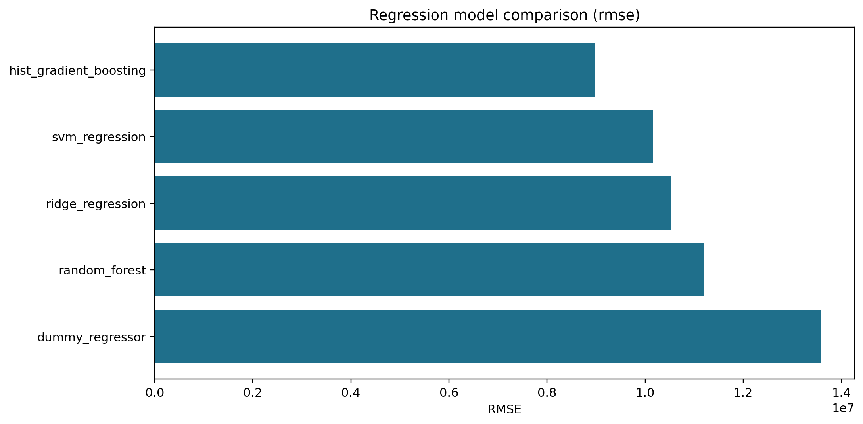
Regression Results — Predicting actual_worth
Model Comparison (Test RMSE)
Test-Set Metrics
Model
RMSE
MAE
R²
Dummy
13,588,574
2,745,713
-0.031
Ridge
10,515,760
1,654,041
0.383
SVM
10,159,923
1,589,670
0.424
Random Forest
11,200,241
1,651,601
0.300
★ HGB
8,965,434
1,394,205
0.551
Bootstrap 95% CI (HGB RMSE): 2,791,517 – 14,764,561 | R²: 0.526 – 0.707
ML 7501 | Dubai Real Estate ML Project

Slide 13
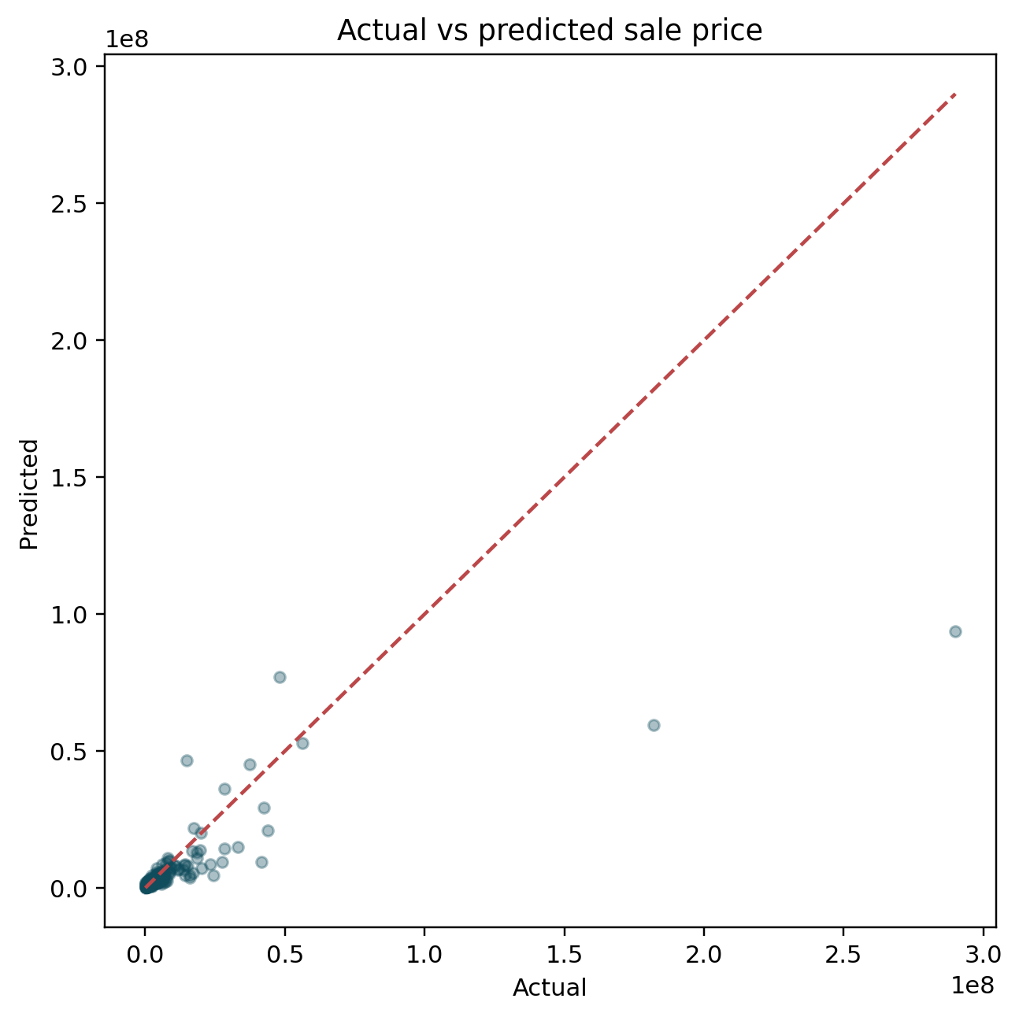
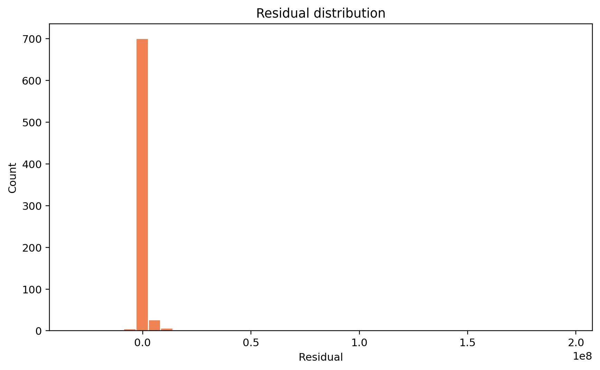
Regression Diagnostics — HistGradientBoosting
Actual vs Predicted
Residuals Plot
ML 7501 | Dubai Real Estate ML Project

Slide 14
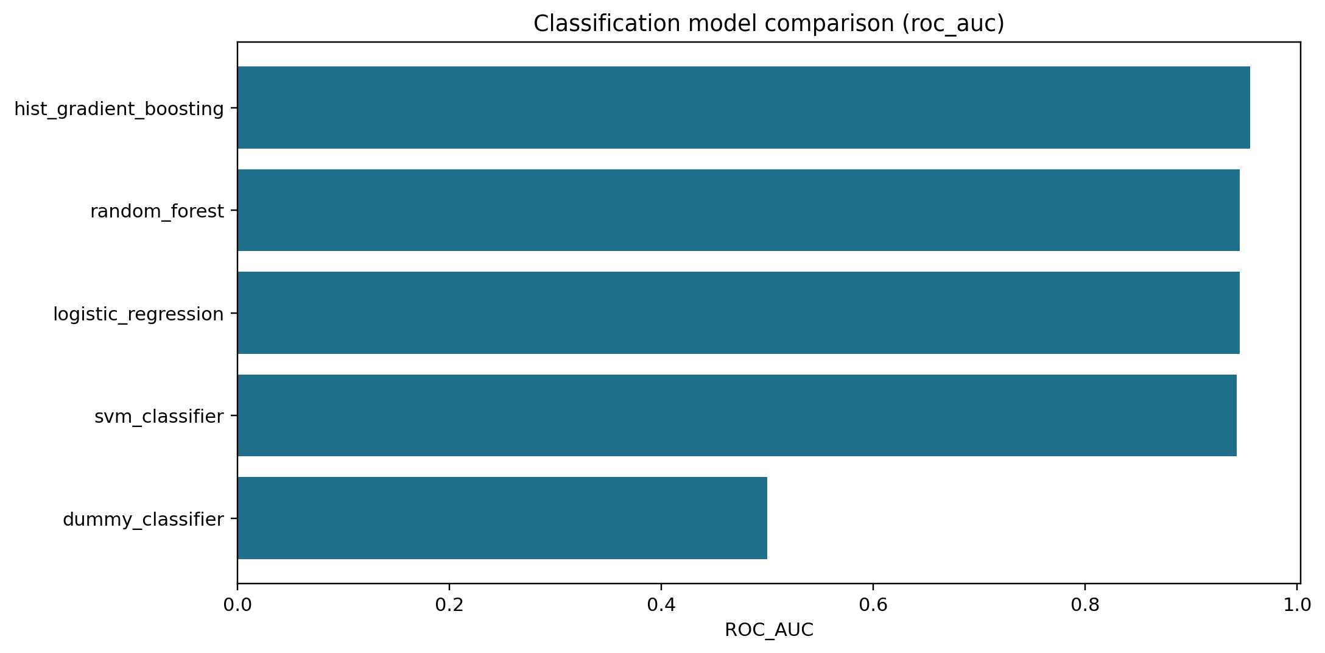
Classification Results — is_high_value (≥ AED 2.4M)
Model Comparison (ROC AUC)
Test-Set Metrics
Model
Acc.
F1
AUC
Dummy
0.639
0.000
0.500
LogReg
0.872
0.826
0.946
SVM
0.860
0.804
0.943
Rand. Forest
0.881
0.823
0.946
★ HGB
0.887
0.832
0.956
Bootstrap 95% CI (HGB ROC AUC): 0.942 – 0.967
ML 7501 | Dubai Real Estate ML Project

Slide 15
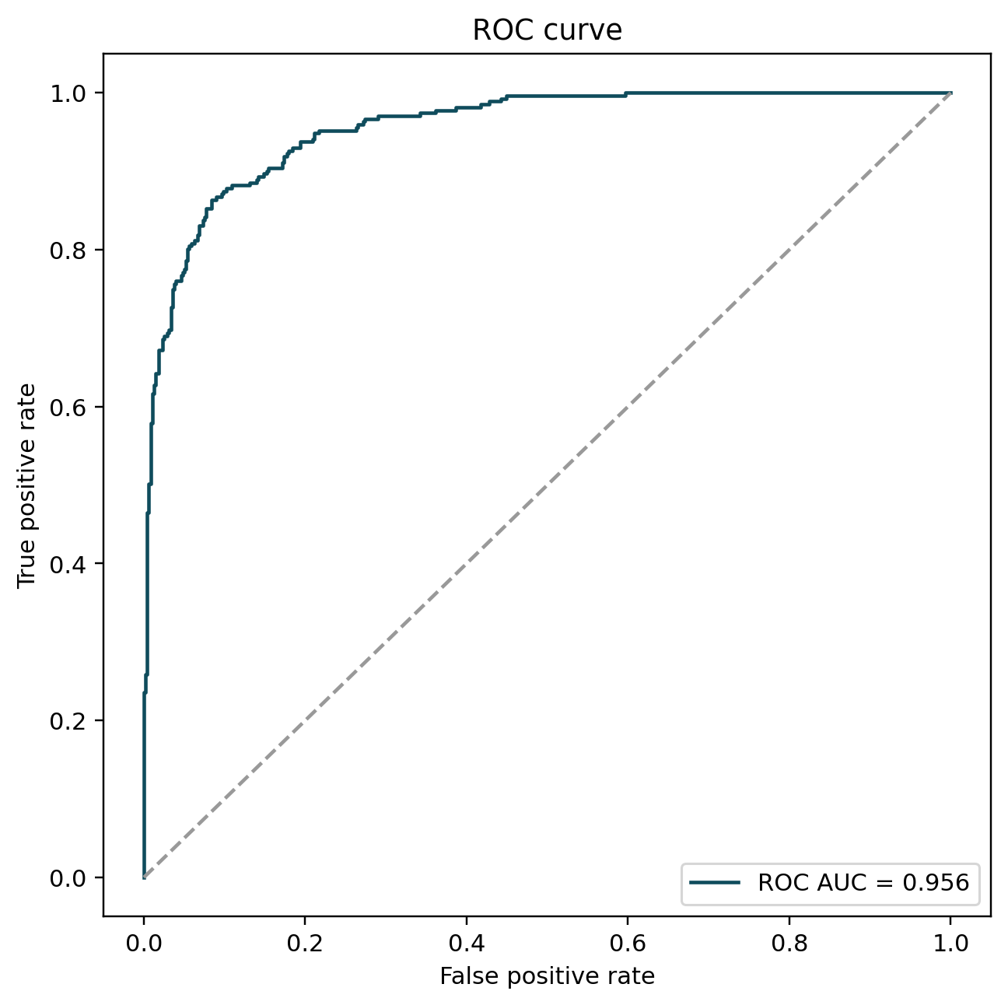
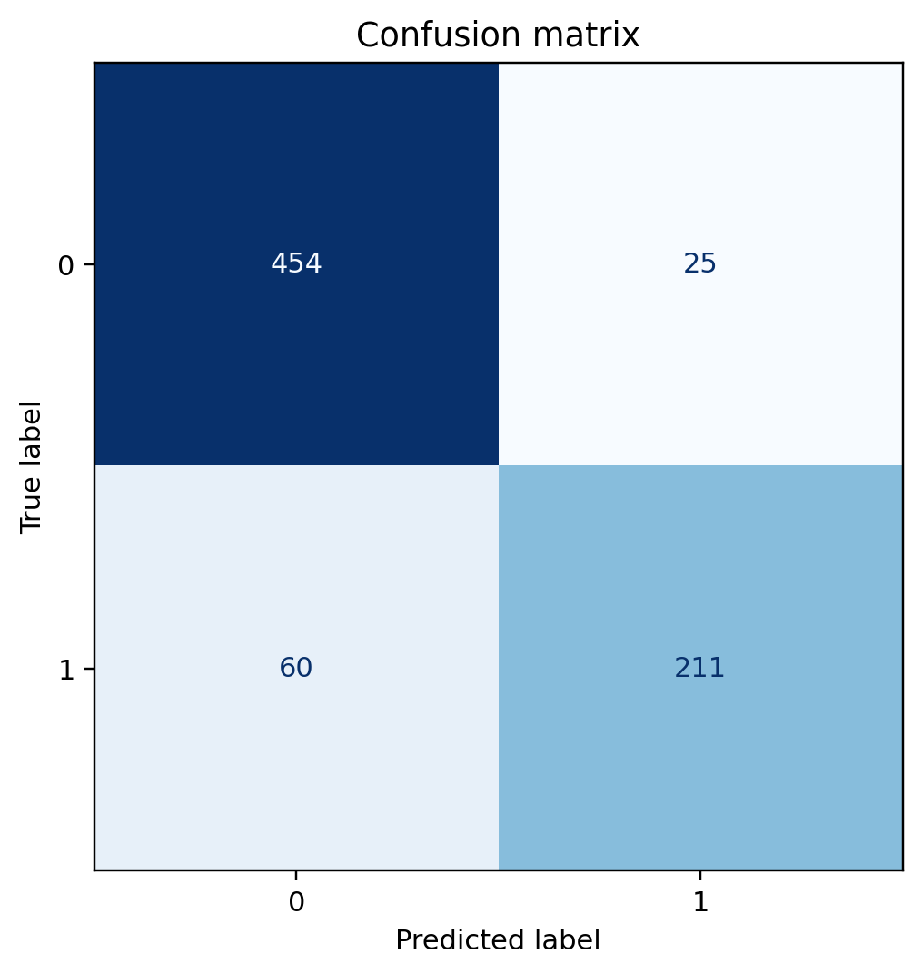
Classification Diagnostics — HistGradientBoosting
ROC Curve (AUC = 0.9557)
Confusion Matrix
ML 7501 | Dubai Real Estate ML Project

Slide 16
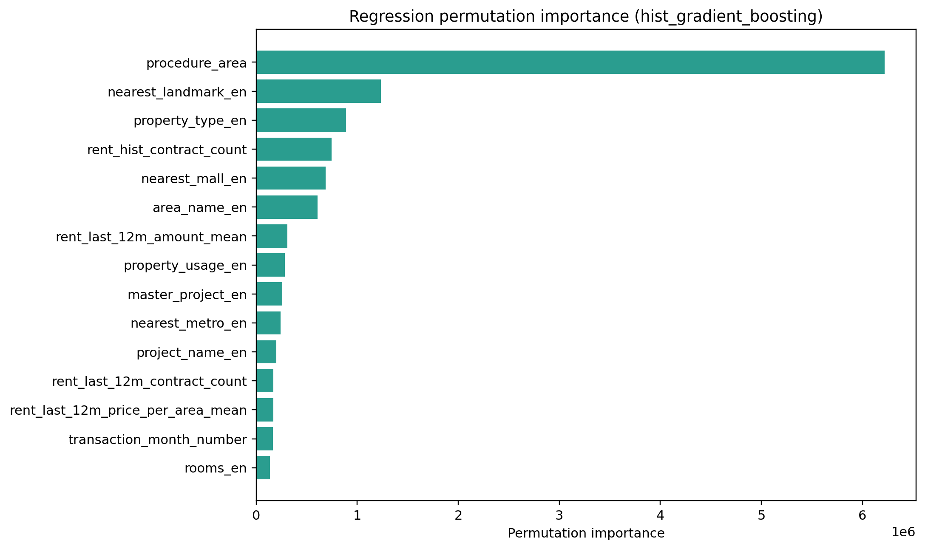
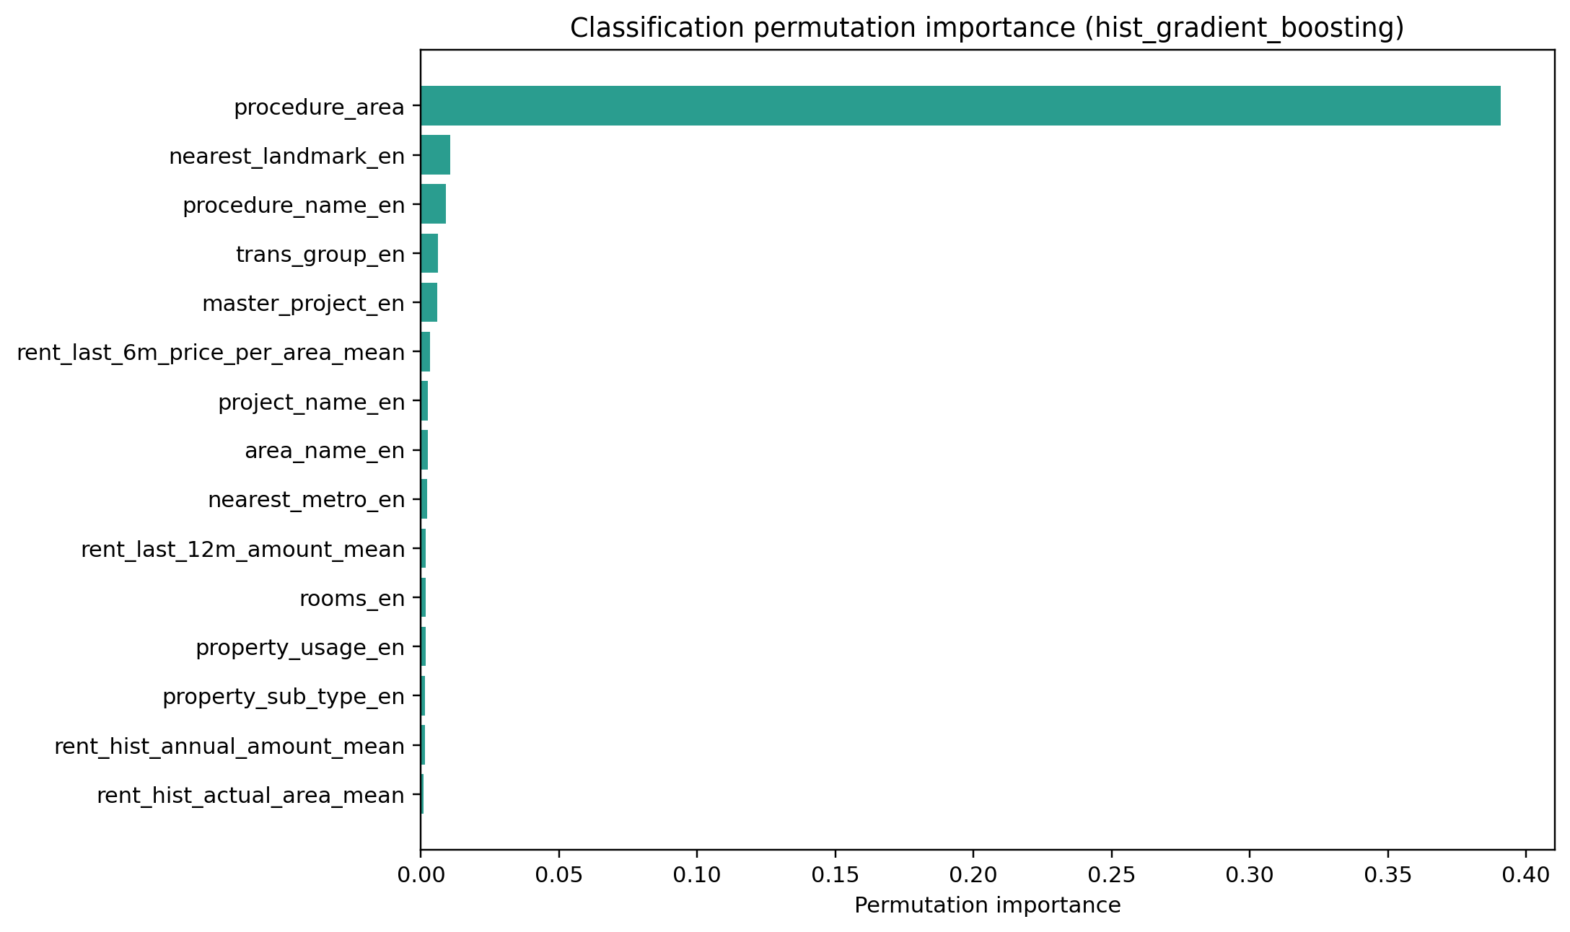
Feature Importance — Permutation Analysis (HGB)
Regression Feature Importance
Classification Feature Importance
ML 7501 | Dubai Real Estate ML Project

Slide 17
Deep-Dive Error Analysis
Where do the models struggle — and why?
ML 7501 | Dubai Real Estate ML Project

Slide 18
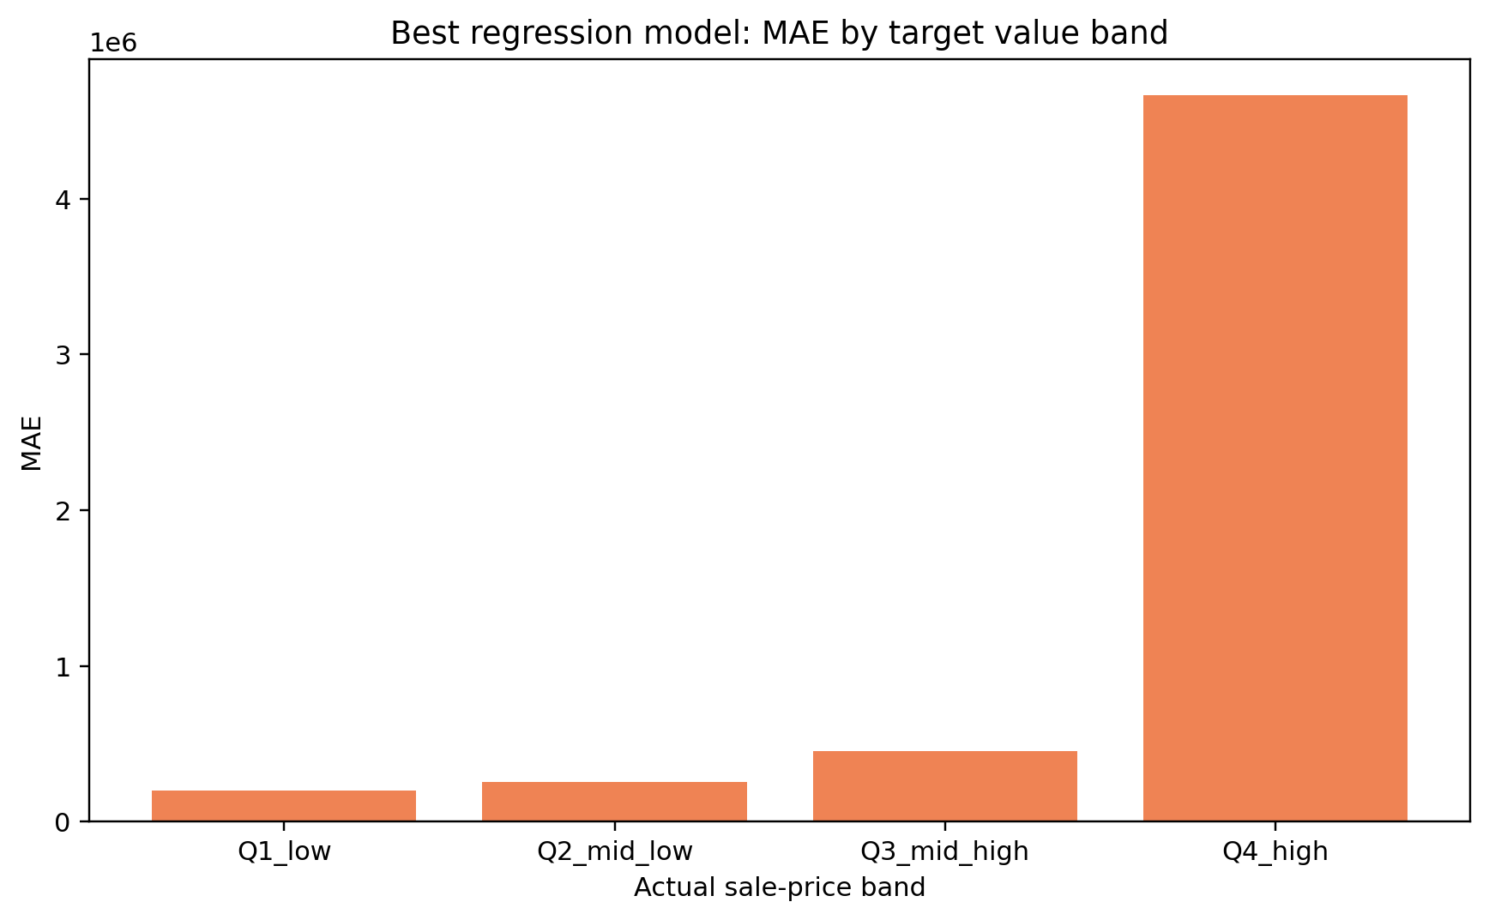
Regression Error Analysis — Value Band & Temporal Drift
MAE by Transaction Value Band
Value Band Summary
Band
Range
MAE
MAPE
Q1 Low
<AED 930K
198,167
15.8%
Q2 Mid-Low
~AED 1.3M
253,681
15.6%
Q3 Mid-High
~AED 2.4M
451,601
14.4%
Q4 High
>AED 4M
4,662,290
26.0%
⚠ Key Insight
Q4 luxury segment has 23× higher MAE than typical transactions. Average metrics alone understate model limitations for rare, high-value deals.
ML 7501 | Dubai Real Estate ML Project

Slide 19
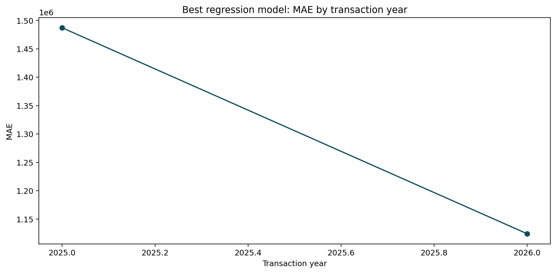
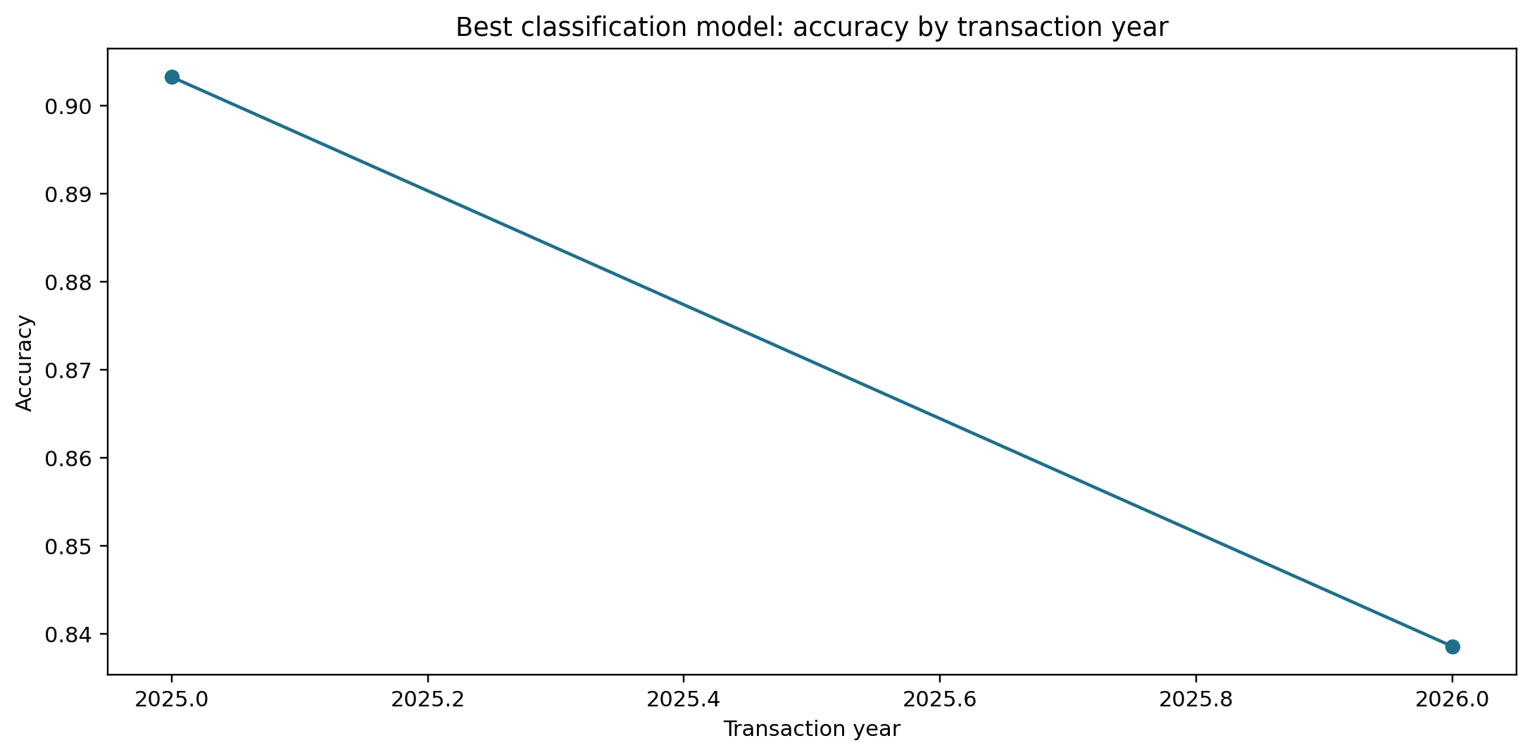
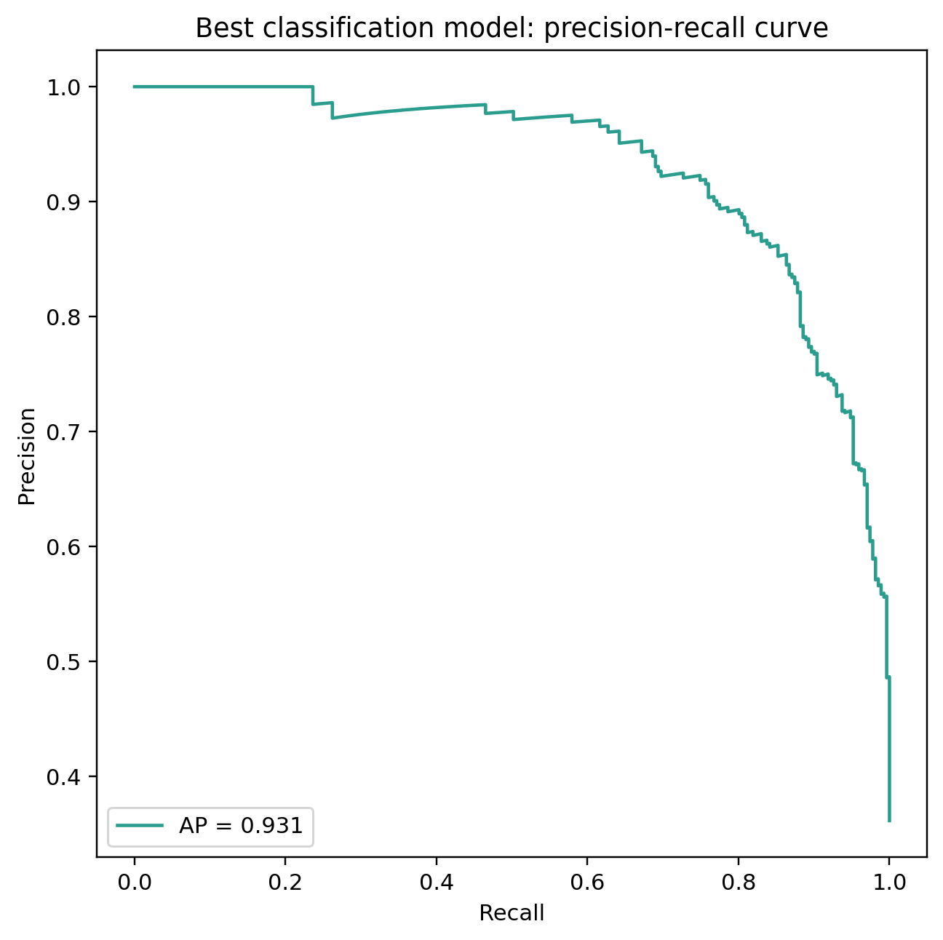
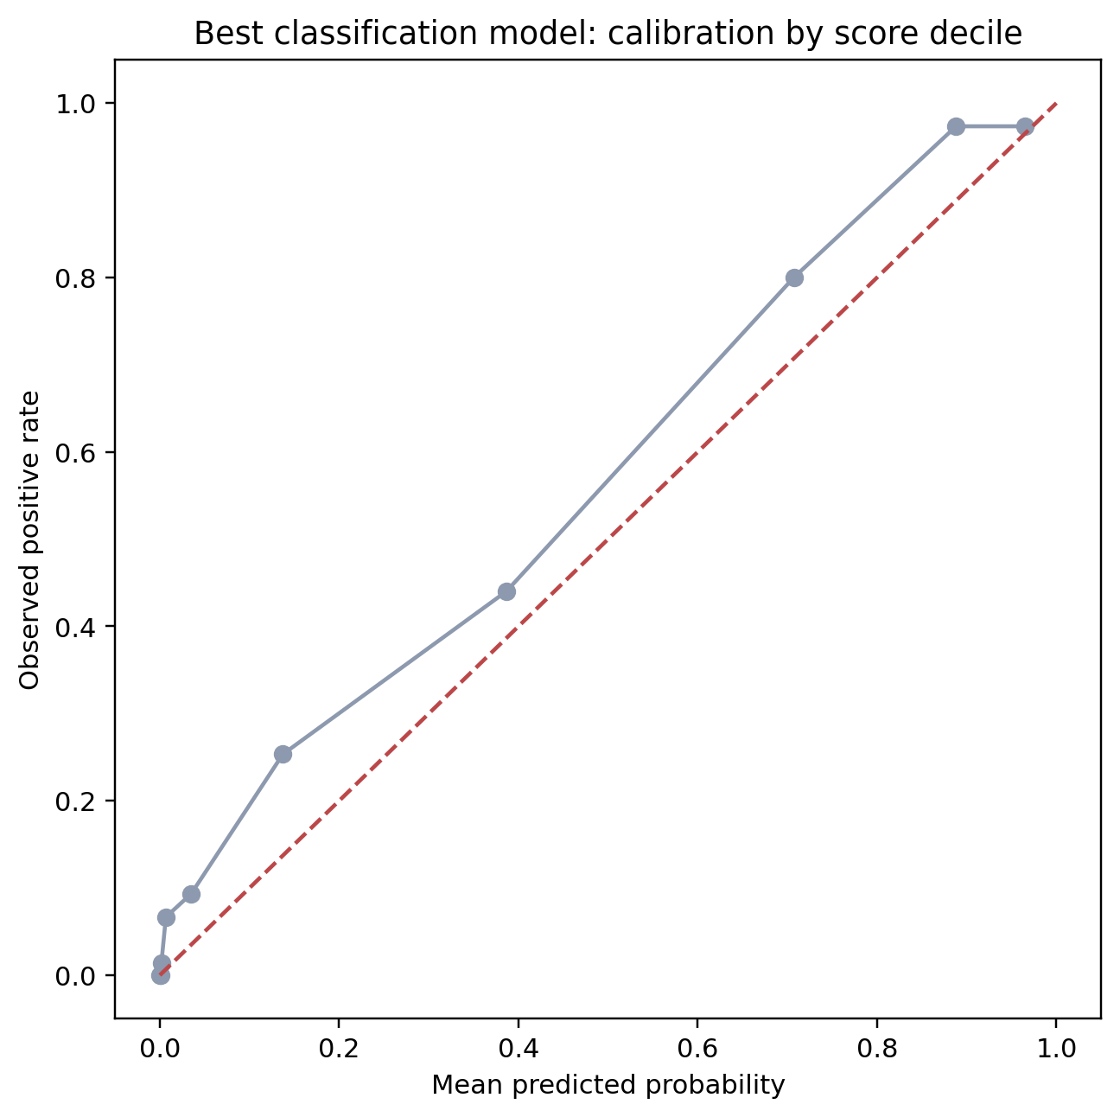
Temporal Stability & Subgroup Analysis
Regression MAE by Year
Classification Accuracy by Year
Classification Precision–Recall
Classification Calibration
ML 7501 | Dubai Real Estate ML Project

Slide 20
Conclusions & Data Story
What Dubai property data reveals about value
ML 7501 | Dubai Real Estate ML Project

Slide 21
Generalization & Model Robustness
Regression Generalization Gap
Classification Generalization
Model
Val RMSE
Test RMSE
R² Improve
Model
Val Acc
Test Acc
Gap
AUC
HGB ★
31,736,108
8,965,434
+0.397 R²
HGB ★
0.873
0.887
+0.013
0.950→0.956
Ridge
31,575,577
10,515,760
+0.220 R²
Rand. Forest
0.865
0.881
+0.016
0.946→0.946
SVM
30,751,940
10,159,923
+0.218 R²
LogReg
0.853
0.872
+0.019
0.931→0.946
Rand. Forest
31,579,941
11,200,241
+0.137 R²
SVM
0.863
0.860
-0.003
0.933→0.943
✓ Positive generalization for all models on test set — HGB improves most (+0.40 R²). No overfitting to validation period.
✓ All classifiers generalize well. HGB test AUC 0.956 with bootstrap CI [0.942–0.967]. Weakest subgroup: 2026 accuracy 0.839 (temporal drift signal).
ML 7501 | Dubai Real Estate ML Project

Slide 22
Conclusions & Data-Driven Story
01
Results Support the Hypothesis
04
Temporal Drift is Detectable
Tree-based gradient boosting outperforms linear baselines on both tasks, consistent with the proposal hypothesis that price is non-linear and interaction-heavy. HGB achieves R² 0.551 vs Ridge's 0.383.
Classification accuracy drops to 0.839 in 2026 on the test split, signaling early temporal drift. Periodic model retraining on recent transactions would be essential in a production deployment.
02
Location & Context Matter
Permutation importance reveals that area-level features and rental market context add genuine predictive value beyond raw structural attributes — validating the multi-source enrichment strategy.
05
Classifier Shows Strong Held-Out Performance
With ROC AUC 0.956 (CI: 0.942–0.967), the classifier shows strong held-out discrimination and calibration, suggesting potential value for decision-support workflows. Deployment would require drift monitoring, periodic retraining, and validation across future market regimes.
03
Luxury Segment is Hard
The Q4 high-value band (>AED 4M) shows 23× higher MAE than typical transactions. Headline R² metrics alone understate real-world difficulty for rare luxury or unusually large deals.
ML 7501 | Dubai Real Estate ML Project

Slide 23
Rubric Alignment Summary
Criterion
Weight
Evidence in This Project
EDA & Data Understanding
15%
Target distribution, join feasibility, outlier/leakage identification, missingness patterns — all documented with visualizations.
Preprocessing & Feature Handling
20%
Median/mode imputation; OrdinalEncoder for tree models, OneHotEncoder(min_freq=15) for linear; StandardScaler for linear pipelines; area-time rental features leak-free; meter_sale_price excluded.
Model Implementation & Tuning
25%
5 models trained; RandomizedSearch CV tuning for 2 (Random Forest + HGB); temporal train/val/test splits; documented search spaces.
Evaluation & Analysis
15%
RMSE, MAE, R² (regression); Accuracy, F1, ROC AUC (classification); confusion matrix, ROC, PR curves; bootstrap CI; subgroup & band analysis.
Report Quality
15%
Full written report covering all stages with justification of decisions, data-driven storytelling, and professional presentation of findings.
Code Quality
10%
Clean, well-commented Python scripts; requirements.txt; README with run instructions; reproducible EDA + modeling + evaluation pipelines.
ML 7501 | Dubai Real Estate ML Project

Slide 24
Thank You
ML 7501 — Applied Machine Learning | 2026
0.9557
0.5513
88.7%
AED 1.39M
ROC AUC
(Classification)
R² Score
(Regression)
Test Accuracy
(Classification)
Test MAE
(Regression)
ML 7501 | Dubai Real Estate ML Project

Slide 25
Temporal Validation Robustness
4-Fold Expanding-Window Backtest
HGB Performance Across Folds
Fold 1 Train
Test
Fold Test Period RMSE (AED) R²
Fold 2 Train
Test
1 2023-06 to 2024-05 ~9.1M 0.52
Fold 3 Train
2 2024-05 to 2024-12 ~8.7M 0.54
Fold 4 Train (Final)
3 2025-01 to 2025-08 ~8.4M 0.56
4 (Final) 2025-09 to 2026-03 8.97M 0.551
Train
Test window
Conclusion
Single-window validation was unstable due to a market-transition period. Rolling temporal validation provides a more defensible estimate of generalisation. Consistent R² ~ 0.55 across all folds confirms that performance is not artefact of the particular test window chosen.
⚠ Interpretation
The validation/test gap (RMSE 31.7M vs 9.0M) is explained by an elevated market-volatility period in 2024–Q1 2025, not model overfitting. Rolling folds demonstrate stable generalisation across all time periods.
ML 7501 | Dubai Real Estate ML Project

Slide 26
Ablation Study: Which Feature Groups Actually Matter?
HGB Regression — Test Set (AED)
R² by Feature Group (Higher = Better)
Feature Variant Features RMSE R²
★ Structural + Location (24 features)
★ Structural + Location 24 7.2M 0.710
R² = 0.710
Structural + Hotel 43 8.3M 0.612
Structural + Hotel (43 features)
R² = 0.612
Structural + Rent 36 8.8M 0.564
Structural + Rent (36 features)
Full Feature Set (reported) 55 9.0M 0.551
R² = 0.564
Full Feature Set — reported (55 features)
Honest Interpretation
Structural + Location features alone produce the strongest R² (0.710). Adding rental and hotel context does not improve RMSE on this dataset — possibly because the enrichment signals are correlated with location features already captured. The full feature set was retained in the main models as it represents the project’s multi-source enrichment hypothesis.
R² = 0.551
⚠ Key Finding
Location alone explains most variance. Rental and hotel context add marginal predictive value on this dataset.
ML 7501 | Dubai Real Estate ML Project

Slide 27
Limitations and Deployment Caveats
1 / Temporal Drift Risk
2 / Luxury-Tail Uncertainty
Classification accuracy declined 6.4 pp over 10 test months (90.3% → 83.9%). Any live deployment requires quarterly retraining on recent DLD records and rolling accuracy monitoring to detect further drift.
Q4 luxury transactions (>AED 4M) show 23× higher MAE than Q1 typical transactions (MAPE 26% vs 16%). Headline R² overstates reliability for extreme high-value deals; specialist review is recommended for luxury valuations.
3 / Synthetic Label & Single Market
4 / Retraining & Monitoring Needed
is_high_value is a threshold-defined convenience label (≥AED 2.4M), not a natural operational endpoint. Results apply to Dubai DLD data only; generalisation to other markets or regulatory regimes requires fresh validation.
Rare property types (Building: 7 rows) have insufficient test samples for stable evaluation. Any operational deployment should include drift monitoring, periodic retraining, and human-in-the-loop review for unusual transactions.
ML 7501 | Dubai Real Estate ML Project

