Slide 1
Jumping for JS

Slide 2
Today’s Class

Slide 3
Objectives
In today’s class we’ll be covering:
The Art of Pseudo-Coding
Building Rock-Paper Scissors
JavaScript Functions

Slide 4
Basics Recap

Slide 5
Deep Philosophy
What is JavaScript?
(And what is it used for?)

Slide 6

JavaScript Definitions
JavaScript is the third of the three fundamental programming languages of the modern web (along with HTML, CSS)
JavaScript allows developers to create dynamic web applications capable of taking in user inputs, changing what’s displayed to users, animating elements, and much more.

Slide 7
Please… Don’t Pick Me.
What is a Variable?
(And how do we declare one?)

Slide 8
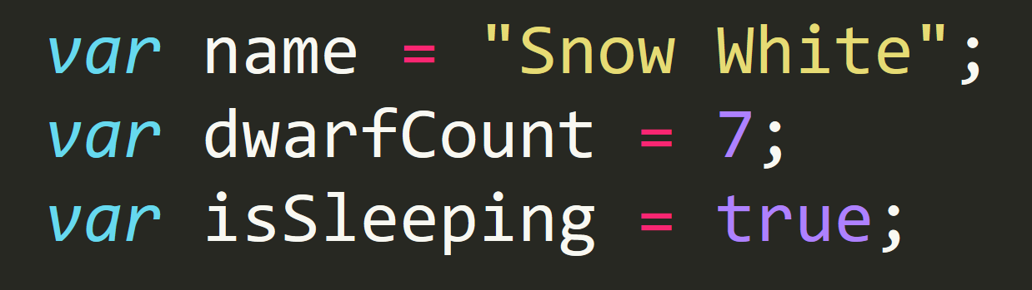
Basic Variables
Variables are the nouns of programming.
They are “things” (Numbers, Strings, Booleans, etc.)
They are composed of variable names and values

Slide 9
Please… Don’t Pick Me.
What is meant by console.log?
(And how does it differ from an alert, prompt, or confirm?)

Slide 10
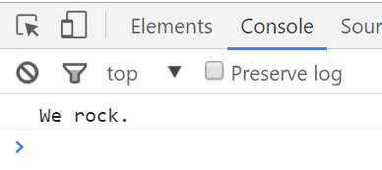
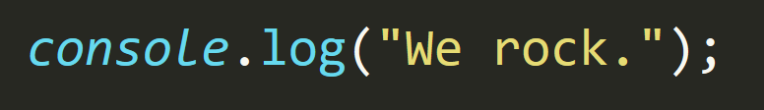
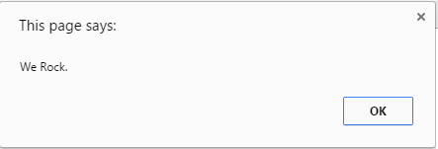
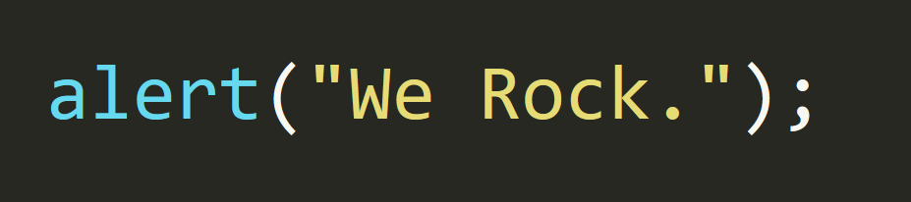
Basic Variables
Console.log displays discreetly to the debugger.
Alert displays a pop-up message to the user.

Slide 11
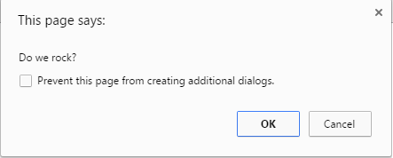
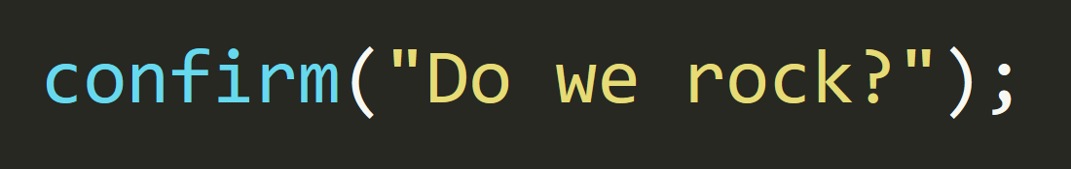
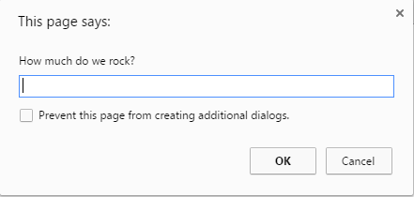
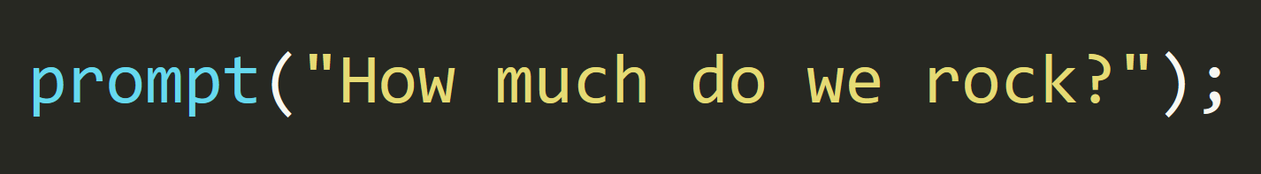
Basic Variables
Confirm displays a True/False popup.
Alert displays a prompt with a text-box input.

Slide 12
Please… Don’t Pick Me.
How do we “write” text to the HTML itself?

Slide 13
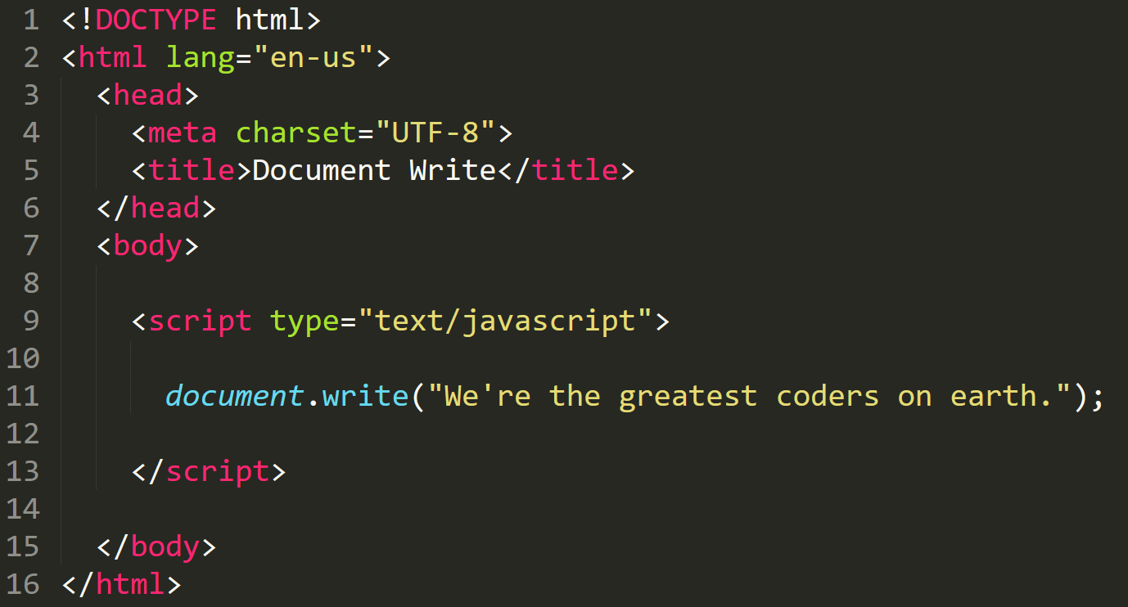

Writing to HTML
We can use JavaScript to directly write to the HTML page itself using document.write( ).
Later we will go over much more advanced approaches for writing HTML using JavaScript and jQuery.
Test.html (chrome)
Test.html
(sublime)

Slide 14
Please… Don’t Pick Me.
How do we check conditions?

Slide 15
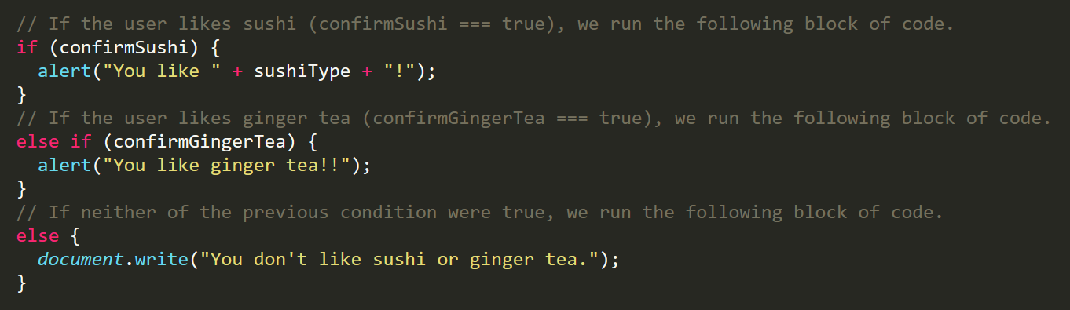
If/Else Statements
If/Else statements are critical.
Each statement is composed of an if, else-if, or else (keyword), a condition, and the resulting code in { } curly brackets.

Slide 16
Please… Don’t Pick Me.
What is an array?

Slide 17
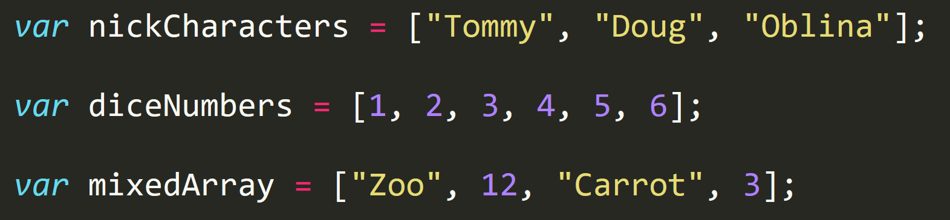
Basic Arrays
Arrays are a type of variable that are collections.
These collections can be made up of strings, numbers, booleans, other arrays, objects, anything.
Each element of the array is marked by an index. Indexes always start with 0.

Slide 18
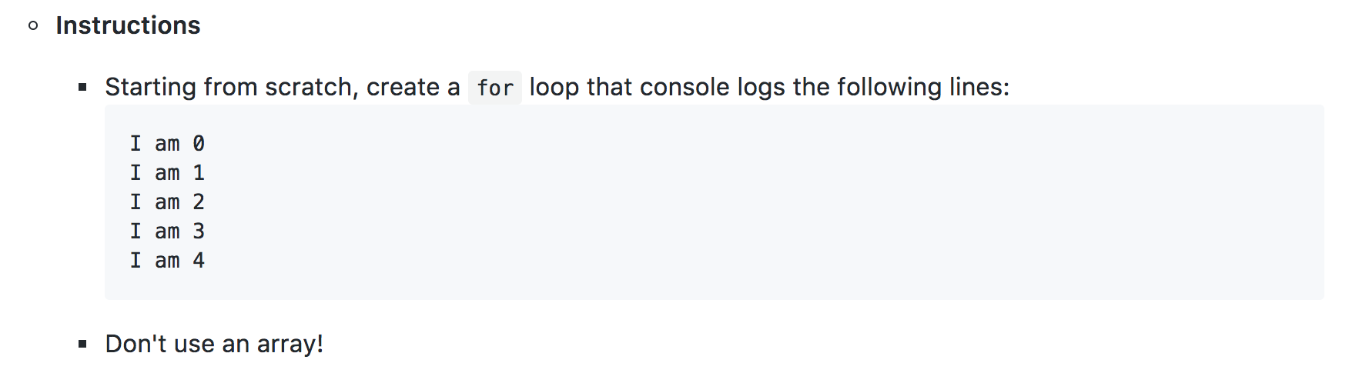
> YOUR TURN!!
Students Do: Another Loop | 7 min

Slide 19
> YOUR TURN!!
Rock, Paper Scissors
A player who decides to play rock will beat another player who has chosen scissors ("rock crushes" — or sometimes "blunts" — scissors"),
but will lose to one who has played paper ("paper covers rock");
a play of paper will lose to a play of scissors ("scissors cuts paper").

Slide 20
> YOUR TURN!!
Rows Do: R,P,S | 10 min
Instructions
With a partner, spend a few moments outlining all the steps and conditions that go into a single game of rock paper scissors.
Try to break it down into steps that you could code out.
Think of basic elements like loops, if-then statements, arrays, alerts, etc.
Be prepared to share your outlined approach.

Slide 21
> YOUR TURN!!
Partners Do: R,P,S | 60 min
File:
rps-2.html in 23-RPS-Coded/Unsolved
Instructions
With a partner, begin the process of coding out the rock-paper-scissors game.
Do as much as you can on your own, but don't be afraid to ask for help if you feel your team is struggling.
Note: Don't use document.write as it will delete the contents of the body, including your JavaScript. Instead, use document.getElementById in conjunction with the textContent property, as you were shown earlier.
Note: Don’t worry. We know this is a very challenging assignment. We also know that you won’t know where to start. In fact, we haven’t shown you EVERYTHING you need yet, but that’s okay. Part of being a developer is figuring things out on your own through trial and error.

Slide 22
Lunch – 12:50pm

Slide 23
Functions

Slide 24
> YOUR TURN!!
Activity: 25-LoopTV | Suggested Time: 10 min
Code Dissection: Array Building
Run the program in gitlab (25-LoopTV).
Then, with a partner, fill in the missing comments for each line of code.
Make sure both of you can fully explain what each line means.
Be prepared to share with the class.

Slide 25
No Functions
26-SuperHeroLogging – no functions
(SuperHeroLogging_withFunctions.html | 26-SuperHeroLogging)

Slide 26
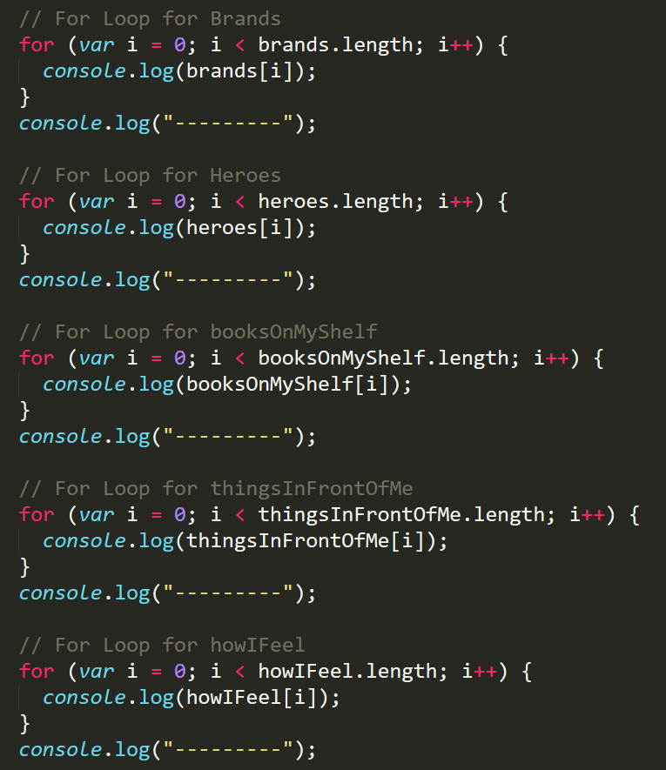
Mondo Repetitive…
Who wants to maintain this??
Hint: No one.

Slide 27
Fun Fun Function Time
Let’s Dry it up!
(SuperHeroLogging_NoFunctions.html | 26-SuperHeroLogging)

Slide 28
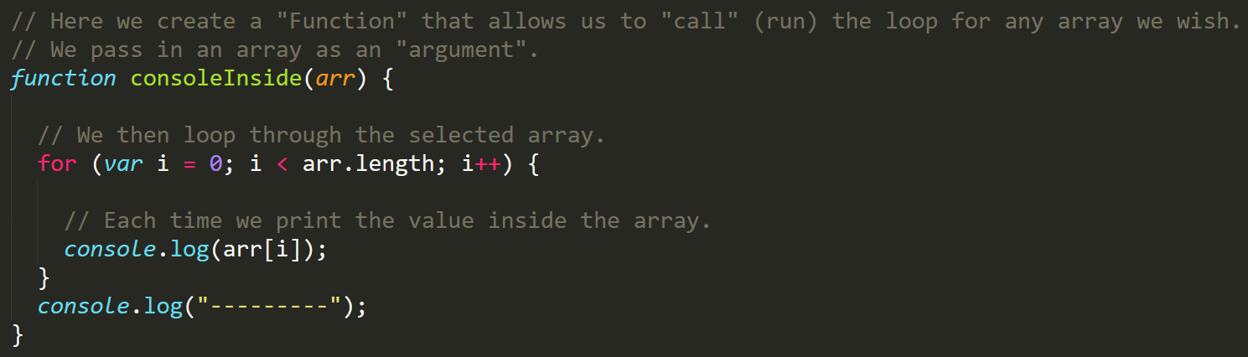
Much Better with Functions!
Squeaky Clean Code.
Minimal repetition

Slide 29
> YOUR TURN!!
Activity: 27-MyFirstFunctions | Suggested Time: 20 min
Code Creation: Function Building
Working in pairs and using the starter file sent to you via slack–fill in the missing functions and function calls.
Note: Try to finish all four functions if you can, but don’t be distressed if you only get 1 or 2. The important thing is that you get at least one function fully done.
HINT: Look back to the previous example if you need help.

Slide 30
Questions

Slide 31
Groups Do: Homework

