Slide 1
JavaScript Juggernauts

Slide 2
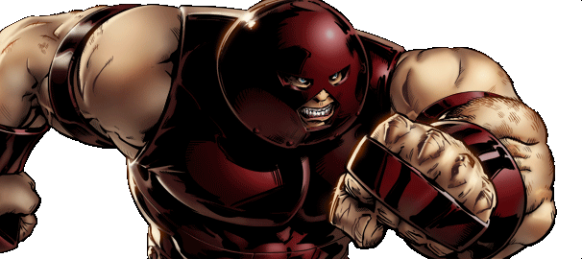
This will soon be you…
JavaScript Juggernauts.

Slide 3
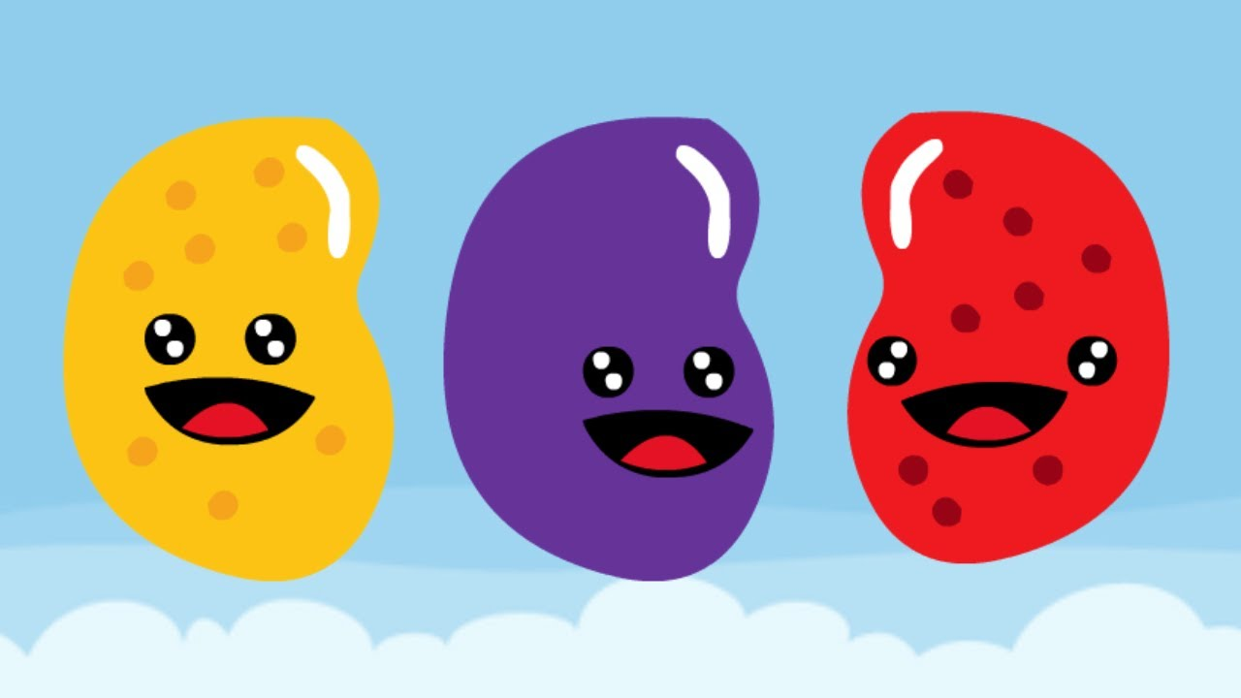
But right now…
Maybe feeling like
JavaScript Jellybeans.

Slide 4
Transformation to Come
HANG IN THERE!

Slide 5
Objects

Slide 6
Arrays!
The Good Array
(GoodArray.html | 4-GoodArray)

Slide 7
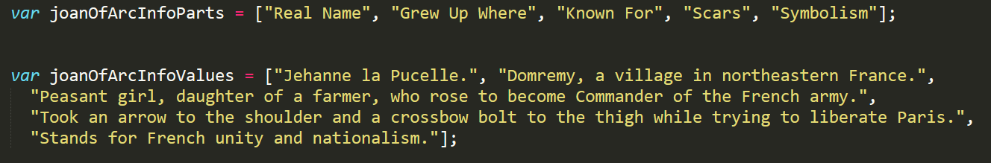
File: 5-JoanOfArcArrays
The first array has various labels and the second array has the descriptions associated with these labels for our Joan of Arc character.
How would one link these two arrays so that they could easily determine what Joan of Arc's "Real Name" is or what "Scars" she has?

Slide 8
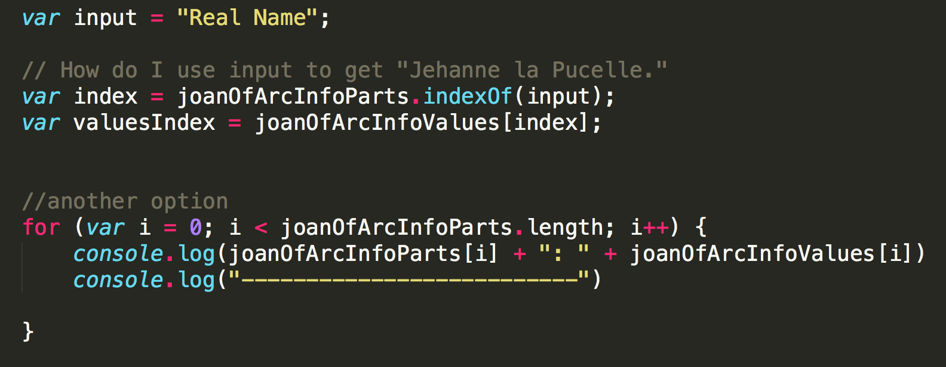
Associated Data ==/== Arrays

Slide 9
Associated Data ==/== Arrays
Relating two separate arrays is not fun.

Slide 10
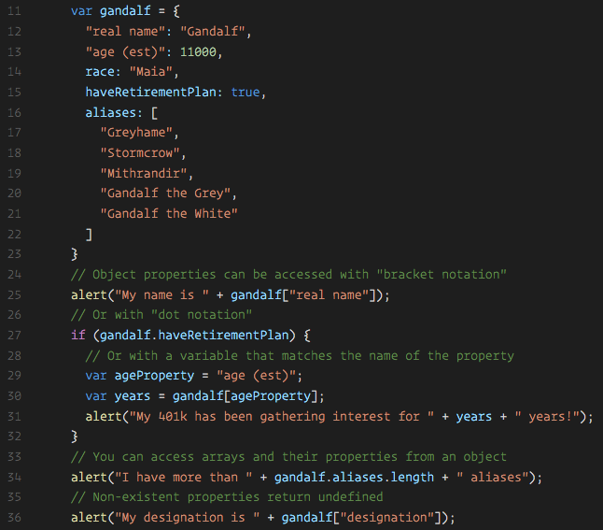
Gandalf – The Object

Slide 11
Gandalf – The Object
Gandalf’s “properties” and “values” are associated in object form, making it easy to recall specific data.

Slide 12
Objects Visualized
var gandalf
=
{
“real name”
:
“Gandalf”
,
“age (est)”
:
11000
,
“race”
:
“Maia”
}
This is Gandalf. According to code… Gandalf is an Object.

Slide 13
Objects Visualized
var gandalf
=
{
“real name”
:
“Gandalf”
,
“age (est)”
:
11000
,
“race”
:
“Maia”
}
These are Gandalf’s properties (like descriptors).

Slide 14
Objects Visualized
var gandalf
=
{
“real name”
:
“Gandalf”
,
“age (est)”
:
11000
,
“race”
:
“Maia”
}
These are the “values” of Gandalf’s properties.

Slide 15
Objects Visualized
var gandalf
=
{
“real name”
:
“Gandalf”
,
“age (est)”
:
11000
,
“race”
:
“Maia”
}
Thus: gandalf[“race”] = “Maia

Slide 16
Gandalf – The Object
Gandalf – The Object
(gandalf-the-grey-objects.html | 30-GandalfTheGreyObjects)

Slide 17
> YOUR TURN!!
Activity: 7-MyFirstObject | Suggested Time: 15 min
Code Dissection / Creation: Basic Objects
With a partner, spend the next few moments studying the code just slacked to you.
Then, write code below each comment to log the relevant information about the provided car object.
Bonus: If you finish early, create a brand new object of your own. Slack out a snippet of the code to the class when you are done. Be Creative!

Slide 18
Car Game!
Demo Car Game
(carGame_Solved.html | 8-CarGame)

Slide 19
> YOUR TURN!!
Activity: 8-CarGame | Suggested Time: 30 min
Code Creation: Run that Car!
Using the code from the previous activity as a starting point, create a complete application such that:
Users can enter keyboard input (letters).
Each of the car's methods are assigned to a key.
When the user presses a key it calls the appropriate function.
These letters also trigger a global function called reWriteStats() that logs the car’s make, model, color, mileage, and isWorking status to the console.
HINT: You will need to use the document.onkeyup() function to collect input from the user's keyboard.

Slide 20
Lunch – 12:35

Slide 21
JS Scope: scope-examples.html
Everyone Do: Scope / 33-Scope
scope-examples.html

Slide 22
JS Scope: Students Do | 33-Scope/unsolved
Students Do: Scope / 33-Scope
33-Scope/unsolved

Slide 23
> YOUR TURN!!
Activity: 9-TriviaGame | Suggested Time: 45 min
Extra Activity: Trivia Game
With whatever class time remains, complete the following activity in pairs.
Starting from a blank HTML file:
Create an array of objects with 10 questions. The object should be structured like this: [{q: "Are chicken's mammals?", a: "f"},
{q: "Are chicken's mammals?", a: "f"}]
Then create code that will ask the user questions, one by one. The user must answer by hitting t (for true) or f (for false).
Check the user’s answer against the correct answer, and provide them with an alert telling them if they are right or wrong.
Bonus: Keep track of the user’s score.
Hint: Don’t worry about having DRY code to start with. Just focus on getting working code first.

Slide 24
Questions

