Slide 1
BEACLS: Berkeley Efficient API in C++ for Level Set methods Installation Guide
Ken TANABE
2017/04/11

Slide 2
Table of contents
System requirement
Mac OS X
Ubuntu Linux without GPU
Ubuntu Linux with GPU
Windows without GPU
Windows with GPU
Bash on Ubuntu on Windows without GPU

Slide 3
Table of contents
System requirement
Mac OS X
Ubuntu Linux without GPU
Ubuntu Linux with GPU
Windows without GPU
Windows with GPU
Bash on Ubuntu on Windows without GPU

Slide 4
System requirements
Required
OS
Mac OS X Sierra
Ubuntu Linux 16.04 LTS (x86_64)
Windows 7/8.1/10 (64bit)
Hardware
CPU: Intel Core Processor CPU
Recommended
Hardware
CPU: 4th Generation Intel Core Processor CPU (Haswell arch.) or later
GPU: NVIDIA GeForce 900 Series GPU (Maxwell arch) or later
OS
Windows 10 Creators Update (version 1703, Redstone 2)
Required for Bash on Ubuntu on Windows

Slide 5
Table of contents
System requirement
Mac OS X
Ubuntu Linux without GPU
Ubuntu Linux with GPU
Windows without GPU
Windows with GPU
Bash on Ubuntu on Windows without GPU

Slide 6
Install to Mac OS X Sierra
Install Homeberw
$ export PATH=/usr/local:$PATH
$ sudo mkdir -p /usr/local
$ ruby -e "$(curl -fsSL https://raw.githubusercontent.com/Homebrew/install/master/install)"
Install OpenMP, boost, OpenCV and hdf5
$ brew update; brew upgrade
$ brew install llvm boost hdf5
$ brew install -with-ffmpeg -with-tbb opencv3
$ brew link opencv3 --force
Download BEACLS
$ mkdir ~/BEACLS; cd ~/BEACLS
$ git clone https://github.com/HJReachability/beacls
$ cd beacls
Build BEACLS
$ cd beacls/sources
$ make all
Test BEACLS
$ cd samples/Plane_test
$ make test

Slide 7
Table of contents
System requirement
Mac OS X
Ubuntu Linux without GPU
Ubuntu Linux with GPU
Windows without GPU
Windows with GPU
Bash on Ubuntu on Windows without GPU

Slide 8
Install to Ubuntu Linux 16.04 LTS (Without GPU)
These instructions only work for Ubuntu 16.04, not 18.04!
For Ubuntu 14.04, use branch 14.04.
Install boost, OpenCV and hdf5
$ sudo apt update
$ sudo apt upgrade
$ sudo apt install libhdf5-dev libboost-dev libopencv-dev
Download BEACLS
$ mkdir ~/BEACLS; cd ~/BEACLS
$ git clone https://github.com/HJReachability/beacls
$ cd beacls
Build BEACLS
$ cd beacls/sources
$ make all
Test BEACLS
$ cd samples/Plane_test
$ make test

Slide 9
Table of contents
System requirement
Mac OS X
Ubuntu Linux without GPU
Ubuntu Linux with GPU
Windows without GPU
Windows with GPU
Bash on Ubuntu on Windows without GPU

Slide 10
Install to Ubuntu Linux 16.04 LTS (With GPU)
Install zlib, boost, OpenCV and hdf5
$ sudo apt-get update
$ sudo apt-get upgrade
$ sudo apt-get install zlib libhdf5-dev libboost-dev libopencv-dev
Download and install CUDA 8.0
https://developer.nvidia.com/cuda-downloads
Download BEACLS
$ mkdir ~/BEACLS; cd ~/BEACLS
$ git clone https://github.com/HJReachability/beacls
$ cd beacls
Build BEACLS
$ cd beacls/sources
$ make WITH_GPU=Y NVCC=/usr/local/cuda-8.0/bin/nvcc all
Test BEACLS
$ cd samples/Plane_test
$ make test

Slide 11
Table of contents
System requirement
Mac OS X
Ubuntu Linux without GPU
Ubuntu Linux with GPU
Windows without GPU
Windows with GPU
Bash on Ubuntu on Windows without GPU

Slide 12
Install to Windows 7/8.1/10 (Without GPU)
Download and install HDF5 Pre-built Binary Distributions
Download binary distribution from HDF group site
https://www.hdfgroup.org/HDF5/release/obtain5.html
1.8.18-win64-vs2015: http://www.hdfgroup.org/ftp/HDF5/current/bin/windows/extra/hdf5-1.8.18-win64-vs2015-shared.zip
Extract a zip file and install it.
Download and install Boost
Download binary distribution from the site: http://www.boost.org/users/download/
1.63.0: https://sourceforge.net/projects/boost/files/boost/1.63.0/boost_1_63_0.zip/download
Extract a zip file to c:\Boost\Boost_1_63_0
Download and install OpenCV
Download binary distribution from the site: http://opencv.org/
3.2.0: https://sourceforge.net/projects/opencvlibrary/files/opencv-win/3.2.0/opencv-3.2.0-vc14.exe/download
Execute installer and extract files to c:\OpenCV3\opencv3.2.0

Slide 13
Install to Windows 7/8.1/10 (Without GPU) (cont'd.)
Download and install git for Windows
Download binary distribution from the site : https://git-for-windows.github.io/
2.12.0-64bit: https://github.com/git-for-windows/git/releases/download/v2.12.0.windows.1/Git-2.12.0-64-bit.exe
Execute installer
Download and install tortoisegit
Download Boost from Boost site: https://tortoisegit.org/
2.4.0.2-64bit: https://download.tortoisegit.org/tgit/2.4.0.0/TortoiseGit-2.4.0.2-64bit.msi
Execute installer
Download and install Visual Studio 2015
https://www.visualstudio.com/vs/older-downloads/

Slide 14
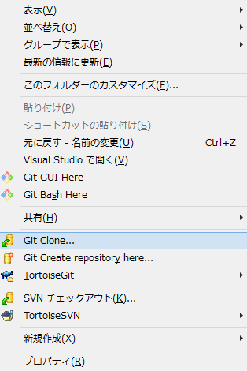
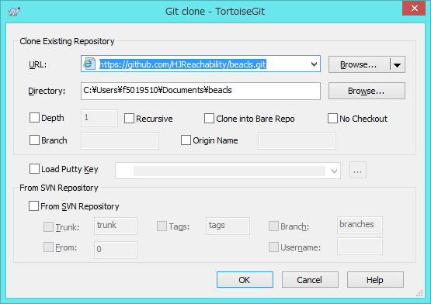
Install to Windows 7/8.1/10 (Without GPU) (cont'd.)
Download BEACLS
Open Documents folder by explorer
Choose “Git clone…” from cotext memu.
Set repository information and push OK
URL: https://github.com/HJReachability/beacls
Open beacls folder

Slide 15
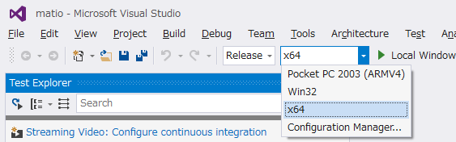
Install to Windows 7/8.1/10 (Without GPU) (cont'd.)
Build matio (Matlab file I/O library)
Run Visual Studio solution from the batch file
sources\run_visualstudio14_matio.bat
It sets environmental variables for some libraries paths.
Choose “Release” as Solution Configuration and “x64” as Solution Platform
Build matio by pushing “F7” key.

Slide 16
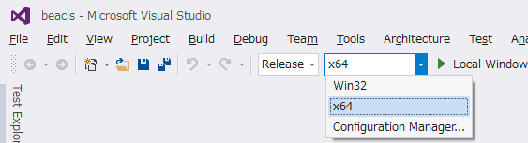
Install to Windows 7/8.1/10 (Without GPU) (cont'd.)
Build BEACLS
Run Visual Studio solution from the batch file
sources\run_visualstudio14_beacls.bat
It sets environmental variables for some libraries paths.
Choose “Release” as Solution Configuration and “x64” as Solution Platform
Build all projects of beacls solution by pushing “F7” key.

Slide 17
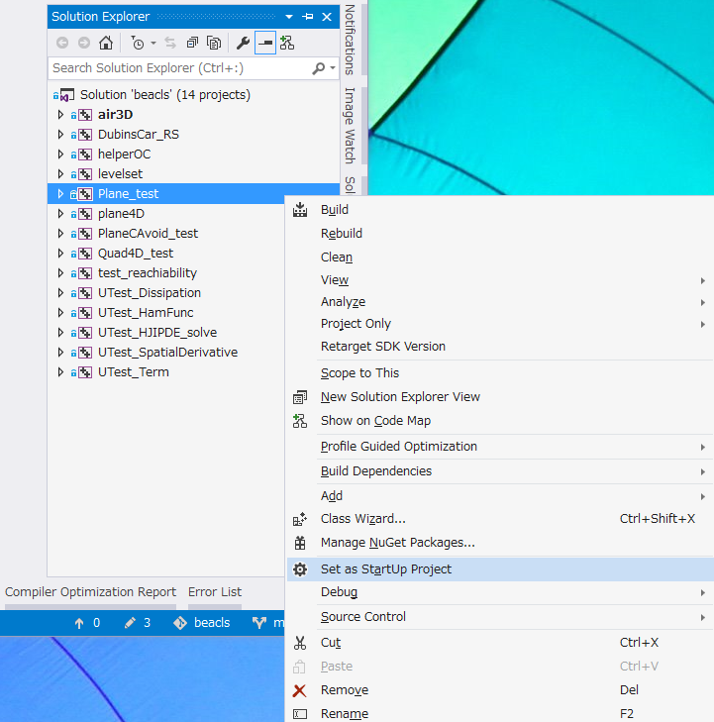
Install to Windows 7/8.1/10 (Without GPU) (cont'd.)
Execute Plane_test
Click “Set as StartUp Project” from a context menu of Plane_test in Solution Explorer
Execute Plane_test by pushing “F5” key.

Slide 18
Table of contents
System requirement
Mac OS X
Ubuntu Linux without GPU
Ubuntu Linux with GPU
Windows without GPU
Windows with GPU
Bash on Ubuntu on Windows without GPU

Slide 19
Install to Windows 7/8.1/10 (With GPU)
Install from step 1 to step 8 of Windows 7/8.1/10 (without GPU)
Download and install CUDA 8.0
https://developer.nvidia.com/cuda-downloads

Slide 20
Install to Windows 7/8.1/10 (With GPU) (cont'd.)
Build BEACLS
Run Visual Studio solution from the batch file
sources\run_visualstudio14_beacls_cuda.bat
It sets environmental variables for some libraries paths.
Run Visual Studio solution from the batch file

Slide 21
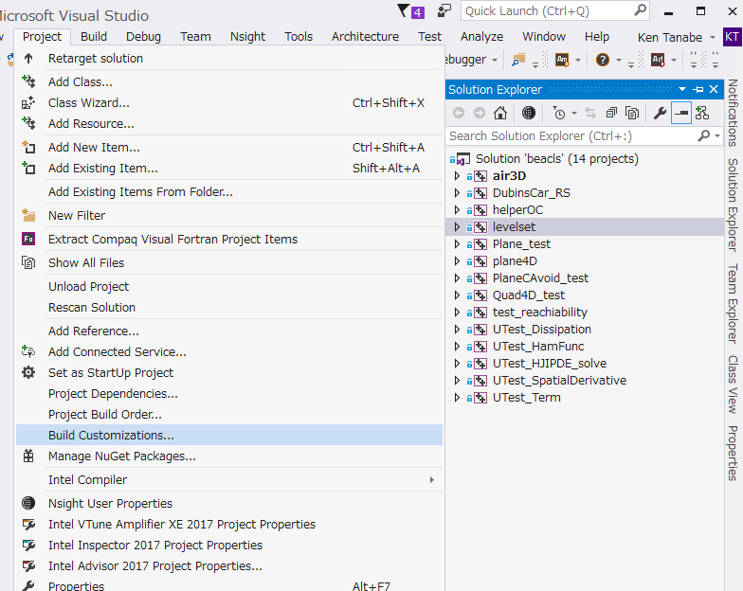
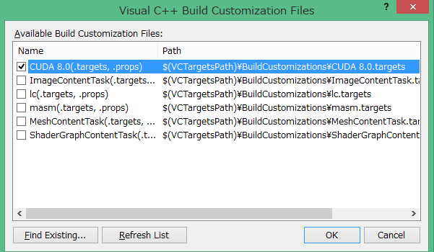
Install to Windows 7/8.1/10 (With GPU) (cont'd.)
Build BEACLS (Cont’d)
Enable CUDA build for levelset project.
Choose “levelset” in Solution Explorer
click “Builld Customizations…” from Project tab of tool bar.
Enable “CUDA 8.0(.targets, .props)”
Enable CUDA build for helperOC project.

Slide 22
Install to Windows 7/8.1/10 (With GPU) (cont'd.)
Build BEACLS
Choose “Release” as Solution Configuration and “x64” as Solution Platform
Build all projects of beacls solution by pushing “F7” key.

Slide 23
Install to Windows 7/8.1/10 (With GPU) (cont'd.)
Execute Plane_test
Click “Set as StartUp Project” from a context menu of Plane_test in Solution Explorer
Execute Plane_test by pushing “F5” key.

Slide 24
Table of contents
System requirement
Mac OS X
Ubuntu Linux without GPU
Ubuntu Linux with GPU
Windows without GPU
Windows with GPU
Bash on Ubuntu on Windows without GPU

Slide 25
Install to Bash on Ubuntu on Windows (Without GPU)
Update Windows 10 to Windows 10 Creators Update (version 1703, Redstone 2)
Install X Window System Server for Windows
Cf) Xming : http://www.straightrunning.com/XmingNotes/
Run X Windows System Server
Install Bash on Ubuntu on Windows
https://msdn.microsoft.com/en-us/commandline/wsl/install_guide
Run bash
Set DISPLAY environment variable
$ export DISPLAY=0:0

Slide 26
Install to Bash on Ubuntu on Windows (Without GPU) (cont’d)
Install boost, OpenCV and hdf5
$ sudo apt-get update
$ sudo apt-get upgrade
$ sudo apt-get install libhdf5-dev libboost-dev libopencv-dev
Download BEACLS
$ mkdir ~/BEACLS; cd ~/BEACLS
$ git clone https://github.com/HJReachability/beacls
$ cd beacls
Build BEACLS
$ cd beacls/sources
$ make all
Test BEACLS
$ cd samples/Plane_test
$ make test

Slide 27
Thank you!

