Slide 1
A Mobile Application for Diabetes Self-Management with Psychological Analysis
Team 6
Nam, Geun Woo
Kim, Myeong Gyu
Sung, Ho Joon

Slide 2
Table of Contents
Feedback
Progress
Next Schedule
Q & A

Slide 3
Feedback

Slide 4
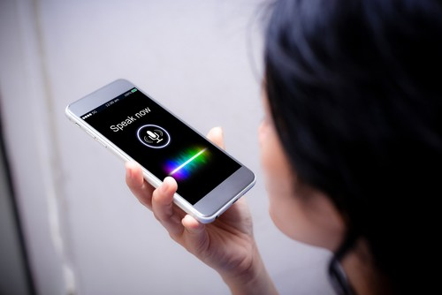
Usability Issues
Fine motor skills and cognitive ability decreases by aging.
It leads to more frequent typos.
We need to consider usability of elderly users.
We will add voice recognition system to write diary data.

Slide 5
Language support
Most NLP models supports English.
We have 2 alternatives to support Korean.
Korean
Sentiment
Analysis
Result
Alt. 1
Korean
English
Sentiment
Analysis
Result
Translation
Alt. 2

Slide 6
Progress

Slide 7
NLP models from GitHub
 | Language support | modes | Written in | License
Stanford CoreNLP (https://github.com/Ruthwik/Sentiment-Analysis) | English | Deep learning, Rule-based, statistical | JAVA | LGPL v3.0
Sentiment-Analysis-in-Java (https://github.com/atripa5/Sentiment-Analysis-in-Java) | English | Rule-based (scoring by words in dictionary) | JAVA | ?
NLTK Vader Sentiment Analyzer (https://github.com/apanimesh061/VaderSentimentJava) | English | Rule-based | Python | MIT
Notes:
https://darkpgmr.tistory.com/89(공개 SW 라이센스 GPL, LGPL, BSD)

Slide 8
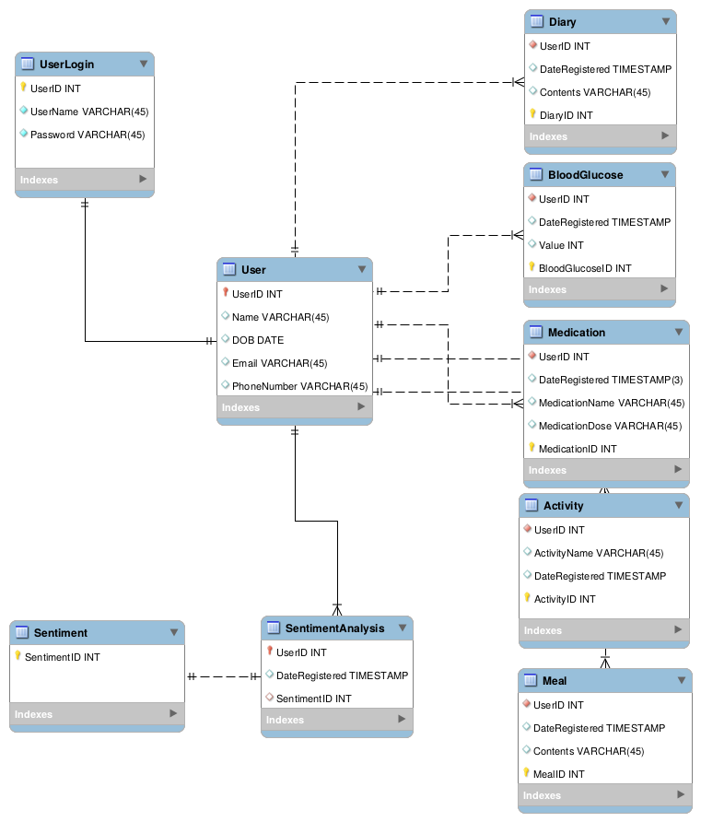
Database design changed & issues(by Nam, Geun woo)
Issue 1
Original database design had wrong primary keys.
It defines 1:1 relation.
We meant 1:N relation.
So we added surrogate keys for each entry.

Slide 9
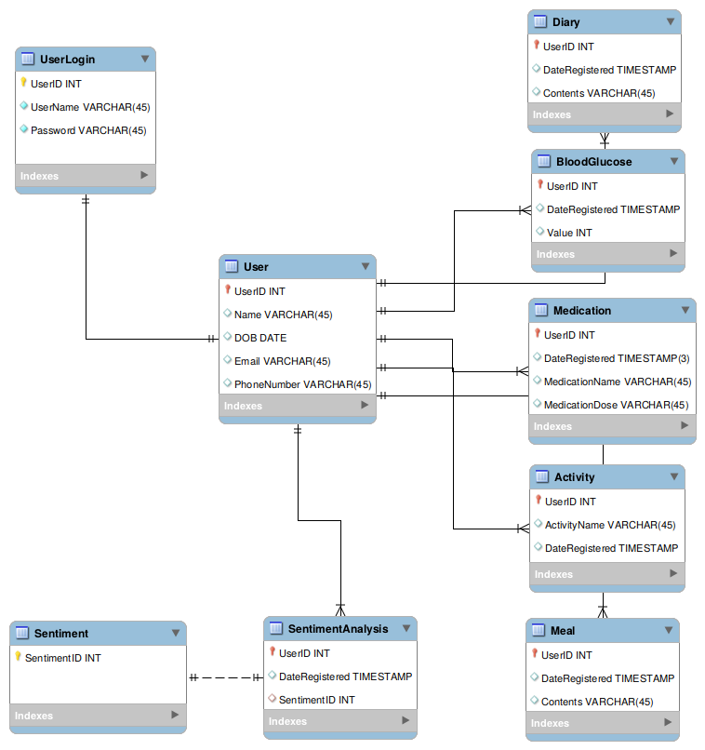

Slide 10
Database design changed & issues
Issue 2
Hosting service(Cafe24) only supports MyISAM storage engine for MySQL. (No InnoDB).
It does not support foreign key.
Referential integrity is not guaranteed.
Checking it in server-side PHP is required.

Slide 11
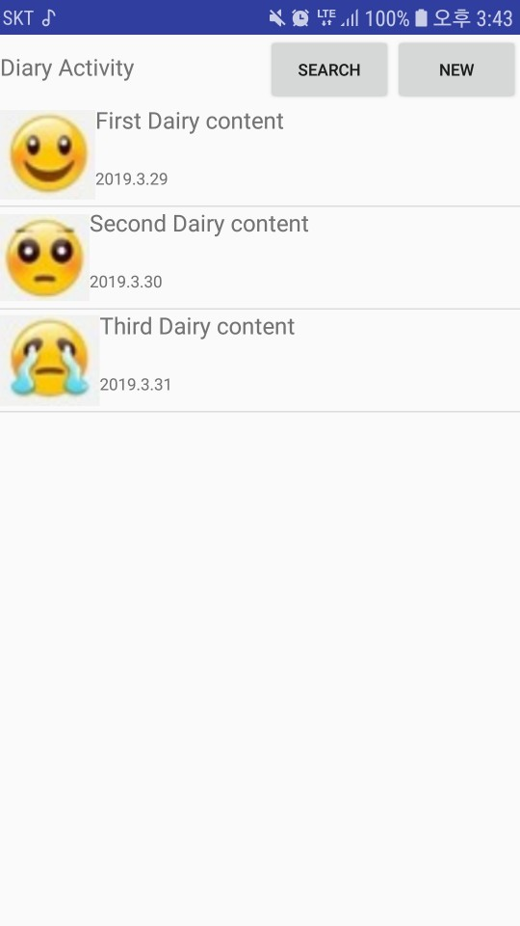
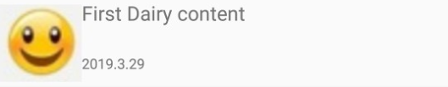
Diary Activity UI Design Implementation and database connection(by Sung, Ho Joon)
ListView
Custom Layout
Displays diary contents
Displays registered date
Displays moods by emojis.

Slide 12
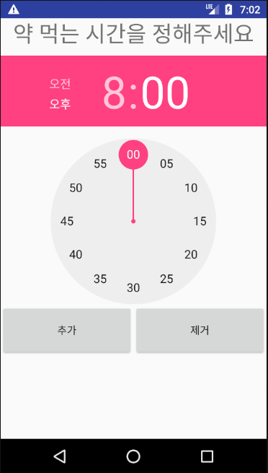
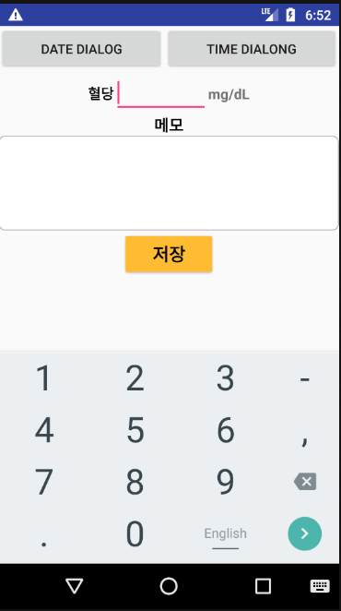
BG and medication UI Design Implementation(by Kim, Myeong Gyu)

Slide 13
Next Schedule

Slide 14
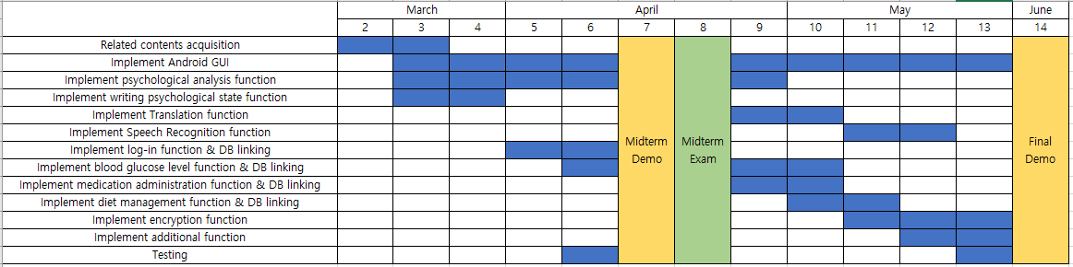
Schedules

Slide 15
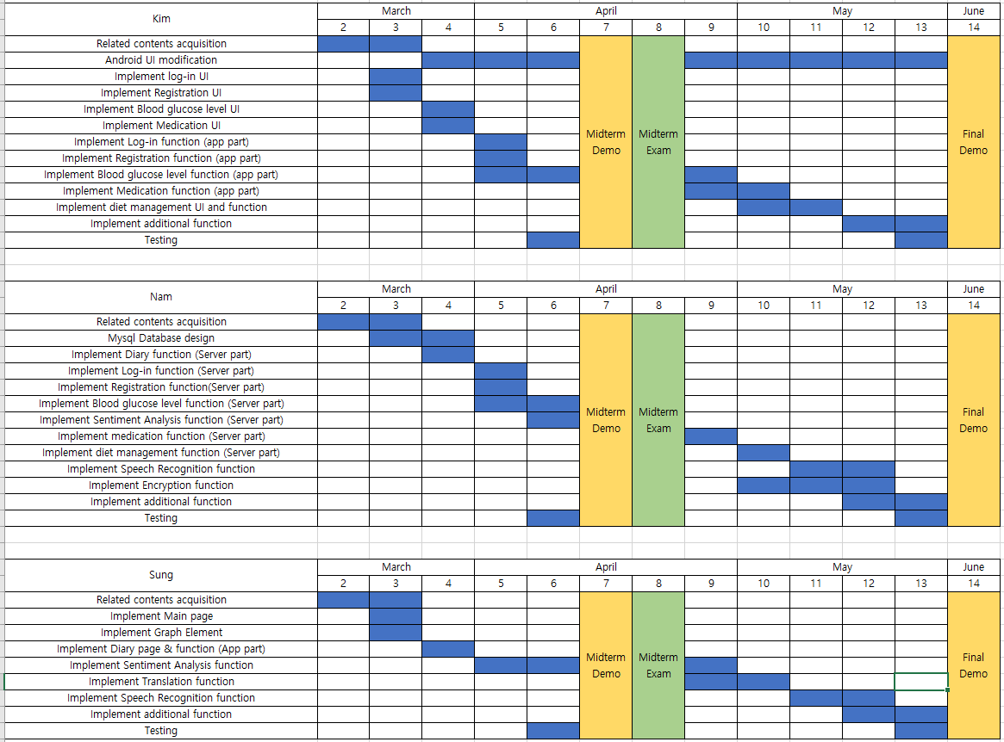

Slide 16
Q & A

