Slide 1
Implementing sentiment analysis
Application
Server
VADER
sentiment analysis
Database
Sentiment
value
Contents
Contents

Slide 2
Improving sentiment analysis
- Installed PHP version in the server is 5.2.
- We contracted for PHP 5.5, but they provided 5.2 version.
- We had to modify the original PHP code to run on the server with legacy system.
- We considered upgrading the PHP version to 7, but it might have caused side effect because it deletes all the data on the server.

Slide 3
Implementing sentiment analysis
- Short array syntax: supported since PHP 5.4
e.g. $PUNC_LIST = [“.”,”!”, …, “"!?!?"”]; → $PUNC_LIST = array(“.”,”!”, …, “"!?!?"”);
- const keyword for non-scalar values: supported since PHP 5.3
e.g. const NEGATE = ["aint", …, "despite"]; → $NEGATE = array("aint", …, "despite");
- Anonymous function: supported since PHP 5.4
e.g. $works_only = array_filter($words_only,function($word){ return strlen($word) > 1; });
+ $works_only = array_filter($words_only,"anonymous");

Slide 4
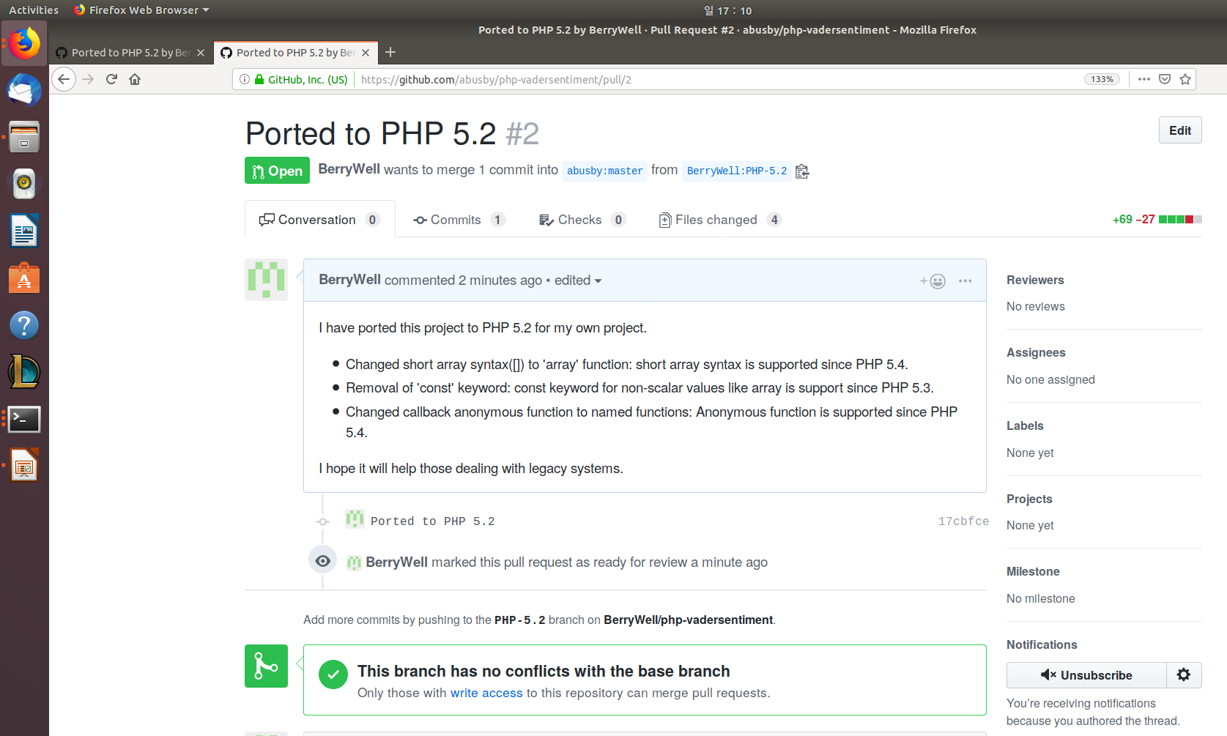
Pull request

Slide 5
Retrieve diary
- Implemented a PHP script to retrieve meal, exercise, blood glucose data with the User ID.

