Slide 1
Password encryption
- Used SHA-256
- plain text + salt => avalanche effect
Hash function
SHA-256
message
salt
message
“test”
“123”
“ecd71870d1963316 a97e3ac3408c9835a d8cf0f3c1bc703527c 30265534f75ae”

Slide 2
Password encryption
- Faced challenge: registration success, but log-in failed.
- result of SHA-256: 64 bytes.
- but the database saves 45 bytes for password.
- It saves the truncated password data.
- So we modified the Password column from VARCHAR(45) to VARCHAR(100).

Slide 3
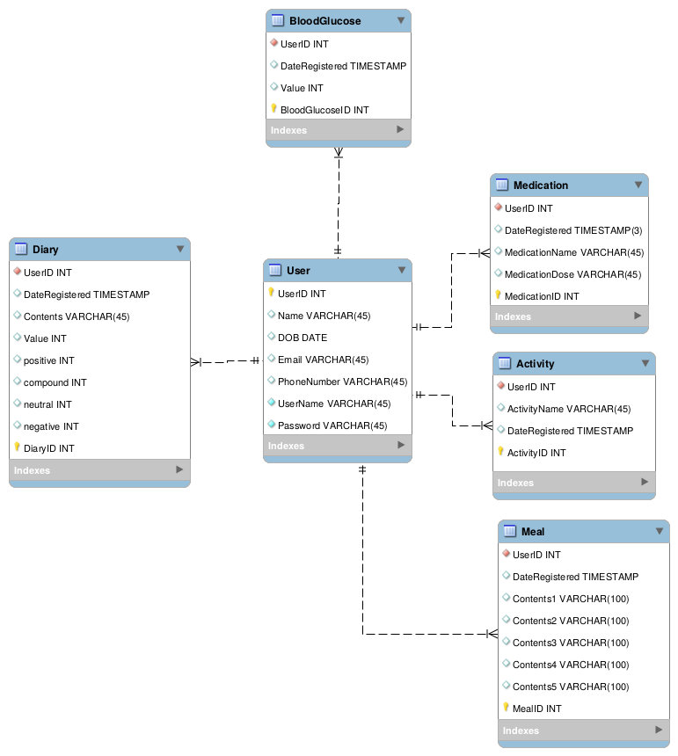
Database change
- Merged Sentiment table to Diary table.
- Added columns in Meal(Contents)

Slide 4
Retrieve diary
- Implemented a PHP script to retrieve a diary data with the User ID.

