Slide 1
Diabetes Trackers
Team 6
Nam, Geun Woo
Kim, Myeong Gyu
Sung, Ho Joon

Slide 2
Table of Contents
Feedback
Progress
Next Schedule
Q & A

Slide 3
Feedback

Slide 4
Sentiment analysis
Still working on the client-side.
Main cause: dependency issues.
Will find a way to process on the server-side.
Considering the use of PHP, JavaScript port of Vader Sentiment.

Slide 5
Progress

Slide 6
Translation function implementation
Naver Papago NMT API
< Application >
< Server >
Korean text
Source language / Target language
Translation
JSON data
Parsed data for sentiment analysis

Slide 7
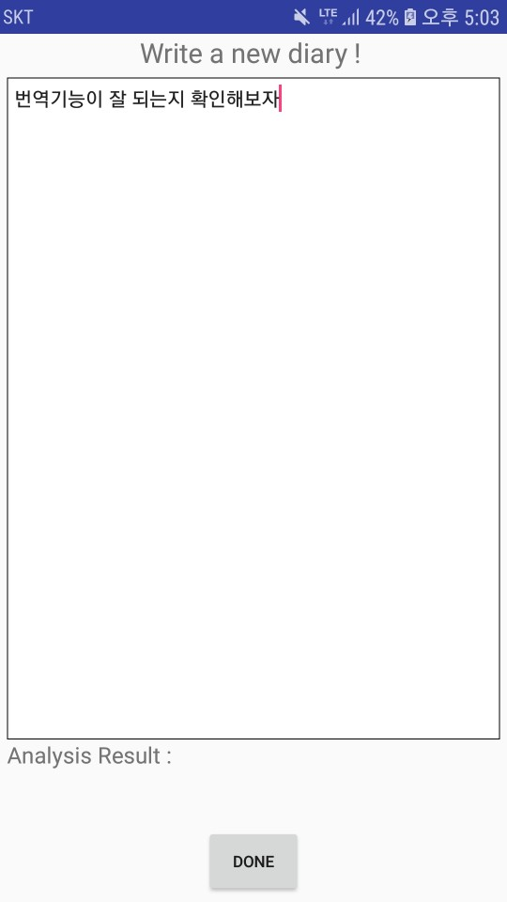
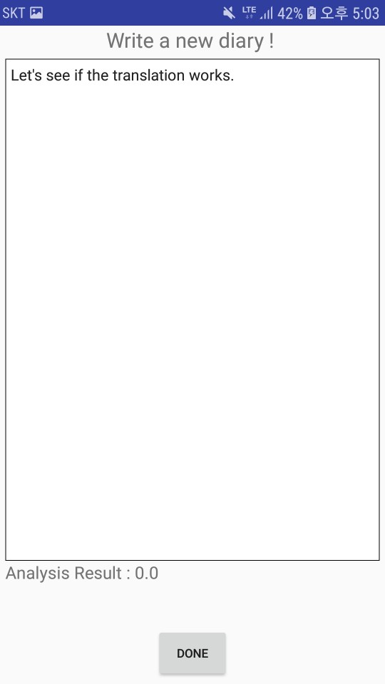
Translation function implementation

Slide 8
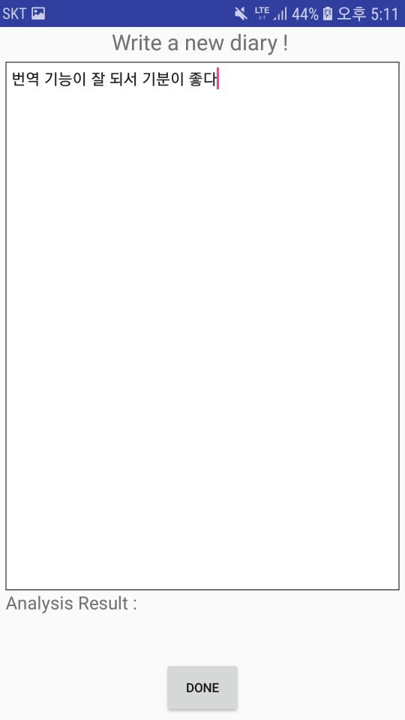
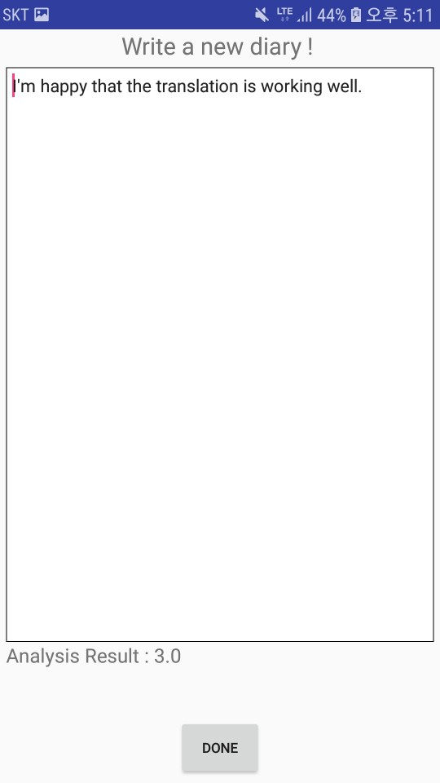
Translation function implementation

Slide 9
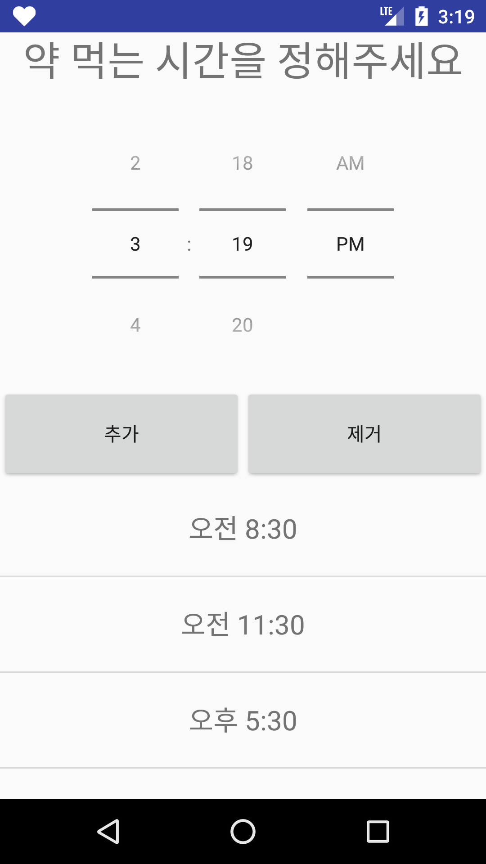
Medication alarm system

Slide 10
Encryption method
Password encryption
 | AES | MD5 | SHA-256
Classification | Symmetric-key cipher | Hash | Hash
First introduced | 1998 | 1992 | 2001
Need key? | Yes | No | No
Can be decrypted? | Yes | No | No

Slide 11
Encryption method
Application
Database
Password encrypted by hash function

Slide 12
Next Schedule

Slide 13
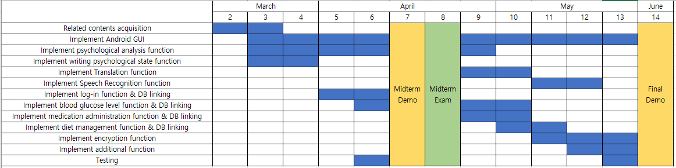
Schedules

Slide 14
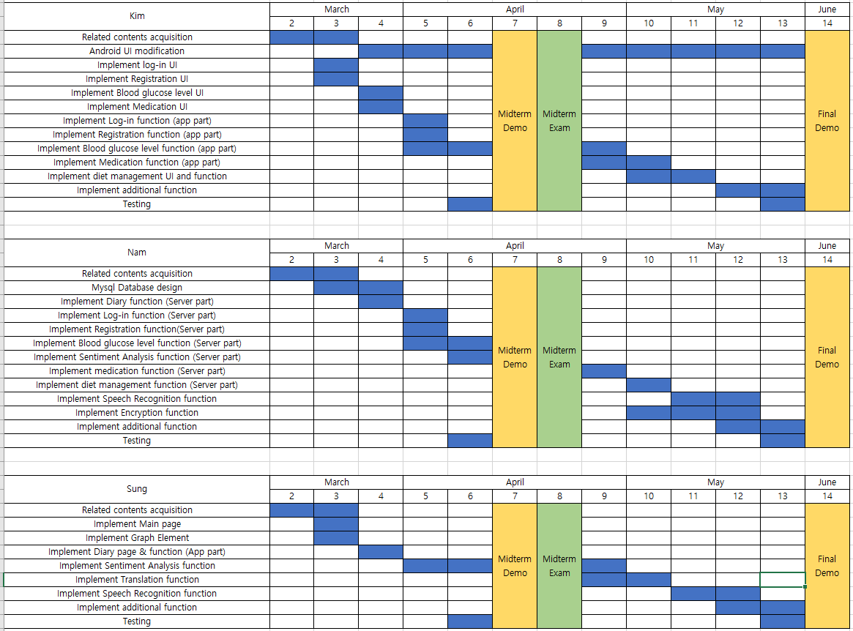
Android UI modification
Diet management function and UI implementation
Implement speech recognition function
Implement encryption function
Implement speech recognition function

Slide 15
Q & A

