Slide 1
An Mobile Application for Diabetes Self-Management with Self-guided Cognitive-Behavioral Therapy(CBT)
Team 6
Nam, Geun Woo
Kim, Myung Gyu
Sung, Ho Joon

Slide 2
Table of Contents
Background
Implementation
Schedule
Q & A

Slide 3
Background

Slide 4
A need for managing both physiological and psychological aspects
A need for managing depression comorbid with diabetes
Increasing prevalence rate of diabetes
A need for continuous management of lifestyle
Correlation between depression and diabetes
A limitation of prior applications
Notes:
당뇨병 유병률 증가
2010년: 201만 9000명 -> 2015년 251만 5000명
지속적 라이프스타일 관리의 필요성
당뇨병은 만성 질환으로 지속적인 관리가 필요
당뇨병과 우울증 사이의 상관 관계
일반 인구에 비해 우울증 유병율 약 2배 높음
기존 어플리케이션의 한계
단순한 생활 관리에만 초점

Slide 5
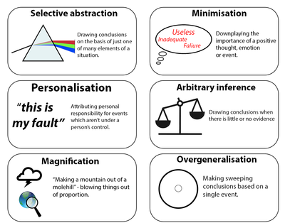
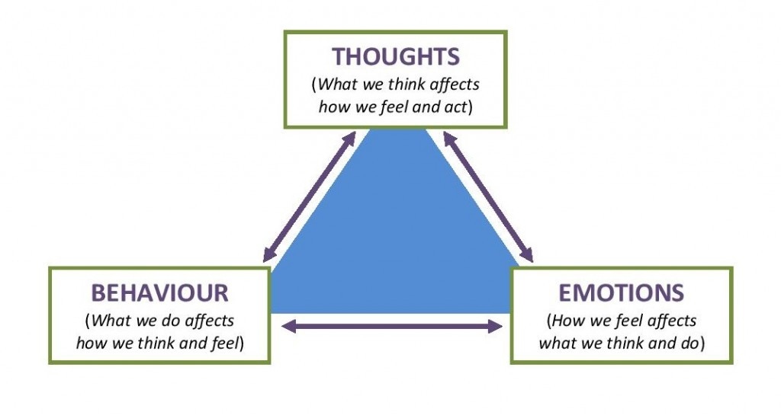
Cognitive-Behavioral Therapy(CBT)
Developed by A. T. Beck, an psychotherapist
Most commonly used psychotherapeutic approach
Common cognitive distortion of people with depression
Notes:
미국의 A. T. Beck이 개발한 심리치료 도구로 널리 쓰임
수많은 임상 실혐 결과로 그 효과가 과학적으로 뒷받침됨
치료자와의 직접적인 상담 뿐만 아니라 자조(self-help), 즉 혼자서도 책이나 어플리케이션으로 진행할 수 있음

Slide 6
Cognitive-Behavioral Therapy(CBT) diary
Situation | Distress (1-10) | Emotions | Negative Thoughts | Cognitive Distortions | Challenge | Outcome
I forget to take my medication, once. | 7 | Sad, Frustrated | I’m sure I must have Alzheimer’s disease. | Overgeneralization | Taking my medication only once doesn’t mean I have Alzheimer’s disease. | I gained more self-efficacy in managing diabetes.
My blood glucose after dinner was over 200mg/dL. | 9 | Worry | I am not in control of my diabetes. | Mental filter | In general, I’m able to keep my blood glucose within my target range after dinner, and my A1C stays below 70%. | I am in control of my diabetes.
* Examples by Dr. Beverly S. Adler(http://www.askdrbev.com/)
Notes:
미국의 A. T. Beck이 개발한 심리치료 도구로 널리 쓰임
수많은 임상 실혐 결과로 그 효과가 과학적으로 뒷받침됨
치료자와의 직접적인 상담 뿐만 아니라 자조(self-help), 즉 혼자서도 책이나 어플리케이션으로 진행할 수 있음

Slide 7
Cognitive-Behavioral Therapy(CBT) diary
Situation | Distress (1-10) | Emotions | Negative Thoughts | Cognitive Distortions | Challenge | Outcome
Compare the data
In case of emergency, report automatically
Sentiment analysis
Output data
Ex. Happiness(0-10)
Sadness(0-10)
…
Notes:
미국의 A. T. Beck이 개발한 심리치료 도구로 널리 쓰임
수많은 임상 실혐 결과로 그 효과가 과학적으로 뒷받침됨
치료자와의 직접적인 상담 뿐만 아니라 자조(self-help), 즉 혼자서도 책이나 어플리케이션으로 진행할 수 있음

Slide 8
Implementation

Slide 9
Physiological data management module
CBT module
Blood glucose(BG) tracking
Drug intake tracking
Diet tracking
Tracking CBT diary
Analysis of CBT diary to track mood
Notes:
2개 모듈
BG, drug, diet tracking
CBT diary -> nlp, sentiment analysis -> track mood

Slide 10
Doctor / psychotherapist
Database
Feedback / comment
Read data
Patient
Physiological data
CBT diary data
Review data

Slide 11
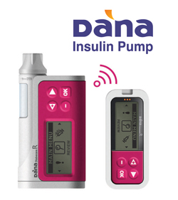
Further plans
Validate the effectiveness of this application with clinical trials in collaboration with doctors, psychologists.
Prepare for the expansion (ex. Compliant to HL7 to integrate into HIS, automatic BG recording with Bluetooth, etc.)
Researchers
Psychologists
HIS (Hospital Information System)
Database
Doctors
Patient
Physiological data
CBT diary data
BG data
Insulin injection data
Review data

Slide 12
Schedule

Slide 13
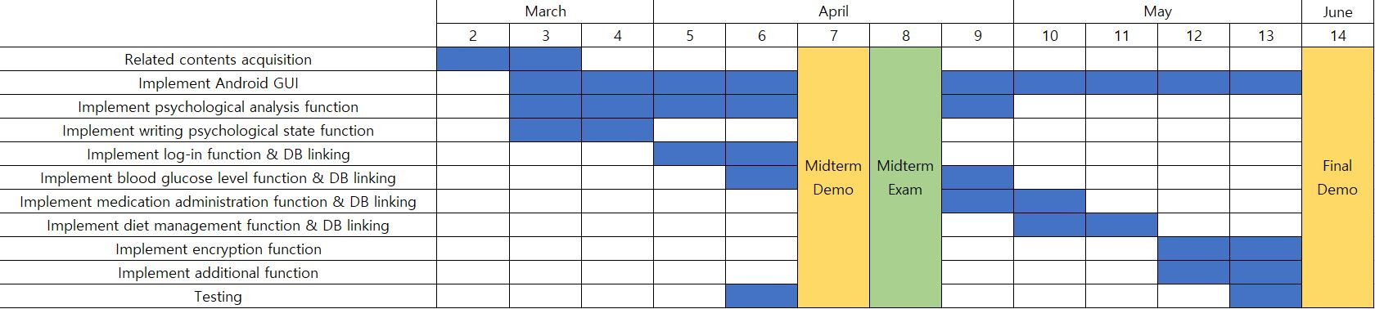
Processing personal information
- Login function
- Encryption
Storing Physiological information
- Blood glucose tracking
- Drug intake tracking
- Diet tracking
CBT feature
- Storing CBT diary
- Analyzing the diary using sentiment analysis

Slide 14
Q & A

