Slide 1

Introduction to Face Detection and Recognition using OpenCV
By : Hrithik Jerath 102383014

Slide 2
Introduction Importance of Face Recognition
Implementation of Face Detection and Recognition by simply using laptop’s webcam.
We are using video feed from a webcam which are sequence of frames of still images being updated one after the other to recognize and predict faces.
Furthermore, An Image source of Hollywood Actor named Robert Downey JR. is used for face recognition sample.
Goals
To Train the image dataset and store them with proper face ID.
Passing the frames captured by webcam one by one to detect faces.
Validating the test results with multiple test cases.

Slide 3
Implementation
Biometric identification is the automated technique of measuring the biological data. The term biometrics is commonly used today to recognize a person by analyzing his/her physical characteristics and comparing these characteristics to a database such as fingerprint recognition, retinal scanning, face recognition etc. Face recognition is one of the biometric techniques that are used for identifying and verifying the identity of a person. This paper presents the design and implementation of a face recognition system for Android mobile phone platform. The design methodology includes two main steps. The first step is the extraction of the image’s features and the second one is the recognition according to the classification of patterns.

Slide 4
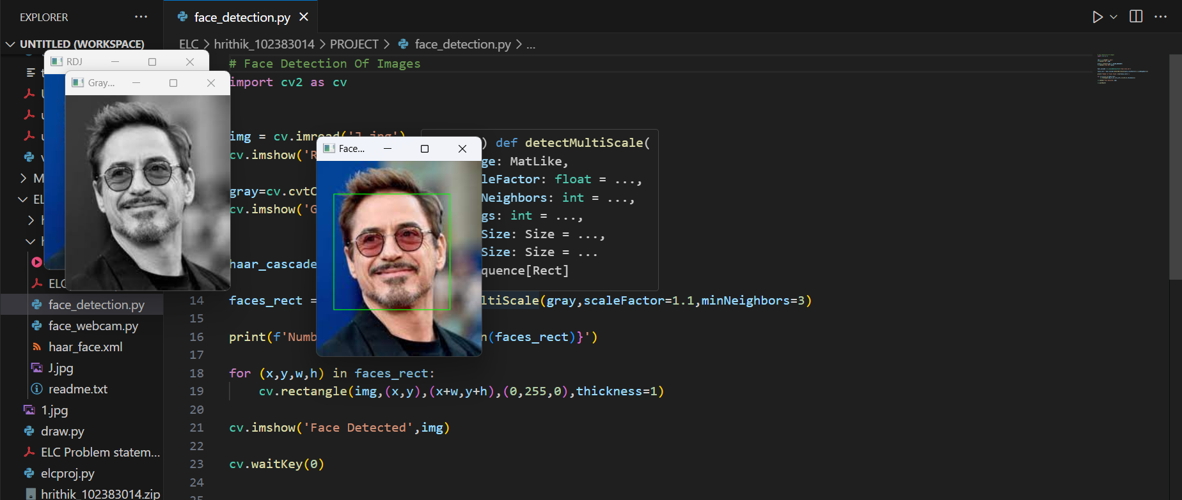
Pictorial Representation Of Face Detection On An Image

Slide 5
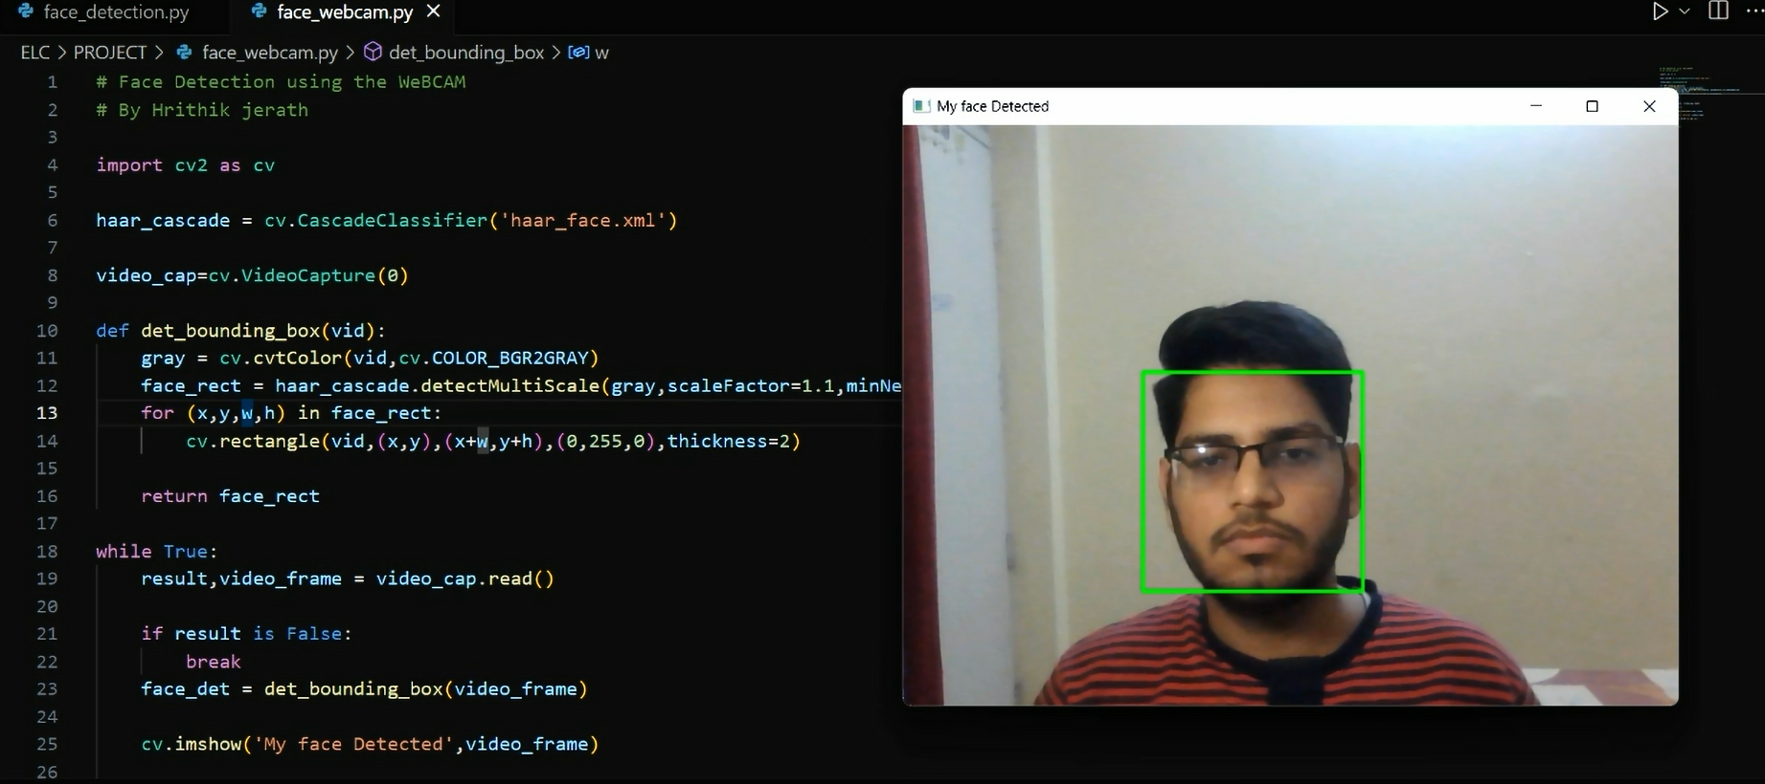
Demonstration Clip for Real Time Face detection on webcam

Slide 6
Real Life Applications On The Face Recognition and Detection
Why do we need computer vision when human vision is a relatively trivial task for most humans to accomplish?
While it is true that humans can perform visual tasks with ease and require only a few data samples, AI is highly scalable. Computer vision models can process millions of data points when deployed in surveillance and autonomous vehicles. This is a scale that simply cannot be achieved by human vision.
Furthermore, computer vision applications can be integrated into sensors, cameras, and intelligent devices for real-time image processing that involves 24/7 operation. Again, this is an incredibly challenging feat for humans to achieve.
Finally, AI is not susceptible to biases, fatigue, and inattention. While humans may get tired and overlook a security breach, a computer vision application will never falter, thereby reducing the risk of missed incidents.
1)Surveillance 2)Retail 3)Autonomous Vehicle

Slide 7
Summary
In summary, real-time face detection is a technology that plays a pivotal role in enabling swift and accurate identification of faces within video streams, offering a wide array of applications across various industries and sectors.
In this activity, we learned about the most important topic under Computer Vision “Face Detection", which was able to create a very innovative technology used by the famous car industry named Tesla,
Which was able to bring their project on their automobiles.

Slide 8
Thank You

