Slide 1
DBS next-day returns: evolving local rules
LIN Jingzhao | method section | preliminary, not frozen
13 causal features; nine chronological test years (2017–2025)
Training-only preprocessing; 2026 DENFIS holdout remains reserved
Question: can an interpretable local model add forecast or trading value?
AI6124 Group 18 | Draft | 1/5 | Sources: docs/refs.md
Notes:
Target approximately 55 seconds. Explain assumptions and uncertainty; do not imply instructor approval or guaranteed predictive advantage. Use writing/A_method.md for the detailed account.

Slide 2
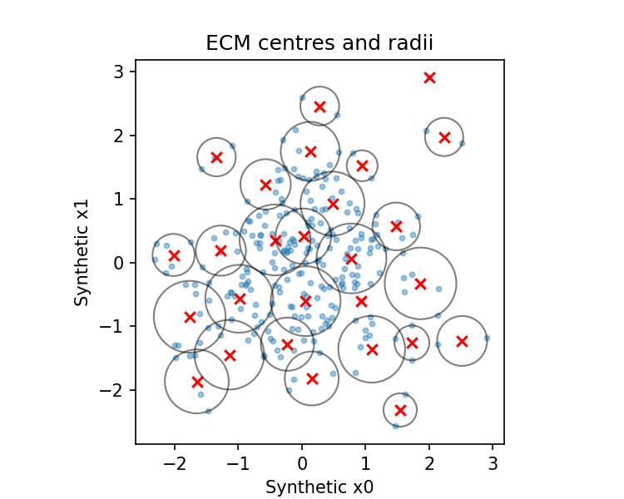
ECM → Gaussian rules → first-order TSK
Normalised centre distance; threshold controls new regions
At most 200 rules; optional support-based merging
Two-pass batch fit: antecedents first, then local weighted RLS
A DENFIS-inspired implementation; original-paper differences disclosed
AI6124 Group 18 | Draft | 2/5 | Sources: docs/refs.md
Notes:
Target approximately 55 seconds. Explain assumptions and uncertainty; do not imply instructor approval or guaranteed predictive advantage. Use writing/A_method.md for the detailed account.

Slide 3
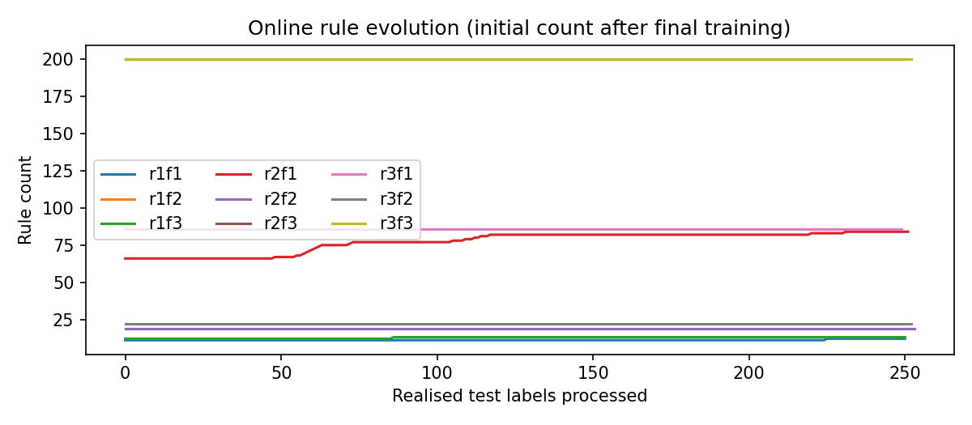
Frozen main comparison; online is a separate extension
Predict → record → realised-label update; predict never changes state
20 Dthr × lambda settings selected using validation RMSE
Final refit includes validation; thresholds selected before test
Nine-fold default explicitly excludes the holdout
AI6124 Group 18 | Draft | 3/5 | Sources: docs/refs.md
Notes:
Target approximately 55 seconds. Explain assumptions and uncertainty; do not imply instructor approval or guaranteed predictive advantage. Use writing/A_method.md for the detailed account.

Slide 4
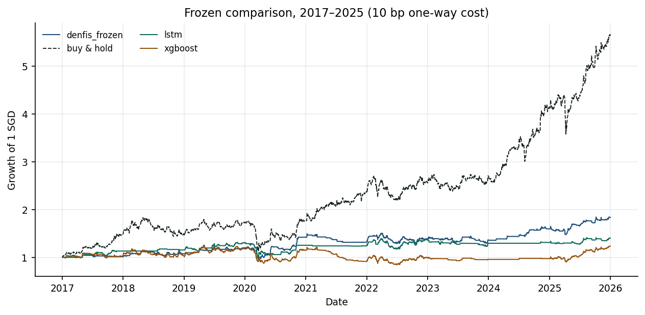
Forecast error and trading outcomes tell different stories
Frozen: RMSE 0.012066; DA 50.1%; Sharpe 0.654
Maximum drawdown 20.3%; exposure 34.4%
No lower pooled RMSE than the historical baselines
Sharpe point estimate below buy-and-hold; discuss statistical uncertainty
AI6124 Group 18 | Draft | 4/5 | Sources: docs/refs.md
Notes:
Target approximately 55 seconds. Explain assumptions and uncertainty; do not imply instructor approval or guaranteed predictive advantage. Use writing/A_method.md for the detailed account.

Slide 5
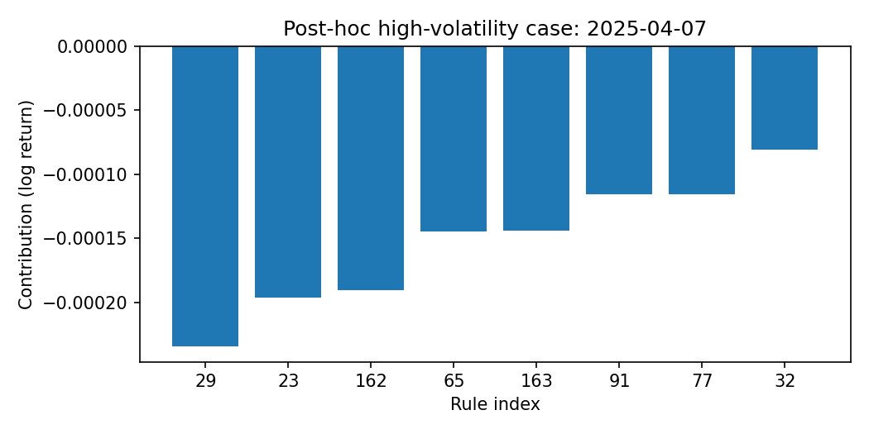
What the rules explain — and what remains uncertain
Memberships and local contributions expose the numerical prediction
Three-fold transfer and inherited-parameter ablations are exploratory
Single asset, regime sensitivity and bounded approximations limit claims
Next: consultation, joint freeze, full notebook integration and rehearsal
AI6124 Group 18 | Draft | 5/5 | Sources: docs/refs.md
Notes:
Target approximately 55 seconds. Explain assumptions and uncertainty; do not imply instructor approval or guaranteed predictive advantage. Use writing/A_method.md for the detailed account.

