Slide 1
Creating Backburns Dataset with Spatial Analysis
ETC5543 – DEECA Internship
Hendrickson Joewono You & Ifaz Ibtesam

Slide 2

About DEECA
Supporting thriving, productive and sustainable communities, environments and industries.
Key responsibilities:
  Land and environment management
  Bushfire management
  Climate and energy policy
DEECA → Bushfire and Forest Services (BFS)
Role of BFS:
  Protect Victorian state forests and tourism sites
  Bushfire prevention, preparation, and response
  Preserve communities and culture
BFS → Knowledge Planning & Risk (KPR)

Slide 3
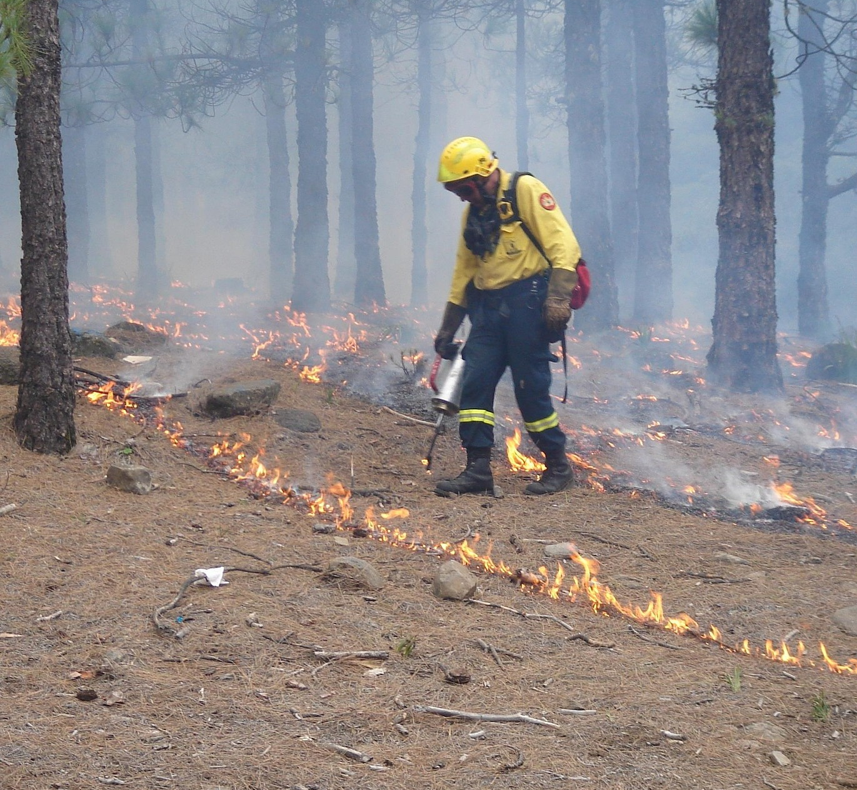
What is Backburning?
A fire-suppression technique used during an active bushfire
How it works:
  Light a fire along a control line
  Removes fuel in the path of the fire
  Reduces fire spread and impact
  Creates safe environment to fight fire
Requires careful planning as many risks involved
Source:[insert], Credit : [insert]
[Insert location], [TO Country name]

Slide 4
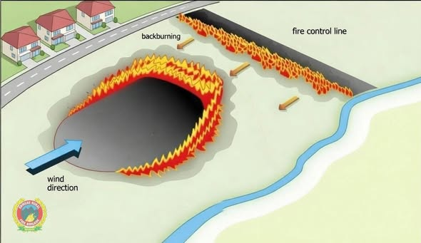

Slide 5
Problem Overview
  Background
  Received a dataset containing 396 backburns matched to bushfire incidents.
  Problem 1: Incorrect Fire Association
  Some backburns matched to the wrong fire incident
  Mismatches can occur due to entry errors, incomplete information, missing updates
  Problem 2: Duplicate/Similar Backburn Records
  Some backburn operations are presented multiple time in the data
  Similar or overlapping backburns need to be identified and grouped
  Aim
  Provide AFS with a comprehensive backburn dataset to support future analysis of backburn effectiveness using topography, elevation, weather, and wind data.

Slide 6
Dataset Variables
Column name | Type | Description
eMap_obs_date | datetime | Date of backburn observation
backburn_geometry | LineString / MultiLineString | Backburn geometry, stored as lines.
eMap_obs_type | string | Type of observation (BackburnPlanned or BackburnCompleted).
vwfrd_id | int | Fire ID in Victorian Wildfire Research Database (VWFRD).
vwfrd_fire_name | string | Fire name in VWFRD.
reported_time | datetime | Time that the fire was first reported.
under_control_time | datetime | Time that the fire was deemed under control
stop_time | datetime | Time that the fire was stopped/extinguished
Incident_geometry | Polygon / MultiPolygon | Final fire polygon
distance | float | The minimum distance between a backburn and the fire it is linked to.

Slide 7
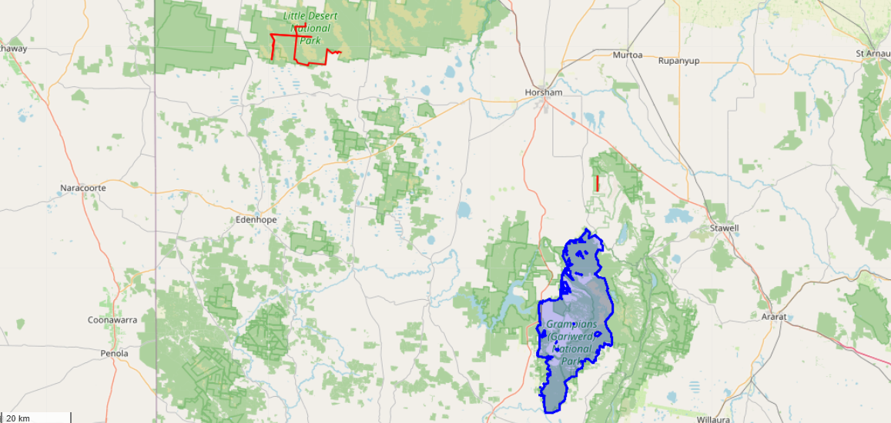
Problem 1: Incorrect Fire Association

Slide 8
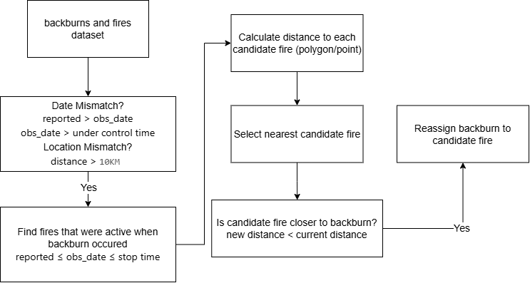
Reassignment Algorithm

Slide 9
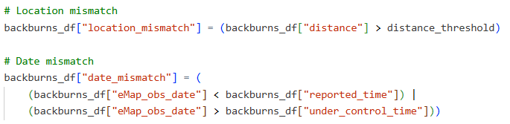

Step 1: Flagging Mismatches
  There are two ways to identify a mismatch: Location & Time
  If distance of backburn to fire more than threshold (10km), we flag as “location mismatch
  If date of backburn is not within the date range of the active fire, we flag as “date mismatch”
  396 entries, 108 backburns are flagged as a mismatch

Slide 10
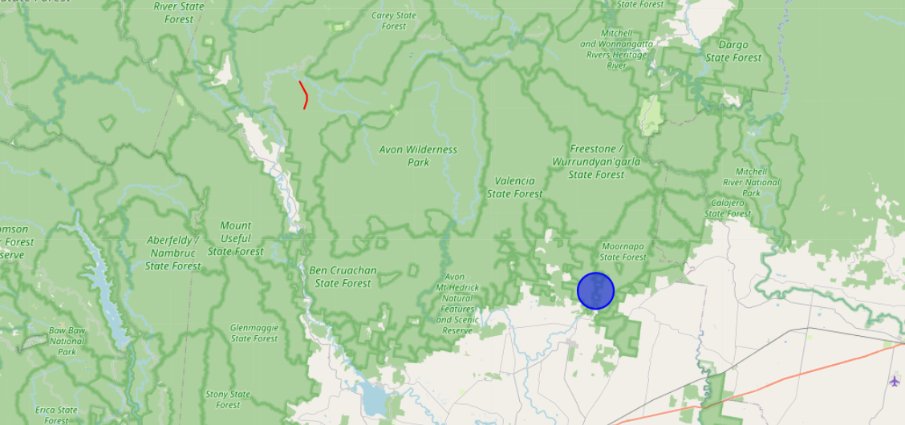
Backburn Example: Date & Location Mismatch
46184 meters
Backburn observation date almost a year after the fire

Slide 11
Step 2: Attempt to reassign flagged backburns
For each backburn flagged as mismatch, take the following steps:
  Create list of candidate fire incidents
  Calculate distance of incidents to backburn
  From the list, select the closest incident
  Reassign only if candidate incident closer
Initial Match
Candidate Match

Slide 12
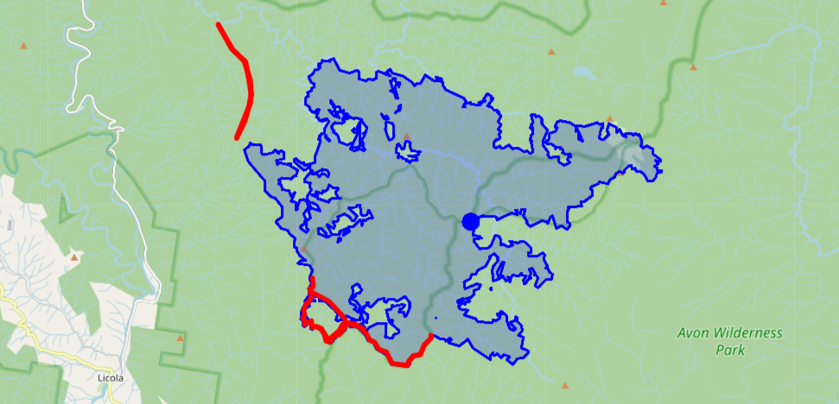
Backburn Example: Reassigned
46184 meters

Slide 13
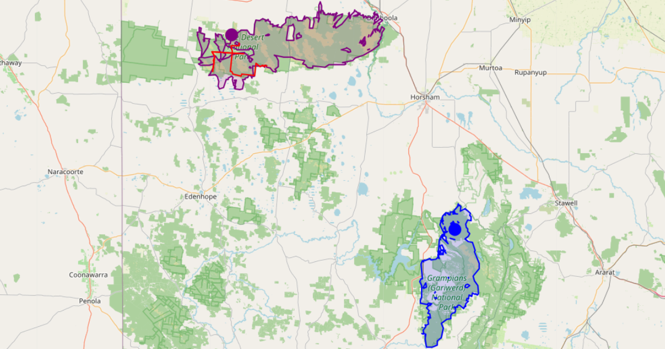
Backburn Example 2
New fire
Old fire

Slide 14
Results and Limitation
Previously, 108 of 396 backburns were flagged as a potential mismatch.
After reassignment, 66 backburns remained flagged, reducing the number of mismatches by 39%.
Most location mismatches were successfully reassigned to a more appropriate fire.
Most remaining mismatches were date-related rather than spatial-related.
Limitation: Fire status records do not always capture changes in fire behaviour. Some backburns may occur after a fire is marked Under Control, resulting in false-positive date mismatches.

Slide 15
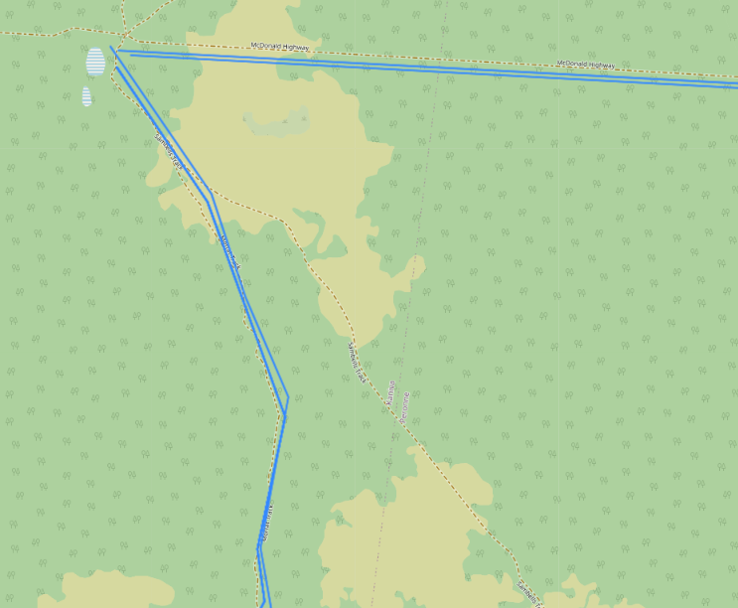
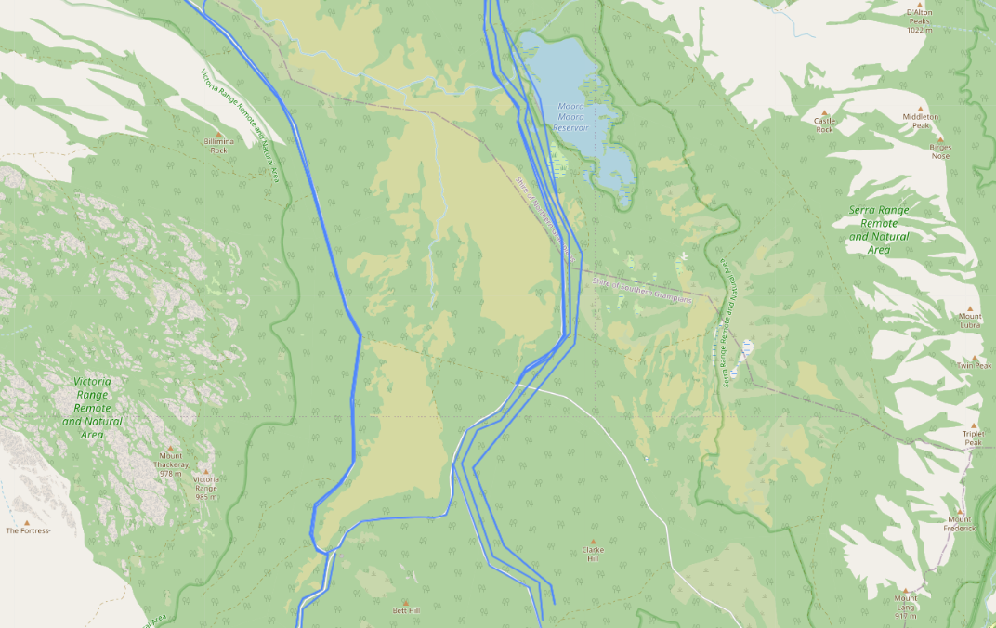
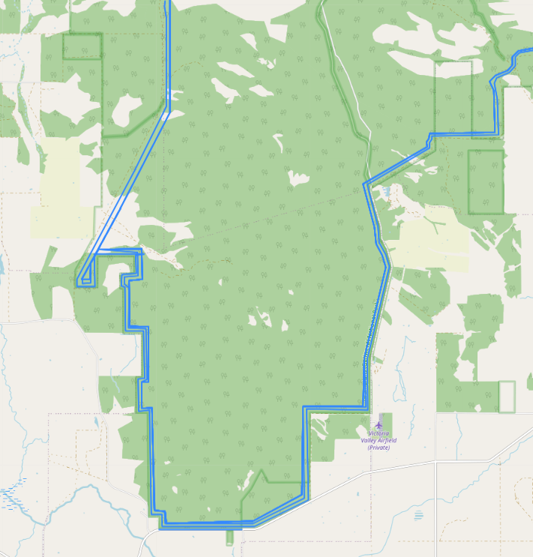
Problem 2: Duplicate Backburns
Little Desert National Park in 2025
Grampians National Park in 2024
Grampians National Park in 2025

Slide 16
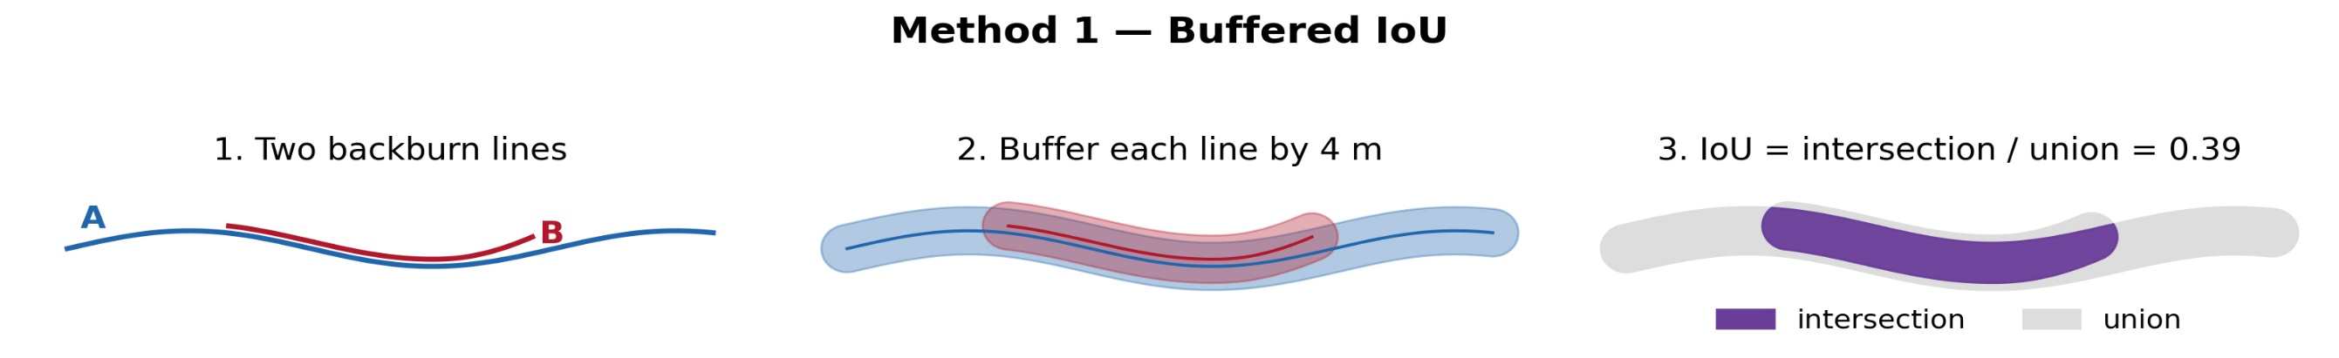
Method 1 : Buffered IoU
Intersection IoU (Intersection over union)
Calculates area of intersection
Scores each pair between 0 to 1

Slide 17
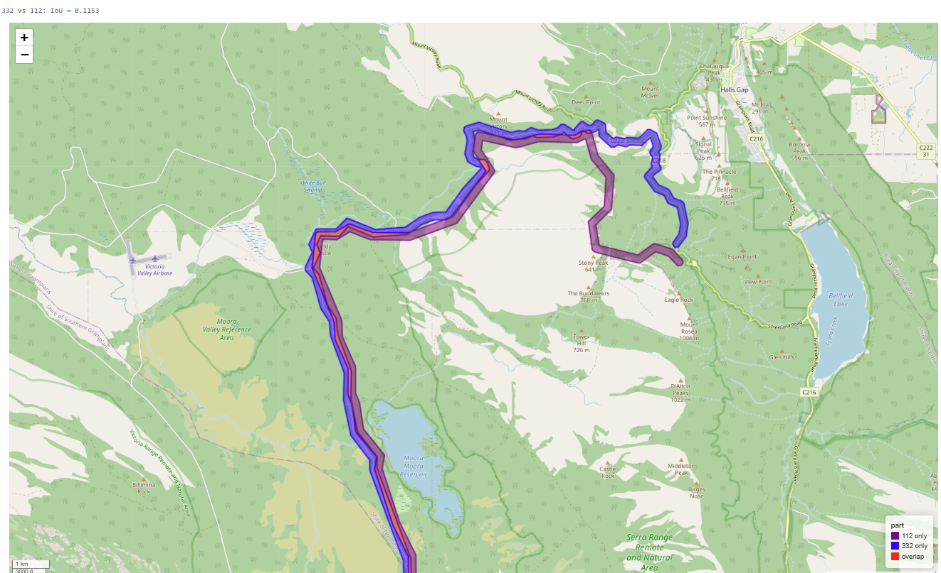

Slide 18
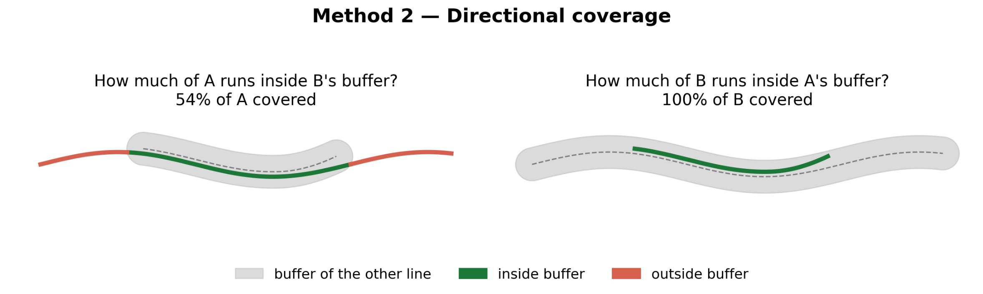
Method 2: Directional Coverage
Buffers one backburn and scores how much of the other’s length falls inside
Repeats in the other direction
Takes the max of two

Slide 19
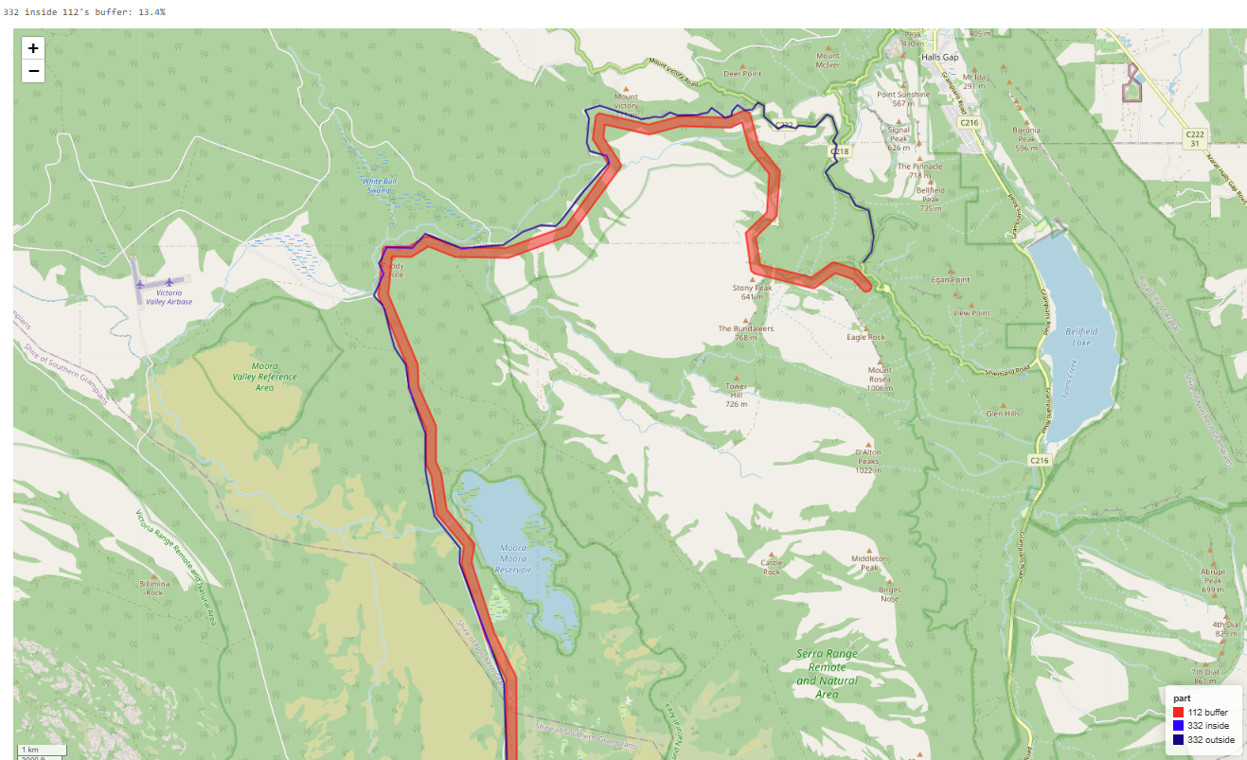

Slide 20
A combination of both methods
How to assign each backburn to a group?
  Compare every pair of backburn against one another
  Score each pair with both IoU and directional coverage (100m buffer)
  Pairs with IoU and coverage scores above 5%
  Linked pairs are chained to groups
  Assign each backburn to a group through the newly created variable group_id

Slide 21
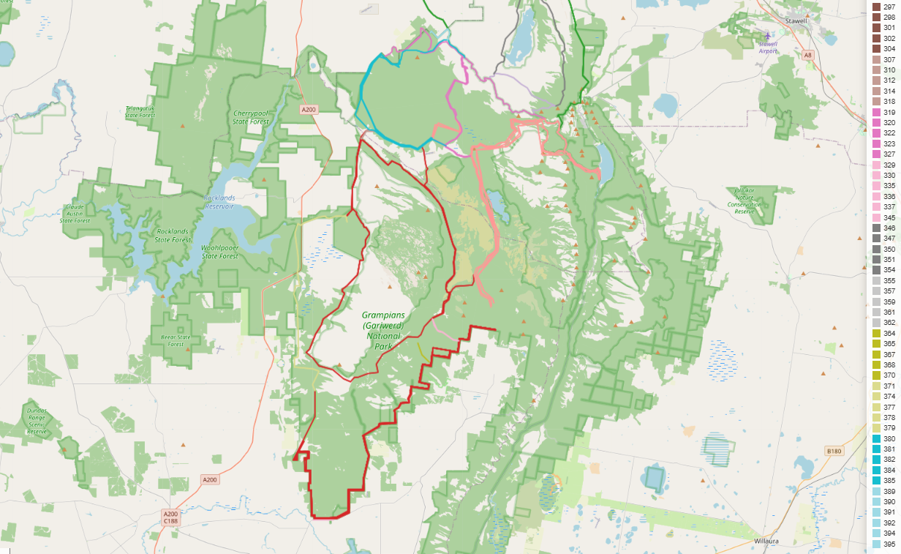
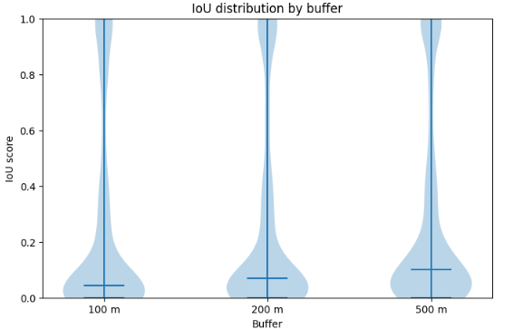
Results
104 groups assigned on a 100m buffer
80 groups for 200m buffer
54 groups for 500m
Limitations
Buffer size drives the results
Only considers geometry

