Slide 1
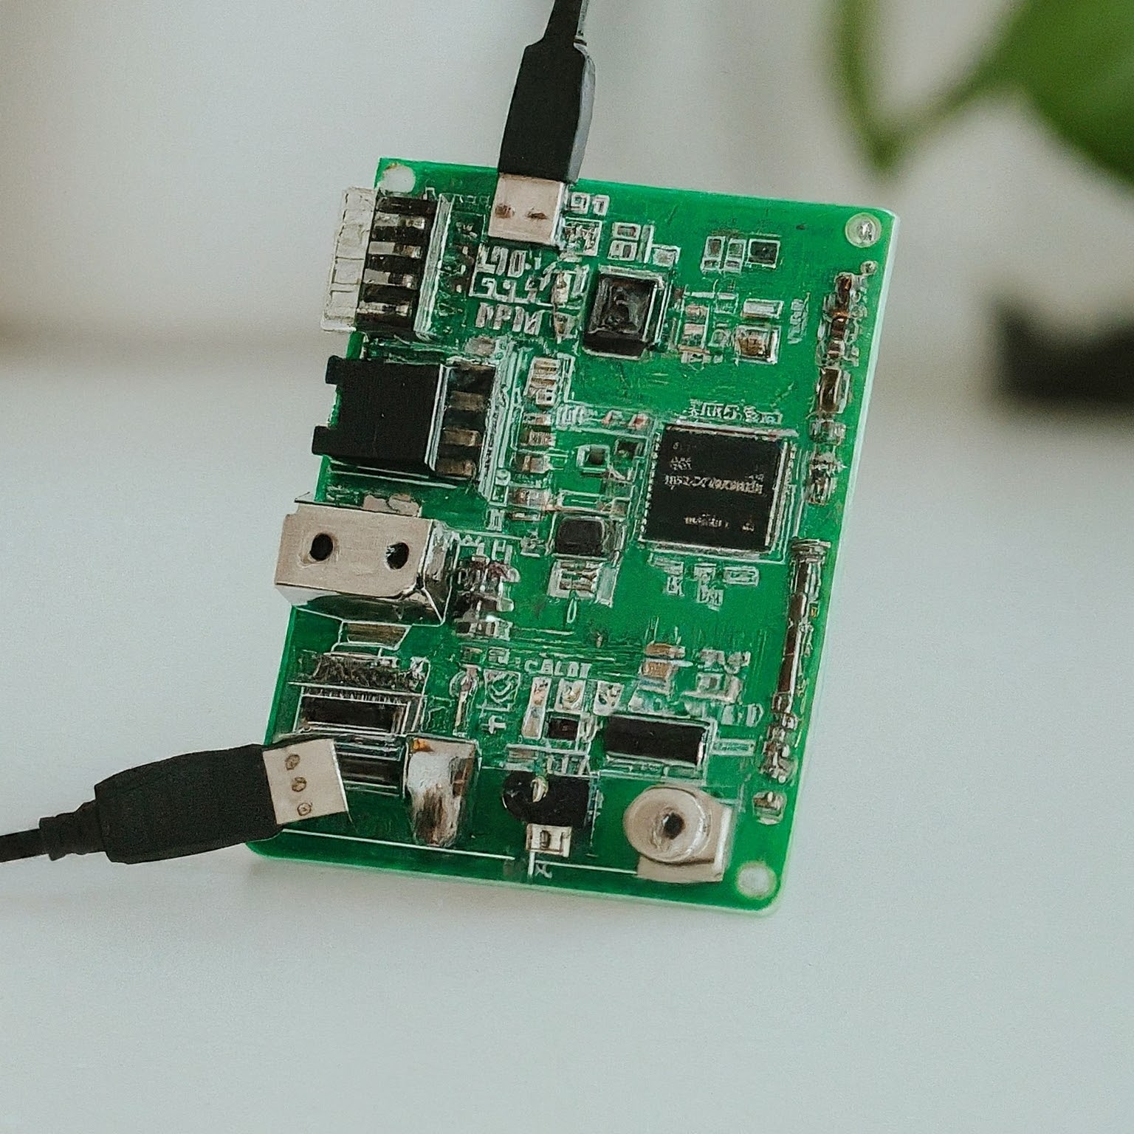

Arduino Based Bluetooth Control Device
Supervised by : Dr. Nishat Anwar
Department of Electrical Engineering
National Institute of Technology Patna

Slide 2
Contents
Introduction
Components
Software Components
Bluetooth Control App
Monitoring website
Vercel and GitHub
Hardware Components
Arduino Board
HC05
Relay
IR Sensor
LED
Block Diagram
Working Principle
Circuit Diagram
Conclusion

Slide 3
Introduction
The Arduino Based Bluetooth control device combines hardware and software for wireless, real-time control and monitoring, providing real-time sensor data to a mobile app and remote website.
The system is applicable to real-world scenarios, allowing control of both low-power devices (LEDs) and high-power devices (bulbs), while also displaying real-time sensor data such as temperature or distance
The hardware consists of a Bluetooth module (e.g., HC-05) connected to the Arduino board, enabling wireless communication for device control.
The software includes an Arduino program for the board and a mobile app to send and receive data, which is also displayed on a remotely accessible website.

Slide 4
Software Components
Centralized Functionality
The app serves as a centralized platform for Bluetooth-based control and monitoring of data.
This app also sends data to a website, which is accessible remotely
Device Control
On/Off LED
Users can toggle LED states via the app, with connection established via Bluetooth using the HC-05 for remote operation
Normal Light Control
The app extends functionality to control normal lighting, using a relay to manage the power supply to the light, enabling remote control through the Bluetooth connection.

Slide 5
Software Components
App Terminal Feature
The app incorporates a terminal for real-time data display, essential for immediate feedback, such as IR sensor readings, etc.
Website Integration
Additionally, there is a website that receives data from the app and displays it, allowing remote access and monitoring. This website is hosted by Vercel using GitHub for seamless experience..

Slide 6
Hardware Components
The Arduino board serves as the core processing unit.
The LED provides visual feedback.
The HC-05 Bluetooth module facilitates wireless communication, enabling remote control and monitoring.
The relay module controls high-power devices, such as normal lights, by switching the power supply, ensuring safe and efficient operation.
The versatile IR sensor captures real-world data.
Together, these components form a robust and interconnected system, allowing users to control devices and receive real-time data seamlessly.

Slide 7
Arduino Board
The Arduino board is the heart of an Arduino Based Bluetooth control device. It's a single-board microcontroller, essentially a small, self-contained computer specifically designed for electronics projects. Here's a breakdown of its role:
Microcontroller: It has a central processing unit (CPU) that executes the code you upload, similar to a computer's brain. This code instructs the board on how to interact with the connected components.
Input/Output (I/O) pins: These pins act like communication ports, allowing the Arduino to receive signals from sensors (inputs) and send signals to control devices like LEDs (outputs).
Power supply: The board can be powered through a USB cable connected to your computer or via an external power source like a battery pack.
In the context of Bluetooth control, the Arduino receives commands transmitted wirelessly from the HC-05 module through its I/O pins. It then interprets these commands using the uploaded code and sends corresponding instructions to control the connected components. Essentially, the Arduino acts as the bridge between the user's wireless controls and the physical world.

Slide 8
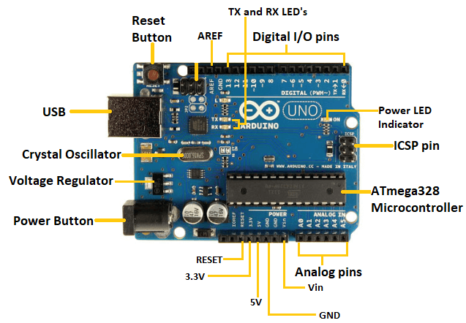
Arduino Board

Slide 9
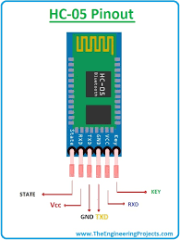
HC-05 Bluetooth Module
Function: This tiny module acts as the translator, enabling wireless communication between your Arduino and a Bluetooth device like your smartphone.
Description: It's a small circuit board with six pins typically labeled VCC, GND, TX, RX, EN, and STATE. These pins connect to the Arduino board and provide power, ground, transmit, receive, enable, and status signals, respectively.
Benefits: The HC-05 module offers:
Wireless communication: Control your Arduino project remotely using your smartphone or other Bluetooth device.
Simplicity: Relatively easy to set up and use compared to other communication methods.
Affordability: A cost-effective way to add Bluetooth functionality to your projects.

Slide 10
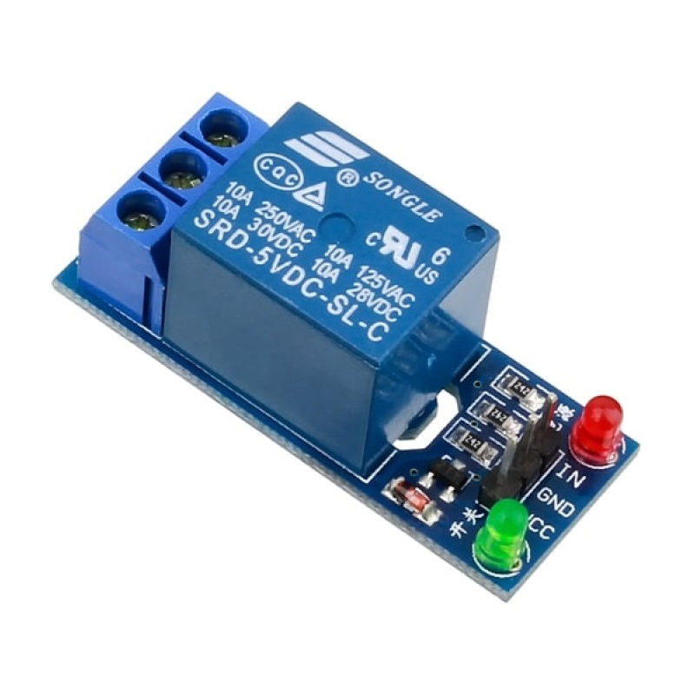
Relay
A relay is an electrically operated switch that allows low-power circuits to control high-power devices, enabling safe wireless control of bulbs and motors in Arduino systems.
Switching Mechanism: The relay uses an electromagnet to open or close a switch, enabling control of high-power devices like bulbs or motors.
Electrical Isolation: It provides isolation between the low-voltage Arduino control circuit and the high-voltage load circuit, ensuring safe operation.
Control via Arduino: The Arduino controls the relay through a digital I/O pin, activating or deactivating the relay to manage the flow of current to the connected load device.
Power Handling: Relays can handle larger currents and voltages than the Arduino, making them essential for controlling high-power devices like bulbs or motors safely.

Slide 11
IR Sensor
IR sensors are used to detect infrared radiation, which is invisible to the human eye but emitted by all objects with some level of heat. They have various applications in electronics and projects, including:
Motion detection: In security systems, IR sensors can detect the movement of warm objects, like humans, within their range.
Obstacle detection: Robots and other automated systems can use IR sensors to avoid obstacles in their path.
Line following: Robots can use IR sensors to follow a line on the ground, typically black on white, for navigation purposes.

Slide 12
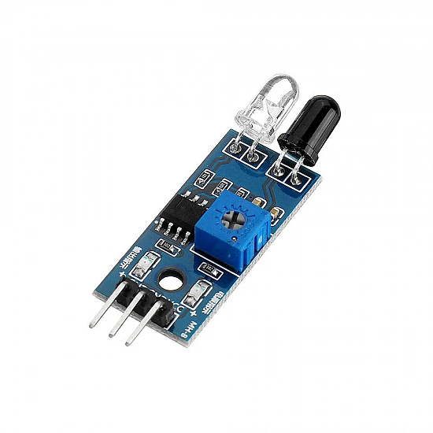
IR Sensor
A 3-pin IR sensor is a basic electronic component used to detect infrared radiation.
Components: It consists of three pins: VCC (power), GND (ground), and OUT (output).
Functionality: It works by emitting and receiving infrared (IR) light. An internal IR LED emits IR radiation invisible to the human eye. When an object is near the sensor and reflects some of this IR light back to the sensor, the output voltage changes.
Output: In absence of reflected IR light (no object detected), the output voltage remains low. When IR light reflects back (object detected), the output voltage increases.

Slide 13
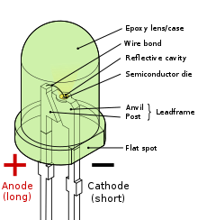
Light Emitting Diode (LED)
LEDs, or light-emitting diodes, are like miniature, colorful light bulbs perfect for electronics projects. Unlike traditional bulbs that heat up, LEDs use electricity to create light, making them super energy-efficient. They come in various sizes and colors, allowing you to add pops of color or informative lighting to your projects. Plus, their long lifespan and low power consumption make them ideal for battery-powered devices. So, whenever your project needs a little visual spark, consider using an LED!.

Slide 14
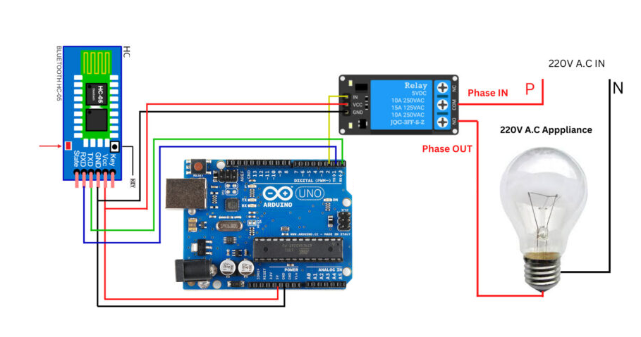
Block diagram

Slide 15
Working Principle
User Input: The user sends a command from their smartphone app, which utilizes Bluetooth technology.
Bluetooth Communication: The smartphone transmits the command signal wirelessly via Bluetooth to the HC-05 module connected to the Arduino board.
Data Reception: The HC-05 module receives the transmitted data signal and converts it into a format the Arduino can understand.
Arduino Processing: The Arduino board receives the data from the HC-05 module through its RX (receive) pin. The uploaded code within the Arduino then interprets the received data, identifying the specific command sent from the smartphone app.
Output Control: Based on the interpreted command, the Arduino code sends instructions to the connected components through its output pins. These components could be LEDs, bulbs, motors, sensors, or any other devices you've integrated into your project.
Data Transmission to Website: In addition to controlling devices, the app also sends sensor data to a website, allowing users to access and monitor this data remotely.
Feedback: In some cases, the Arduino code might send a response signal back to the smartphone app through the HC-05 module's TX (transmit) pin, providing feedback on the executed action or sensor readings.

Slide 16
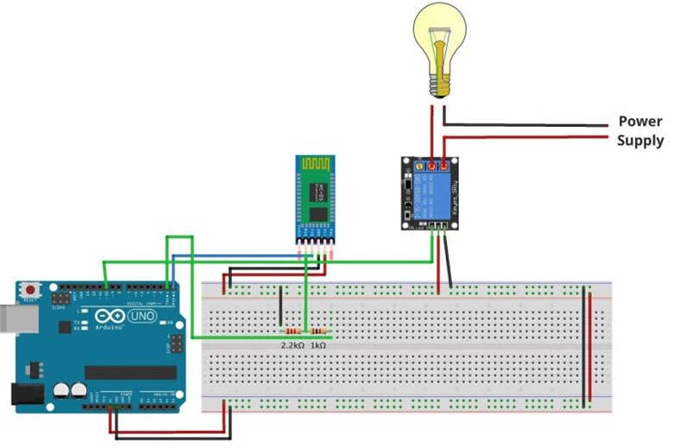
Circuit diagram

Slide 17
Conclusion
The Arduino Based Bluetooth Control Device integrates hardware and software for wireless device control and real-time monitoring, providing a user-friendly solution.
Seamless communication between the Arduino board, HC-05 Bluetooth module, and mobile app allows smooth control of devices like LEDs and bulbs, as well as real-time sensor data monitoring.
Users can remotely control and monitor devices (LEDs and bulbs) through the app and website, offering immediate feedback and enhancing convenience.
The relay module ensures safe operation for higher-power devices like bulbs, demonstrating the system’s scalability for broader IoT applications, including home automation and industrial use.
Real-time streaming of sensor data to the app and website allows users to remotely monitor and respond to environmental changes, making the system ideal for security, environmental monitoring, and automation.
The system’s ability to handle various devices and stream real-time data positions it for future expansion and adaptability across diverse use cases.

Slide 18
Thank you
Presented by:
Harshit Jajoo(2102109)
Vinod kumar (2102048)
L.Harsha Vardhan (2102069)
Palaparthi Vamsi (2102127)

