Slide 1
R-CNN
arXiv:1311.2524v5 [cs.CV] 22 Oct 2014
Made by : Kim Hyunjun
bryn0419@naver.com

Slide 2


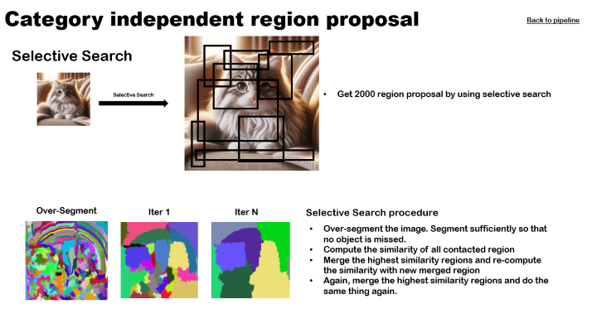
Guide
Click these numbers to get detailed information
Click “Back to pipeline” if you want to go back
Extract region proposals
Input image
Selective Search

Slide 3


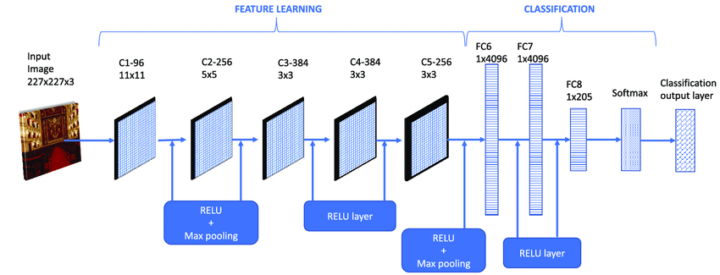



Pipeline
Optimization
Extract region proposals
Input image
Warp region proposals
IOU>0.5 : positive
else : negative
CNN Network
Train
Bounding Box Regression
Selective Search
Extract pool5 layer
output
Feature extraction
Final output
Cat 0.9
Greedy Non-Maximum Suppression
Test mode
Linear SVM
Train mode
Ground Truth : Positive
IOU<0.3 : Negative
Optimization

Slide 4



Category independent region proposal
Back to pipeline
Selective Search
Selective Search
Get 2000 region proposal by using selective search
Over-Segment
Iter 1
Iter N
Selective Search procedure
Over-segment the image. Segment sufficiently so that no object is missed.
Compute the similarity of all contacted region
Merge the highest similarity regions and re-compute the similarity with new merged region
Again, merge the highest similarity regions and do the same thing again.

Slide 5
Warp region proposals
Back to pipeline
Extract region proposals
Region proposals with various size
Each extracted region proposals have various size
In the paper, they extracted 2000 proposals
Need to make them have same size
Various method can be applied, but in paper, they use warping
Warp region proposals
Warp
CNN Network
Ground Truth
Positive
IOU = 0.9 > 0.5
Negative
IOU = 0.1 < 0.5
Sample the minibatch with ratio of positive and negative 36:92 (IOU threshold = 0.5)
Bias the sampling towards positive because positive proposals are very rare
All input image tensor have same shape of (3,227,227)
Because CNN network require this shape of input

Slide 6
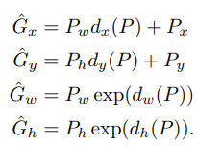
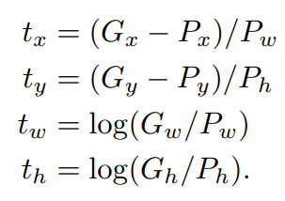


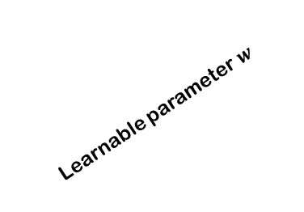
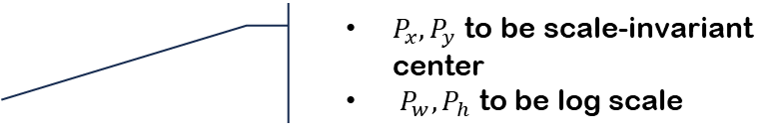
CNN network – Bounding Box Regression
Back to pipeline
CNN Network : Cafe
Predicted geometric value of bounding box
Target value
Optimize CNN
MSE loss function with regularization term
N stands for number of training pairs
Extract pool5 layer output with
tensor shape (2000,4,1,1)
Learnable parameter $w$
$P_{x},P_{y}$ to be scale-invariant center
$P_{w},P_{h}$ to be log scale
Linear transformation
$$φ_{5}\left(P\right)=(P_{x}, P_{y},P_{w},P_{h})$$
They stands for center coordinate (x,y) and width, height of bounding box
Only single proposal which has maximum IOU overlap > 0.6 with ground truth. Therefore, training pair (P,G) is made.
To predict normalized value…

Slide 7
CNN Network - Feature extraction
Back to pipeline
CNN Network : Cafe
Extract feature with dimension of 4096
Linear SVM
Ground Truth
Positive
IOU = 0.9 > 0.5
Pre-train
Domain-specific fine -tuning
Negative
Task : Classification (ILSVRC2012)
Only image-level annotation (not detection task)
Task : Object detection
Stochastic gradient descent with learning rate of 0.001 (1/10 smaller than pre-train)
32 positive proposals and 96 negative (background) proposals consist minibatch
Replace classification layer which was for pre-train with Linear SVM layer. Output shape should be (2000,C+1) where C stands for number of classes
Linear SVM then classifies each class
IOU = 0.1 < 0.5

Slide 8
Linear SVM - Train mode
Back to pipeline
Positive : Ground truth only
Negative : Proposals with IOU < 0.3
※ Neglect (no use) proposals with IOU > 0.3
Since it needs to classify multiple classes, 1 vs all classification method is used
Adopt hard negative mining method because training data is quite large

Slide 9
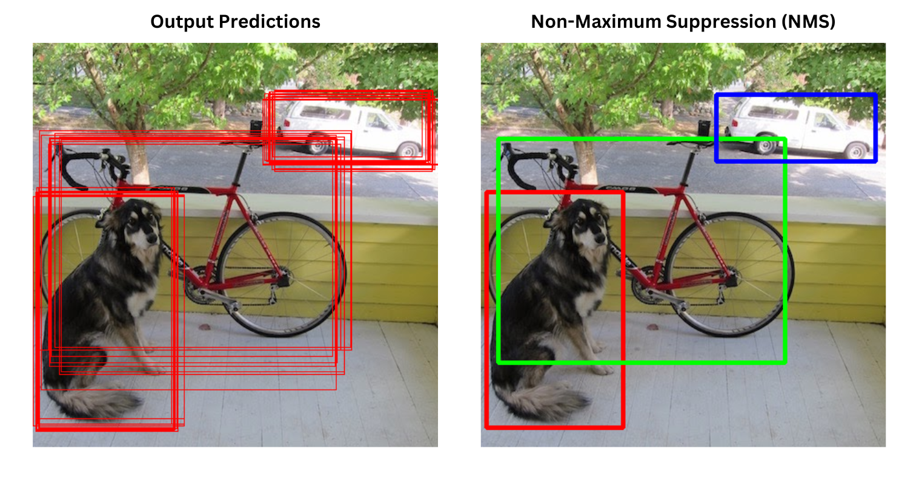
Linear SVM - Test mode
Back to pipeline
2000 (number of proposals)
Linear SVM
Get score of each class for single proposal
Apply non-maximum suppression method
C+1 Class + Background
※ Non-maximum suppression
If there is two proposals with IOU > threshold reject the lower score one
Repeatedly do the same thing until there is single proposal left for each class

Slide 10
Reference
https://donghwa-kim.github.io/SelectiveSearch.html
https://developer-lionhong.tistory.com/31
Rich feature hierarchies for accurate object detection and semantic segmentation : Ross Girshick Jeff Donahue Trevor Darrell Jitendra Malik UC Berkeley ; arXiv:1311.2524v5 [cs.CV] 22 Oct 2014

Slide 11




Diagrams
Convolutional
Layer
Progress
Progress
Description 1
Description 2
Text Box

