Slide 1
Mini Project – 0th Review

Slide 2
Automated Recognition Of Over Flowing Garbage Bins

Slide 3
Base Paper Details
Citation:
M. Wasim, I. Ahmed, J. Ahmad and M. M. Hassan, "A Novel Deep Learning Based Automated Academic Activities Recognition in Cyber-Physical Systems," in IEEE Access, vol. 9, pp. 63718-63728, 2021, doi: 10.1109/ACCESS.2021.3073890.
Paper Link: https://ieeexplore.ieee.org/document/9406808

Slide 4

Problem Statement
A big challenge in the enclosed campus is solid waste management. The garbage collecting authority in traditional waste management system doesn’t know about the level of garbage in dustbin or the garbage segregated in a place, if the dust bins gets full by garbage then it gets overflowed as well as spelled out from the dustbin leading to unhygienic condition in the campus. People throw garbage on that dustbin which is already overflowed. Sometimes due to unclean garbage bins bad smell arises also toxic and unhygienic gases are produced which is way to support to the air pollution and to some harmful diseases which are easily spreadable.

Slide 5
Objective
Build a model to detect overflowing of trash.
Give input to the model using a secondary camera device.
Embed that device in a Quadcopter.

Slide 6
Work Flow
Start
Acquring Dataset
Analysing Dataset
Testing
Training
Modelling
Validating
Testing with live video
Embedding into Quadcopter
Stop

Slide 7
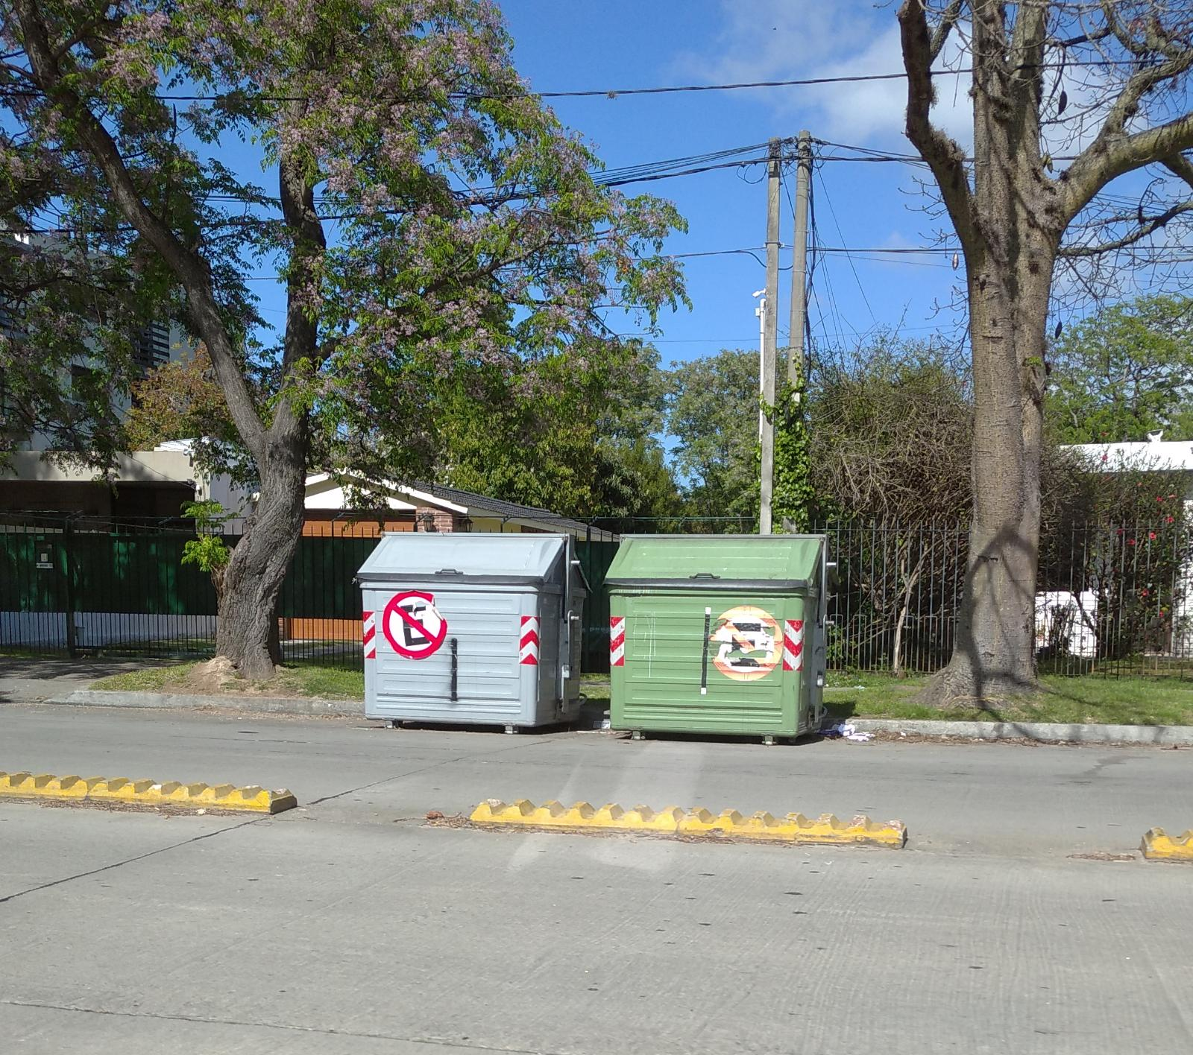
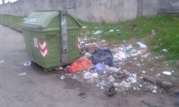
Acquired Dataset
Garbage dataset
Kaggle Link: Dataset
Shape: 3412 Images
Clean: 1806
Trash: 1606
Citation: G Mittal, K B Yagnik, M Garg, and N C Krishnan, Spot Garbage: Smartphone App to Detect Garbage Using Deep Learning, ACM International Joint Conference on Pervasive and Ubiquitous Computing, 940-945, 2016
Clean
Trash

Slide 8
Novelty
Implemented in the Journal
Deep learning model is used to classify the activities taking place in a classroom of an institution.
Modifications to be made
Deep learning model is to be used to identify garbage dumping inside a campus through a quadcopter.

Slide 9
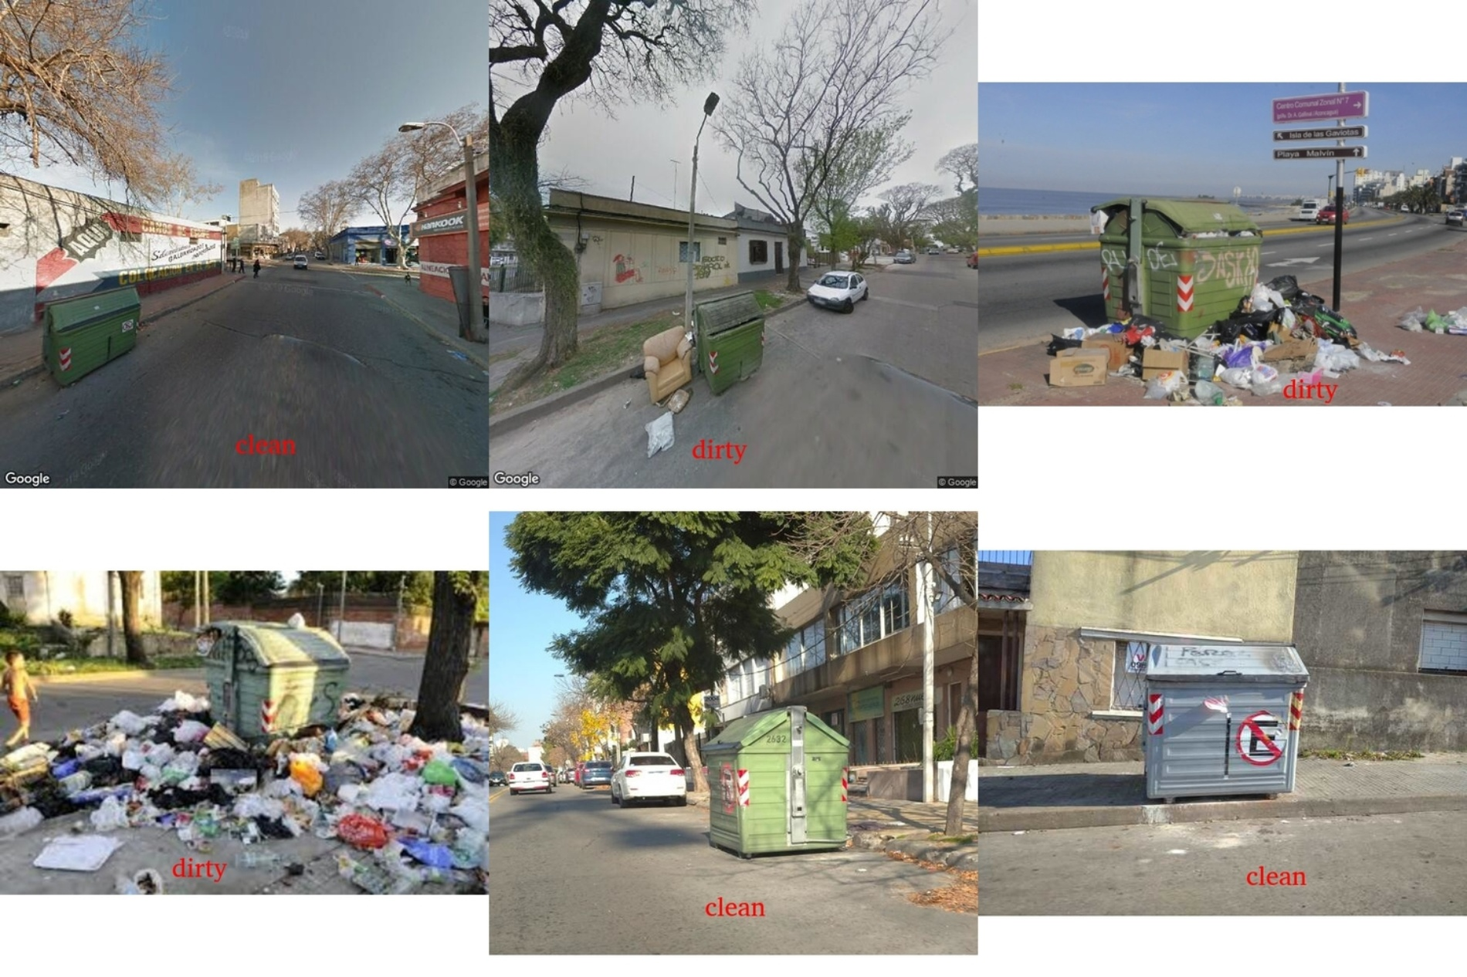
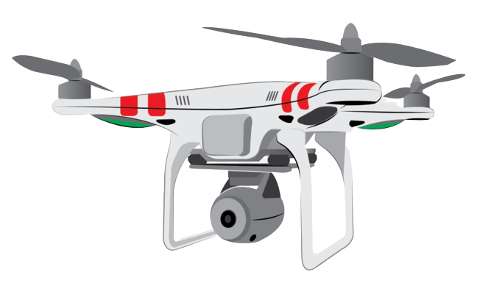


Conclusion and Result
The study in the journal paper proposed an efficient deep learning model for a novel set of academic activities in a campus domain. The presented activity recognition system can be easily using a smart cyber-physical system. The work implemented in this paper gave a result with 98% accuracy

Slide 10
Reference
A. Canziani, A. Paszke, and E. Culurciello, ‘‘An analysis of deep neural network models for practical applications,’’ 2016, arXiv:1605.07678. [Online]. Available: http://arxiv.org/abs/1605.07678
H. Wang and C. Schmid, ‘‘Action recognition with improved trajectories,’’ in Proc. IEEE Int. Conf. Comput. Vis., Dec. 2013, pp. 3551–3558.
I. Rodríguez-Moreno, J. M. Martínez-Otzeta, B. Sierra, I. Rodriguez, and E. Jauregi, ‘‘Video activity recognition: State-of-the-art,’’ Sensors, vol. 19, no. 14, p. 3160, Jul. 2019.
W. Wu and Y. Zhang, ‘‘Activity recognition from mobile phone using deep CNN,’’ in Proc. Chin. Control Conf. (CCC), Jul. 2019, pp. 7786–7790.

Slide 11
Thank You

