Slide 1
Mini Project – 1th Review

Slide 2
Automated Detection of Overflowing Garbage Bin

Slide 3

Problem Statement
A big challenge in the enclosed campus is solid waste management. The garbage collecting authority in traditional waste management system doesn’t know about the level of garbage in dustbin or the garbage segregated in a place, if the dust bins gets full by garbage then it gets overflowed as well as spelled out from the dustbin leading to unhygienic condition in the campus. People throw garbage on that dustbin which is already overflowed. Sometimes due to unclean garbage bins bad smell arises also toxic and unhygienic gases are produced which is way to support to the air pollution and to some harmful diseases which are easily spreadable.

Slide 4
Motivation
Segregation of trash is being a major problem in the society and there is no proper recognition model especially build for this purpose.
The recognition of Highly segregated garbage is to be build using YOLOv5(A novel CNN using pytorch).
As there is no pre-trained model available the accuracy in the initial model will be low, So the accuracy should be increased.

Slide 5
Objective
Build a model to detect overflowing of trash.
The model is to be build using deep learning Convocutional Neural Network.
Imporve the accuracy of the prediction using proper weights for the classification

Slide 6
Literature Survey
Research on the Use of YOLOv5 Object Detection Algorithm in Mask Wearing Recognition, Liu, Yifan, Lu, BingHang, Peng, Jingyu, Zhang, Zihao. World Scientific Research Journal ; 6(11):276-284, 2020.
Zhang, D., Islam, M. M., & Lu, G. (2012). A review on automatic image annotation techniques. Pattern Recognition, 45(1), 346-362.
Mahamkali, Naveenkumar & Ayyasamy, Vadivel. (2015). OpenCV for Computer Vision Applications.

Slide 7
Proposed Flow
Start
Dataset
After getting the dataset, The dataset is splitted into training and testing dataset.
Annote the images in the training dataset.
Using the annoted training dataset build a model and train it.
Acquire the weights from the training.
Use the weight and the model for prediction
Dataset Split
Testing
Training
Annotation
Acquiring
the weights
Model
Prediction
Clean
Dirty

Slide 8
Proposed Method
After acquring the image data annote the images with a LabelImg package.
Once the image labeling is over use YOLOv5 to train the model.
YOLOv5 will provide the weights for classification of the images.
Among those weights use the best fit weights for prediction.
Model evaluation:
Box loss
Object loss
Class loss
Precision
Recall score

Slide 9
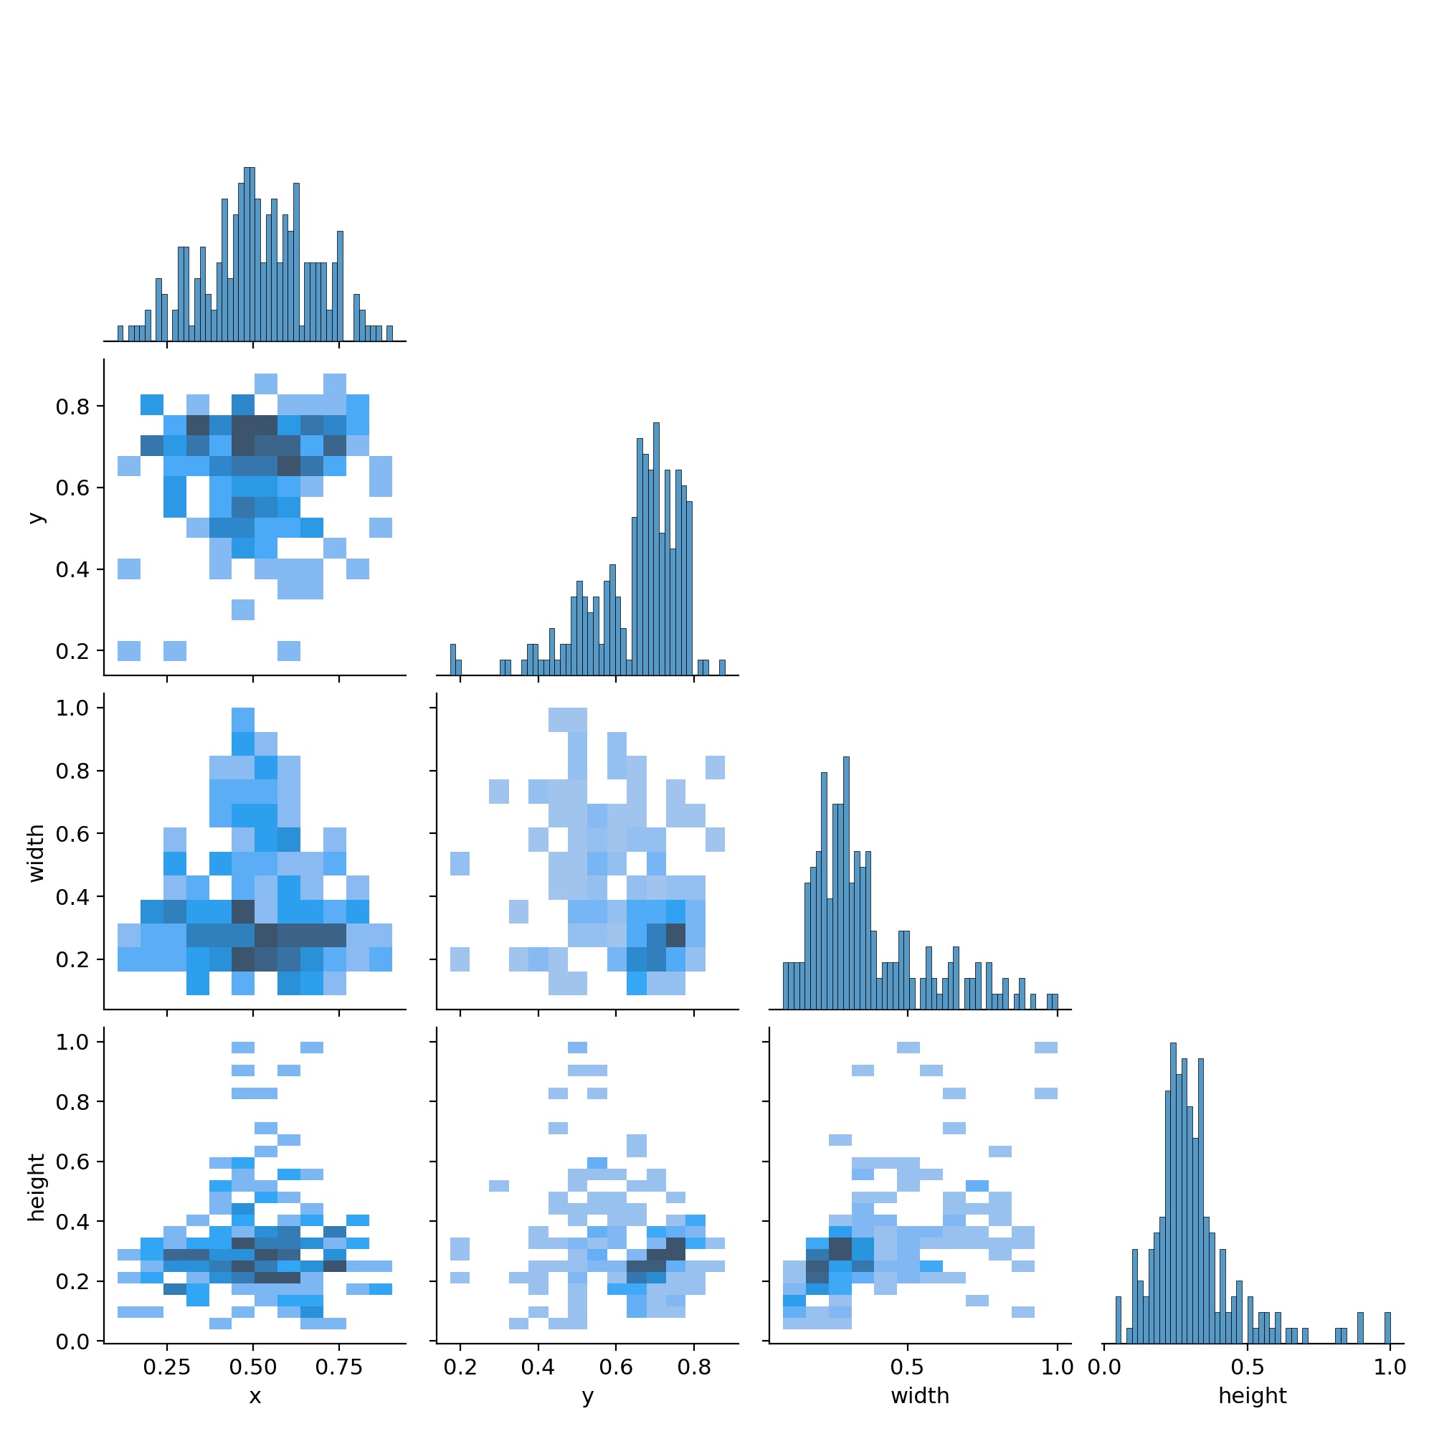
Model Creation
YOLOv5 is used to create the weights for the model using the training data and with that weight the model is made for prediction of unseen data. OpenCV video capturing techniques are used to obtain the frame images for prediction

Slide 10
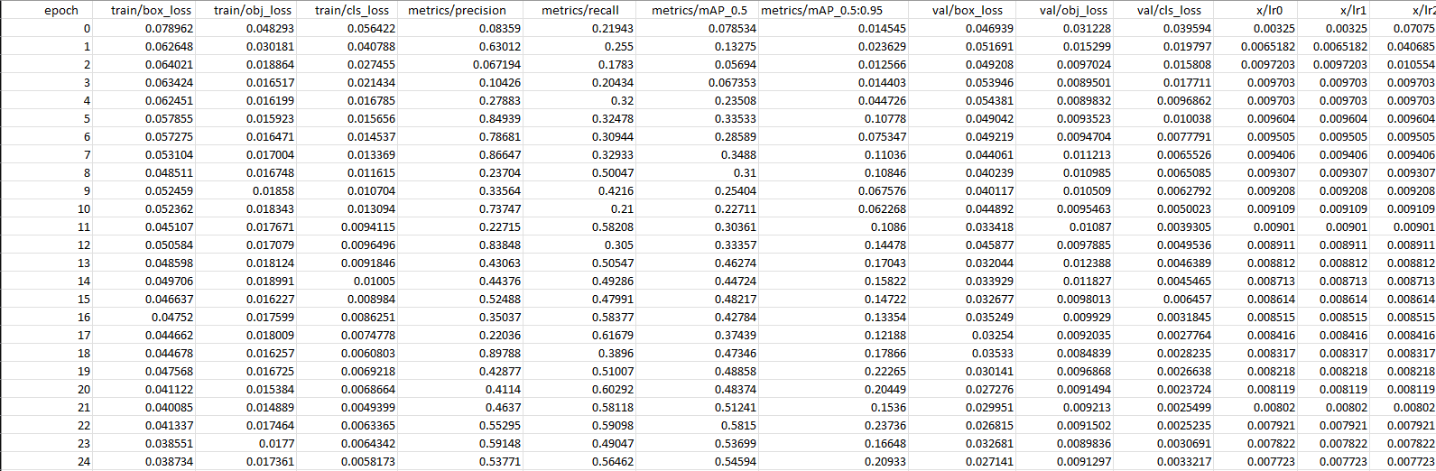
Performance Measurement
The follwing are used to evatuate the performance for testing and validation for each epoch:
Box loss
Object loss
Class loss
Precision
Recall score
Mean Average Precition
Learning Rate

Slide 11
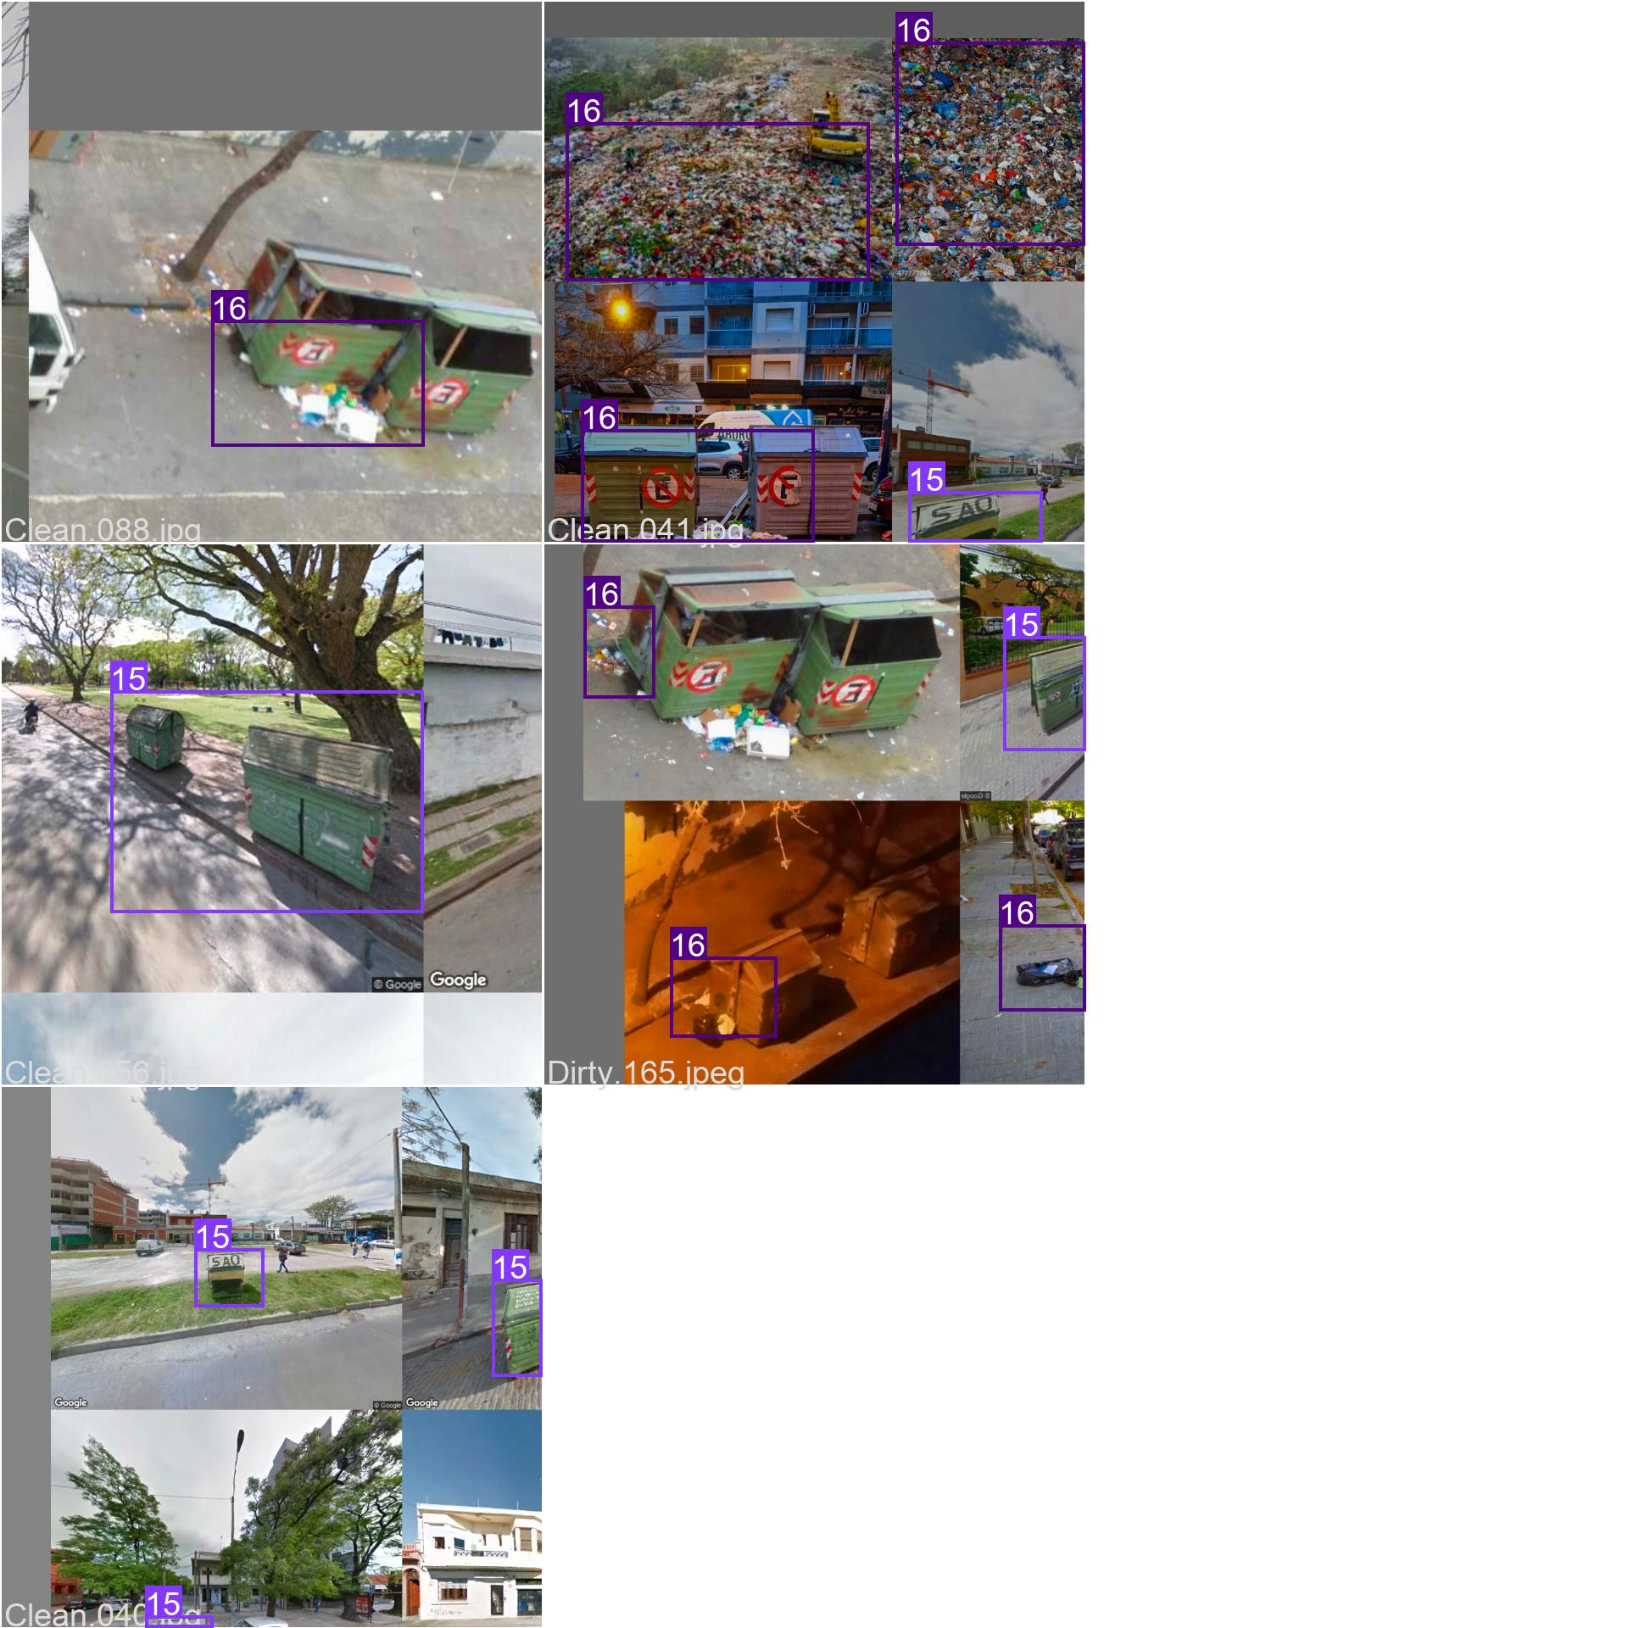
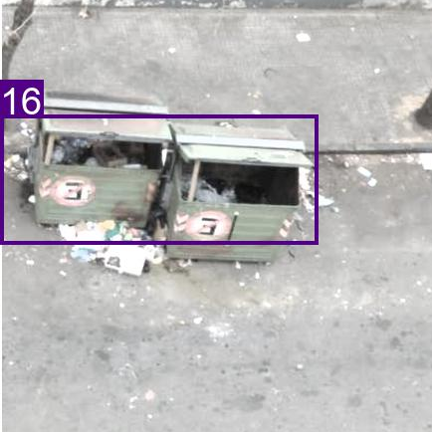
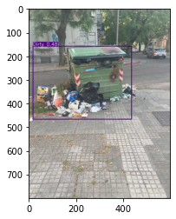
Work Completed
Collection of image data.
Annotation of data
Using YOLOv5 to weight the image classification
Using the weights to build a model
Testing the model with random images

Slide 12
Future work
More image annotation
Improve the accuracy of the model
Video capture using OpenCV for model input
Use CUDA for higher processing speed

Slide 13
Reference
A. Canziani, A. Paszke, and E. Culurciello, ‘‘An analysis of deep neural network models for practical applications,’’ 2016, arXiv:1605.07678. [Online]. Available: http://arxiv.org/abs/1605.07678
H. Wang and C. Schmid, ‘‘Action recognition with improved trajectories,’’ in Proc. IEEE Int. Conf. Comput. Vis., Dec. 2013, pp. 3551–3558.
I. Rodríguez-Moreno, J. M. Martínez-Otzeta, B. Sierra, I. Rodriguez, and E. Jauregi, ‘‘Video activity recognition: State-of-the-art,’’ Sensors, vol. 19, no. 14, p. 3160, Jul. 2019.
W. Wu and Y. Zhang, ‘‘Activity recognition from mobile phone using deep CNN,’’ in Proc. Chin. Control Conf. (CCC), Jul. 2019, pp. 7786–7790.

Slide 14
Thank You

