Slide 1
Automated Detection of Overflowing Garbage Bin

Slide 2
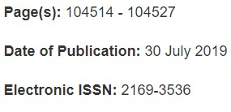
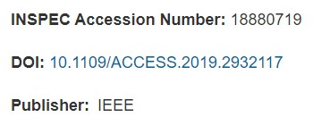
Introduction to Base Paper
D. Zeng, S. Zhang, F. Chen and Y. Wang, "Multi-Scale CNN Based Garbage Detection of Airborne Hyperspectral Data," in IEEE Access, vol. 7, pp. 104514-104527, 2019, doi: 10.1109/ACCESS.2019.2932117.
Date of Publishing: 30 July 2019
Link to base paper:https://ieeexplore.ieee.org/document/8782106

Slide 3
Problem Statement
A big challenge in the enclosed campus is solid waste management. The garbage collecting authority in traditional waste management system doesn’t know about the level of garbage in dustbin or the garbage segregated in a place, if the dust bins gets full by garbage then it gets overflowed as well as spelled out from the dustbin leading to unhygienic condition in the campus. People throw garbage on that dustbin which is already overflowed. Sometimes due to unclean garbage bins bad smell arises also toxic and unhygienic gases are produced which is way to support to the air pollution and to some harmful diseases which are easily spreadable.

Slide 4
Literature Survey
Source Content | Research on the Use of YOLOv5 Object Detection Algorithm in Mask Wearing Recognition
Source Author | Liu, Yifan, Lu, BingHang, Peng, Jingyu, Zhang, Zihao
Authors work | They have used the latest CNN model – YOLOv5 for detecting and DEEPSORT for tracing a specific object.
Overall Comment | I would like to thank the author’s work on using the YOLOv5 model for detection. I have used some of his techniques in my project.

Slide 5
Objectives
Build a model to detect overflowing of trash.
The model is to be build using deep learning Convocutional Neural Network.
Imporve the accuracy of the prediction using proper weights for the classification
Compare different YOLOv5 models for the project

Slide 6
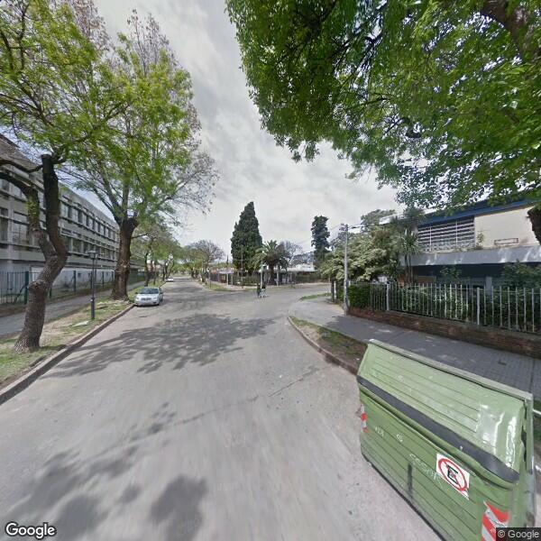
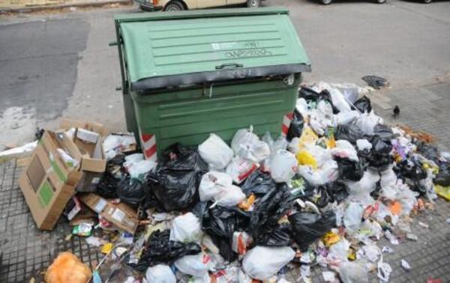
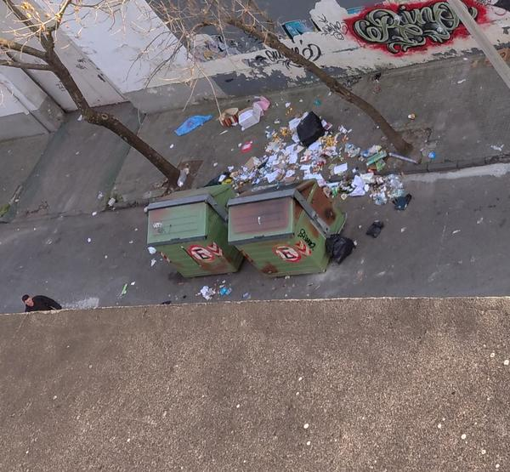
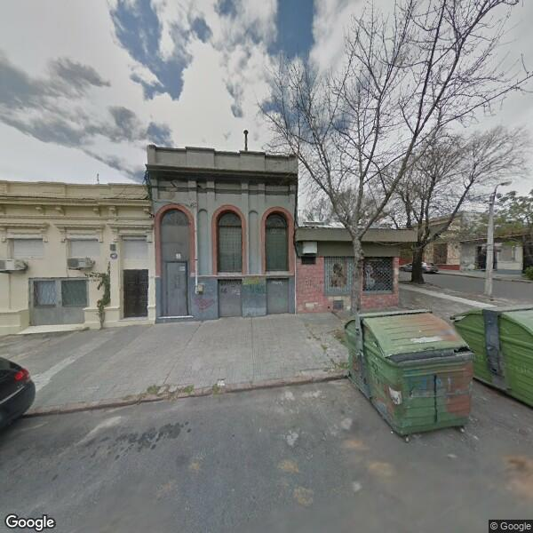
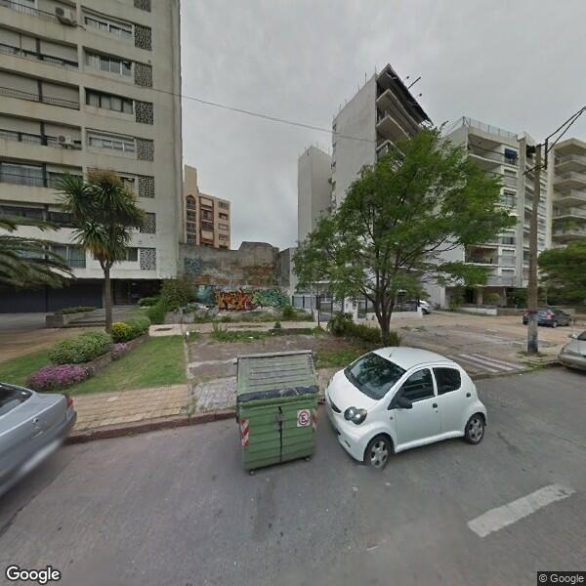
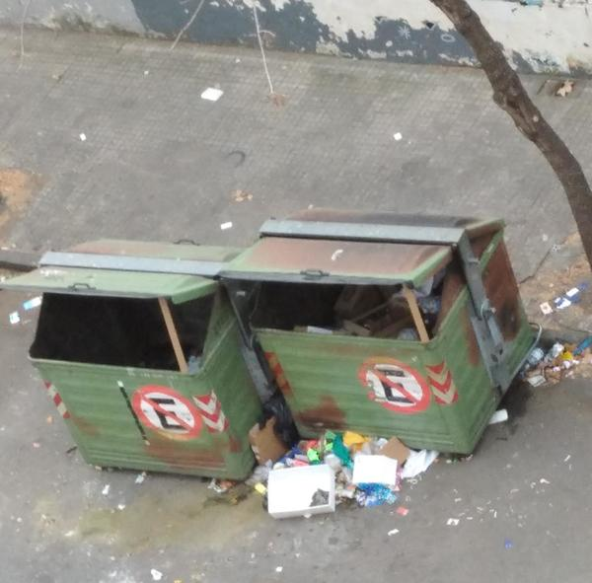
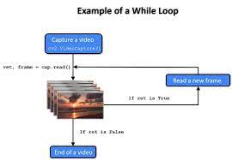
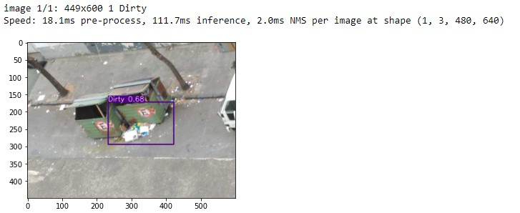
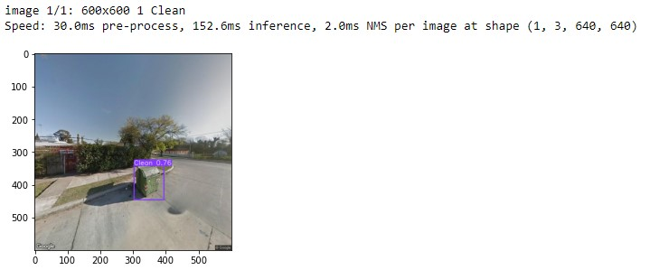
Flow Chart
Clean
Collected Dataset
Annotation
Dirty
Getting the weights form the trained model
Training the model with the help of labeled images
Capturing the input frames
Running the frames through the model using best weights
Display the Output

Slide 7
Dataset
Garbage dataset
Kaggle Link: Dataset
Shape: 3412 Images
Clean: 1806
Trash: 1606
Citation: G Mittal, K B Yagnik, M Garg, and N C Krishnan, Spot Garbage: Smartphone App to Detect Garbage Using Deep Learning, ACM International Joint Conference on Pervasive and Ubiquitous Computing, 940-945, 2016

Slide 8
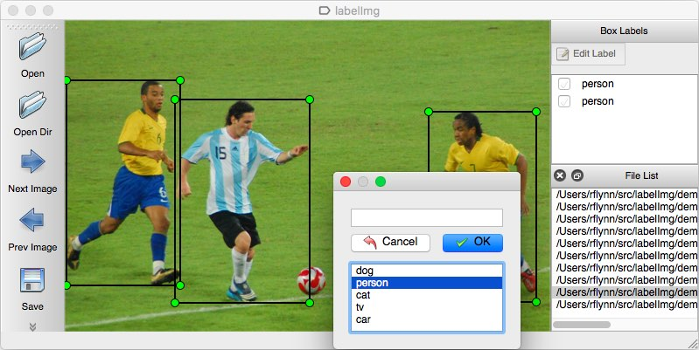
Methods : Annotation
Using LabelImg package.
Link : https://github.com/tzutalin/labelImg

Slide 9
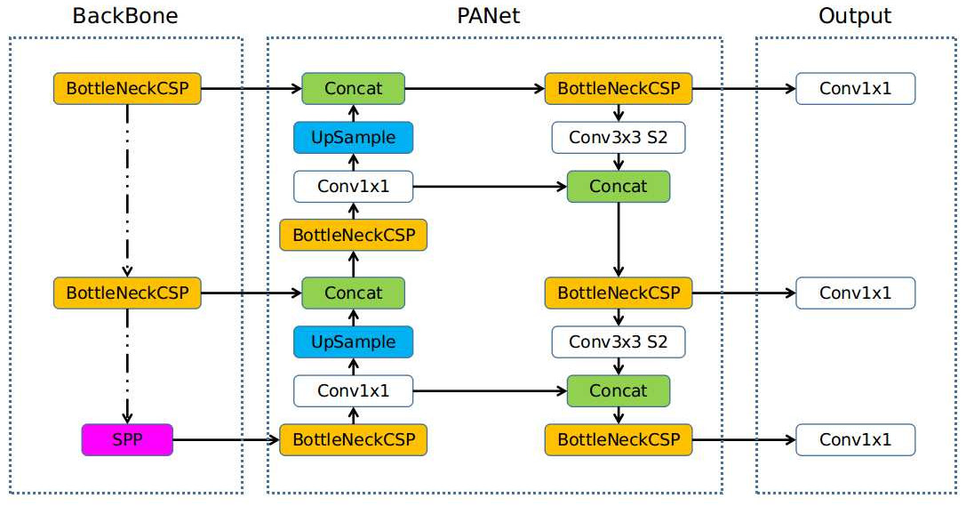
Methods : YOLOv5
YOLOv5 is a family of object detection architectures and models pretrained on the COCO dataset
Link : https://github.com/ultralytics/yolov5

Slide 10
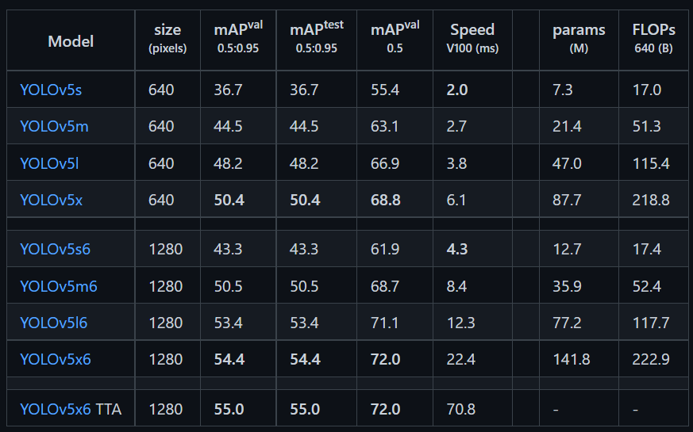
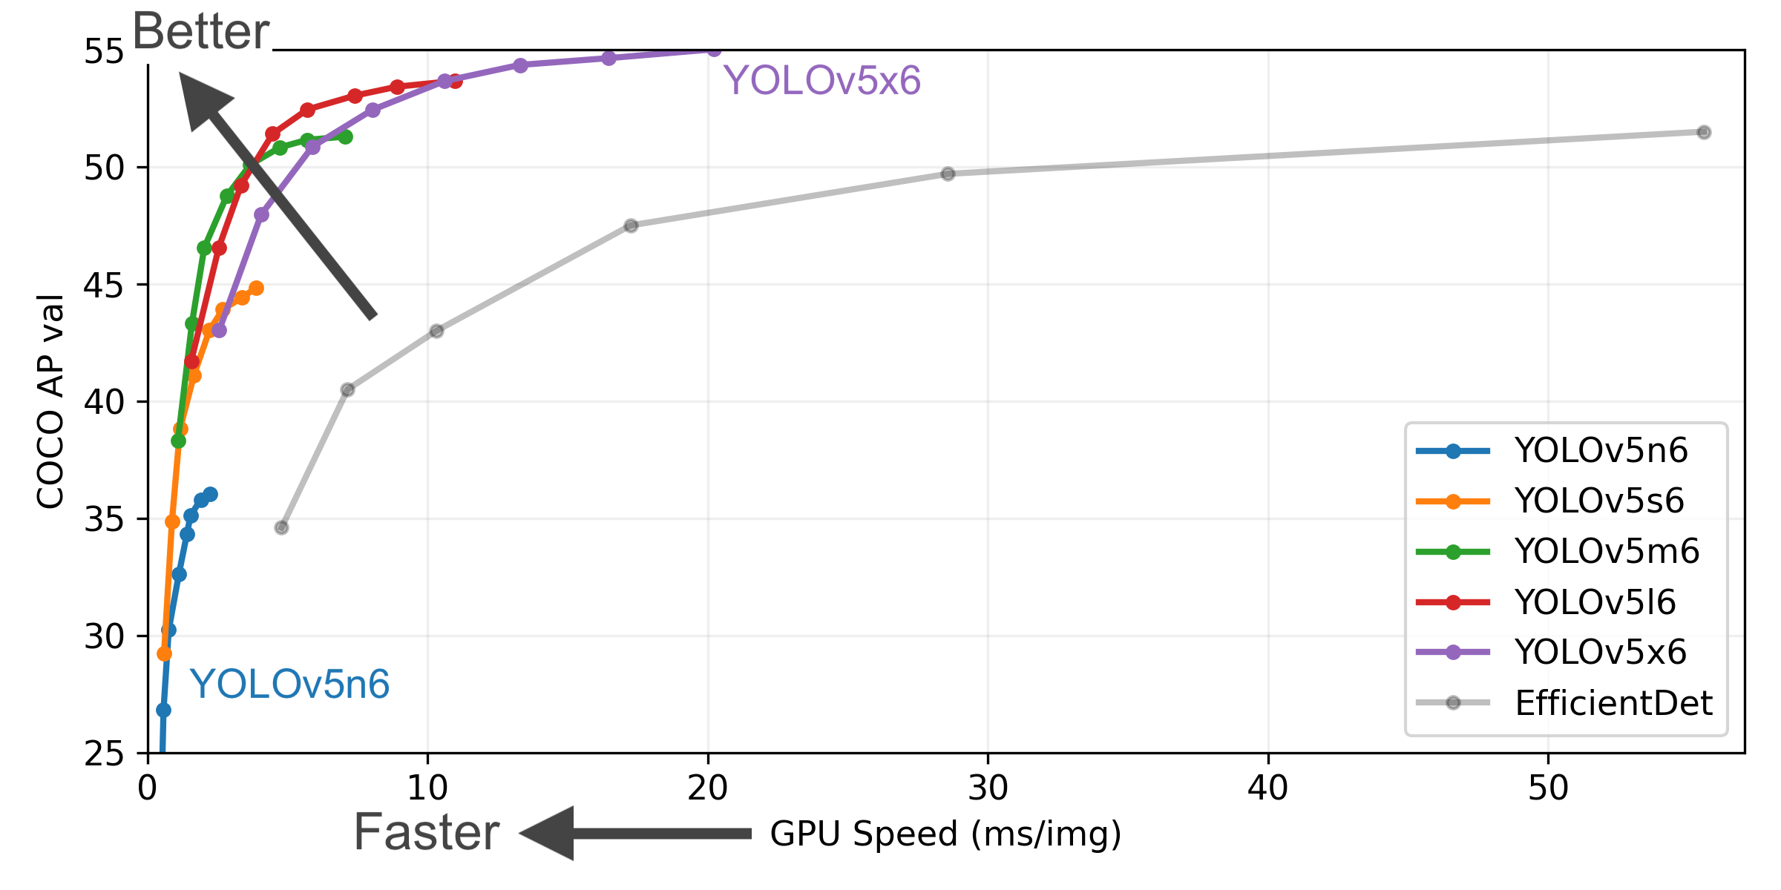
YOLOv5 Models

Slide 11
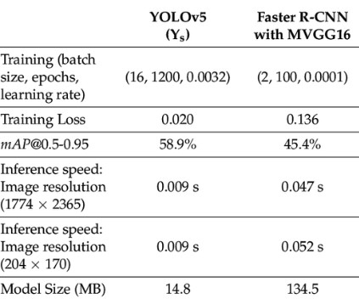
Methods : Yolov5 vs Faster R-CNN

Slide 12
Performance Measurement
The following metrics are used to measure the performance of the model.
Precision
Recall score
Mean average precision
Box loss
Object loss
Class loss
Information retrieval

Slide 13
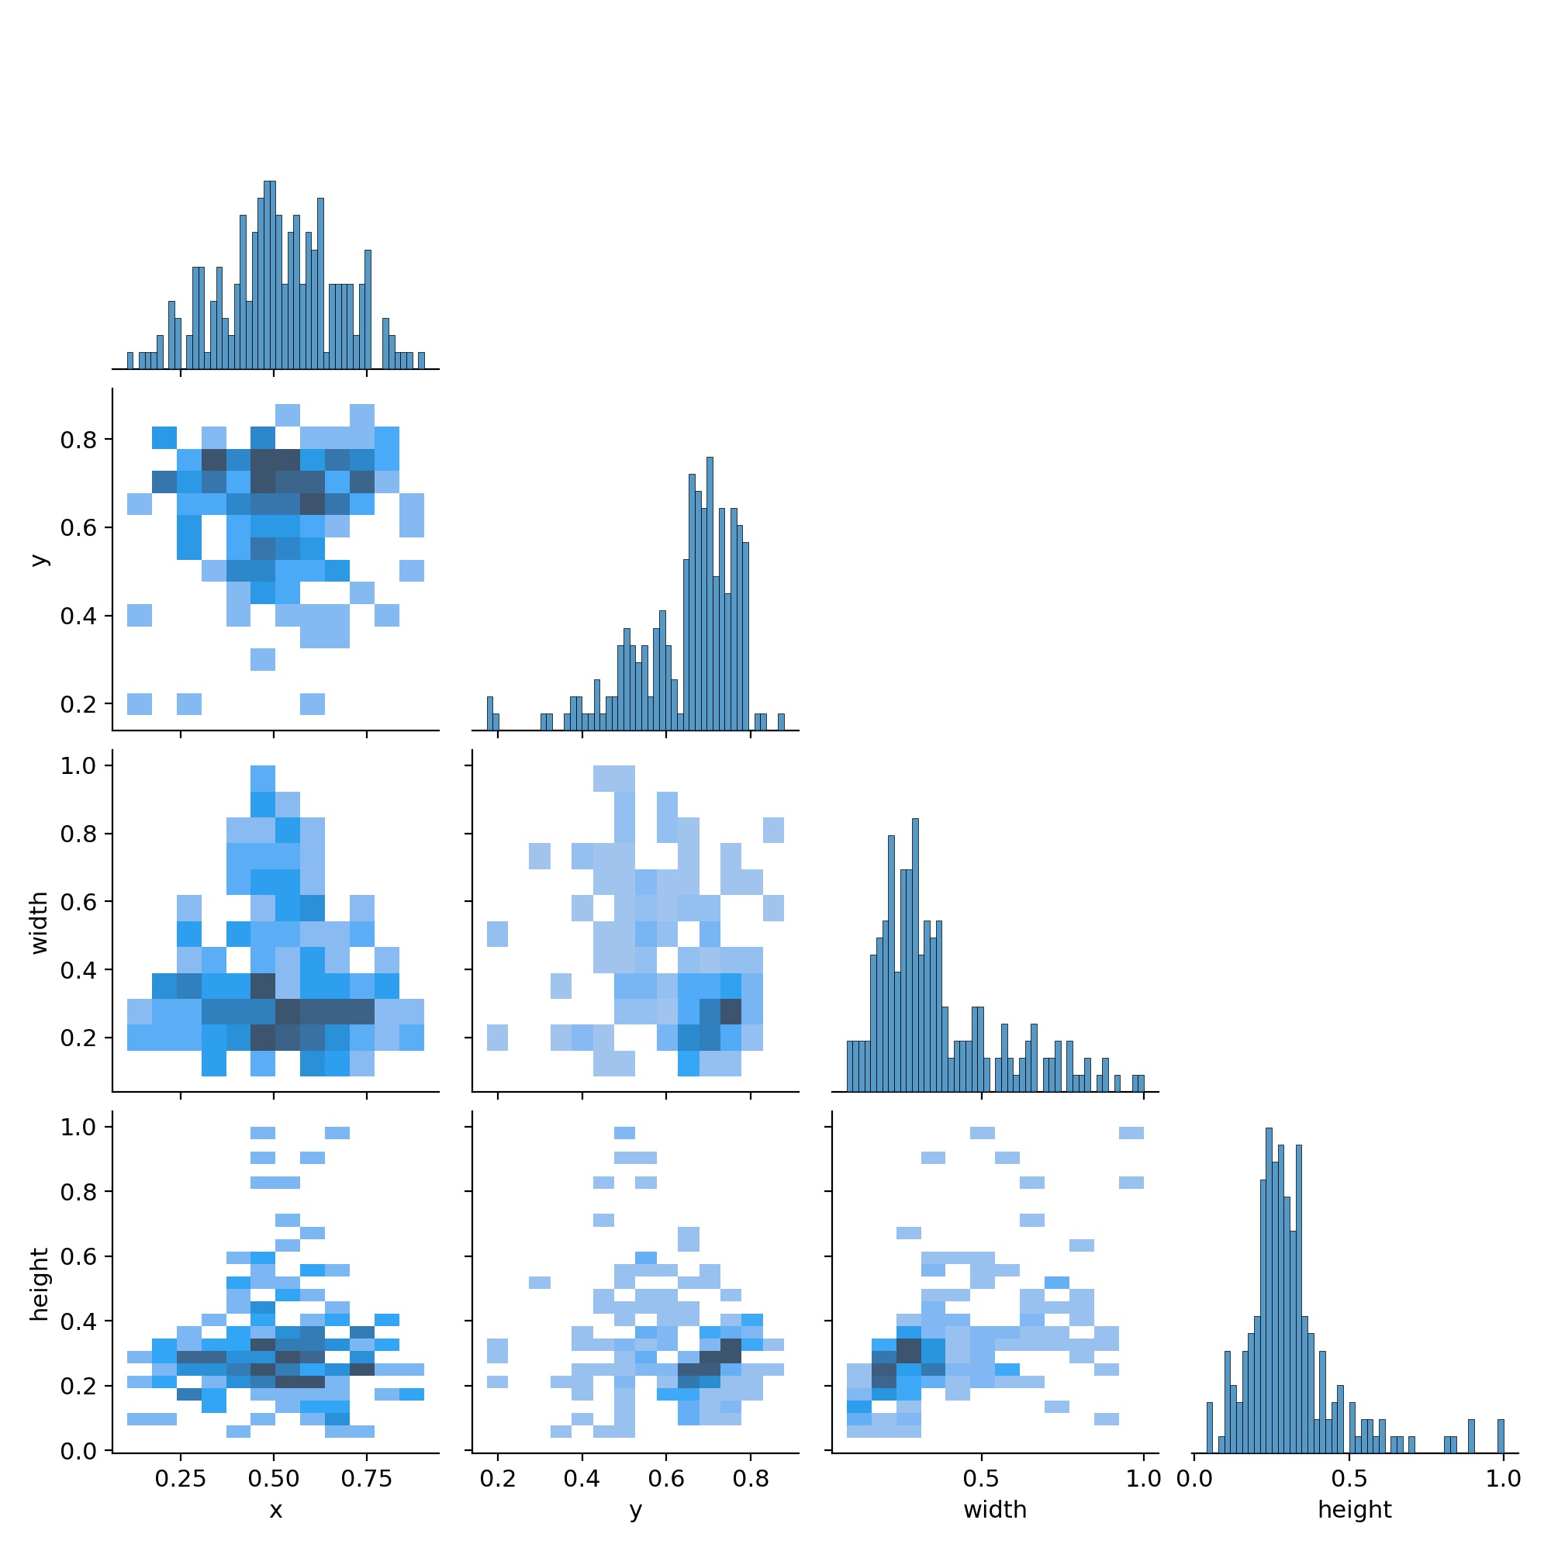
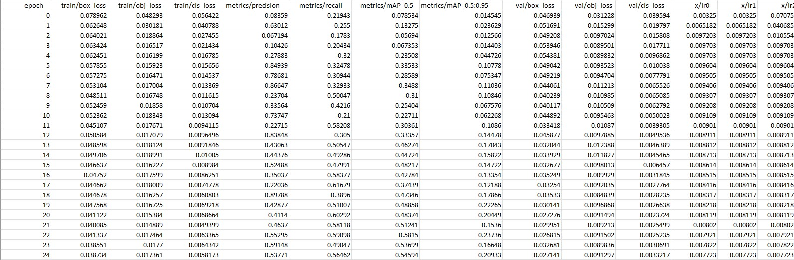
Performance recorded

Slide 14

Recorded Output: GUI

Slide 15
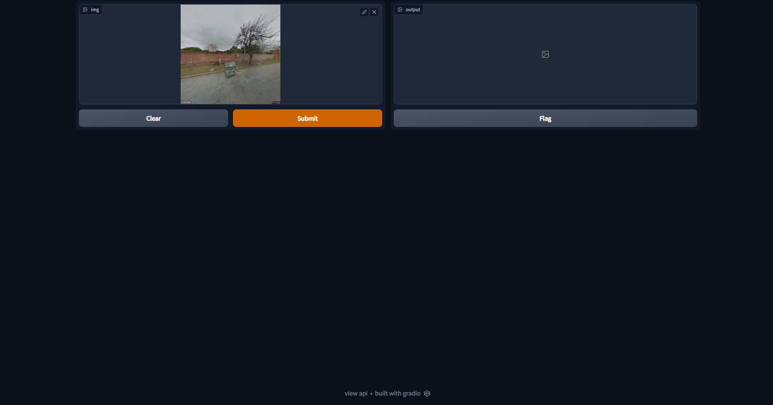
Recorded Output: Giving Input

Slide 16
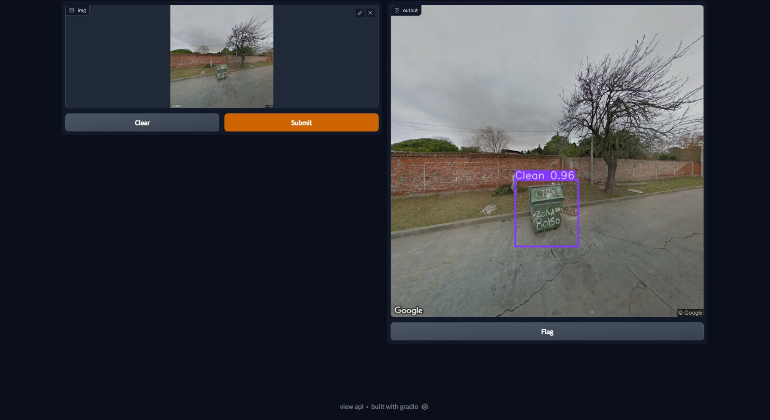
Recorded Output: Displaying the processed Image

Slide 17
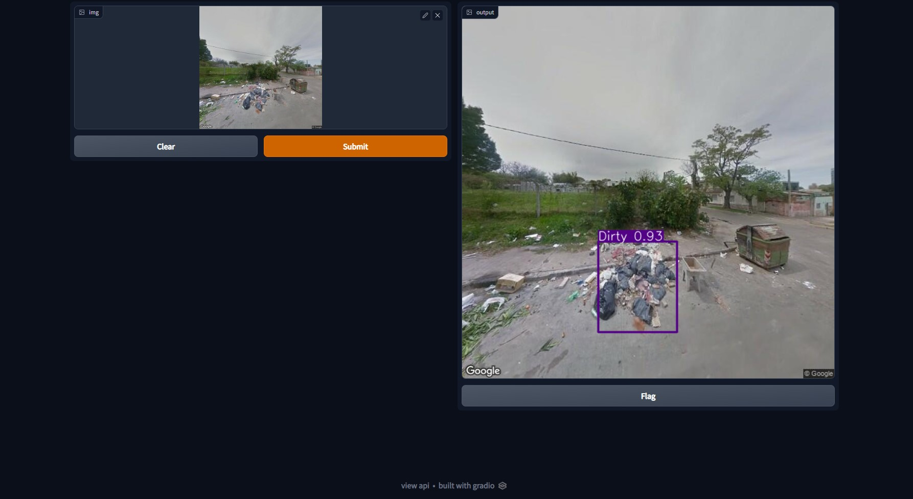
Recorded Output: Clear function

Slide 18
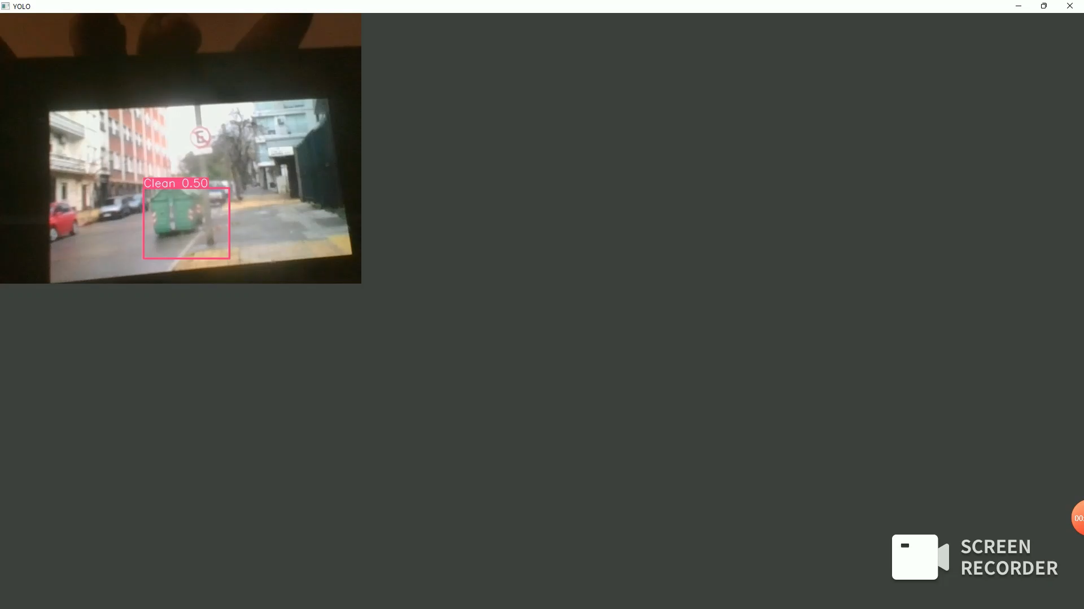
Recorded Output

Slide 19
Conclusion and Possible developments
YOLOv5 model has a high accuracy rate for the given problem.
YOLOv5 perform well when the input is in image format but when the input is in video format the performance is not consistent.
In order to increase the performance we can use DeepSort to track the position of the garbage if the camera carrier is moving.
Secondary camera device can be used for application purpose.

Slide 20
Reference
A. Canziani, A. Paszke, and E. Culurciello, ‘‘An analysis of deep neural network models for practical applications,’’ 2016, arXiv:1605.07678. [Online]. Available: http://arxiv.org/abs/1605.07678
H. Wang and C. Schmid, ‘‘Action recognition with improved trajectories,’’ in Proc. IEEE Int. Conf. Comput. Vis., Dec. 2013, pp. 3551–3558.
I. Rodríguez-Moreno, J. M. Martínez-Otzeta, B. Sierra, I. Rodriguez, and E. Jauregi, ‘‘Video activity recognition: State-of-the-art,’’ Sensors, vol. 19, no. 14, p. 3160, Jul. 2019.
W. Wu and Y. Zhang, ‘‘Activity recognition from mobile phone using deep CNN,’’ in Proc. Chin. Control Conf. (CCC), Jul. 2019, pp. 7786–7790.

Slide 21
Thank You
Hareekrishna V S
123018031
B.Tech CSBS

