Slide 1





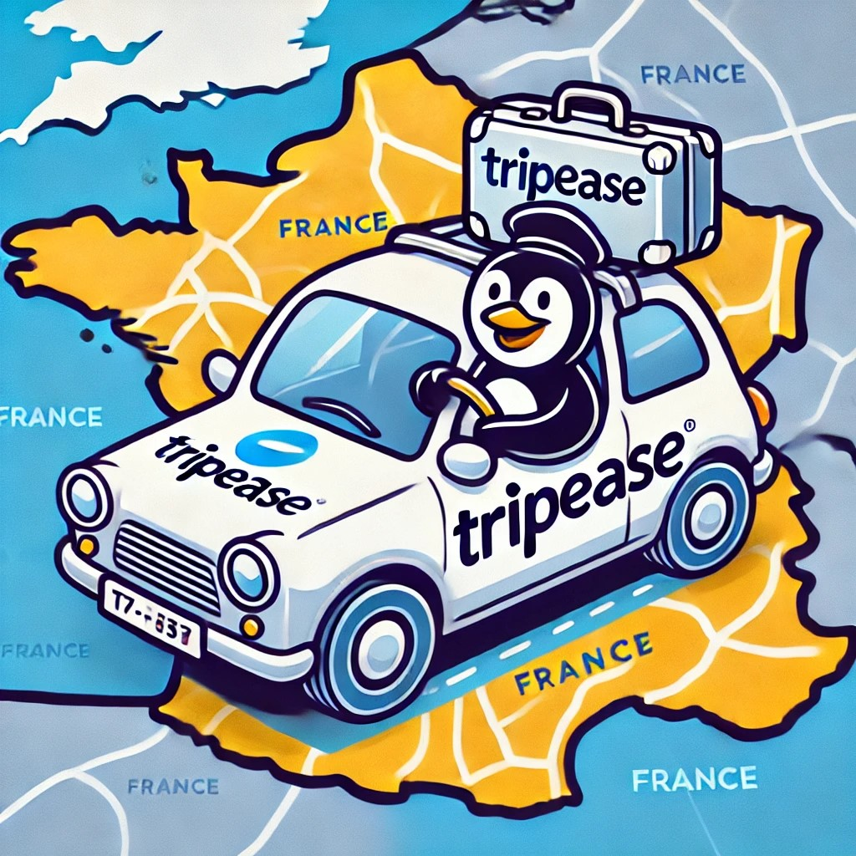
TripEase

Slide 2
Problem Description
Planning a road trip can be complex. Travelers often face challenges such as:
Find routes that meet time and distance constraints.
When / where to eat according to preference of the driver and passenger(s)
Find perfect place to take break
Find the cheapest gas station
Traditional navigation tools like “google maps” don’t automatically combine these factors, the driver must pre plan his travel in order to have this planning.
Your project addresses the need for an intelligent, flexible solution that caters to these diverse demands.

Slide 3
Proposed Solutions
The project will be a road-planning application that:
Inputs user preferences:
Start and end destinations.
Restaurant preferences (ratings, prices, cuisine).
Frequency and duration of breaks.
Points of interest along the route.
If gas station needed and when
How much time you are willing to waste

Slide 4
Proposed Solutions
Generates an optimized itinerary:
Combines user inputs with real-time traffic, location data.
Balances user constraints like break frequency, meal timings, and arrival deadlines.
Dynamically adjusts:
Offers updates and rerouting based on traffic delays, user feedback, or schedule changes.
Key Features:
Personalized itineraries.
Interactive map view with detailed stop recommendations.
Integration with APIs for restaurant reviews and gas stations.
Time management for scheduled breaks and meals.

Slide 5
Technical Architecture
Backend:
Python-Django: Backend framework for handling user inputs, calculations, and API integrations.
Routing API: OpenRouteService for route optimization and directions.
Database: PostgreSQL with PostGIS for geospatial data storage.
Frontend:
React.js: For a responsive user interface.
Mapbox GL JS: For interactive maps with location plotting.

Slide 6
Technical Architecture
External APIs:
Google Places API: For restaurant recommendations.
OSRM API: For real-time traffic data.
Cloud Hosting:
Host on DigitalOcean.
Use Docker for containerized deployment.

Slide 7
Technical Architecture
Workflow:
User Inputs: Collect preferences via frontend forms.
Data Aggregation: Fetch geolocation, traffic, and restaurant data using APIs.
Optimization Algorithm:
Implement route planning using A* algorithm.
Adjust breaks and meal stops using constraints defined by the user.
Dynamic Adjustments:
Real-time updates via WebSocket or polling mechanisms.
Output: Display interactive itinerary with scheduled stops and adjustments.

Slide 8
Project Plan
Minimal Development:
Basic user input for destinations, breaks, and dining preferences.
Route generation using OpenRouteService.
Display of basic itinerary on an interactive map.
Integration of restaurant data from Google Places.
Testing:
Ensure accurate route calculations.
Validate API integration for restaurant.
Deployment:
Host the project on a cloud platform.
Set up a basic CI/CD pipeline for iterative improvements.

Slide 9
Project Plan
Advanced Features:
Add dynamic adjustments for delays and user feedback.
Enhance itinerary customization (choosing specific cuisines, gas stops).
Improved UI/UX.
Add multi-language support.

