Slide 1

MLRP GLOB PROJECT-1
UBER ANALYSIS
Domain: Machine Learning with R
Category- Software
Batch ID- 01
Students' Names & Roll Number :
A. Sheershika (22241A3203)
H. K. Bhavana (22241A3216)
K. Meghana (22241A3223)

Slide 2
UBER ANALYSIS
Proposed Solution
Analyze historical Uber pickup data to identify patterns in time, location, and base performance using advanced visualization tools.
Generates actionable insights for resource allocation and operational planning based on data trends and visualizations.
Combines interactive heatmaps and geographic visualizations to make complex data easy to interpret.
Offers a scalable framework for localized analysis, which can be replicated for other regions and datasets.

Slide 3
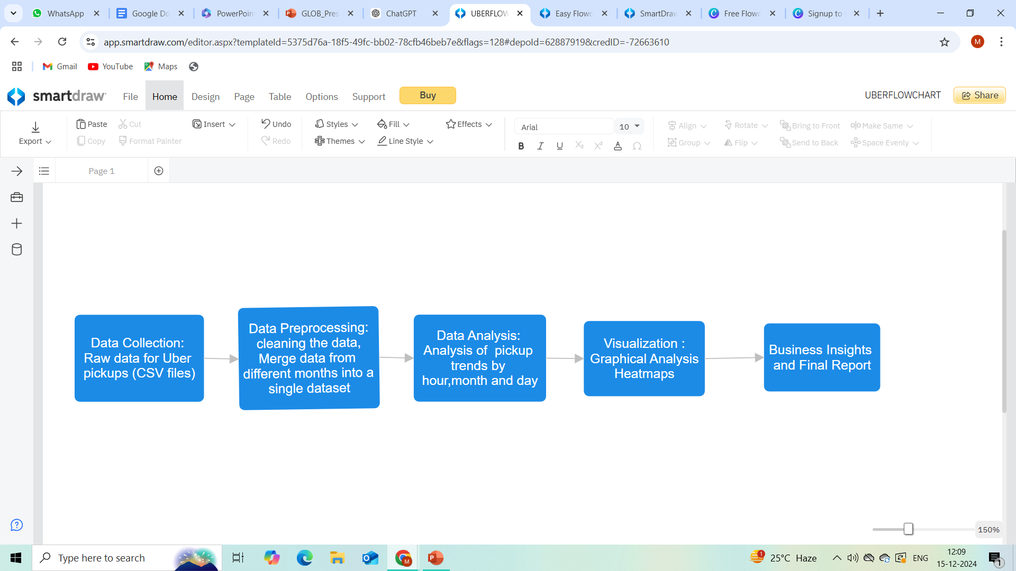
TECHNICAL APPROACH
Programming Language: R
Libraries: ggplot2, dplyr, lubridate, tidyr, DT, and scales
IDE: RStudio
Process for implementation:

Slide 4
FEASIBILITY AND VIABILITY
Tools and technologies required are cost-effective and readily available.
Scalable for larger datasets and adaptable to other cities.
Incomplete or inaccurate data affect insights.
Handling larger datasets strain computational resources.
Clean and validate datasets rigorously.
Customize analyses for regional patterns and pilot in multiple regions.

Slide 5
IMPACT AND BENEFITS
Improved User Experience
Optimized Operations
Drivers can earn more by operating during high-demand periods and in busy locations.
Enhanced mobility for NYC residents and visitors through better service availability.
Reduction in ride-hailing stress during peak hours.
Reduced operational costs by limiting resources during low-demand periods.
Potential to support urban planning by identifying traffic hotspots.

Slide 6
RESEARCH AND REFERENCES
https://data-flair.training/blogs/r-data-science-project-uber-data- analysis/ (Uber data analysis in R)
https://www.analyticsvidhya.com/blog/2021/10/end-to-end-predictive-analysis-on-ubers-data/ (End-to-End Predictive Analysis on Uber's Data )
https://www.jespublication.com/upload/2021-V12I759.pdf (Uber data analysis using ggplot)

