Slide 1
作業1
Horazon
基礎遊戲引擎應用(Y2)

Slide 2
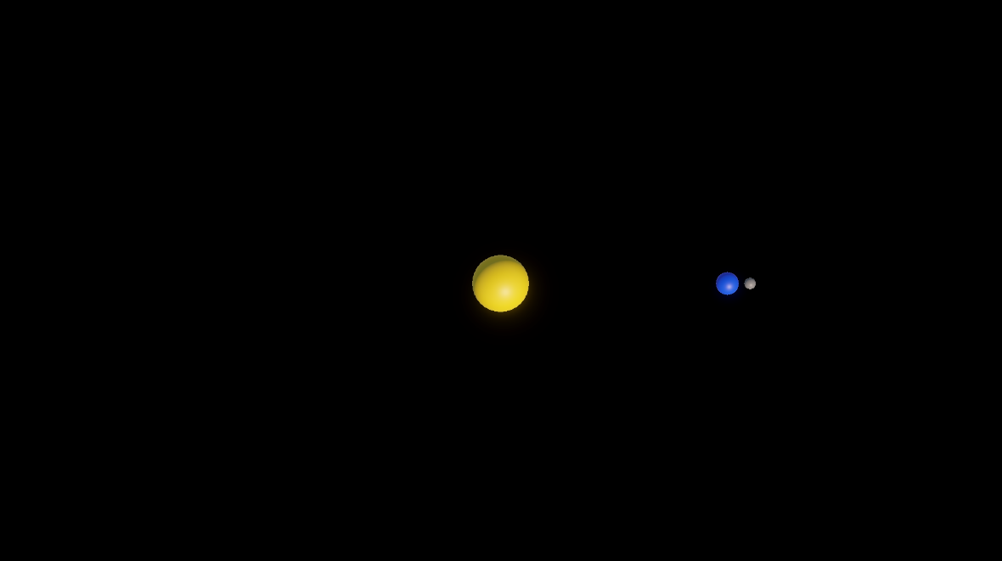
作業內容預覽
https://youtu.be/bsRbt6ivKcw

Slide 3
作業內容
Use Sphere to create the Sun, the Earth, and the Moon.
Distance between Sun and Earth = 20
Distance between Earth and Moon = 2
 | Sun | Earth | Moon
Color | Yellow | Blue | Gray
Size | 5 | 2 | 1
Rotation speed (degree/second) | 0 | 10 | 120

Slide 4
如何繳交作業
Save the Scene
After you are finished, be sure to save the scene via File > Save (ctrl+s).
Find your scene in the Project window, usually located in Assets\Scene.

Slide 5
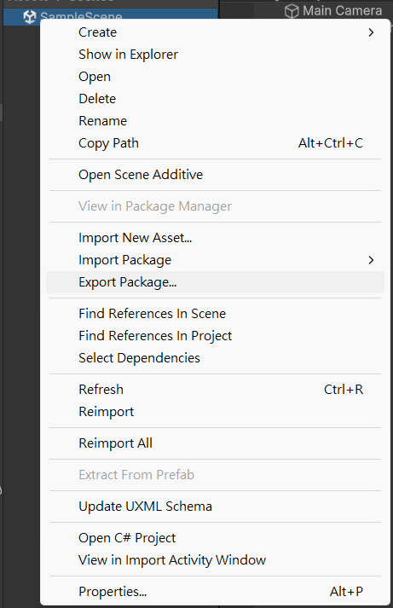
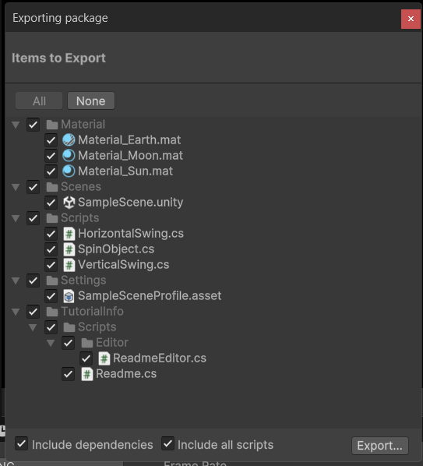
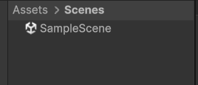
如何繳交作業
Right-click on the scene file and select Export Package....
Make sure to check the two options at the bottom (as shown in the image) and click Export....
Submit the generated .unitypackage file.

Slide 6
提示
First, create three spheres, adjust their sizes according to the assignment requirements, and place them in the corresponding positions.
Create three materials, modify them according to the assignment requirements, and apply them to the three spheres.
(Note: Even if step 2 is difficult, you can still try starting from this step.)
Think about how to make the Earth revolve around the Sun.
Think about how to make the Moon revolve around the Earth.
Check if the preview condition is presented.
Adjust the speeds of the two rotations.

