Slide 1
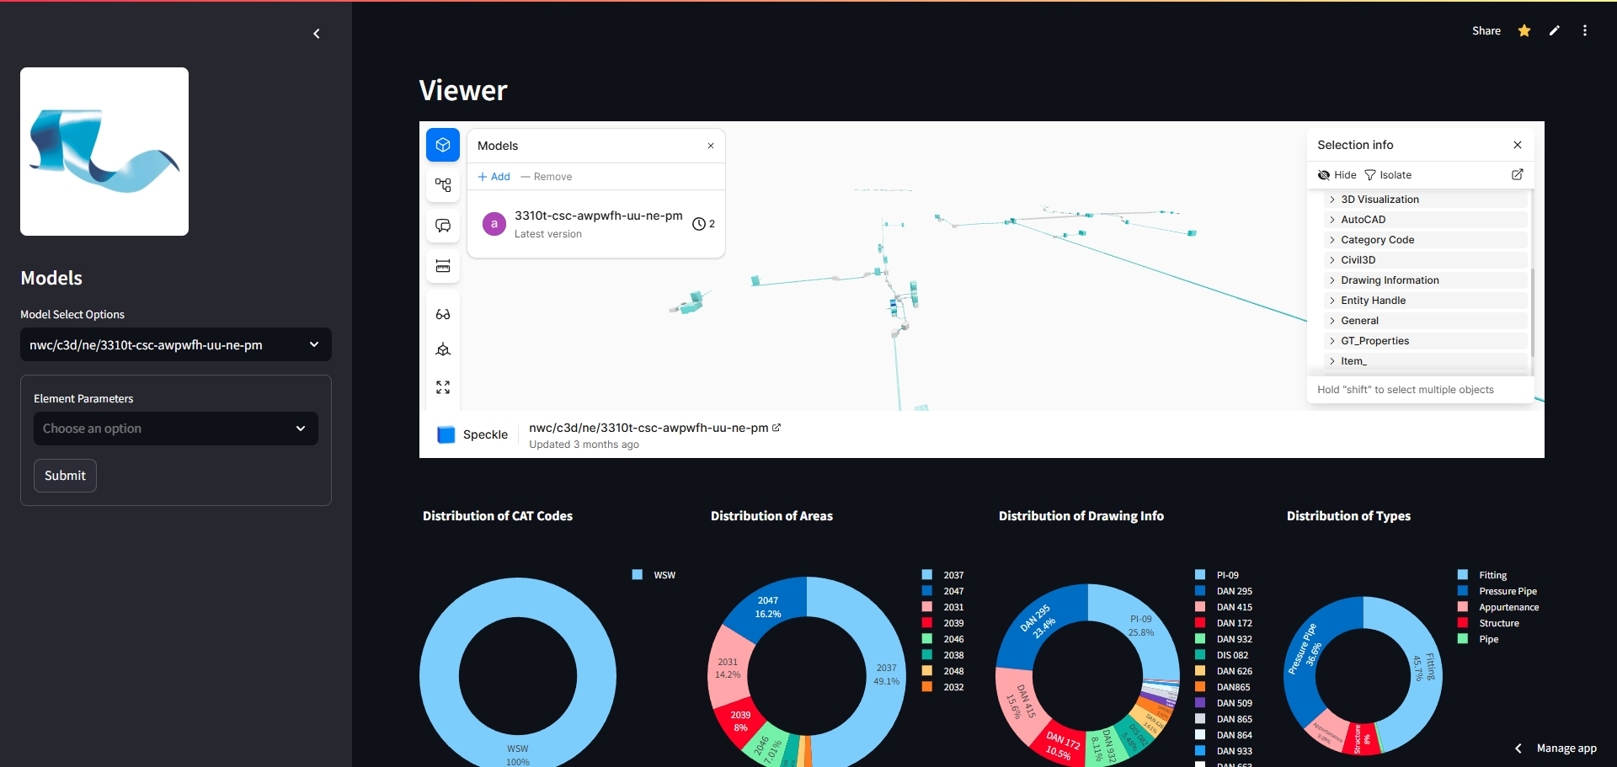
Web_App-Online_Model_Viewer_Solution
Application No: 1306182327
This solution enables owners, project teams, construction teams, and consultants to conveniently browse or inspect models online. It also allows users to quickly extract the information they need. By providing a user-friendly platform, it streamlines collaboration and enhances efficiency across all stakeholders. Whether reviewing designs, checking details, or gathering specific data, the tool simplifies the process, saving time and effort. Its accessibility and speed make it an invaluable resource for managing projects effectively, ensuring everyone involved can stay informed and aligned throughout the workflow.

Slide 2
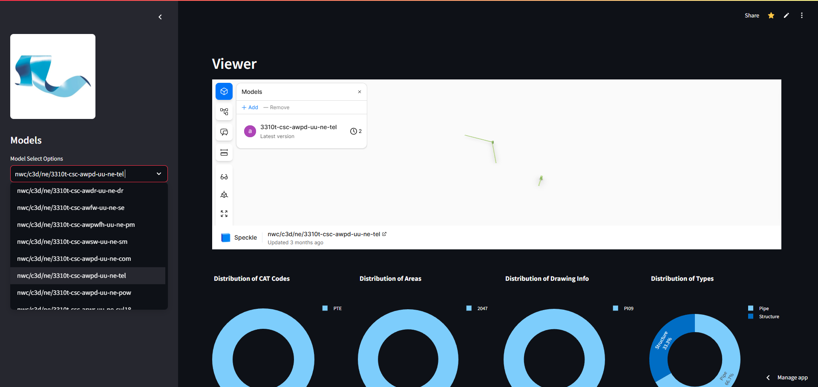
Web_App-Online_Model_Viewer_Solution
Application No: 1306182327
This tool lets you pick and view models online with a simple dashboard. It’s easy to use, showing key data clearly so you can check and compare things fast.

Slide 3
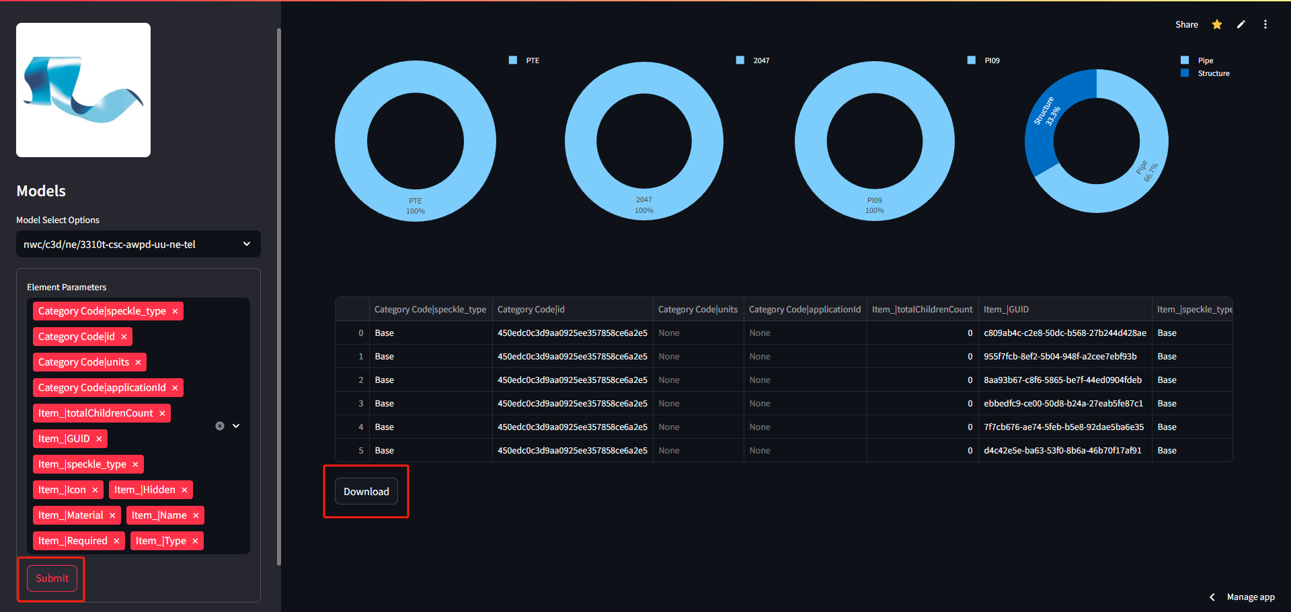
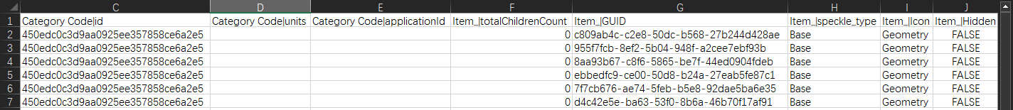
Web_App-Online_Model_Viewer_Solution
Application No: 1306182327
On the web, you can choose the properties you want, hit "Submit," and instantly pull up the info you need online. It’s straightforward and quick.

