Slide 1
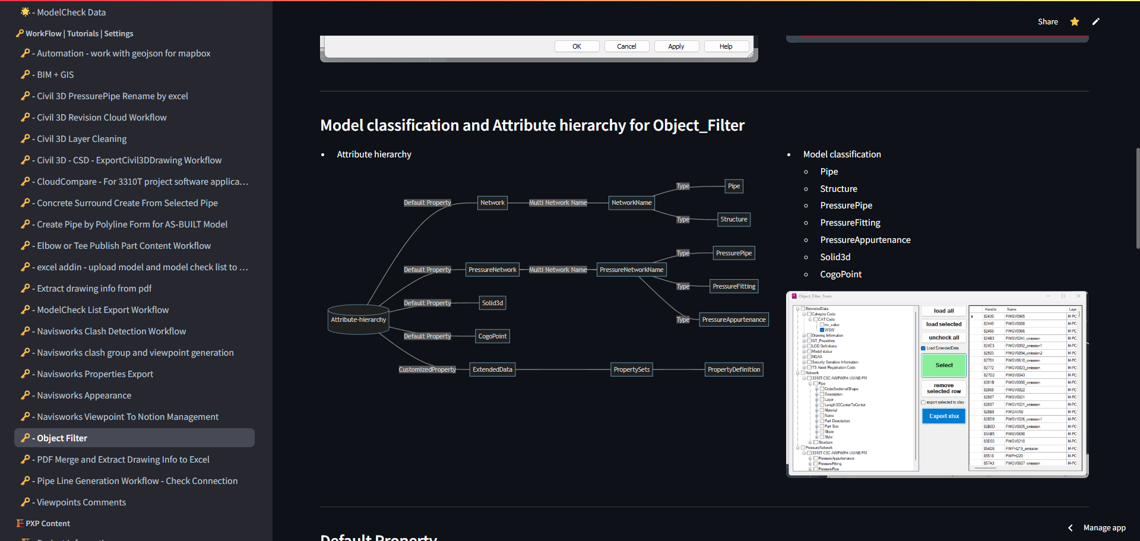
Web_App-More_Than_BEP_Solution
Application No: 1306183639
Compared to traditional Word-based BEPs, this innovative solution truly embodies the "ALL-IN-ONE" concept. BEPs are no longer limited to text and images, they now integrate advanced features like model displays, data visualization, online data tables, workflows, and embedded URLs. This comprehensive approach allows users to fully understand projects while leveraging defined standards and processes within the BEP for BIM content creation. It’s a dynamic, all-encompassing tool that enhances project clarity and efficiency.

Slide 2
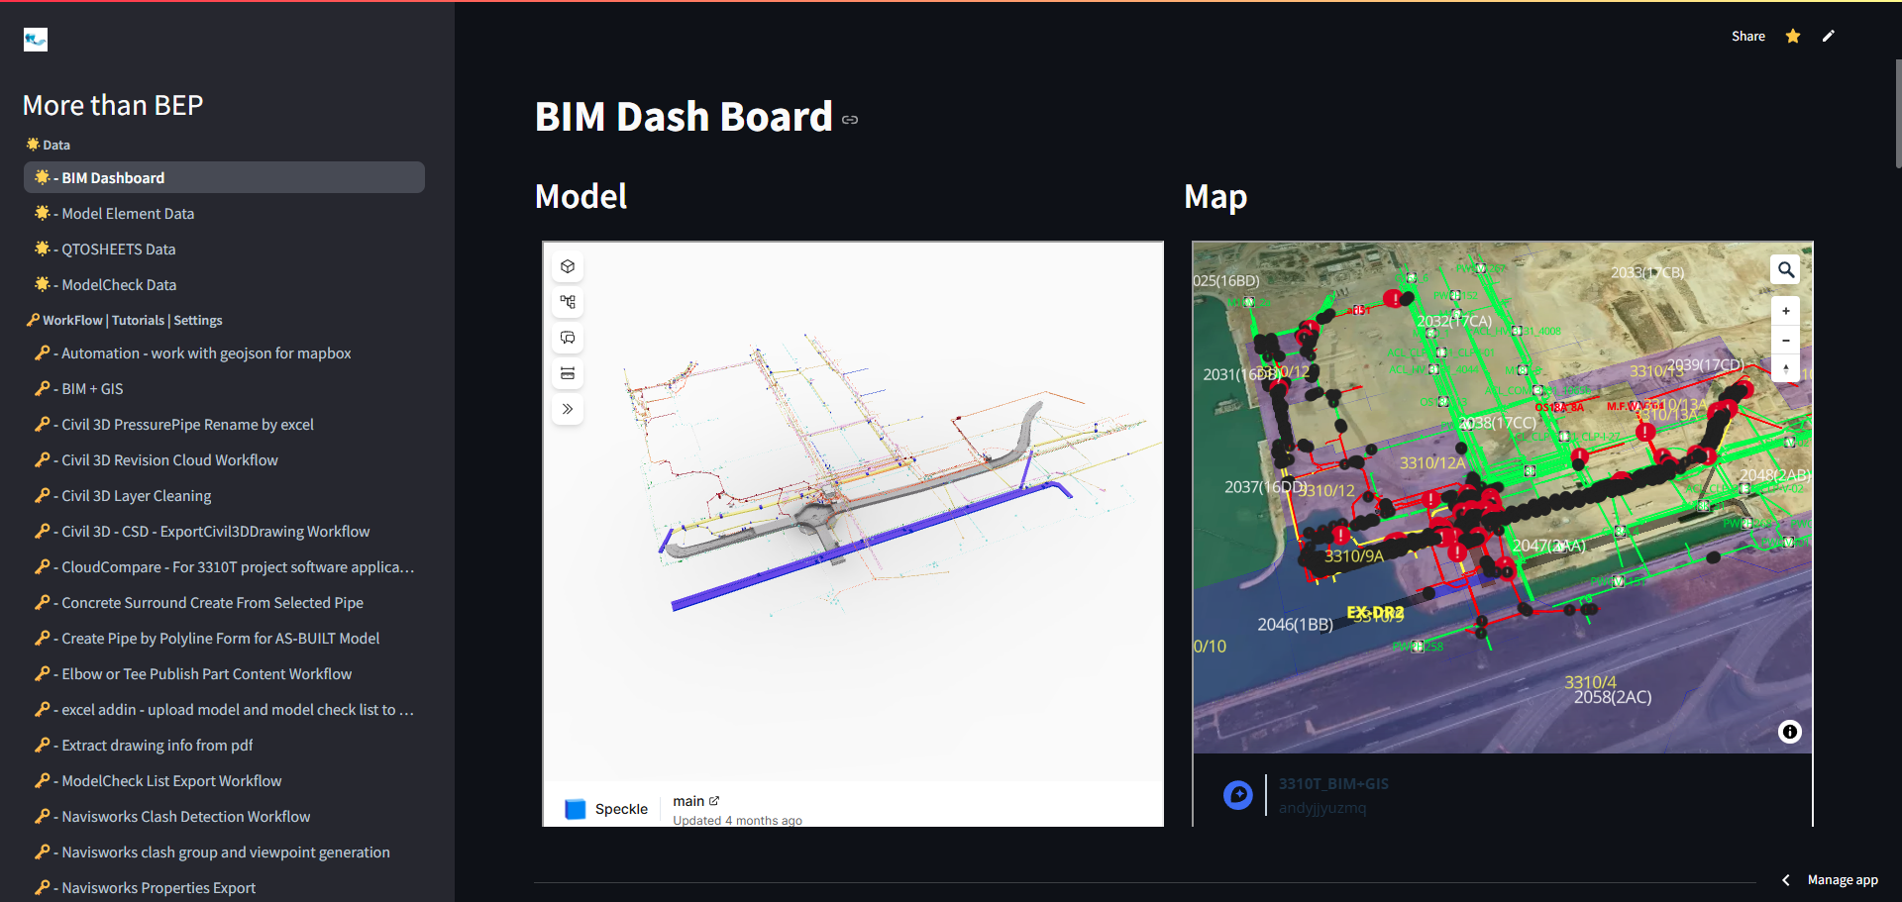
Web_App-More_Than_BEP_Solution
Application No: 1306183639
Embedding BIM models and GIS information directly into the BEP empowers managers to gain a clear and immediate understanding of project status. This integration combines detailed 3D modeling with geospatial data, offering a holistic view of the project’s progress, spatial relationships, and key metrics. By providing real-time insights within a single platform, it enhances decision-making, streamlines oversight, and ensures alignment with project goals, making management more effective and informed.

Slide 3
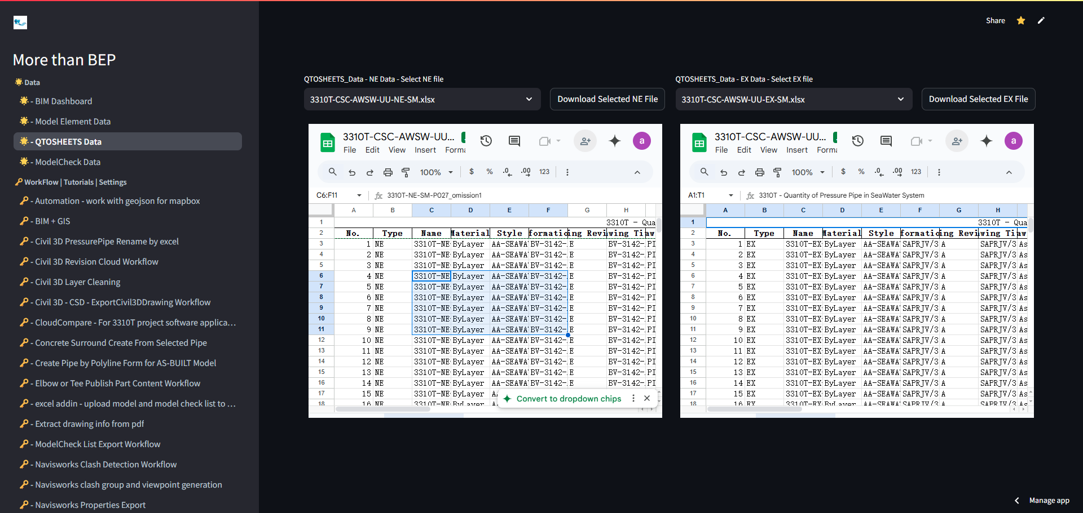
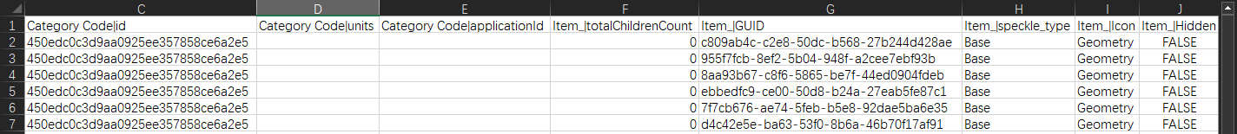
Web_App-More_Than_BEP_Solution
Application No: 1306183639
Embedded URLs enable the online display of Excel tables, ensuring that data remains up-to-date and reflects the latest information. Users can access and download the most current data at any time, directly from the platform. This feature eliminates outdated versions, enhances data reliability, and provides seamless, real-time interaction with project metrics, making it easier for users to stay informed and act on the latest insights.

