Slide 1
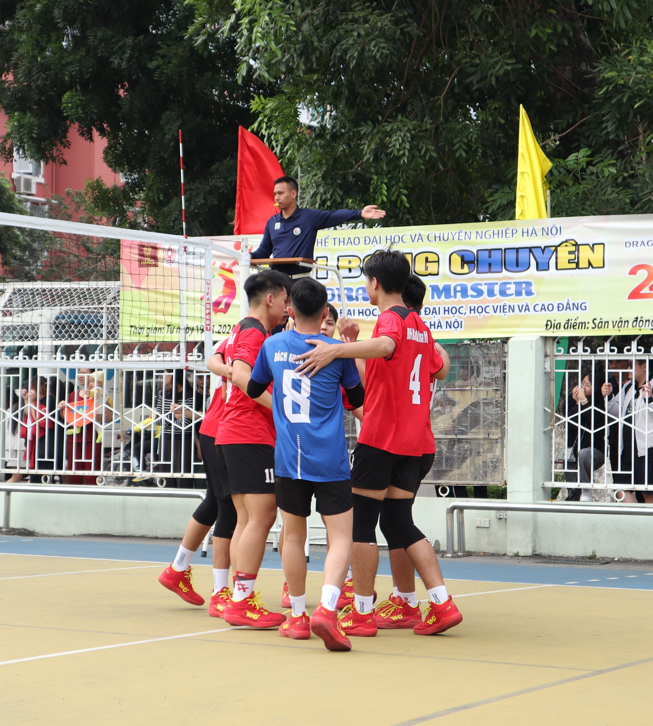


HUST CLUB VOLLEYBALL
HUST CLUB VOLLEYBALL
HUST CLUB VOLLEYBALL
HANOI UNIVERSITIES AND ACADEMY VOLLEYBALL TOURNAMENT
HUST CLUB VOLLEYBALL
HUST CLUB VOLLEYBALL
HUST CLUB VOLLEYBALL
BÁN KÊT I – NÔI DUNG NAM
.
SÂN VẬN ĐỘNG ĐẠI HỌC HÀ NỘI 8:00 – 26.11.2024
HUST CLUB VOLLEYBALL
HUST CLUB VOLLEYBALL
HUST CLUB VOLLEYBALL
HUST CLUB VOLLEYBALL
VS
HUST CLUB VOLLEYBALL
HUST CLUB VOLLEYBALL
HUST CLUB VOLLEYBALL
HUST CLUB VOLLEYBALL
HUST CLUB VOLLEYBALL
HUST CLUB VOLLEYBALL

